Slide 1
Practice Session

Slide 2

Assignment groups
Register your assignment groups today
https://forms.gle/7Kr67d48ahSKefnJ6
Deadline: Sunday 29 Jan, 8PM, IST
Fill in this form even if you have not been able to find a group yet
Each group should fill-in this form once
Auditors are not allowed in groups
Updated list of students https://web.cse.iitk.ac.in/users/purushot/tmp/cs771/cs771_registration_270123.pdf

Slide 3

Quiz 1
Feb 01 (Wed), 6:30PM, L18, L19, L20
Only for registered students (regular + audit)
Assigned seating – will be announced soon
Open notes (handwritten only)
No mobile phones, tablets etc
Bring your institute ID card
If you don’t bring it you will have to spend precious time waiting to get verified
Syllabus:
All videos, slides, code linked on the course discussion page (link below) till 28 Jan, 2023 https://www.cse.iitk.ac.in/users/purushot/courses/ml/2022-23-w/discussion.html
See GitHub for practice questions

Slide 4

Midsem Exam
Feb 26 (Sun), 8AM, Venue TBD
Only for registered students (regular + audit)
More details as we get closer to the date!

Slide 5


Linear Models
We have $Δ_{63}=w_{0} ⋅x_{0}+w_{1}⋅x_{1}+…+w_{63}⋅x_{63}+β_{63}=w^{⊤}x+b$
where $x_{i}=d_{i}⋅d_{i+1}⋅…⋅d_{63}$ $w_{0}=α_{0}$ $w_{i}=α_{i}+β_{i−1} \left(for i>0\right)$
If $Δ_{63}<0$, upper signal wins and answer is 0
If $Δ_{63}>0$, lower signal wins and answer is 1
Thus, answer is simply $\frac{sign\left(w^{⊤}x+b\right)+1}{2}$
$$w$$
This is nothing but a linear classifier!

Slide 6


Practice Questions (True/False)
If a set $𝒞⊂ℝ^{2}$ is convex, then all its subsets must be convex too i.e., if we have $𝒞^{′}⊂𝒞$ then $𝒞′$ must be convex.
Consider the optimization problem $\max_{x,y}{−x^{2}−y^{2}}$ s.t $x∈\left[1,3\right],y∈\left[1,2\right]$. The solution to this problem is achieved at $\left(3,2\right)$.
3
2
1
0
1 2 3

Slide 7

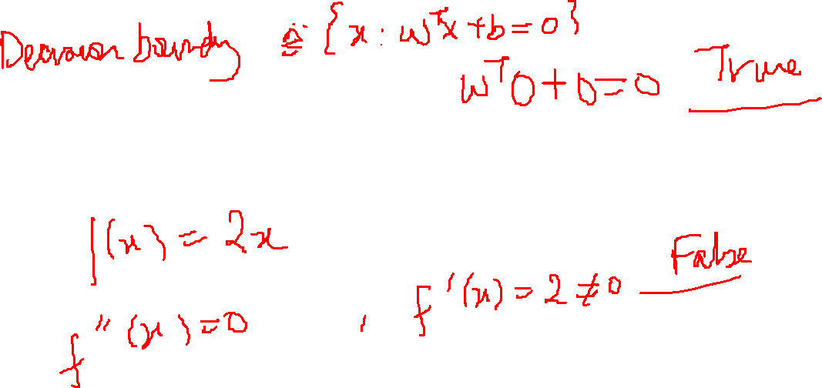
Practice Questions (True/False)
For a linear classifier with model parameters: vector $w∈ℝ^{d}$ and bias $b=0$, the origin point (i.e., the vector $0∈ℝ^{d}$) must always lie on the decision boundary.
Let $f:ℝ→ℝ$ be a doubly differentiable function (i.e., first and second derivatives exist). If $f^{′′}\left(x^{0}\right)=0$ at $x^{0}∈ℝ$, then it is always the case that $f^{′}\left(x^{0}\right)=0$ too.

Slide 8

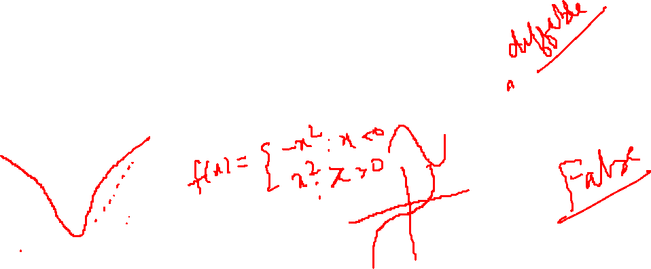
Practice Questions (True/False)
Let $f:ℝ→ℝ$ be a doubly differentiable function (i.e., first and second derivatives exist). If $f^{′}\left(x^{0}\right)>0$ at $x^{0}∈ℝ$, then it may be possible that $f^{′′}\left(x^{0}\right)<0$.
Let $f:ℝ→ℝ$ be a function that is neither convex nor concave. Then $f$ must have at least 2 stationary points (e.g., 2 local minima or 1 local min + 1 local max or 1 local max + 1 saddle point etc)

Slide 9

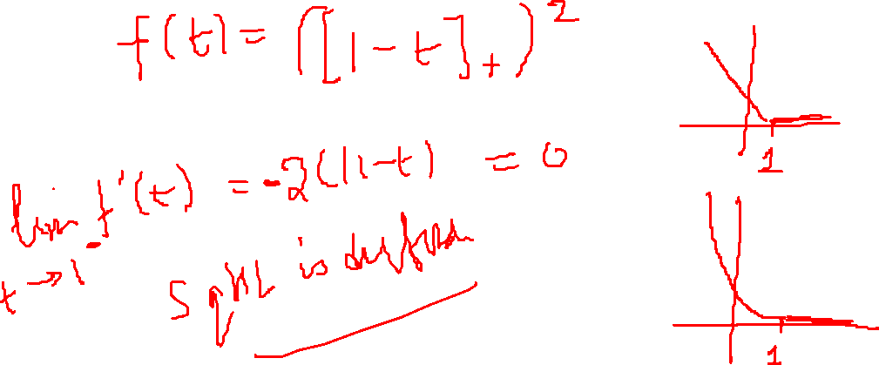
Practice Questions (Calculus)
Consider the squared hinge loss $ℓ\left(w\right)≝{\left({\left[1−y⋅w^{⊤}x\right]}_{+}\right)}^{2}$. Is this function differentiable? Find its gradient or subdifferential at all $w$

Slide 10

Practice Questions (True/False)
For any dimension $d∈ℕ$, the dot product of two $d$-dimensional vectors is always another $d$-dimensional vector.
If a set $𝒞⊂ℝ^{2}$ is convex, then its translation $𝒞^{′}=𝒞+a$ must be convex too for any vector $a∈ℝ^{2}$ where we define the translation as $𝒞^{′}≝\left\{v+a:v∈𝒞\right\}$

Slide 11

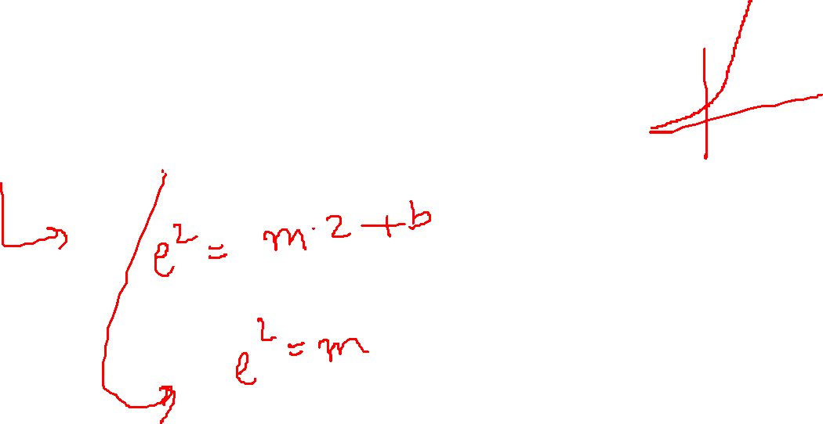
Practice Questions (Calculus)
Melbo claims that for some values of $m,b∈ℝ$, the function $f\left(x\right)=\left\{\begin{matrix}\begin{matrix}e^{x} \\ mx+b\end{matrix} & \begin{matrix}x≤2 \\ x>2\end{matrix}\end{matrix}\right.$
is continuous and differentiable for all $x∈ℝ$. Find these values of $m,b$.

Slide 12

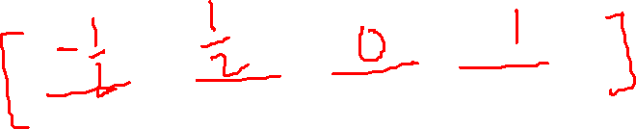
Practice Questions (Geometry)
Give examples of 4D vectors such that
A vector $v∈ℝ^{4}$with $L_{1}$ norm of two i.e., ${\left\|v\right\|}_{1}=2$
A vector $v∈ℝ^{4}$ with unit $L_{2}$ norm i.e., ${\left\|v\right\|}_{2}=1$.

Slide 13


Practice Questions (Geometry)
A vector $v∈ℝ^{4}$ equal to its own negative i.e., $v=−v$.
A vector $v∈ℝ^{4}$ with same $L_{1}$ and $L_{2}$ norm i.e ${\left\|v\right\|}_{1}={\left\|v\right\|}_{2}$.
A vector $v∈ℝ^{4}$ whose $L_{2}$ norm is half its $L_{1}$ norm i.e., ${\left\|v\right\|}_{2}=\frac{1}{2}{\left\|v\right\|}_{1}$

Slide 14

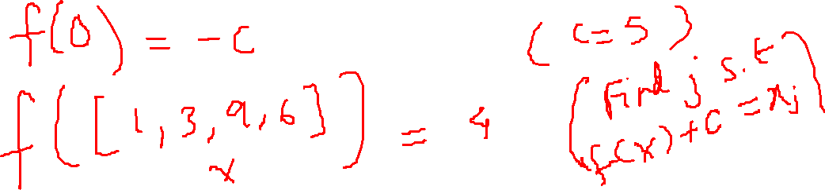
Practice Questions (Geometry)
Melbo has a secret model $f:ℝ^{4}→ℝ$. It is known that $f$ calculates its output by biasing one of the input coordinates i.e., $f\left(x\right)=x_{j}−c$ for some $j∈\left[4\right]$ and $c∈ℝ$. I want to steal Melbo’s model by finding out what value of $j,c$ are being used. I can send Melbo any number of inputs $x^{1},x^{2}…∈ℝ^{4}$ and get model outputs $f\left(x^{1}\right),f\left(x^{2}\right)…$. Design an algorithm to steal Melbo’s model using as few queries as possible.
Such attacks are known as model exfiltration attacks.

Slide 15

Practice Questions (Calculus)
Melbo likes to play volleyball. Melbo finds that if thrown straight up from a height of 1 metre (assuming $g=10 m/s^{2}$), the height of the ball $t$ seconds after being launched is $h=1+5t−5t^{2}$
The maximum height attained by the ball
Time taken to reach the highest point

Slide 16
Practice Questions (Calculus)
Time taken for the ball to hit the ground initially
The velocity with which Melbo threw the ball
The velocity of the ball at its highest point

