Slide 1
My first Solver
Optimization for ML

Slide 2
The “best” Linear Classifier

Slide 3
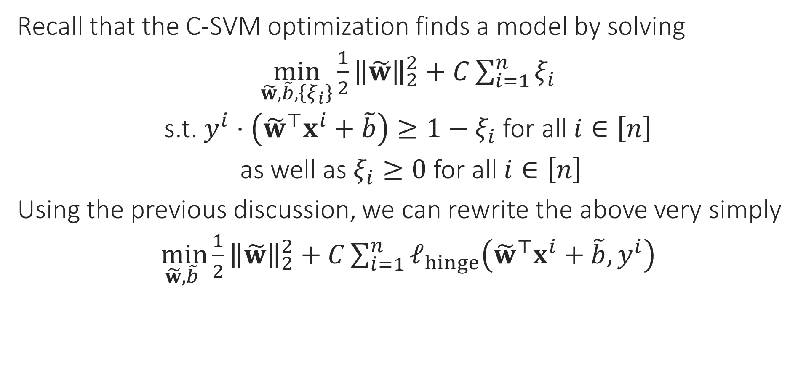
Final Form of C-SVM
Recall that the C-SVM optimization finds a model by solving
$\min_{\tilde{w},\tilde{b},\left\{ξ_{i}\right\}}{{\frac{1}{2}\left\|\tilde{w}\right\|}_{2}^{2}+C\sum_{i=1}^{n}{ξ_{i}}}$
s.t. $y^{i}⋅\left({\tilde{w}}^{⊤}x^{i}+\tilde{b}\right)≥1−ξ_{i}$ for all $i∈\left[n\right]$
as well as $ξ_{i}≥0$ for all $i∈\left[n\right]$
Using the previous discussion, we can rewrite the above very simply
$\min_{\tilde{w},\tilde{b} }{{\frac{1}{2}\left\|\tilde{w}\right\|}_{2}^{2}+C\sum_{i=1}^{n}{ℓ_{hinge}\left({\tilde{w}}^{⊤}x^{i}+\tilde{b},y^{i}\right)}}$

Slide 4
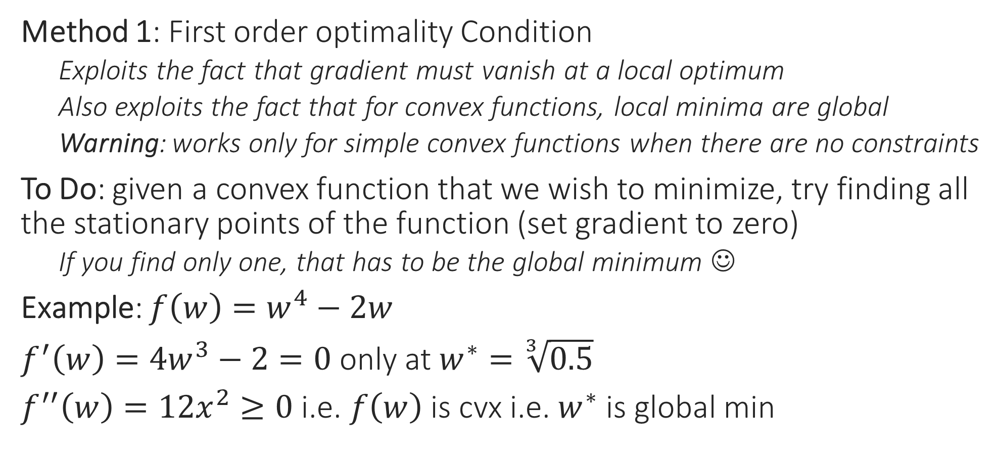
Use Calculus for Optimization
Method 1: First order optimality Condition
Exploits the fact that gradient must vanish at a local optimum
Also exploits the fact that for convex functions, local minima are global
Warning: works only for simple convex functions when there are no constraints
To Do: given a convex function that we wish to minimize, try finding all the stationary points of the function (set gradient to zero)
If you find only one, that has to be the global minimum ☺
Example: $f\left(w\right)=w^{4}−2w$
$f^{′}\left(w\right)=4w^{3}−2=0$ only at $w^{∗}=\sqrt[3]{0.5}$
$f^{′′}\left(w\right)=12x^{2}≥0$ i.e. $f\left(w\right)$ is cvx i.e. $w^{∗}$ is global min

Slide 5


Use Calculus for Optimization
Method 2: Perform (sub)gradient descent
Recall that direction opposite to gradient offers steepest descent
(SUB)GRADIENT DESCENT
Given: obj. func. $f:ℝ^{d}→ℝ$ to minimize
Initialize $w^{0}∈ℝ^{d}$
For $t=0, 1, …$
Obtain a (sub)gradient $g^{t}∈∂f\left(w^{t}\right)$
Choose a step length $η_{t}$
Update $w^{t+1}←w^{t}−η_{t}⋅g^{t}$
Repeat until convergence
How to initialize $w^{0}$?
How to choose $η_{t}$
Often called “step length” or “learning rate”
What is convergence?
How to decide if we have converged?

Slide 6
Gradient Descent (GD)
Choose step length carefully else may overshoot the global minimum even with great initialization
Move opposite to the gradients
Also, initialization may affect result
Our initialization was such that we converged to a local minimum
This time initialization was really nice!
Global minimum
With convex fns, all local minima are global minima and can afford to be less carefull with initialization
Still need to be careful with step lengths otherwise may overshoot global minima

Slide 7



Behind the scenes in GD for SVM
So gradient descent, although a mathematical tool from calculus, actually tries very actively to make the model perform better on all data points
$f\left(w\right)=\frac{1}{2}{\left\|w\right\|}_{2}^{2}+C⋅{\sum_{i=1}^{n}{\left[1−y^{i}⋅w^{⊤}x^{i}\right]}}_{+}$ (ignore bias $b$ for now)
$∇f\left(w\right)=w+C⋅\sum_{i=1}^{n}{g^{i}y^{i}⋅x^{i}}$, where $g^{i}∈∂ℓ_{hinge}\left(y^{i}⋅w^{⊤}x^{i}\right)$
$w^{new}=w−η⋅∇f\left(w\right)=\left(1−η\right)⋅w−ηC⋅\sum_{i=1}^{n}{g^{i}y^{i}⋅x^{i}}$
Assume $n=1$ for a moment for sake of understanding
$w^{new}=\left(1−η\right)⋅w−ηC⋅g^{1}y^{1}⋅x^{1}$
Small $η$: $\left(1−η\right)$ is large $⇒$ do not change $w$ too much!
Large $η$: Feel free to change $w$ as much as the gradient dictates
If $w$ does well on $\left(x^{1},y^{1}\right)$, say $y^{1}⋅w^{⊤}x^{1}>1$, then $g^{1}=0$
If $w$ does badly on $\left(x^{1},y^{1}\right)$, say $y^{1}⋅w^{⊤}x^{1}<0$, then $g^{1}=−1$
$w^{new}=\left(1−η\right)⋅w+ηC⋅y^{1}⋅x^{1}$
$y^{1}⋅{\left(w^{new}\right)}^{⊤}⋅x^{1}={\left(1−η\right)y}^{1}⋅w^{⊤}x^{1}+ηC⋅{\left\|x^{1}\right\|}_{2}^{2}$
No change to $w$ due to the data point $\left(x^{1},y^{1}\right)$
$w^{new}$ may get much better margin on $\left(x^{1},y^{1}\right)$ than $w$

Slide 8

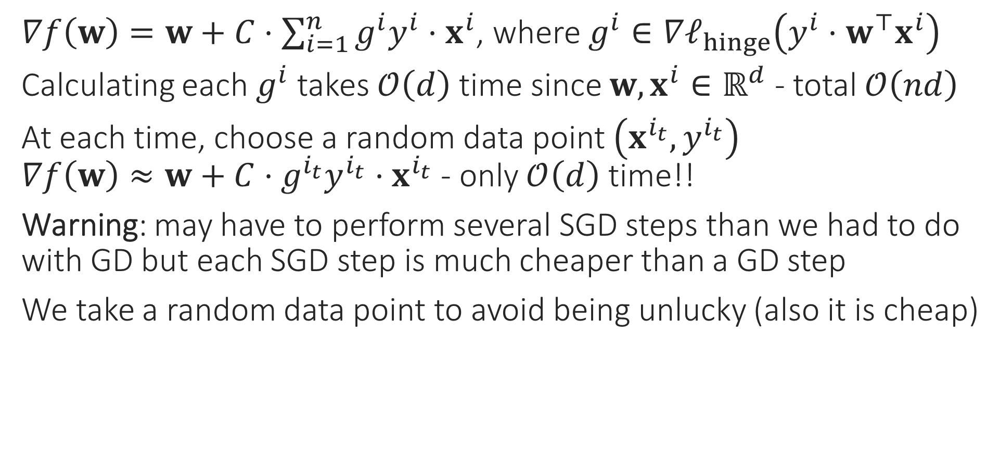
Stochastic Gradient Method
$∇f\left(w\right)=w+C⋅\sum_{i=1}^{n}{g^{i}y^{i}⋅x^{i}}$, where $g^{i}∈∇ℓ_{hinge}\left(y^{i}⋅w^{⊤}x^{i}\right)$
Calculating each $g^{i}$ takes $𝒪\left(d\right)$ time since $w,x^{i}∈ℝ^{d}$ - total $𝒪\left(nd\right)$
At each time, choose a random data point $\left(x^{i_{t}},y^{i_{t}}\right)$ $∇f\left(w\right)≈w+C⋅g^{i_{t}}y^{i_{t}}⋅x^{i_{t}}$ - only $𝒪\left(d\right)$ time!!
Warning: may have to perform several SGD steps than we had to do with GD but each SGD step is much cheaper than a GD step
We take a random data point to avoid being unlucky (also it is cheap)
Do we really need to spend so much time on just one update?
Initially, all we need is a general direction in which to move
Especially in the beginning, when we are far away from the optimum!
No, SGD gives a cheaper way to perform gradient descent

Slide 9
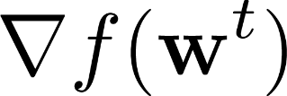

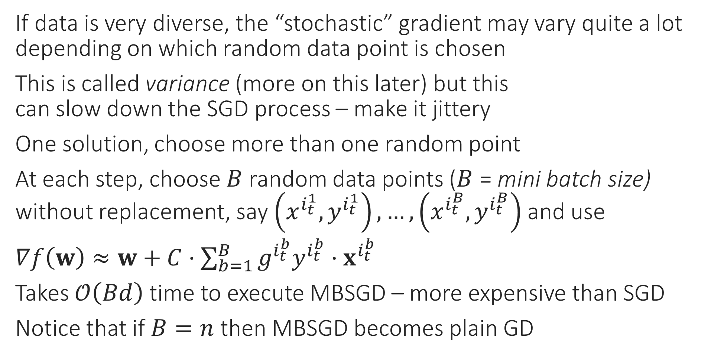
Mini-batch SGD
If data is very diverse, the “stochastic” gradient may vary quite a lot depending on which random data point is chosen
This is called variance (more on this later) but this can slow down the SGD process – make it jittery
One solution, choose more than one random point
At each step, choose $B$ random data points ($B$ = mini batch size) without replacement, say $\left(x^{i_{t}^{1}},y^{i_{t}^{1}}\right),…,\left(x^{i_{t}^{B}},y^{i_{t}^{B}}\right)$ and use
$∇f\left(w\right)≈w+C⋅\sum_{b=1}^{B}{g^{i_{t}^{b}}y^{i_{t}^{b}}⋅x^{i_{t}^{b}}}$
Takes $𝒪\left(Bd\right)$ time to execute MBSGD – more expensive than SGD
Notice that if $B=n$ then MBSGD becomes plain GD

Slide 10



Coordinate Descent
Sometimes we are able to optimize completely along a given variable (even if constraints are there) – called coordinate minimization (CM)
Similar to GD except only one coordinate is changed in a single step
E.g. $\min_{x∈ℝ^{d}}{f\left(x\right)}$ s.t. $x∈𝒞$ with $∇_{j}f\left(x\right)=\frac{∂f}{∂x_{j}}$ as $j$th partial derivative
CCD: choose coordinate cyclically i.e. $j_{t}=1,2,…,d,1,2,…,d,…$
SCD: choose $j_{t}$ randomly
Block CD: choose a small set of coordinates at each $t$ to update
Randperm: permute coordinates randomly and choose them in that order. Once the list is over, choose a new random permutation and start over (very effective)
COORDINATE DESCENT
1. For $t=0,1,…$
Select a coordinate $j_{t}∈\left[d\right]$
Let $u_{j_{t}}^{t+1}←x_{j_{t}}^{t}−η_{t}⋅∇_{j_{t}}f\left(x^{t}\right)$
Let $u_{j}^{t+1}←x_{j}^{t}$ for $j≠j_{t}$
Repeat until convergence

Slide 11






Constrained Optimization
Method 3: Creating a Dual Problem
Suppose we wish to solve $\min_{x∈ℝ^{d}}{f\left(x\right)}+r\left(x\right)$ s.t. $g\left(x\right)≤0$
Trick: sneak this constraint into the objective
Construct a barrier (indicator) fn $r\left(x\right)$ so that $r\left(x\right)=0$ if $g\left(x\right)≤0$ and $r\left(x\right)=∞$ otherwise, and simply solve
Easy to see that both problems have the same solution
One very elegant way to construct such a barrier is the following $r\left(x\right)=\max_{α≥0}{α⋅g\left(x\right)}$
Thus, we want to solve $\min_{x∈ℝ^{d}}\left\{f\left(x\right)+\max_{α≥0}{α⋅g\left(x\right)}\right\}$
Let us see how to handle multiple constraints and equality constraints
Hmm … we still have a constraint here, but a very simple one i.e. $α≥0$
Same as $\min_{x∈ℝ^{d}}\left\{\max_{α≥0} \left\{f\left(x\right)+α⋅g\left(x\right)\right\}\right\}$

Slide 12

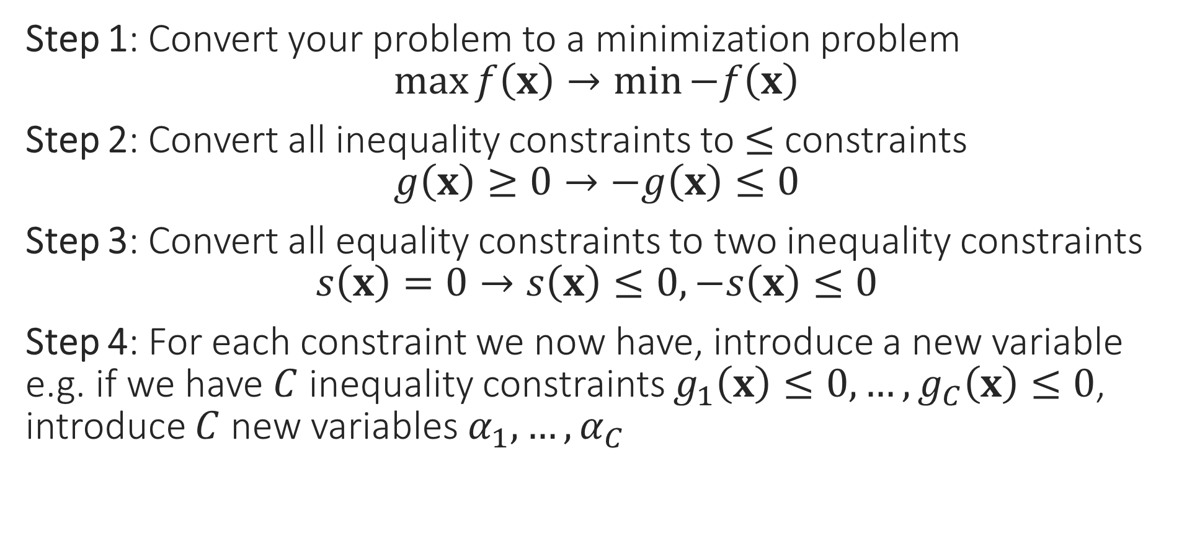

A few Cleanup Steps
Step 1: Convert your problem to a minimization problem $\max{f\left(x\right)}→\min{−f\left(x\right)}$
Step 2: Convert all inequality constraints to $≤$ constraints $g\left(x\right)≥0→−g\left(x\right)≤0$
Step 3: Convert all equality constraints to two inequality constraints $s\left(x\right)=0→s\left(x\right)≤0,−s\left(x\right)≤0$
Step 4: For each constraint we now have, introduce a new variable e.g. if we have $C$ inequality constraints $g_{1}\left(x\right)≤0,…,g_{C}\left(x\right)≤0$, introduce $C$ new variables $α_{1},…,α_{C}$
These new variables are called dual variables or sometimes even called Lagrange multipliers
The variables of the original optimization problem, e.g. $x$in this case, are called the primal variables by comparison

Slide 13

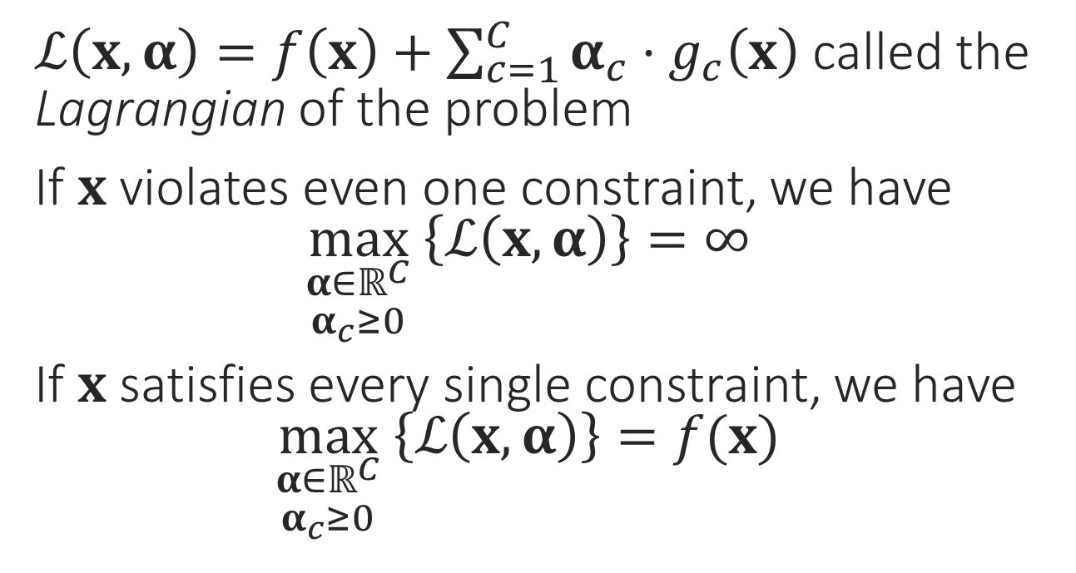

The Lagrangian
$\min_{x}{f\left(x\right)}$
s.t. $g_{1}\left(x\right)≤0$
$g_{2}\left(x\right)≤0$ $$⋮$$ $g_{C}\left(x\right)≤0$
$ℒ\left(x,α\right)=f\left(x\right)+\sum_{c=1}^{C}{α_{c}⋅g_{c}\left(x\right)}$ called the Lagrangian of the problem
If $x$ violates even one constraint, we have $\max_{\begin{aligned}α∈ℝ^{C} \\ α_{c}≥0\end{aligned}} \left\{ℒ\left(x,α\right)\right\}=∞$
If $x$ satisfies every single constraint, we have $\max_{\begin{aligned}α∈ℝ^{C} \\ α_{c}≥0\end{aligned}} \left\{ℒ\left(x,α\right)\right\}=f(x)$
This is just a nice way of rewriting the above problem
$$\min_{x∈ℝ^{d}}\left\{\max_{\begin{aligned}α∈ℝ^{C} \\ α_{c}≥0\end{aligned}} \left\{f\left(x\right)+\sum_{c=1}^{C}{α_{c}⋅g_{c}\left(x\right)}\right\}\right\}$$

