Slide 1
OBJECT ORIENTED DEVELOPMENT WITH JAVA CT038-3-2 – OODJ Version 2
Introduction

Slide 2
Lecturer information
Lecturer Name: Usman Hashmi
Email: usman@staffemail.apu.edu.my

Slide 3
Pre-requisites for this module
CT010-3-1(Fundamentals of Software Development) or equivalent

Slide 4
Aims of this module
This is a programming module designed to introduce you to programming in the Java language and software development using Object Oriented techniques.

Slide 5
Learning outcomes
At the end of this module, you should be able to:
Explain the techniques of Object Oriented Design(C2,PLO1)
Implement a software application that exploits the strength of object-oriented paradigm(C6,PL02)
Demonstrate the use of object oriented concepts and their functionalities in the existing system(A3,PL04)

Slide 6
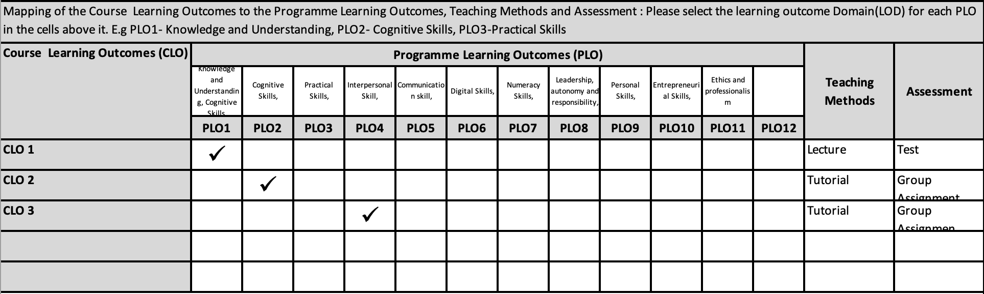
Mapping of CLOs with MOEs Domain

Slide 7
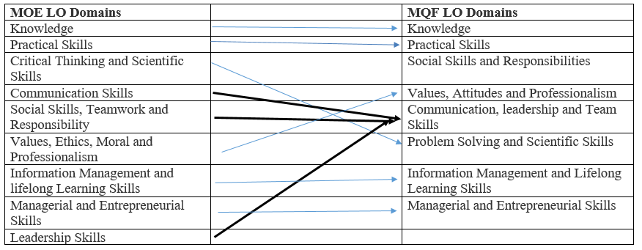
MQF and MOE Domains

Slide 8
Teaching Strategies
Lecture
Tutorial Lab

Slide 9
How you will be assessed
Incourse Assessment 100%
One Group Assignment weighted at 50%
Two Test assessments weighted at 25% each
Test 1 will be held in Week 9
Test 2 will be held in Week 14

Slide 10
Student Learning Time (SLT)
Module Credit Value: 3.0
Total Learning Hours:
Lecture: 1 time 2 hours per week
Practical: 1 time 2 hours per week
Student Learning Time: 120

Slide 11
Methods of Delivery
Hence,
We are now moving from the traditional topic based teaching to outcome-based education

Slide 12
Outcomes Based Education (OBE)
OBE is education based on producing particular educational outcomes that:
Focus on what students can actually do after they are taught
Expect all learners / students to successfully achieve particular (sometimes minimum) level of knowledge and abilities.

Slide 13
So…What is OBE?
It’s
NOT
What we want to teach,
It’s
What You should learn

Slide 14
Course Content Outline
Introduction to Java and IDE – JDK + Netbeans IDE
Overview of Java language
UML diagrams
Overview of OOP with Java classes
Object oriented programming concepts
Packages: Putting classes together
Java GUI
Managing errors and exceptions
File Input/Output

Slide 15
What is expected of you
You should abide to all the rules & regulation of APU
Proper attire
No speaking of dialects
Attendance is compulsory and valid medical certificates or letters from parents /guardians must support any absence from class.
Three lateness will be equal to one absence
All pagers and handphones should be turned off during lectures.

Slide 16
What support is available for you
Consultation hours
Resources
Reference material
Essential Reading
Paul,Deitel and Harvey, Deitel. (2018) Java:How to Program,Early Objects.11th Ed.Harlow,United Kingdom:Pearson Education.ISBN13: 978-0134743356
Sedgewick, R. and Wayne, K.( 2017) Introduction to programming in Java: an interdisciplinary approach.2nd Ed.Berkeley,United States:Pearson Education(US).ISBN13:978-0672337840
Daniel,Y.(2013) Intro to Java Programming, Comprehensive Version.10th Ed.New Jersey,United States: Prentice Hall.ISBN13: 978-0133813463
Internet resources

Slide 17
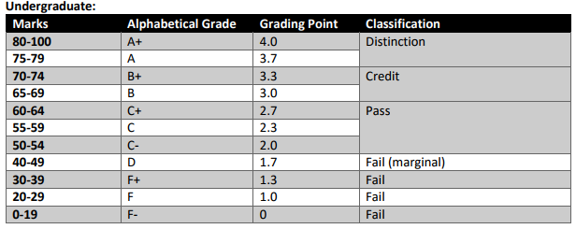
Achievement requirements

Slide 18
Question and answer session
Q & A

