Slide 1
Principles of Visual Modeling
Object Oriented Development
with Java
(CT038-3-2)
System Modeling
Prepared by: Lee Kim Keong First Prepared on: June 13 Last Modified on: April 19
Quality checked by: null
Copyright 2019 Asia Pacific University of Innovation and Technology

Slide 2
Learning outcome
At the end of this lesson, you will be able to
Describe the importance of visual modeling and the role of model drive architecture
Define four principles of visual modeling

Slide 3

What Is a Model?
A model is a simplification of reality.

Slide 4
Why Model?
Modeling achieves four aims:
Helps you to visualize a system as you want it to be.
Permits you to specify the structure or behavior of a system.
Gives you a template that guides you in constructing a system.
Documents the decisions you have made.

Slide 5
Cont’d
You build models of complex systems because you cannot comprehend such a system in its entirety.
You build models to better understand the system you are developing.

Slide 6
The Importance of Modeling
Less Important
More Important
Paper Airplane
Fighter Jet

Slide 7
Software Teams Often Do Not Model
Many software teams build applications approaching the problem like they were building paper airplanes
Start coding from project requirements
Work longer hours and create more code
Lacks any planned architecture
Doomed to failure
Modeling is a common thread to successful projects

Slide 8
Model Driven Architecture (MDA)
An approach to using models in software development
Separate the specification of the operation of a system from the details of the way that system uses the capabilities of its platform.
specifying a system independently of the platform that supports it
specifying platforms
choosing a particular platform for the system
transforming the system specification into one for a particular platform

Slide 9
Four Principles of Modeling
The model you create influences how the problem is attacked.
Every model may be expressed at different levels of precision.
The best models are connected to reality.
No single model is sufficient.

Slide 10
Principle 1: The Choice of Model is Important
The models you create profoundly influence how a problem is attacked and how a solution is shaped.
In software, the models you choose greatly affect your world view.
Each world view leads to a different kind of system.

Slide 11
Principle 2: Levels of Precision May Differ
Every model may be expressed at different levels of precision.
The best kinds of models let you choose your degree of detail, depending on:
Who is viewing the model.
Why they need to view it.
View for Customers
View for Designers

Slide 12
Principle 3: The Best Models Are Connected to Reality
All models simplify reality.
A good model reflects potentially fatal characteristics.

Slide 13
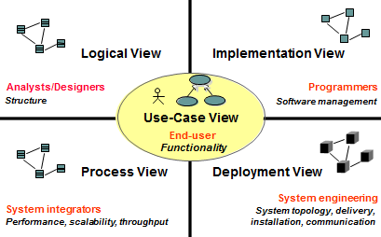
Principle 4: No Single Model Is Sufficient
No single model is sufficient. Every non-trivial system is best approached through a small set of nearly independent models.
Create models that can be built and studied separately, but are still interrelated.

Slide 14
Review
What is a model?
What are the viewpoints of MDA? Describe each one.
What are the four principles of modeling? Describe each one.

Slide 15
Q & A

