Slide 1
Use-case Modeling
Object Oriented Development
with Java
(CT038-3-2)
Object Oriented Modeling
Prepared by: Lee Kim Keong First Prepared on: June 13 Last Modified on: April 19
Quality checked by: null
Copyright 2019 Asia Pacific University of Innovation and Technology

Slide 2
Learning outcome
At the end of this lesson, you will be able to
Explain what is Unified Modeling Language (UML)
Model a system using a use-case diagram

Slide 3
What Is the UML?
The UML is a language for
Visualizing
Communicating conceptual models to others is prone to error unless everyone involved speaks the same language.
Specifying
The UML builds models that are precise, unambiguous, and complete.
Constructing
UML models can be directly connected to a variety of programming languages.
Documenting
The UML addresses documentation of system architecture, requirements, tests, project planning, and release management.

Slide 4


Use Case Diagram
Used for describing a set of user scenarios by showing the relationships between actors and use cases in a system for capturing user requirements.
Works like a contract between the end user and software developers

Slide 5
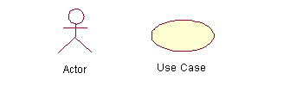
Components of a Use Case Diagram
Actors: A role that a user plays with respect to the system, including human users and other systems. e.g., inanimate physical objects (e.g. robot); an external system that needs some information from the current system.
Use case: A set of scenarios that describe an interaction between a user and a system, including alternatives. Begin with a verb. Sequence of use case shows timing of events/operations
System boundary: rectangle diagram representing the boundary between the actors and the system.

Slide 6
Components of a Use Case Diagram (core relationship)
Association: communication between an actor and a use case and is represented by a solid line.
Generalization: relationship between one general use case and a special use case (used for defining special alternatives)
Represented by a line with a triangular arrow head toward the parent use case.

Slide 7
Components of a Use Case Diagram (core relationship)
Include: a dotted line labeled <<include>> which begins at the base use case and ends with an arrow pointing to the include use case. The include relationship occurs when a chunk of behavior is similar across more than one use case. Use “include” in stead of copying the description of that behavior.
<<include>>
Extend: a dotted line labeled <<extend>> with an arrow toward the base case. The extending use case may add behavior to the base use case. The base class declares “extension points”.
<<extend>>

Slide 8
Use Case Diagrams Guidelines and Cautions
Use Case MUST always begin with a verb – i.e generate report.
Avoid showing communication between actors.
Actors should be named as singular. i.e student and NOT students.
Do NOT show workflow in a use case diagram; instead only depict only system functionality.
Avoid showing include and extends as much as possible unless you have to.
KISS – Keep It Small and Simple

Slide 9








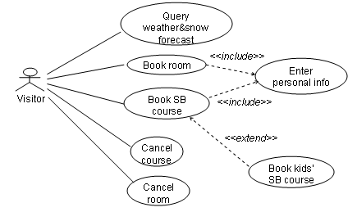

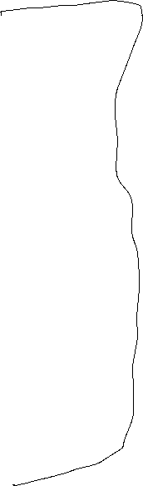








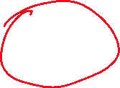

Use Case Diagram – Example
Library Management System

Slide 10
Use Case Specification
Use Case | Cancel Room
Brief Description | This use case allows a visitor to cancel booking made earlier.
Actors | Visitor
Preconditions | Visitor must be logged into the system. Visitor provides room number(s) that is to be cancelled
Main Flow | (a) The use case begins when a visitor activates the option to cancel booking. (b) The system requests that the visitor enters room number to be cancelled (ref. Alternative flow). (c) The system searches in the database and displays a confirmation before a room booking cancellation is made (ref. Alternative flow).
Alternative Flows | (bentry. ) (i) The actor does not remember the room number and a reception is contacted to help search via IC number. (c) (i) The system searches through the database and is not able to find a pervious booking in which case a previous may have not been made else receptionist is contacted to verify

Slide 11
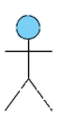
Use Case Diagram: Smart Phone
Smart Phone
Search Phone Book
<<Includes>>
Manipulate Contacts
<<Extends>>
{Option==Delete}
<<Extends>>
{Option==Edit}
<<Extends>>
{Option==Contact}
Call Contact
Modify a Contact
Contact Person
Delete Contact
Smart Phone User
Add New Contact
<<Extends>>
{Option==Message}
<<Extends>>
{Option==Call}
Place a Call
Send a Message
Receive a Call

Slide 12
Use Case Diagram: ATM
ATM Machine
Withdraw Cash
<<Extends>>
Pay Bills
Print Receipt
Customer
Transfer Funds
<<Includes>>
Restock Paper
Maintenance Man

Slide 13

Review
What is the UML? Describe each of its four benefits.
What are the components of a use case diagram?
Draw the use case diagram for borrowing a book from the library

Slide 14
Q & A

