Slide 1
Exception Handling
Object Oriented Development
with Java
(CT038-3-2)
Object Oriented Modeling
Prepared by: Lee Kim Keong First Prepared on: June 13 Last Modified on: April 19
Quality checked by: null
Copyright 2019 Asia Pacific University of Innovation and Technology

Slide 2
Topic & Structure of the lesson
Exception Handler
Exception Class
Handling Exception
Handling multiple exceptions
finally clause
Checked and unchecked exceptions
throw exception
Creating (your own) exception class
2

Slide 3
Learning outcomes
At the end of this lecture you should be able to:
Handle exceptions
Understand the difference between checked and unchecked exceptions
Use try-catch-finally block
3

Slide 4
Exception
An exception is an event that occurs during the execution of a program that disrupts the normal flow of instructions
Exceptions are said to have been “thrown”
It is the programmers responsibility to write code that detects and handles exceptions
Unhandled exceptions will crash a program
4

Slide 5
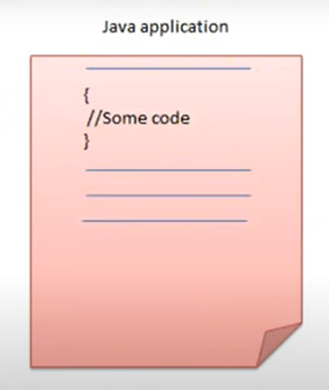
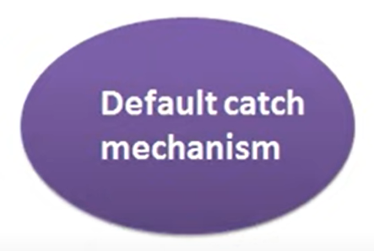
EXCEPTION OBJECT

Slide 6
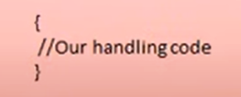
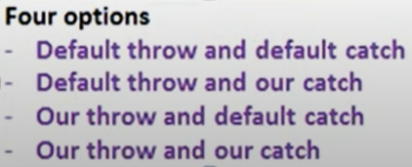
EXCEPTION OBJECT

Slide 7
Exception Handler
Java allows you to create exception handlers
An exception handler is a section of code that gracefully responds to exceptions
The process of intercepting and responding to exceptions is called exception handling
7

Slide 8
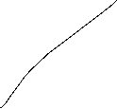





try {
==========
========
========
} catch (Exception e){
======
======
}finally {
=======
==========
}

Slide 9
Exception Class
Exception objects are created from classes in the Java API hierarchy of exception classes
All of the exception classes in the hierarchy are derived from the Throwable class
Error and Exception are derived from the Throwable class
9

Slide 10
Exception Class
Object
Throwable
Error
Exception
…
…
IOException
RuntimeException
…
EOFException
FileNotFoundException
…
10

Slide 11
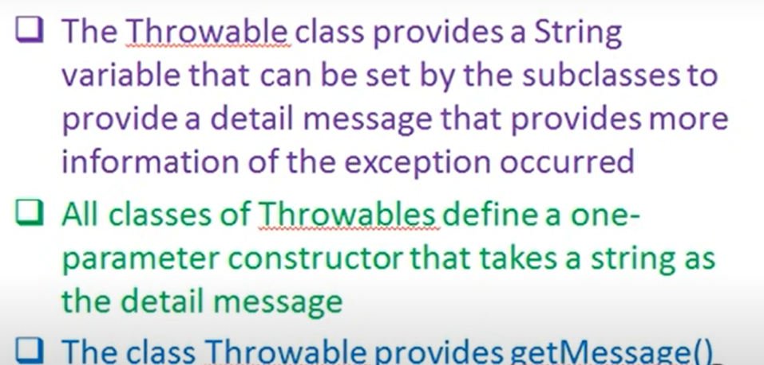
Throwable Class
The class Throwable provides getMessage()
Function to retrieve an exception

Slide 12
Exception Class
Classes that are derived from Error:
are for exceptions that are thrown when critical errors occur. (i.e.)
an internal error in the Java Virtual Machine, or
running out of memory.
Applications should not try to handle these errors because they are the result of a serious condition
Programmers should handle the exceptions that are instances of classes that are derived from the Exception class
12

Slide 13
Handling Exception
To handle an exception, you use a try statement.
try
{
//try block statements...
}
catch (ExceptionType ParameterName)
{
//catch block statements...
}
The keyword try indicates a block of code will be attempted (the curly braces are required)
This block of code is known as a try block
13

Slide 14
Handling Exception
A try block is:
one or more statements that are executed, and
can potentially throw an exception
The application will not halt if the try block throws an exception
After the try block, a catch clause appears
catch (ExceptionType ParameterName)
ExceptionType - name of an exception class and ParameterName - variable name that references the exception object if the code in the try block throws an exception
14

Slide 15

Example
This code is designed to handle a FileNotFoundException if it is thrown
try
{
File file = new File ("MyFile.txt");
Scanner inputFile = new Scanner(file);
}
catch (FileNotFoundException e)
{
System.out.println("File not found.");
}
15

Slide 16
Polymorphic References to Exceptions
When handling exceptions, you can use a polymorphic reference as a parameter in the catch clause
Most exceptions are derived from the Exception class
A catch clause that uses a parameter variable of the Exception type is capable of catching any exception that is derived from the Exception class
https://docs.oracle.com/javase/7/docs/api/java/lang/Exception.html
16

Slide 17
Example
try
{
number = Integer.parseInt(str);
}
catch (Exception e)
{
System.out.println("The following error occurred: " + e.getMessage());
}
The Integer class’s parseInt method throws a NumberFormatException object
The NumberFormatException class is derived from the Exception
class
17

Slide 18
Handling Multiple Exceptions
The code in the try block may be capable of throwing more than one type of exception
A catch clause needs to be written for each type of exception that could potentially be thrown
The JVM will run the first compatible catch clause found
The catch clauses must be listed from most specific to most general
18

Slide 19
Handling Multiple Exceptions
try
{
number = Integer.parseInt(str);
}
catch (NumberFormatException e)
{
System.out.println(str + "is not a number.");
}
catch (IllegalArgumentException e)
{
System.out.println("Bad number format.");
}
19

Slide 20
Handling Multiple Exceptions
try
{
number = Integer.parseInt(str);
}
catch (NumberFormatException e)
{
System.out.println("Bad number format.");
}
catch (NumberFormatException e) // ERROR!!!
{
System.out.println(str + " is not a number.");
}
Duplicated catch with same parameter type
20

Slide 21
Handling Multiple Exceptions
try {
number = Integer.parseInt(str);
}
catch (IllegalArgumentException e)
{
System.out.println("Bad number format.");
}
catch (NumberFormatException e) // ERROR!!!
{
System.out.println(str + " is not a number.");
}
The NumberFormatException class is derived from the IllegalArgumentException class.
21

Slide 22
Handling Multiple Exceptions
You should catch from
specific type to general type
In Java SE 7 and later, a single catch block can handle more than one type of exception
This feature can reduce code duplication and lessen the temptation to catch an overly broad exception
catch (IOException|SQLException ex) { logger.log(ex);
throw ex;
}
Implicitly final
22

Slide 23
finally clause
The try statement may have an optional finally clause
If present, the finally clause must appear after all of the catch clauses
try {
//try block statements...
}
catch (ExceptionType ParameterName) {
//catch block statements...
}
finally {
//finally block statements...
}
23

Slide 24
finally clause
always executed after the try block has executed and
after any catch blocks have executed if an exception was thrown
try {
System.out.println(a[3]); //assume that array size is 2
}
catch(ArrayIndexOutOfBoundsException e) { System.out.println("Exception thrown: " + e);
}
finally {
System.out.println("First element: " + a[0]);
}
24

Slide 25
Checked and Unchecked Exception
There are two categories of exceptions:
unchecked
checked
25

Slide 26
Checked Exception
All exceptions that are not derived from Error or RuntimeException are checked exceptions
Occurs during compile time
Invalid conditions that are not within the control of the program such as invalid user input, database problems, network outages, absent files
Eg. IOException, SQLException, ClassNotFoundException
26

Slide 27
Unchecked Exception
Unchecked exceptions are program bugs (errors in program logic) at time of execution (runtime)
derived from the RuntimeException class
RuntimeException serves as a superclass for exceptions that result from programming errors
Subclasses: llegalArgumentException, NullPointerException, ArithmeticException or ArrayIndexOutOfBoundsException
27

Slide 28
throws exception
If the code in a method can throw a checked exception, the method:
must handle the exception, or
it must have a throws clause listed in the method header
The throws clause informs the compiler what exceptions can be thrown from a method
28

Slide 29
Example
Compiled!
// This method will not compile!
public void displayFile(String name)
{
// Open the file.
File file = new File(name);
Scanner inputFile = new Scanner(file);
// Read and display the file's contents.
while (inputFile.hasNext())
{
System.out.println(inputFile.nextLine());
}
// Close the file.
inputFile.close();
}
throws FileNotFoundException
29

Slide 30
throw exception
You can write code that:
throws one of the standard Java exceptions, or
an instance of a custom exception class that you have designed
The throw statement is used to manually throw an exception
throw new ExceptionType(MessageString);
30

Slide 31
Creating Exception Class
You can create your own exception classes by deriving them from the Exception class or one of its derived classes
31

Slide 32
Example
public class NegativeStartingBalance extends Exception {
public NegativeStartingBalance() {
super("Error: Negative starting balance");
}
public NegativeStartingBalance(double amount) {
super("Error: Negative starting balance: " +
amount);
}
}
32

Slide 33
Scenario for Customised Exception
Some examples of exceptions that can affect a bank account:
A negative starting balance is passed to the constructor
A negative interest rate is passed to the constructor
A negative number is passed to the deposit method
A negative number is passed to the withdraw method
The amount passed to the withdraw method exceeds the account’s balance
We can create exceptions that represent each of these error conditions
33

Slide 34
Review
What is exception handling?
How to handle exception?
What is the different between throws and throw?
What is checked exception?
What is unchecked exception?
Can I customise a specific exception type in my problem domain?
34

Slide 35
Q & A

