Slide 1
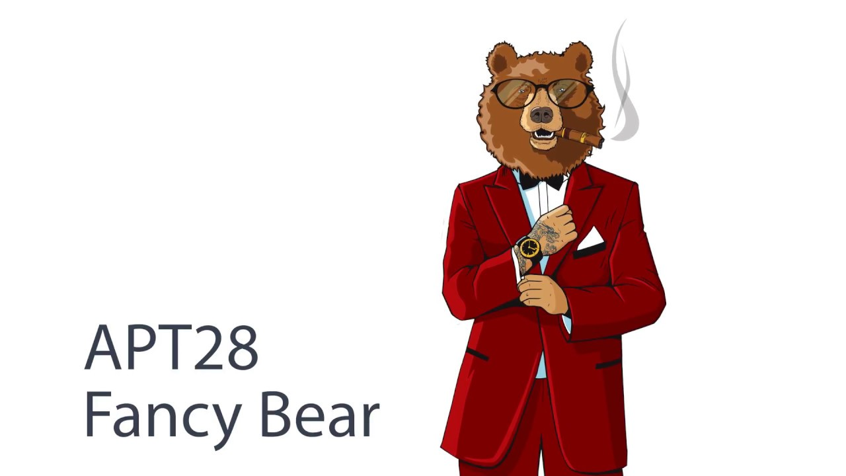

Slide 2
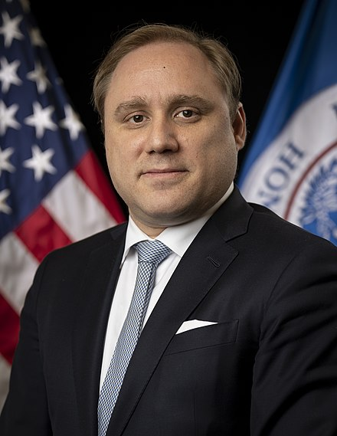
Fancy Bear is a Russian cyber espionage group.
The name "Fancy Bear" comes from a coding system security researcher Dmitri Alperovitch uses to identify hackers.
Dmitri Mikhailovich Alperovitch (born 1980) is a Russian American think-tank founder, investor, philanthropist, podcast host and former computer security industry executive. He is the chairman of Silverado Policy Accelerator, a geopolitics think-tank in Washington, D.C. and a co-founder and former chief technology officer of CrowdStrike. Alperovitch is a naturalized U.S. citizen born in Russia who came to the United States in 1994 with his family.

Slide 3

Motives
The group promotes the political interests of the Russian government, and is known for hacking Democratic National Committee emails to attempt to influence the outcome of the United States 2016 presidential elections.
The main targets:
government
military
security organizations, especially Transcaucasian and NATO-aligned states

Slide 4

Tactics
Since 2008, the Fancy Bear has used fear and social engineering to trick victims into opening malicious email attachments or clicking on malicious links.
This group is also known for registering domains that closely resemble domains of legitimate organizations they plan to target in order to establish phishing sites that spoof the look and feel of the victim’s web-based email services, with the intention of harvesting their credentials.

Slide 5
Events
Fancy Bear is thought to be responsible for cyber attacks on the:
German parliament
Norwegian parliament
French television station TV5Monde
White House
NATO
Democratic National Committee
Organization for Security and Co-operation in Europe
Campaign of French presidential candidate Emmanuel Macron

