Slide 1
Bonadan
MITRE ATT&CK
Cloud Service Discovery
Execution

Slide 2
Cloud Discovery
Adversaries may attempt to get a listing of cloud accounts. Cloud accounts are those created and configured by an organization for use by users, remote support, services, or for administration of resources within a cloud service provider or SaaS application.
Adversaries may attempt to get a listing of cloud accounts. Cloud accounts are those created and configured by an organization for use by users, remote support, services, or for administration of resources within a cloud service provider or SaaS application.
With authenticated access there are several tools that can be used to find accounts. The Get-MsolRoleMember PowerShell cmdlet can be used to obtain account names given a role or permissions group in Office 365.[1][2] The Azure CLI (AZ CLI) also provides an interface to obtain user accounts with authenticated access to a domain. The command az ad user list will list all users within a domain.[3][4]
The AWS command aws iam list-users may be used to obtain a list of users in the current account while aws iam list-roles can obtain IAM roles that have a specified path prefix.[5][6] In GCP, gcloud iam service-accounts list and gcloud projects get-iam-policy may be used to obtain a listing of service accounts and users in a project.[7]

Slide 3
MALWARE on Linux, malicious OpenSSH, since 2018
has discovered the username of the user running the backdoor (System Owner/User Discovery)
can find the external IP address of the infected host (System Network Configuration Discovery)
has discovered the OS version, CPU model, and RAM size of the system it has been installed on (System Information Discovery)
can download an additional module which has a cryptocurrency mining extension (Resource Hijacking)
can use the ps command to discover other cryptocurrency miners active on the system (Process Discovery)
can download additional modules from the C2 server (Ingress Tool Transfer)
can XOR-encrypt C2 communications (Encrypted Channel: Symmetric Cryptography)
has maliciously altered the OpenSSH binary on targeted systems to create a backdoor (Compromise Client Software Binary)
can create bind and reverse shells on the infected system (Command and Scripter Interpreter)

Slide 4
Bonadan
Bonadan is a malicious version of OpenSSH which acts as a custom backdoor. Bonadan has been active since at least 2018 and combines a new cryptocurrency-mining module with the same credential-stealing module used by the Onderon family of backdoors

Slide 5
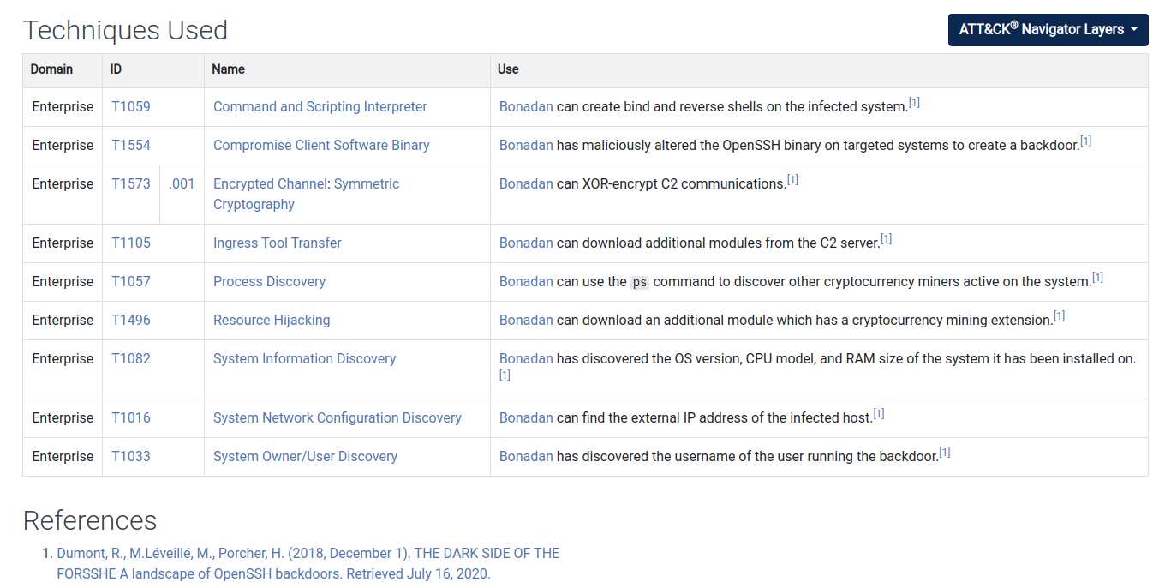

Slide 6
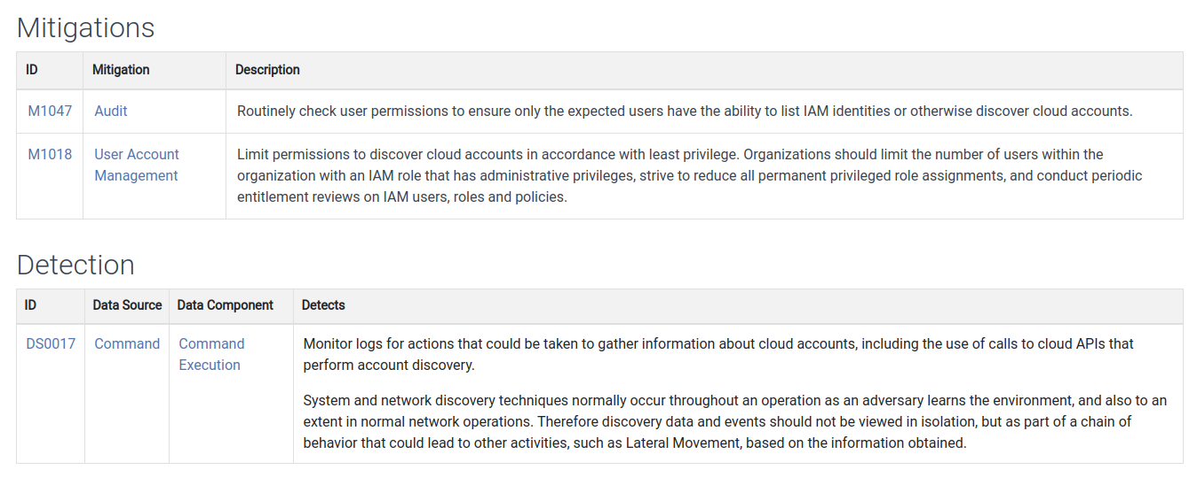

Slide 7
