Slide 1
ORANGEWORM

Slide 2
Who are they?
Cybercrime alliance that was going after organizations within healthcare and similar fields
No hallmarks of a nation-state actor
Likely the work of an individual or a small group of individuals

Slide 3
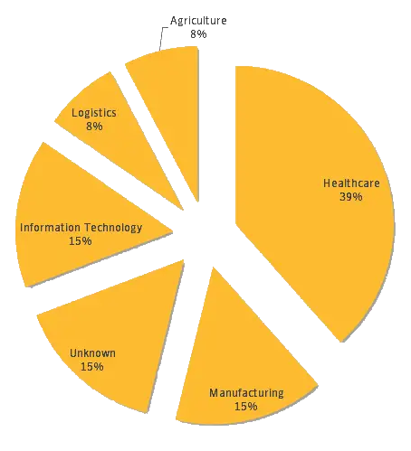
What they do?
CORPORATE ESPIONAGE
United States, Europe, and Asia
Healthcare sector and related industries
Since 2015

Slide 4
How they do it?
Installing a custom backdoor called Trojan.Kwampirs within large international corporations.
Choose its targets carefully and deliberately, conducting a good amount of planning before launching an attack.
Other industries have also been targeted as part of a larger supply-chain attack in order for Orangeworm to get access to their intended victims related to healthcare

Slide 5
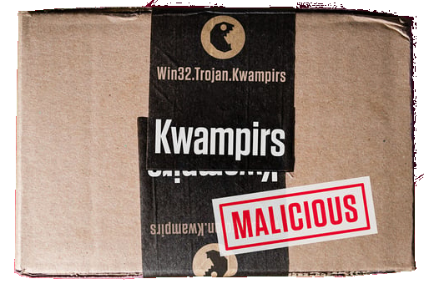
How they do it?
Once Orangeworm has infiltrated a victim’s network, they deploy Trojan.Kwampirs, a backdoor Trojan that provides the attackers with remote access to the compromised computer.
When executed, Kwampirs decrypts and extracts a copy of its main DLL payload from its resource section. Before writing the payload to disk, it inserts a randomly generated string into the middle of the decrypted payload in an attempt to evade hash-based detections.
To ensure persistence, Kwampirs creates a service with the following configuration to ensure that the main payload is loaded into memory upon system reboot
Notes:
What is DLL injection? DLL injection is a technique that is often used for Trojans. The pen-testing industry blog Penetration Testing Lab noted that DLL injection enables an intruder to run whatever script they want within another process’s address space. In the event that the process involved has heightened privileges, the nefarious party might be able to run sinister code within a DLL file that would further increase their privileges and, in turn, allow them to inflict widespread damage.

Slide 6
Once in…
Once Kwampirs is on a computer, the hackers are able to make the malware’s toolset more robust. They can download and run other modules within memory if that is what the attacker wants to do. The additional modules allow the criminal to customize their efforts to the environment of their target so that it is possible for them to accomplish what they want, which is broad information theft.

Slide 7
Orangeworm is bold
The Trojan used a self-propagation technique leveraging open network shares
Works in environments that have older operating systems running on the servers
The malware copies itself to other parts of the network, it changes a tiny part of its code in order to steer clear of detection
Not concerned with being discovered

Slide 8
Risks
It has an affinity for the installation software for the control and use of imaging devices, including MRI and X-ray machines and other copier-type imaging devices that take patient or client input of a sensitive nature.
Machines used to assist patients in completing consent forms for required procedures
HIPAA (Health Insurance Portability and Accountability Act)
Ransomware in 2019

Slide 9
Protection
Customers with Intelligence Services or WebFilter-enabled products are protected against activity associated with the Orangeworm group.
IoC: Indicators of Compromise

