Slide 1
Lysosomes Detector GUI
Automated 3D Lysosome Detection
Cell Segmentation
Quantitative Fluorescence Analysis

Slide 2
Why this software?
Problems:
• Manual counting
• Observer bias
• Time-consuming
Solution:
• Automated detection
• Cell assignment
• Quantification
• Publication-ready outputs

Slide 3
Software Overview
GUI
Image Loader
Detection
Segmentation
Quantification
Export

Slide 4
Complete Workflow
Input
Metadata
Gaussian
LoG
Radius
Watershed
Assign
Quantify
Export

Slide 5
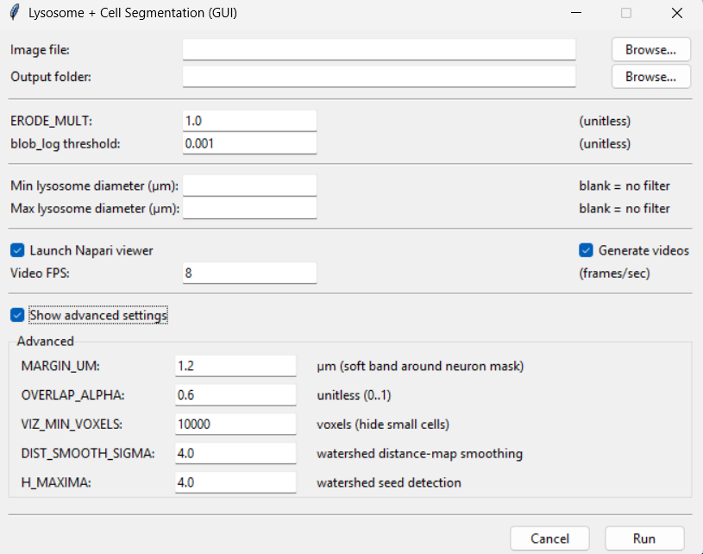
GUI Overview
Image
Parameters
Results

Slide 6
Image Loading & Metadata
📁 Input Image
TIFF / OME-TIFF / CZI
Purpose
• Supports multiple microscopy formats
• Automatically extracts voxel metadata
• Requests manual values only when needed
• Ensures accurate physical measurements
🔍 Read Metadata
Extract voxel size and image dimensions
📏 Physical Pixel Size
X, Y and Z spacing (µm)
❓ Metadata Missing?
Prompt user to enter voxel size manually
✅ Ready for Processing
Validated image and metadata

Slide 7
Image Preprocessing
Raw Image
Original fluorescence stack
Why preprocess?
• Improve signal-to-noise ratio
• Reduce false detections
• Enhance blob detection
• Increase segmentation robustness
Normalization
Intensity scaling
Gaussian Smoothing
Noise suppression
Background Correction
Remove low-frequency background
Preprocessed Image
Optimized for LoG detection

Slide 8
Lysosome Detection
blob_log identifies candidate lysosomes in the 3D volume.
LoG
Threshold
Blob Candidates
Coordinates
Detected

Slide 9
Radius Refinement
3D Gaussian Fit
Fits σx, σy and σz around each lysosome.
Radial Intensity
Computes radial profile and FWHM.
Final Radius
Combines both estimates into a robust radius.

Slide 10
Detection Outputs
Coordinates
3D centroid
Diameter
Physical size
Volume
µm³
Peak Intensity
Maximum fluorescence
CSV Export
Publication-ready table
Overlay
Visual validation

Slide 11
Cell Segmentation Pipeline
Cell Channel
Gaussian
Adaptive
Threshold
Morphology
Distance
Transform
Watershed
Labeled
Cells

Slide 12
Lysosome Assignment
Input
Detected lysosomes + Cell labels
Decision
Inside cell? Overlap? Nearest cell?
Output
Cell ID Outside Serial IDs

Slide 13
Signal Quantification
Cell Signal
Total fluorescence
Lysosome Signal
Integrated intensity
Cell Volume
Voxel count
Distance Analysis
0–0.2, 0.2–0.5 µm
Residual Signal
Outside puncta
Statistics
Per-cell CSV

Slide 14
Napari Interactive Editing
Editable Objects
• Add/remove lysosomes • Change cell IDs • Mark outside/cell • Filter cells • Save edited tables
Workflow
Load results ↓ Inspect detections ↓ Manual correction ↓ Export corrected CSV

Slide 15
Generated Outputs
lysosome_blobs_regions.csv
Final Deliverables
✓ Publication-ready tables ✓ Segmentation images ✓ Movies ✓ Quantitative statistics ✓ Napari-edited results
lysosomes_with_cell_vs_outside.csv
cell_signal_vs_lysosome_signal_extended.csv
Overlay TIFF stacks
MP4 / GIF videos
Debug masks

Slide 16
Software Architecture
GUI
Image Loader
Metadata
Detection
Segmentation
Quantification
Visualization
Napari
Export

Slide 17
Main Parameters
Detection
BLOB_THRESHOLD MIN/MAX_SIGMA
Segmentation
CH2_SMOOTH_SIGMA THRESH_BLOCK_SIZE ERODE_MULT
Watershed
DIST_SMOOTH_SIGMA H_MAXIMA
Classification
MARGIN_UM OVERLAP_ALPHA
Visualization
VIDEO_FPS NAPARI VIZ_MIN_VOXELS

Slide 18
Repository Structure
README.md
Generated Outputs
CSV TIFF MP4 GIF Napari-edited tables Debug masks
requirements.txt
Lysosomes_Detector_GUI.py
Example images
Documentation
Output folder

Slide 19
Installation
Quick Start
git clone <repository> pip install -r requirements.txt python Lysosomes_Detector_GUI.py Supports Python 3.12

Slide 20
Future Developments
Deep learning segmentation
GPU acceleration
Batch processing
Parallel computing
Automatic report generation
Cloud processing
Plugin architecture
Multi-channel support

