Slide 1
3D Image Segmentation and Quantification of Lysosomes
16/4/2025

Slide 2
L3 1 SCRIPT WITHOUT SPOTIFLOW

Slide 3
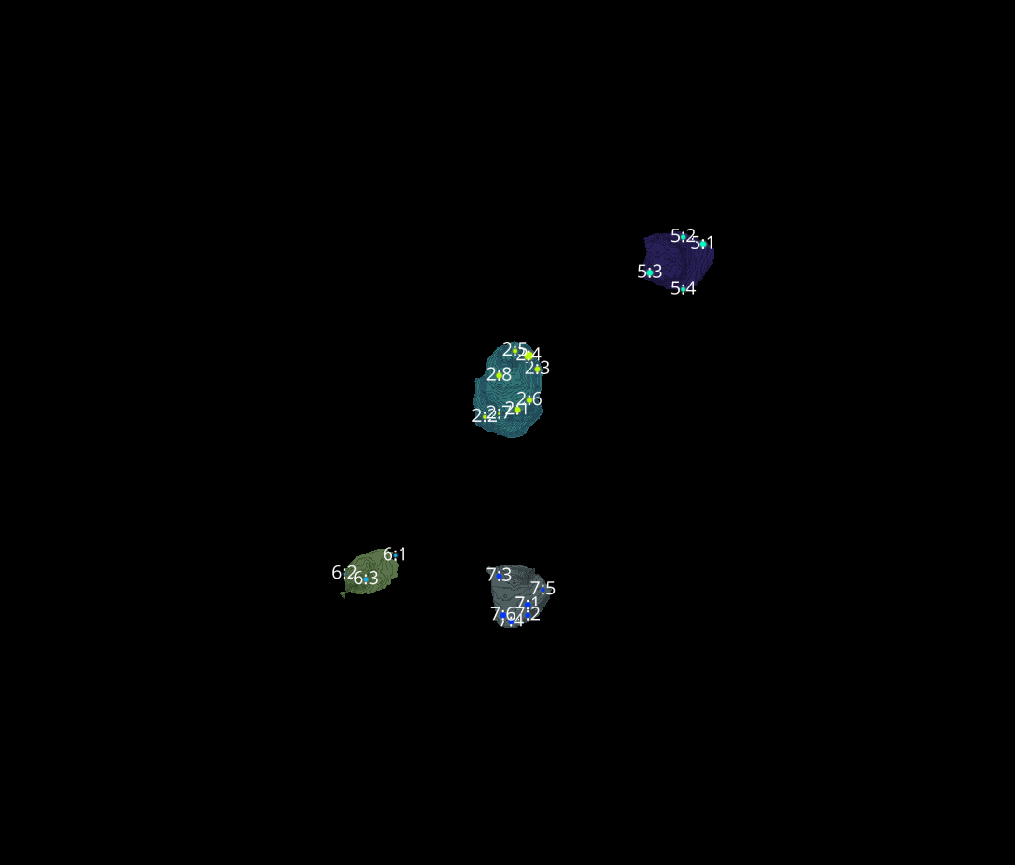
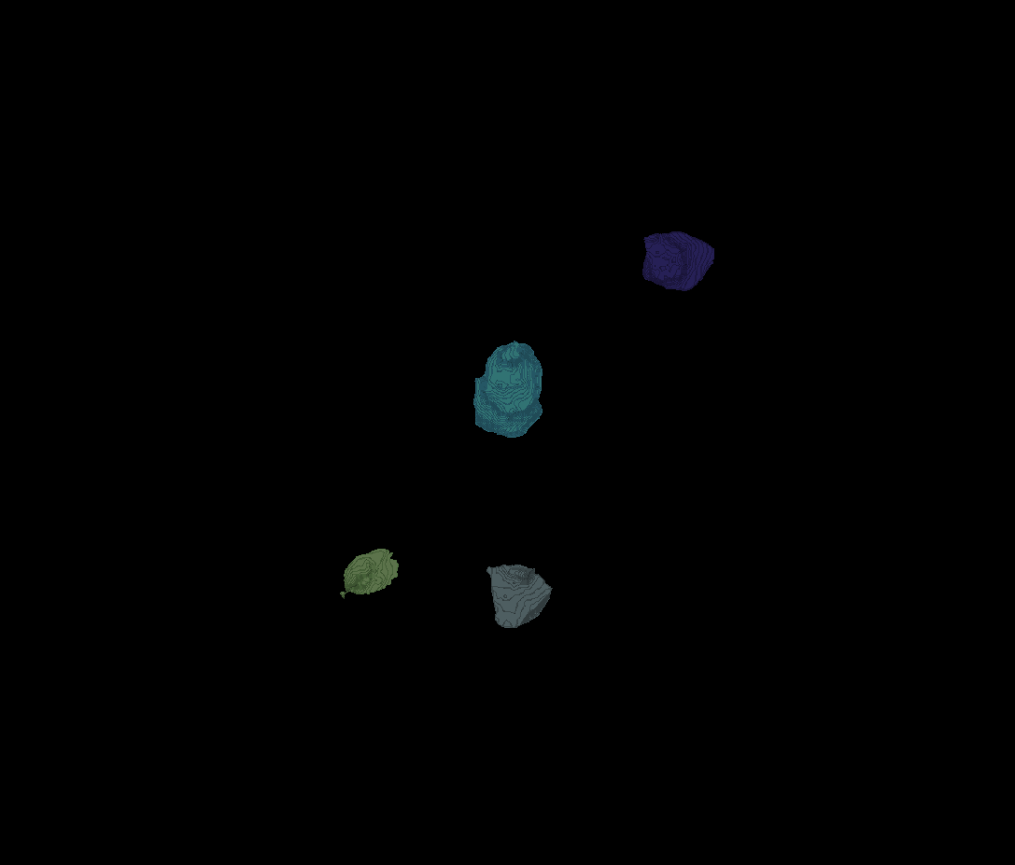
L3 1
Erosion = 8
Thresholding = 0.0025
margin um = 1.2
overlap alpha = 0.6
viz min voxels = 12000

Slide 4
L3 1

Slide 5
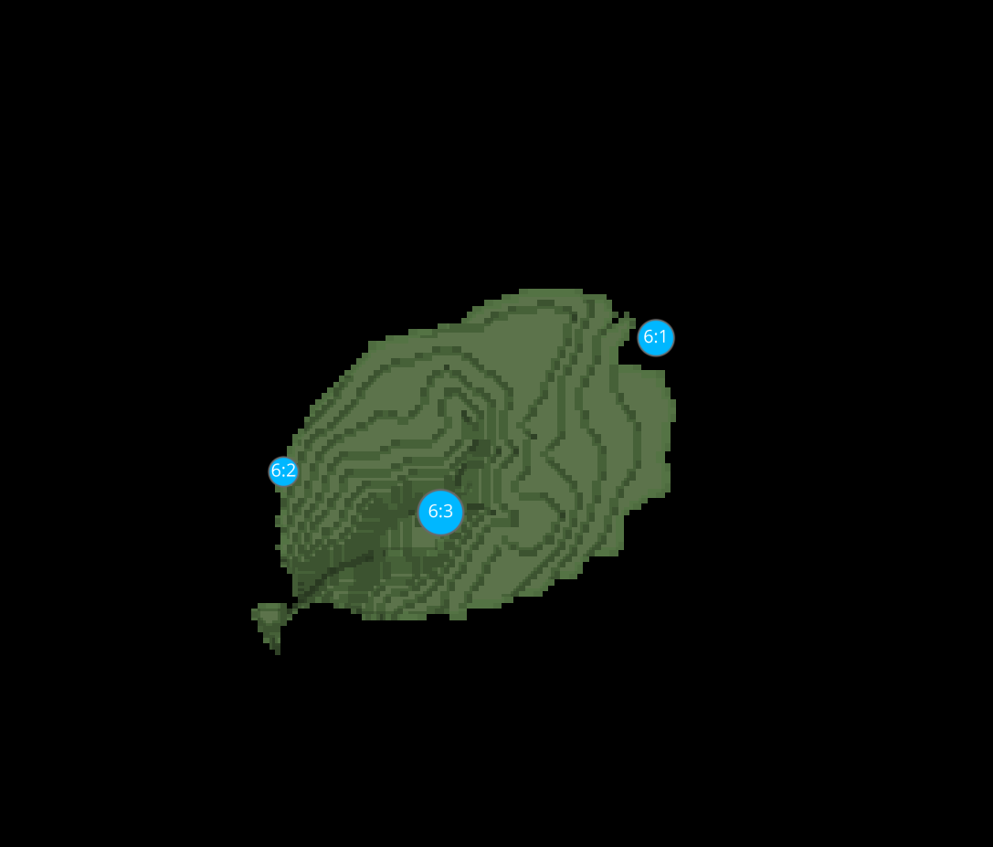
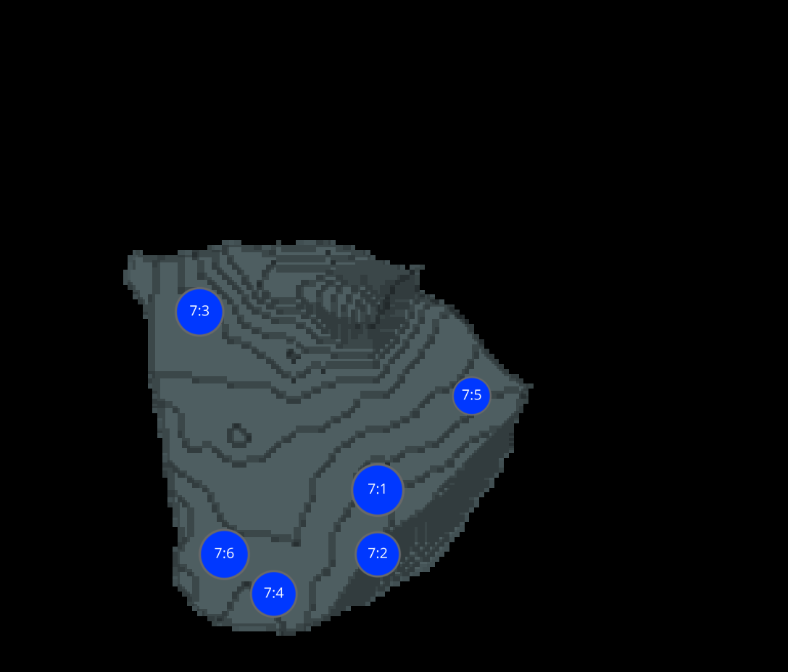
L3 1 CELLS

Slide 6
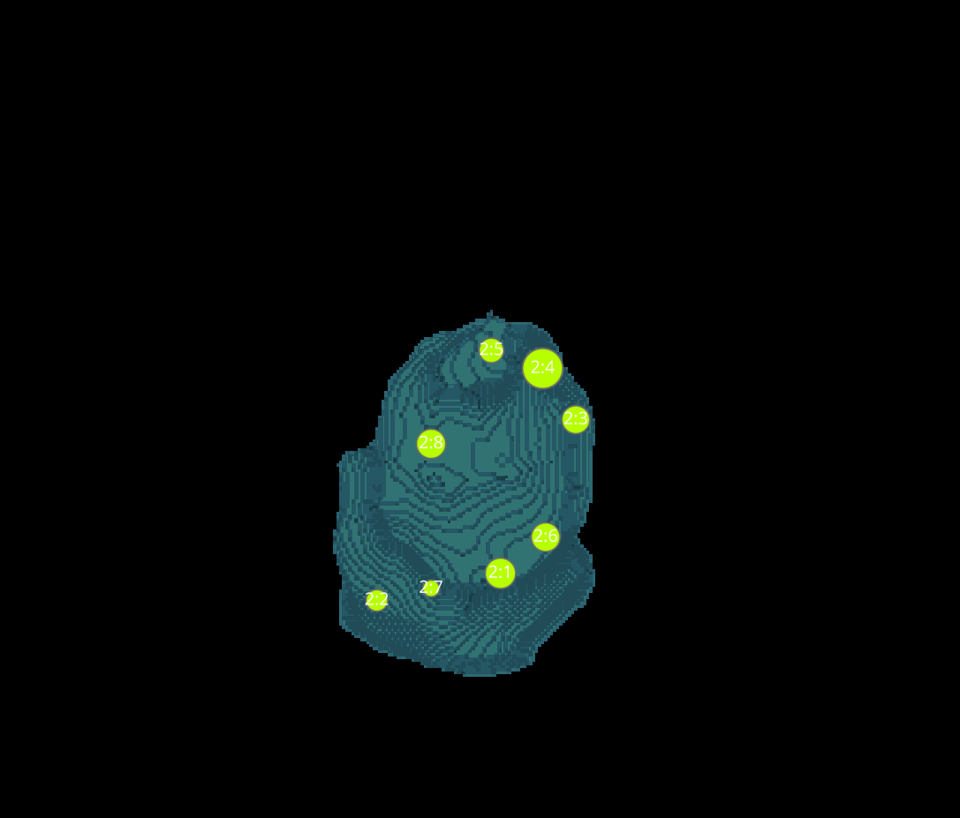
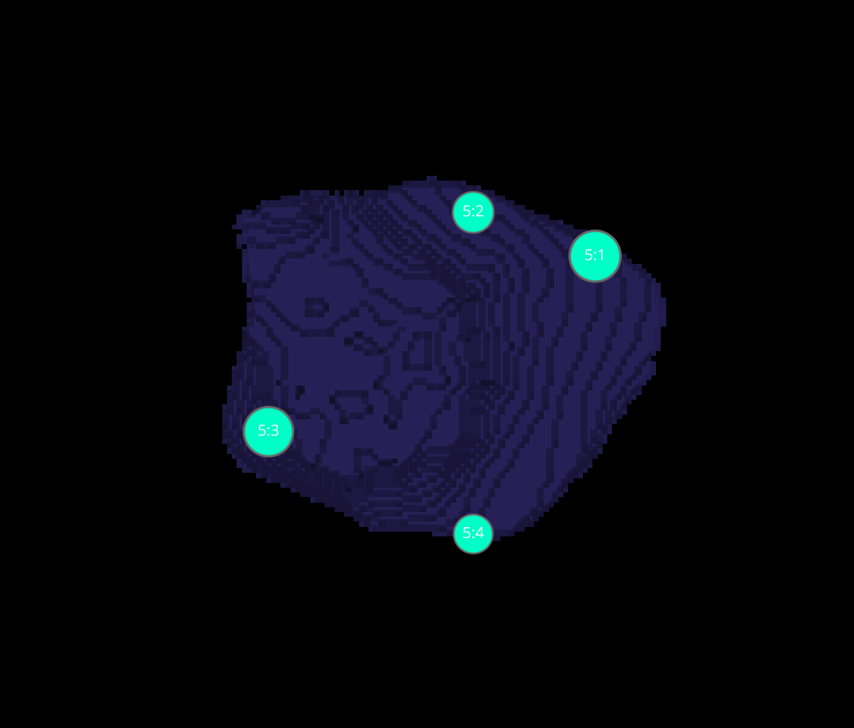
L3 1 CELLS

Slide 7
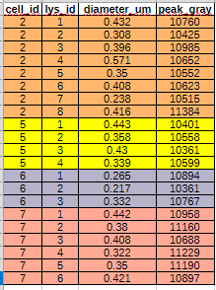
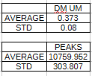
DATASETS L3-1

Slide 8
L3 1 WITH SPOTIFLOW

Slide 9

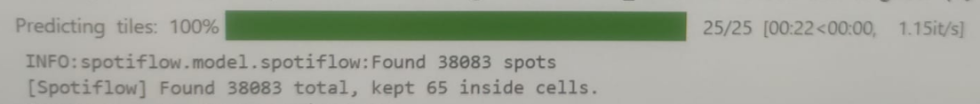
SPOTIFLOW
This computes one global intensity threshold from the smoothed channel 2 image using Otsu’s method.
This creates a binary mask:
True where channel 2 is brighter than the threshold.
False where it is darker.
So this is your rough “inside cell” mask.
What is Otsu’s method?
Otsu’s method is an automatic thresholding method.
It tries to split image pixels into two groups:
background
foreground
by choosing a threshold that best separates their intensity distributions.
Simply way
Imagine a histogram of image intensities:
one peak for dark background
one peak for brighter objects
Otsu searches for the threshold between those peaks.
It picks the threshold that gives the best separation between the two classes.

Slide 10
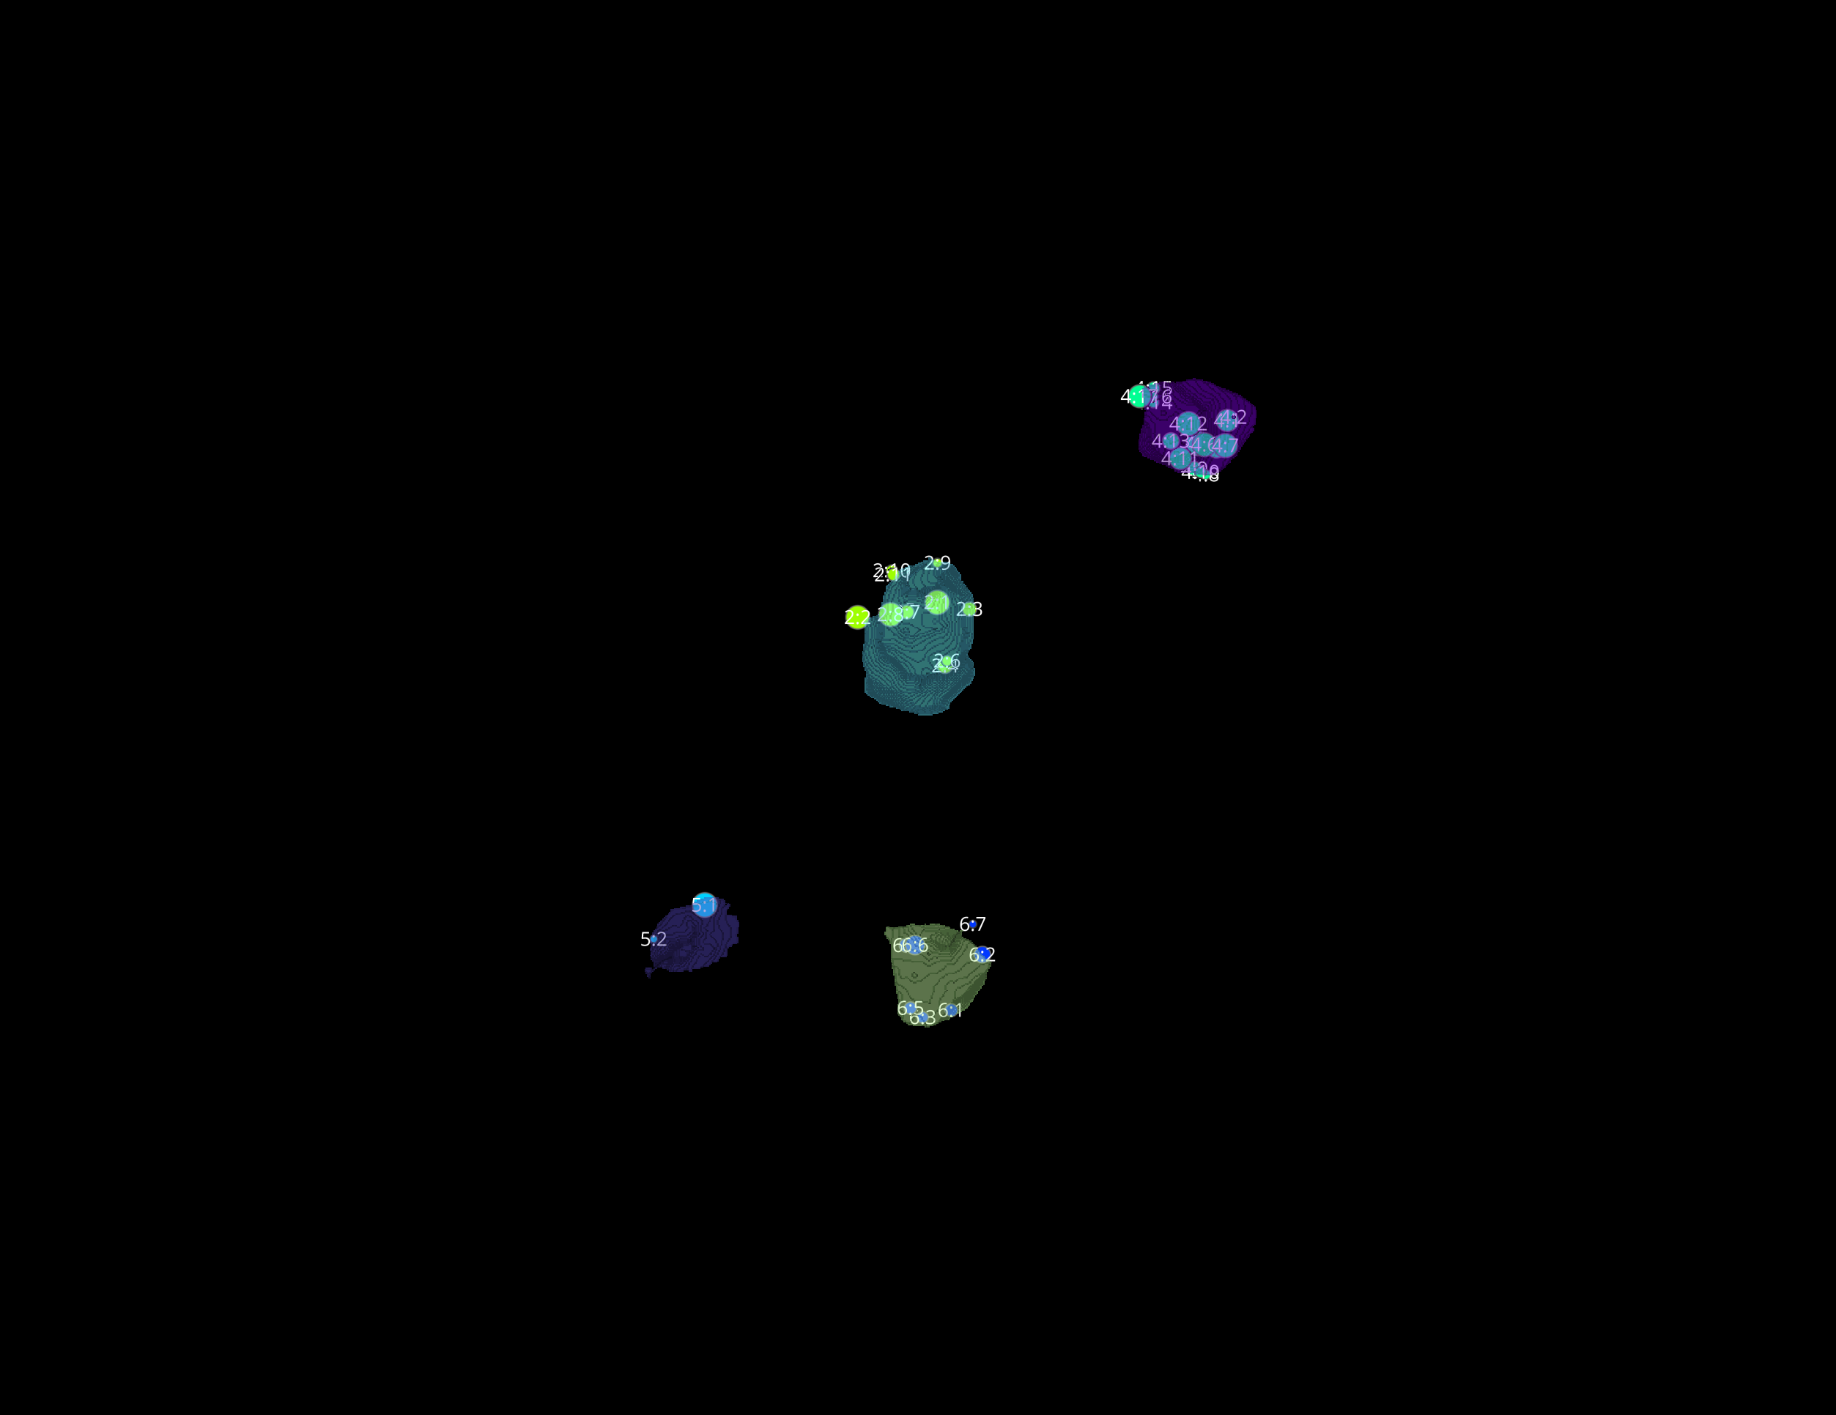
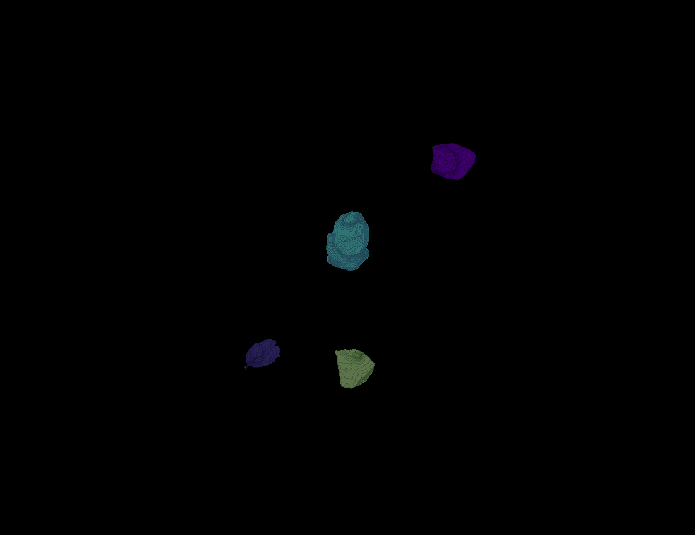
L3 1
Erosion = 8
Thresholding = 0.0025
margin um = 1.2
overlap alpha = 0.6
viz min voxels = 12000

Slide 11
L3 1

Slide 12
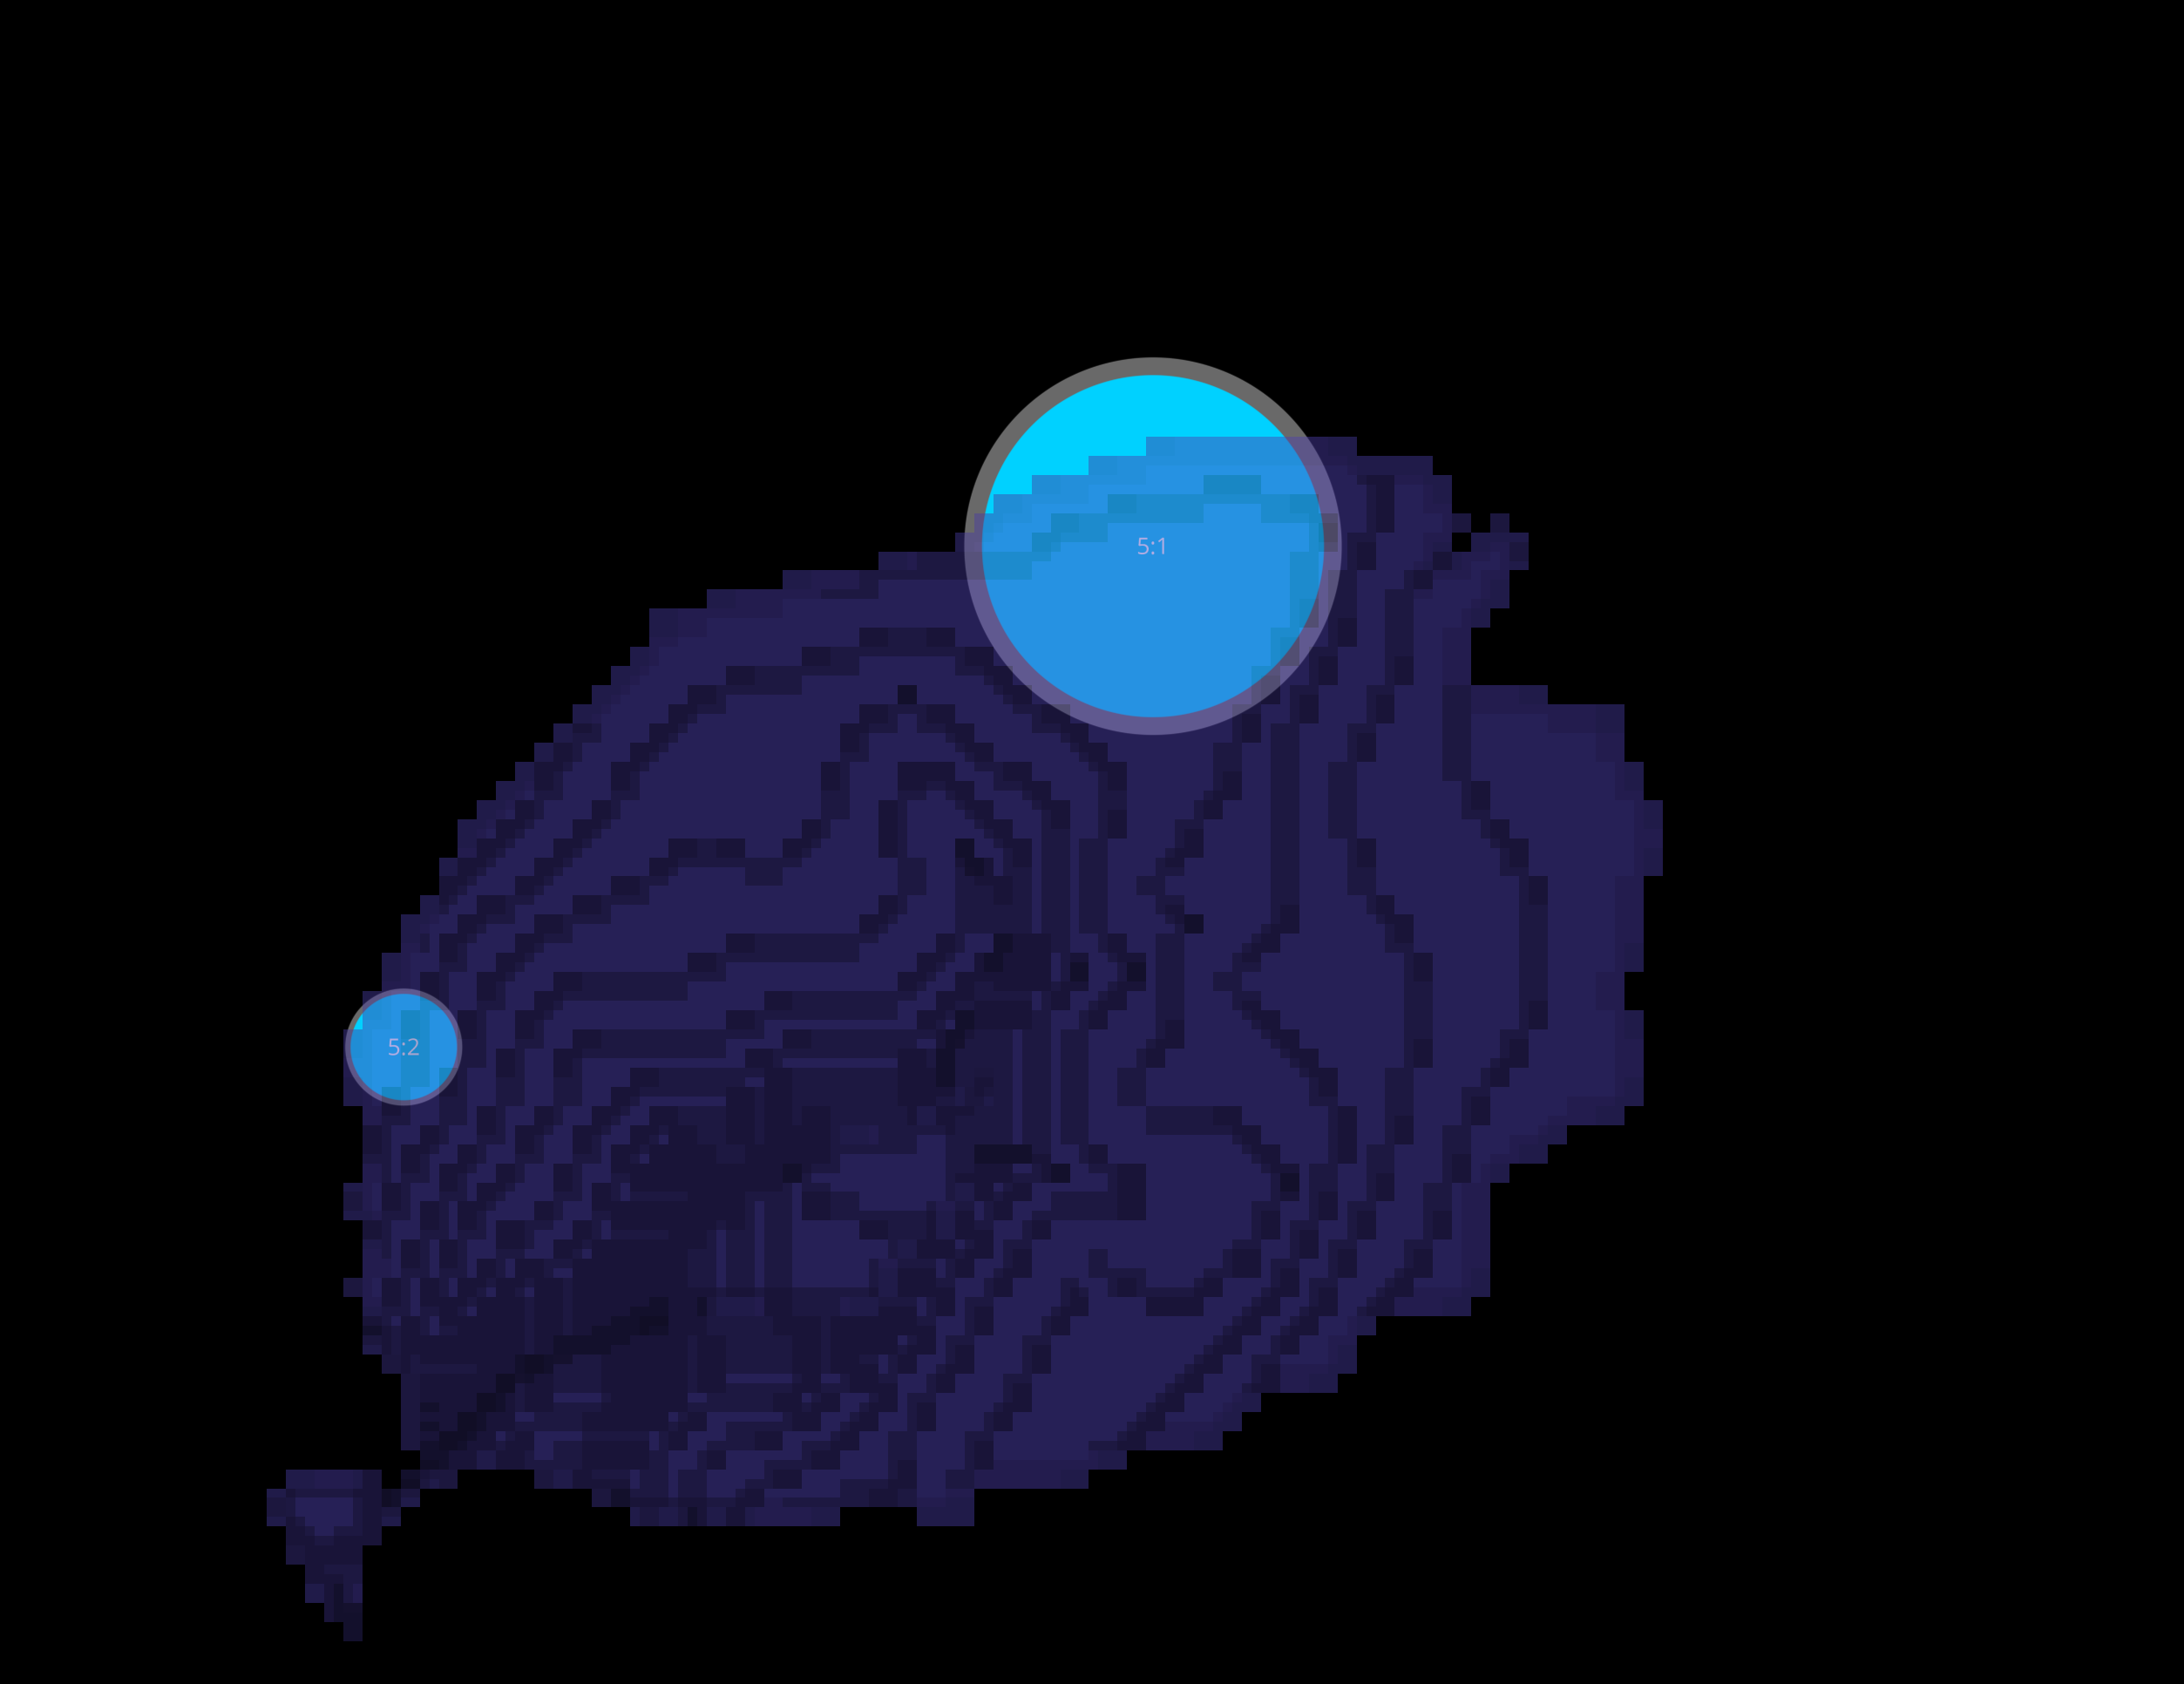
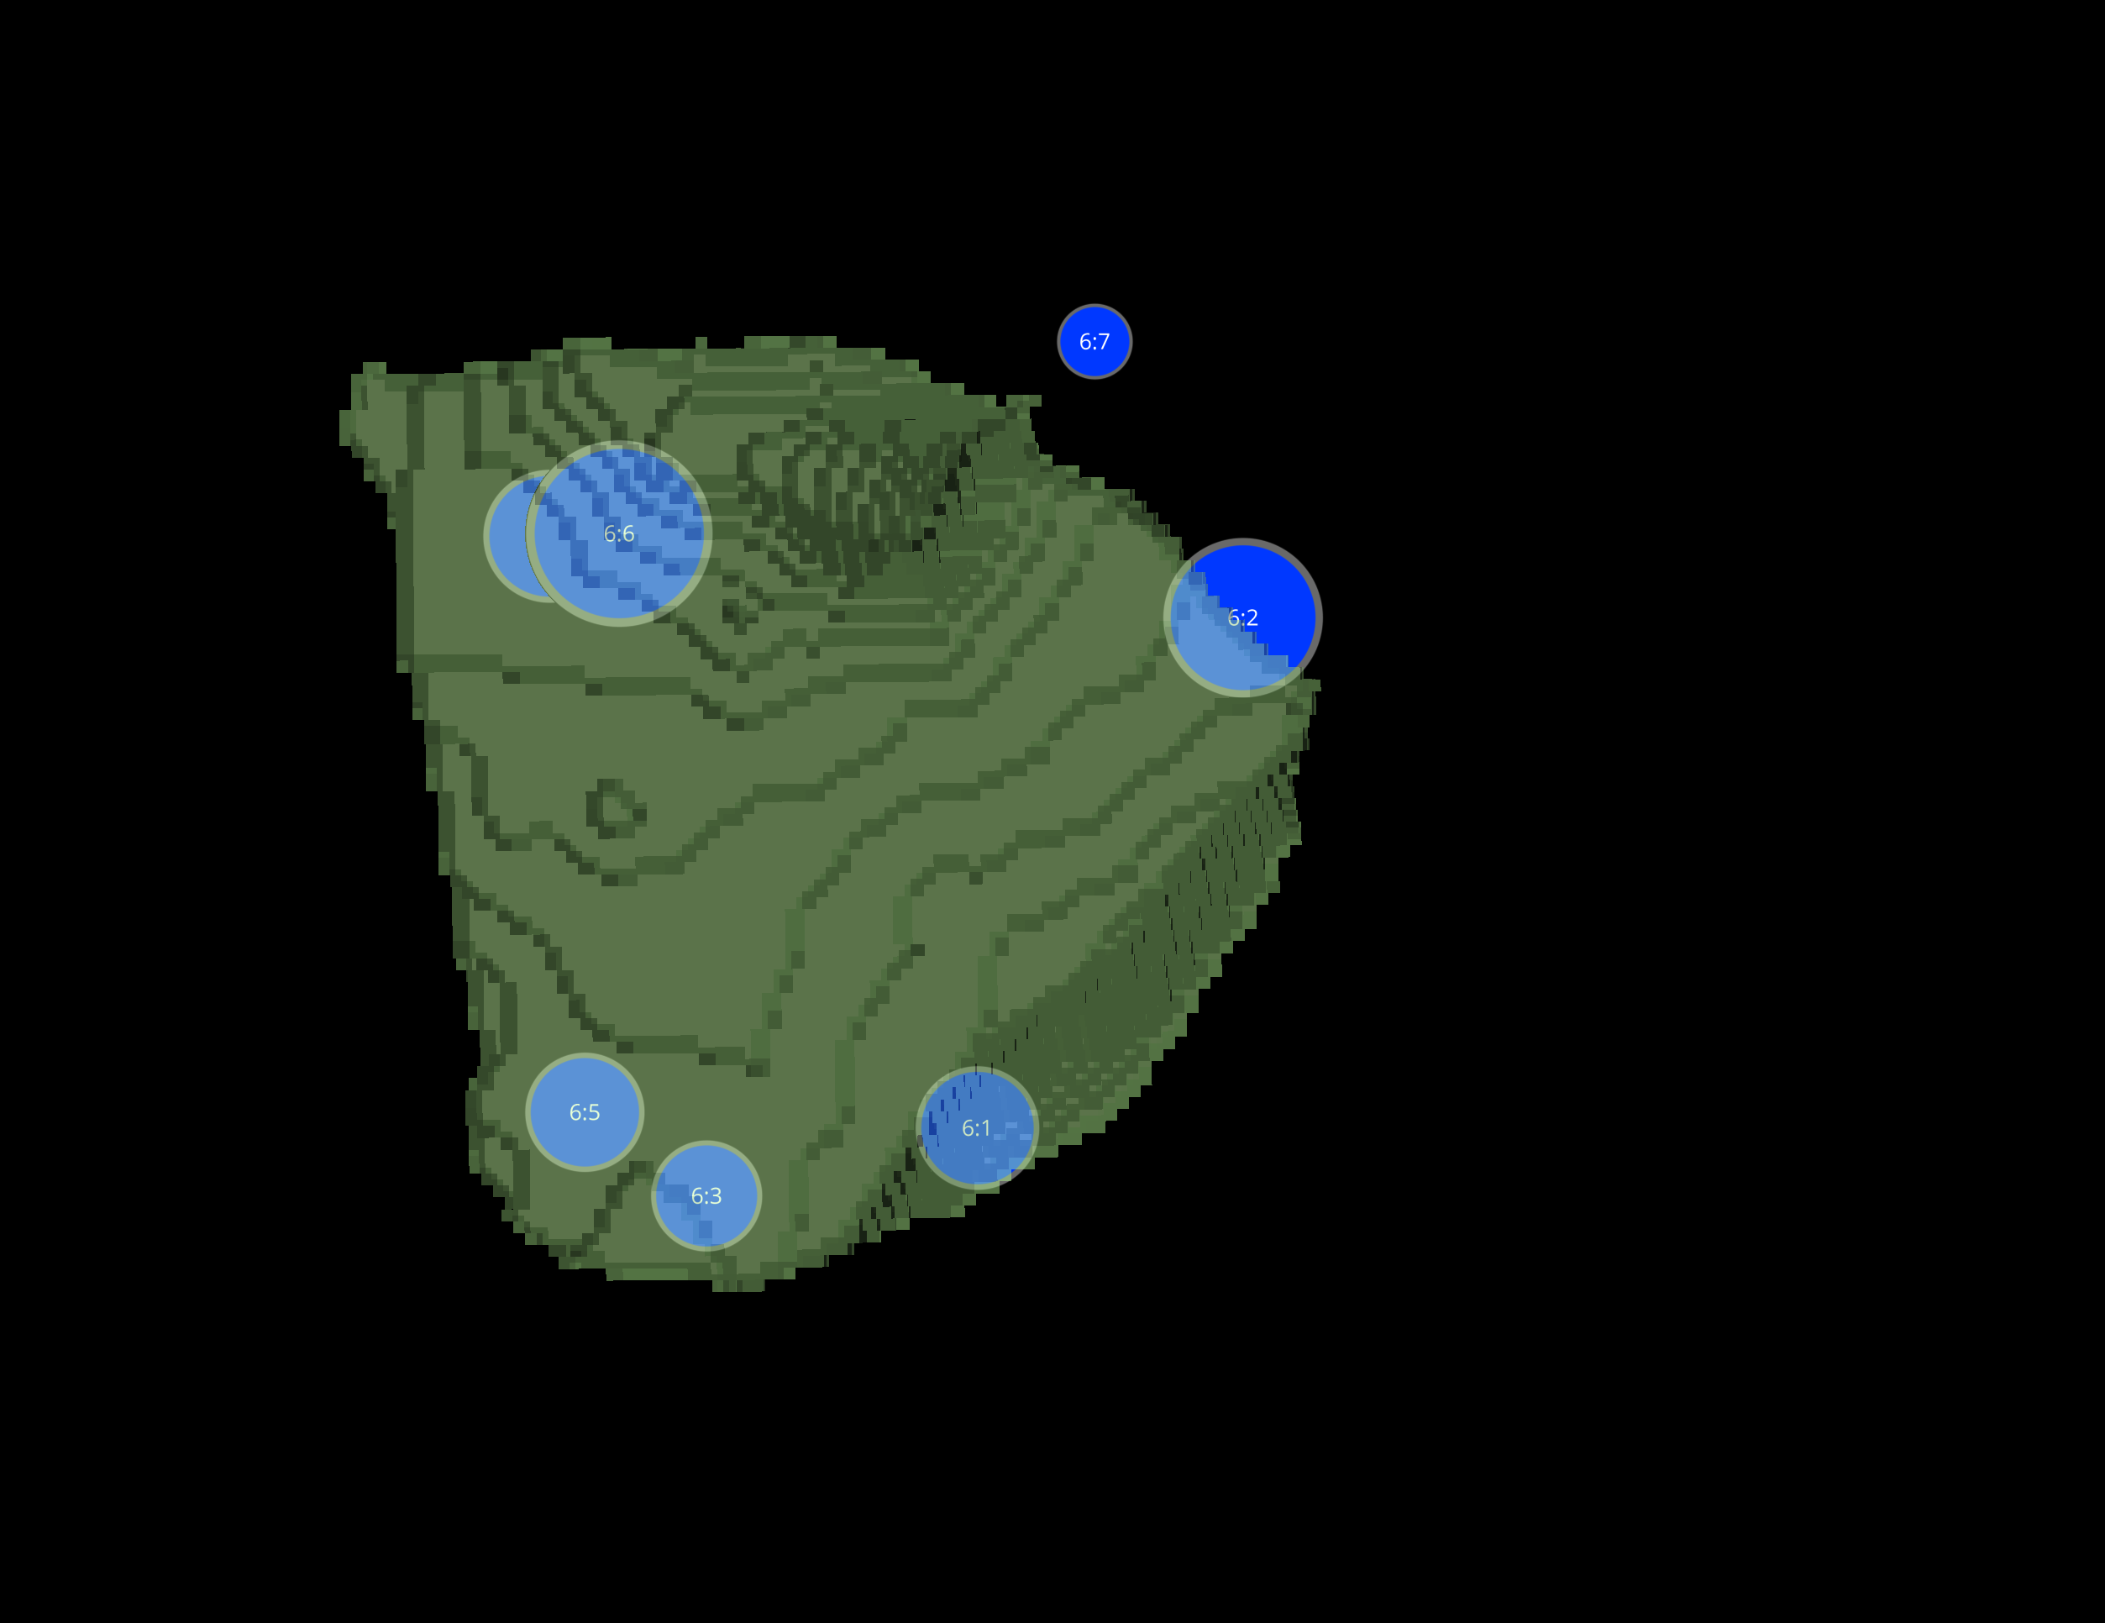
L3 1 CELLS

Slide 13
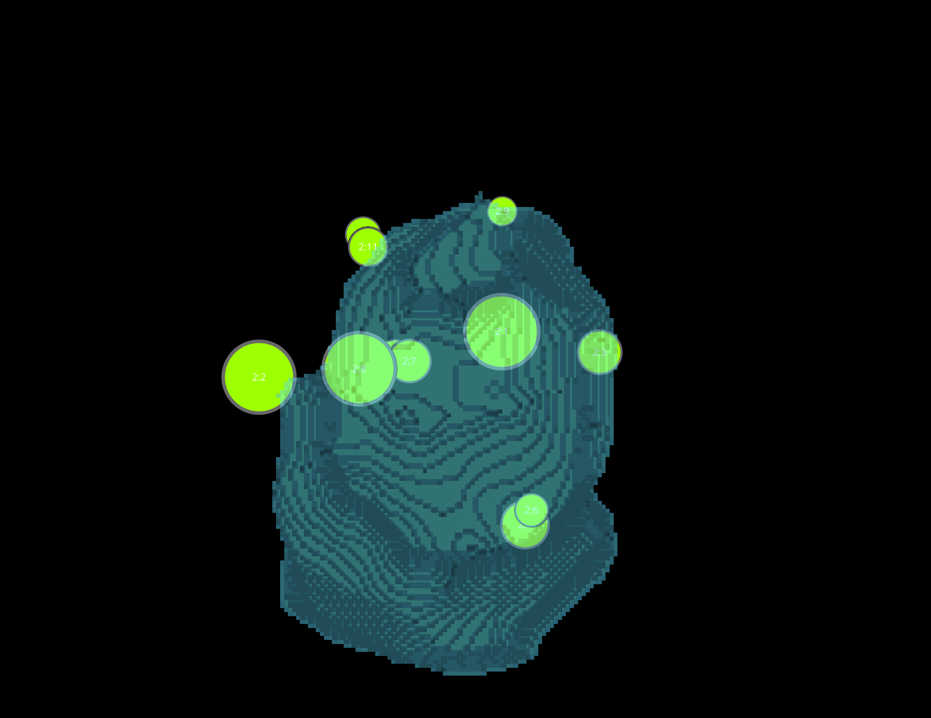
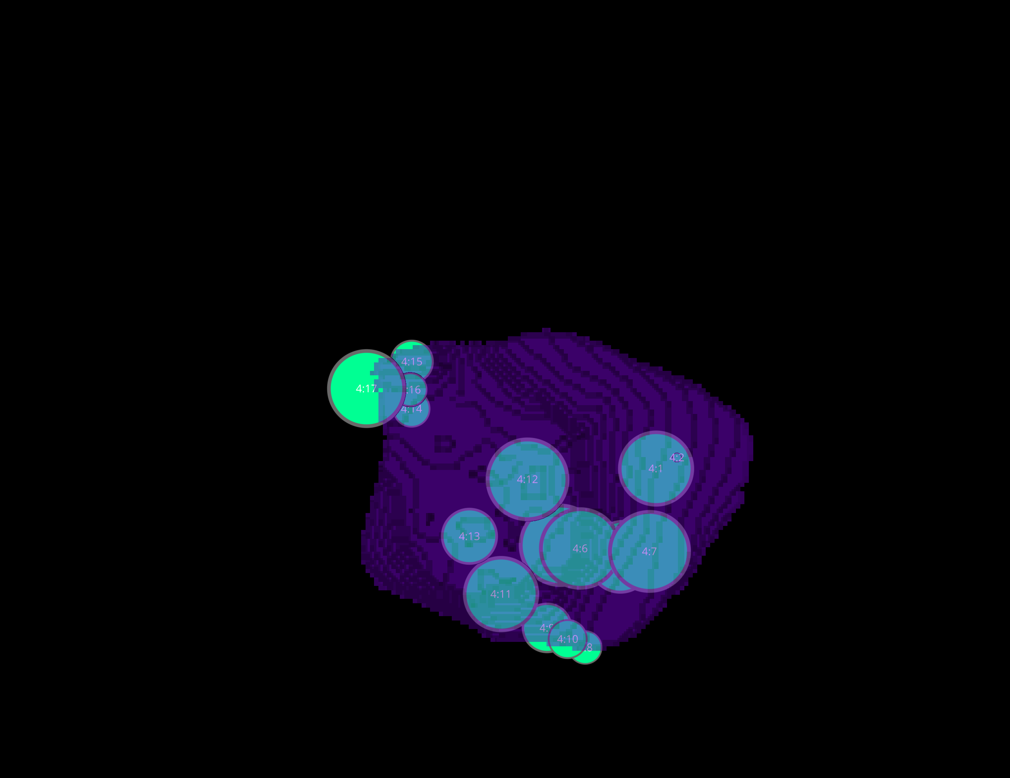
L3 1 CELLS

Slide 14
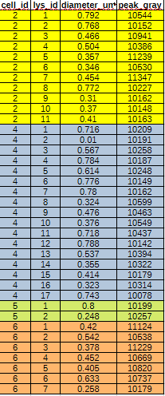
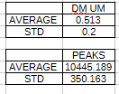
DATASETS L3-1

Slide 15
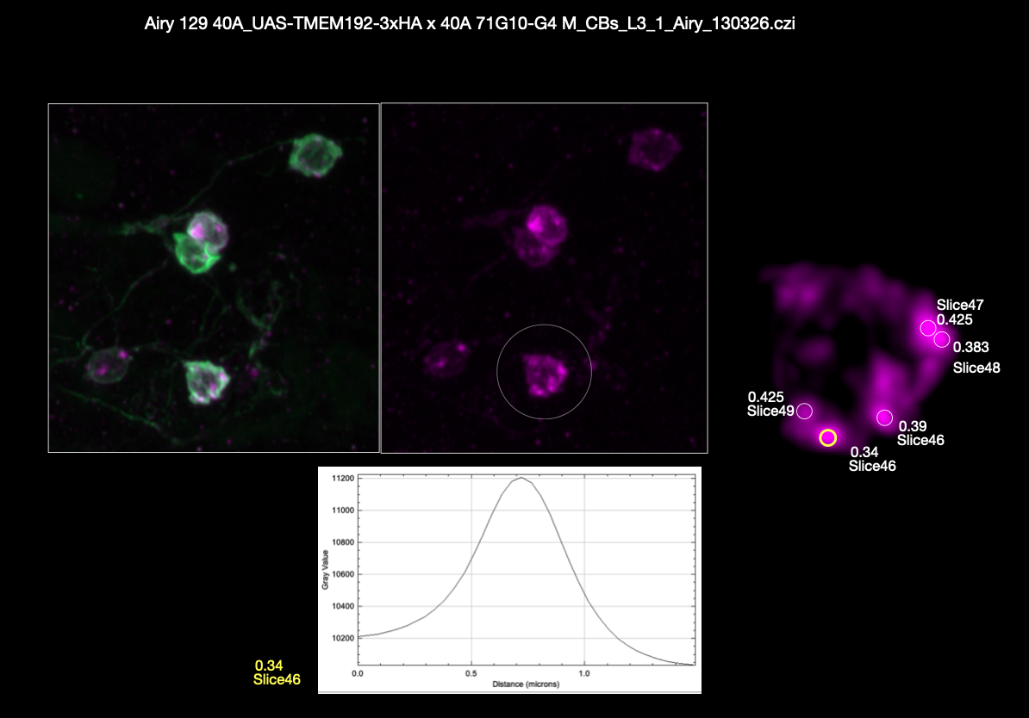
L3 1(manual analysis)

Slide 16
L3 1(CELL IMAGES, SAME PARAMETERS GUI)
WITH SPOTIFLOW
WITHOUT SPOTIFLOW

Slide 17



L3 1(manual.VS.aut spotiflow, not spotiflow)

Slide 18
TRACING
ImageJ/Fiji tools
Simple Neurite Tracer (SNT) – semi-automatic 2D/3D tracing
NeuronJ – manual/semi-manual 2D tracing
3D neuron reconstruction platforms
Vaa3D
-APP2 (automatic tracing)
-SmartTracing / Neutube plugins
Machine learning approaches
ilastik – pixel classification (segmentation before tracing)
DeepNeuron (Vaa3D) – deep learning tracing
U-Net pipelines – custom deep learning segmentation
Python-based workflows
scikit-image – segmentation + skeletonization
networkx – graph reconstruction
Kimimaro – skeletonization (large volumes)
Navis – neuron analysis & visualization
Commercial software
Imaris (Filament Tracer) – user-friendly semi-automatic tracing
Neurolucida – high-end neuron reconstruction
Common output / analysis
SWC format (standard neuron morphology file)
Analysis tools: L-Measure, Navis

