Slide 1
3D Image Segmentation and Quantification of Lysosomes
17/5/2025

Slide 2
PIMI
A = LYS SIGNAL / VOL LYS
B = SIGNAL REST OF CELL / VOL REST OF CELL
PIMI = (A-B)/(A+B)

Slide 3
FILES
WITHOUT MUTATION
40A_UAS-TMEM192-3xHA x OK107 40A GFP MARCM_18h_2_airy_CB_120323
MUTATION VAMP7
VAMP7-TRIP_40A_UAS-TMEM192-3xHA x OK107 40A GFP MARCM _18h_2_CB_airy_120223

Slide 4
18H-2

Slide 5
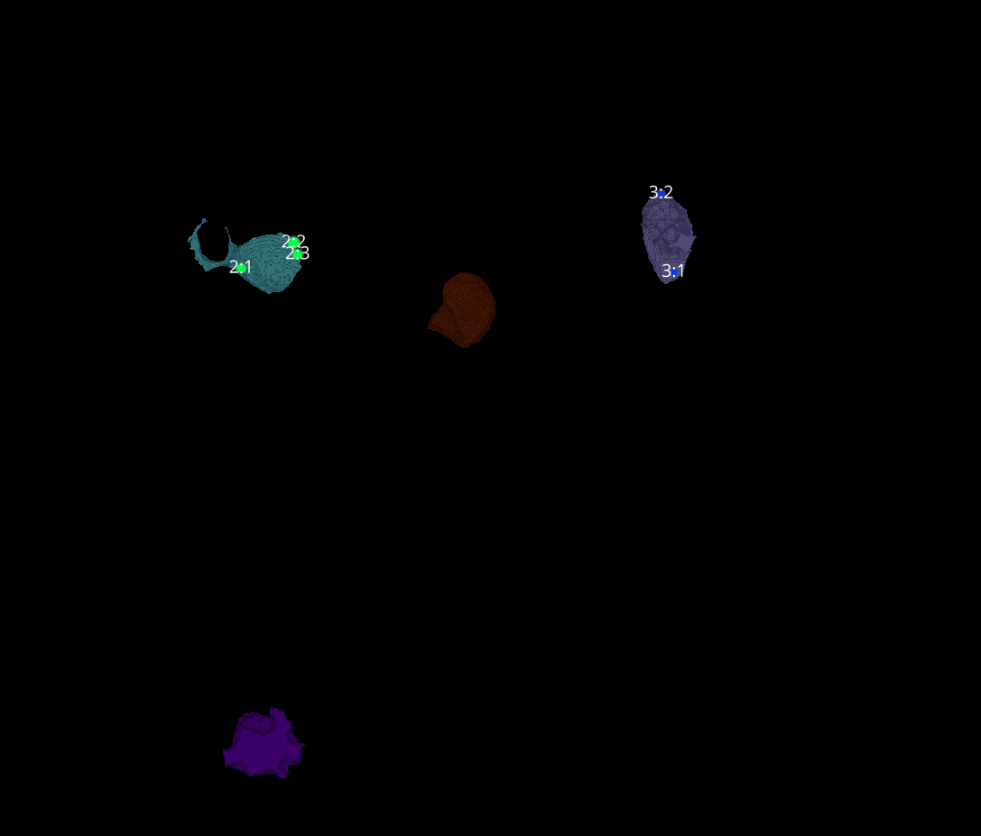
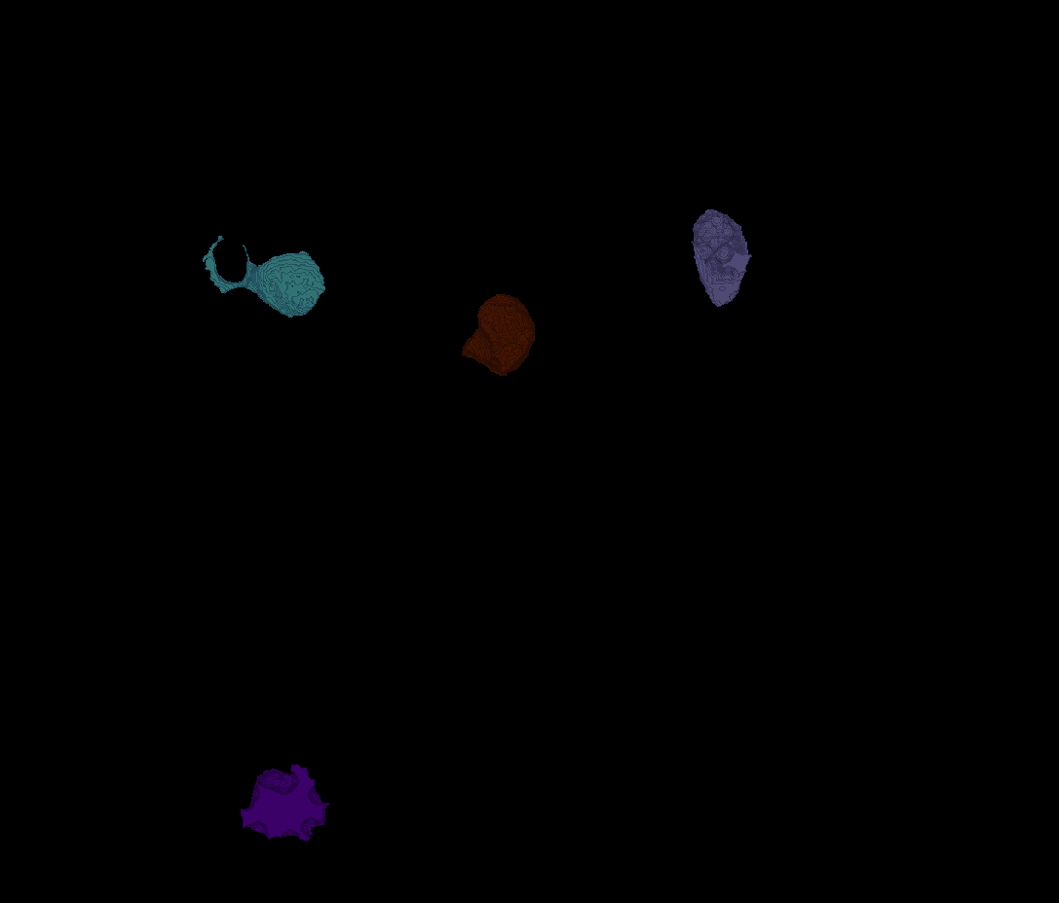
18H-2
Erosion = 8
Thresholding = 0.015
margin um = 1.2
overlap alpha = 0.6
viz min voxels = 10000

Slide 6
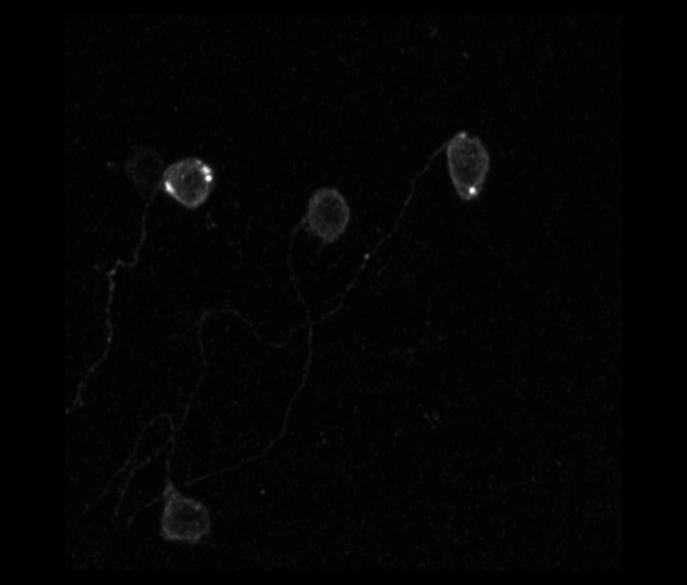
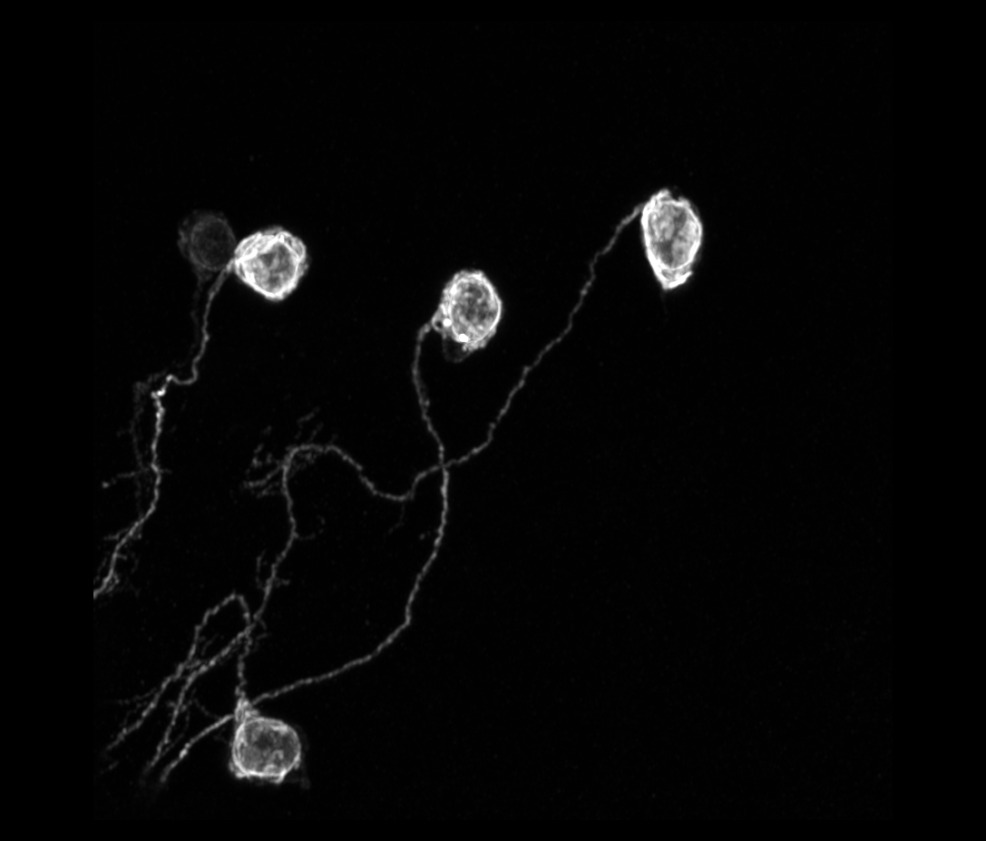
18H-2

Slide 7
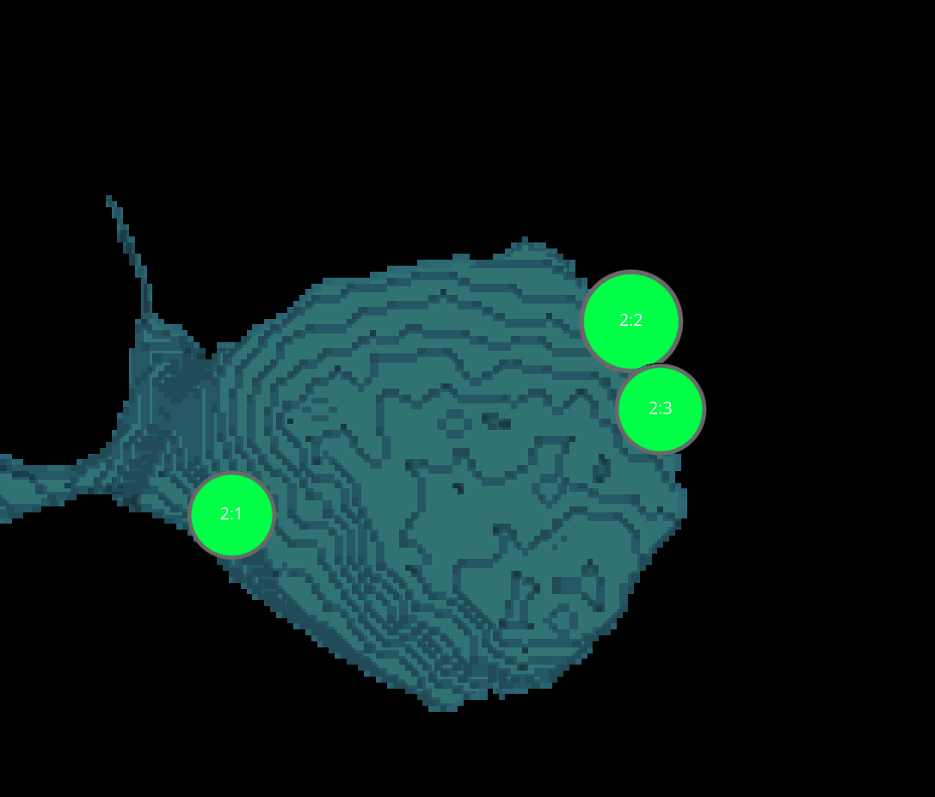
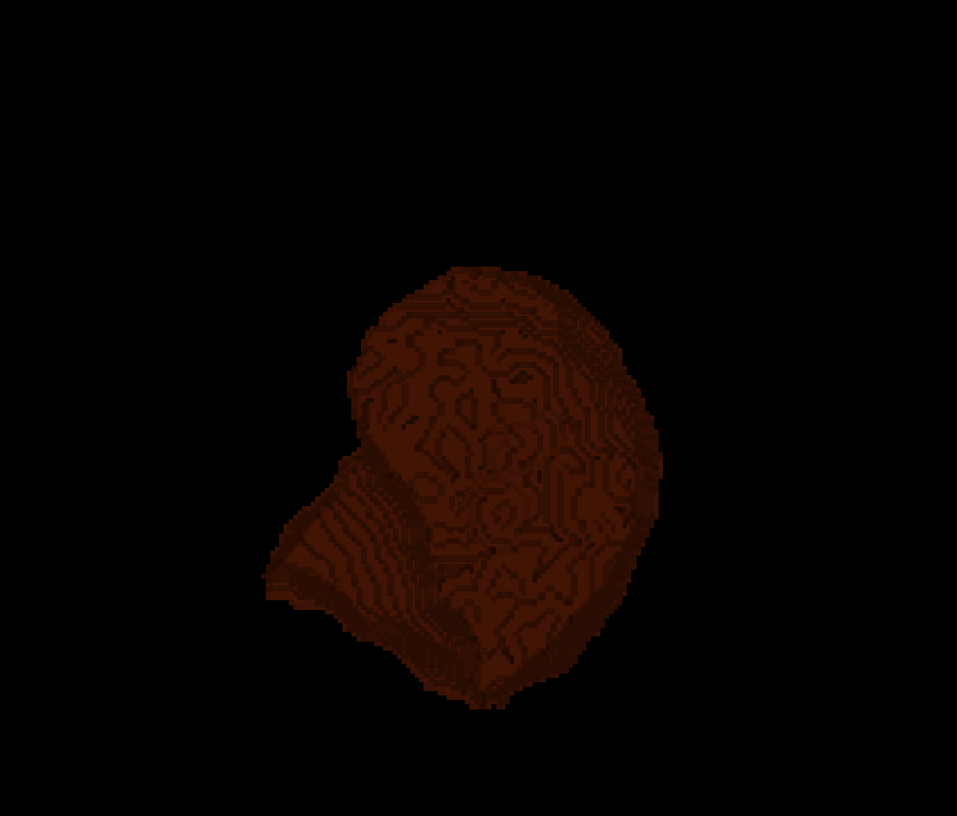
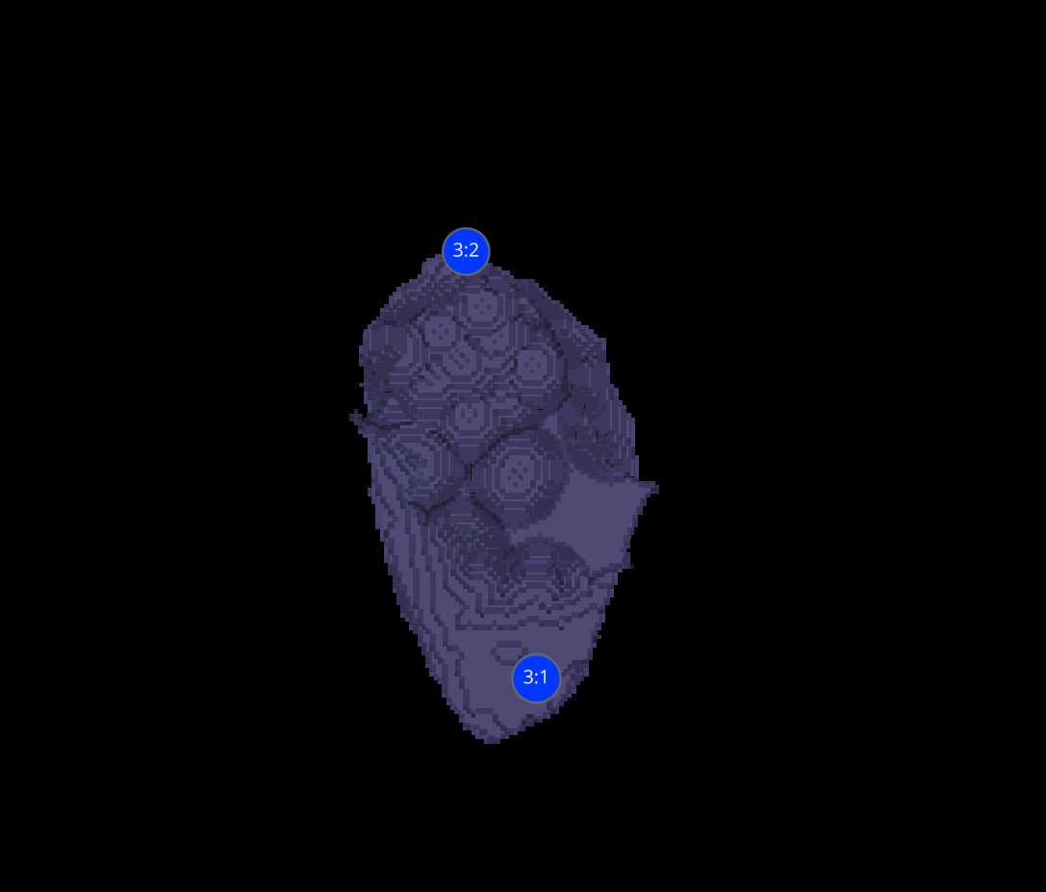
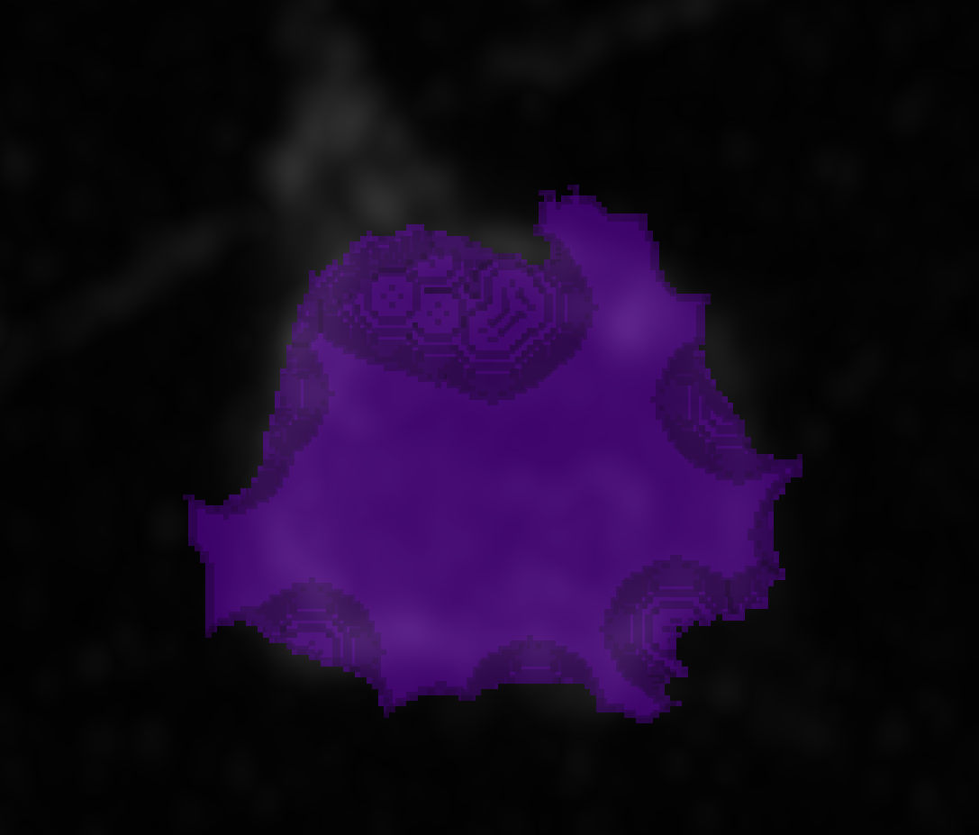
18H-2 CELLS
2
1
3
4

Slide 8



DATASETS 18H-2

Slide 9
18H-2 VAMP7

Slide 10
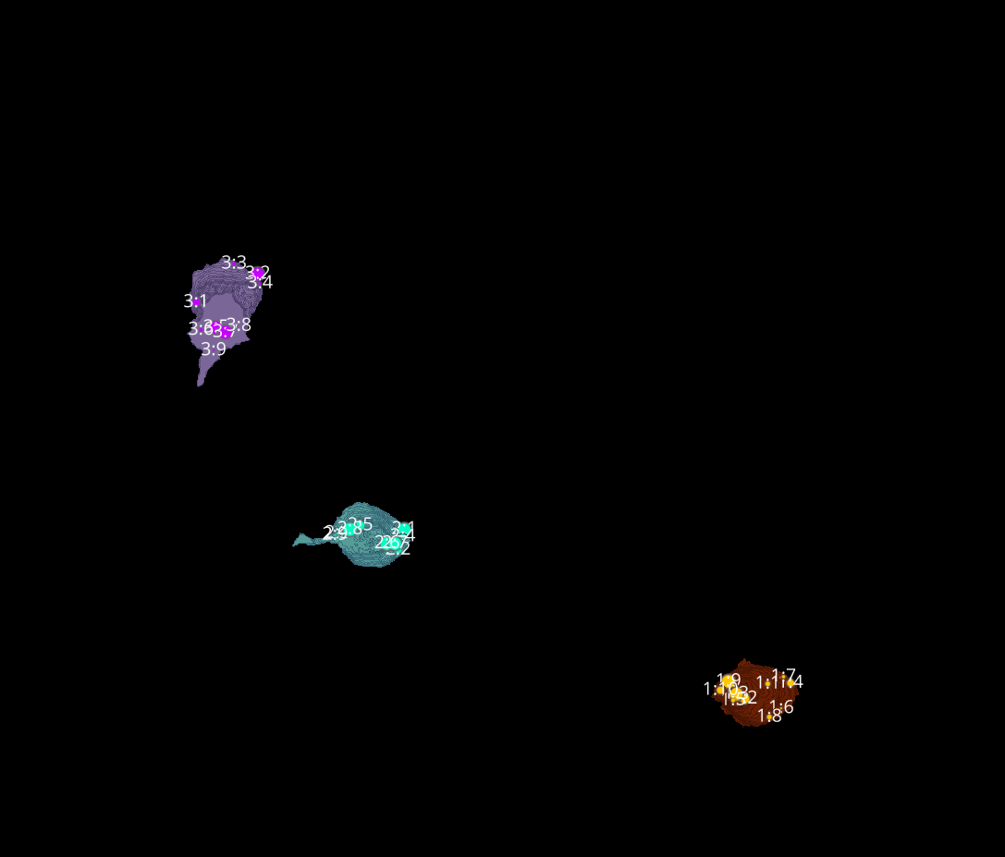
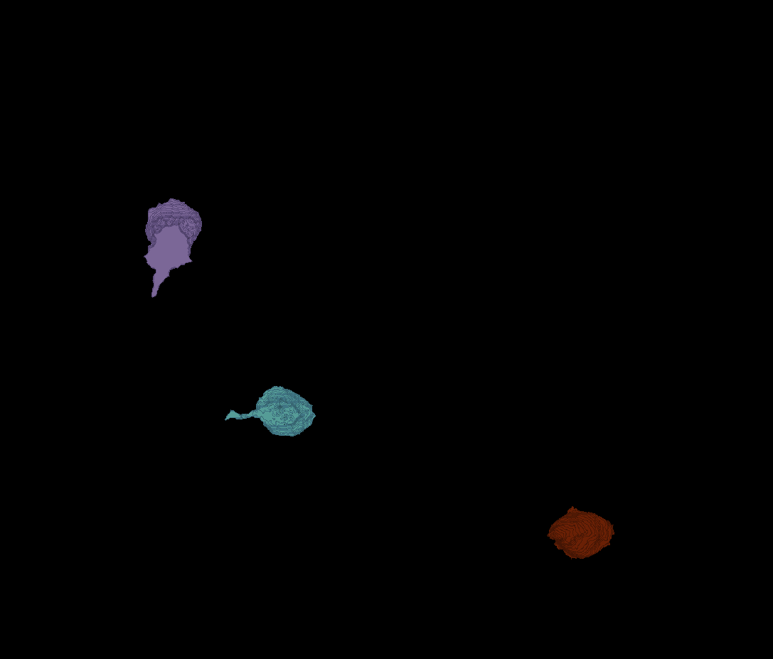
18H-2 VAMP7
Erosion = 4
Thresholding = 0.04
margin um = 1.2
overlap alpha = 0.6
viz min voxels = 20000

Slide 11
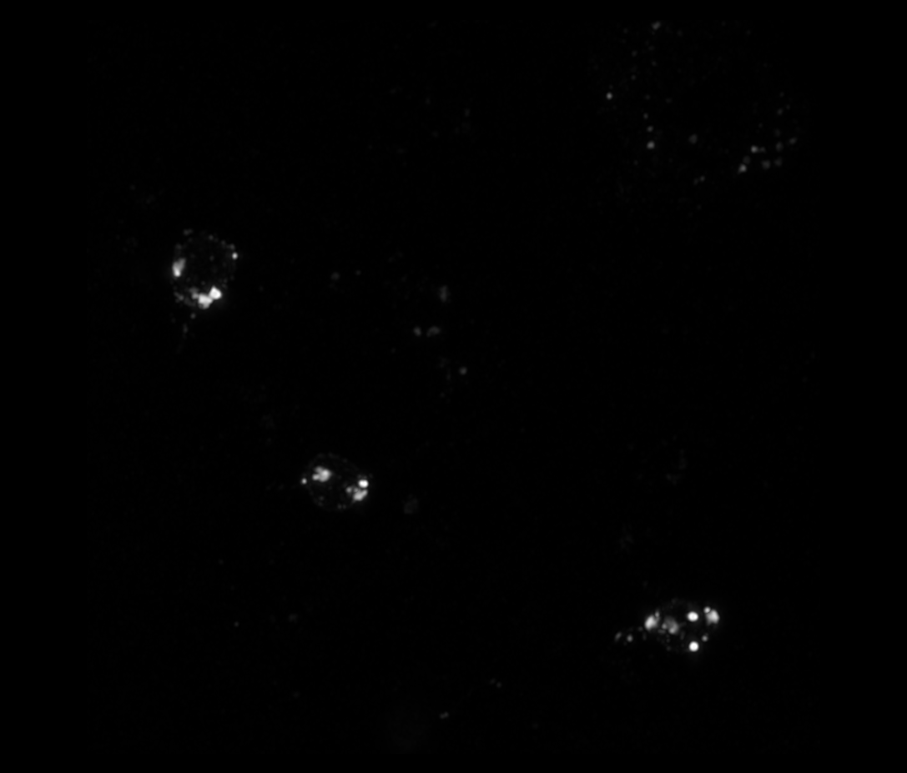
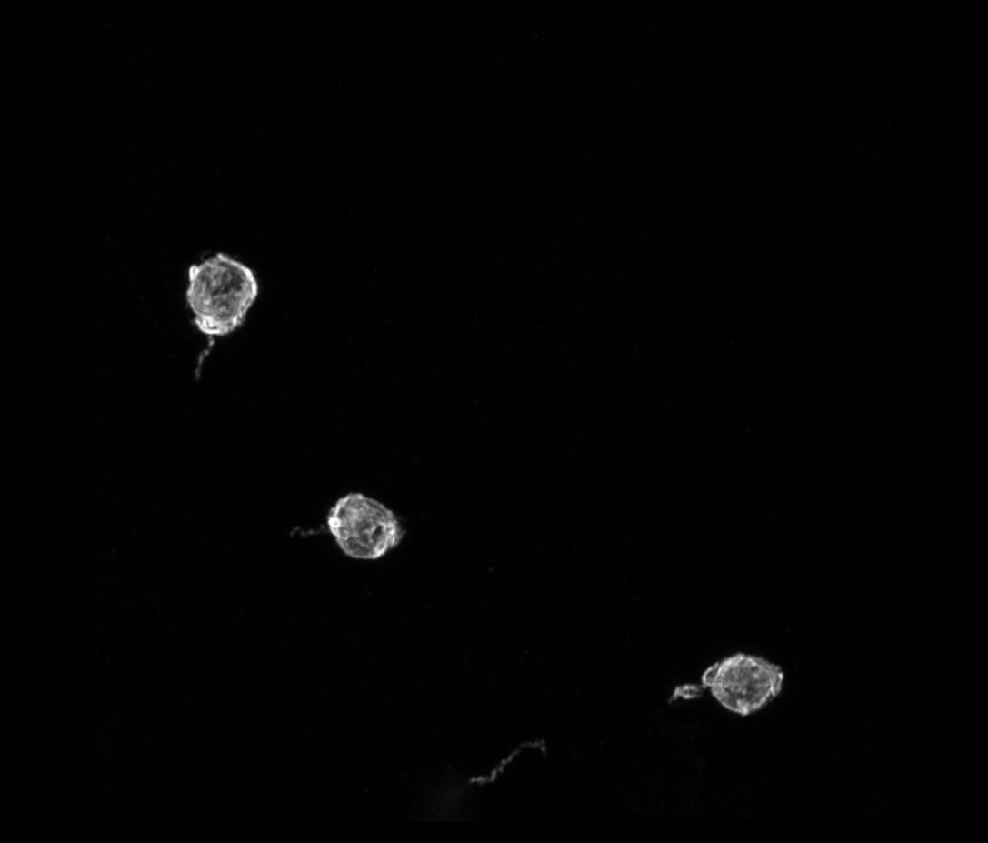
18H-2 VAMP7

Slide 12
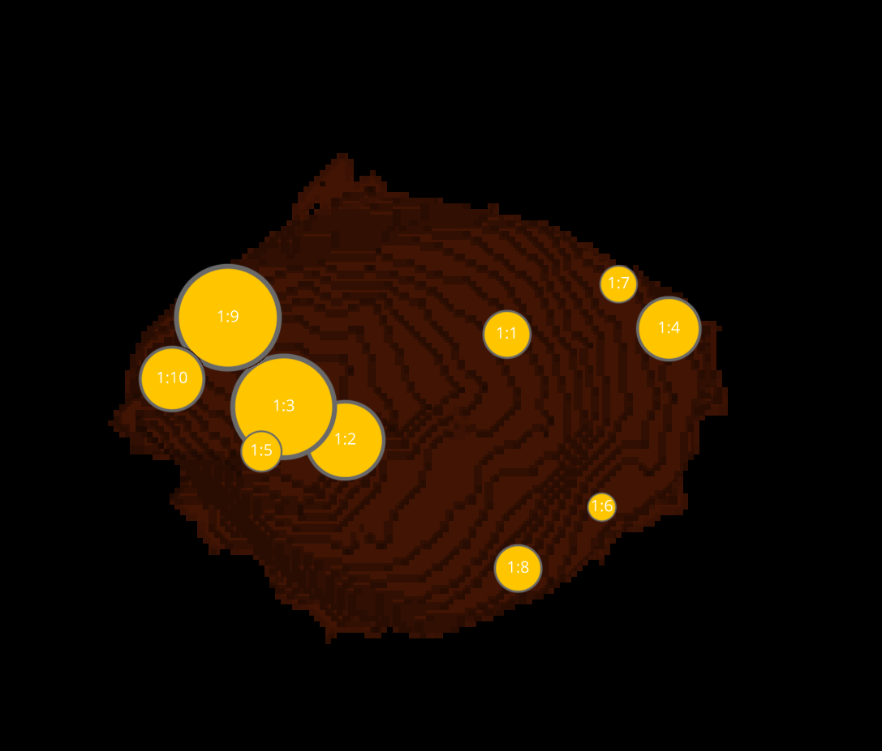
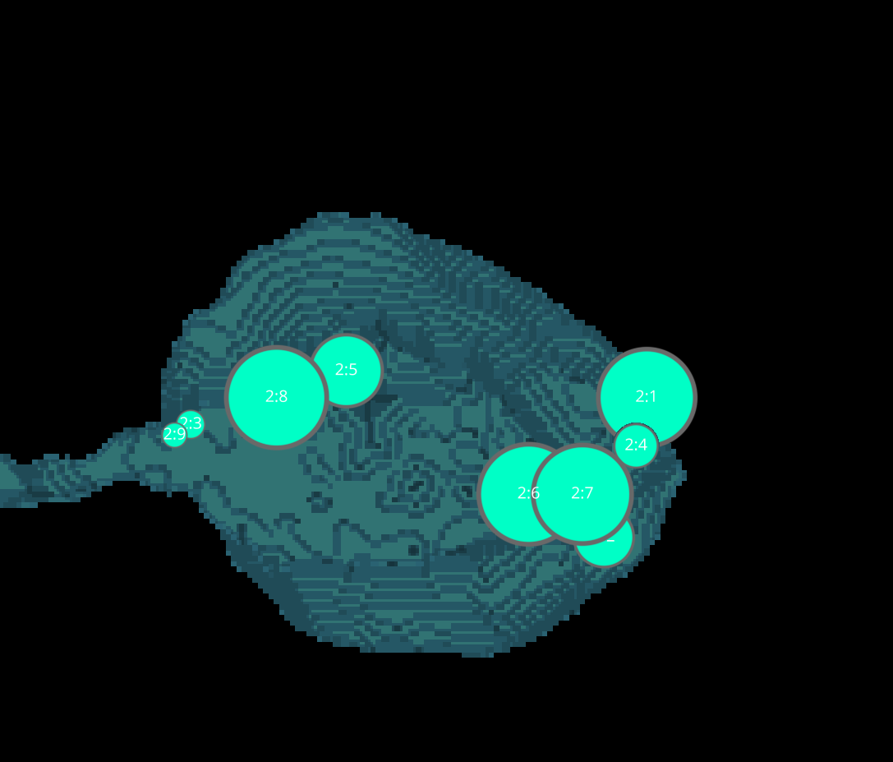
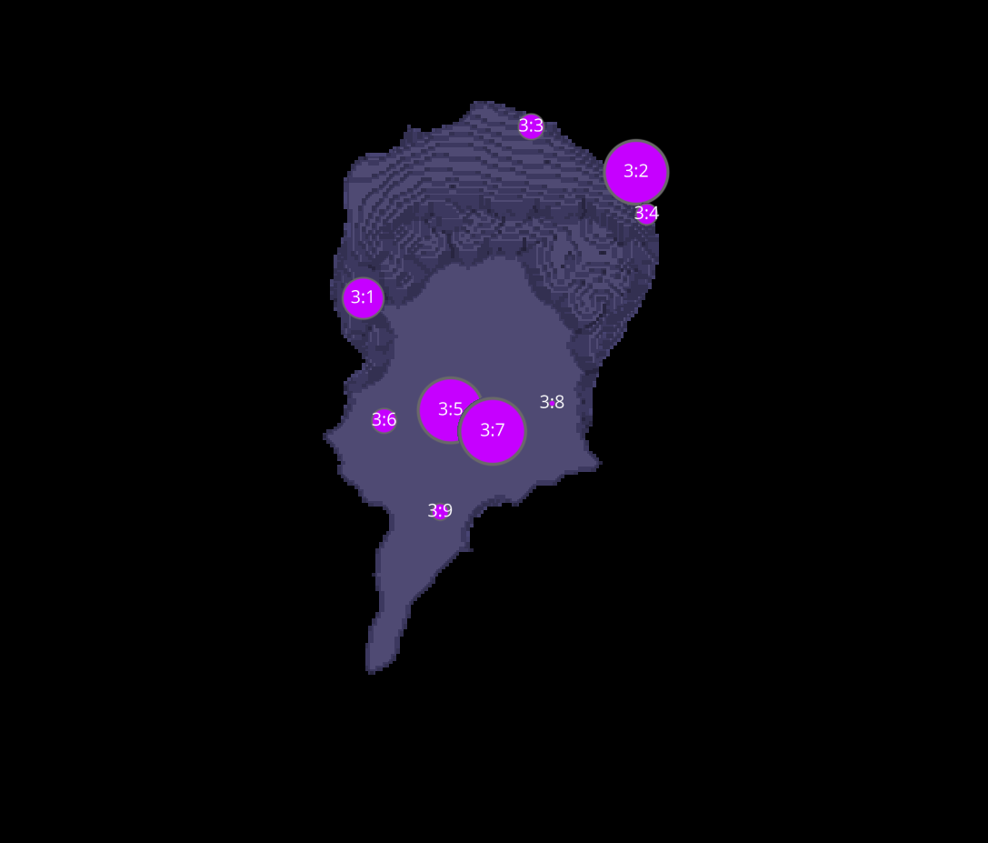
18H-2 VAMP7 CELLS
1
2
3

Slide 13
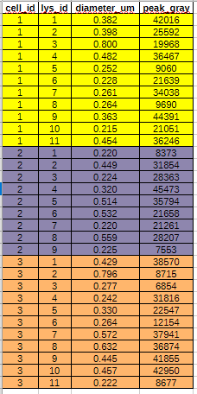


DATASETS 18H-2 VAMP7

