Slide 1
3D Image Segmentation and Quantification of Lysosomes
28/5/2025

Slide 2
How does my code calculate the signal?

Slide 3
40A_UAS-TMEM1923x-HA x 71G10 40A MARCM_L3_1_Airy_010724

Slide 4

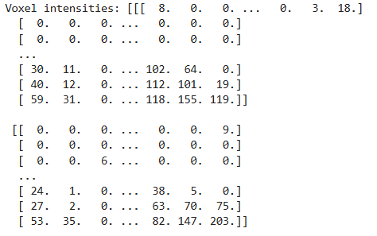
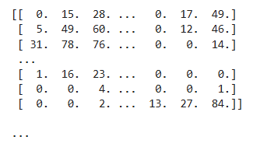
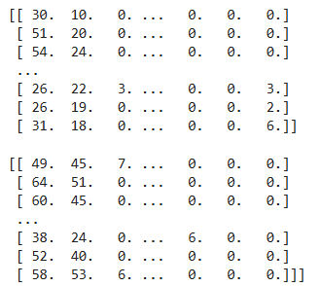
STAGE 1: VOXEL INTENSITIES
1)USE CH1 AS THE SIGNAL CHANNEL
What is img_ch1? This is the lysosome fluorescence channel.
Why .astype(np.float32)? Converts image to decimal numbers and later it subtract background. Also
OUTCOME: ARRAY WITH VOXEL INTENSITIES

Slide 5



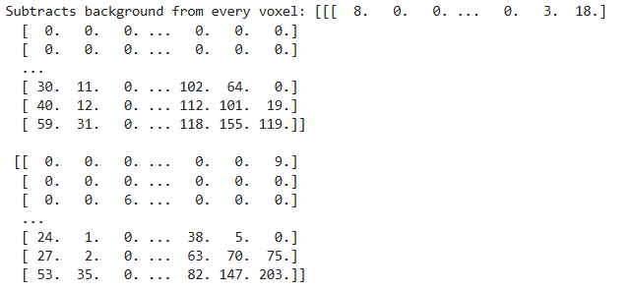
STAGE 2: BACKGROUND SUBTRACTION
This computes the 5th percentile intensity.
What is it mean?
5% of pixels are darker than this value.
The assumption is:
most voxels are background/dark
only a minority contain bright biological signal
the darkest few percent approximate background noise
5th percentile only works well if:
image has lots of dark background
signal occupies small fraction of volume
It becomes problematic when:
image is densely fluorescent
lysosomes fill most of the image
strong diffuse staining exists
Then the 5th percentile may already contain real biology.
Why clip? If subtraction gives negative values, clip makes negatives become 0 and so signal never becomes negative.

Slide 6


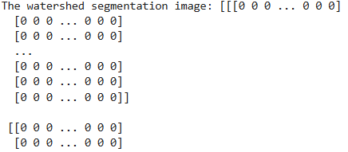
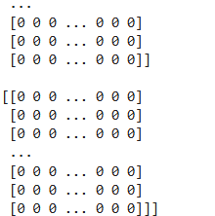
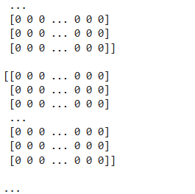
STAGE 3: GET ALL CELL IDs
cell_seg is the watershed segmentation image with unique labels.
Removes background. Background label is always 0.

Slide 7
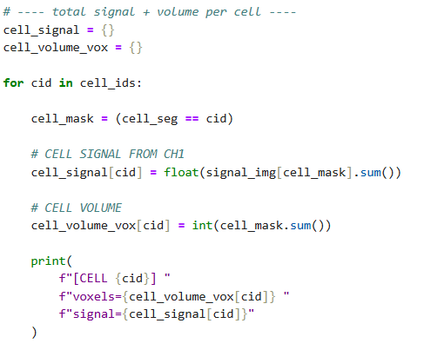
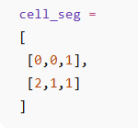
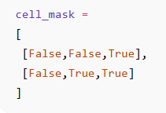


STAGE 4: COMPUTE SIGNAL PER CELL
Loop over every cell.
Cell_mask: Creates a boolean mask.
Calculate signal per cell.
Calculate volume per cell.

Slide 8
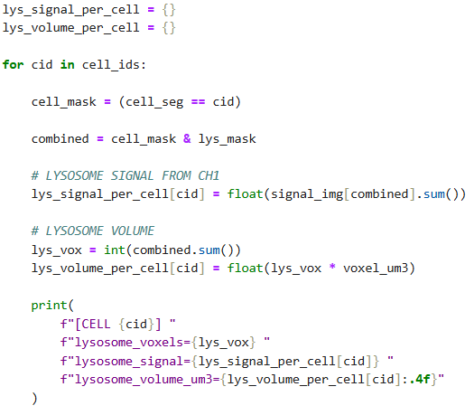
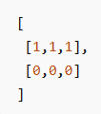
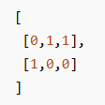

STAGE 5: COMPUTE LYSOSOME SIGNAL PER CELL
Loop over every cell.
Cell_mask: Creates a boolean mask.
Combined: Intersection of cell voxels AND lysosome voxels.
Lysosome voxels inside this specific cell.
Cell mask
Lysosome mask
Combined
Lysosome mask

Slide 9
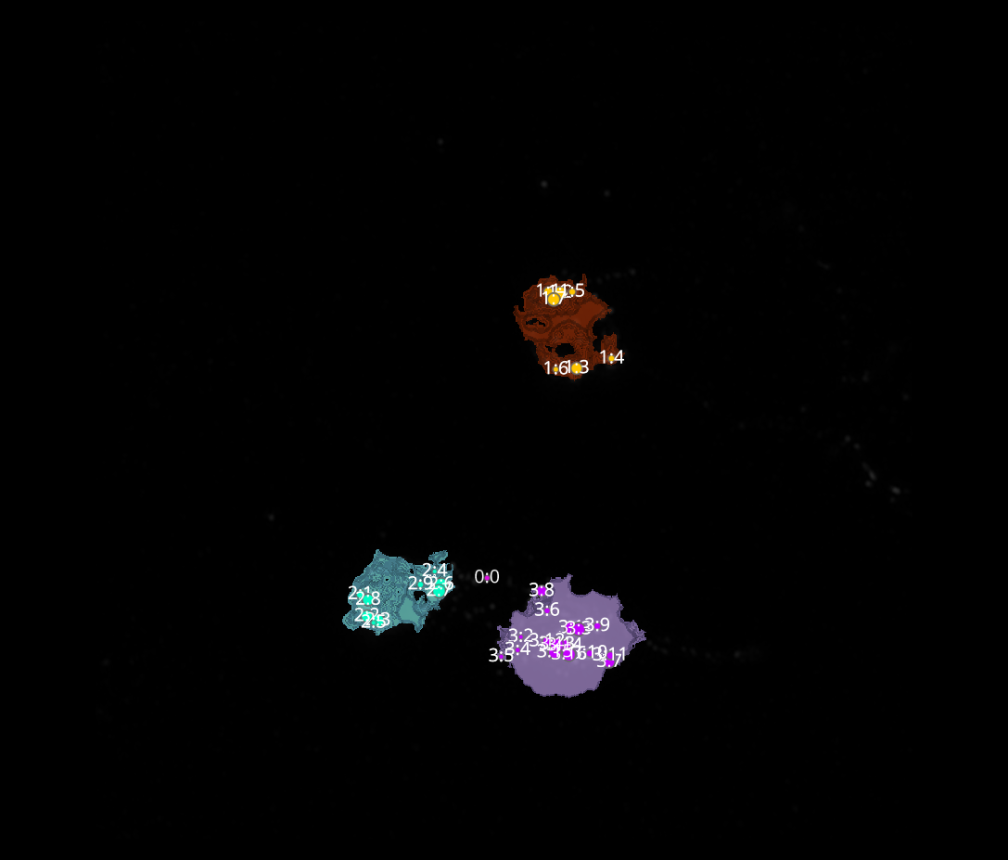
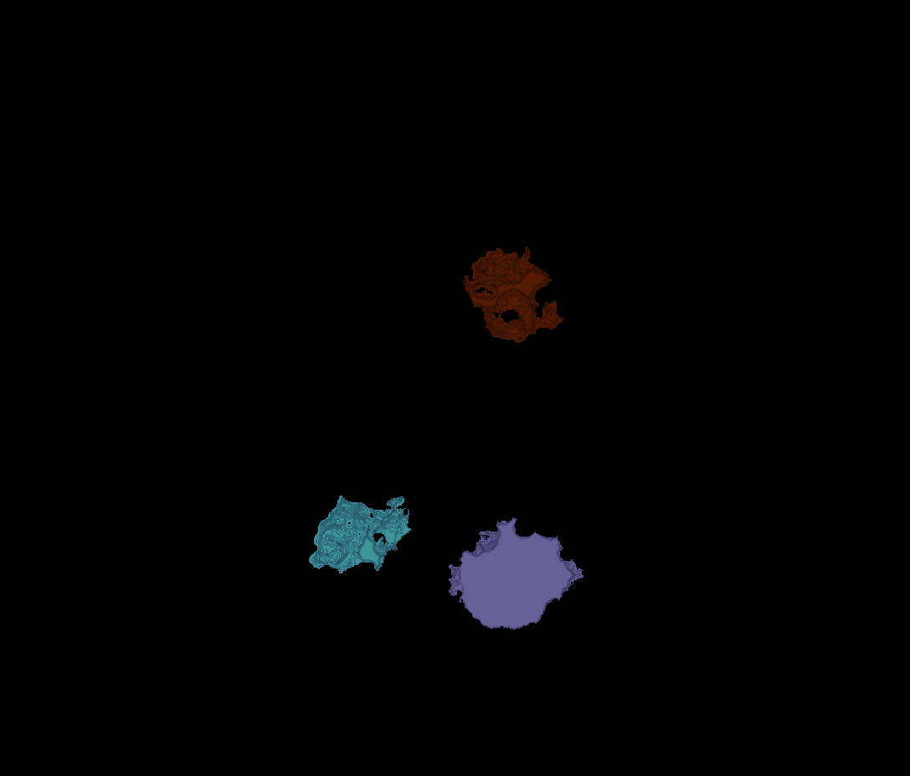
L3-1
Erosion = 3
Thresholding = 0.05
margin um = 0.3
overlap alpha = 0.6
viz min voxels = 5000

Slide 10
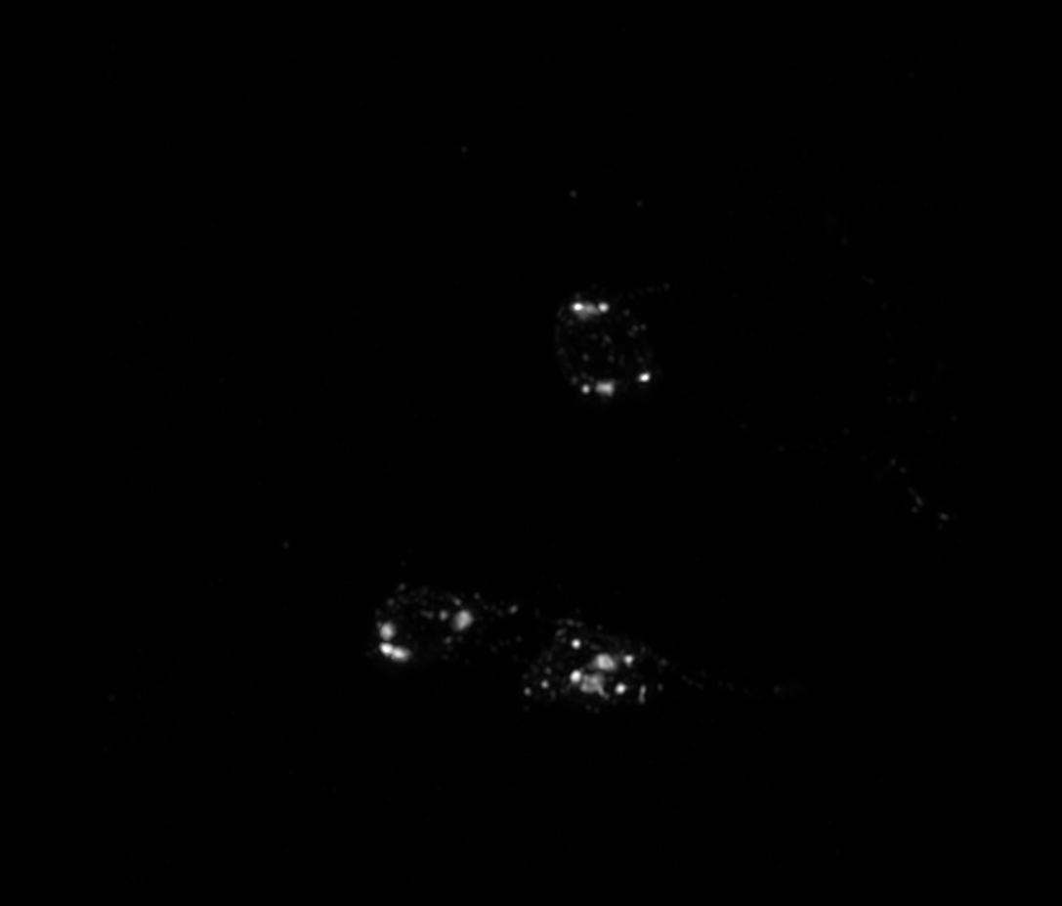
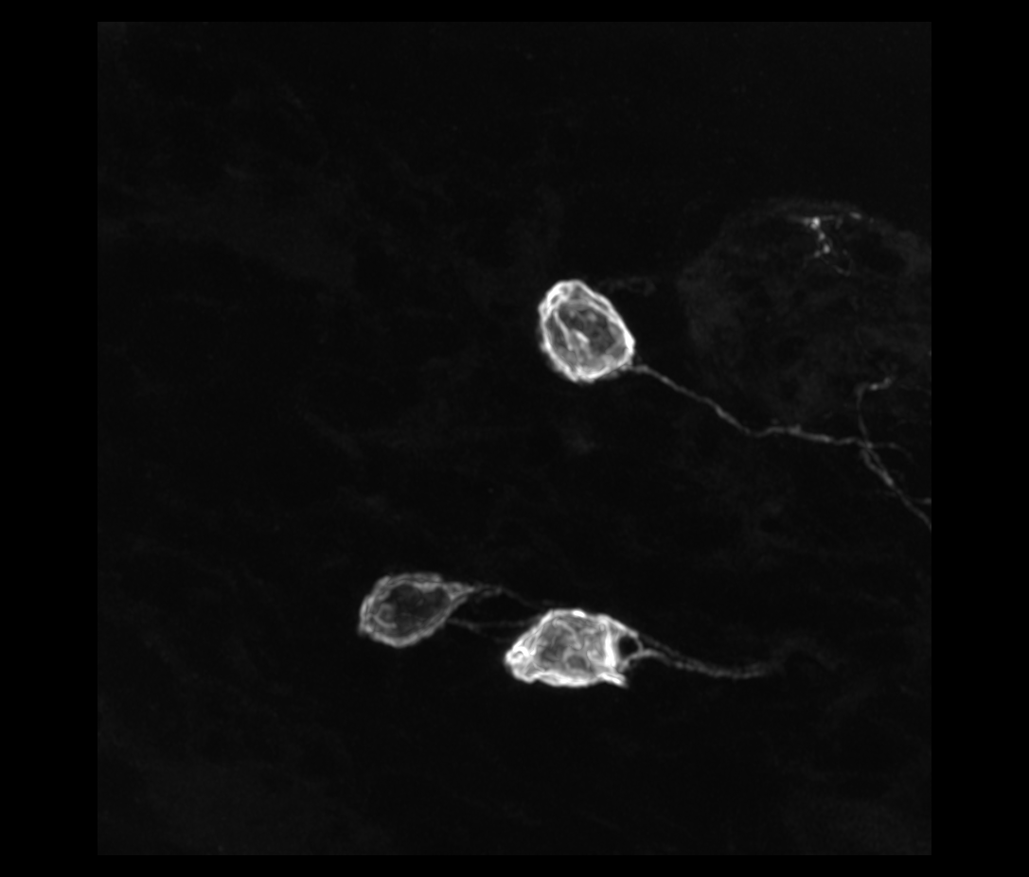
L3-1

Slide 11
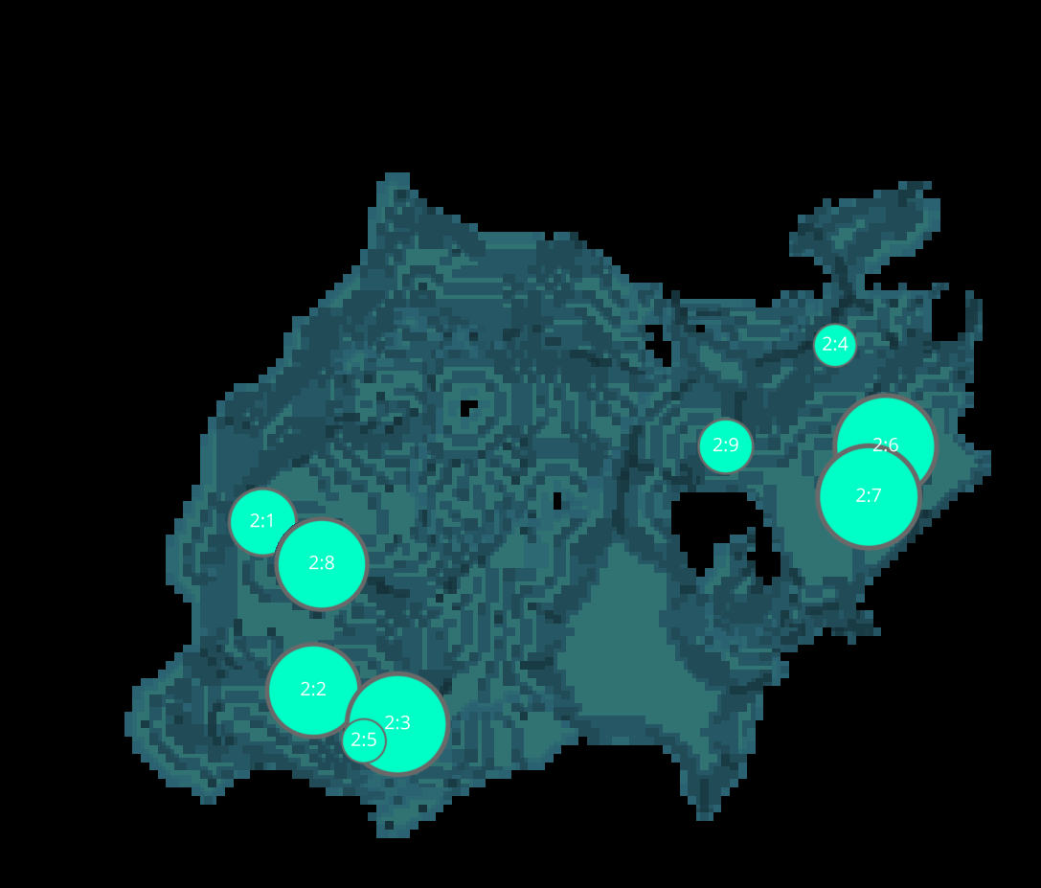
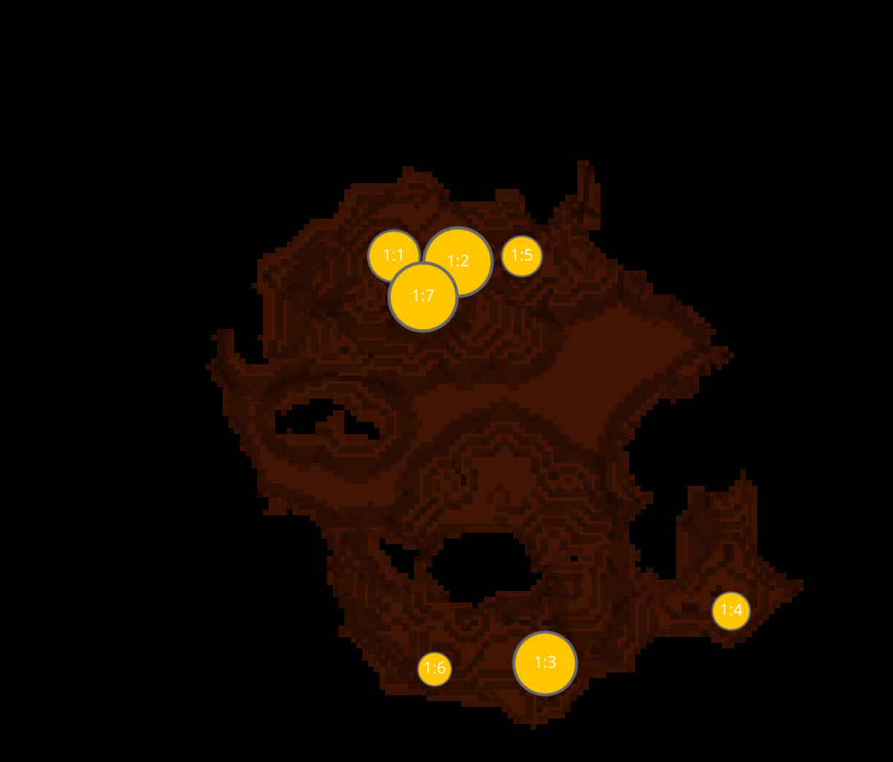
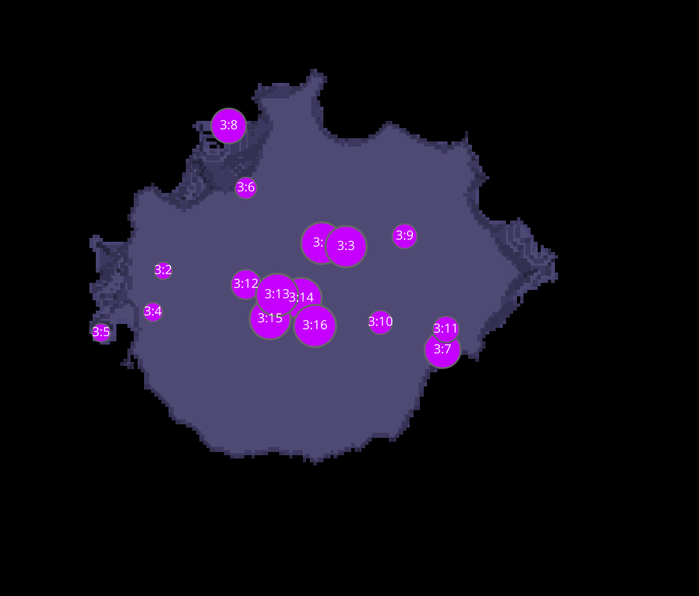
L3-1 CELLS
1
2
3

Slide 12
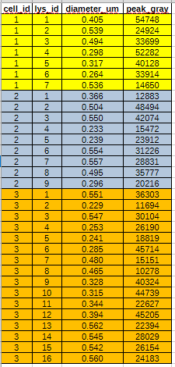




DATASETS L3-1
VOXEL * INTENSITY = SIGNAL
INTENSITY =SIGNAL/ VOXEL

