Slide 1
3D Image Segmentation and Quantification of Lysosomes
6/4/2025

Slide 2
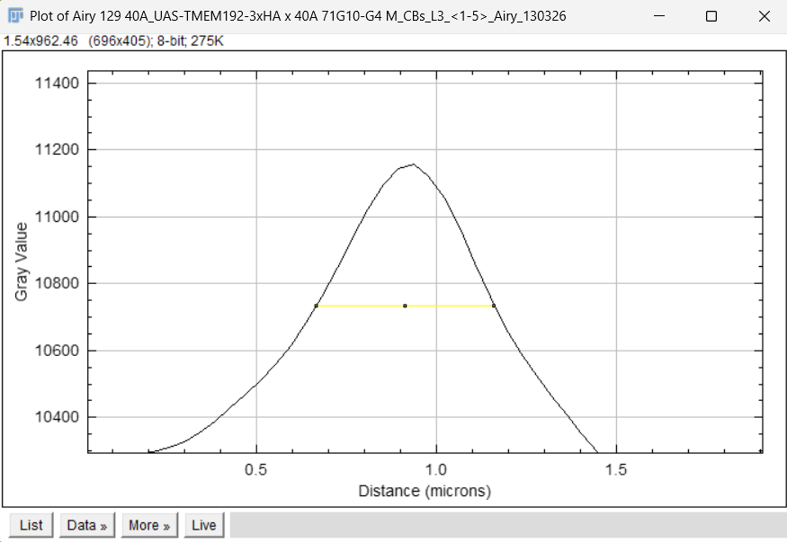
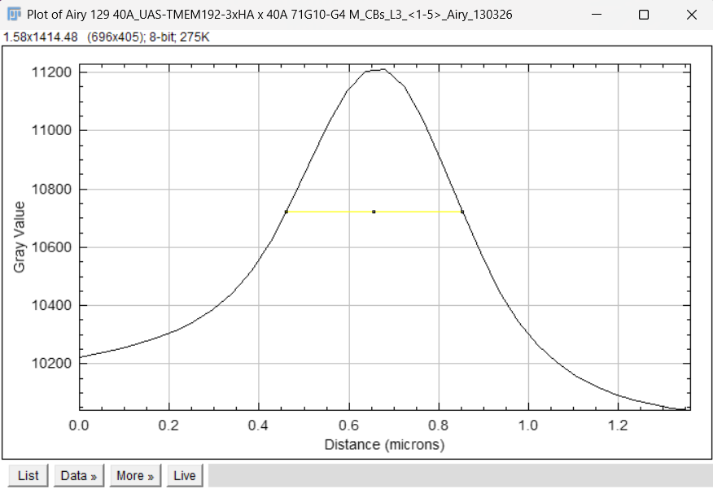

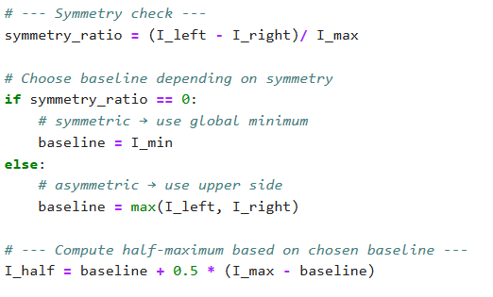
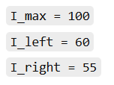

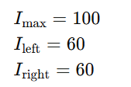

SCRIPT
SYMMETRIC
ASYMMETRIC
BEFORE
NOW
EXAMPLES WITH NUMBERS
ASYMMETRIC
SYMMETRIC

Slide 3
L3 1

Slide 4
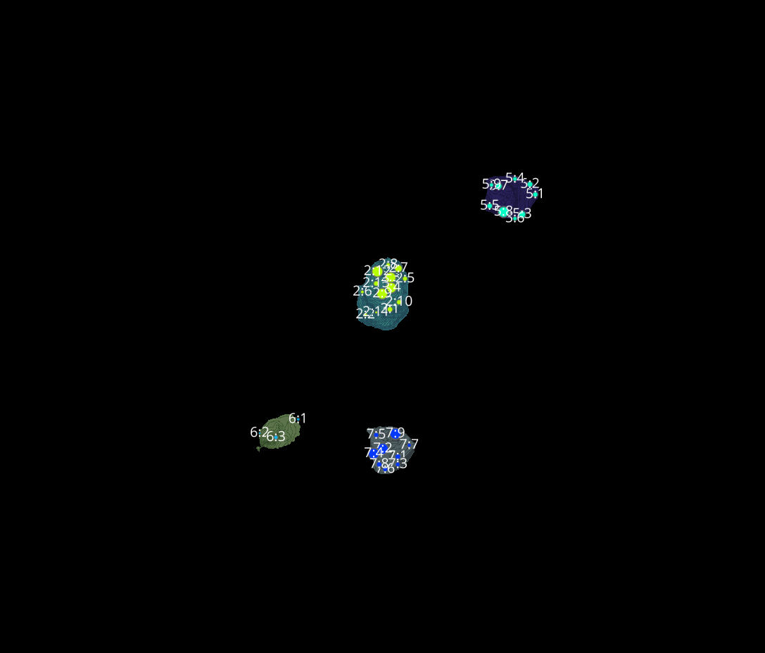
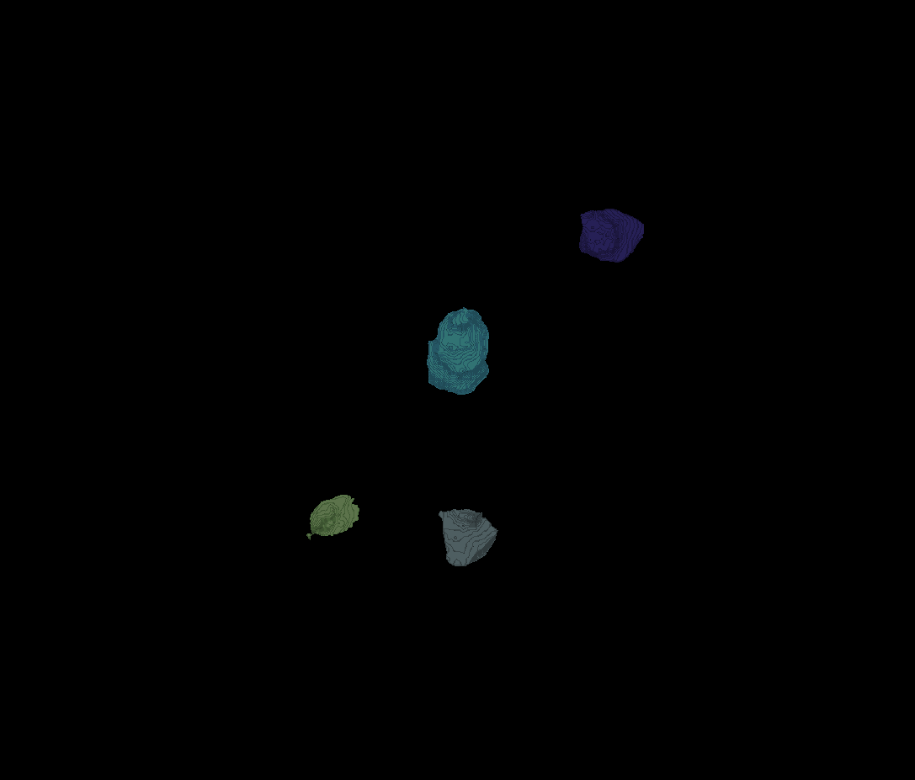
L3 1
Erosion = 8
Thresholding = 0.002
margin um = 1.2
overlap alpha = 0.6
viz min voxels = 12000

Slide 5
L3 1

Slide 6
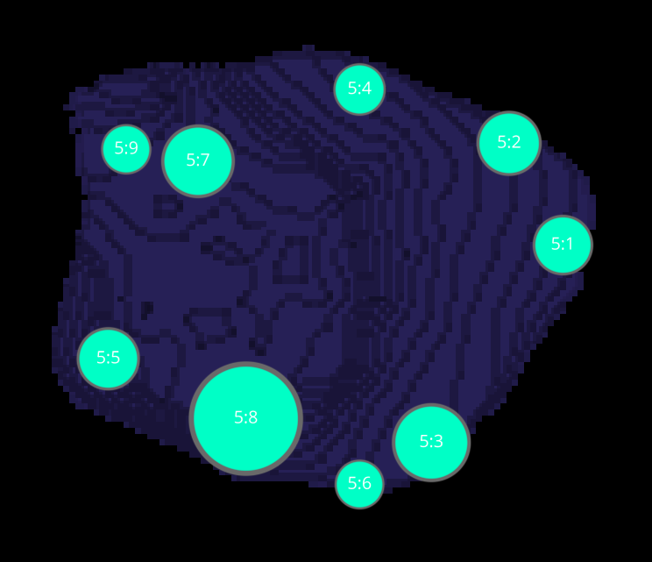
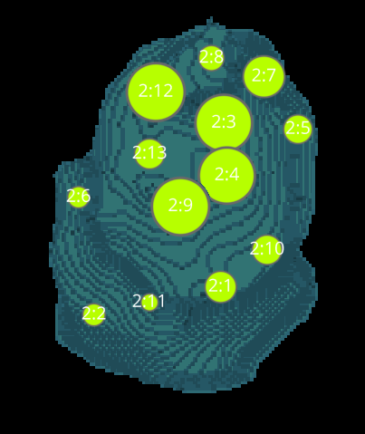
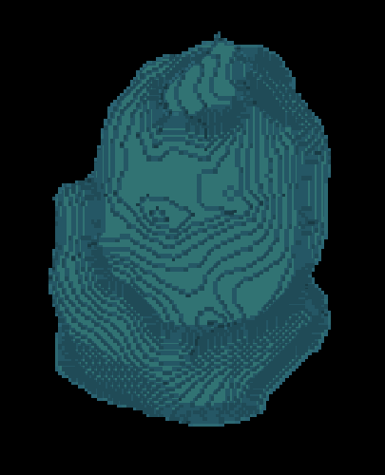
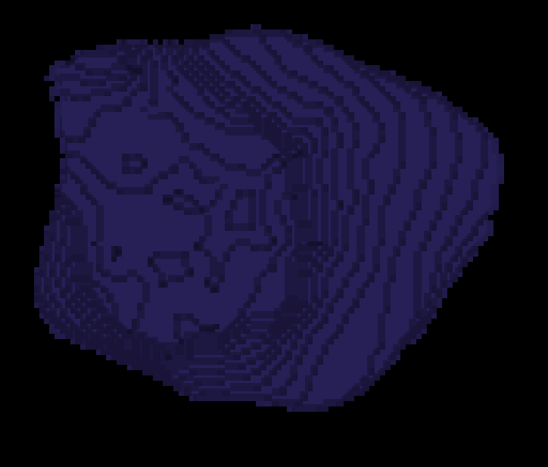
L3 1 CELLS

Slide 7
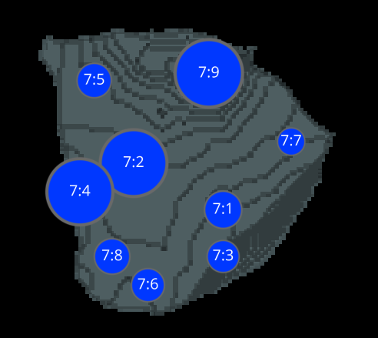
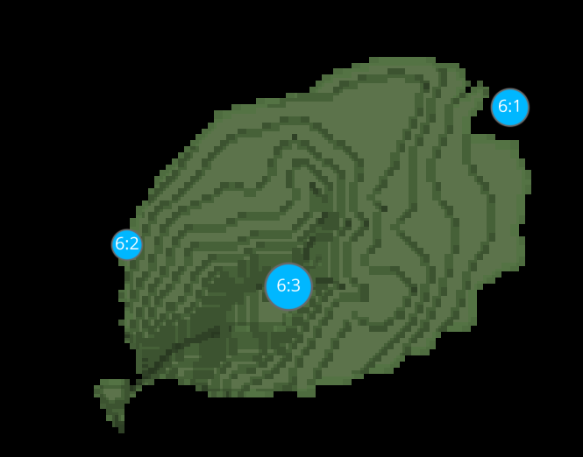
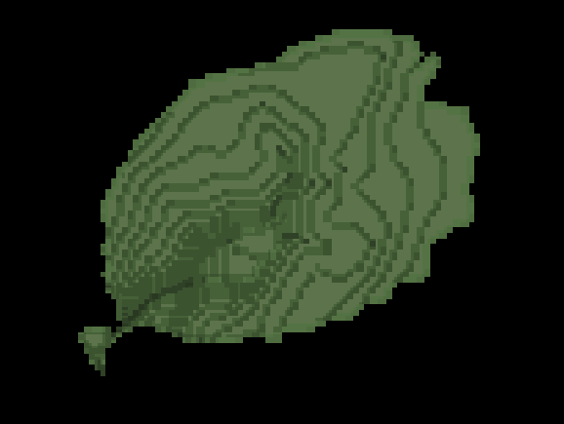
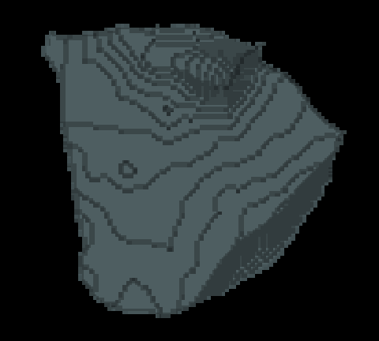
L3 1 CELLS

Slide 8
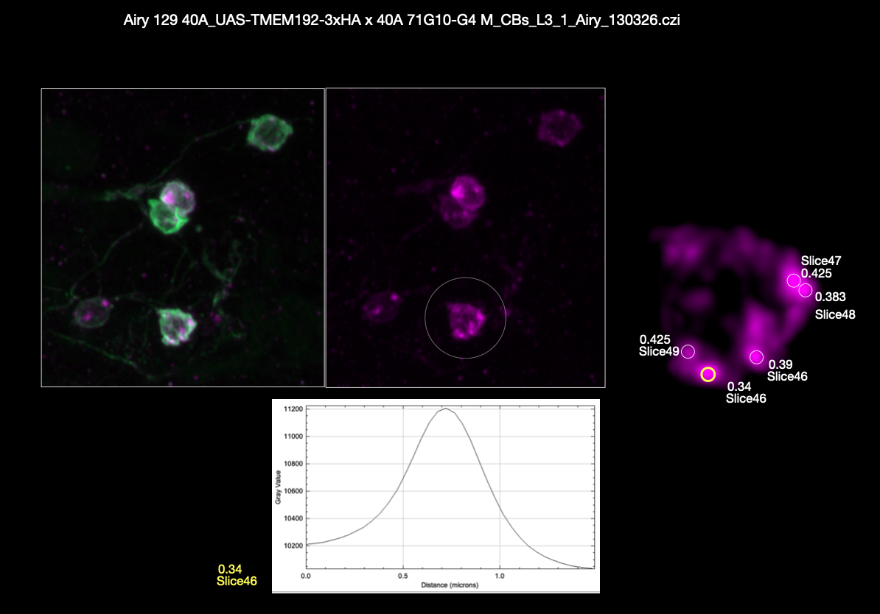
L3 1(manual analysis)

Slide 9
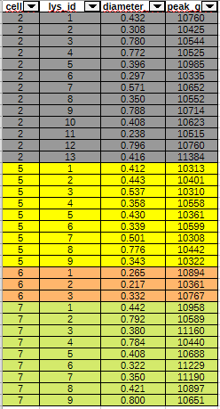
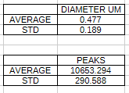

L3 1(manual.VS.aut COMPARATIVE)

Slide 10
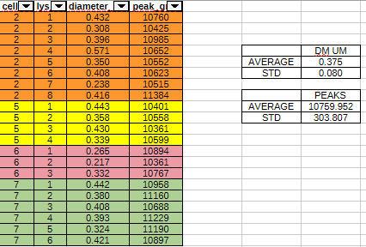
DATASETS L3-1

Slide 11
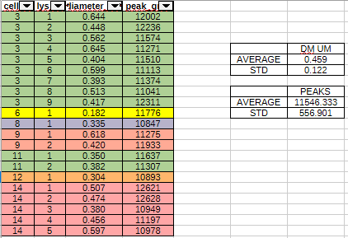
DATASETS L3-2

Slide 12
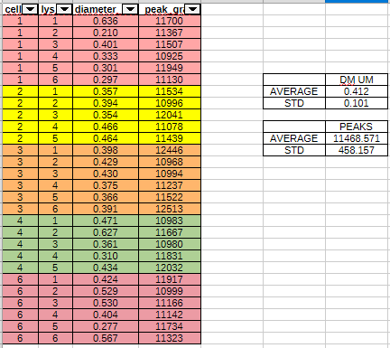
DATASETS L3-3

Slide 13
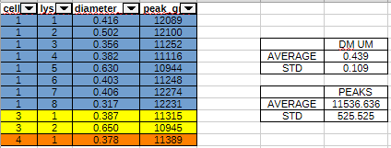
DATASETS L3-4

Slide 14
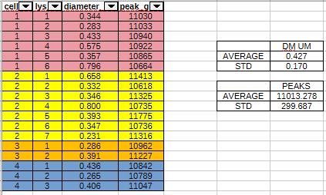
DATASETS L3-5

Slide 15
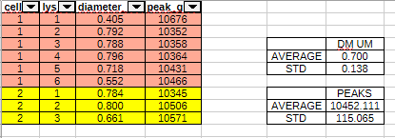
DATASETS 0H-3

Slide 16
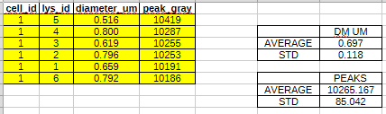
DATASETS 0H-4

Slide 17
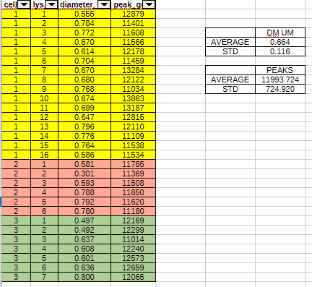
DATASETS 0H-5

Slide 18
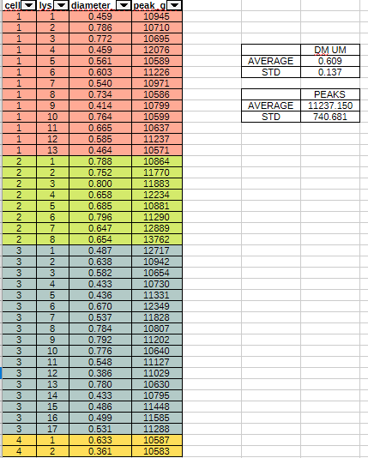
DATASETS 3H-1

Slide 19
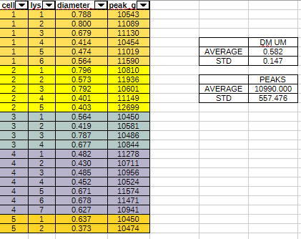
DATASETS 3H-2

Slide 20
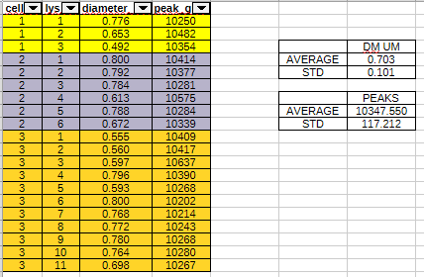
DATASETS 3H-3

Slide 21
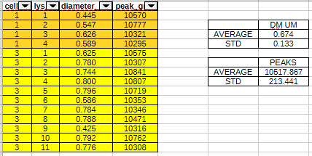
DATASETS 3H-4

Slide 22
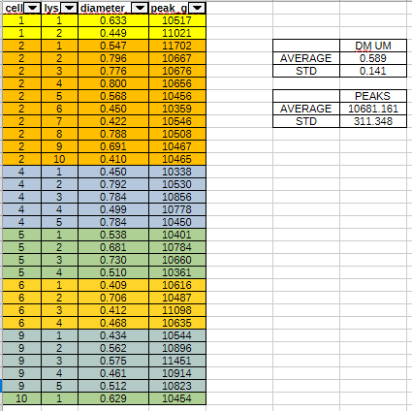
DATASETS 3H-5

