Slide 1
3D Image Segmentation and Quantification of Lysosomes
6/4/2025

Slide 2
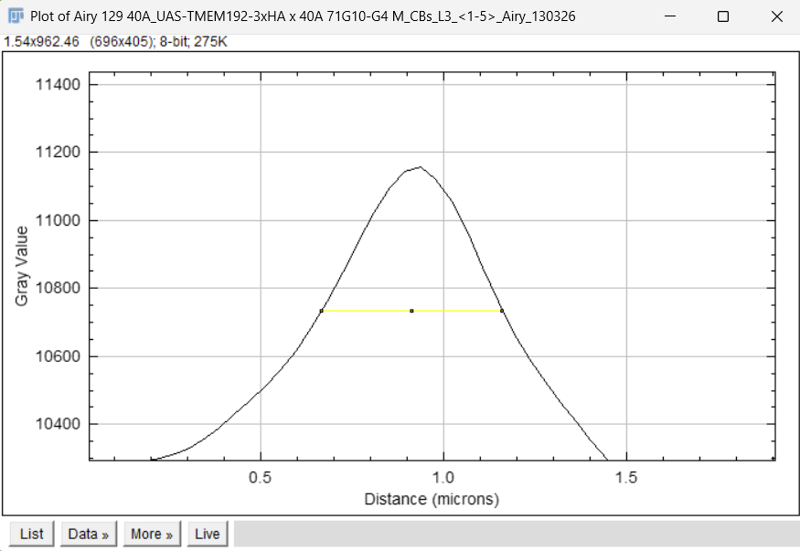
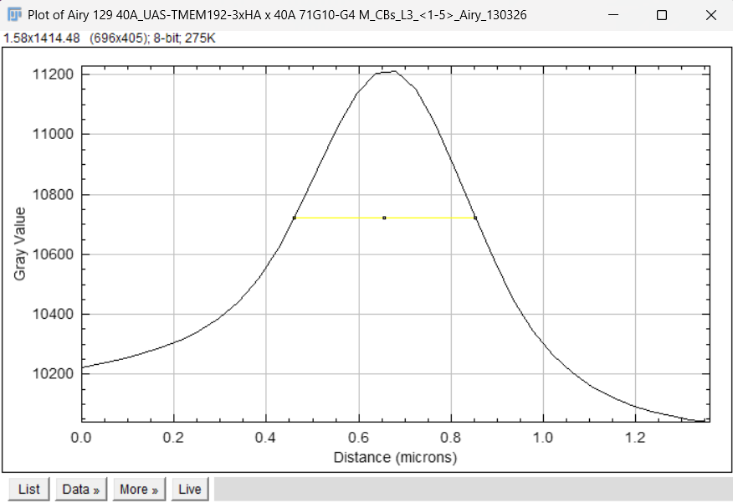

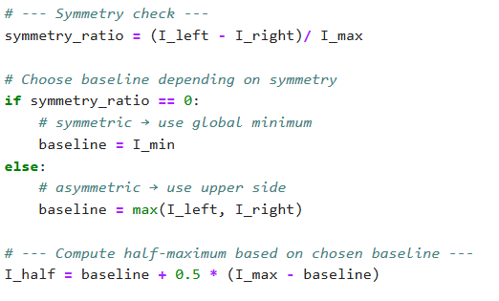
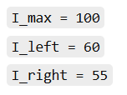

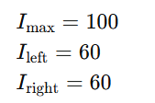

SCRIPT
SYMMETRIC
ASYMMETRIC
BEFORE
NOW
EXAMPLES WITH NUMBERS
ASYMMETRIC
SYMMETRIC

Slide 3
L3 1

Slide 4
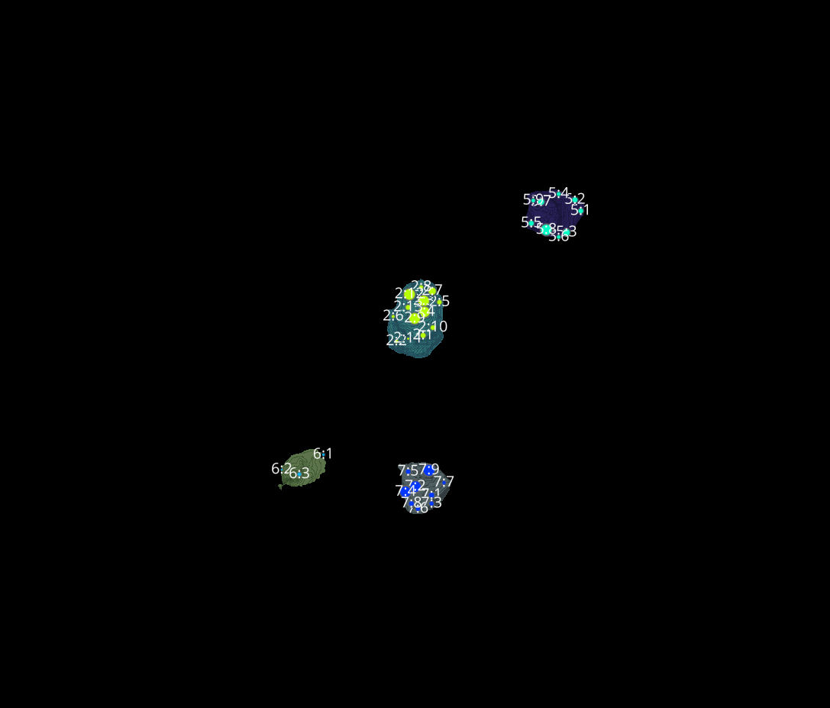
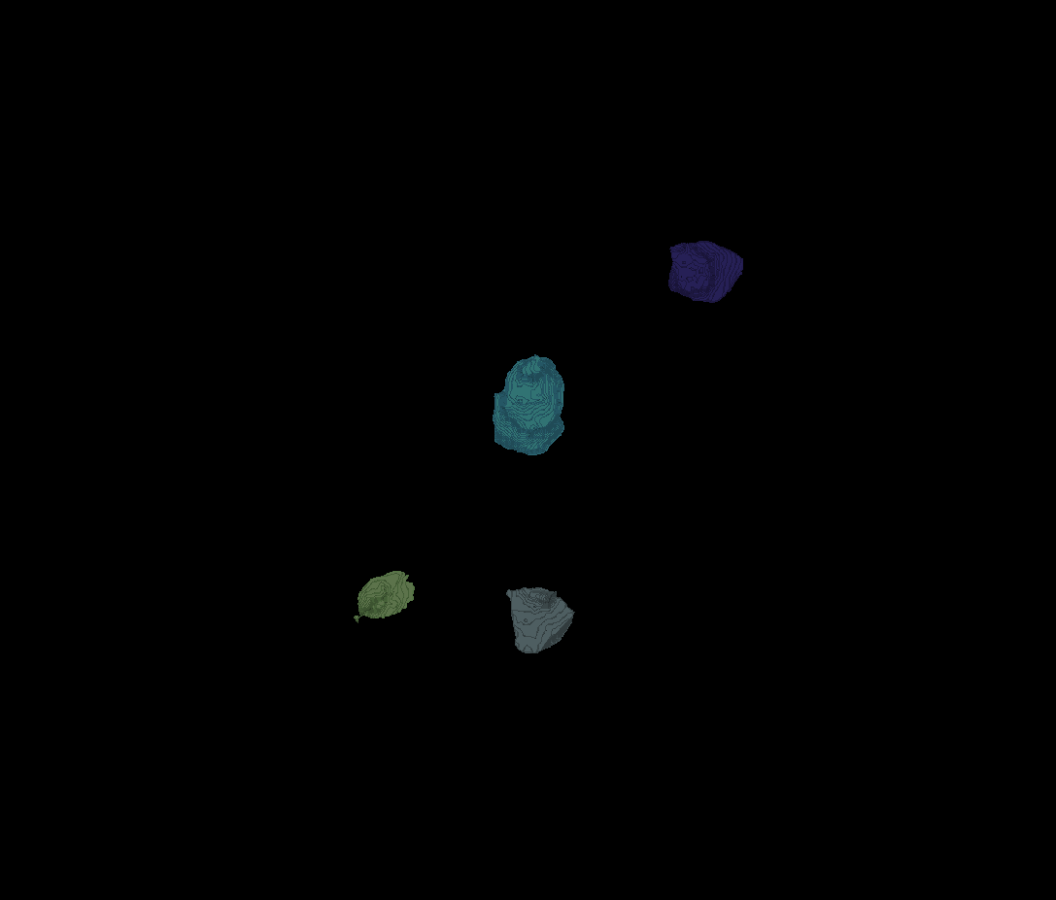
L3 1
Erosion = 8
Thresholding = 0.002
margin um = 1.2
overlap alpha = 0.6
viz min voxels = 12000

Slide 5
L3 1

Slide 6
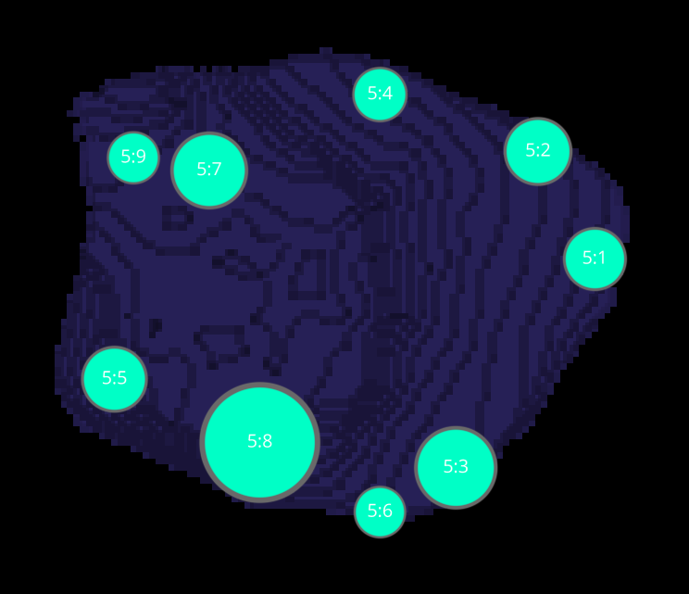
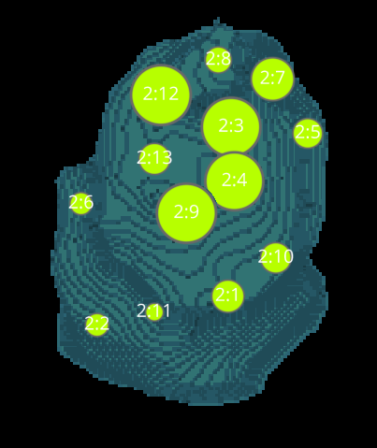
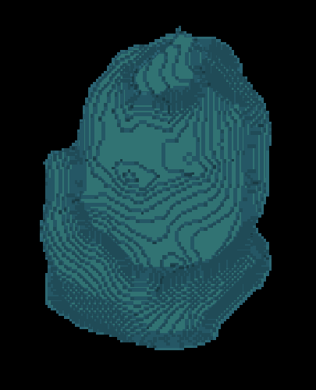
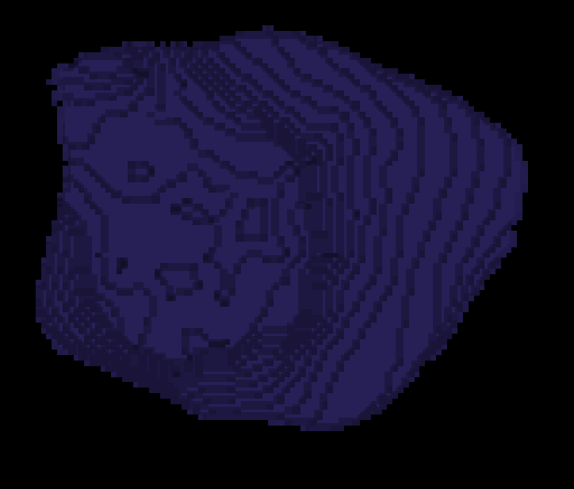
L3 1 CELLS

Slide 7
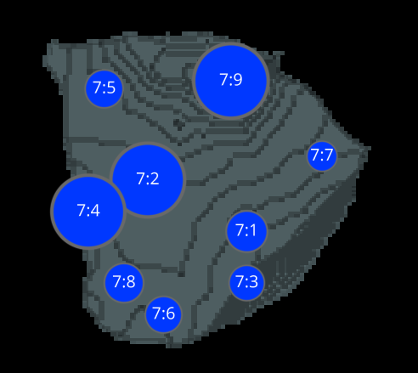
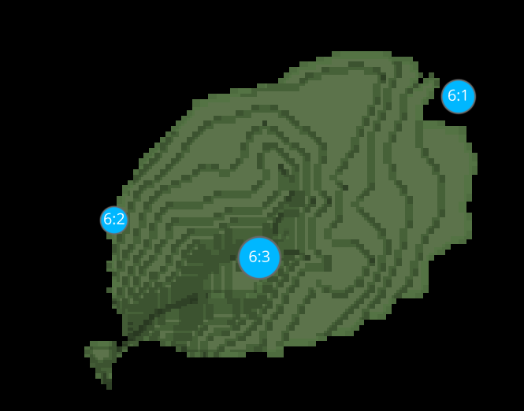
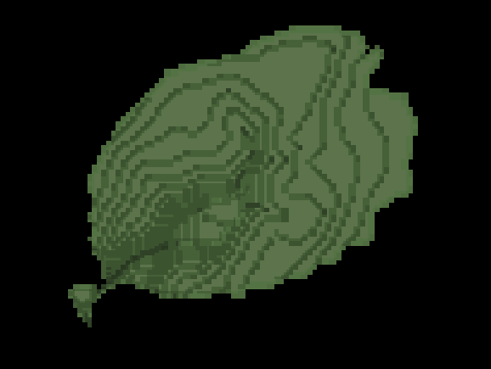
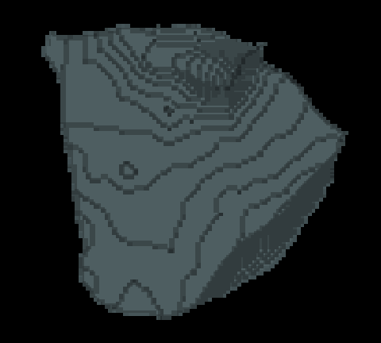
L3 1 CELLS

Slide 8
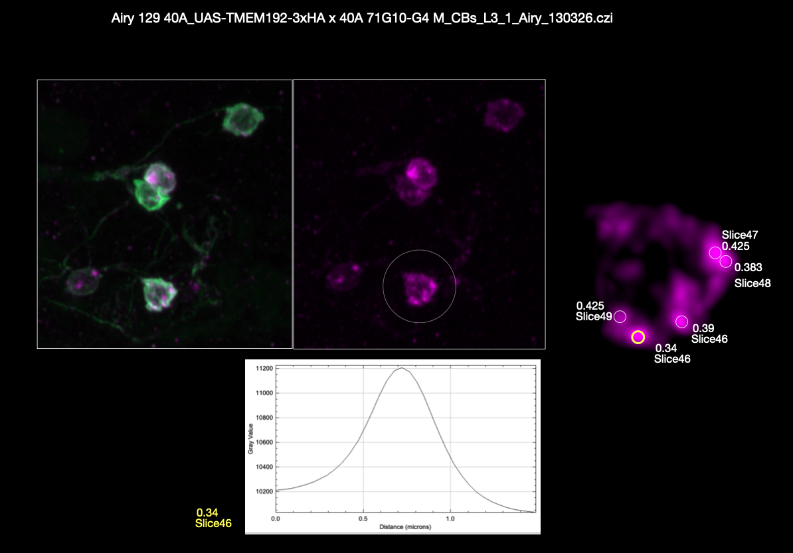
L3 1(manual analysis)

Slide 9
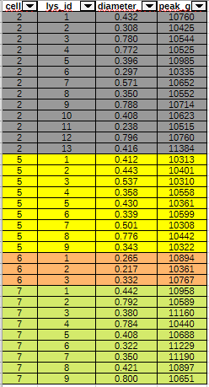
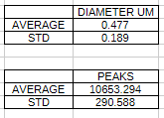

L3 1(manual.VS.aut COMPARATIVE)

