Slide 1
3D Image Segmentation and Quantification of Lysosomes
26/3/2025

Slide 2
SPOTIFLOW

Slide 3
Deep Learning Spot Detection
Features
AI for microscopy analysis
Spot detection = identifying single molecules
Use Pretrained Models in 2D and 3D.
Critical for quantitative biology
Problems or challenges of the biology detection:
High noise levels
Overlapping / dense spots
Low signal-to-noise ratio
Manual parameter tuning

Slide 4
Classical Methods
Thresholding + filtering
Gaussian fitting
Blob detection
Limitations in generalization

Slide 5
Deep Learning Shift
CNN-based detection(Convolutional Neural Network):
Model learns what a lysosome looks like and finds it directly.
Spotiflow is already a CNN, but only predicts centers (not size)
It’s a type of AI model that learns patterns in images automatically
Learns features from data
Reduces manual tuning
Improves robustness

Slide 6
Spotiflow Overview
Predicts two outputs:
1. Heatmap (probability of spot)
2. Flow field (direction vectors)
Combines both for detection
Deep learning (heatmap + flow)
Flow Concept
Each pixel predicts direction
Vectors point toward nearest spot
Intersection → spot center
Neural networking processing
Heatmap
IMAGE
Spot coordinates
Flow

Slide 7
Python Frameworks Used
PyTorch (deep learning)
NumPy (data handling)
SciPy (image processing)
scikit-image (analysis)
Matplotlib (visualization)

Slide 8
Training
Supervised learning
Ground truth spot annotations
Loss combines heatmap + flow accuracy
Data augmentation improves robustness

Slide 9
Inference
Run trained model on new images
Predict flow vectors
Cluster convergence points
Extract precise spot positions

Slide 10
Mathematical Formulation
Heatmap: probability density of spot centers
Flow: vector field v(x,y) → center
Optimization: minimize L = L_heatmap + L_flow
Subpixel localization via convergence

Slide 11
Post-processing Algorithm
Initialize pixels
Follow flow vectors iteratively
Cluster convergence points
Extract final coordinates

Slide 12
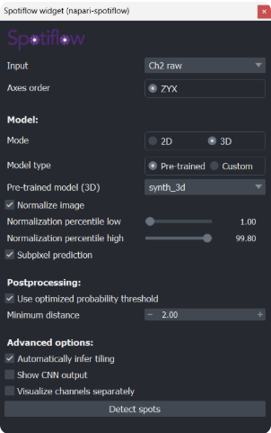
Interface
Input: ch2 raw(puncta), ch1 raw(cells)
Axes order: ZYX
Your data is interpreted as:
Z = depth (slices)
Y = height
X = width
Model
Mode: 3D
The model detects spots in full 3D volume, not slice-by-slice.
It considers spatial continuity across Z.
Model type: Pre-trained
Using a ready-made neural network.
Pre-trained model (3D): synth_3d
A model trained on synthetic 3D spot-like data.
Works well for:
Spherical/compact bright spots
Isotropic-ish objects

Slide 13
Interface
Normalize image
Applies intensity normalization across the 3D stack.
Helps compensate for:depth attenuation and uneven illumination
Normalization percentiles low: 1.0%(Removes very dark background noise)
High: 99.8%(Caps very bright pixels)
In 3D, this is especially useful because intensity often varies with depth.

Slide 14
Interface
Subpixel prediction ✔
Outputs spot coordinates with fractional precision (x.y, y.z, z.t).
Important for:
accurate spatial measurements
downstream quantification
🔹 Postprocessing
Use optimized probability threshold ✔
Automatically determines detection cutoff.
In 3D, this is very helpful since manual tuning is harder.
Minimum distance: 2.0
Minimum spacing between detected spots (in pixels).
⚠️ In 3D, this applies in XYZ space, not just XY.
Interpretation:
If two detections are closer than 2 pixels → merged or suppressed.
👉 Important:
If your Z spacing is larger than XY (common!), this value may need adjustment.

Slide 15
Interface
🔹 Advanced options
Automatically infer tiling ✔
Splits volume into smaller blocks during inference.
Prevents memory crashes with large stacks.
👉 Highly recommended for 3D data.
Show CNN output ❌
Disabled.
If enabled, would show:
probability maps (where the model “thinks” spots are)
Visualize channels separately ❌
Not relevant here since:
You selected a single channel input
🔹 Detect spots (button)
Runs full pipeline:
Normalize
Apply 3D CNN
Postprocess detections
Output:
A points layer in napari with (Z, Y, X) coordinates

Slide 16
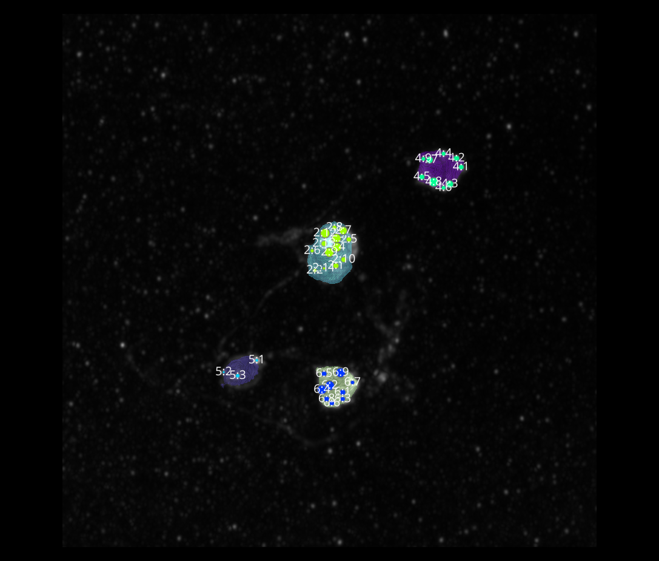
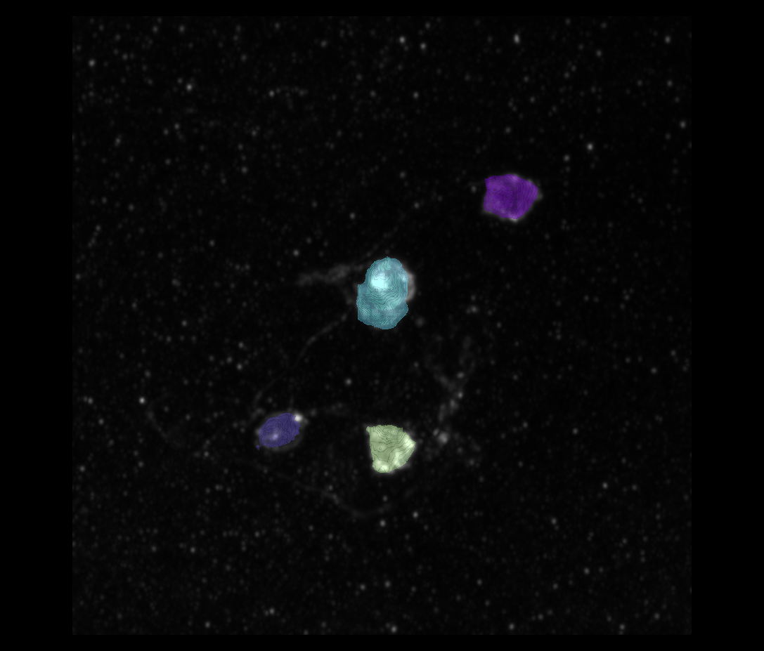
L3 1
Erosion = 8
Thresholding = 0.002
margin um = 1.2
overlap alpha = 0.6
viz min voxels = 12000

Slide 17
L3 1

Slide 18
L3 1 CELLS

Slide 19
L3 1 CELLS

Slide 20
L3 1

