Slide 1
3D Image Segmentation and Quantification of Lysosomes
7/5/2025

Slide 2
SIGNAL
UNITS
Cell signal: Sum of intensity over ALL voxels in the cell.
Lysosome signal individual: Sum of intensity over ONLY the lysosome voxels.
Lysosome signal per cell: Sum of the pixel intensities of all lysosomes within a cell.
They are in arbitrary intensity units (A.U.)
If the raw data is 16-bit → values are typically 0–65535
After removing the background and obtaining the mask → A.U
So:
Unit = "integrated fluorescence intensity" (A.U.).
Values are relative fluorescence (A.U.)
A.U. represent total fluorescence in the cell and lysosomes.

Slide 3
SIGNAL
LYSOSOME SIGNAL PER CELL = signal lys 1 + signal lys 2 + ………………...+ signal lys n
TOTAL SIGNAL = LYSOSOME SIGNAL PER CELL + REST CELL SIGNAL
REST CELL SIGNAL = TOTAL SIGNAL -LYSOSOME SIGNAL PER CELL
 | VOXEL | INTENSITY | SIGNAL
LYS PER CELL | 45 | 100 | 4500
REST CELL | 150 | 10 | 1500
TOTAL SIGNAL |  |  | 6000
 | %
LYS PER CELL | 75
REST CELL | 25

Slide 4
FILES
WITHOUT MUTATION
40A_UAS-TMEM192-3xHA x 40A 71G10 MARCM_around 12h - for quantification_3 Airy-Cbs_300425
40A_UAS-TMEM192-3xHA x 40A 71G10 MARCM_around 12h - for quantification_3 Airy-Cbs_300425
40A_UAS-TMEM192-3xHA x 40A 71G10 MARCM_around 12h - for quantification_3 Airy-Cbs_040525
40A_UAS-TMEM192-3xHA x 40A 71G10 MARCM_around 12h - for quantification_3 Airy-Cbs_060525
40A_UAS-TMEM192-3xHA x OK107 40A GFP MARCM_18h_2_airy_CB_120323
MUTATION VAMP7
VAMP7-TRIP_40A_UAS-TMEM192-3xHA x OK107 40A GFP MARCM _18h_2_CB_airy_120223
VAMP7-TRIP_40A_UAS-TMEM192-3xHA x OK107 40A GFP MARCM _18h_3_CB_airy_070323

Slide 5
12H-3

Slide 6
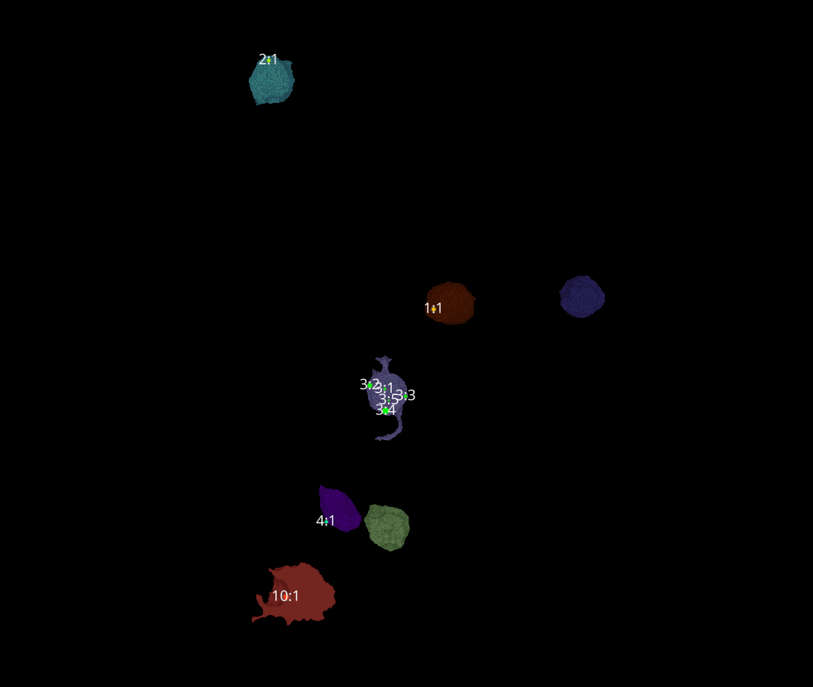
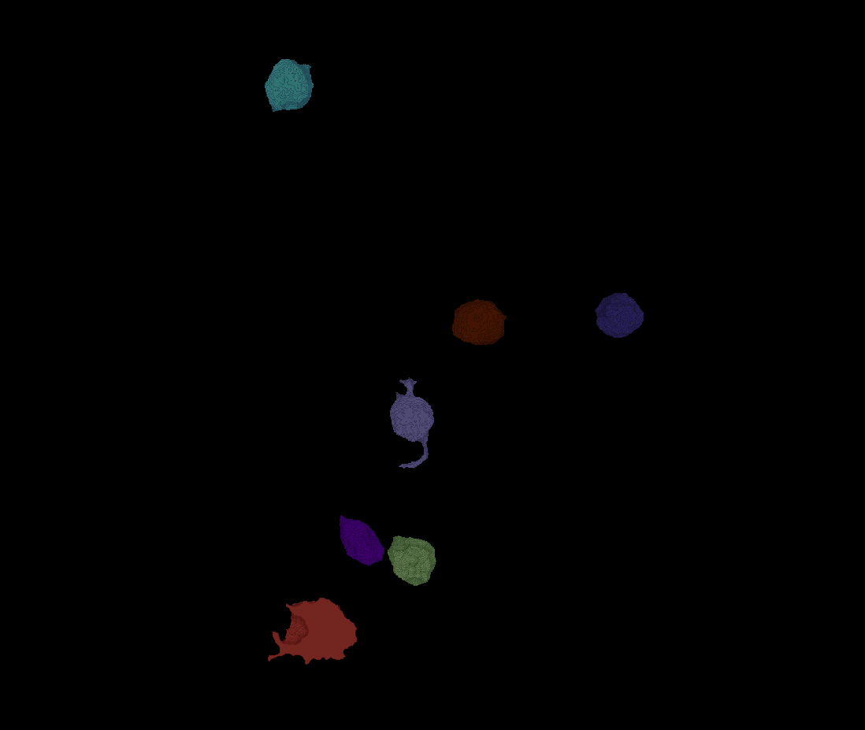
12H-3
Erosion = 9
Thresholding = 0.0085
margin um = 1.2
overlap alpha = 0.6
viz min voxels = 20000

Slide 7
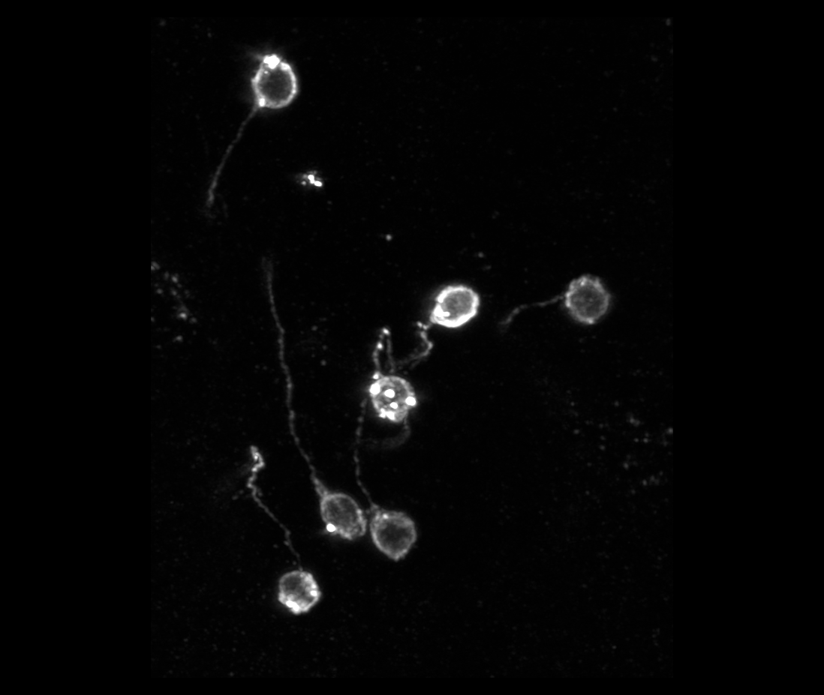
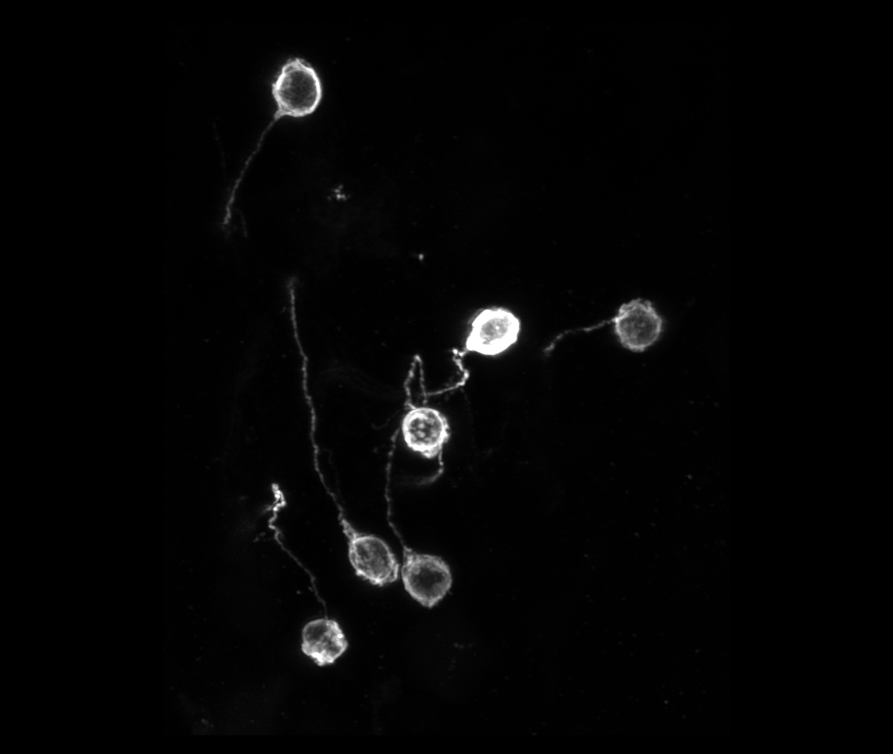
12H-3

Slide 8
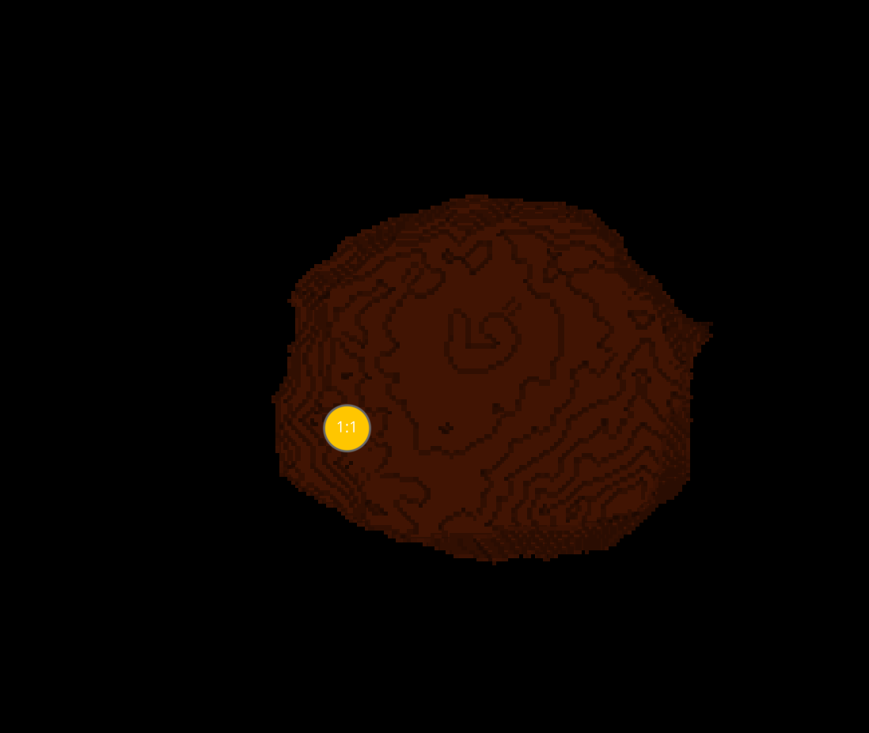
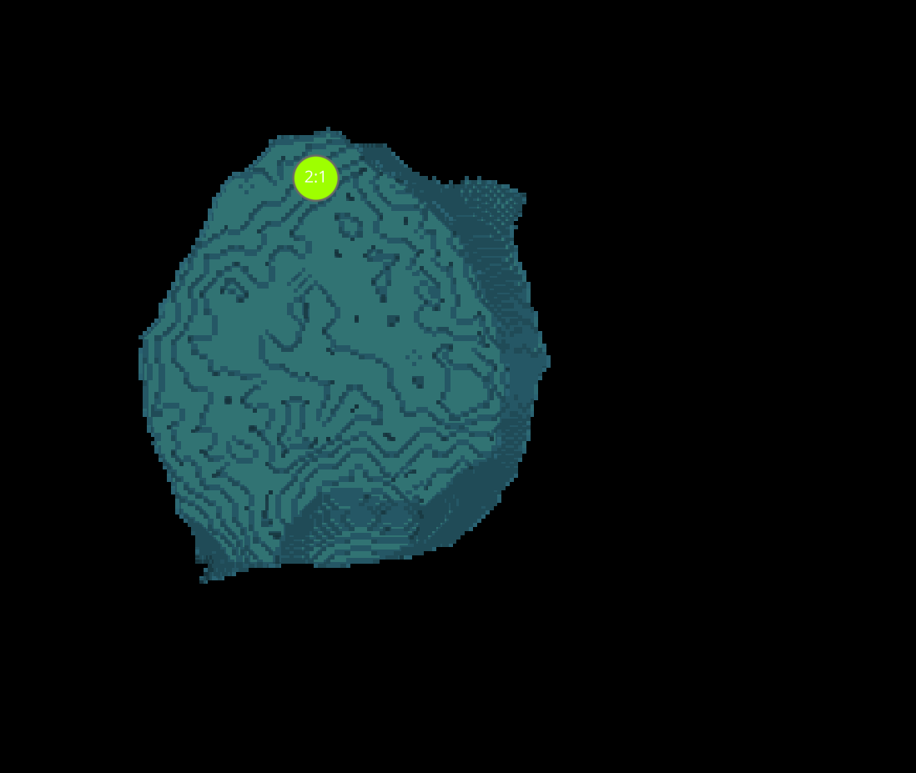
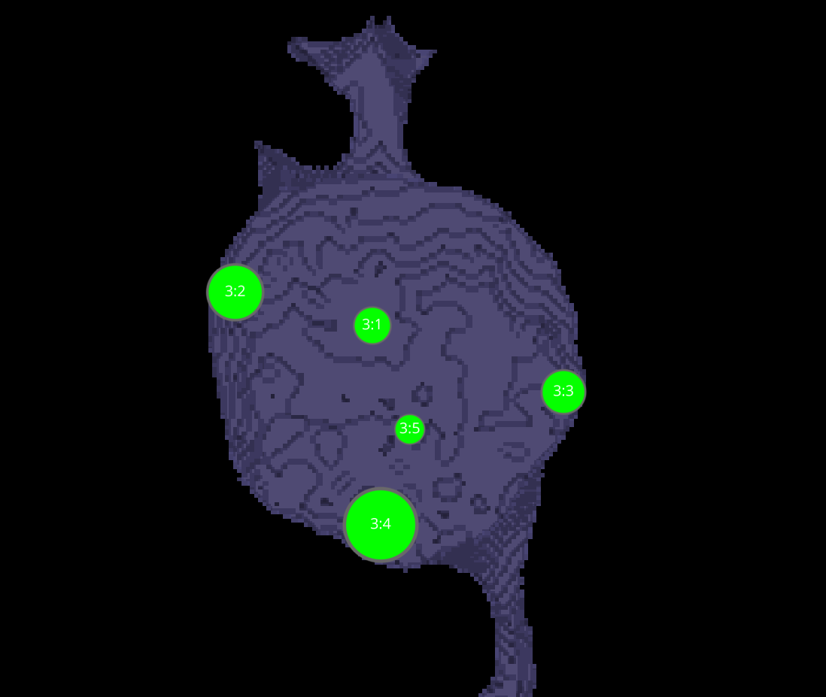
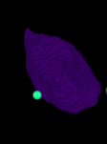
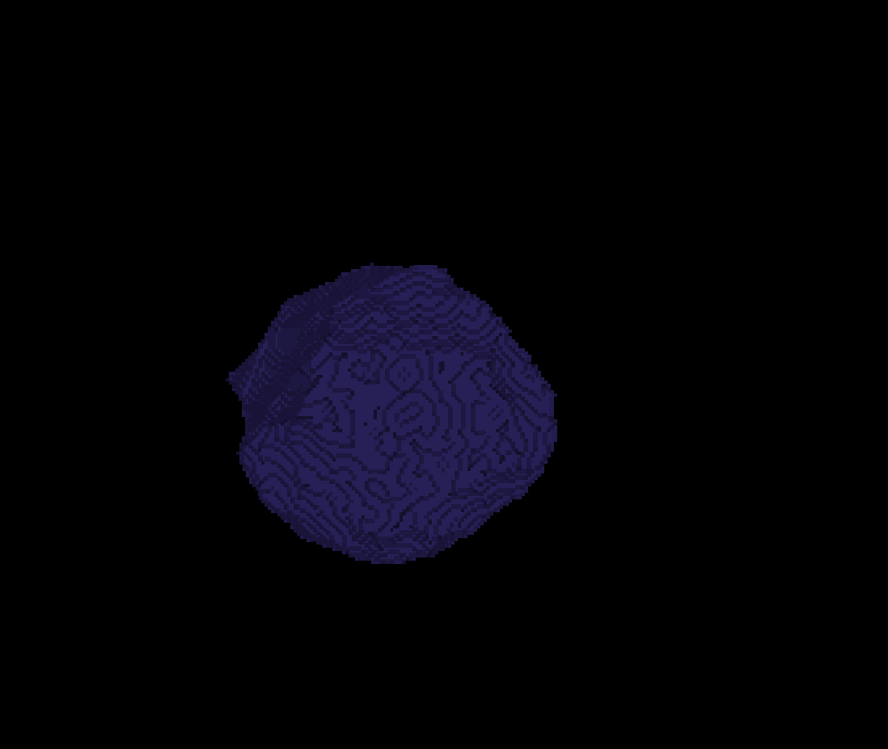
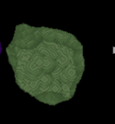
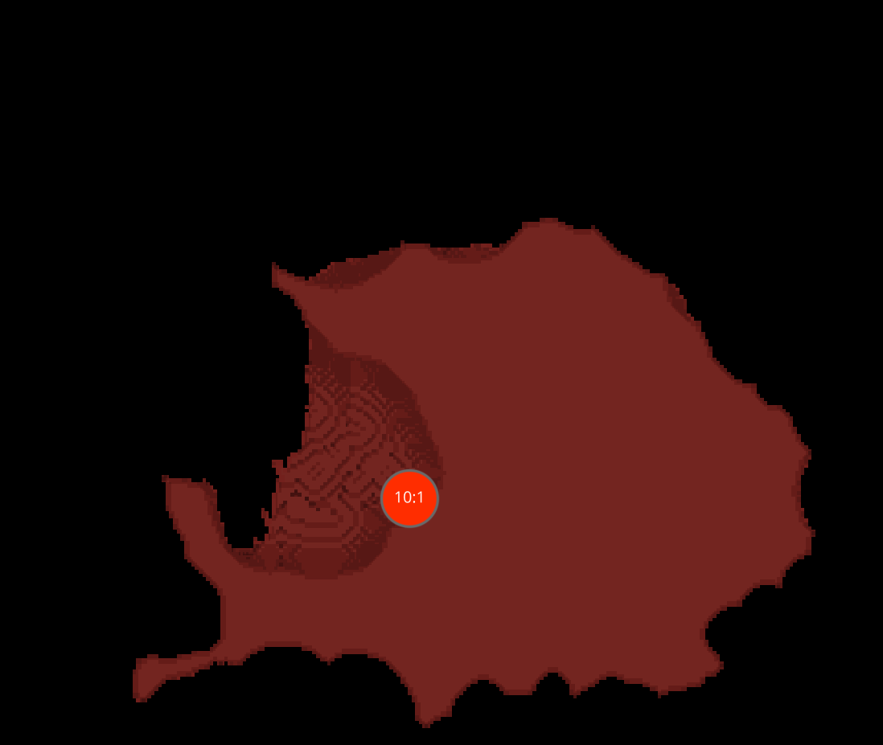
12H-3 CELLS
1
2
3
4
5
6
10

Slide 9
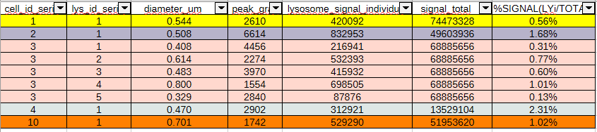
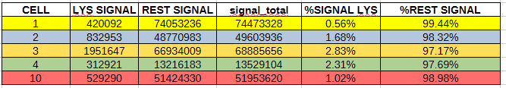


DATASETS 12-H3

Slide 10
12H-4

Slide 11
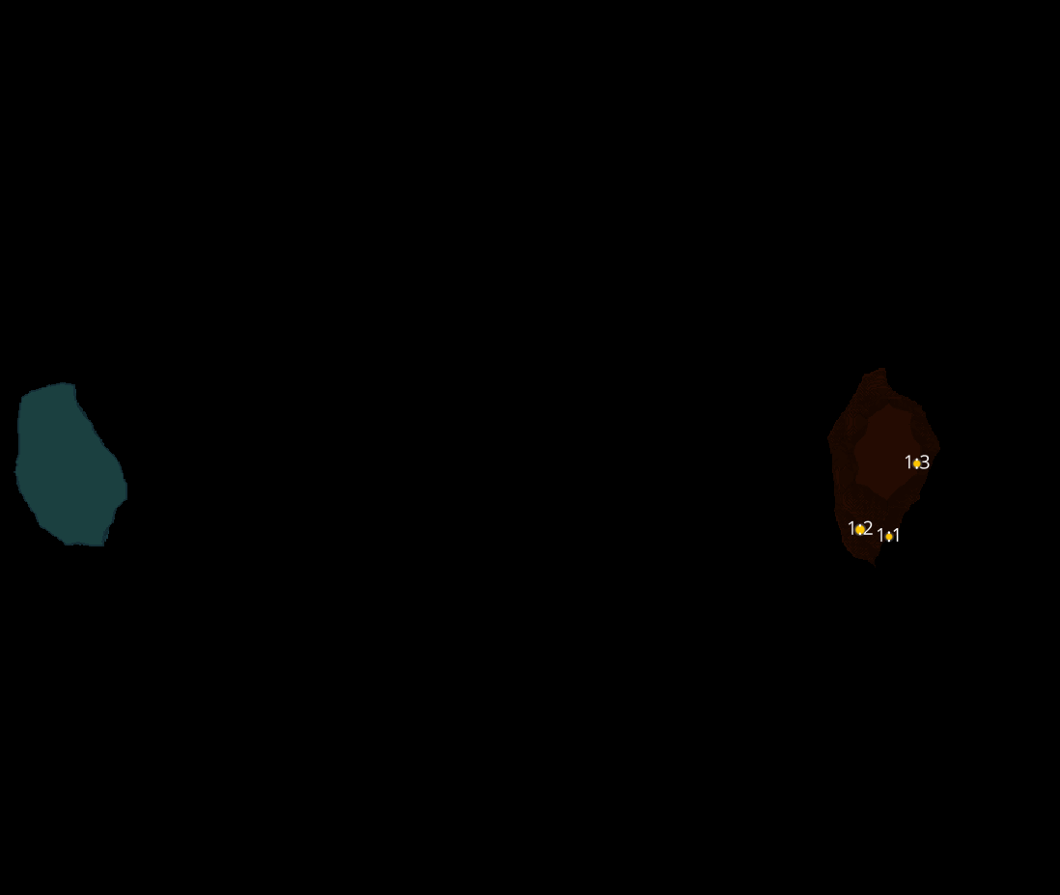
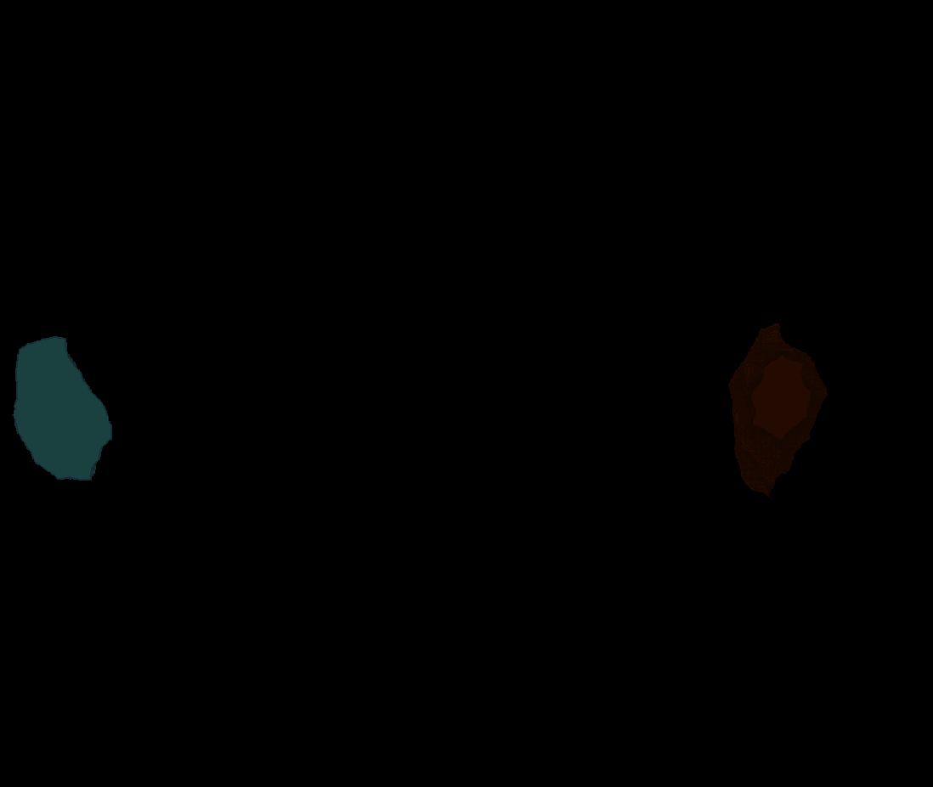
12H-4
Erosion = 8
Thresholding = 0.0125
margin um = 1.2
overlap alpha = 0.6
viz min voxels = 15000

Slide 12
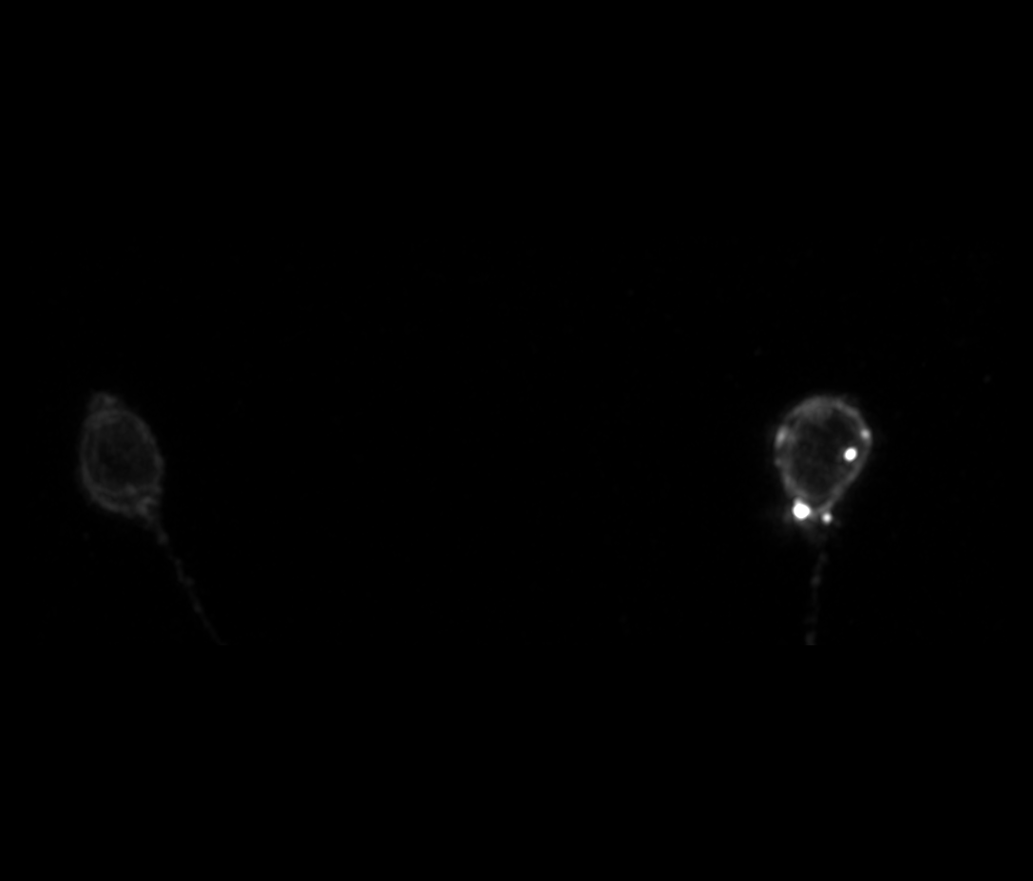
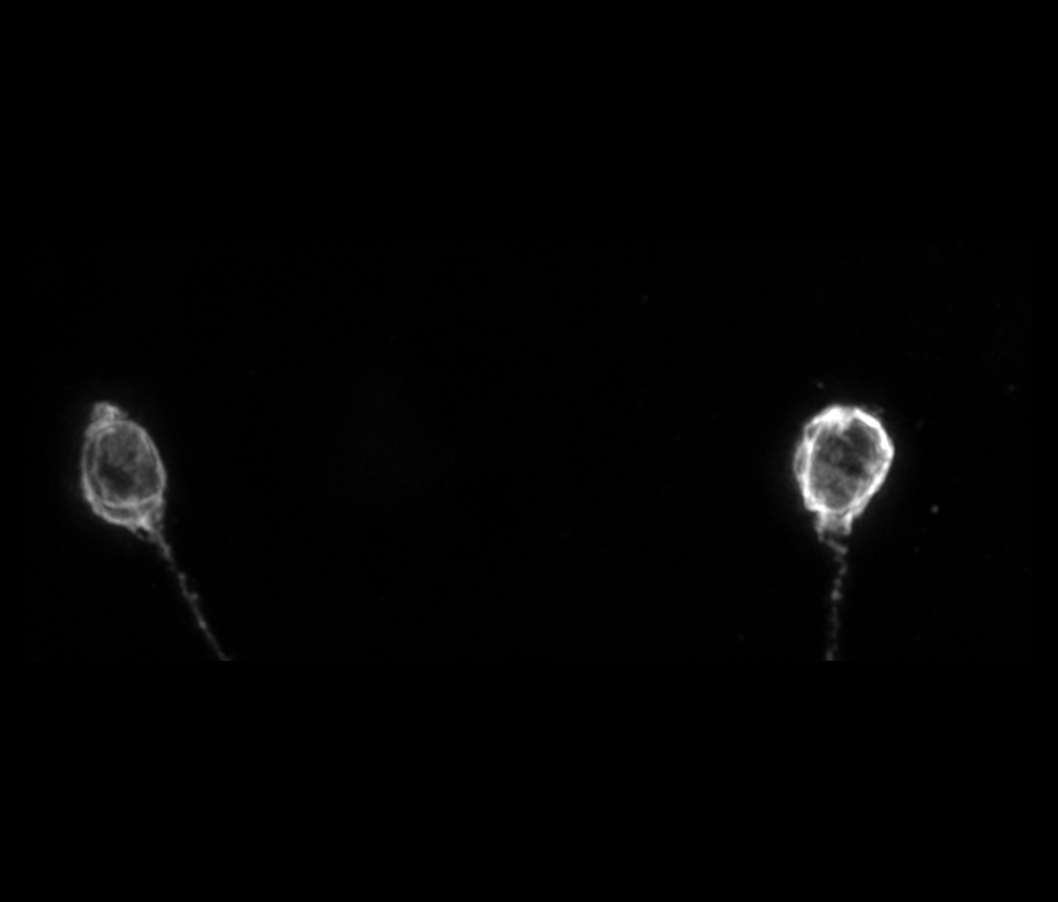
12H-4

Slide 13
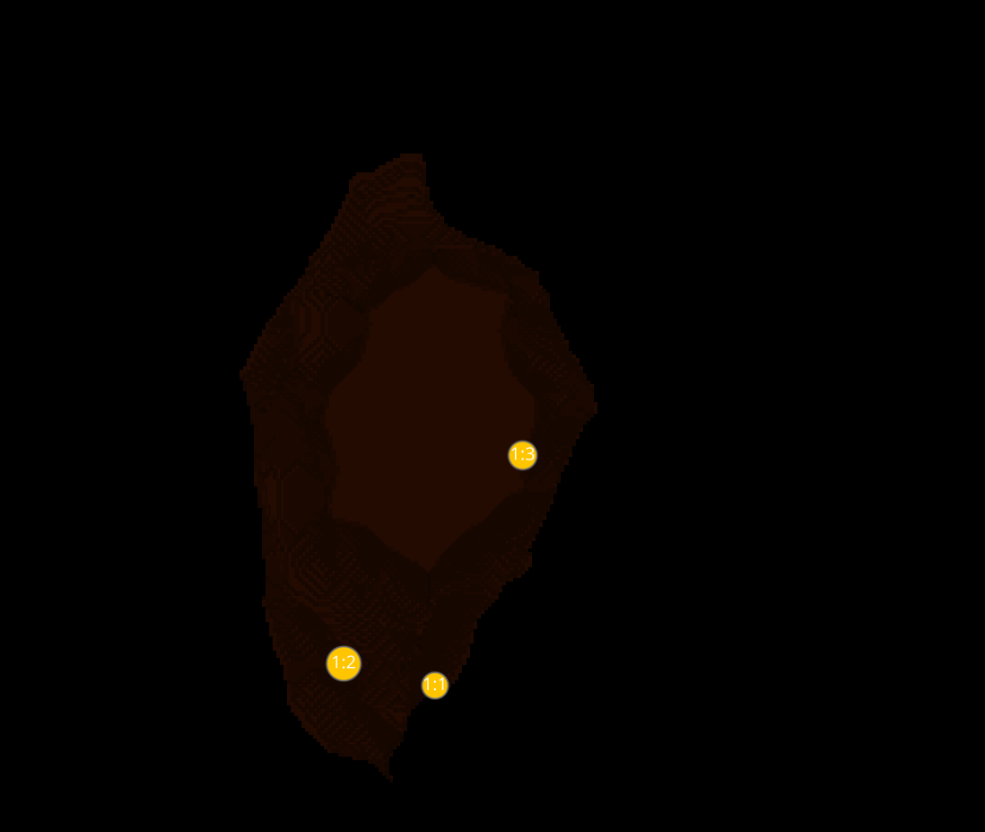
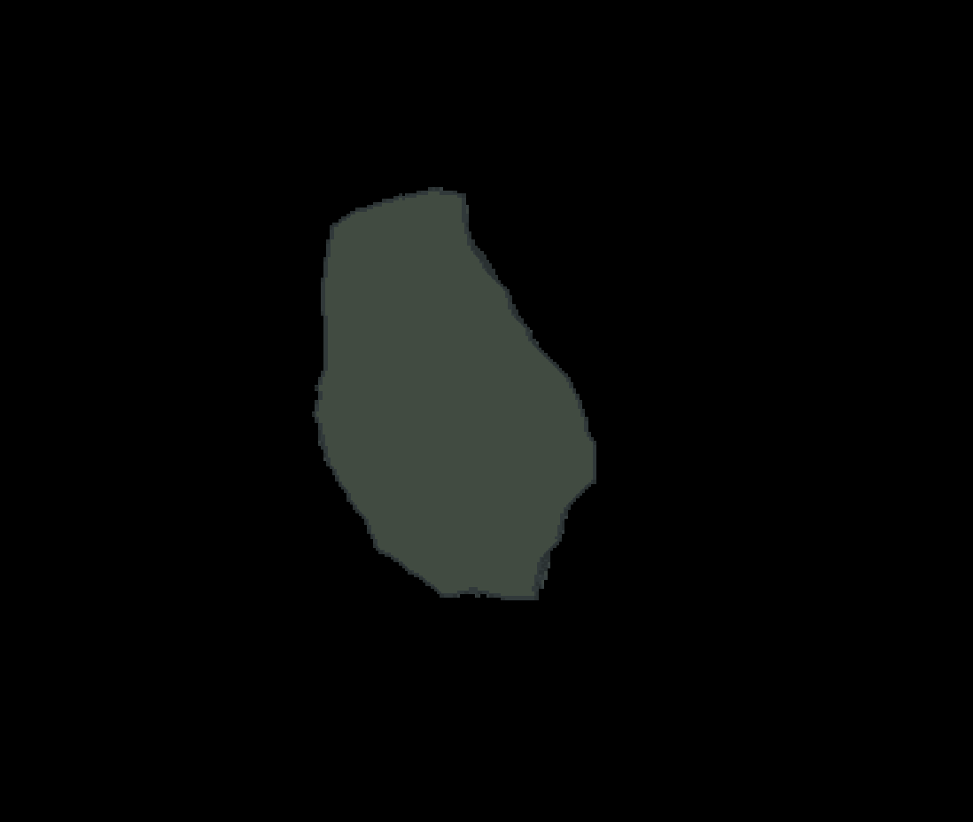
12H-4 CELLS
1
2

Slide 14


DATASETS 12H-4

Slide 15
12H-5

Slide 16
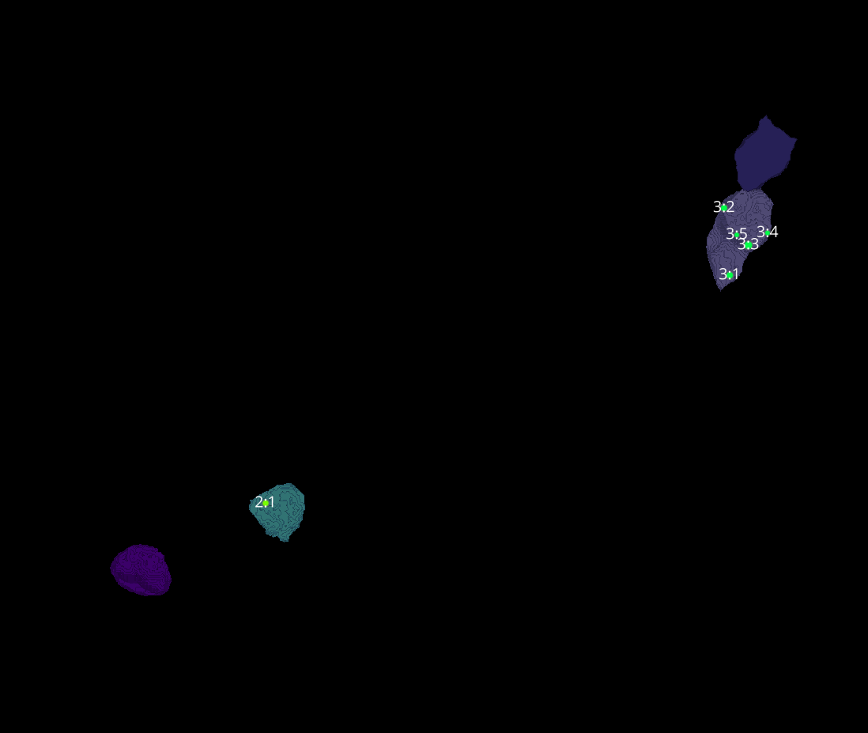

12H-5
Erosion = 10
Thresholding = 0.004
margin um = 1.2
overlap alpha = 0.6
viz min voxels = 22000

Slide 17
12H-5

Slide 18
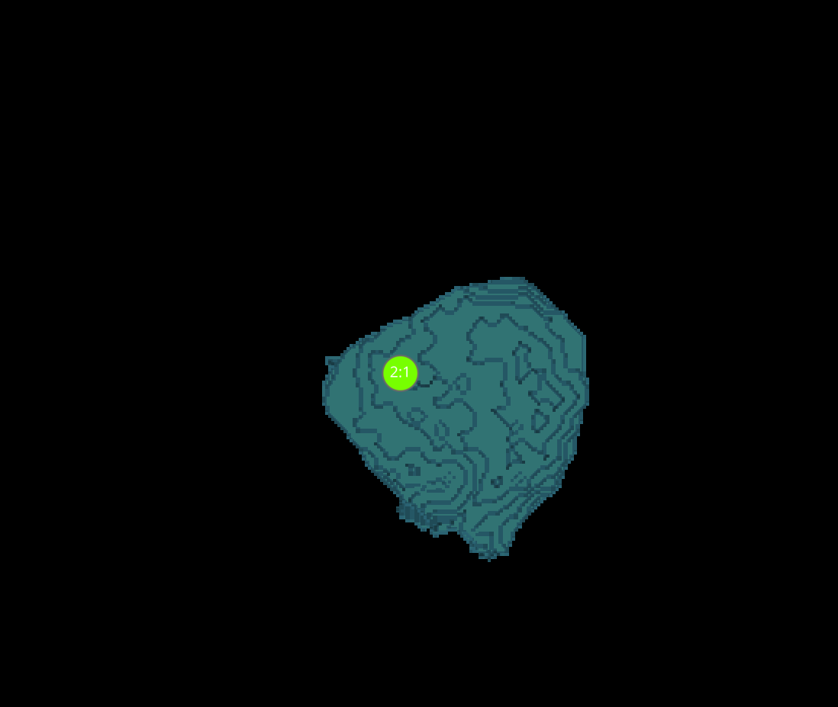
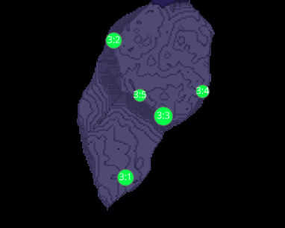
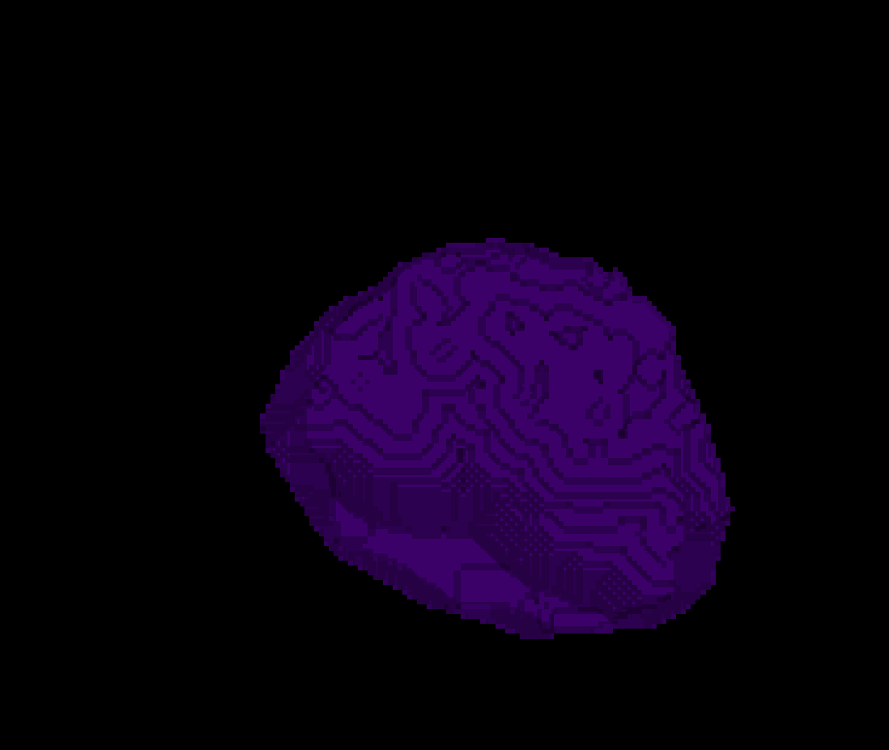
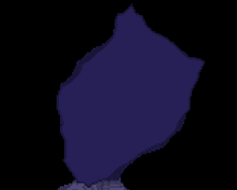
12H-5 CELLS
2
3
4
5

Slide 19
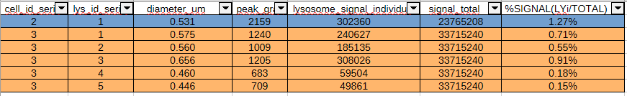



DATASETS 12H-5

Slide 20
12H-6

Slide 21
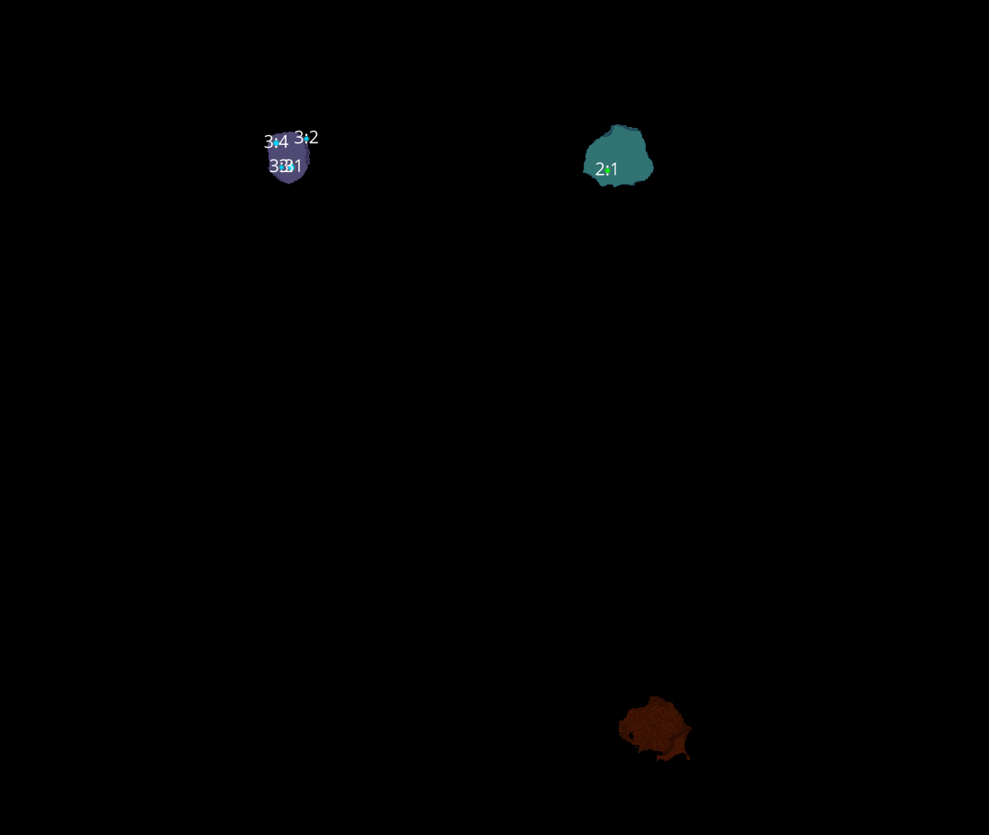
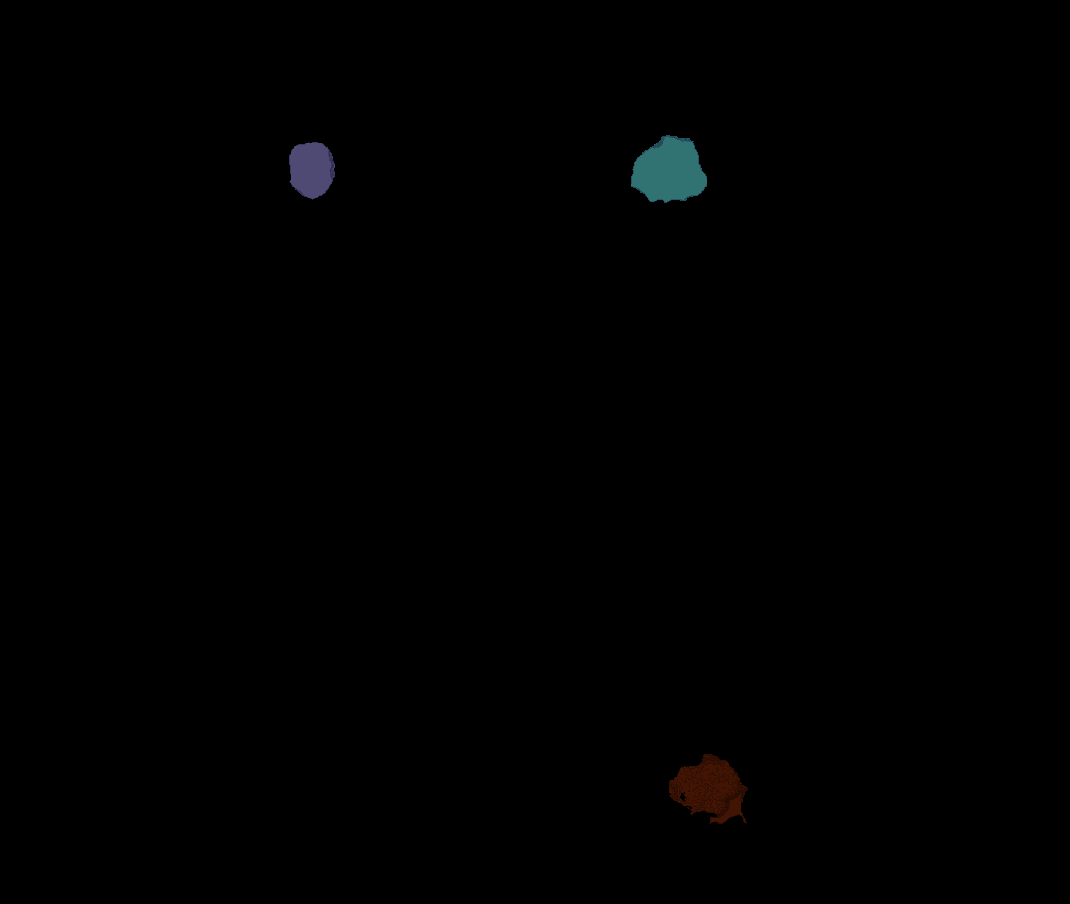
12H-6
Erosion = 10
Thresholding = 0.0045
margin um = 1.2
overlap alpha = 0.6
viz min voxels = 25000

Slide 22
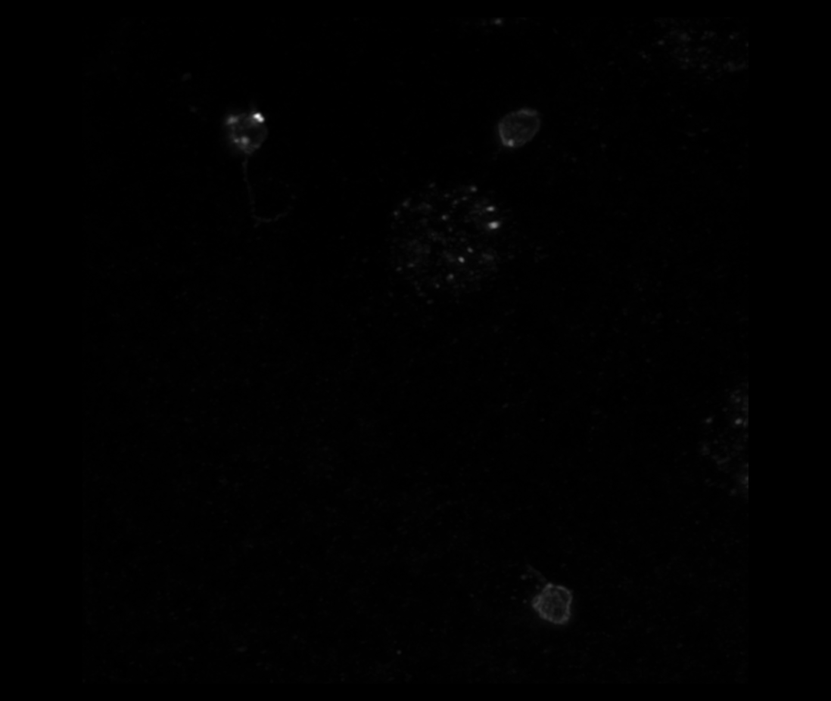
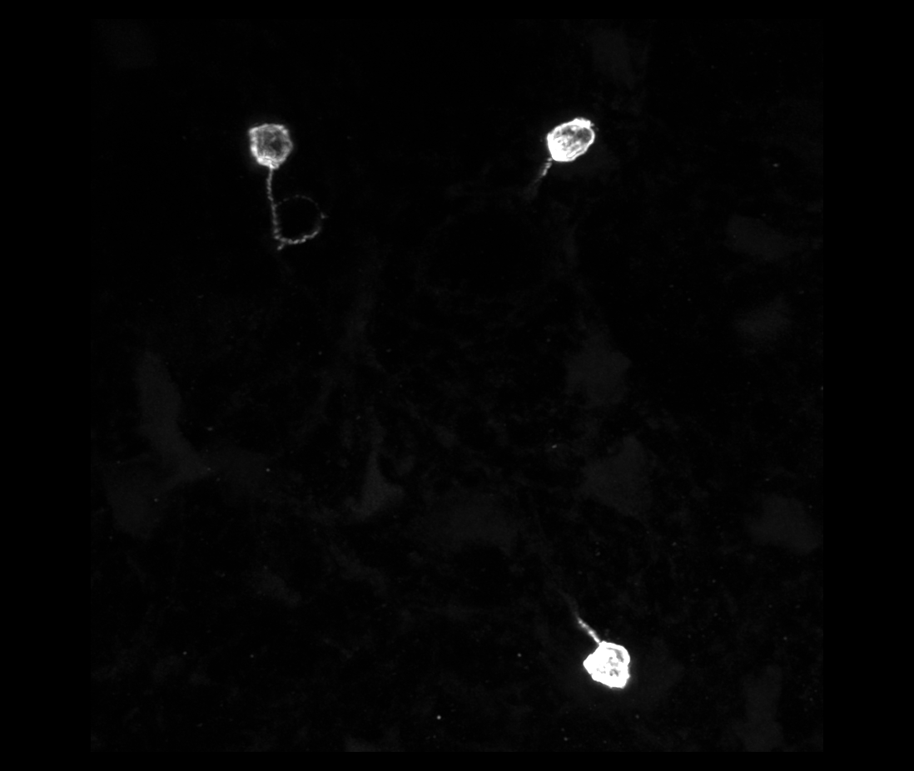
12H-6

Slide 23
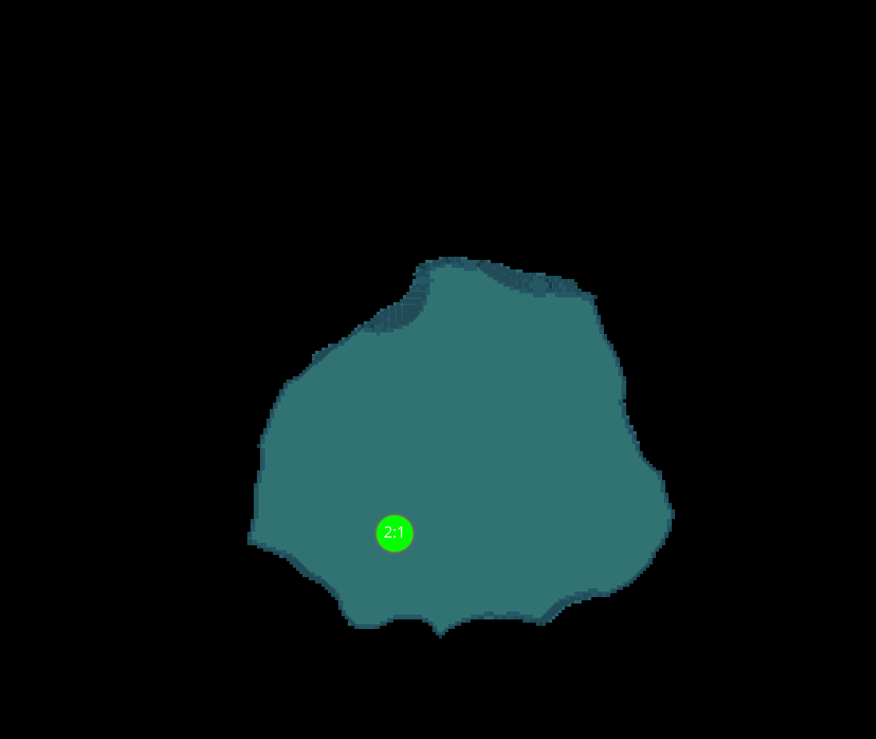

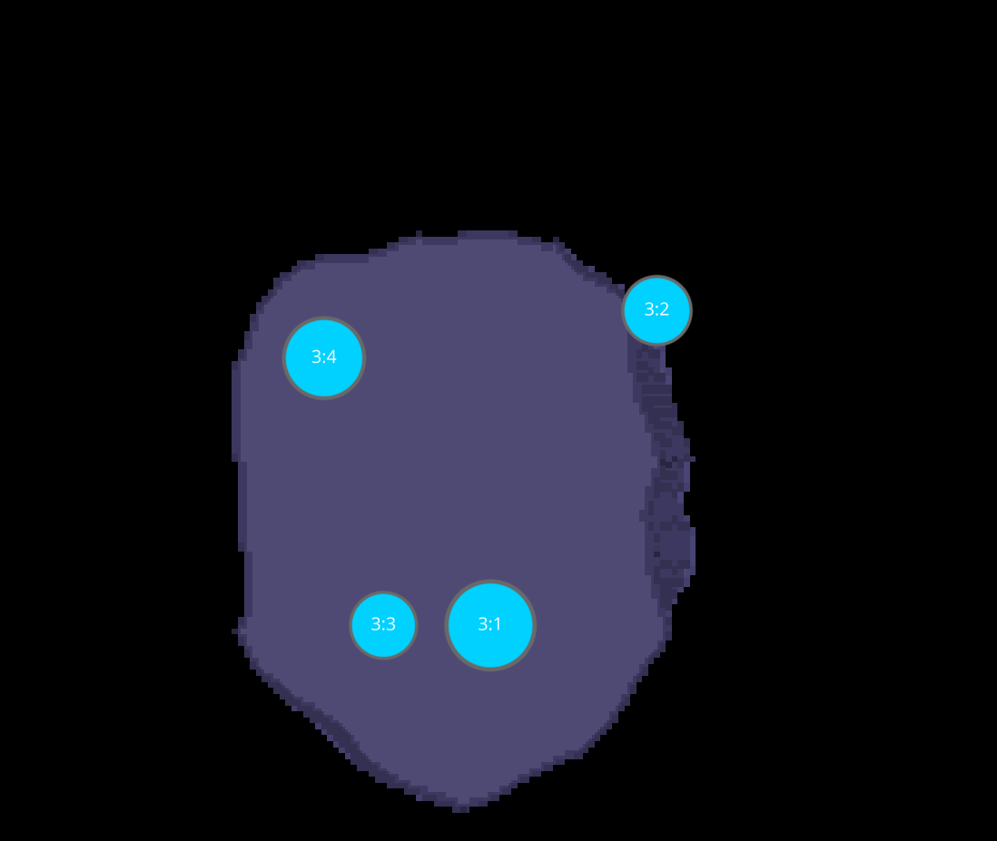
12H-6 CELLS
1
2
3

Slide 24
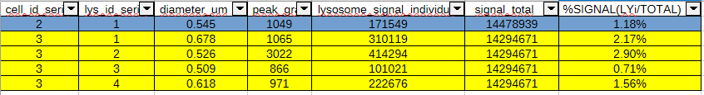



DATASETS 12H-6

Slide 25
18H-2

Slide 26
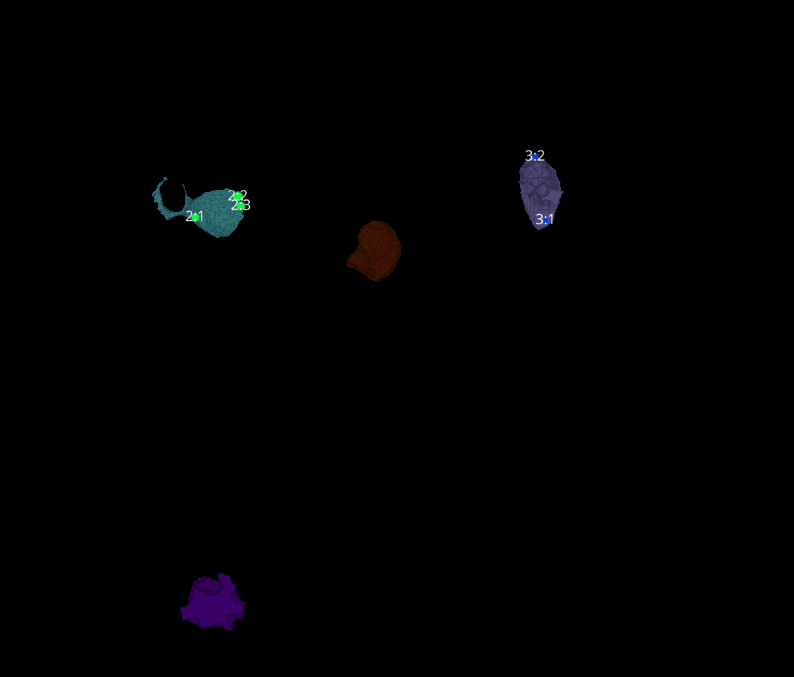
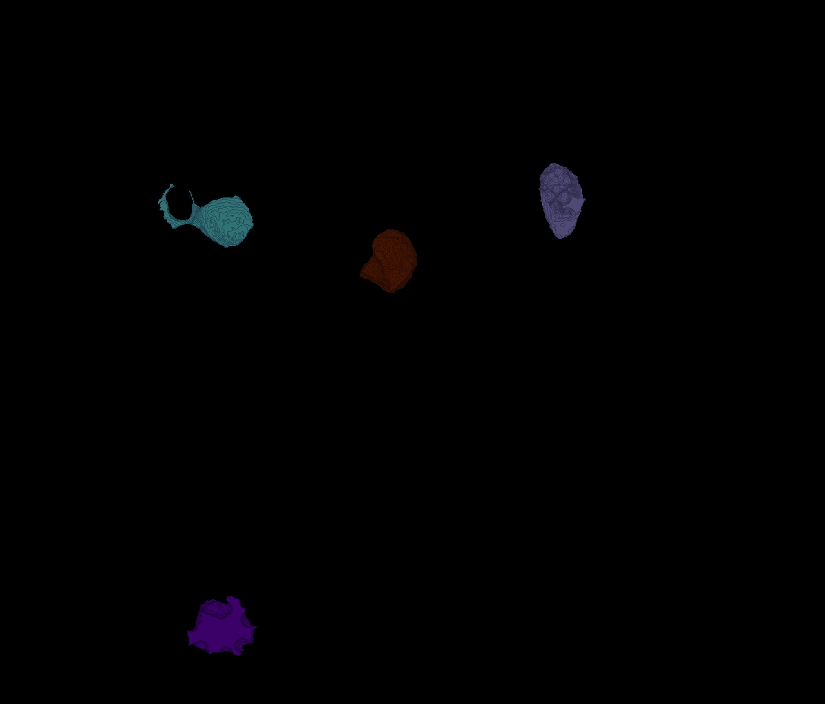
18H-2
Erosion = 8
Thresholding = 0.015
margin um = 1.2
overlap alpha = 0.6
viz min voxels = 10000

Slide 27
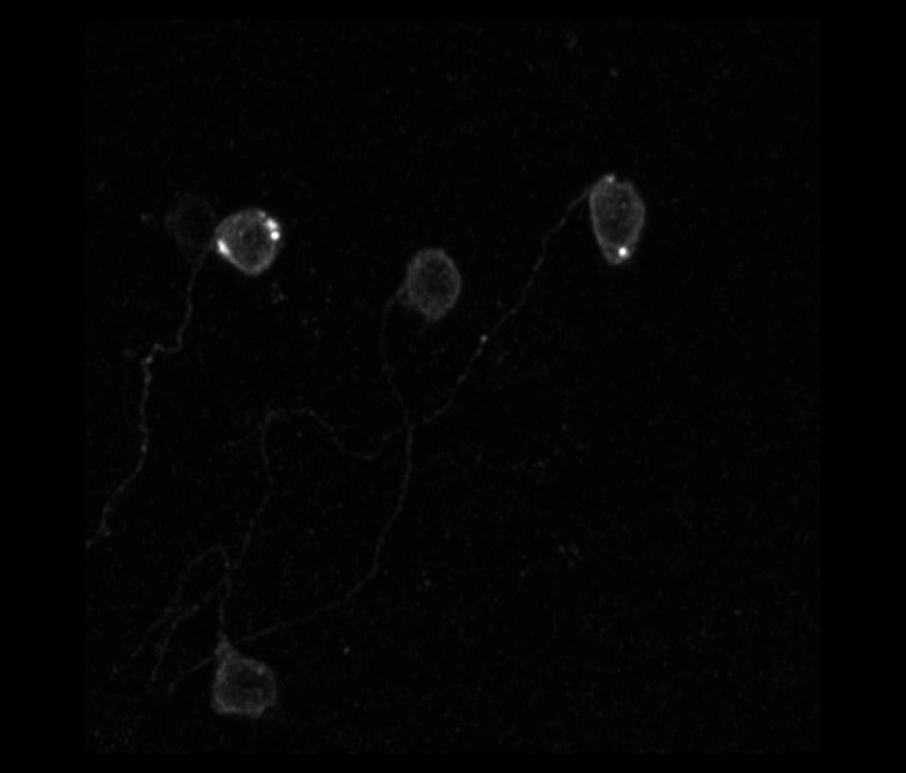
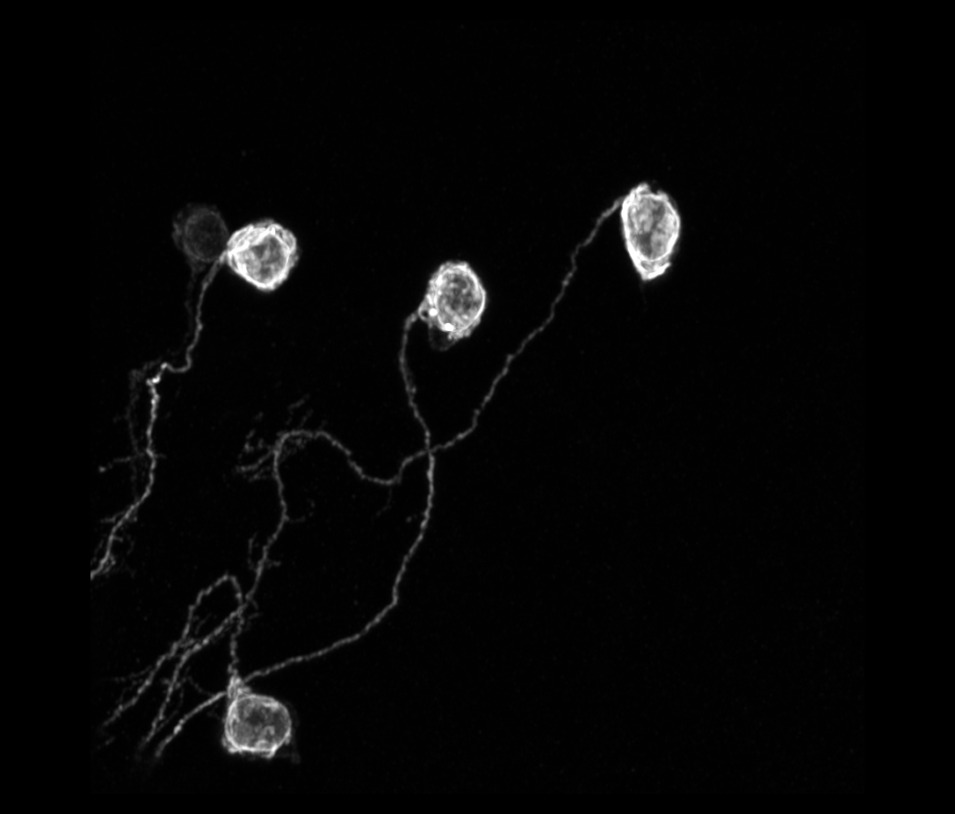
18H-2

Slide 28
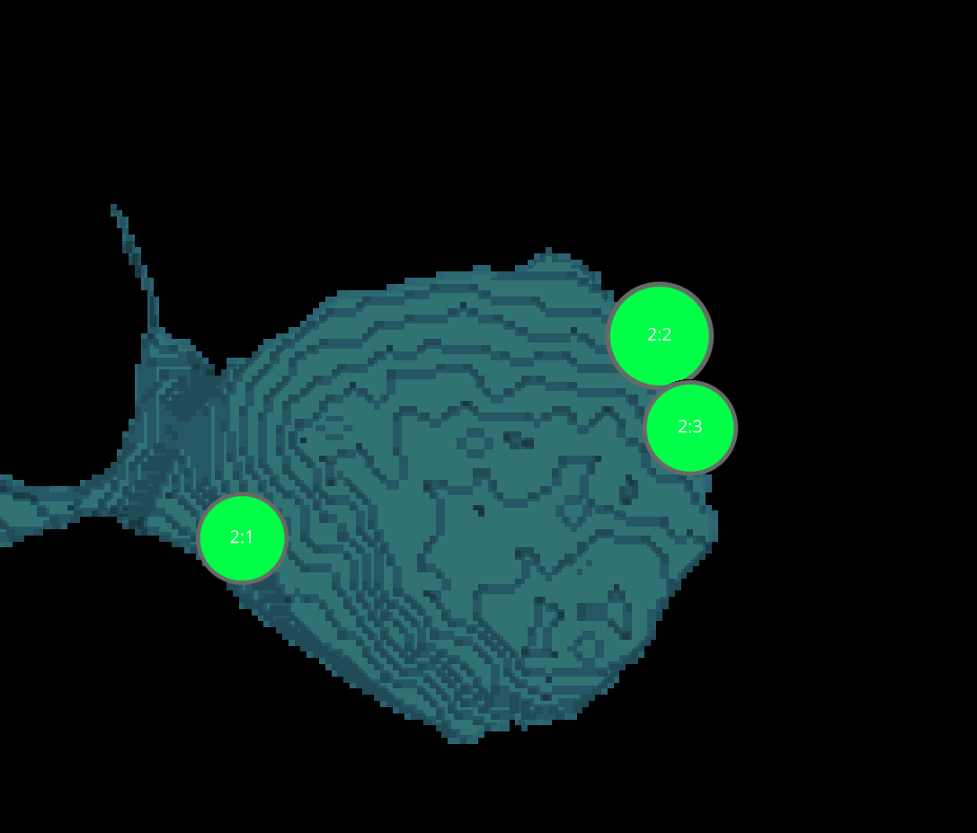
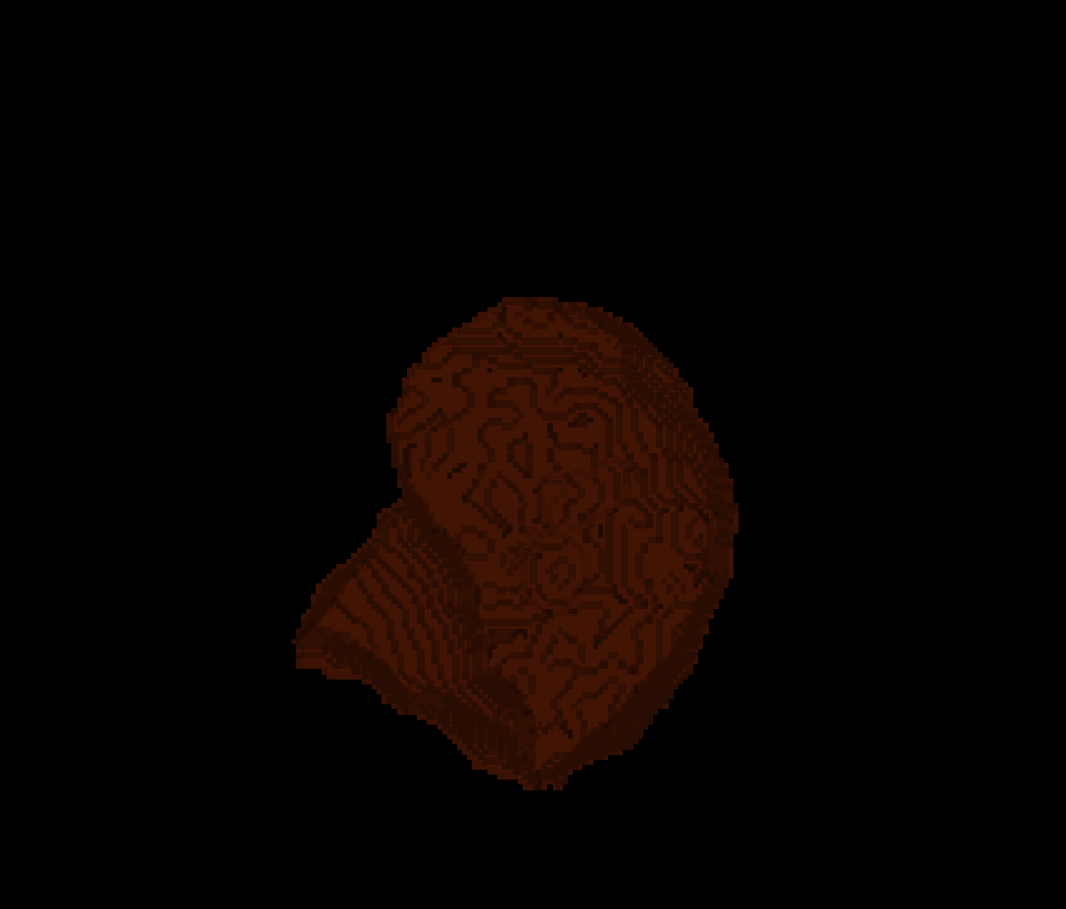
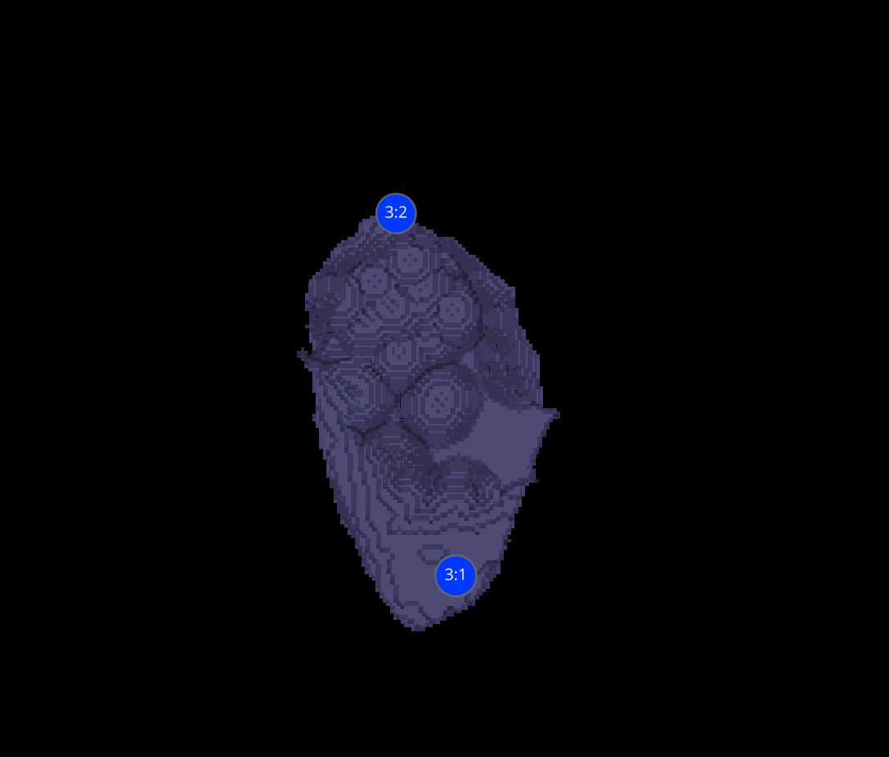
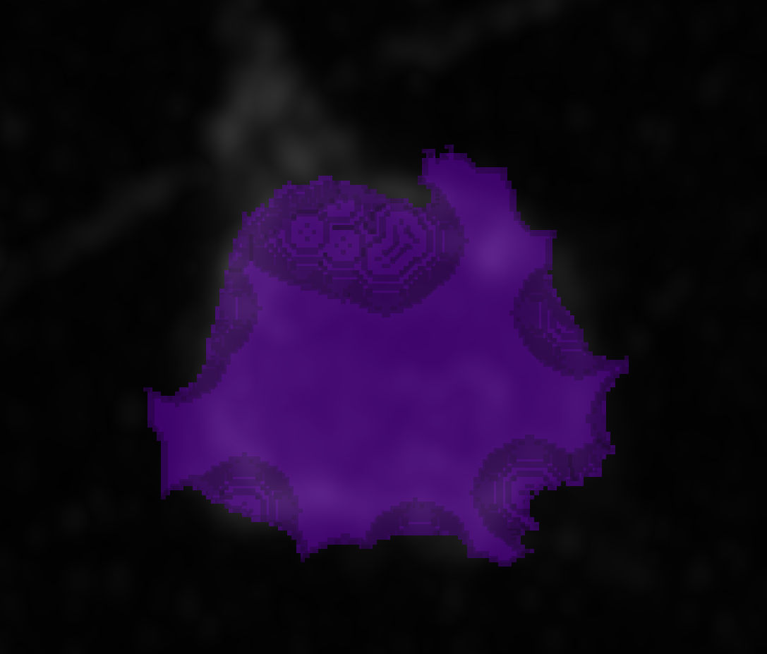
18H-2 CELLS
2
1
3
4

Slide 29
DATASETS 18H-2

Slide 30
18H-2 VAMP7

Slide 31
18H-2 VAMP7
Erosion = 4
Thresholding = 0.04
margin um = 1.2
overlap alpha = 0.6
viz min voxels = 20000

Slide 32
18H-2 VAMP7

Slide 33
18H-2 VAMP7 CELLS
1
2
3

Slide 34
DATASETS 18H-2 VAMP7

Slide 35
18H-3 VAMP7

Slide 36
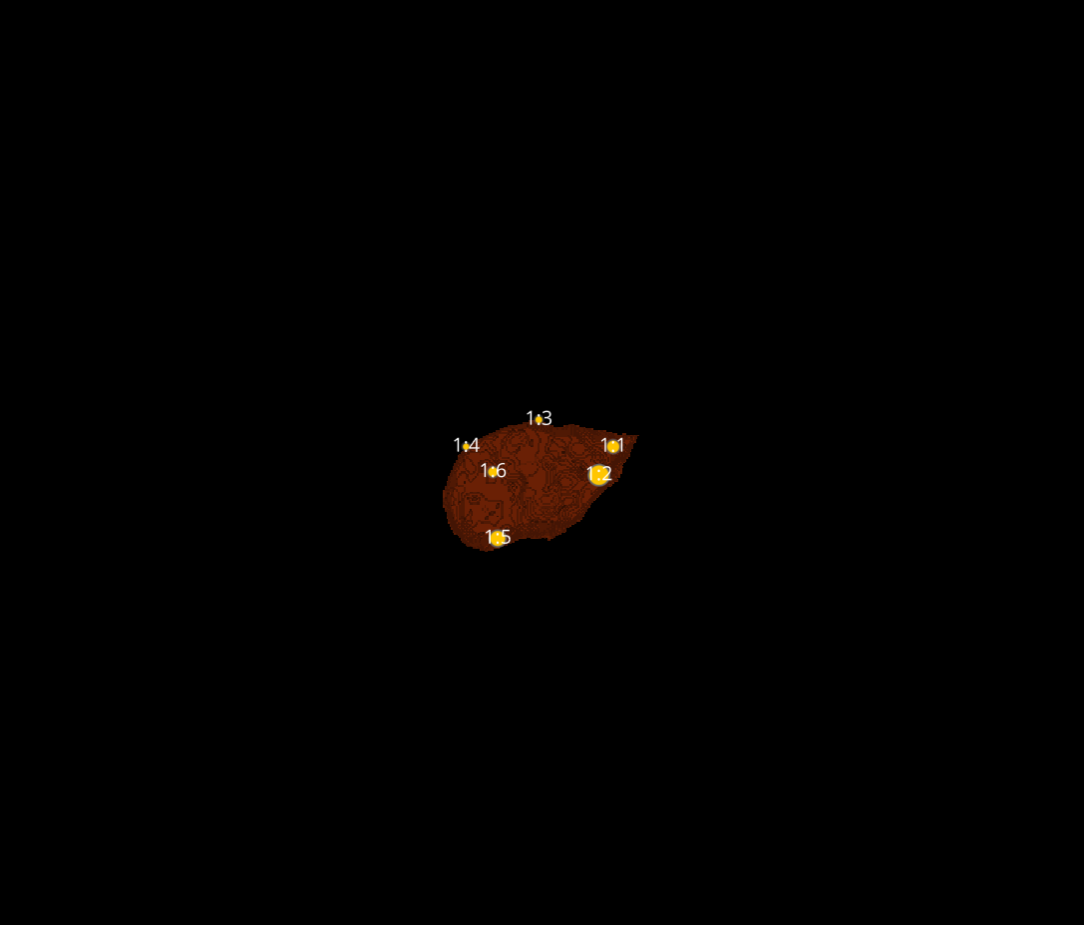

18H-3 VAMP7
Erosion = 4
Thresholding = 0.025
margin um = 1.2
overlap alpha = 0.6
viz min voxels = 10000

Slide 37
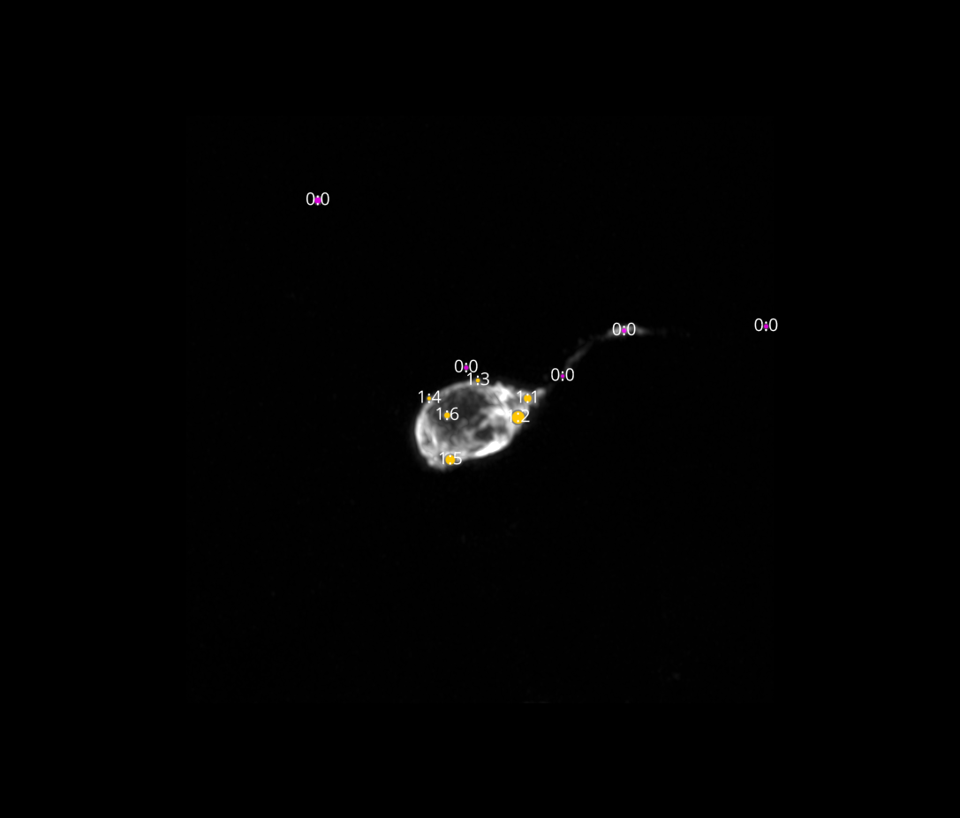
18H-3 VAMP7

Slide 38
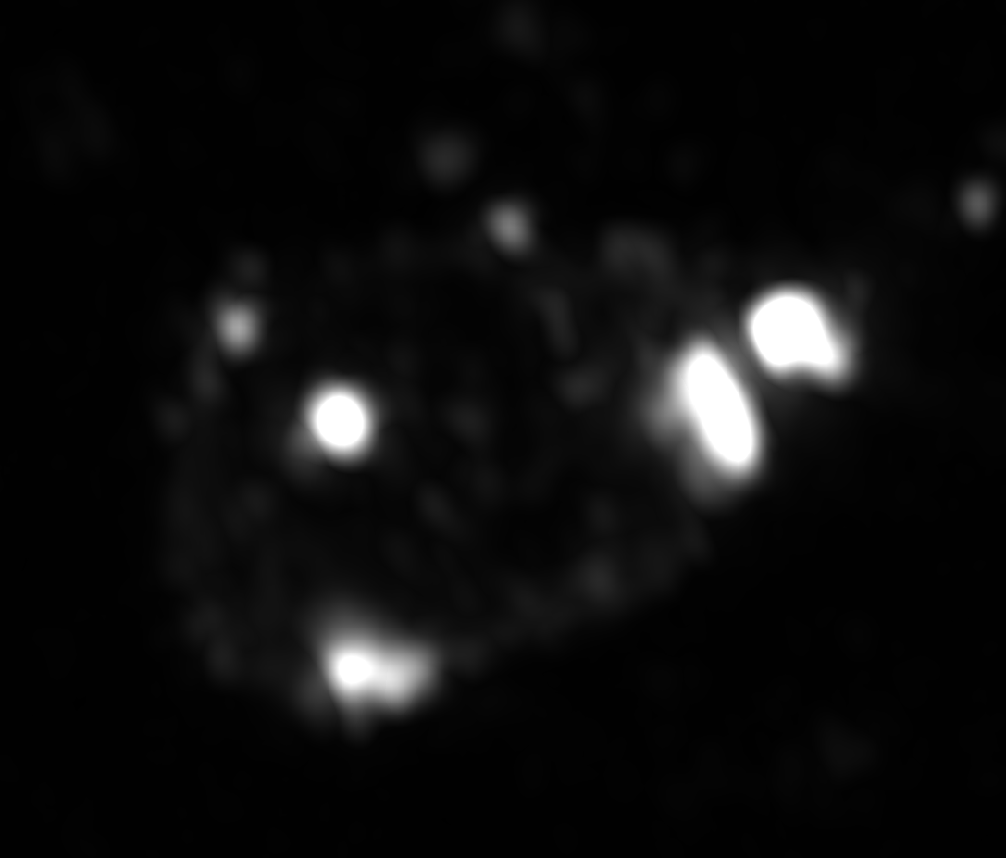
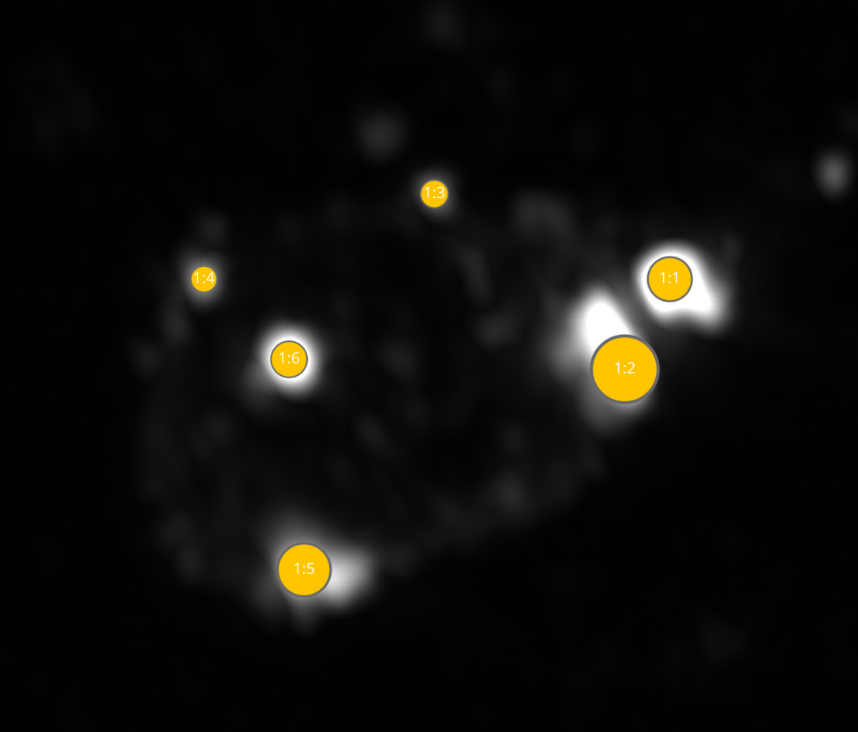
18H-3 VAMP7 CELL

Slide 39
DATASETS 18H-3 VAMP7

