Slide 1



Adventure Works Cycles financial performance
WORLD
USA

Slide 2
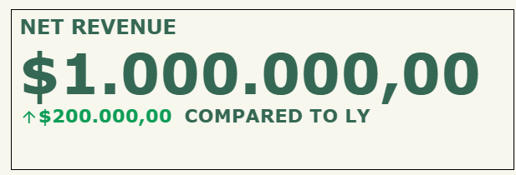
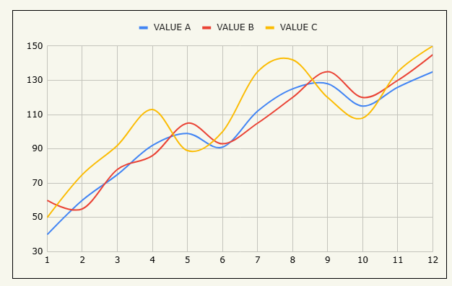
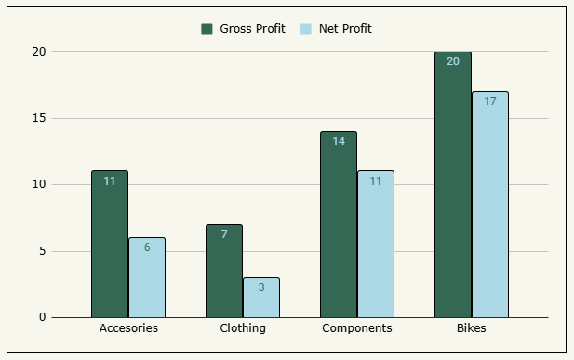
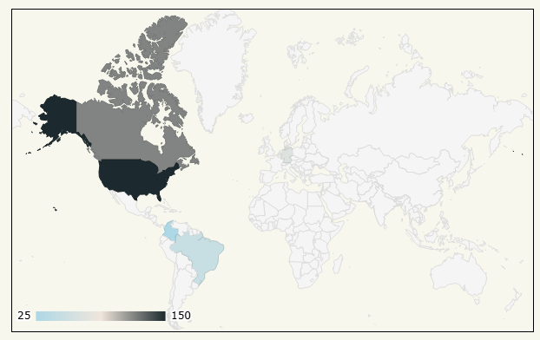

HOME
WORLD
USA
Year filter
TOTAL BILLING
UNIT SOLD
COGS
2024
$1.000.000
$1.000.000
$1.000.000
Subcategory filter
Subcat
Customers Worldwide
Net revenue Margin
Operating cost ratio vs LY
Gross Revenue Margin
COGS %

Slide 3
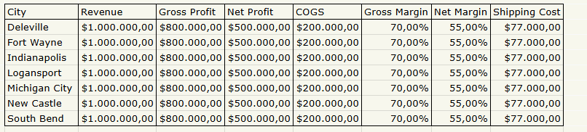
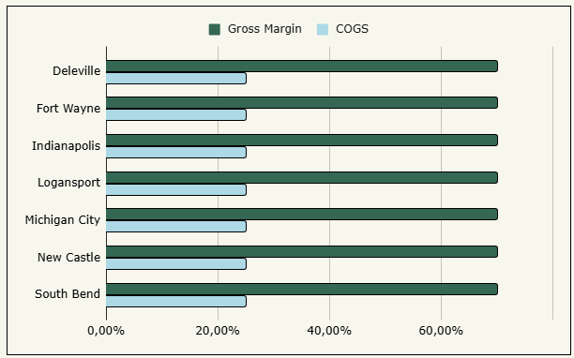
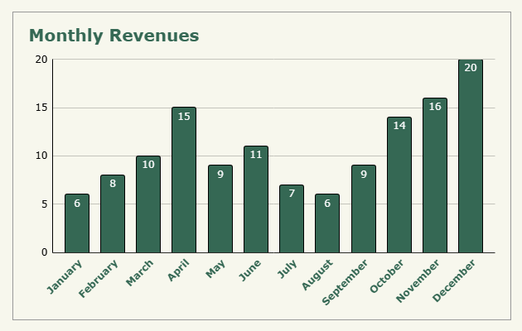
HOME
WORLD
USA
Year filter
TOTAL BILLING
UNIT SOLD
COGS
2024
$1.000.000
$1.000.000
$1.000.000
Category filter
Category
Subcategory filter
Subcat
State filter
Indiana
Gross revenue margin
COGS %

