Slide 1
Electrochemistry

Slide 2
Electrochemistry is the branch of physical chemistry that deals with the study of
electrical properties of solutions of electrolytes.
Conductors of electricity are of two types: Electronic and electrolytic. The electronic
conductors such as metals, where electricity is carried by electrons and the
electrolytic conductors for example, solutions of acids, bases and salts where the
electricity is carried by the ions.
The solutes which conduct electricity in solution are called electrolytes. The
capacity of conducting electricity is not the same for all electrolytes. Strong
electrolytes are those which are good conductors where as those which are poor
conductors are called weak electrolytes.

Slide 3
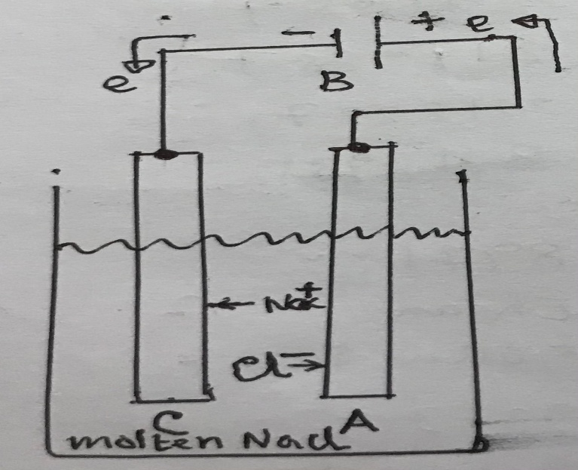
Electrolysis: The phenomenon of decomposition of compounds (electrolytes)
by an electric current passed through the substance in a dissolved or molten
state. Electrolytes are ionized into electrically charged ions, and when an electric
current is passed through them by means of conducting electrodes, give up their
electric charges, become uncharged atoms or groups and are either liberated or
deposited at the electrodes. An example of electrolysis of molten sodium chloride
is discussed below.

Slide 4
Electrode reactions:
2Na⁺ + 2e → 2Na (Reduction at cathode)
2Cl⁻ → Cl₂ + 2e (Oxidation at anode)
2Na⁺ + 2Cl⁻ → 2Na(l) + Cl₂(g) (Electrolysis product)
The overall reaction : 2NaCl(l) → 2Na(l) + Cl₂(g)
In case of electrolysis of water, the reactions are:
dissociation of water gives ; H₂O (acidic) → H⁺ + OH⁻
Electrode reactions: 4H⁺ + 4e → 4H (2H₂) (Reduction at cathode)
4OH⁻ → 2H₂O +4e + O₂ (Oxidation at anode)
4H₂O → 2H₂ (g)+ 2H₂O + O₂(g) (overall reaction)
Note: H⁺ + e → H ; OH⁻ + OH⁻ → H₂O + O⁼
H⁺ + e → H OH⁻ + OH⁻ → H₂O + O⁼
H + H → H₂(g) O⁼ + O⁼ → O₂ + 4e

Slide 5
Electrolytic conduction
Conductance of electrolytic solution
Conductance is nothing but the reciprocal of Resistance (R). Resistance is directly proportional to length and inversely proportional to area of cross-section i.e.
R ∞ l
∞ 1/a
R = k l/a k = specific resistance, l = length in cm, a = area
Conductance, L = 1/R = 1/k . a/l
L = Ls . a/l
or Ls = L. l/a =L.K, Ls is called specific conductance, K is called cell constant.
Ls = L ( K=1, when l is 1 cm and a is 1 sq cm) ; Ls=L.K or K=Ls/L
Specific conductance is the conductance of one cm cube of substance.
1 cm
1 cm
1 cm
Conductance(L) of this cube is nothing but the Specific conductance(Ls)

Slide 6
Units
Unit of Resistance : ohm
Unit of Conductance : ohm⁻ᶦ (mho or Siemens)
Specific Conductance : ohm ⁻ᶦ cm ⁻ᶦ or siemens cm⁻¹
Molar conductance : The conductance of a solution which contains one mole
of an electrolyte.
Ʌm = Ls x V V = volume in ml containing one mole
suppose, C moles present in 1000 ml of solution
1 mole present in 1000/C ml of solution
now 1 ml has a conductance of Ls, therefore, 1000/C ml will have conductance, (1000xLs)/C. (1000xLs)/C = Ʌ_{m} (molar conductance)
Unit of Ʌ_{m} = ohm ⁻ᶦ cm ⁻ᶦ cmᶟ mole ⁻ᶦ = ohm ⁻ᶦ cm² mole ⁻ᶦ
There is one more conductance called Equivalent conductance, Ʌ.
The conductance of a solution which contains one gram equivalent of an electrolyte. (1000xLs)/C = Ʌ (equivalent conductance)
The unit of Ʌ = ohm ⁻ᶦ cm² eqv ⁻ᶦ

Slide 7
Measurement and determination of conductances
Measure resistance (R) by using Wheatstone Bridge Principle.
Determine conductance (L), specific conductannce (Ls), molar conductance
and equivalent conductance (Ʌ) by using the respective relationships.
Conductance can also be measured directly by using the conductance bridge or conductivity meter.
C
I₁
R_{X} G R_{S} I₁
A R₁ R₂ B
I₂ D I₂
↑
I →
Wheatstone Bridge

Slide 8
R₁, R₂, R_{S} and R_{X} are the resistances at different arms. R_{X} is the unknown resistance. I is the current from the battery and I₁ and I₂ are the branch components. G is the galvanometer.
When galvanometer shows zero deflection the potentials at the points C and D are same. Hence,
R_{S}I₁ = R₂I₂ and
R_{X}I₁ = R₁I₂
dividing: R_{X}/R_{S} = R₁/R₂
therefore, R_{X} = R_{S}(R₁/R₂)
When unknown resistance R_{X} is determined, the conductance, specific conductance
and the molar/equivalent conductances can be calculated.

Slide 9
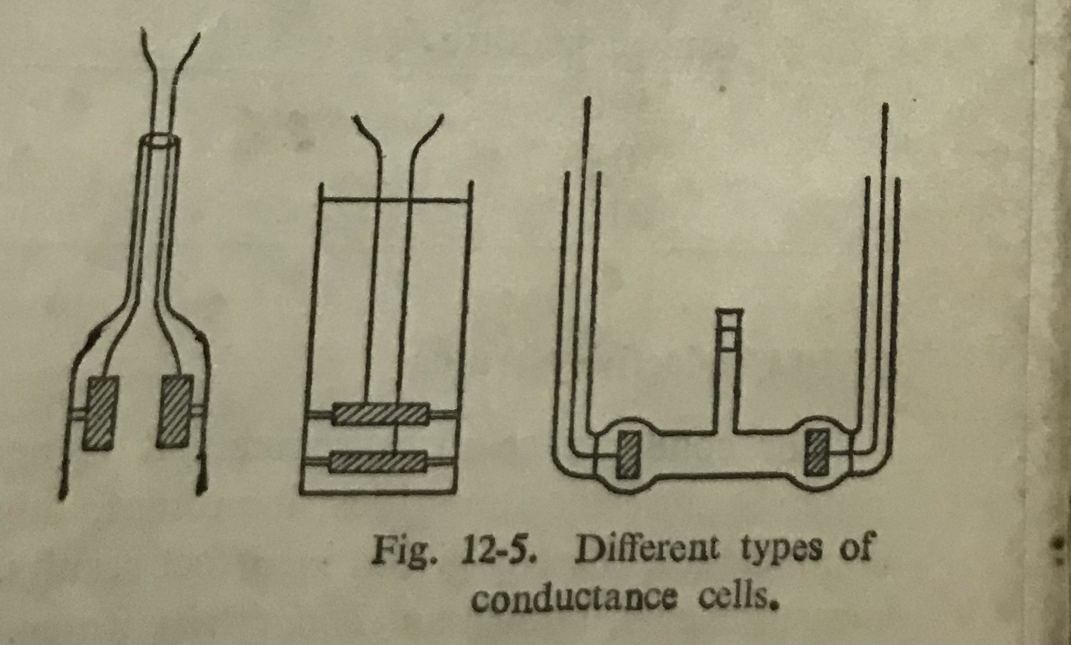

Slide 10
Variation of conductance with concentration
Kohlrausch was the first to point out that when Ʌ for strong electrolytes is
plotted against √C the curve approaches linearity in dilute solutions, i.e., in
dilute solutions
Ʌ = Ʌ₀ - b √C where b is a constant
ᴧ = 1000xLs/C
Ʌ₀ HCl and KCl are strong electrolytes.
CH₃COOH is a weak electrolyte
Ʌ₀
Ʌ HCl
KCl
CH₃COOH
√C
To obtain Ʌ₀ of an electrolyte, the curve may be extrapolated to √C=0. The
plot for weak electrolyte acetic acid does not approach linearity.

Slide 11
The decrease in equivalent conductances with increase in concentration for weak electrolytes can be explained as due essentially to a decrease in degree
of ionization. However, such an explanation cannot apply to strong elctrolytes.
The behavior of the plots in case of strong electrolytes can be explained
with the help of Interionic Attraction Theory of conductances. According
to this theory, two effects are mainly responsible for the decrease in equivalent conductances with the increase of concentration for strong electrolytes. The effects are:
i) the Relaxation effect of the ionic atmosphere due an applied potential;
ii) the Electrophoretic effect: moving ion experiences a viscous drag reduces
the mobilities of the ions and hence reduces their conductivities.
Considering all the factors the Kohlrauch’s equation was modified to
Debye-Hϋckel-Onsager equation of conductances.
Ʌ = Ʌ₀ - ( A + B Ʌ₀) √C
82.4 8.20x10⁵
A = (DT)^{1/2}η B= (DT)^{3/2}
D is dielectric constant of solvent, η is the viscosity of the medium and
T is the temperature.

Slide 12
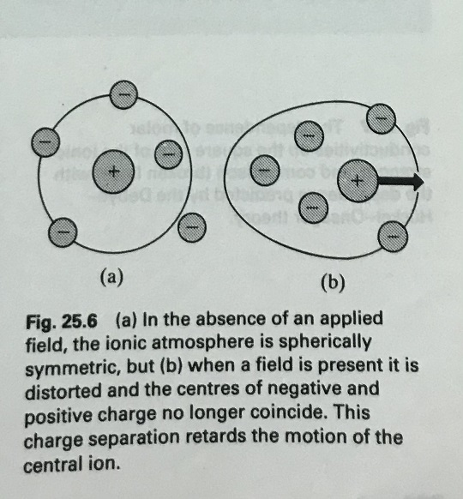
( Determination of Ʌ₀ for weak electrolytes)

Slide 13
Kohlrausch’s law of Independent migration of Ions
The law states that at infinite dilution, where dissociation for all electrolytes
is complete and where all interionic effects disappear, each ion migrates
independently of its co-ion, and contributes to the total equivalent conductance
of an electrolyte a definite share which depends only on its own nature and not
at all on that of the ion with which it is associated. If this is the case, then Ʌ₀ of
any electrolyte should be the sum of the equivalent conductances of ions
composing it, provided, of course, that the solvent and temperature are same.
Ʌ₀ is the equivalent conductance at infinite dilution, λ°₊ and λ°₋ are the ionic
conductances of positive and negative ions respectively at infinite dilution.
Ʌ₀ = λ°₊ + λ°₋
For example : Ʌ₀(HCl) = λ°(H⁺) + λ°(Cl⁻)
Ʌ₀(CH_{ɜ}COOH) = λ°(H⁺) + λ°(CH_{ɜ}COO⁻)

Slide 14
Determination of Ʌ₀ for acetic acid (CH_{ɜ}COOH) by using Kohlrausch’s law:
Ʌ₀(CH_{ɜ}COOH) can not be determined by extrapolation method. Using the
values of Ʌ₀(HCl), Ʌ₀(NaCl), and Ʌ₀(NaOOCCH_{ɜ}), Ʌ₀(CH_{ɜ}COOH), is determined by the following way:
Ʌ₀(CH_{ɜ}COOH) = Ʌ₀(HCl) + Ʌ₀(NaOOCCH_{ɜ}) - Ʌ₀(NaCl),
[ λ°(H⁺) + λ°(Cl⁻) + λ°(Na⁺) + λ°(CH_{ɜ}COO⁻) - λ°(Na⁺) - λ°(Cl⁻) ]
= Ʌ₀(CH_{ɜ}COOH)
HCl, NaOOCCH_{ɜ} and NaCl are the strong electrolytes, their equivalent
conductances at infinite dilution can be easily determined by extrapolation method.

Slide 15
Effect of other factors on conductivity
The conductance of all electrolytes increases with temperature. the variation of
ᴧ₀ with temperature can be represented by the equation,
ᴧ₀ = ᴧ₀ _{(25C)} [1+β(t-25), β is a constant, for salts β is usually 0.022-0.025,
for acids 0.016 – 0.019. Similar behavior is exhibited by equivalent conductances
of strong electrolytes in finite concentration. For weak electrolytes, the variation
of ᴧ with temperature is not so regular,for these not only to the velocities of ions
and the interionic force change, but also the degree of dissociation. There is
another factor, dielectric constant of the solvent. The dielectric constant of water
is 78.6 at 25⁰C, where as for methyl alcohol, ethyl alcohol and dioxane are,
respectively, 31.5, 24.3 and 2.2. As the dielectric constant of the solvent is lowered, the conductance of an electrolyte decreases. In solvents having dielectric constant less than 25, the dependence of molar conductance on the concentration becomes complex. To explain these in general it has been suggested that in these solvents ions exhibit a tendency to associate into complexes such as A⁺B⁻, A⁺B⁻A⁺, B⁻A⁺B⁻ which decrease the number of ions available to carry current and hence the conductance.

Slide 16
Application of Conductance Measurement ( conductometric titration)
conductance(L)
volume of alkali added (ml)
1 3 2 4
1. Titration curve for strong acid vs strong alkali ; HCl + NaOH = NaCl + H₂O
2. Titration curve for strong acid vs weak alkali ; HCl + NH₄OH = NH₄Cl + H₂O
3 . Titration curve for weak acid vs strong alkali ; CH₃COOH + NaOH=NaOOCCH₃+ H₂O
4 . Titration curve for weak acid vs weak alkali; CH₃COOH + NH₄OH=NH₄OOCCH₃+ H₂O

Slide 17
Conductometric Titration for a Mixture of a strong acid and a weak acid with a
strong alkali :
NaOH
HCl
conductance CH_{ɜ}COOH HCl+ NaOH = NaCl + H₂O
(L)
CH₃COOH + NaOH=NaOOCCH₃+ H₂O
volume of alkali added (ml)
(HCl + CH_{ɜ}COOH) mixture with NaOH

