Slide 1


Columbia's Final Mission
Leadership and Management [GELM-275]
Submitted To : Maj Gen Md Anwarul Islam
Presenters:
Aunindya Prosad Saha 202114014
Anika Tasnim 202214008
Maisha Nanjeeba 202214033
Mausin Jannat Mritteka 202214034
Md. Nahul Rahman 202214049
Mst. Nusrat Jahan 202214072
Sumaiya Yeasmin 202214102
Suraiya Mustari Labiba 202214103

Slide 2

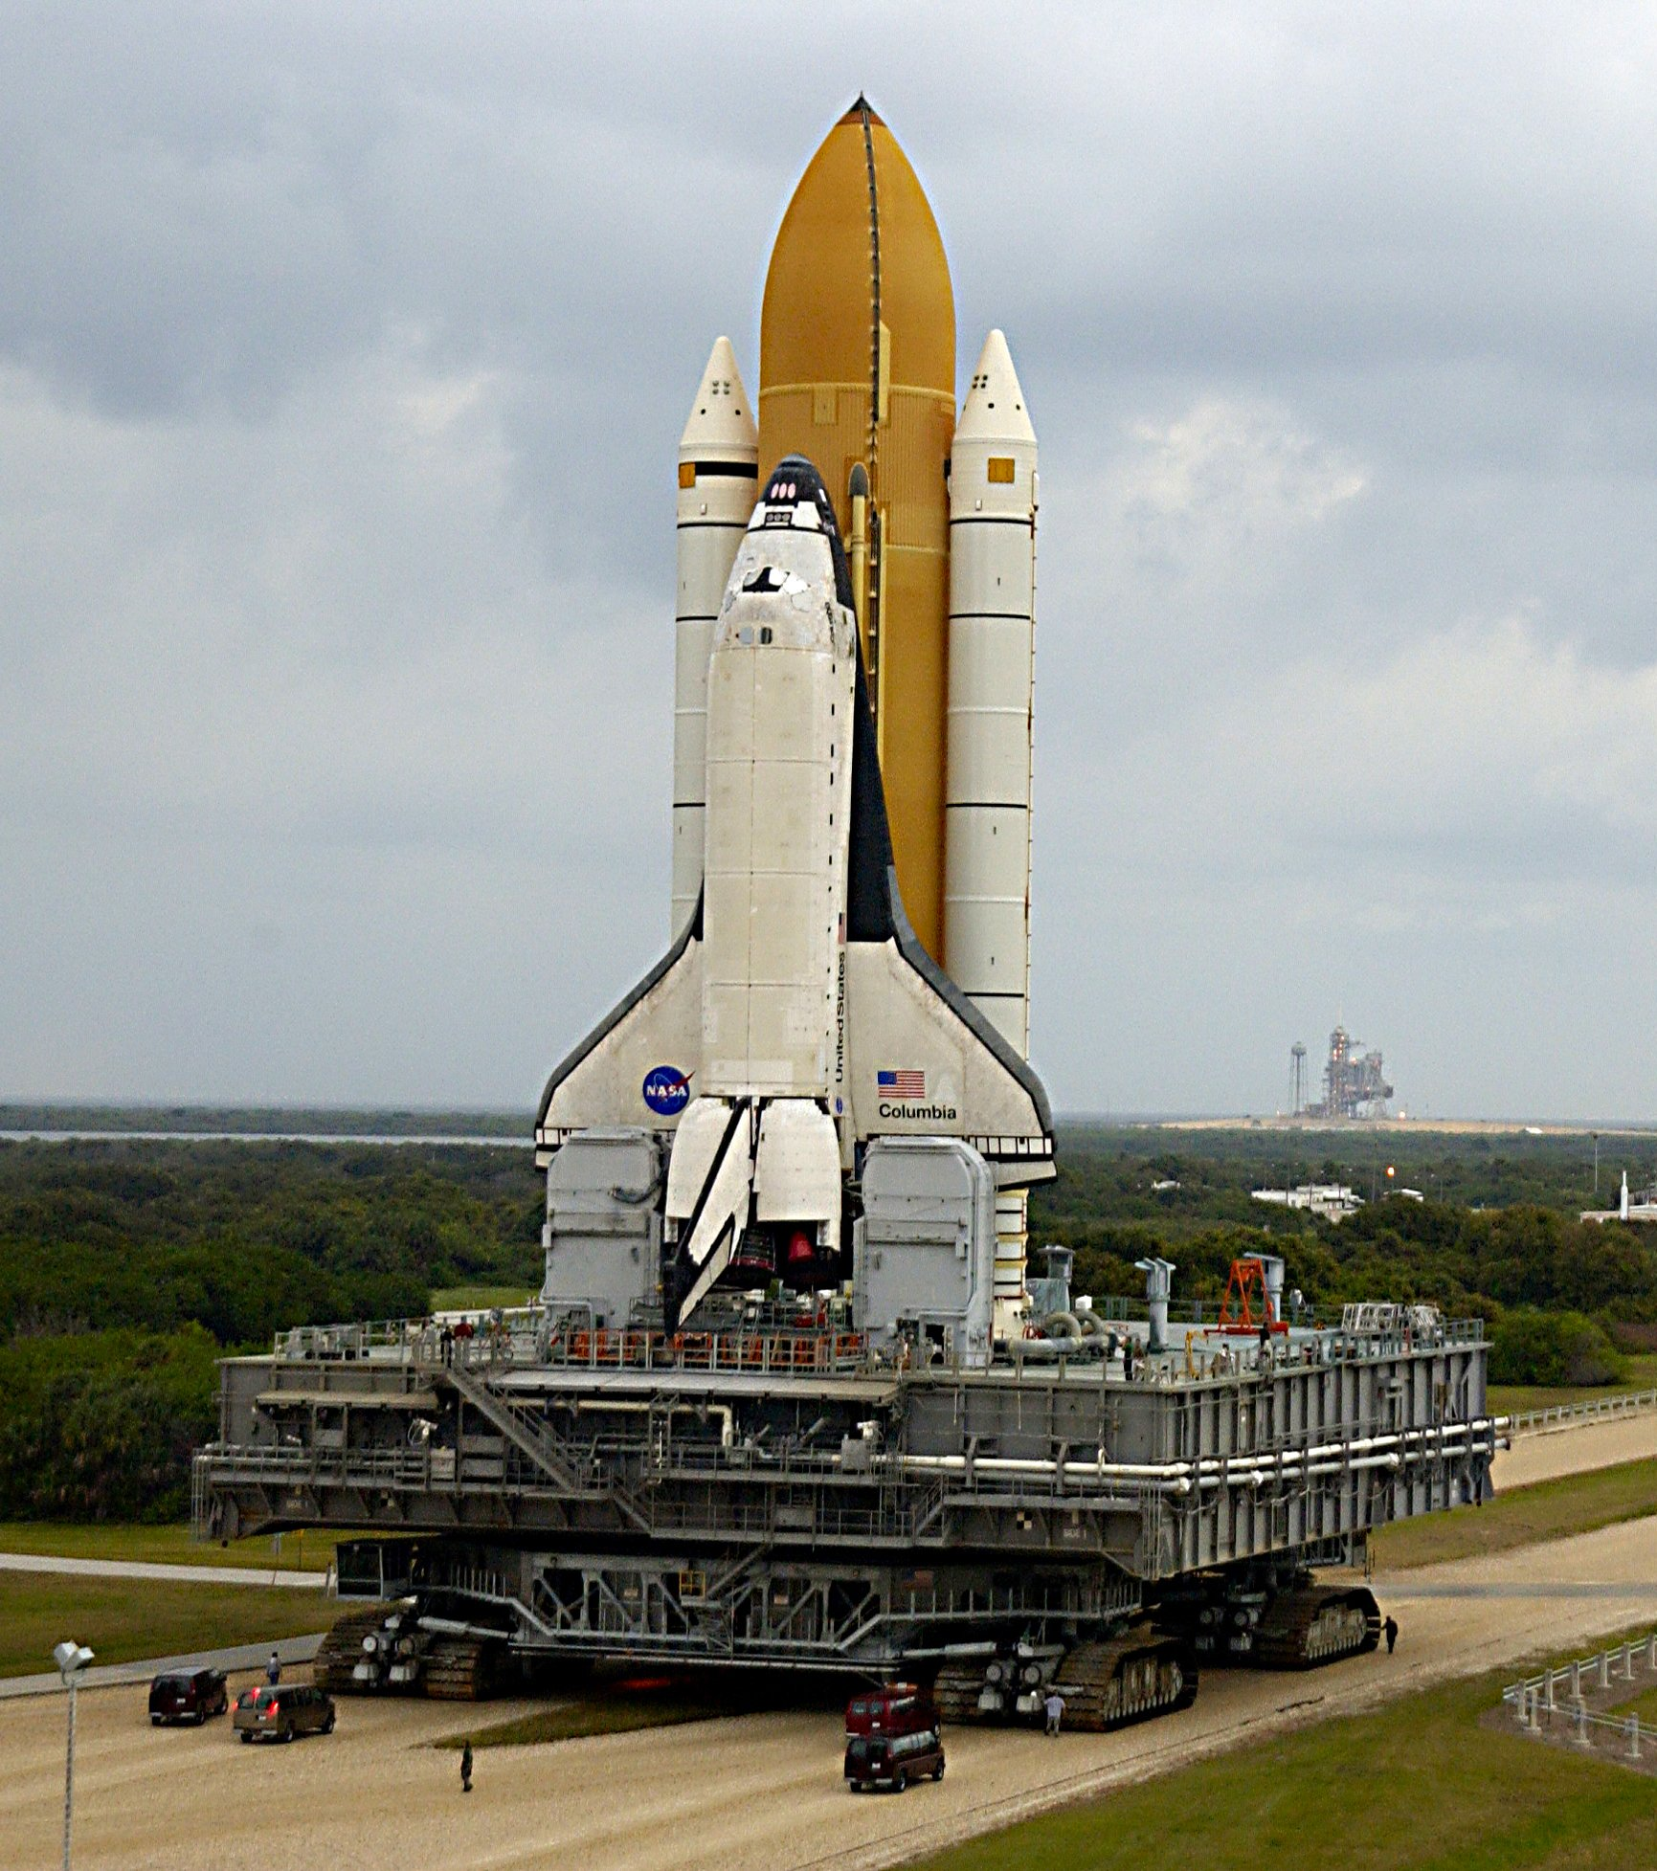
Introduction
- On February 1, 2003, the Columbia Mission tragically lost all seven crew members.
- NASA's maiden shuttle, the Columbia, conducted its final microgravity research mission.
- STS-107 was launched from Kennedy Space Center on January 16, 2003, with a seven-member crew.
- The mission aimed for research, Earth observation, technology development, medical studies, and education.
- Initially planned for 16 days, the mission ended tragically as the Columbia disintegrated over Texas.
- This catastrophe led to an extensive NASA inquiry, as crew unaware due to assessment failure and concluding the space shuttle era.

Slide 3
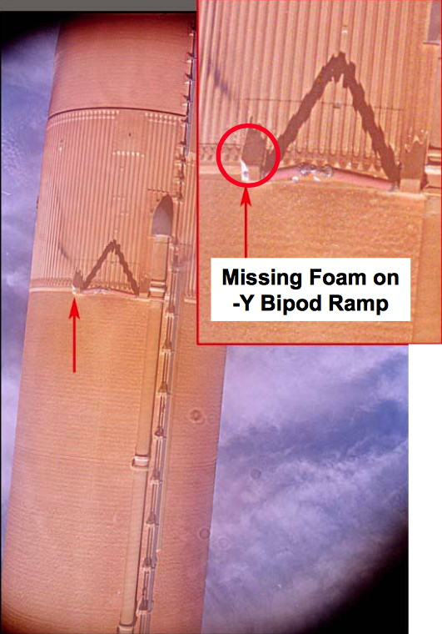
Scientific Reasons for Columbia Failure
- Foam debris strike: On January 16, 2003, a foam piece approximately 21x15x6-8 inches broke off the fuel tank, striking the orbiter's left wing's leading edge near RCC panels.
- Wing damage assessment: NASA initially viewed foam strike footage as safe. Despite efforts to gather data, damage to the wing's leading edge remained uncertain.
- Re-entry and breakup: During re-entry on February 1, 2003, intense heat and aerodynamic stress damaged the left wing's RCC panels, causing structural failure and the orbiter's tragic loss.
- Investigation and findings: The Columbia Accident Investigation Board (CAIB) attributed critical damage to the left wing's leading edge, compromising thermal protection, to the launch foam strike.

Slide 4
Leadership Failure of Columbia
Crisis Management
Effective Communication
Risk Management
Effective Leadership
Crisis management encompasses preparation, response, and recovery from crises. The Columbia disaster necessitated coordinated action from NASA and stakeholders demanding understanding, decisive action, and effective communication
The Columbia disaster emphasized the significance of effective communication. Clear channels and protocols are essential in high-risk situations, ensuring accurate and timely information sharing. The absence of such communication between NASA and the Columbia crew contributed to the tragedy.
NASA's failure to assess risks led to the catastrophe, stressing the need for effective risk management and a safety commitment. That demands preparation, response, and recovery, as demonstrated in the Columbia disaster. Effective crisis management relies on situational understanding, decisive action, communication.
communication, risk management, and safety commitment are vital. Leaders should admit and learn from mistakes, inspiring and guiding others toward common goals. NASA's leadership failed in addressing risks associated with the foam strike. Effective leadership entails risk-taking, tough decision-making, and accountability.

Slide 5
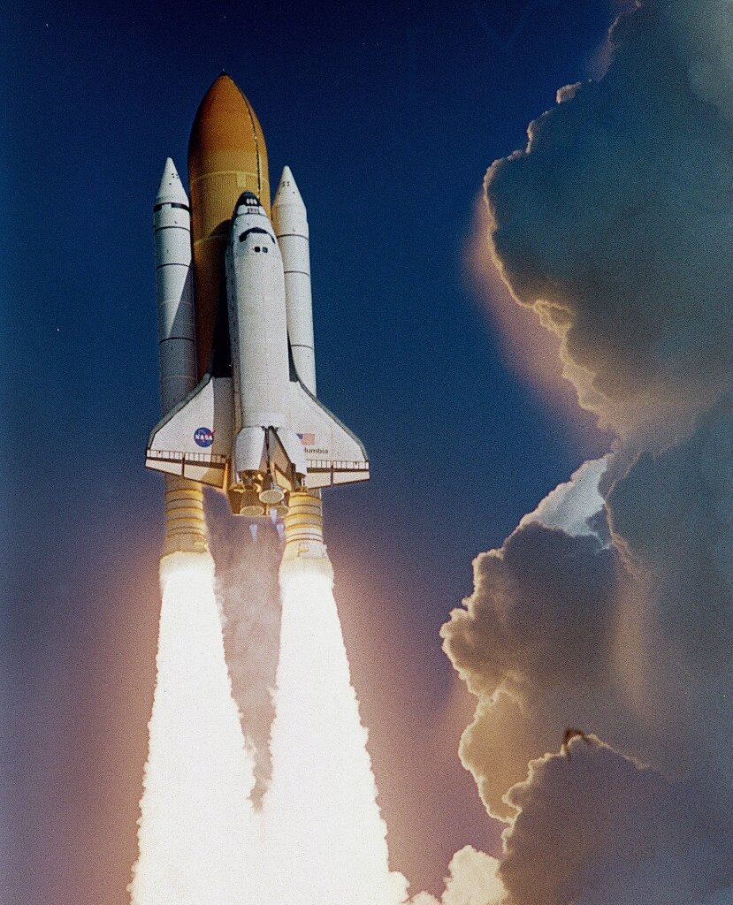

Recommendations
Promote a culture of safety
Foster collaboration for decisions
Develop robust contingency plans
Perform in-orbit inspections
Address foam debris
Analyze Real-time data
Adapt Organization
Deploy crew escape systems
Explore rescue and repairs
Presentation Title

Slide 6
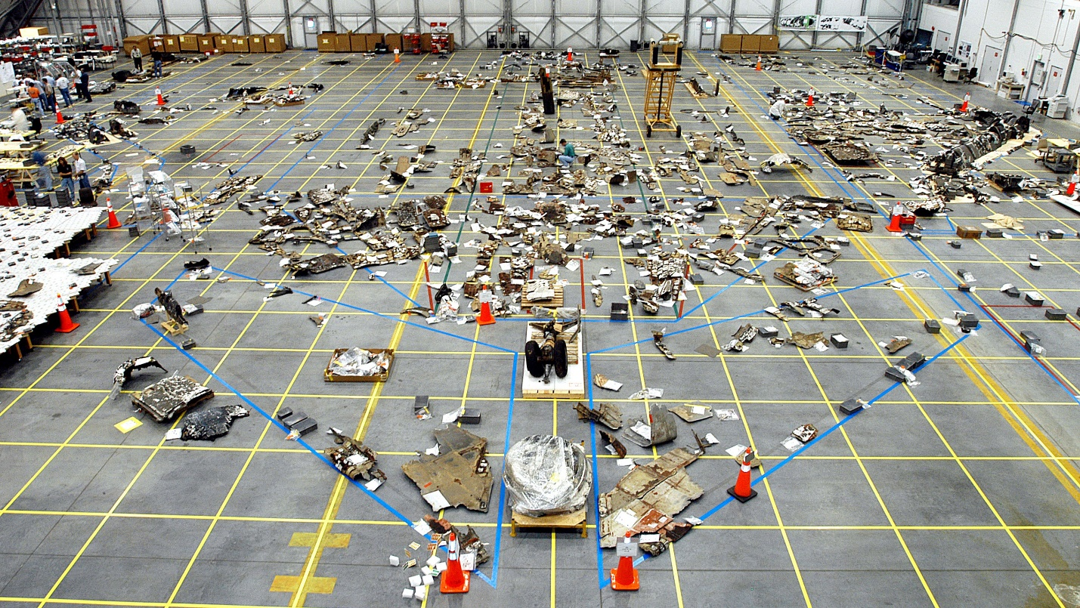

Conclusion
• Columbia tragedy offers vital leadership insights.
• Strong leadership needs communication, risk control, and safety commitment.
• Learning from errors and pursuing constant improvement is crucial.

Slide 7




Thank you
Do you have any questions?

