Slide 1
SUBSTITUTION REACTION

Slide 2
Definition
Definition: A substitution reaction is a type of chemical reaction where an atom or functional group of a molecule is replaced by another atom or functional group.

Slide 3
Examples: CH₃Cl reacted with a hydroxy ion (OH⁻) will produce CH₃OH and chlorine. This substitution reaction replaces the chlorine atom on the original molecule with the hydroxy ion.
CH₃Cl + (−OH) —→ CH₃OH(methanol) + Cl-

Slide 4
Types of Substitution Reaction
1. Nucleophilic substitution
2. Electrophilic substitution
3. Radical substitution
4. Organometallic substitution

Slide 5

Nucleophiles
A nucleophile is a species (an ion or a molecule) which is strongly attracted to a region of positive charge in something else.
Nucleophiles are either fully negative ions, or else have a strongly - charge somewhere on a molecule. Common nucleophiles are hydroxide ions, cyanide ions, water and ammonia.

Slide 6
Definition of Nucleophilic substitution reaction

Slide 7
Nucleophilic substitution is a reactions in which
an Electron rich nucleophile bonds with the
positively charged atom or a group of atoms to
replace a leaving group.
The positive or partially positive atom is referred
to as an electrophile.

Slide 8
Nucleophilic substitution reactions are of two types namely:
S_{N}1 reaction
S_{N}2 reaction

Slide 9
The nucleophilic substitution reaction - an S_{N}2 reaction

Slide 10
In the S_{N}2 reaction, S stands for substitution,
N for nucleophilic, and the 2 is for bimolecular,
because the initial stage of the reaction involves
two species, – the haloethane and the Nu⁻ ion.

Slide 11
S_{N}2 Reaction Mechanism

Slide 12
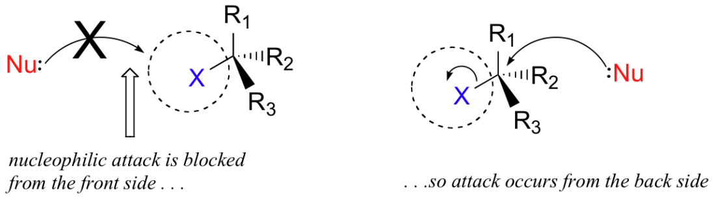
In S_{N}2 reaction, the nucleophile, being an electron-rich species, must attack the electrophilic carbon from the back side relative to the location of the leaving group. Approach from the front side simply doesn't work: the leaving group - which is also an electron-rich group - blocks the way.

Slide 13
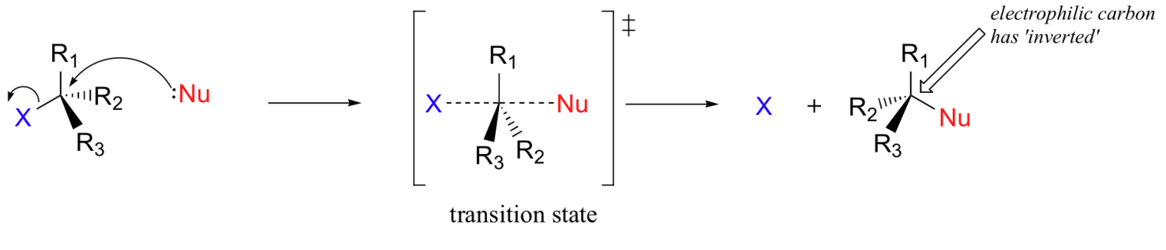
The result of this backside attack is the inversion of the molecule; i.e. the molecule is turned inside out. At the transition state, the electrophilic carbon and the three 'R' substituents all lie on the same plane.

Slide 14
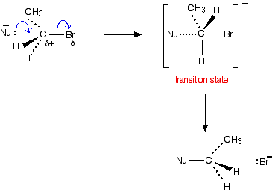
EXAMPLE
Nucleophilic attack on primary halogenoalkane

Slide 15
The Nu⁻ ion approaches the (+) carbon from the
side, away from the bromine atom. The large
bromine atom hinders attack from its side and,
being (-), would repel the incoming Nu⁻ anyway.

Slide 16
The Nu⁻ is half attached to the carbon, and the C-Br
bond is half way to being broken. This is called
a transition state. It isn't an intermediate. It can't
be isolated – even for a very short time. It's just the
mid-point of a smooth attack by one group and the
departure of another.

Slide 17
The nucleophilic substitution reaction - an S_{N}1 reaction

Slide 18
In the S_{N}1 reaction, "S_{N}" stands for nucleophilic
substitution and the "1" represents the fact that
the rate-determining step is unimolecular that is
only one species involved.

Slide 19
The reaction involves a carbocation intermediate
and is commonly seen in reactions of secondary
or tertiary alkyl halides under strongly basic
conditions, or, under strongly acidic conditions,
with secondary or tertiary alcohols.

Slide 20
The S_{N}1 mechanism

Slide 21
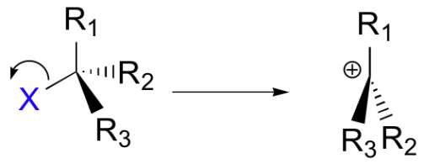
In 'S_{N}1' mechanism the reaction happens in two stages. In this mechanism the C-X bond breaks first, before the nucleophile approaches:

Slide 22
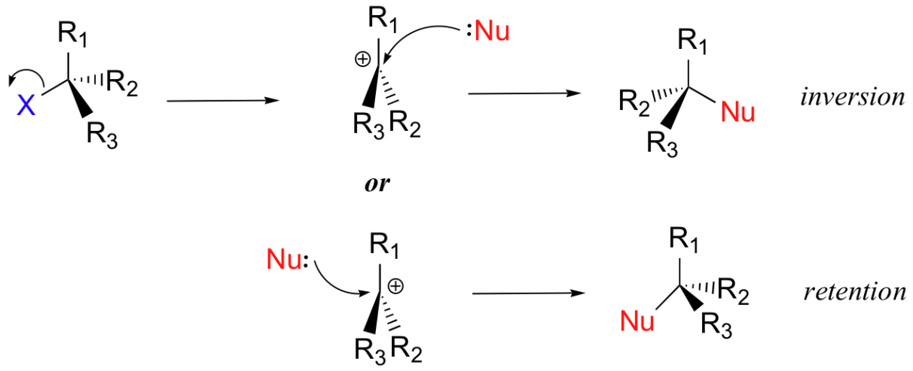
This results in the formation of a carbocation: because the central carbon has only three bonds, it bears a formal charge of +1. In the second step of this two-step reaction, the nucleophile attacks the carbocation to form a new bond

Slide 23
In the S_{N}1 reaction shown above, the leaving group dissociates completely from the carbon before the nucleophile begins its attack.
Because the leaving group is no longer in the molecule, the nucleophile is free to attack from either side of the carbocation electrophile.

Slide 24
EXAMPLE
Nucleophilic substitution in tertiary halogenoalkanes

Slide 25

A tertiary halogenoalkane has three alkyl groups
attached to the carbon with the halogen on it.
These alkyl groups can be the same or different.
(CH₃)₃CBr - 2-bromo-2-methylpropane is taken as
example.

Slide 26

In this reaction at first, the halogenoalkane ionises
to give a carbocation and a bromide ion.

Slide 27

Once the carbocation is formed, it react with a nucleophile
Nu⁻.

Slide 28
Why don't tertiary halogenoalkanes use the S_{N}2 mechanism?

Slide 29
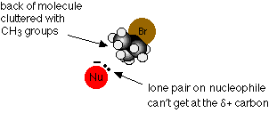
when a nucleophile attacks a primary halogenoalkane, it
approaches the + carbon atom from the side away from
the halogen atom. With a tertiary halogenoalkane, this
is impossible. The back of the molecule is completely
cluttered with CH₃ groups.
Since any other approach is prevented by the bromine atom, the reaction has to go by an alternative mechanism.

Slide 30
The S_{N}1 mechanism tends to dominate when the central carbon atom is surrounded by bulky groups because such groups sterically hinder the S_{N}2 reaction. The resultant carbocation is also stabilized by both inductive effect and hyperconjugation from attached alkyl groups.

Slide 31
Why don't primary halogenoalkanes use the S_{N}1 mechanism?

Slide 32

If a primary halogenoalkane did use this
mechanism, the first step would be, for example:

Slide 33
A primary carbocation would be formed, and
this is much more energetically unstable than
the tertiary one formed from tertiary
halogenoalkanes - and therefore much more
difficult to produce.

Slide 34
This instability means that there will be a very
high activation energy for the reaction involving
a primary halogenoalkane. The activation energy
is much less if it undergoes an S_{N}2 reaction - and
so that's what it does instead.

Slide 35
Electrophilic substitution

Slide 36
Electrophile
An electrophile is a electron loving species, it itself is positively charged and wants to stabilize itself by making a sigma bond with the electron rich carbon centre.
Electrophiles are involved in electrophilic substitution reactions and particularly in electrophilic aromatic substitutions.

Slide 37
Electrophilic substitution reaction
Electrophilic substitution reactions are chemical reactions in which an electrophile displaces a functional group in a compound, which is typically, but not always, a hydrogen atom. The Electrophilic reactions occur mostly with the aromatic compounds.

Slide 38
Electrophilic aromatic substitution
Electrophilic aromatic substitution is an organic reaction in which an atom that is attached to an aromatic system (usually hydrogen) is replaced by an electrophile. The arene system contains an electron rich C=C system which react with electrophiles via a substitution pathway (to preserve aromaticity) what is known as electrophilic aromatic substitution (EArS).

Slide 39

Electrophilic aromatic substitution reactions are characteristic of aromatic compounds, and are important ways of introducing functional groups onto benzene rings.

Slide 40
Specific aromatic substitution reaction

Slide 41

Friedel-Crafts Alkylation of Benzene
Stepwise Mechanism is as follows:

Slide 42

Step 1: The alkyl chloride reacts with the Lewis acid (AlCl₃) to form a complex that makes the alkyl group more electrophilic.

Slide 43

Step 2: The electrophilic alkyl complex reacts with the pi-electrons of the nucleophilic C=C of the arene, displacing aluminum tetrachloride. This step destroys the aromaticity of the benzene ring and the cyclohexadienyl intermediate is formed.

Slide 44

Step 3: Removal of the proton from the carbon bearing the alkyl group and reforms the C=C and the aromatic system.

Slide 45

Friedel-Crafts Acylation of Benzene
Stepwise Mechanism is as follows:

Slide 46

Step 1: The acyl chloride reacts with the Lewis acid (AlCl₃) to form a complex that makes the alkyl group more electrophilic.

Slide 47

Step 2: The electrophilic acyl complex reacts with the pi-electrons of the nucleophilic C=C of the arene, displacing aluminum tetrachloride. This step destroys the aromaticity of the benzene ring and affords the cyclohexadienyl intermediate.

Slide 48

Step 3: Removal of the proton from the carbon bearing the acyl group and reforms the C=C and the aromatic system.

