Slide 1
STARTING with UNITY

Slide 2
What is unity?
Unity is a cross-platform game engine developed by Unity Technologies,
The engine has since been gradually extended to support a variety of desktop, mobile, console, augmented reality, and virtual reality platforms.
The engine can be used to create three-dimensional (3D) and two-dimensional (2D) games, as well as interactive simulations.

Slide 3
Why Unity in automotive?
Unity Industry offers a comprehensive range of tools and solutions that enable developers to construct personalized real-time 3D encounters for AR, VR, mobile, desktop, and web applications.
With Unity, we create and deploy immersive, real-time interactivity to accelerate team collaboration and speed our pace of development and innovation.

Slide 4
Unity in HMI
Embedded HMIs should be beautiful, responsive, and intuitive user experiences, which is what Unity is made for. With Unity's real-time 3D solutions
Everyone can collaborate and iterate on a live experience early in the production pipeline and make use of technologies not available in traditional toolchains

Slide 5
Learning links for Unity
https://learn.unity.com/course/create-with-code
https://www.youtube.com/watch?v=E6A4WvsDeLE&list=PLzDRvYVwl53vxdAPq8OznBAdjf0eeiipT
https://learn.unity.com/
https://www.udemy.com/courses/search/?src=ukw&q=Unity

Slide 6
Use Cases in MBRDI
Unity is partnering with Mercedes-Benz AG to power the infotainment domain of its new operating system, which will roll out across its vehicle portfolio. The first vehicles running MB.OS and Unity hit the road in 2024.
TOP 5 Use-Cases - NTG7 UI-2020 - Confluence (mercedes-benz.com)

Slide 7
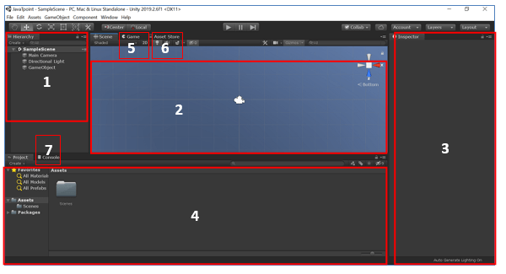
Unity IDE
The main editor window is made up of tabbed windows that can be rearranged, detached, grouped, and docked.
We can say that the editor looks different from one project to the next, and one developer to the next, depending on personal preference and what type of work you are doing.

Slide 8
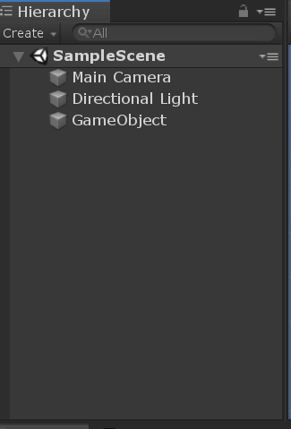
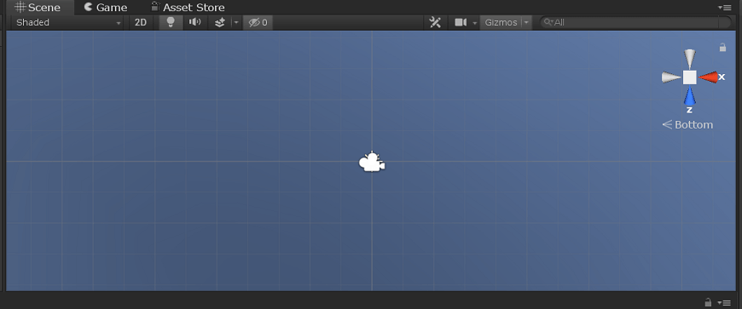
Unity IDE details
1. Hierarchy Window
2. Scene View

Slide 9
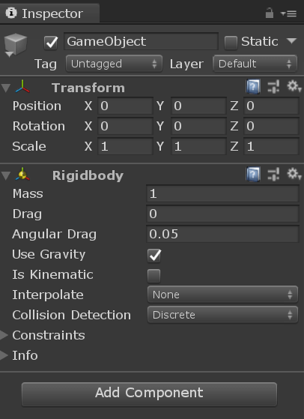
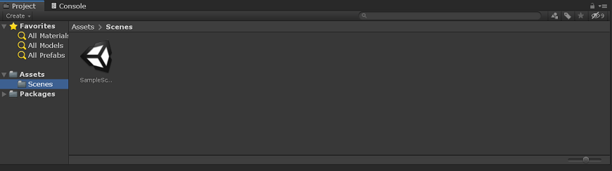
Unity IDE details
3. Inspector Window
4. Project Window

Slide 10
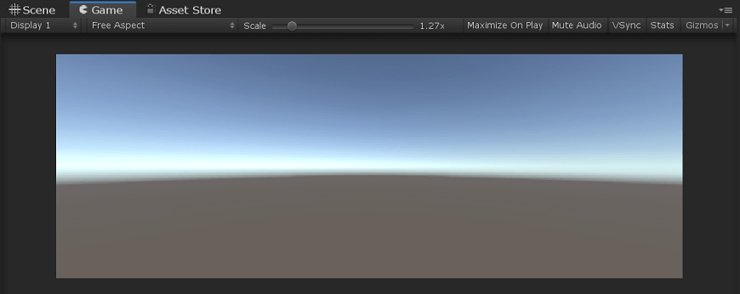
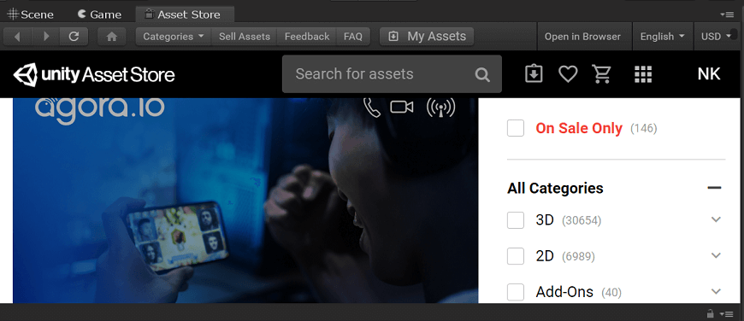
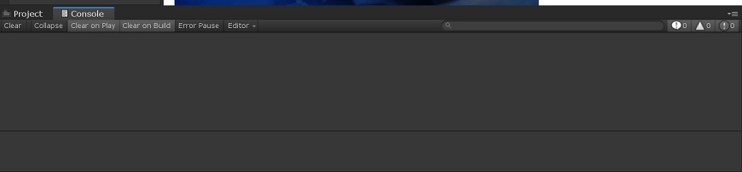
5. Game Window
6. Asset Store
7. Console Window

Slide 11
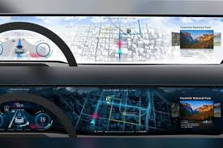
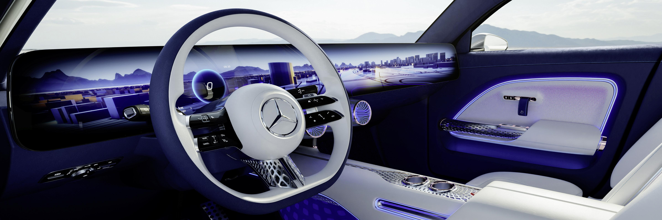
Images of unity in MB

