Slide 1
Deep Learning (CS324)
9. Generative adversarial networks*
Prof. Jianguo Zhang
SUSTech
*Based on http://www.deeplearningbook.org chapter 20.10.4 + various sources cited in the slides

Slide 2
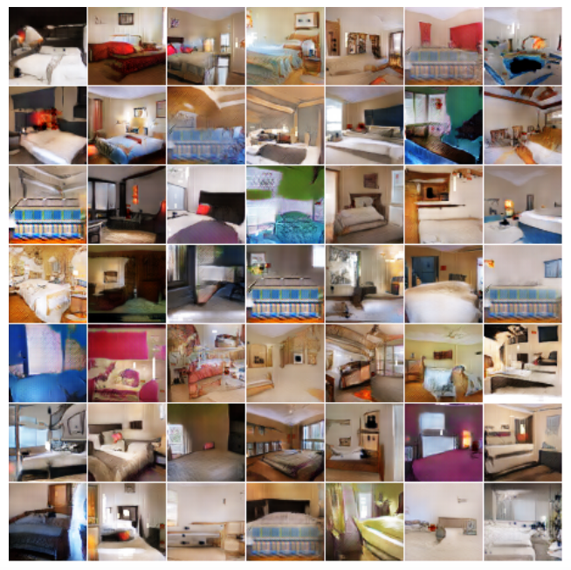
Generative tasks
Generation (from scratch): learn to sample from the distribution represented by the training set
Unsupervised learning task

Slide 3
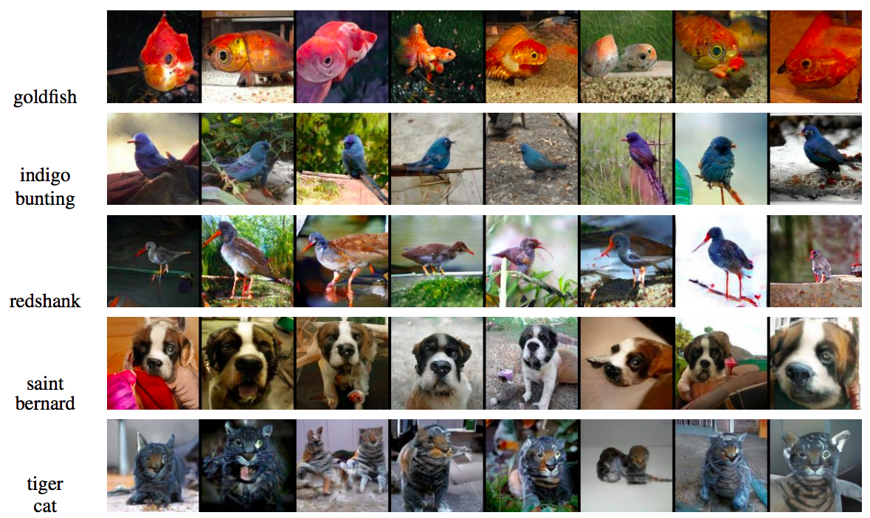
Generative tasks
Conditional generation
Figure source

Slide 4
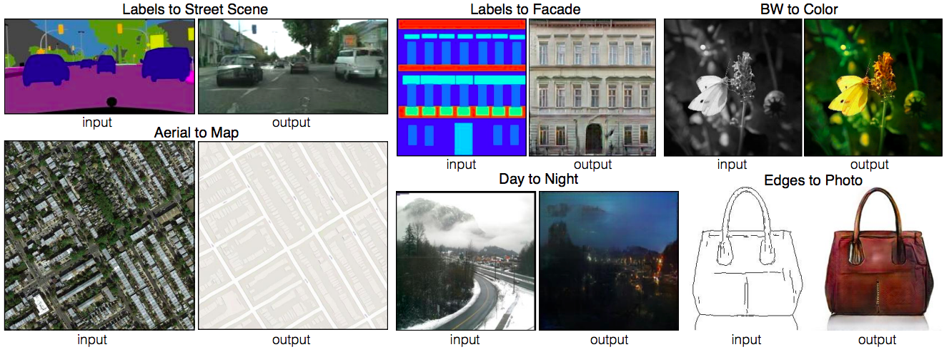
Generative tasks
Image-to-image translation
P. Isola, J.-Y. Zhu, T. Zhou, A. Efros, Image-to-Image Translation with Conditional Adversarial Networks, CVPR 2017

Slide 5
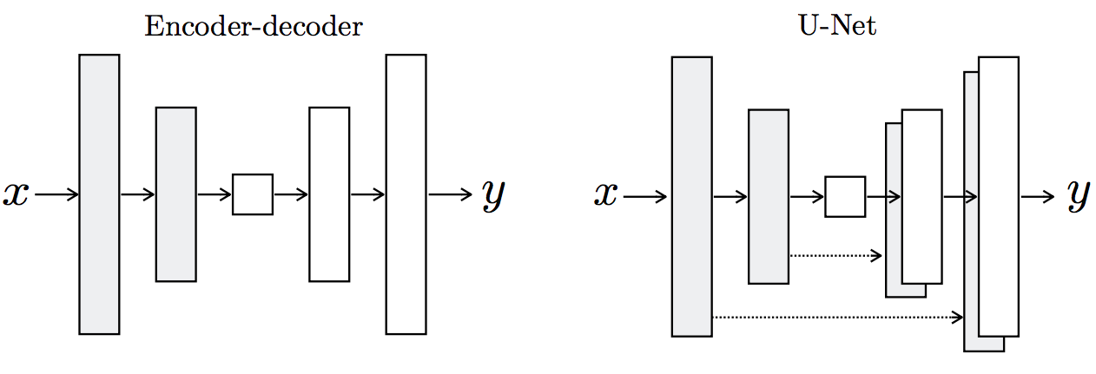
Designing a network for generative tasks
We saw that VAEs can learn to generate data by training both an encoder and a decoder (generator)
Can we learn just the generator?
Recall the decoder of VAE
Random seed or latent code
Unconditional generation

Slide 6
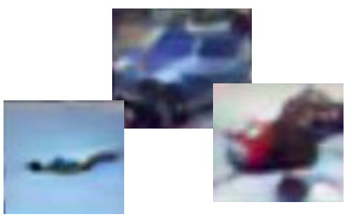
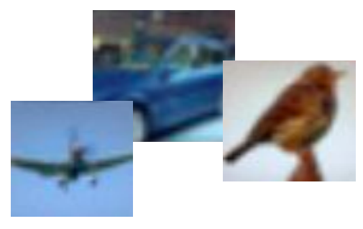
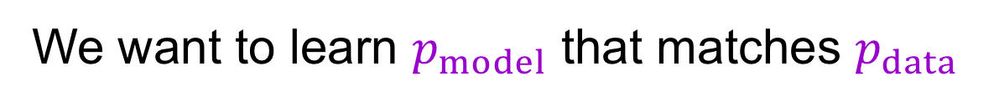
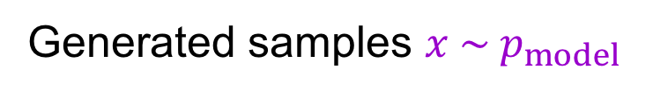
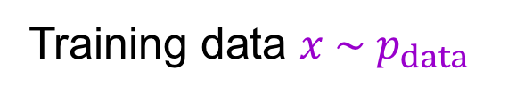
Learning to sample
Training data $x \sim p_{data}$
Generated samples $x \sim p_{model}$
We want to learn $p_{model}$ that matches $p_{data}$
Adapted from Stanford CS231n

Slide 7
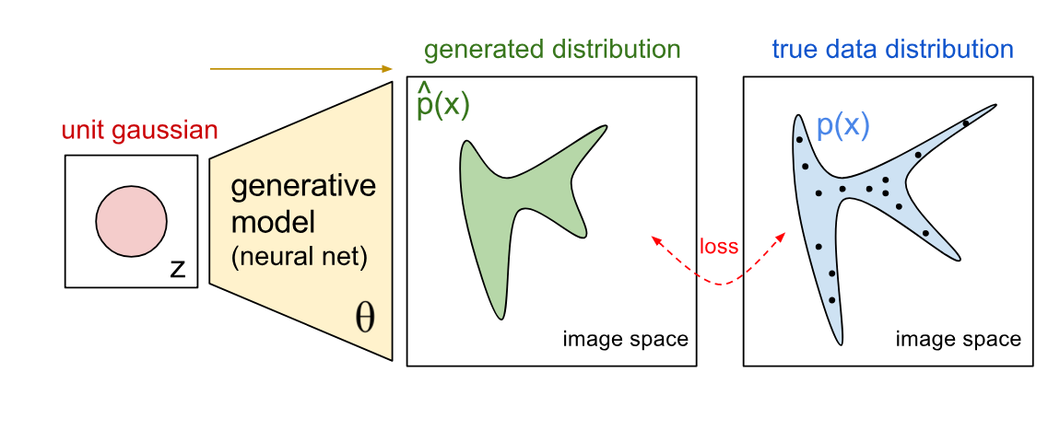
From VAEs to GANs
We saw that VAEs can learn to generate data by training both an encoder and a decoder (generator)
Can we learn just the generator?
Source: https://openai.com/blog/generative-models/

Slide 8
From VAEs to GANs
But, how do we measure the quality of the generator without an encoder?
In other words, what’s the loss function?
Source: https://openai.com/blog/generative-models/

Slide 9
Generative adversarial networks
GANs propose to learn the loss function
The training process is a game between two networks
Source: https://openai.com/blog/generative-models/

Slide 10




Generative adversarial networks
Train two networks with opposing objectives:
Generator: learns to generate samples
Discriminator: learns to distinguish between generated and real samples
$$G$$
$$D$$
Random noise $z$
“Fake”
$$D$$
“Real”
Figure adapted from F. Fleuret
I. Goodfellow, J. Pouget-Abadie, M. Mirza, B. Xu, D. Warde-Farley, S. Ozair, A. Courville, Y. Bengio, Generative adversarial nets, NIPS 2014

Slide 11
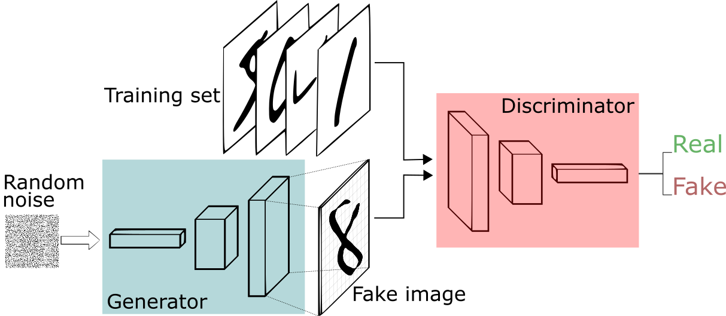
Generative adversarial networks
Generator: G(z) takes random noise z as input and outputs a (fake) image
Source: https://medium.freecodecamp.org/an-intuitive-introduction-to-generative-adversarial-networks-gans-7a2264a81394

Slide 12
Generative adversarial networks
Generator: G(z) takes random noise z as input and outputs a (fake) image
Discriminator: D(x) receives an image x in input, real or fake, and estimates its probability to be real
Source: https://medium.freecodecamp.org/an-intuitive-introduction-to-generative-adversarial-networks-gans-7a2264a81394

Slide 13
Generative adversarial networks
Adversarial training: the generator tries to fool the discriminator while the discriminator tries to get better at distinguishing fake vs real images
Source: https://medium.freecodecamp.org/an-intuitive-introduction-to-generative-adversarial-networks-gans-7a2264a81394

Slide 14
Generative adversarial networks
When the discriminator spots a fake the generator adjusts its parameters, until at the end the generator reproduces the true data distribution and the discriminator is unable to find differences
Source: https://medium.freecodecamp.org/an-intuitive-introduction-to-generative-adversarial-networks-gans-7a2264a81394

Slide 15
Generative adversarial networks
Note: both the generator and the discriminator need to be differentiable
Typically both implemented as (deep) neural networks, so we can use backpropagation
Source: https://medium.freecodecamp.org/an-intuitive-introduction-to-generative-adversarial-networks-gans-7a2264a81394

Slide 16
Generative adversarial networks
That’s like saying that the discriminator at the end in unable to tell the difference between the generated data distribution and the true data distribution (where training data comes from)
Source: https://medium.freecodecamp.org/an-intuitive-introduction-to-generative-adversarial-networks-gans-7a2264a81394

Slide 17
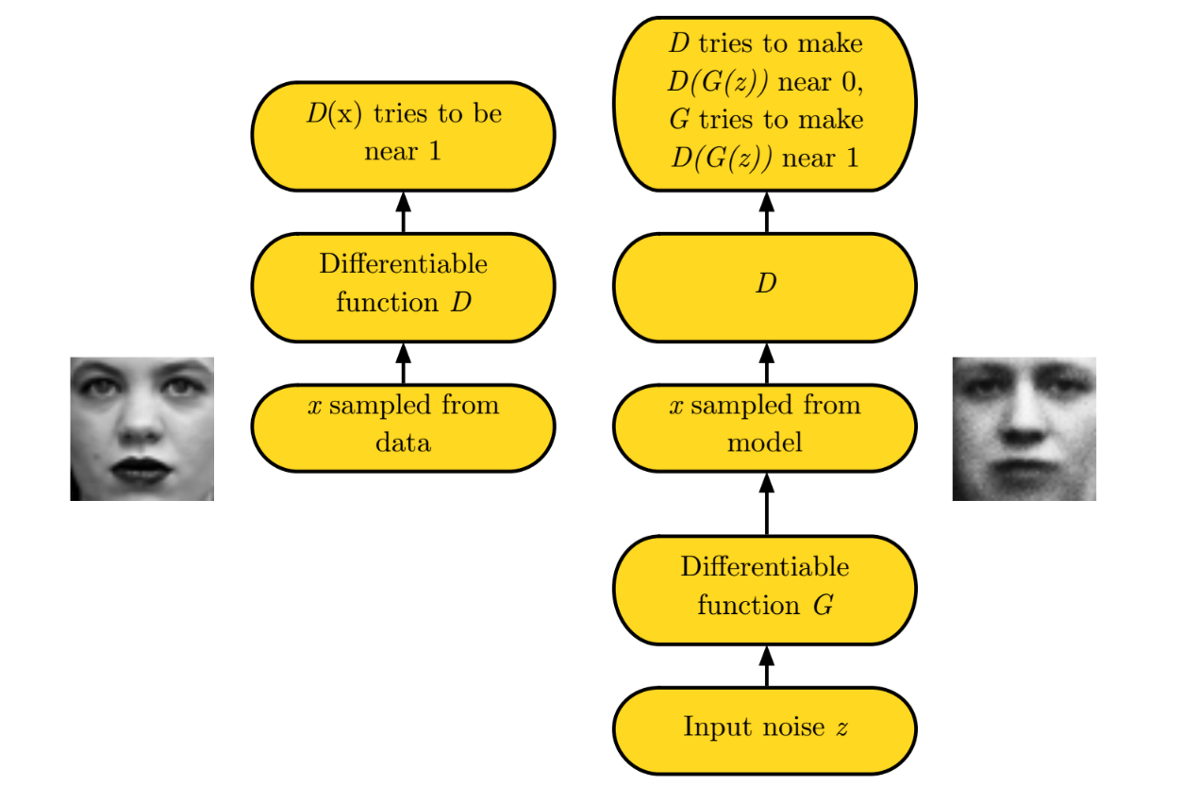
GANs pipeline
Real
Fake
Source: UVA 2018 deep learning course

Slide 18
Source: https://medium.freecodecamp.org/an-intuitive-introduction-to-generative-adversarial-networks-gans-7a2264a81394

Slide 19
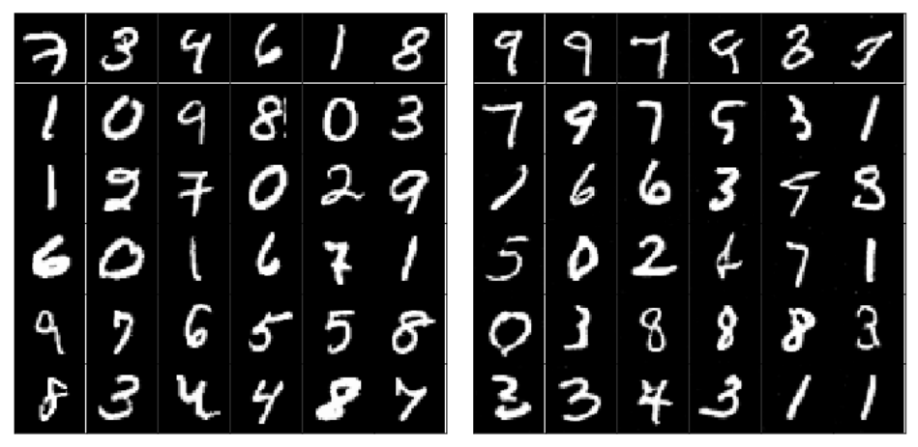
Real
Fake
Source: https://medium.freecodecamp.org/an-intuitive-introduction-to-generative-adversarial-networks-gans-7a2264a81394

Slide 20
Minimax and zero-sum games
G and D follow a minimax strategy

Slide 22
Minimax and zero-sum games
G and D follow a minimax strategy
Prior distribution on input noise variables

Slide 23
Minimax and zero-sum games
G and D follow a minimax strategy
The generator is a differentiable function (e.g., MLP) mapping noise to data space

Slide 24
Minimax and zero-sum games
G and D follow a minimax strategy
The discriminator is a differentiable function (e.g., MLP) with single scalar output,
i.e., the probability that x comes from the true data distribution

Slide 25
Minimax and zero-sum games
G and D follow a minimax strategy
D(x) = 1 when the discriminator thinks x is a real image

Slide 26
Minimax and zero-sum games
G and D follow a minimax strategy
D(G(z)) = 1 when the discriminator thinks G(z) is a real image

Slide 27
Minimax and zero-sum games
G and D follow a minimax strategy
D is trained to maximise the probability of giving the correct label to samples from the true data distribution (the label should be 1) as well as to samples from G (the label should be 0)

Slide 28
Minimax and zero-sum games
G and D follow a minimax strategy
Large when D(x) close to 1

Slide 29
Minimax and zero-sum games
G and D follow a minimax strategy
Large when D(G(z)) close to 0

Slide 30
Minimax and zero-sum games
G and D follow a minimax strategy
Simultaneously G is trained to minimise log(1 − D(G(z))), i.e., fool the discriminator

Slide 31
Minimax and zero-sum games
G and D follow a minimax strategy
For a fixed G, the loss is effectively the binary cross-entropy
The minimax strategy is used for zero-sum games, i.e., loss of one player = gain of the adversary
The minimax solution is the Nash equilibrium
Nash equilibrium is a state in which D and G don’t have any incentive to change
because doing so would make the value of the objective function worse

Slide 32
Minimax and zero-sum games
G and D follow a minimax strategy
For a fixed G, the loss is effectively the binary cross-entropy
The minimax strategy is used for zero-sum games, i.e., loss of one player = gain of the adversary
The minimax solution is the Nash equilibrium
In machine learning terms it means we reached convergence of the gradient
descent for the joint optimisation problem

Slide 33
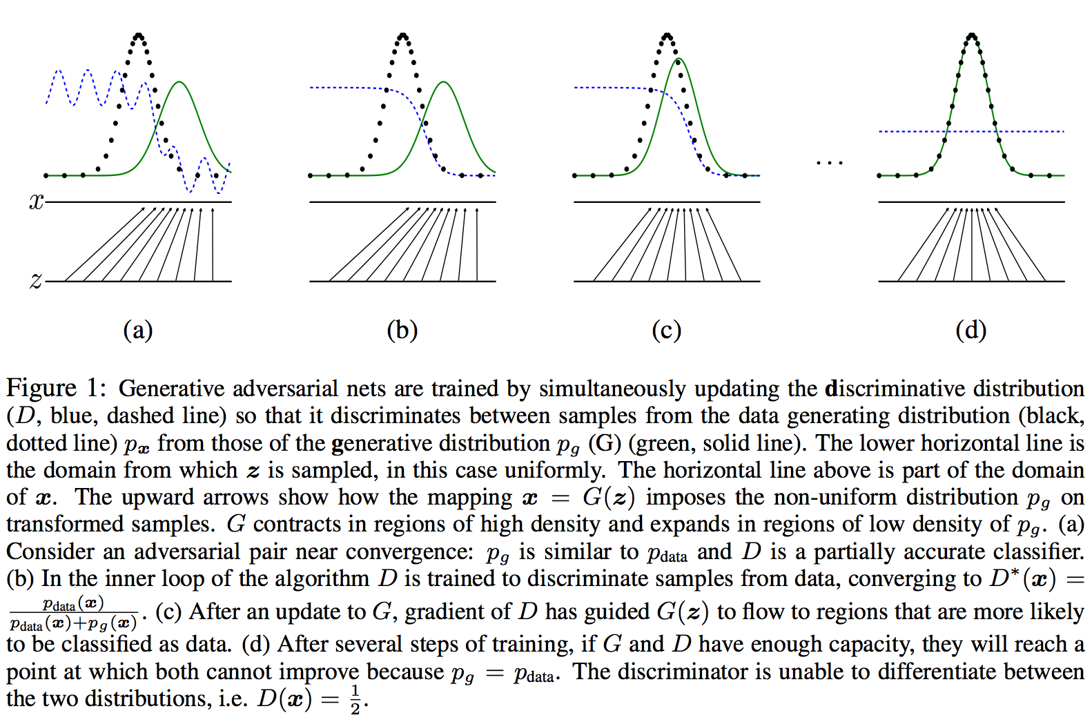
Source: https://papers.nips.cc/paper/5423-generative-adversarial-nets.pdf

Slide 34
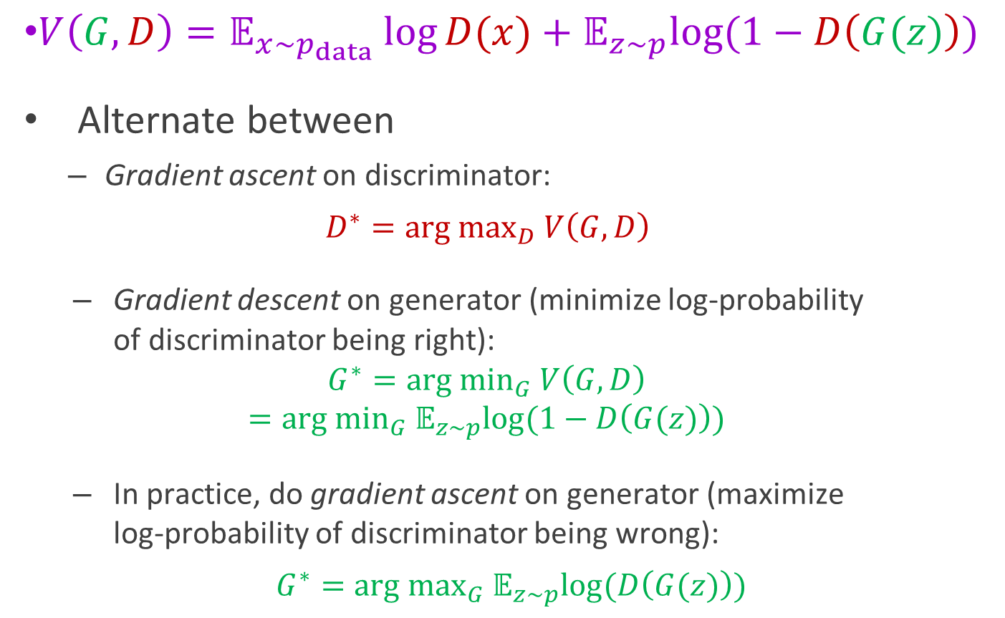
GAN training
$V\left(G,D\right)=𝔼_{x\sim p_{data}}\log{D(x)}+𝔼_{z\sim p}log⁡(1−D\left(G(z)\right))$
Alternate between
Gradient ascent on discriminator:
$$D^{∗}={arg max}_{D} V\left(G,D\right)$$
Gradient descent on generator (minimize log-probability of discriminator being right):
$$G^{∗}={arg min}_{G} V\left(G,D\right)$$
$$={arg min}_{G} 𝔼_{z\sim p}log⁡(1−D\left(G(z)\right))$$
In practice, do gradient ascent on generator (maximize log-probability of discriminator being wrong):
$$G^{∗}={arg max}_{G} 𝔼_{z\sim p}log⁡(D\left(G(z)\right))$$

Slide 35
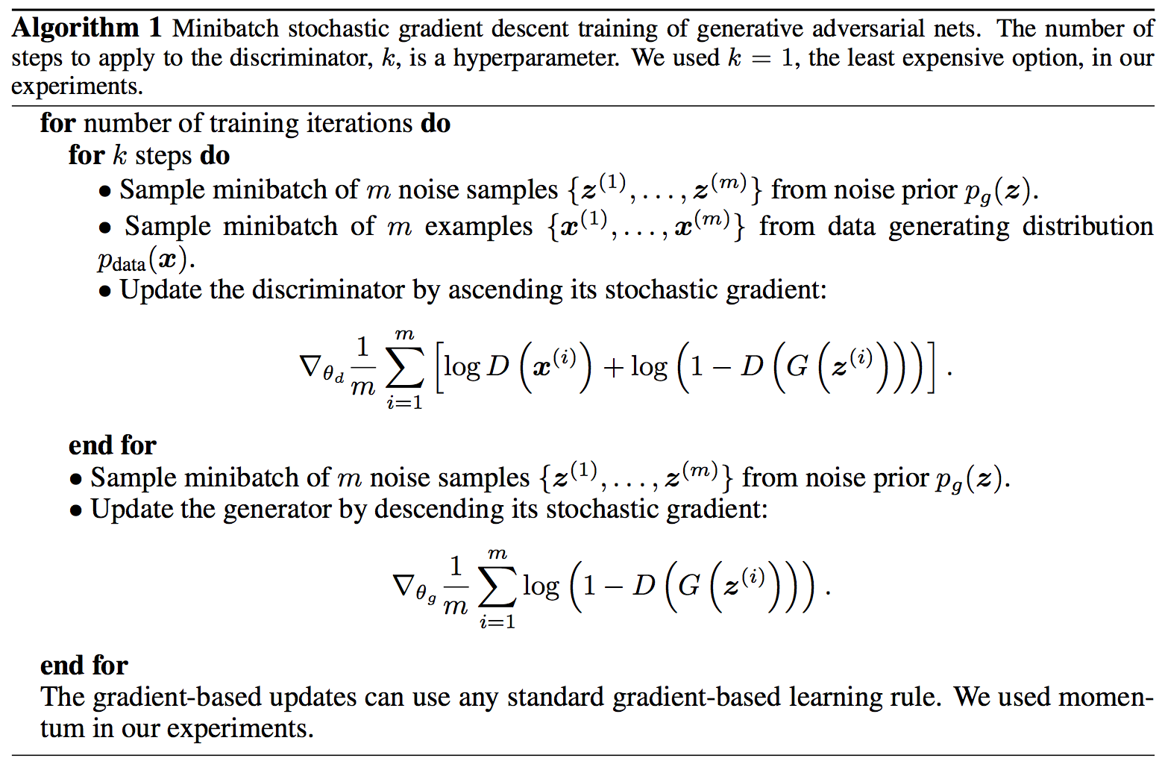
Training GANs
Source: https://papers.nips.cc/paper/5423-generative-adversarial-nets.pdf

Slide 36
Training GANs
In practice this saturates in the beginning
since D rejects the samples with high
confidence because they are clearly
different from the training data
Source: https://papers.nips.cc/paper/5423-generative-adversarial-nets.pdf

Slide 37
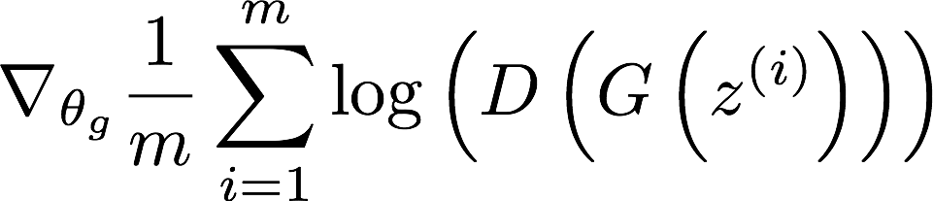
Training GANs
So we use this loss function for the
generator instead, i.e., the generator
maximises the log-prob of the
discriminator being mistaken
Source: https://papers.nips.cc/paper/5423-generative-adversarial-nets.pdf

Slide 38
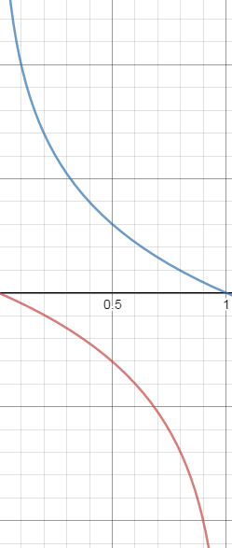



GAN training
$\min_{w_{G}}𝔼_{z\sim p} log⁡(1−D\left(G(z)\right))$ vs. $\max_{w_{G}}𝔼_{z\sim p} log⁡(D\left(G(z)\right))$
$$−log⁡(D(G(z))$$
Large gradients for low-quality samples
Small gradients for high-quality samples
Low discriminator score (low-quality samples)
High discriminator score (high-quality samples)
Want to learn from confidently rejected sample but gradients here are small
These samples already fool the discriminator so we don’t need large gradients here
$$log⁡(1−D(G(z))$$
Figure source

Slide 39
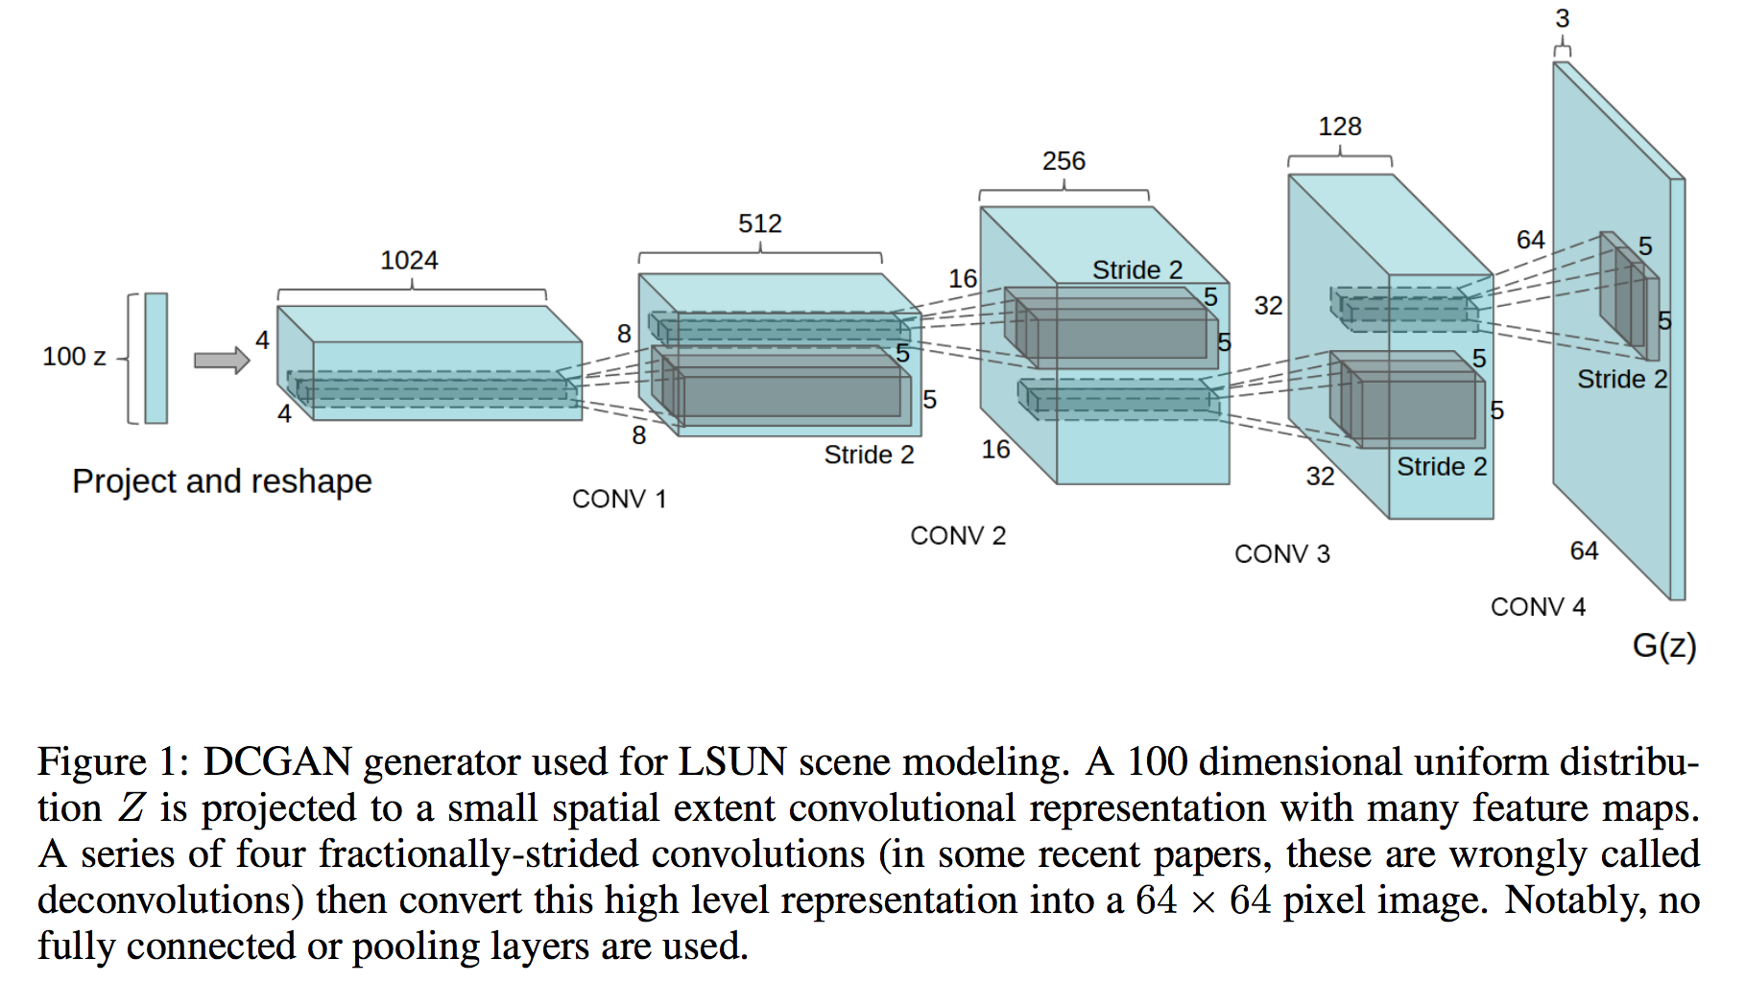
Example generator: DCGAN
Source: https://arxiv.org/pdf/1511.06434.pdf

Slide 40
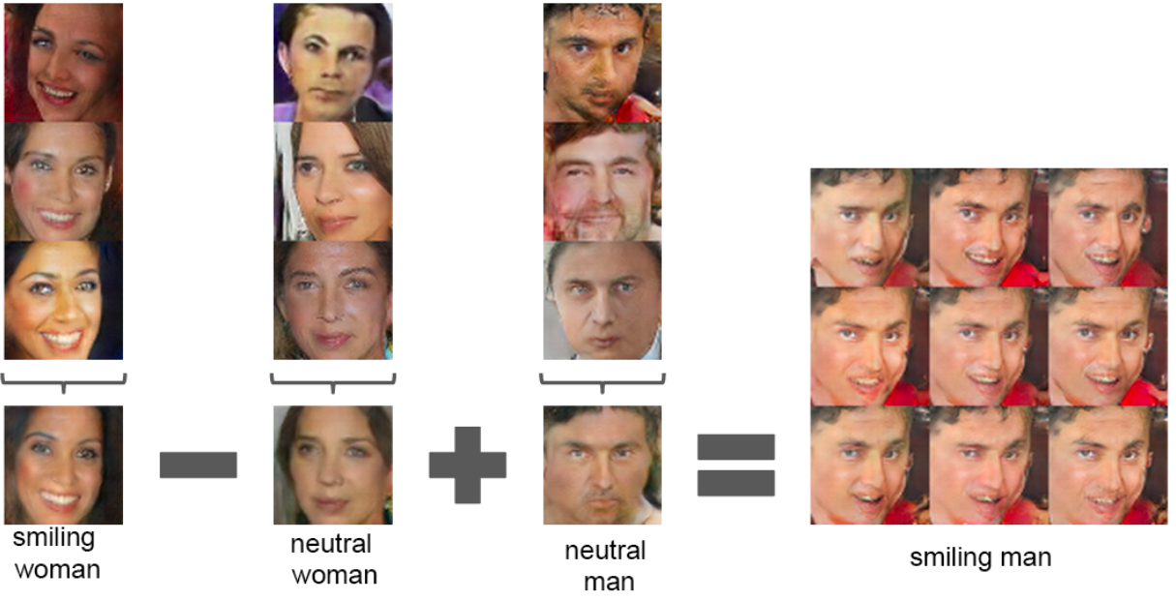
DCGAN results
Vector arithmetic in the z space
Notes:
For each column, the Z vectors of samples are averaged. Arithmetic was then performed on the mean vectors creating a new vector Y . The center sample on the right hand side is produce by feeding Y as input to the generator. To demonstrate the interpolation capabilities of the generator, uniform noise sampled with scale +-0.25 was added to Y to produce the 8 other samples

Slide 41
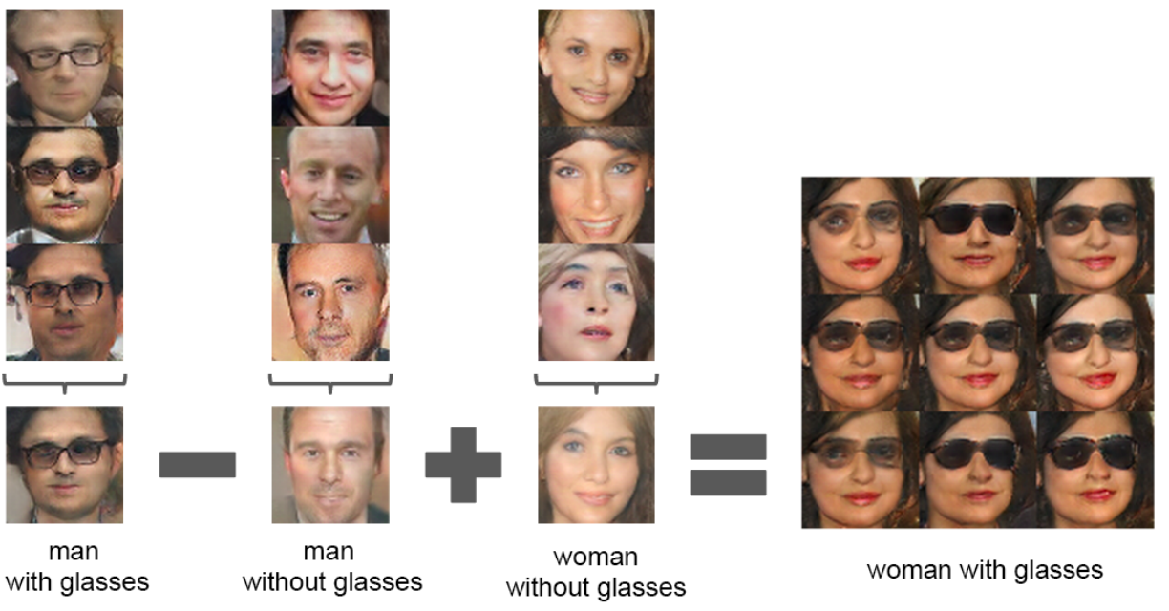
DCGAN results
Vector arithmetic in the z space
Notes:
For each column, the Z vectors of samples are averaged. Arithmetic was then performed on the mean vectors creating a new vector Y . The center sample on the right hand side is produce by feeding Y as input to the generator. To demonstrate the interpolation capabilities of the generator, uniform noise sampled with scale +-0.25 was added to Y to produce the 8 other samples

Slide 42
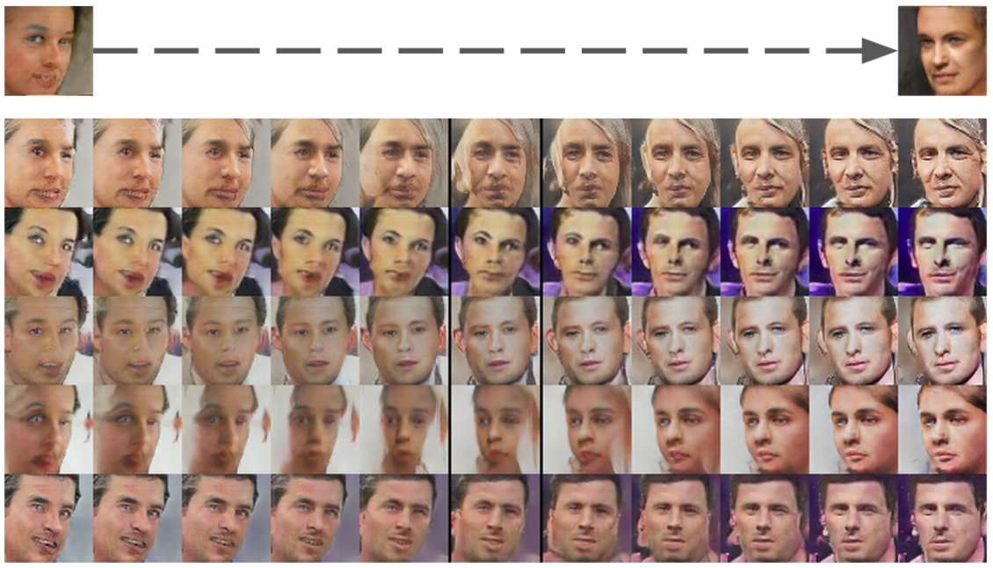
DCGAN results
Pose transformation by adding a “turn” vector
Notes:
A ”turn” vector was created from four averaged samples of faces looking left vs looking right. By adding interpolations along this axis to random samples we were able to reliably transform their pose.

Slide 43
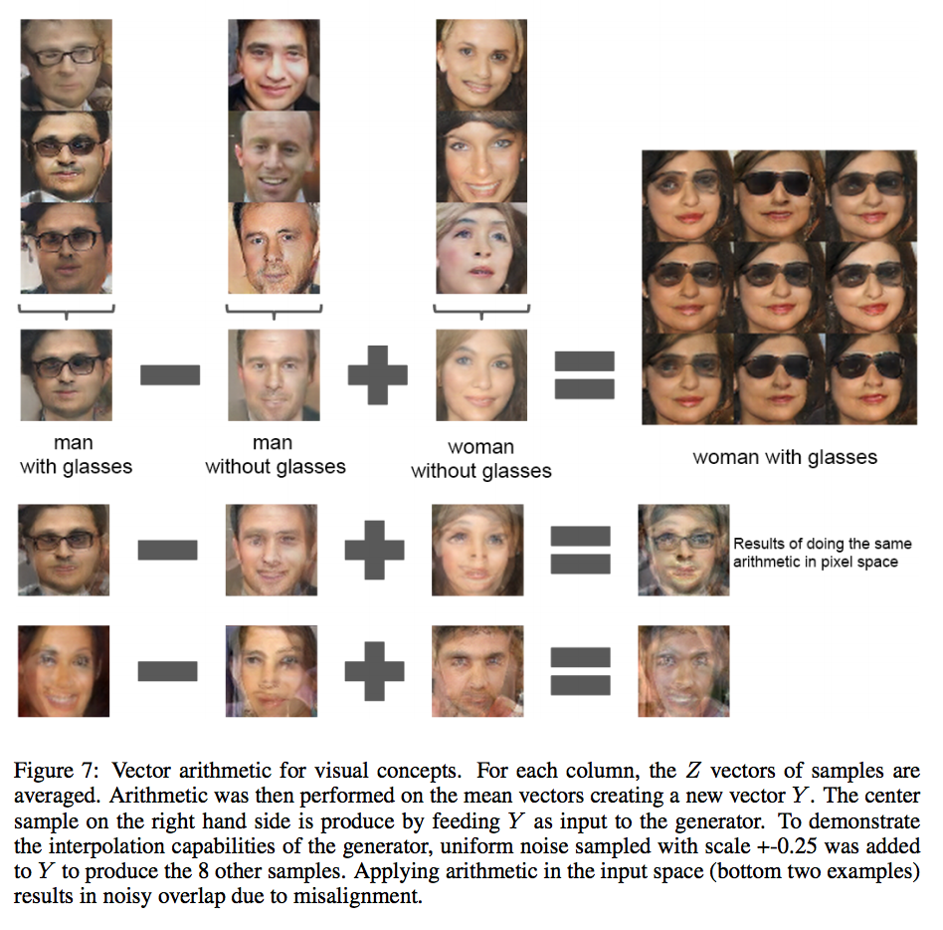
Source: https://arxiv.org/pdf/1511.06434.pdf

Slide 44
Problems with GANs
In the real world we face multiple problems when training GANs:
Finite sample size: training set is finite, not the full distribution
Limited capacity: the generator has limit capacity, i.e. cannot perfectly represent any distribution
Optimisation errors: optimisers can get stuck in local optima or never exactly converge to global optima

Slide 45
Problems with GANs
In the real world we face multiple problems when training GANs:
Saddle point problem: harder than finding a maximum or minimum
Balancing updates: D too weak/strong means no gradient for G to improve
M. Arjovsky, S. Chintala, L. Bottou, Wasserstein generative adversarial networks

Slide 46
Conditional generation (cGAN)

Slide 47






Conditional generation (cGAN)
Suppose we want to condition the generation of samples on discrete side information (label) $y$
How do we add $y$ to the basic GAN framework?
$$G$$
$$G(z)$$
$$D$$
$$z$$
$$D(G(z))$$

Slide 48




Conditional generation
Suppose we want to condition the generation of samples on discrete side information (label) $y$
How do we add $y$ to the basic GAN framework?
$$y$$
$$y$$
$$G$$
$$G(z,y)$$
$$D$$
$$z$$
$$D(G\left(z,y\right),y)$$

Slide 49
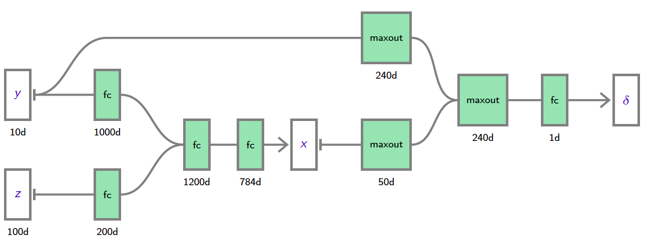


Conditional generation
Example: simple network for generating 28 x 28 MNIST digits
Generator
Class label: 10-dim one-hot vector
Noise vector
Figure source:
F. Fleuret
M. Mirza and S. Osindero, Conditional Generative Adversarial Nets, arXiv 2014

Slide 50
Conditional generation
Example: simple network for generating 28 x 28 MNIST digits
Discriminator
Class label: 10-dim one-hot vector
Noise vector
Figure source:
F. Fleuret
M. Mirza and S. Osindero, Conditional Generative Adversarial Nets, arXiv 2014

Slide 51
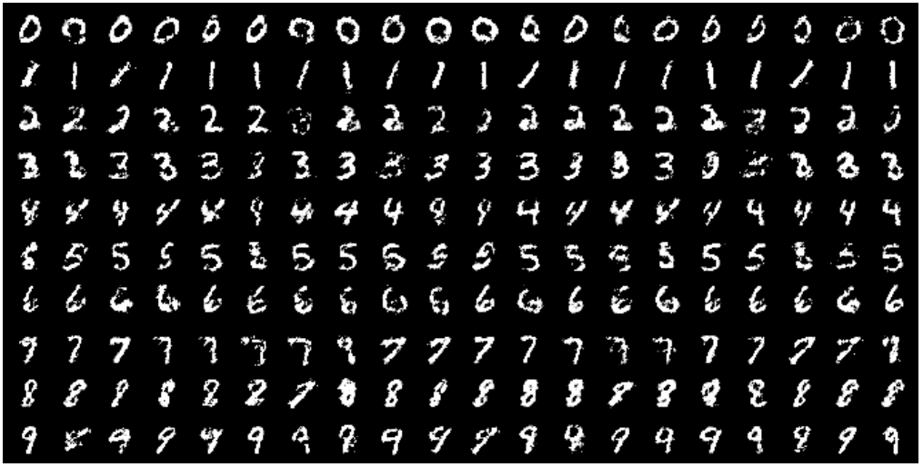
Conditional generation
Example: simple network for generating 28 x 28 MNIST digits
M. Mirza and S. Osindero, Conditional Generative Adversarial Nets, arXiv 2014

Slide 52
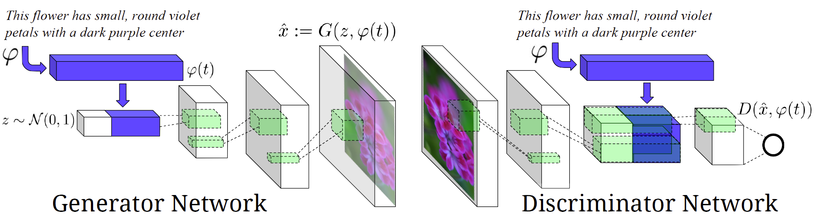
Conditional generation
Another example: text-to-image synthesis
Spatial replication, depth concatenation
LSTM text encoder
S. Reed, Z. Akata, X. Yan, L. Logeswaran, B. Schiele, H. Lee, Generative adversarial text to image synthesis, ICML 2016
Notes:
From the paper: When the spatial dimension of the discriminator is 4 × 4, we replicate the description embedding spatially and perform a depth concatenation. We then perform a 1 × 1 convolution followed by rectification and a 4 × 4 convolution to compute the final score from D

Slide 53
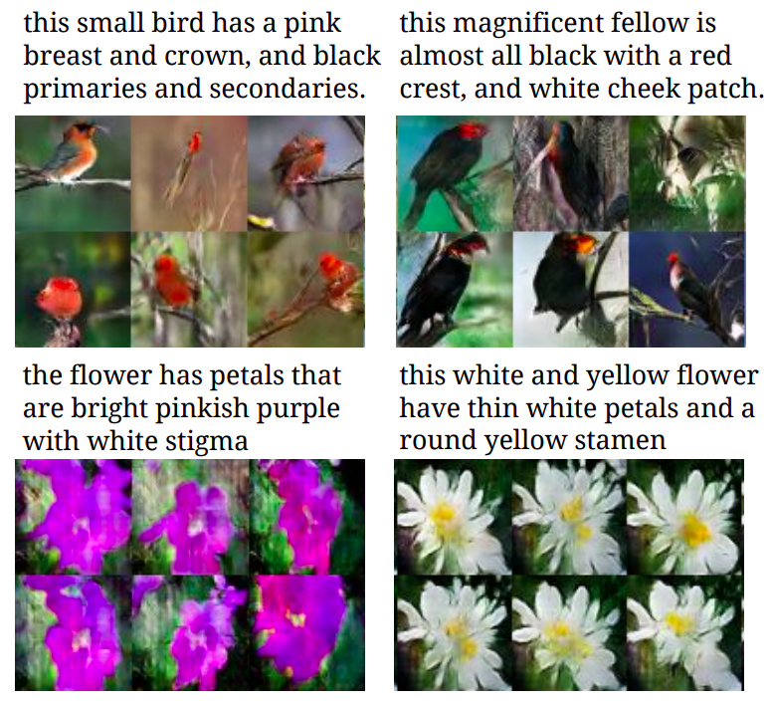
Conditional generation
Another example: text-to-image synthesis
Previously unseen captions (zero-shot setting)
Captions seen in the training set
S. Reed, Z. Akata, X. Yan, L. Logeswaran, B. Schiele, H. Lee, Generative adversarial text to image synthesis, ICML 2016
Notes:
From the paper: When the spatial dimension of the discriminator is 4 × 4, we replicate the description embedding spatially and perform a depth concatenation. We then perform a 1 × 1 convolution followed by rectification and a 4 × 4 convolution to compute the final score from D

Slide 54
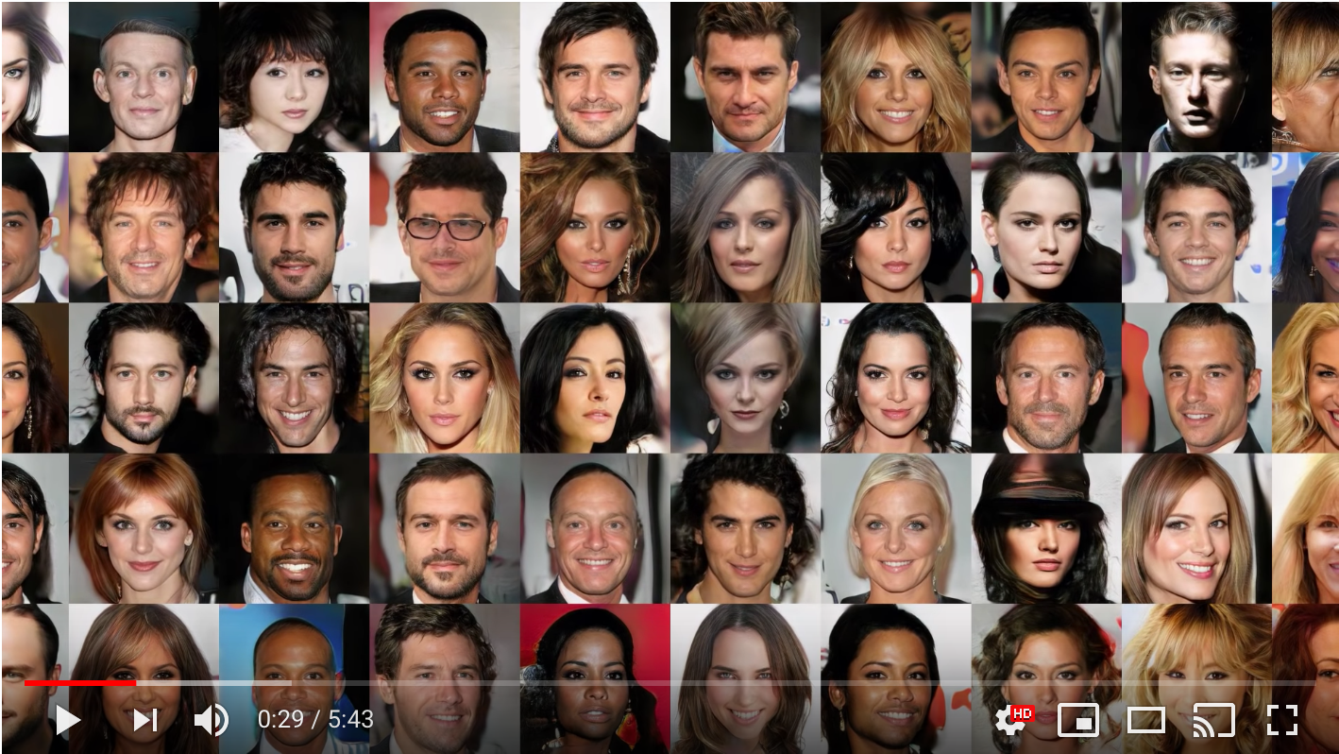
Application: face generation
Source: https://www.youtube.com/watch?v=G06dEcZ-QTg

Slide 55
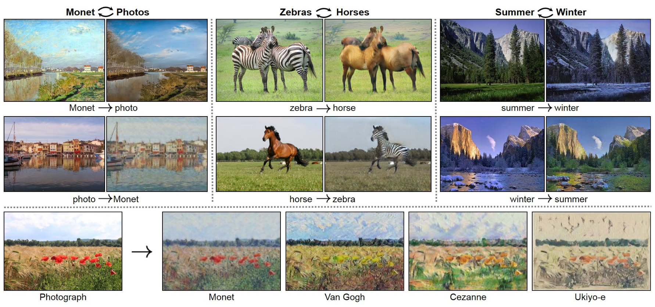
Application: style transfer
Source: https://github.com/junyanz/CycleGAN

Slide 56
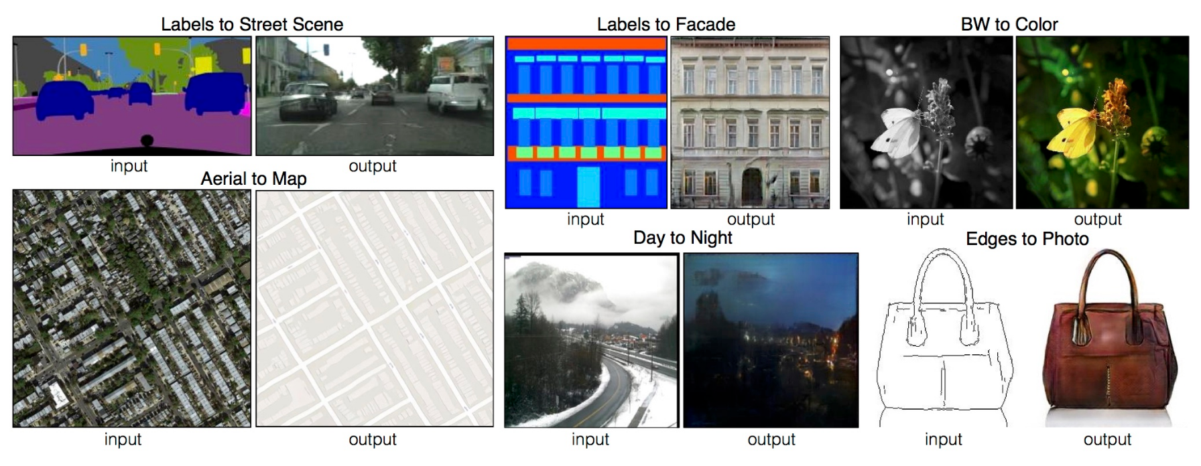
Application: image translation
Source: https://github.com/phillipi/pix2pix

Slide 57
Conclusion
GANs provide an attractive way to create a generative model without using an explicit encode (as in variational auto-encoders) but using supervised learning
However the training is far from trivial and in general finding Nash equilibria in high-dimensional non-convex games is still an important open research problem

