Slide 1
Deep Learning (CS324)
3. Deep networks & backpropagation* Continued
Prof. Jianguo Zhang
SUSTech
*Based on http://www.deeplearningbook.org chapters 5 and 6

Slide 2

Backpropagation
Goal: computing the gradient of the loss with respect to the parameters so we can descend the gradient according to

Slide 3
Backpropagation
Goal: computing the gradient of the loss with respect to the parameters so we can descend the gradient according to
Gradient of loss wrt parameters

Slide 4
Backpropagation
Goal: computing the gradient of the loss with respect to the parameters so we can descend the gradient according to
How to compute it?

Slide 5
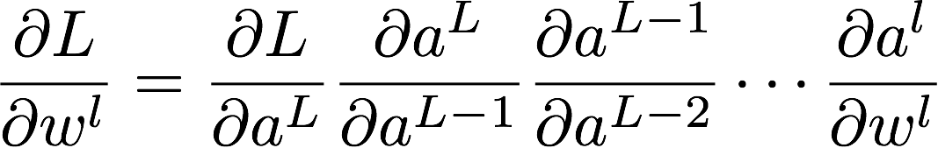
Backpropagation
Goal: computing the gradient of the loss with respect to the parameters so we can descend the gradient according to
How to compute it? For the l-th layer,
where l < l + 1 < l +2 < … < L -2 < L - 1 < L

Slide 6
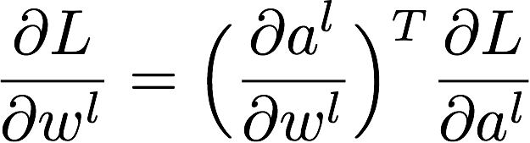
Backpropagation
Goal: computing the gradient of the loss with respect to the parameters so we can descend the gradient according to
How to compute it? For the l-th layer,

Slide 7
Backpropagation
Goal: computing the gradient of the loss with respect to the parameters so we can descend the gradient according to
How to compute it? For the l-th layer,
Gradient of output layer l wrt parameters

Slide 8
Backpropagation
Goal: computing the gradient of the loss with respect to the parameters so we can descend the gradient according to
How to compute it? For the l-th layer,
Can be computed locally: we only need the Jacobian
of the l-th layer output wrt to its parameters

Slide 9
Backpropagation
Goal: computing the gradient of the loss with respect to the parameters so we can descend the gradient according to
How to compute it? For the l-th layer,
Gradient of loss wrt to output of layer l

Slide 10
Backpropagation
Goal: computing the gradient of the loss with respect to the parameters so we can descend the gradient according to
How to compute it? For the l-th layer,
This instead depends on gradient at layer l+1

Slide 11
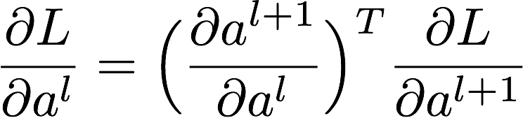
Backpropagation
Goal: computing the gradient of the loss with respect to the parameters so we can descend the gradient according to
How to compute it? For the l-th layer,
This instead depends on gradient at layer l+1

Slide 12
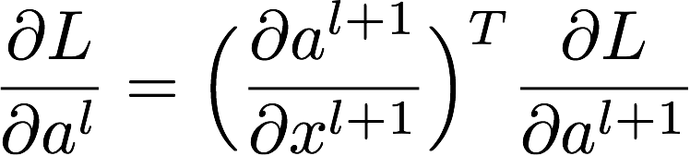
Backpropagation
Goal: computing the gradient of the loss with respect to the parameters so we can descend the gradient according to
How to compute it? For the l-th layer,
This instead depends on gradient at layer l+1

Slide 13
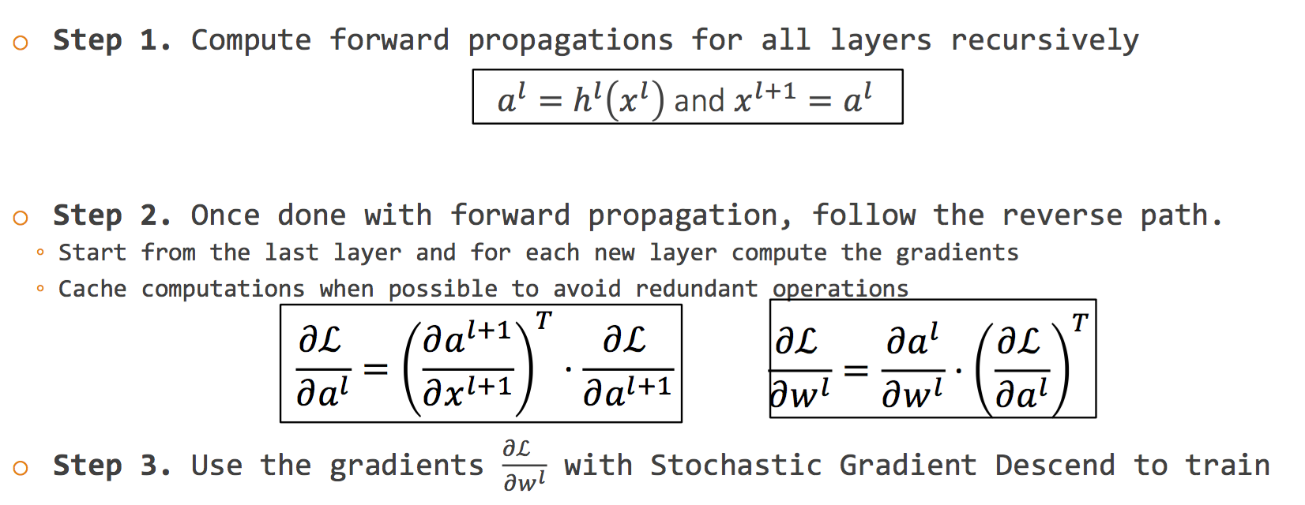
Forward & Back algorithm

Slide 14
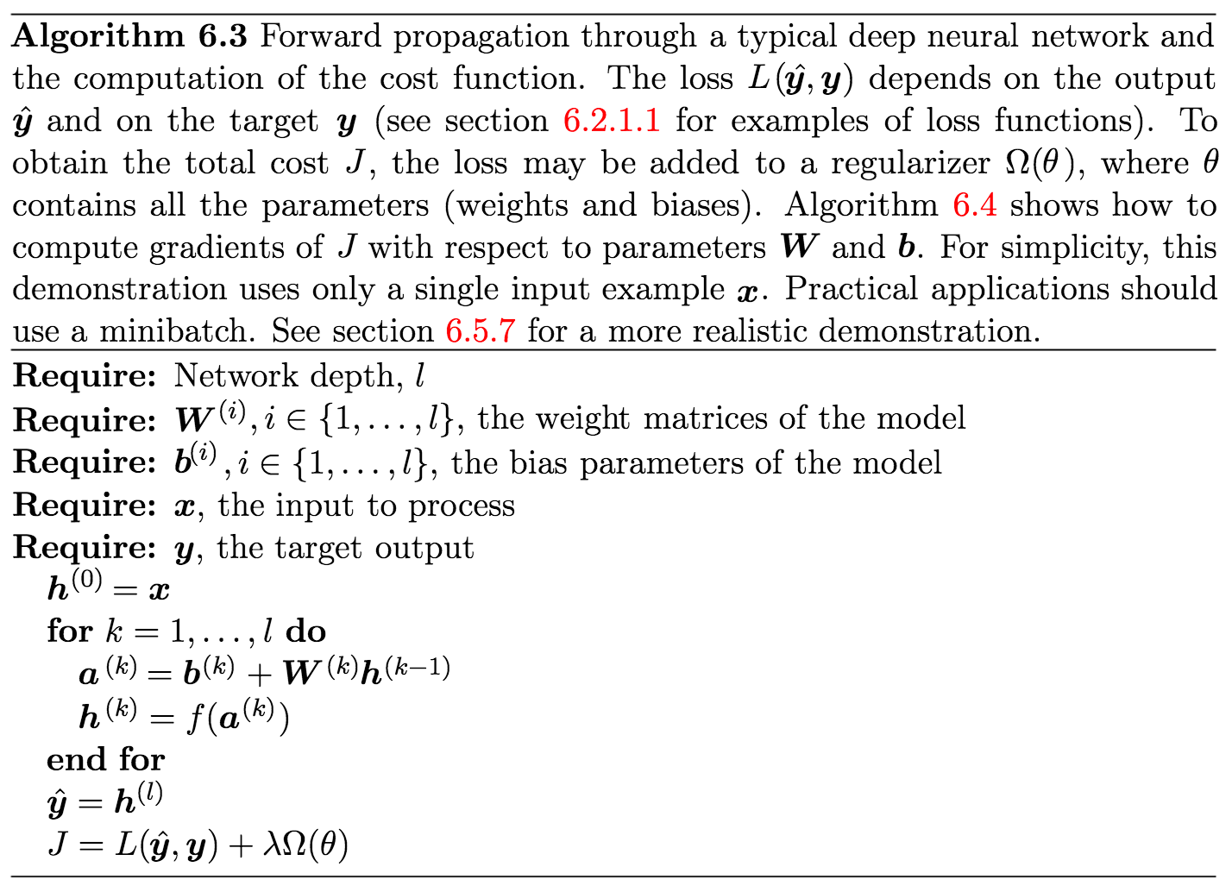
Forward propagation in MLPs

Slide 15
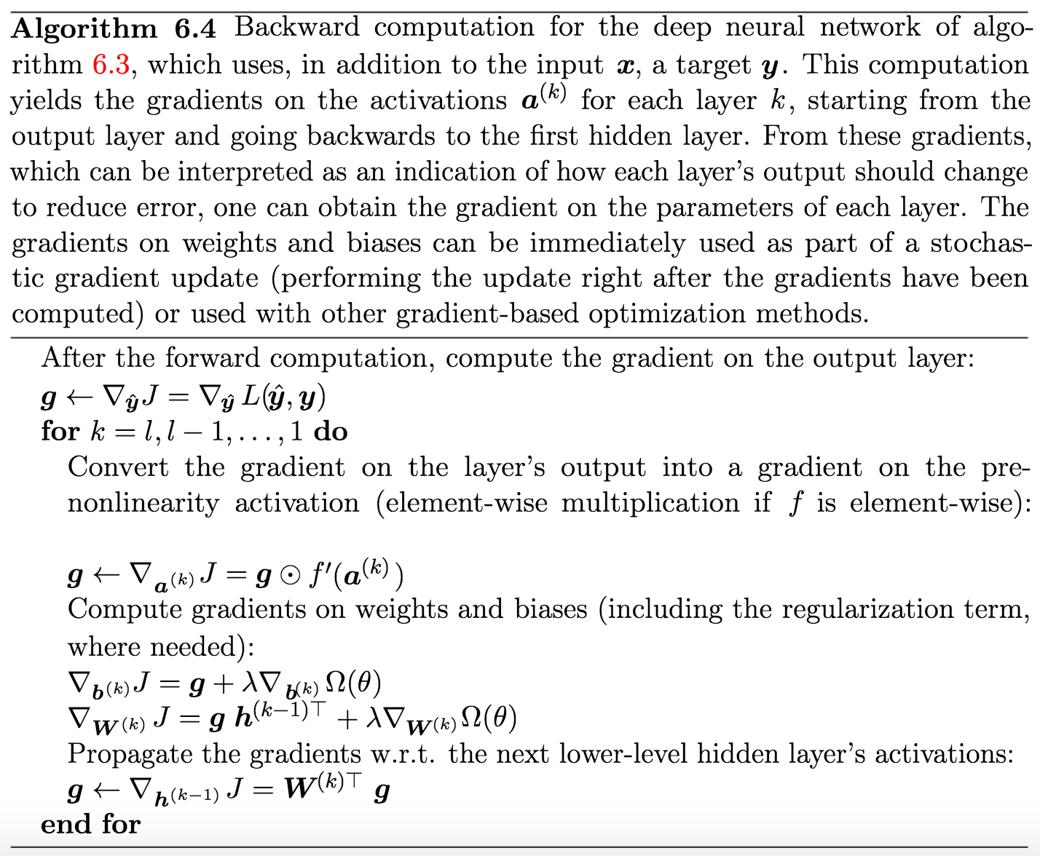
Backpropagation in MLPs

Slide 16
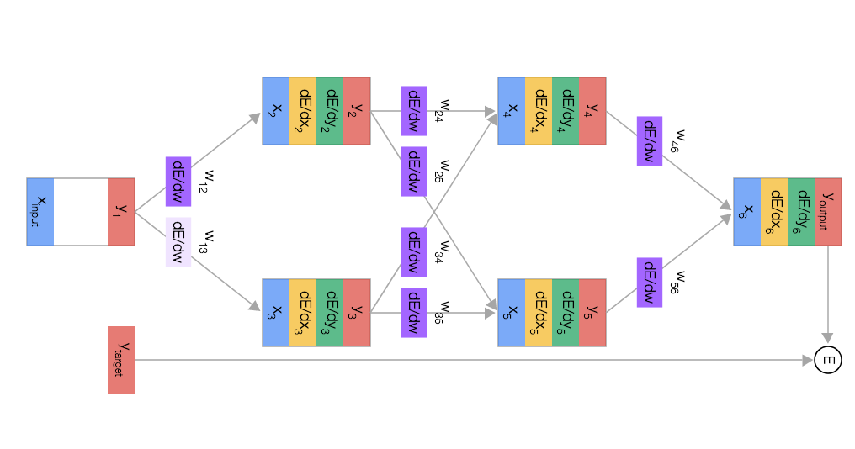
Backpropagation demo
Nice visualisation & explanation of forward prop and back-prop in neural nets https://google-developers.appspot.com/machine-learning/crash-course/backprop-scroll/

Slide 17
Backpropagation demo
Nice visualisation & explanation of forward prop and back-prop in neural nets https://google-developers.appspot.com/machine-learning/crash-course/backprop-scroll/
…and another step-by-step example https://mattmazur.com/2015/03/17/a-step-by-step-backpropagation-example/

Slide 18
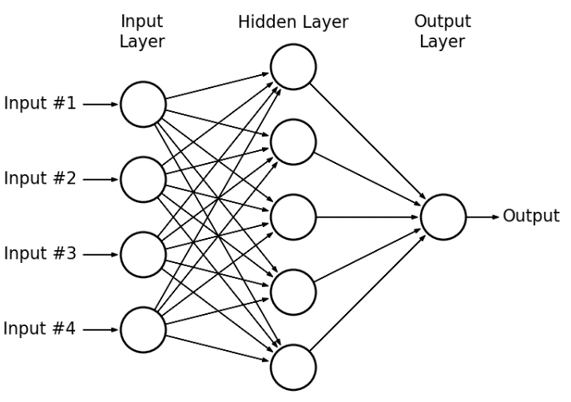
Units and layers

Slide 19
Backpropagation in PyTorch
See https://discuss.pytorch.org/t/what-does-the-backward-function-do/9944 and https://medium.com/@zhang_yang/how-pytorch-tensors-backward-accumulates-gradient-8d1bf675579b to understand what backward() does
And check the blitz tutorial to see how it’s used https://github.com/uvadlc/uvadlc_practicals_2018/blob/master/pytorch/blitz/neural_networks_tutorial.ipynb

