Slide 1
Multi-layer neural networks and backpropagation
Jianguo Zhang

Slide 2
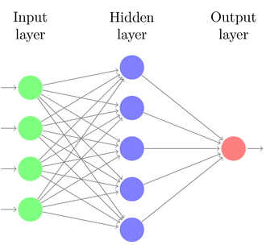







Two-layer neural network
Introduce a hidden layer of perceptrons computing linear combinations of inputs followed by a nonlinearity
$${g(w}_{11}^{T}x)$$
Why do we need the nonlinearity?
$${g(w}_{12}^{T}x)$$
Individual dimensions of $x$
$$g(W_{1}x)$$
$$g\left(w_{2}^{T}g(W_{1}x)\right)$$
$${g(w}_{1K}^{T}x)$$
$W_{1}$ – matrix with rows $w_{1j}^{T}$

Slide 3
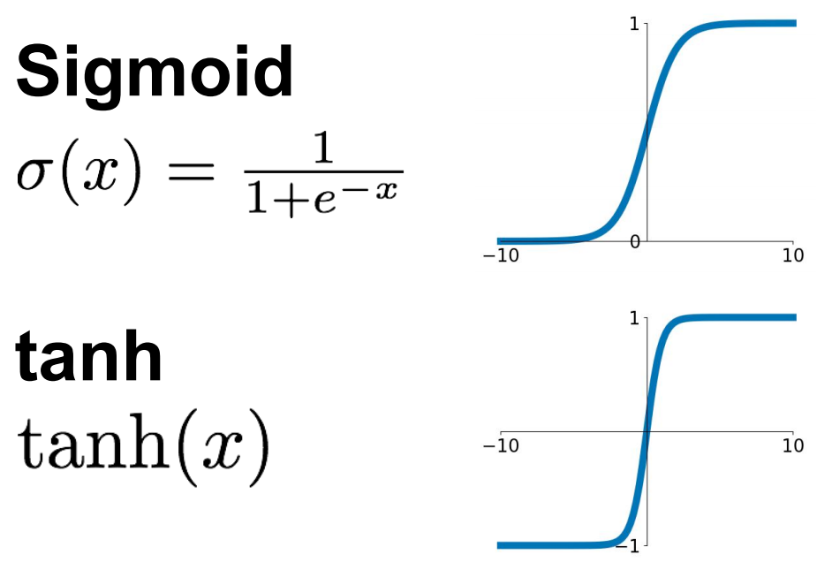
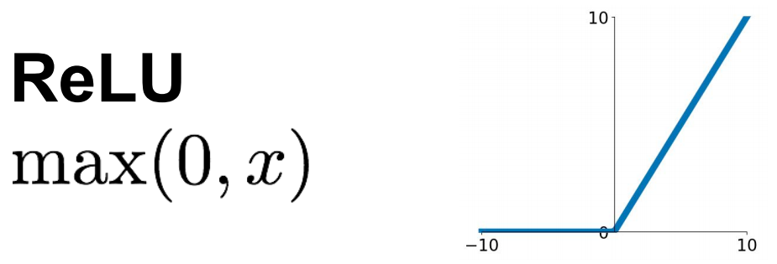
Common nonlinearities
Source: Stanford 231n

Slide 4
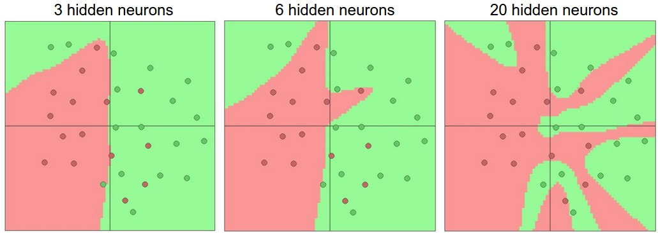
Two-layer neural network
Introduce a hidden layer of perceptrons computing linear combinations of inputs followed by a nonlinearity
This gives a universal function approximator
But the hidden layer may need to be huge
Figure source

Slide 5
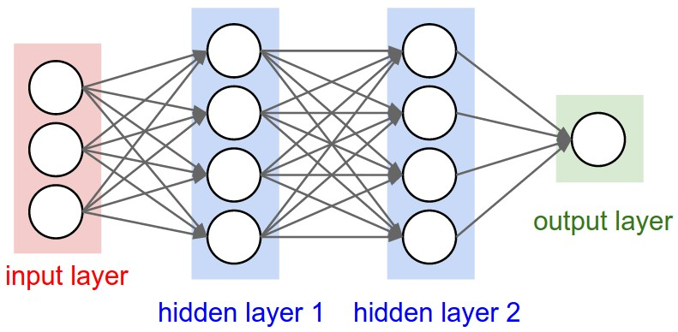
Beyond two layers

Slide 6
“Deep” pipeline
Raw input
Layer 1
Layer 2
Layer 3
Output
Learn a feature hierarchy
Each layer extracts features from the output of previous layer
All layers are trained jointly

Slide 7
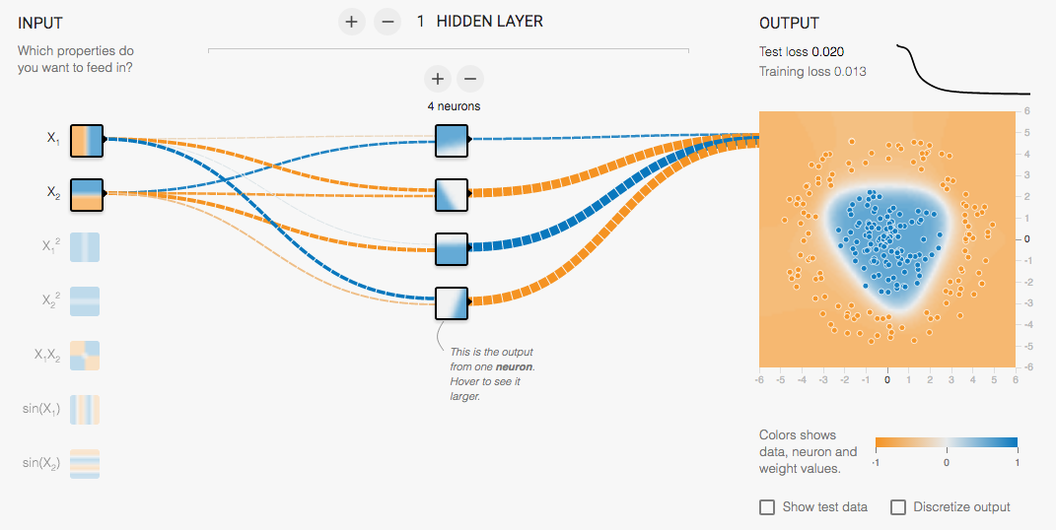
Multi-Layer network demo
http://playground.tensorflow.org/

Slide 8
How to train a multi-layer network?

Slide 9

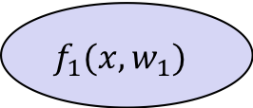


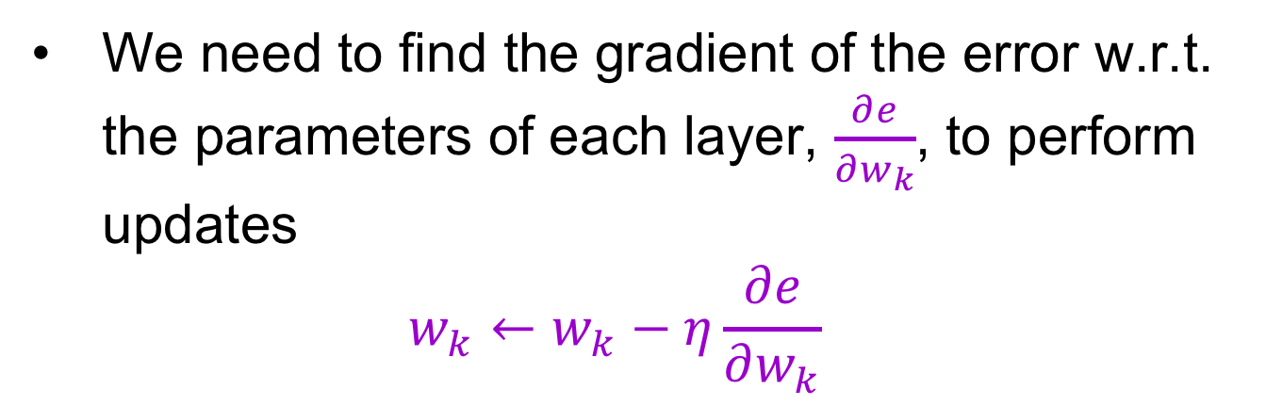
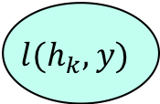

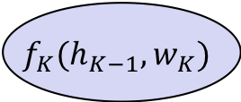

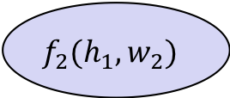

How to train a multi-layer network?
hidden representation
output
$$h_{1}$$
$$h_{2}$$
$$h_{K−1}$$
$$h_{K}$$
$$f_{1}(x,w_{1})$$
$$f_{2}(h_{1},w_{2})$$
$$f_{K}(h_{K−1},w_{K})$$
$$l(h_{k},y)$$
$$x$$
…
$$e$$
input
first layer transformation
second layer transformation
output layer
loss function
error
We need to find the gradient of the error w.r.t. the parameters of each layer, $\frac{∂e}{∂w_{k}}$, to perform updates
$$w_{k}←w_{k}−η\frac{∂e}{∂w_{k}}$$

Slide 10



Computation graph
$$w_{1}$$
$$w_{2}$$
$$w_{K}$$
$$h_{1}$$
$$h_{2}$$
$$h_{K−1}$$
$$h_{K}$$
$$f_{1}(x,w_{1})$$
$$f_{2}(h_{1},w_{2})$$
$$f_{K}(h_{K−1},w_{K})$$
$$l(h_{k},y)$$
$$x$$
…
$$e$$

Slide 11

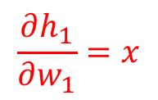
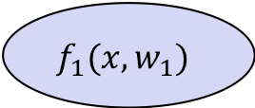
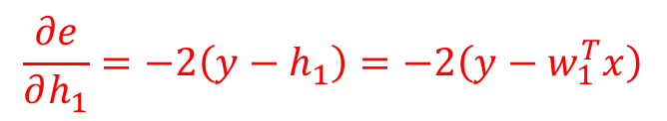
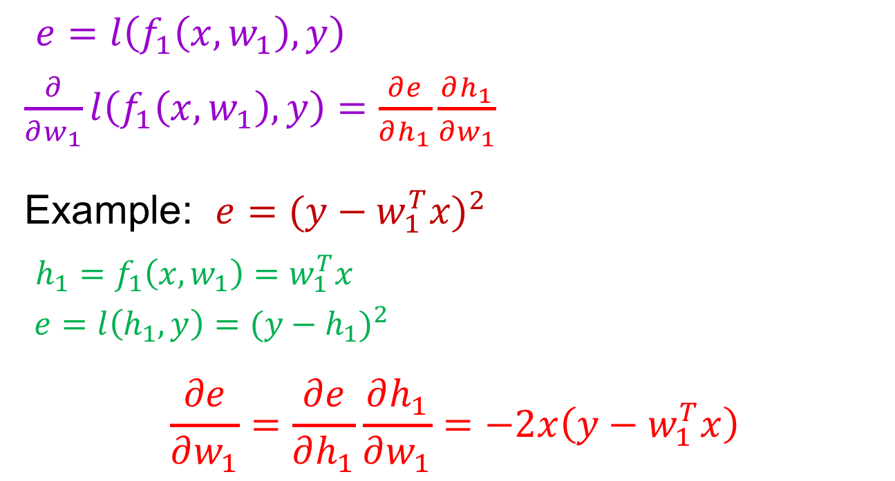

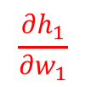

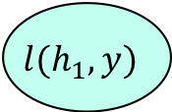
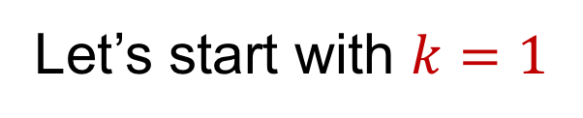
Chain rule
$$w_{1}$$
$$h_{1}$$
Let’s start with $k=1$
$$f_{1}(x,w_{1})$$
$$l(h_{1},y)$$
$$x$$
$$e$$
$$\frac{∂e}{∂h_{1}}$$
$$\frac{∂h_{1}}{∂w_{1}}$$
$e=l\left(f_{1}\left(x,w_{1}\right),y\right)$
$\frac{∂}{∂w_{1}}l\left(f_{1}\left(x,w_{1}\right),y\right)=\frac{∂e}{∂h_{1}}\frac{∂h_{1}}{∂w_{1}}$
Example: $e{=(y−w_{1}^{T}x)}^{2}$
$h_{1}=f_{1}\left(x,w_{1}\right)=w_{1}^{T}x$
$e=l\left(h_{1},y\right)={(y−h_{1})}^{2}$
$$\frac{∂e}{∂w_{1}}=\frac{∂e}{∂h_{1}}\frac{∂h_{1}}{∂w_{1}}=−2x\left(y−w_{1}^{T}x\right)$$
$$\frac{∂h_{1}}{∂w_{1}}=x$$
$$\frac{∂e}{∂h_{1}}=−2\left(y−h_{1}\right)=−2\left(y−w_{1}^{T}x\right)$$

Slide 12








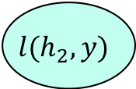

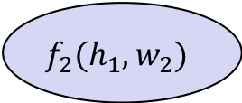
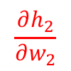
Chain rule
$$w_{1}$$
$$w_{2}$$
$$h_{1}$$
$$h_{2}$$
$$k=2$$
$$f_{1}(x,w_{1})$$
$$f_{2}(h_{1},w_{2})$$
$$l(h_{2},y)$$
$$x$$
$$e$$
$$\frac{∂e}{∂h_{2}}$$
$$\frac{∂h_{2}}{∂w_{2}}$$
$e=l\left(f_{2}(f_{1}(x,w_{1}),w_{2})\right)$
$\frac{∂e}{∂w_{2}}=\frac{∂e}{∂h_{2}}\frac{∂h_{2}}{∂w_{2}} \frac{∂e}{∂w_{1}}=\frac{∂e}{∂h_{2}}\frac{∂h_{2}}{∂h_{1}}\frac{∂h_{1}}{∂w_{1}}$

Slide 13


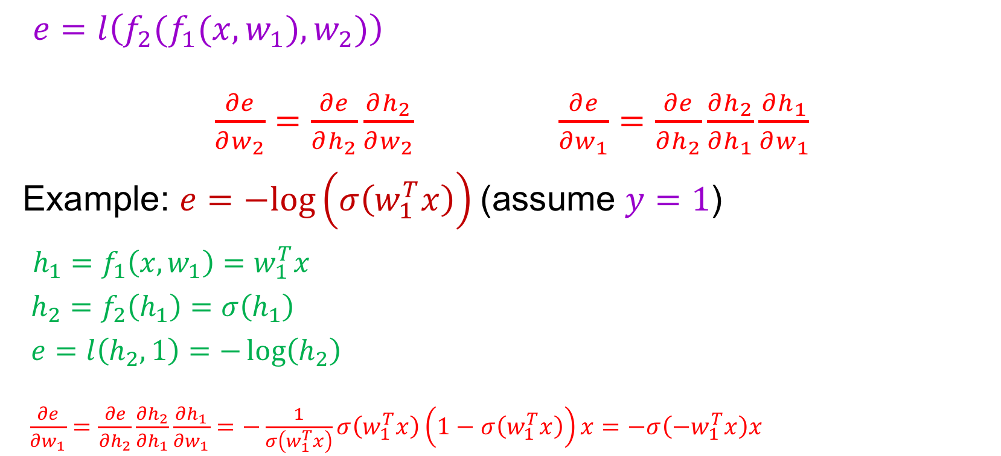
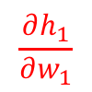



Chain rule
$$w_{1}$$
$$w_{2}$$
$$h_{1}$$
$$h_{2}$$
$$k=2$$
$$f_{1}(x,w_{1})$$
$$f_{2}(h_{1},w_{2})$$
$$l(h_{2},y)$$
$$x$$
$$e$$
$$\frac{∂e}{∂h_{1}}$$
$$\frac{∂e}{∂h_{2}}$$
$$\frac{∂h_{1}}{∂w_{1}}$$
$$\frac{∂h_{2}}{∂h_{1}}$$
$e=l\left(f_{2}(f_{1}(x,w_{1}),w_{2})\right)$
$\frac{∂e}{∂w_{2}}=\frac{∂e}{∂h_{2}}\frac{∂h_{2}}{∂w_{2}} \frac{∂e}{∂w_{1}}=\frac{∂e}{∂h_{2}}\frac{∂h_{2}}{∂h_{1}}\frac{∂h_{1}}{∂w_{1}}$
Example: $e=−log\left(σ\left(w_{1}^{T}x\right)\right)$ (assume $y=1$)
$h_{1}=f_{1}\left(x,w_{1}\right)=w_{1}^{T}x$
$h_{2}=f_{2}\left(h_{1}\right)=σ\left(h_{1}\right)$
$e=l\left(h_{2},1\right)=−\log\left(h_{2}\right)$
$\frac{∂e}{∂w_{1}}=\frac{∂e}{∂h_{2}}\frac{∂h_{2}}{∂h_{1}}\frac{∂h_{1}}{∂w_{1}}=−\frac{1}{σ\left(w_{1}^{T}x\right)}σ\left(w_{1}^{T}x\right)\left(1−σ\left(w_{1}^{T}x\right)\right)x=−σ\left(−w_{1}^{T}x\right)x$
$$\frac{∂h_{1}}{∂w_{1}}=x$$
$$\frac{∂h_{2}}{∂h_{1}}=σ^{′}\left(h_{1}\right)=σ\left(h_{1}\right)(1−σ\left(h_{1}\right))$$
$$\frac{∂e}{∂h_{2}}=−\frac{1}{h_{2}}$$

Slide 14


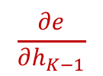
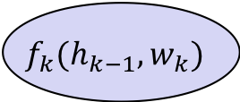

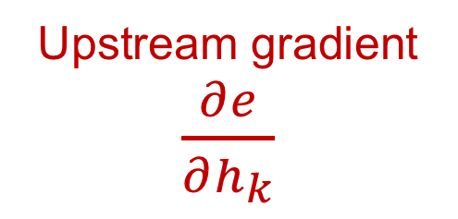
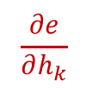
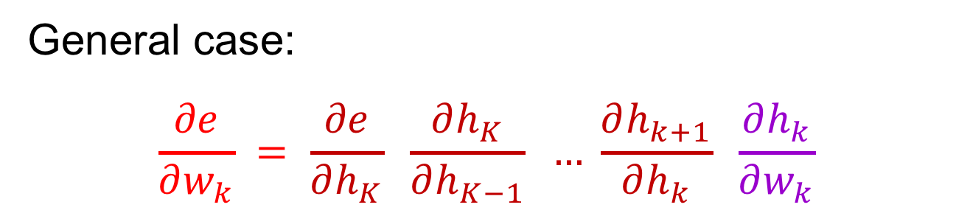
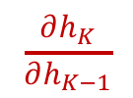
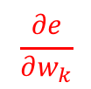
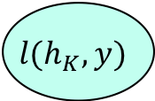
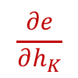
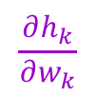
Chain rule
$$\frac{∂e}{∂w_{k}}$$
$$w_{k}$$
$$w_{K}$$
$$h_{k−1}$$
$$h_{k}$$
$$h_{K−1}$$
$$h_{K}$$
$$f_{k}(h_{k−1},w_{k})$$
$$f_{K}(h_{K−1},w_{K})$$
$$l(h_{K},y)$$
…
$$e$$
$$\frac{∂e}{∂h_{k}}$$
$$\frac{∂e}{∂h_{K−1}}$$
$$\frac{∂e}{∂h_{K}}$$
$$\frac{∂h_{k}}{∂w_{k}}$$
$$\frac{∂h_{K}}{∂h_{K−1}}$$
General case:
$$\frac{∂e}{∂w_{k}} = \frac{∂e}{∂h_{K}} \frac{∂h_{K}}{∂h_{K−1}} … \frac{∂h_{k+1}}{∂h_{k}} \frac{∂h_{k}}{∂w_{k}}$$
Upstream gradient $\frac{∂e}{∂h_{k}}$
Local gradient

Slide 15
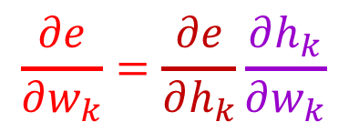
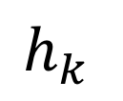
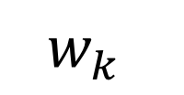
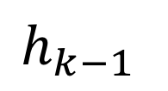

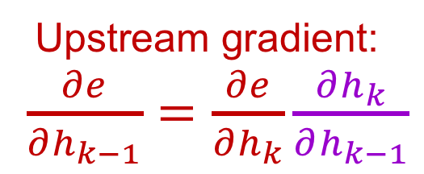
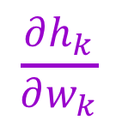
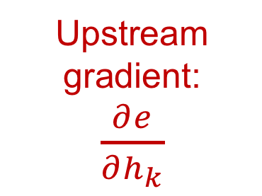
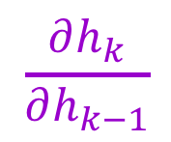
Backpropagation summary
Parameter update:
$$\frac{∂e}{∂w_{k}}=\frac{∂e}{∂h_{k}}\frac{∂h_{k}}{∂w_{k}}$$
$$w_{k}$$
Upstream gradient:
$\frac{∂e}{∂h_{k}}$
$$\frac{∂h_{k}}{∂w_{k}}$$
Local gradient
$$f_{k}$$
$$h_{k}$$
$$\frac{∂h_{k}}{∂h_{k−1}}$$
Local gradient
$$h_{k−1}$$
Upstream gradient:
$\frac{∂e}{∂h_{k−1}}=\frac{∂e}{∂h_{k}}\frac{∂h_{k}}{∂h_{k−1}}$
Forward pass
Backward pass

Slide 16
What about more general computation graphs?
ResNet
ResNeXt
Figure source

Slide 17
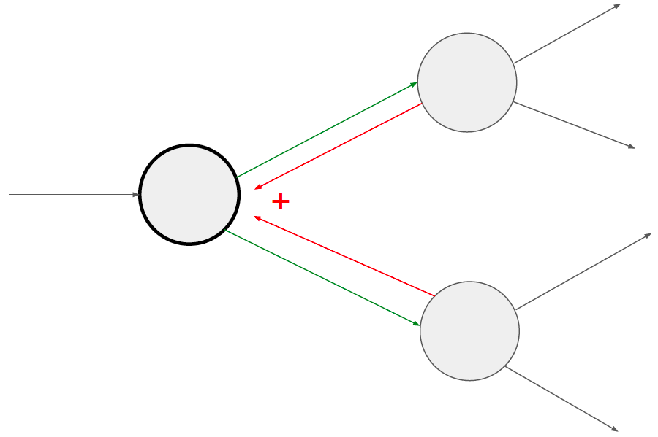
What about more general computation graphs?
+ Gradients add at branches
Source: Stanford 231n

Slide 18
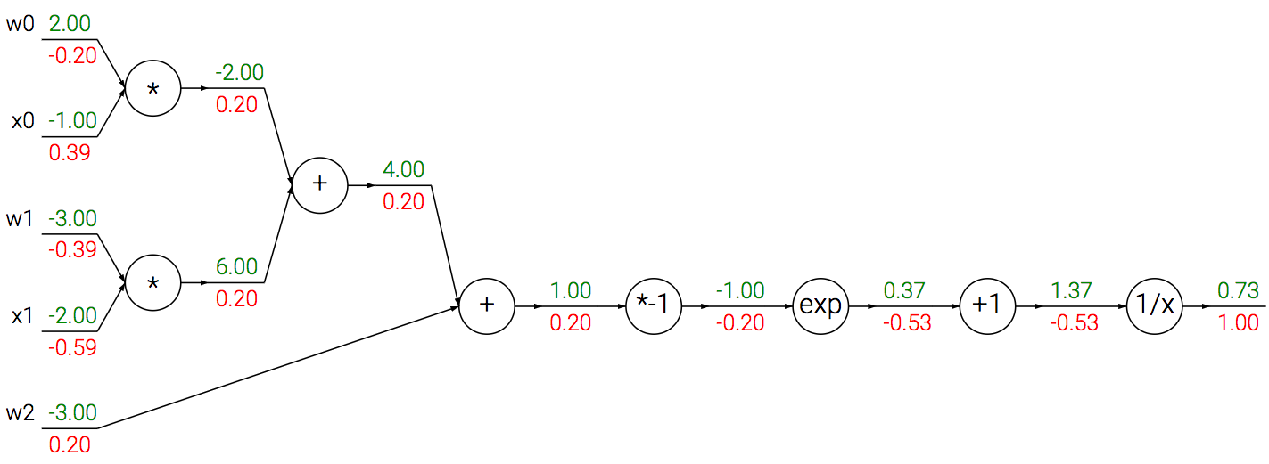
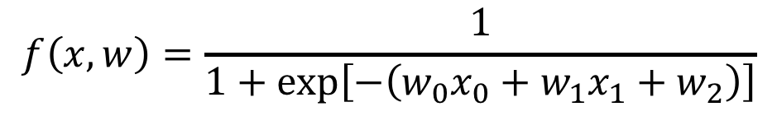
A detailed example
$$f\left(x,w\right)=\frac{1}{1+exp\left[−\left(w_{0}x_{0}+w_{1}x_{1}+w_{2}\right)\right]}$$
Source: Stanford 231n

Slide 19
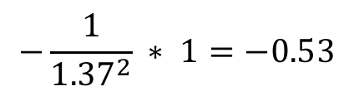

A detailed example
$$f\left(x,w\right)=\frac{1}{1+exp\left[−\left(w_{0}x_{0}+w_{1}x_{1}+w_{2}\right)\right]}$$
Local gradient
Upstream gradient
*
$${\left(1/x\right)}^{′}=−1/x^{2}$$
$$−\frac{1}{{1.37}^{2}} ∗ 1=−0.53$$
Source: Stanford 231n

Slide 20
A detailed example
$$f\left(x,w\right)=\frac{1}{1+exp\left[−\left(w_{0}x_{0}+w_{1}x_{1}+w_{2}\right)\right]}$$
Local gradient
Upstream gradient
*
Source: Stanford 231n

Slide 21

A detailed example
$$f\left(x,w\right)=\frac{1}{1+exp\left[−\left(w_{0}x_{0}+w_{1}x_{1}+w_{2}\right)\right]}$$
Local gradient
Upstream gradient
*
$$\exp\left(−1\right)∗\left(−0.53\right)=−0.20$$
Source: Stanford 231n

Slide 22
A detailed example
$$f\left(x,w\right)=\frac{1}{1+exp\left[−\left(w_{0}x_{0}+w_{1}x_{1}+w_{2}\right)\right]}$$
Local gradient
Upstream gradient
*
Source: Stanford 231n

Slide 23
A detailed example
$$f\left(x,w\right)=\frac{1}{1+exp\left[−\left(w_{0}x_{0}+w_{1}x_{1}+w_{2}\right)\right]}$$
Local gradient
Upstream gradient
*
Source: Stanford 231n

Slide 24
A detailed example
$$f\left(x,w\right)=\frac{1}{1+exp\left[−\left(w_{0}x_{0}+w_{1}x_{1}+w_{2}\right)\right]}$$
Local gradient
Upstream gradient
*
Source: Stanford 231n

Slide 25
A detailed example
$$f\left(x,w\right)=\frac{1}{1+exp\left[−\left(w_{0}x_{0}+w_{1}x_{1}+w_{2}\right)\right]}$$
Source: Stanford 231n

Slide 26
A detailed example
$$f\left(x,w\right)=\frac{1}{1+exp\left[−\left(w_{0}x_{0}+w_{1}x_{1}+w_{2}\right)\right]}$$
Source: Stanford 231n

Slide 27
A detailed example
$$f\left(x,w\right)=\frac{1}{1+exp\left[−\left(w_{0}x_{0}+w_{1}x_{1}+w_{2}\right)\right]}$$
-0.60
Source: Stanford 231n

Slide 28
A detailed example
$$f\left(x,w\right)=\frac{1}{1+exp\left[−\left(w_{0}x_{0}+w_{1}x_{1}+w_{2}\right)\right]}$$
-0.40
-0.60
Source: Stanford 231n

Slide 29
A detailed example
$$f\left(x,w\right)=\frac{1}{1+exp\left[−\left(w_{0}x_{0}+w_{1}x_{1}+w_{2}\right)\right]}$$
0.40
-0.40
-0.60
Source: Stanford 231n

Slide 30
A detailed example
$$f\left(x,w\right)=\frac{1}{1+exp\left[−\left(w_{0}x_{0}+w_{1}x_{1}+w_{2}\right)\right]}$$
0.40
-0.40
-0.60
Source: Stanford 231n

Slide 31
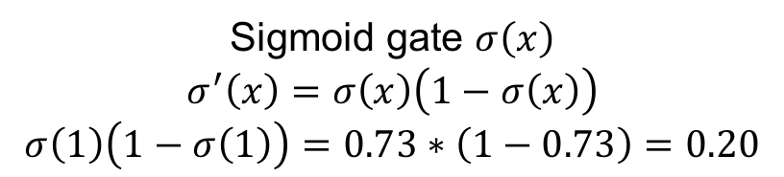
A detailed example
$$f\left(x,w\right)=\frac{1}{1+exp\left[−\left(w_{0}x_{0}+w_{1}x_{1}+w_{2}\right)\right]}$$
0.40
Can simplify computation graph
-0.40
-0.60
Sigmoid gate $σ\left(x\right)$
$$σ^{′}\left(x\right)=σ\left(x\right)\left(1−σ\left(x\right)\right)$$
$$σ\left(1\right)\left(1−σ\left(1\right)\right)=0.73∗\left(1−0.73\right)=0.20$$
Source: Stanford 231n

Slide 32
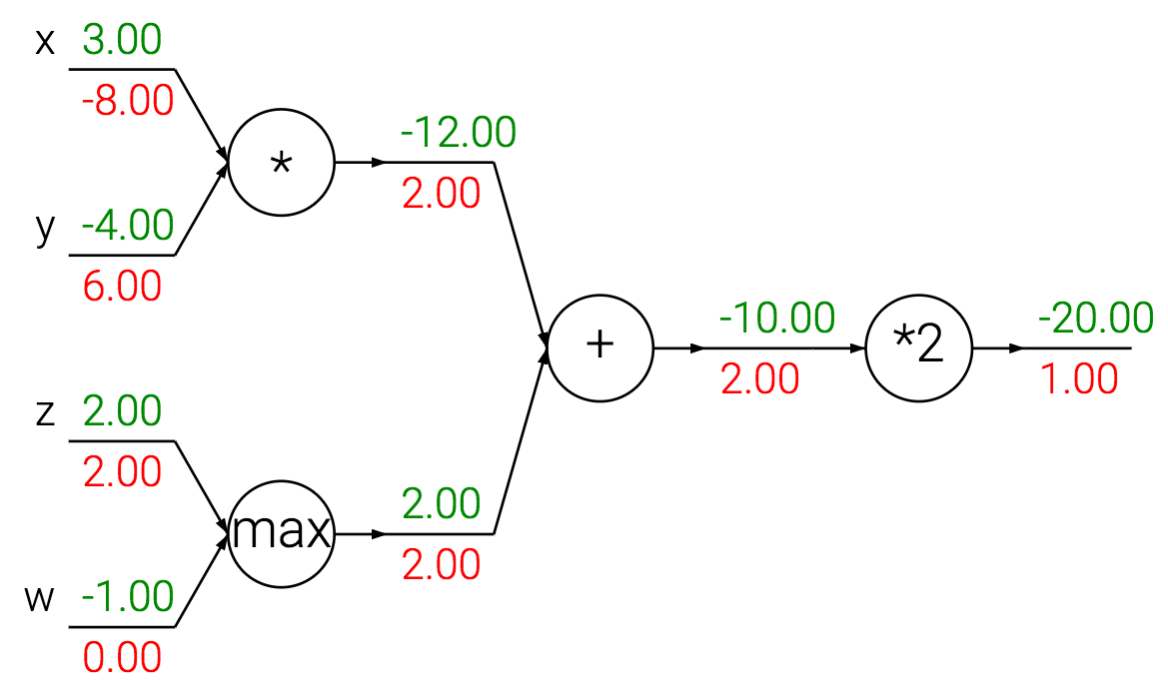
Patterns in gradient flow
Source: Stanford 231n

Slide 33
Patterns in gradient flow
Add gate: “gradient distributor”
Source: Stanford 231n

Slide 34
Patterns in gradient flow
Add gate: “gradient distributor”
Multiply gate: “gradient switcher”
Source: Stanford 231n

Slide 35
Patterns in gradient flow
Add gate: “gradient distributor”
Multiply gate: “gradient switcher”
Max gate: “gradient router”
Source: Stanford 231n

Slide 36




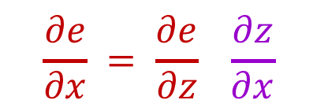









Dealing with vectors
$$=\left(\begin{matrix}\frac{∂z_{1}}{∂x_{1}} & … & \frac{∂z_{1}}{∂x_{M}} \\ ⋮ & ⋱ & ⋮ \\ \frac{∂z_{N}}{∂x_{1}} & … & \frac{∂z_{N}}{∂x_{M}}\end{matrix}\right)$$
$$\frac{∂z}{∂x}$$
$N×M$ Jacobian
$$x$$
$$f(x)$$
$$z$$
$1×M$
$$\frac{∂e}{∂x} = \frac{∂e}{∂z} \frac{∂z}{∂x}$$
$\frac{∂e}{∂z}$
$1×N$
$1×M$
$1×N$
$N×M$
$1×N$

Slide 37
Simple case: Elementwise operation

Slide 38








Simple case: Elementwise operation
$$=\left(\begin{matrix}\frac{∂z_{1}}{∂x_{1}} & … & \frac{∂z_{1}}{∂x_{M}} \\ ⋮ & ⋱ & ⋮ \\ \frac{∂z_{M}}{∂x_{1}} & … & \frac{∂z_{M}}{∂x_{M}}\end{matrix}\right)$$
$$\frac{∂z}{∂x}$$
$M×M$ Jacobian
$$x$$
$$f(x)=max⁡(0,x)$$
$$z$$
$1×M$
$\frac{∂e}{∂z}$
$1×M$
$1×M$

Slide 39









Simple case: Elementwise operation
$$=\left(\begin{matrix}𝕀[x_{1}>0] & … & 0 \\ ⋮ & ⋱ & ⋮ \\ 0 & … & 𝕀[x_{M}>0]\end{matrix}\right)$$
$$\frac{∂z}{∂x}$$
$M×M$ Jacobian
$$x$$
$$f(x)=max⁡(0,x)$$
$$z$$
$1×M$
$\frac{∂e}{∂z}$
$1×M$
$$\frac{∂e}{∂x} = \frac{∂e}{∂z} \frac{∂z}{∂x}$$
$1×M$
$1×M$
$M×M$
$1×M$
$$\frac{∂e}{∂x_{i}}=$$
$$𝕀\left[x_{i}>0\right]\frac{∂e}{∂z_{i}}$$
$$\frac{∂e}{∂x}=$$
$$𝕀\left[x>0\right]∗\frac{∂e}{∂z}$$

Slide 40




















Matrix-vector multiplication
$$\frac{∂e}{∂W} = \frac{∂e}{∂z} \frac{∂z}{∂W}$$
$$\frac{∂z}{∂W}$$
$$M×N$$
$1×N$
$$N×(M×N)$$
$$W$$
$$N×(M×N)$$
$$M×N$$
$$f(x,W)=xW$$
$$z$$
$\frac{∂e}{∂z}$
$$1×N$$
$$\frac{∂z}{∂x}$$
$$1×N$$
$$x$$
$$\frac{∂e}{∂x}= \frac{∂e}{∂z} \frac{∂z}{∂x}$$
$$1×M$$
$N×M$
$1×M$
$1×N$
$N×M$

Slide 41






Matrix-vector multiplication
$$z_{j}=\sum_{i=1}^{M}{x_{i}W_{ij}}$$
$\left(\begin{matrix}z_{1} & … & z_{N}\end{matrix}\right)=\left(\begin{matrix}x_{1} & … & x_{M}\end{matrix}\right)\left(\begin{matrix}W_{11} & … & W_{1N} \\ ⋮ & ⋱ & ⋮ \\ W_{M1} & … & W_{MN}\end{matrix}\right)$
Want: $\frac{∂e}{∂x}=\frac{∂e}{∂z} \frac{∂z}{∂x}$
$$\frac{∂z_{j}}{∂x_{i}}=W_{ij}$$
$$\frac{∂z}{∂x}=W^{T}$$
$$\frac{∂e}{∂x}=\frac{∂e}{∂z}\frac{∂z}{∂x}=\frac{∂e}{∂z}W^{T}$$
$1×M$
$$1×N$$
$N×M$
$j$th row, $i$th column of Jacobian

Slide 42






Matrix-vector multiplication
$$z_{j}=\sum_{i=1}^{M}{x_{i}W_{ij}}$$
$\left(\begin{matrix}z_{1} & … & z_{N}\end{matrix}\right)=\left(\begin{matrix}x_{1} & … & x_{M}\end{matrix}\right)\left(\begin{matrix}W_{11} & … & W_{1N} \\ ⋮ & ⋱ & ⋮ \\ W_{M1} & … & W_{MN}\end{matrix}\right)$
Want: $\frac{∂e}{∂W} = \frac{∂e}{∂z} \frac{∂z}{∂W}$
$$\frac{∂z_{k}}{∂W_{ij}}={𝕀[k=j]x}_{i}$$
$$\frac{∂e}{∂W_{ij}}=\sum_{k=1}^{N}{\frac{∂e}{∂z_{k}}\frac{∂z_{k}}{∂W_{ij}}}=\frac{∂e}{∂z_{j}}\frac{∂z_{j}}{∂W_{ij}}=\frac{∂e}{∂z_{j}}x_{i}$$
$$\frac{∂e}{∂W}=x^{T}\frac{∂e}{∂z}$$
$$M×N$$
$1×N$
$$N×(M×N)$$
$z_{k}$ depends only on $k$th column of $W$

Slide 43
General tips
Derive error signal (upstream gradient) directly, avoid explicit computation of huge local derivatives
Write out expression for a single element of the Jacobian, then deduce the overall formula
Keep consistent indexing conventions, order of operations
Use dimension analysis
Useful resource: see Lecture 4 of Stanford 231n and associated links in the syllabus

