Slide 1
Multi-layer neural networks and backpropagation (Examples)
Jianguo Zhang

Slide 2
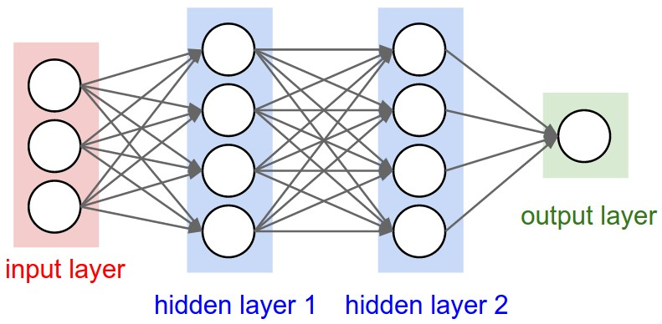
Beyond two layers
Slides adapted from lana lazebnik

Slide 3
“Deep” pipeline
Raw input
Layer 1
Layer 2
Layer 3
Output
Learn a feature hierarchy
Each layer extracts features from the output of previous layer
All layers are trained jointly

Slide 4
How to train a multi-layer network?

Slide 5
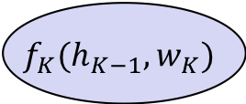

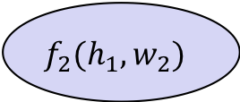

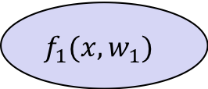

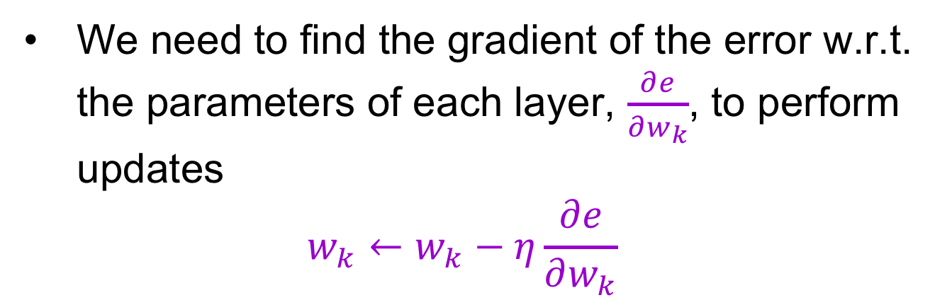


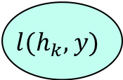

BP examples explained
hidden representation
output
$$h_{1}$$
$$h_{2}$$
$$h_{K−1}$$
$$h_{K}$$
$$f_{1}(x,w_{1})$$
$$f_{2}(h_{1},w_{2})$$
$$f_{K}(h_{K−1},w_{K})$$
$$l(h_{k},y)$$
$$x$$
…
$$e$$
input
first layer transformation
second layer transformation
output layer
loss function
error
We need to find the gradient of the error w.r.t. the parameters of each layer, $\frac{∂e}{∂w_{k}}$, to perform updates
$$w_{k}←w_{k}−η\frac{∂e}{∂w_{k}}$$

Slide 6



Computation graph
$$w_{1}$$
$$w_{2}$$
$$w_{K}$$
$$h_{1}$$
$$h_{2}$$
$$h_{K−1}$$
$$h_{K}$$
$$f_{1}(x,w_{1})$$
$$f_{2}(h_{1},w_{2})$$
$$f_{K}(h_{K−1},w_{K})$$
$$l(h_{k},y)$$
$$x$$
…
$$e$$
Notes:
This kind of chained based graph is very important for us to compute the gradient. It has another name called computation graph. Those are cores for us to implement the backpropagation algorithm based on the chain rule. Now let us look at them one by one

Slide 7
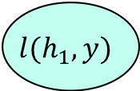
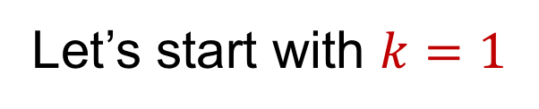
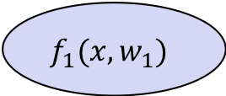

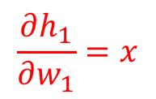
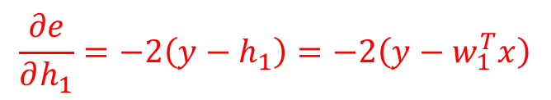
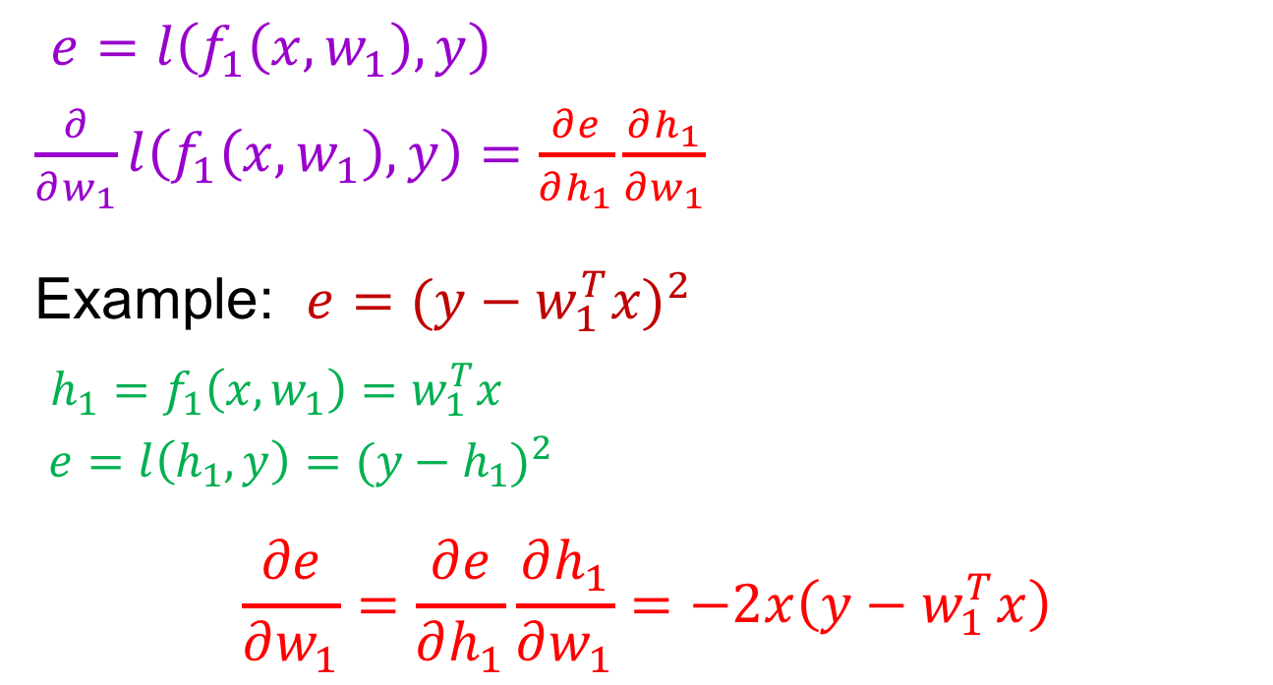
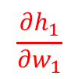


Chain rule
$$w_{1}$$
$$h_{1}$$
Let’s start with $k=1$
$$f_{1}(x,w_{1})$$
$$l(h_{1},y)$$
$$x$$
$$e$$
$$\frac{∂e}{∂h_{1}}$$
$$\frac{∂h_{1}}{∂w_{1}}$$
$e=l\left(f_{1}\left(x,w_{1}\right),y\right)$
$\frac{∂}{∂w_{1}}l\left(f_{1}\left(x,w_{1}\right),y\right)=\frac{∂e}{∂h_{1}}\frac{∂h_{1}}{∂w_{1}}$
Example: $e{=(y−w_{1}^{T}x)}^{2}$
$h_{1}=f_{1}\left(x,w_{1}\right)=w_{1}^{T}x$
$e=l\left(h_{1},y\right)={(y−h_{1})}^{2}$
$$\frac{∂e}{∂w_{1}}=\frac{∂e}{∂h_{1}}\frac{∂h_{1}}{∂w_{1}}=−2x\left(y−w_{1}^{T}x\right)$$
$$\frac{∂h_{1}}{∂w_{1}}=x$$
$$\frac{∂e}{∂h_{1}}=−2\left(y−h_{1}\right)=−2\left(y−w_{1}^{T}x\right)$$

Slide 8
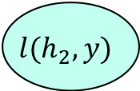

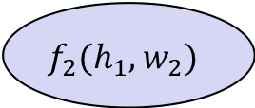
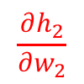








Chain rule
$$w_{1}$$
$$w_{2}$$
$$h_{1}$$
$$h_{2}$$
$$k=2$$
$$f_{1}(x,w_{1})$$
$$f_{2}(h_{1},w_{2})$$
$$l(h_{2},y)$$
$$x$$
$$e$$
$$\frac{∂e}{∂h_{2}}$$
$$\frac{∂h_{2}}{∂w_{2}}$$
$e=l\left(f_{2}(f_{1}(x,w_{1}),w_{2})\right)$
$\frac{∂e}{∂w_{2}}=\frac{∂e}{∂h_{2}}\frac{∂h_{2}}{∂w_{2}} \frac{∂e}{∂w_{1}}=\frac{∂e}{∂h_{2}}\frac{∂h_{2}}{∂h_{1}}\frac{∂h_{1}}{∂w_{1}}$

Slide 9
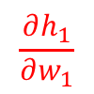



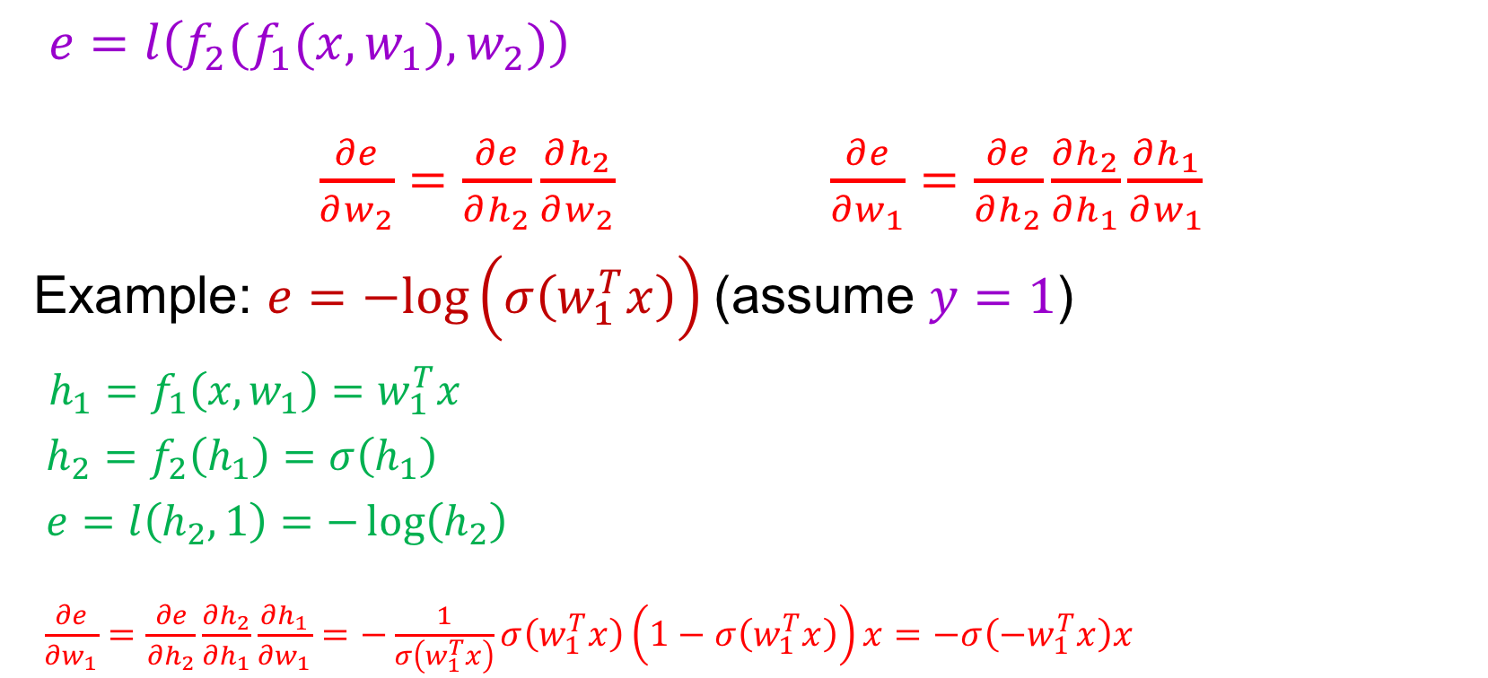


Chain rule
$$w_{1}$$
$$w_{2}$$
$$h_{1}$$
$$h_{2}$$
$$k=2$$
$$f_{1}(x,w_{1})$$
$$f_{2}(h_{1},w_{2})$$
$$l(h_{2},y)$$
$$x$$
$$e$$
$$\frac{∂e}{∂h_{1}}$$
$$\frac{∂e}{∂h_{2}}$$
$$\frac{∂h_{1}}{∂w_{1}}$$
$$\frac{∂h_{2}}{∂h_{1}}$$
$e=l\left(f_{2}(f_{1}(x,w_{1}),w_{2})\right)$
$\frac{∂e}{∂w_{2}}=\frac{∂e}{∂h_{2}}\frac{∂h_{2}}{∂w_{2}} \frac{∂e}{∂w_{1}}=\frac{∂e}{∂h_{2}}\frac{∂h_{2}}{∂h_{1}}\frac{∂h_{1}}{∂w_{1}}$
Example: $e=−log\left(σ\left(w_{1}^{T}x\right)\right)$ (assume $y=1$)
$h_{1}=f_{1}\left(x,w_{1}\right)=w_{1}^{T}x$
$h_{2}=f_{2}\left(h_{1}\right)=σ\left(h_{1}\right)$
$e=l\left(h_{2},1\right)=−\log\left(h_{2}\right)$
$\frac{∂e}{∂w_{1}}=\frac{∂e}{∂h_{2}}\frac{∂h_{2}}{∂h_{1}}\frac{∂h_{1}}{∂w_{1}}=−\frac{1}{σ\left(w_{1}^{T}x\right)}σ\left(w_{1}^{T}x\right)\left(1−σ\left(w_{1}^{T}x\right)\right)x=−σ\left(−w_{1}^{T}x\right)x$
$$\frac{∂h_{1}}{∂w_{1}}=x$$
$$\frac{∂h_{2}}{∂h_{1}}=σ^{′}\left(h_{1}\right)=σ\left(h_{1}\right)(1−σ\left(h_{1}\right))$$
$$\frac{∂e}{∂h_{2}}=−\frac{1}{h_{2}}$$

Slide 10
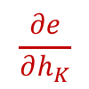
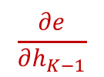
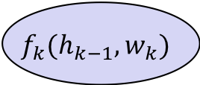

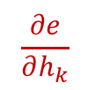
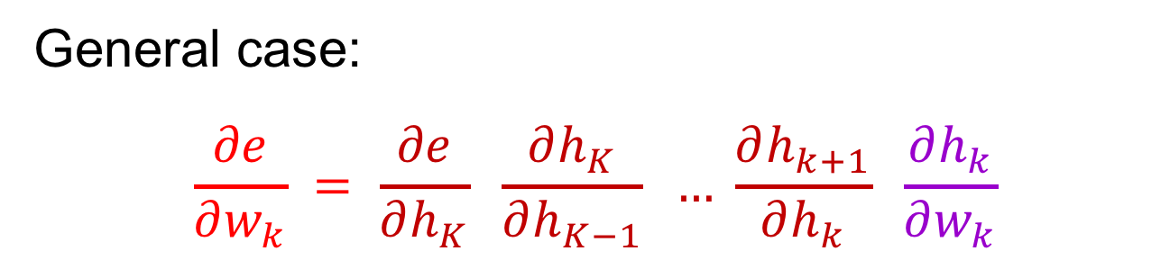

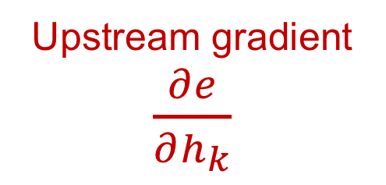
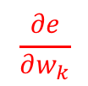

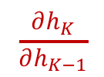
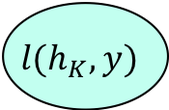

Chain rule
$$\frac{∂e}{∂w_{k}}$$
$$w_{k}$$
$$w_{K}$$
$$h_{k−1}$$
$$h_{k}$$
$$h_{K−1}$$
$$h_{K}$$
$$f_{k}(h_{k−1},w_{k})$$
$$f_{K}(h_{K−1},w_{K})$$
$$l(h_{K},y)$$
…
$$e$$
$$\frac{∂e}{∂h_{k}}$$
$$\frac{∂e}{∂h_{K−1}}$$
$$\frac{∂e}{∂h_{K}}$$
$$\frac{∂h_{k}}{∂w_{k}}$$
$$\frac{∂h_{K}}{∂h_{K−1}}$$
General case:
$$\frac{∂e}{∂w_{k}} = \frac{∂e}{∂h_{K}} \frac{∂h_{K}}{∂h_{K−1}} … \frac{∂h_{k+1}}{∂h_{k}} \frac{∂h_{k}}{∂w_{k}}$$
Upstream gradient $\frac{∂e}{∂h_{k}}$
Local gradient
Notes:
Ok, now let us look at a more general case: If we would like to compute the partial derivatives of the loss function w.r.t. the parameters W_k at the k th layer, first we could compute the partial derivatives of the loss function w.r.t the output of the kth layer, enclosed by the red rectangle. This derivates w.r.t. small h_k is then multiplied with the partial derivative of h_k wrt to the parameters of w_k. This part within the red rectangle is called the upstream gradient, and this part is called local gradient. In general, computing the gradient of the loss function w.r.t the parameters on a specific layer l, is the multiplication of the of the upstream gradient up to that layer with the local gradient at that layer.
Note that this is the small k here. The big K indicates the total number of layers.

Slide 11
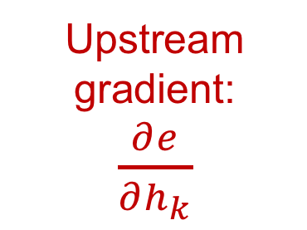
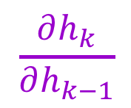
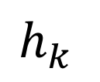
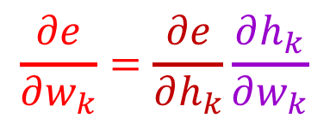
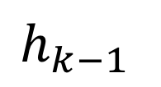
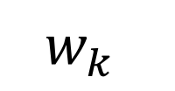

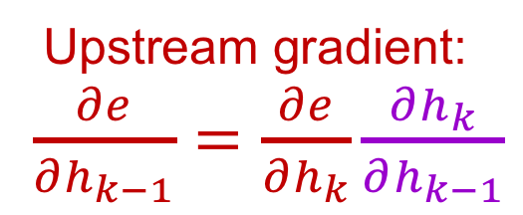
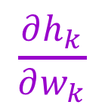
Backpropagation summary
Parameter update:
$$\frac{∂e}{∂w_{k}}=\frac{∂e}{∂h_{k}}\frac{∂h_{k}}{∂w_{k}}$$
$$w_{k}$$
Upstream gradient:
$\frac{∂e}{∂h_{k}}$
$$\frac{∂h_{k}}{∂w_{k}}$$
Local gradient
$$f_{k}$$
$$h_{k}$$
$$\frac{∂h_{k}}{∂h_{k−1}}$$
Local gradient
$$h_{k−1}$$
Upstream gradient:
$\frac{∂e}{∂h_{k−1}}=\frac{∂e}{∂h_{k}}\frac{∂h_{k}}{∂h_{k−1}}$
Forward pass
Backward pass
Notes:
Now let us look at the summary of the backpropagation algorithm. It involves one forward pass (denoted by the green arrows) and then backward pass. For a particular layer k, in the forward pass, we know w_k and h_(k-1) and feed them into the function f_k at the layer, and evaluate its ouput; and then you get h_k, and etc. When doing the backward pass for that particular layer; we have a upstream gradient computed w.r.t the output of layer k, i.e., h_k. For the function at layer k, f_k, we can compute two gradients one is the gradient of f_k wrt the parameters k, i.e., df/dw; the other gradient is the gradient of f_k wrt its input h_, I,e, the output of previous layer. By applying the chain rule on both path, we could obtain the gradient of loss w.r.t the parameters at that layer, and the gradient of loss w.r.t to the output of the layer k-1, i.e., propagate the upstream gradient to the previous layer k-1. DO this recursively, we could get all of the gradient of the loss w.r.t all of the parameters.

Slide 12
What about more general computation graphs?
ResNet
ResNeXt
Figure source
Notes:
In more general case, we just follow the same principle, and evaluate the gradients for all of the possible paths. Now let us look at them

Slide 13
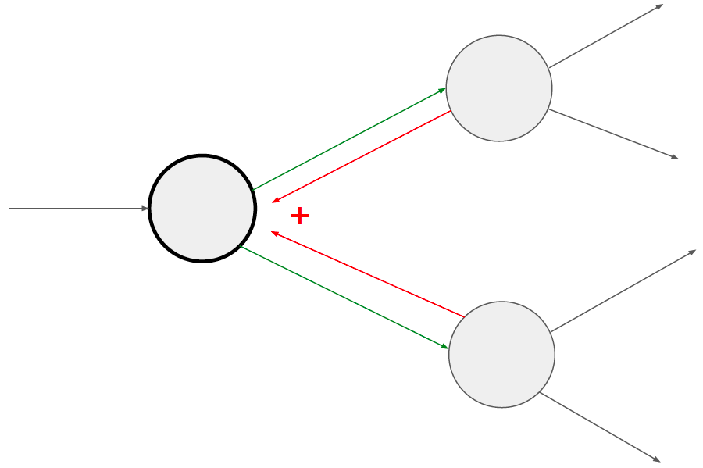
What about more general computation graphs?
+ Gradients add at branches
Source: Stanford 231n
Notes:
The rule is that for each node, the gradients are collected at all of its outgoing branches (i.e., paths.) For example, for this node, the there are two outgoing paths in the forward pass. When propagating the gradient, we consider the onsite direction of those outgoing paths. Those two directions become the in-going branches for gradients computation. And the gradients w.r.t the output of this node is simply the summation of all of the gradients from those branches.

Slide 14
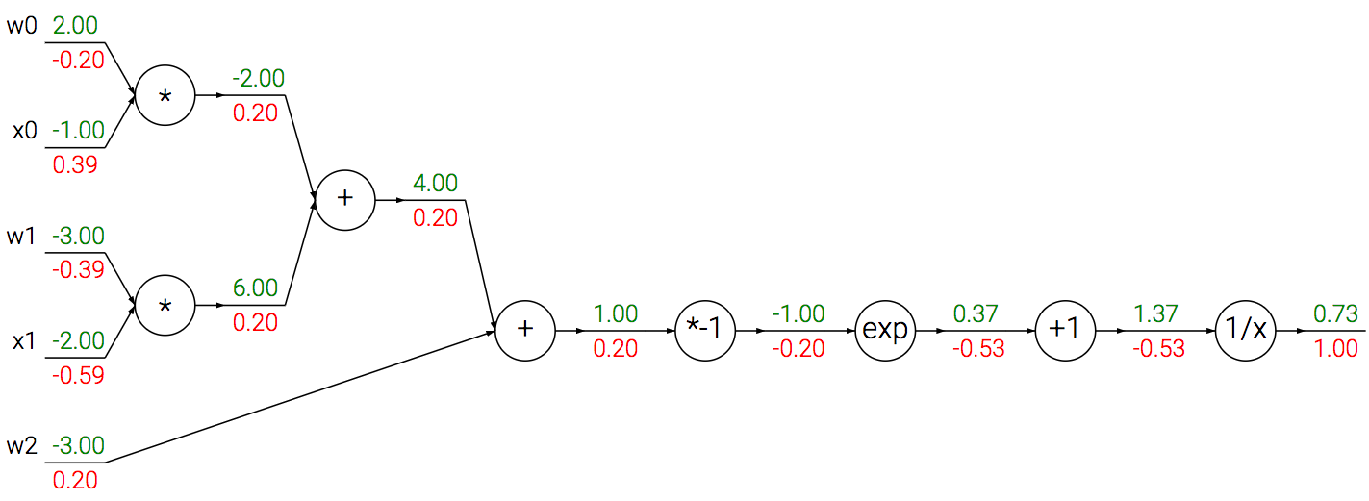
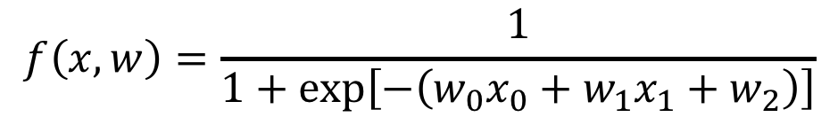
A detailed example
$$f\left(x,w\right)=\frac{1}{1+exp\left[−\left(w_{0}x_{0}+w_{1}x_{1}+w_{2}\right)\right]}$$
Source: Stanford 231n
Notes:
Now let us use a very specific example to illustrate gradient calculation on the graph. Look that we take a logistic regression as an example. The computation grah of the logistic regression example is as follows. Each circle represents one math operation and each line with arrow represents either input variable or output variable. Let us look at the forward pass by first setting those inputs and weights to those values. Then we compute the values of those functions step by step. First is the multiplication and followed by addition.

Slide 15

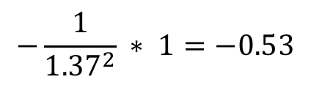
A detailed example
$$f\left(x,w\right)=\frac{1}{1+exp\left[−\left(w_{0}x_{0}+w_{1}x_{1}+w_{2}\right)\right]}$$
Local gradient
Upstream gradient
*
$${\left(1/x\right)}^{′}=−1/x^{2}$$
$$−\frac{1}{{1.37}^{2}} ∗ 1=−0.53$$
Source: Stanford 231n
Notes:
In the forward pass, we could store the output of each node and those values could be potentially used in the backward pass for computing the gradient. In this graph, when we finished the forward pass, we could get the final output as 0.73. Now let us look at the backward. The first local function is1 over x; and its gradient is minus 1 over x square, we know the value of x is 1.37, and based on this we could evaluate the value of this gradient at x=1.37 and get a value of -053.

Slide 16
A detailed example
$$f\left(x,w\right)=\frac{1}{1+exp\left[−\left(w_{0}x_{0}+w_{1}x_{1}+w_{2}\right)\right]}$$
Local gradient
Upstream gradient
*
Source: Stanford 231n
Notes:
And the -0.53 becomes he upstream gradient fort he add 1 layer, and multiply its local gradient 1.

Slide 17

A detailed example
$$f\left(x,w\right)=\frac{1}{1+exp\left[−\left(w_{0}x_{0}+w_{1}x_{1}+w_{2}\right)\right]}$$
Local gradient
Upstream gradient
*
$$\exp\left(−1\right)∗\left(−0.53\right)=−0.20$$
Source: Stanford 231n
Notes:
We get -0.53, which is the upstream gradient for the exp node, and multiply this with the local gradient of exp at input with -1 and we get -0.20

Slide 18
A detailed example
$$f\left(x,w\right)=\frac{1}{1+exp\left[−\left(w_{0}x_{0}+w_{1}x_{1}+w_{2}\right)\right]}$$
Local gradient
Upstream gradient
*
Source: Stanford 231n
Notes:
-0.20 is then upstream gradient for the *multiply by one* node, then multiply the local gradient of -1

Slide 19
A detailed example
$$f\left(x,w\right)=\frac{1}{1+exp\left[−\left(w_{0}x_{0}+w_{1}x_{1}+w_{2}\right)\right]}$$
Local gradient
Upstream gradient
*
Source: Stanford 231n
Notes:
We get 0.20, the upstream gradient for the addition layer.

Slide 20
A detailed example
$$f\left(x,w\right)=\frac{1}{1+exp\left[−\left(w_{0}x_{0}+w_{1}x_{1}+w_{2}\right)\right]}$$
Local gradient
Upstream gradient
*
Source: Stanford 231n
Notes:
And then we could get gradient of the loss w.r.t. w_2, by multiplying the upstream gradient with the local gradient which is 1; this will give us a value of 0.20

Slide 21
A detailed example
$$f\left(x,w\right)=\frac{1}{1+exp\left[−\left(w_{0}x_{0}+w_{1}x_{1}+w_{2}\right)\right]}$$
Source: Stanford 231n
Notes:
The same applied to another branch connecting to the adding node.

Slide 22
A detailed example
$$f\left(x,w\right)=\frac{1}{1+exp\left[−\left(w_{0}x_{0}+w_{1}x_{1}+w_{2}\right)\right]}$$
Source: Stanford 231n

Slide 23
A detailed example
$$f\left(x,w\right)=\frac{1}{1+exp\left[−\left(w_{0}x_{0}+w_{1}x_{1}+w_{2}\right)\right]}$$
-0.60
Source: Stanford 231n
Notes:
and then we could get the upstream gradient for both multiplication nodes. For the the x1 and w1 multiplication node, we multiply the upstream gradient 0.20 with the local gradient w.r.t. the input x1, we could get 0.20 x 03.00 = 0.60

Slide 24
A detailed example
$$f\left(x,w\right)=\frac{1}{1+exp\left[−\left(w_{0}x_{0}+w_{1}x_{1}+w_{2}\right)\right]}$$
-0.40
-0.60
Source: Stanford 231n

Slide 25
A detailed example
$$f\left(x,w\right)=\frac{1}{1+exp\left[−\left(w_{0}x_{0}+w_{1}x_{1}+w_{2}\right)\right]}$$
0.40
-0.40
-0.60
Source: Stanford 231n

Slide 26
A detailed example
$$f\left(x,w\right)=\frac{1}{1+exp\left[−\left(w_{0}x_{0}+w_{1}x_{1}+w_{2}\right)\right]}$$
0.40
-0.40
-0.60
Source: Stanford 231n

Slide 27
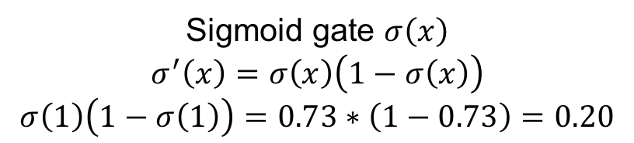
A detailed example
$$f\left(x,w\right)=\frac{1}{1+exp\left[−\left(w_{0}x_{0}+w_{1}x_{1}+w_{2}\right)\right]}$$
0.40
Can simplify computation graph
-0.40
-0.60
Sigmoid gate $σ\left(x\right)$
$$σ^{′}\left(x\right)=σ\left(x\right)\left(1−σ\left(x\right)\right)$$
$$σ\left(1\right)\left(1−σ\left(1\right)\right)=0.73∗\left(1−0.73\right)=0.20$$
Source: Stanford 231n
Notes:
Now we complete one pass of forward propagation and backward propagation. Now let us look at this in a bottom up manner. The graph with the red rectangle is acurally the sigmoid function. In this way, we could use the sigmoid function to replace this red part and simplify the graph.

Slide 28
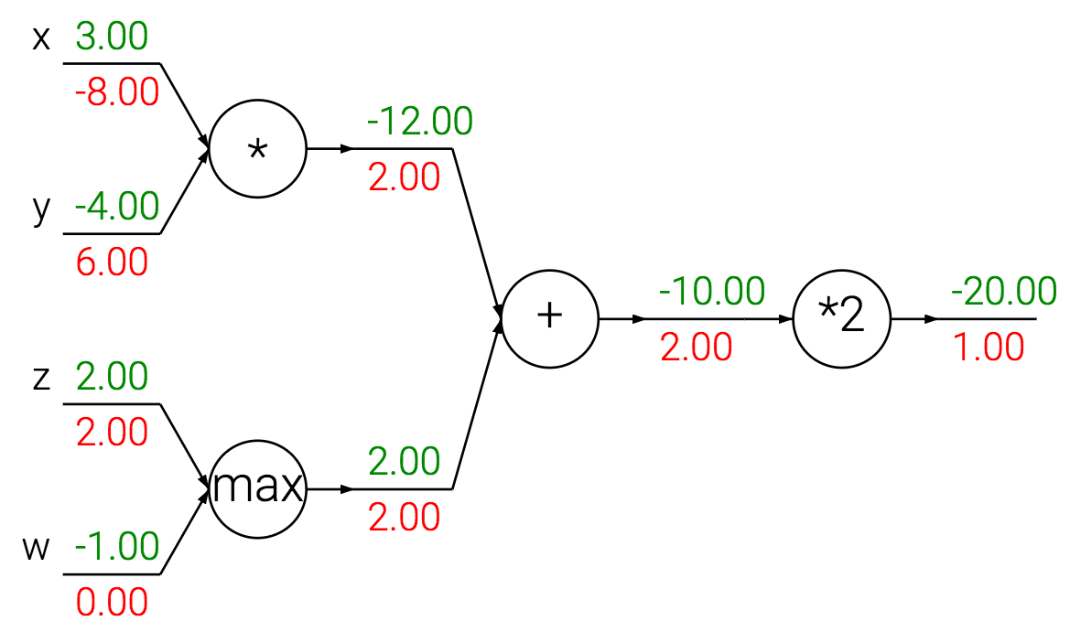
Patterns in gradient flow
Source: Stanford 231n
Notes:
Now let us summarize the patterns in gradient flow using another simple example

Slide 29
Patterns in gradient flow
Add gate: “gradient distributor”
Source: Stanford 231n
Notes:
The add gate is the gradient distributor (equally)

Slide 30
Patterns in gradient flow
Add gate: “gradient distributor”
Multiply gate: “gradient switcher”
Source: Stanford 231n

Slide 31
Patterns in gradient flow
Add gate: “gradient distributor”
Multiply gate: “gradient switcher”
Max gate: “gradient router”
Source: Stanford 231n

Slide 32
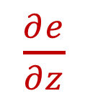





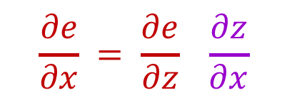


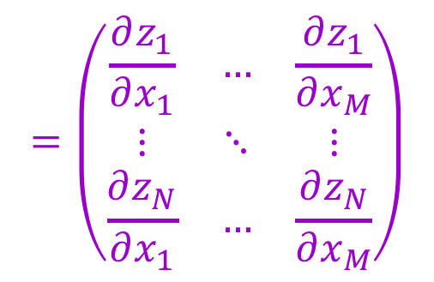
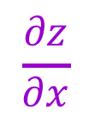

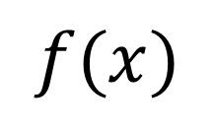

Dealing with vectors
$$=\left(\begin{matrix}\frac{∂z_{1}}{∂x_{1}} & … & \frac{∂z_{1}}{∂x_{M}} \\ ⋮ & ⋱ & ⋮ \\ \frac{∂z_{N}}{∂x_{1}} & … & \frac{∂z_{N}}{∂x_{M}}\end{matrix}\right)$$
$$\frac{∂z}{∂x}$$
$N×M$ Jacobian
$$x$$
$$f(x)$$
$$z$$
$1×M$
$$\frac{∂e}{∂x} = \frac{∂e}{∂z} \frac{∂z}{∂x}$$
$\frac{∂e}{∂z}$
$1×N$
$1×M$
$1×N$
$N×M$
$1×N$
Notes:
In neuro network, we each layer normally has multiple outputs, that is we need to deal with vectors

Slide 33
Simple case: Elementwise operation

Slide 34
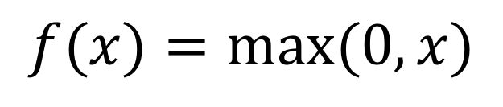

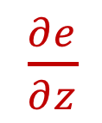





Simple case: Elementwise operation
$$=\left(\begin{matrix}\frac{∂z_{1}}{∂x_{1}} & … & \frac{∂z_{1}}{∂x_{M}} \\ ⋮ & ⋱ & ⋮ \\ \frac{∂z_{M}}{∂x_{1}} & … & \frac{∂z_{M}}{∂x_{M}}\end{matrix}\right)$$
$$\frac{∂z}{∂x}$$
$M×M$ Jacobian
$$x$$
$$f(x)=max⁡(0,x)$$
$$z$$
$1×M$
$\frac{∂e}{∂z}$
$1×M$
$1×M$

Slide 35









Simple case: Elementwise operation
$$=\left(\begin{matrix}𝕀[x_{1}>0] & … & 0 \\ ⋮ & ⋱ & ⋮ \\ 0 & … & 𝕀[x_{M}>0]\end{matrix}\right)$$
$$\frac{∂z}{∂x}$$
$M×M$ Jacobian
$$x$$
$$f(x)=max⁡(0,x)$$
$$z$$
$1×M$
$\frac{∂e}{∂z}$
$1×M$
$$\frac{∂e}{∂x} = \frac{∂e}{∂z} \frac{∂z}{∂x}$$
$1×M$
$1×M$
$M×M$
$1×M$
$$\frac{∂e}{∂x_{i}}=$$
$$𝕀\left[x_{i}>0\right]\frac{∂e}{∂z_{i}}$$
$$\frac{∂e}{∂x}=$$
$$𝕀\left[x>0\right]∗\frac{∂e}{∂z}$$

Slide 36




















Matrix-vector multiplication
$$\frac{∂e}{∂W} = \frac{∂e}{∂z} \frac{∂z}{∂W}$$
$$\frac{∂z}{∂W}$$
$$M×N$$
$1×N$
$$N×(M×N)$$
$$W$$
$$N×(M×N)$$
$$M×N$$
$$f(x,W)=xW$$
$$z$$
$\frac{∂e}{∂z}$
$$1×N$$
$$\frac{∂z}{∂x}$$
$$1×N$$
$$x$$
$$\frac{∂e}{∂x}= \frac{∂e}{∂z} \frac{∂z}{∂x}$$
$$1×M$$
$N×M$
$1×M$
$1×N$
$N×M$

Slide 37






Matrix-vector multiplication
$$z_{j}=\sum_{i=1}^{M}{x_{i}W_{ij}}$$
$\left(\begin{matrix}z_{1} & … & z_{N}\end{matrix}\right)=\left(\begin{matrix}x_{1} & … & x_{M}\end{matrix}\right)\left(\begin{matrix}W_{11} & … & W_{1N} \\ ⋮ & ⋱ & ⋮ \\ W_{M1} & … & W_{MN}\end{matrix}\right)$
Want: $\frac{∂e}{∂x}=\frac{∂e}{∂z} \frac{∂z}{∂x}$
$$\frac{∂z_{j}}{∂x_{i}}=W_{ij}$$
$$\frac{∂z}{∂x}=W^{T}$$
$$\frac{∂e}{∂x}=\frac{∂e}{∂z}\frac{∂z}{∂x}=\frac{∂e}{∂z}W^{T}$$
$1×M$
$$1×N$$
$N×M$
$j$th row, $i$th column of Jacobian

Slide 38






Matrix-vector multiplication
$$z_{j}=\sum_{i=1}^{M}{x_{i}W_{ij}}$$
$\left(\begin{matrix}z_{1} & … & z_{N}\end{matrix}\right)=\left(\begin{matrix}x_{1} & … & x_{M}\end{matrix}\right)\left(\begin{matrix}W_{11} & … & W_{1N} \\ ⋮ & ⋱ & ⋮ \\ W_{M1} & … & W_{MN}\end{matrix}\right)$
Want: $\frac{∂e}{∂W} = \frac{∂e}{∂z} \frac{∂z}{∂W}$
$$\frac{∂z_{k}}{∂W_{ij}}={𝕀[k=j]x}_{i}$$
$$\frac{∂e}{∂W_{ij}}=\sum_{k=1}^{N}{\frac{∂e}{∂z_{k}}\frac{∂z_{k}}{∂W_{ij}}}=\frac{∂e}{∂z_{j}}\frac{∂z_{j}}{∂W_{ij}}=\frac{∂e}{∂z_{j}}x_{i}$$
$$\frac{∂e}{∂W}=x^{T}\frac{∂e}{∂z}$$
$$M×N$$
$1×N$
$$N×(M×N)$$
$z_{k}$ depends only on $k$th column of $W$

Slide 39
General tips
Derive error signal (upstream gradient) directly, avoid explicit computation of huge local derivatives
Write out expression for a single element of the Jacobian, then deduce the overall formula
Keep consistent indexing conventions, order of operations
Useful resource: see Lecture 4 of Stanford 231n and associated links in the syllabus

Slide 40
Next lecture: optimization and regularization

