Slide 1
Deep Learning (CS324)
4. Optimisation and regularisation*
Prof. Jianguo Zhang
SUSTech
*Based on http://www.deeplearningbook.org chapters 7 and 8

Slide 2

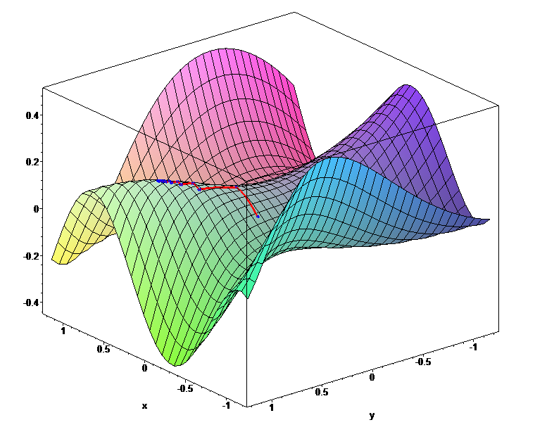
Gradient descent
We’ve already learned how gradient descent works…

Slide 3
Gradient descent
…but actually there are many versions of it!

Slide 4
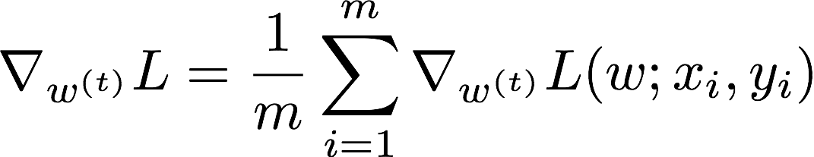
Batch gradient descent
…but actually there are many versions of it!
If we compute the gradient on the full training set we are doing batch gradient descent

Slide 5
Batch gradient descent
…but actually there are many versions of it!
If we compute the gradient on the full training set we are doing batch gradient descent
m training samples (xi,yi)

Slide 6
Batch gradient descent
…but actually there are many versions of it!
If we compute the gradient on the full training set we are doing batch gradient descent
But note that this is just a sample gradient, an estimate that is likely to be
different from the true gradient if we knew the real data distribution

Slide 7
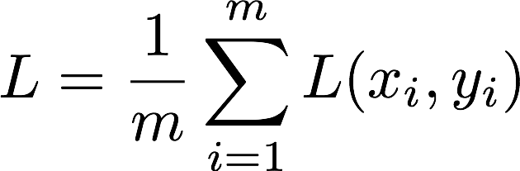
Batch gradient descent
…but actually there are many versions of it!
If we compute the gradient on the full training set we are doing batch gradient descent
In practice we compute the loss as the average loss over all the training samples
and then we compute the gradient of this number wrt w

Slide 8
Batch GD: advantages
Acceleration techniques based on second order derivatives (Hessian) can be used
We can measure not only the gradient but also the curvature of the loss function
It’s possible to do a simple theoretical analysis of the convergence rate

Slide 9
Batch GD: disadvantages
Datasets can be too large for a complete gradient computation to be feasible
Loss surfaces are highly non-convex and high dimensional

Slide 10
Stochastic gradient descent
An alternative is to compute the gradient and use it to update the weights as we input the training samples one by one
This is called Stochastic Gradient Descent (SGD)
Instead of doing…

Slide 11
Stochastic gradient descent
An alternative is to compute the gradient and use it to update the weights as we input the training samples one by one
This is called Stochastic Gradient Descent (SGD)
We do…

Slide 12
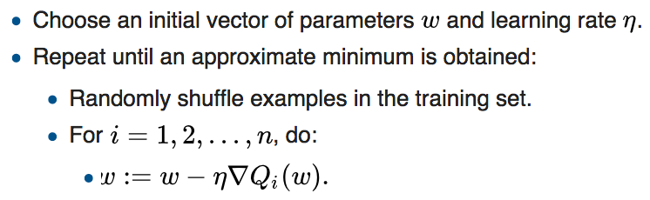
Stochastic gradient descent
An alternative is to compute the gradient and use it to update the weights as we input the training samples one by one
This is called Stochastic Gradient Descent (SGD)
We do…
Source: https://en.wikipedia.org/wiki/Stochastic_gradient_descent#Iterative_method

Slide 13
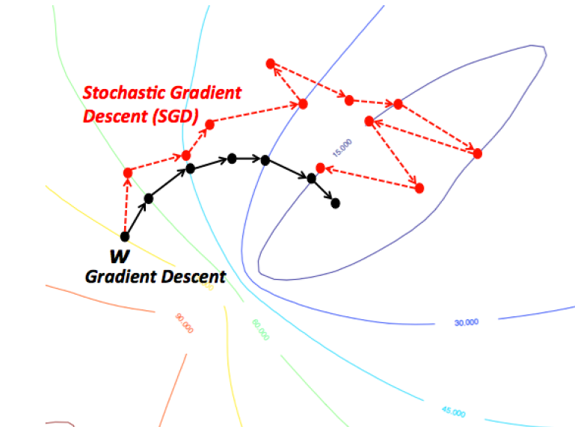
Source: https://www.bogotobogo.com/python/scikit-learn/scikit-learn_batch-gradient-descent-versus-stochastic-gradient-descent.php

Slide 14
SGD: advantages
Faster than gradient descent
Start improving from first sample rather than waiting; also, there may be redundant when considering whole training data
Randomness helps to avoid overfitting, which in turn can improve the accuracy
Suitable for datasets that change over time

Slide 15
SGD: disadvantages
Mostly, it’s an approximation of an approximation so it’s bound to be imperfect
But in practice this is not a problem, in fact it’s an advantage (noise helps against overfitting)
The main problem is that with samples of size 1 we can’t take advantage of massive parallelism…

Slide 16
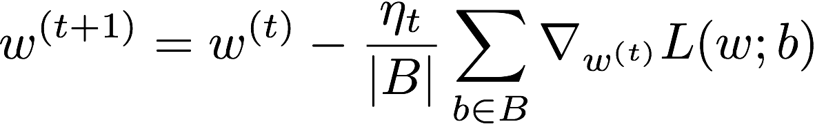
Mini-batch gradient descent
So why not using more than 1 data sample to compute the gradient, but less than the entire training set?
This is called mini-batch gradient descent
where B is a sample of the data
More general version of stochastic gradient descent (so often called SGD)

Slide 17
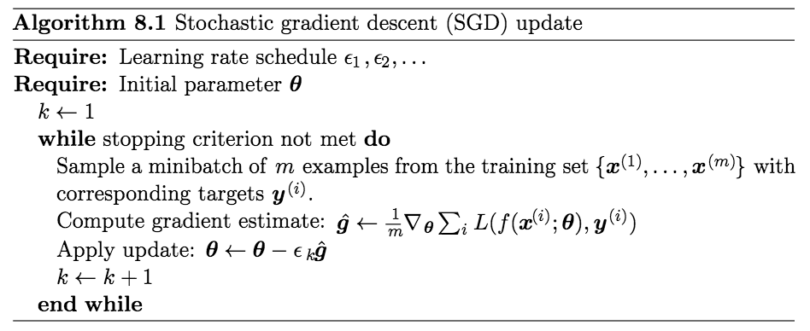
Mini-batch gradient descent

Slide 18
SGD vs GD
SGD works well when the data changes over time, while GD is biased toward “past” samples
SGD can choose samples with maximum information content
SGD can also choose samples that generated the largest errors in the previous epoch, to yield larger gradients and thus faster learning

Slide 19
SGD vs GD
SGD works well when the data changes over time, while GD is biased toward “past” samples
SGD can choose samples with maximum information content
SGD can also choose samples that generated the largest errors in the previous epoch, to yield larger gradients and thus faster learning
…but how many samples? Hyper-parameter, trial & error; usually as many as the GPU fits

Slide 20
SGD vs GD
SGD works well when the data changes over time, while GD is biased toward “past” samples
SGD can choose samples with maximum information content
SGD can also choose samples that generated the largest errors in the previous epoch, to yield larger gradients and thus faster learning
…but how many samples? Hyper-parameter, trial & error; usually as many as the GPU fits
https://blog.paperspace.com/intro-to-optimization-in-deep-learning-gradient-descent/

Slide 21
Challenges in optimisation
Ill-conditioning
Local minima
Plateaus, saddle points, and other flat regions

Slide 22
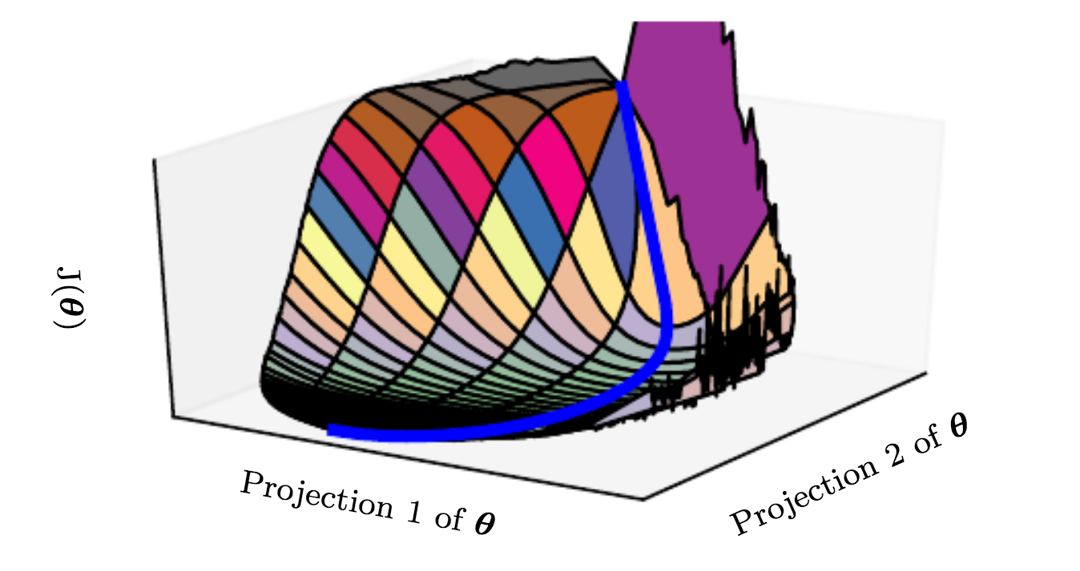
Challenges in optimisation

Slide 23
Challenges in optimisation
Ill-conditioning
Local minima
Plateaus, saddle points, and other flat regions
Cliffs and exploding gradients

Slide 24
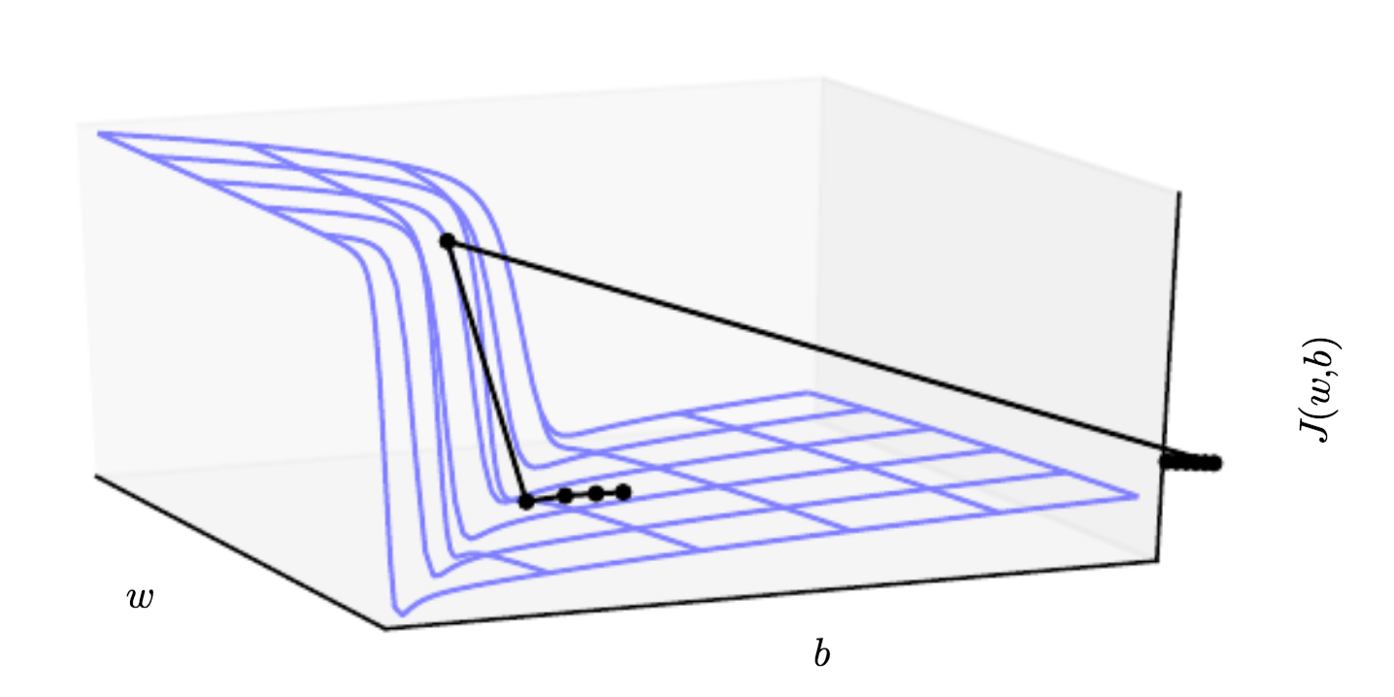
Challenges in optimisation

Slide 25
Challenges in optimisation
See https://www.cs.umd.edu/~tomg/projects/landscapes/ for more cool visualisations

Slide 26
Momentum
Analogy with physical momentum
Keep taking into account past gradients but let their contribution decay exponentially with time
This is performed through a velocity parameter which accumulates the value of previous gradients
This dampens oscillations, yielding a more robust gradients which in turn leads to faster convergence

Slide 27
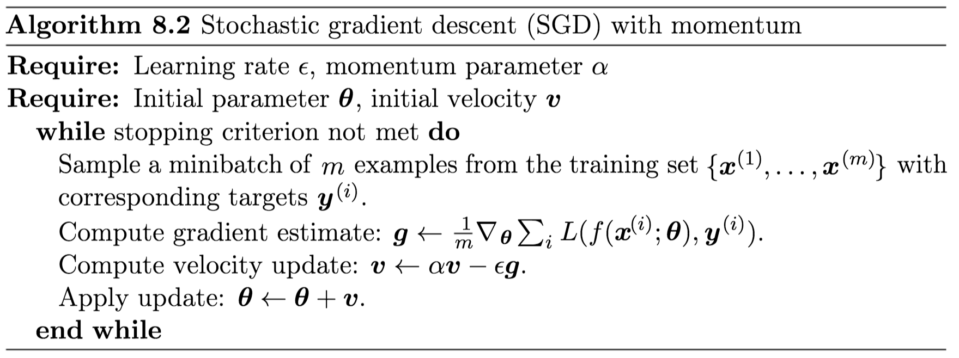
SGD with momentum

Slide 28
SGD with momentum
Typical values are 0.5, 0.9, or 0.99.
Usually it starts at a low value that is then raised with time

Slide 29
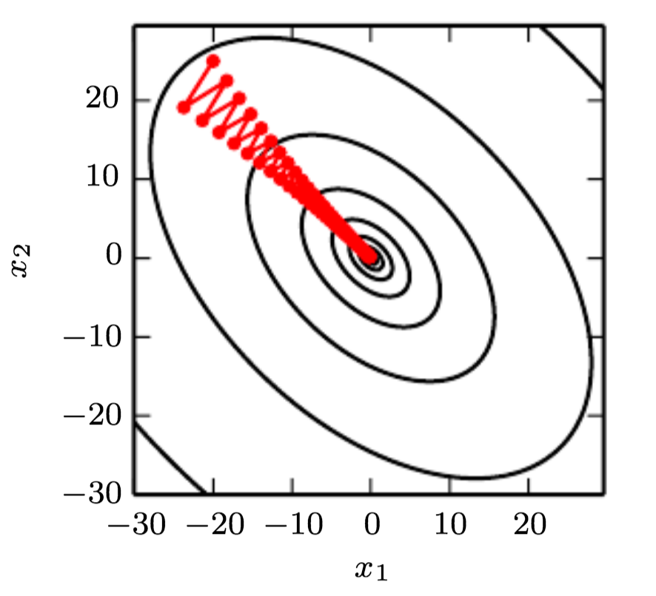
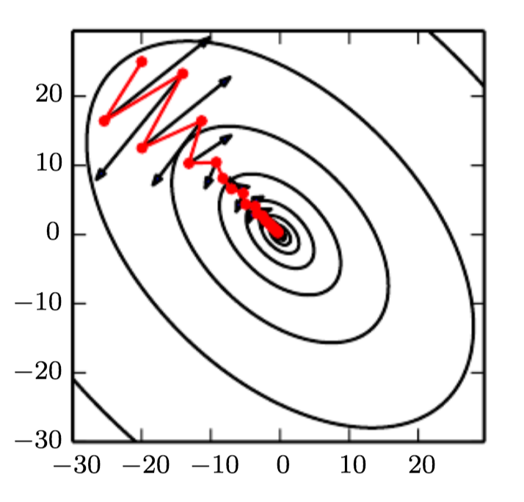
Momentum
Without momentum
With momentum

Slide 30
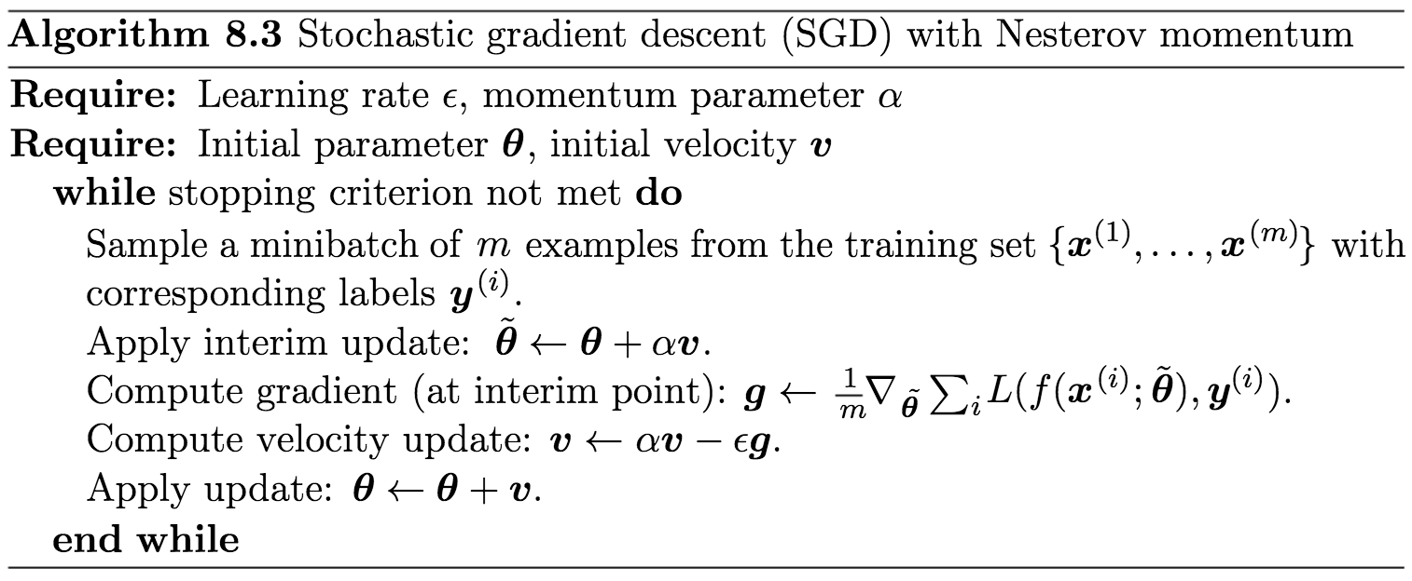
Nesterov momentum
Just like standard momentum, but use the future gradient (which results in better convergence)
Notes:
If you can’t understand this fully, the following website offers a very good tutorial and illustration: https://dominikschmidt.xyz/nesterov-momentum/
Further reading: Sutskever, Martens et al. "On the importance of initialization and momentum in deep learning" 2013

Slide 31
Adaptive learning rates
Learning rate hard to set as it significantly affects the model performance
Loss function can change in very different ways in different directions
Momentum helps, but it’s yet another hyper parameter
We can try to learn individual learning rates for each parameter and automatically adapt them

Slide 32
Delta-bar-delta
One the first heuristics (1988) to adapt individual learning rates during training
If the sign of the partial derivative of the loss with respect to a given model parameter remains the same, then the learning rate should increase
If it changes, the learning rate should decrease
Works only with batch gradient descent (can you guess why?)

Slide 33
AdaGrad
Adapt learning rates of model parameters by scaling them inversely proportional to the square root of the sum of all the past squared values of the gradient
Learning rate of parameters with large (small) value of partial derivative of loss decreases (increases)
Faster progress in gently sloped directions
But long history of gradients can slow things down

Slide 34
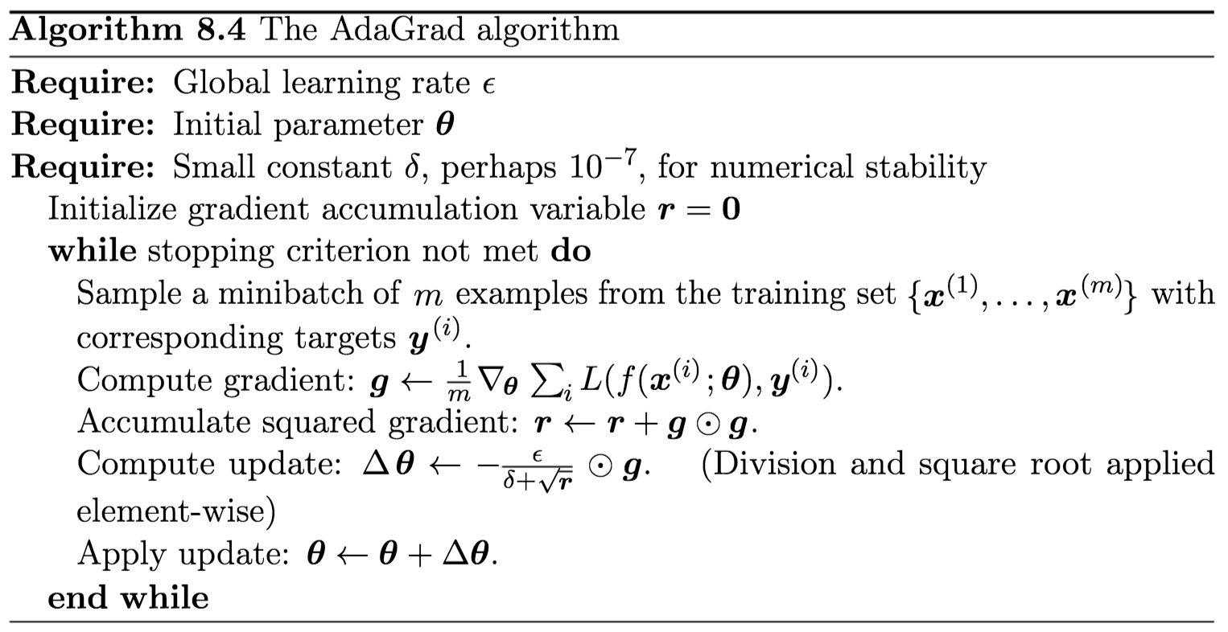
AdaGrad

Slide 35
RMSprop
RMSprop is an (unpublished) modification of AdaGrad that accumulates past gradients using an exponential moving average*
While AdaGrad is designed to work well for convex functions, RMSprop works better in non-convex settings (typical of deep learning)
*https://en.wikipedia.org/wiki/Moving_average#Exponential_moving_average

Slide 36
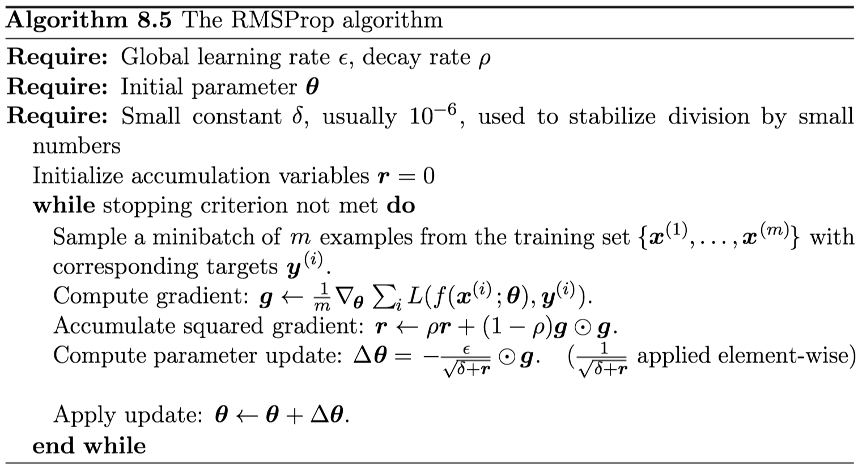
RMSprop

Slide 37
Adam
Best understood as a way of combining RMSprop with SGD + momentum
Uses square gradients to scale learning rate like RMSprop + moving average of gradient for momentum
Turns out to be fairly robust to choice of hyperparameters

Slide 38
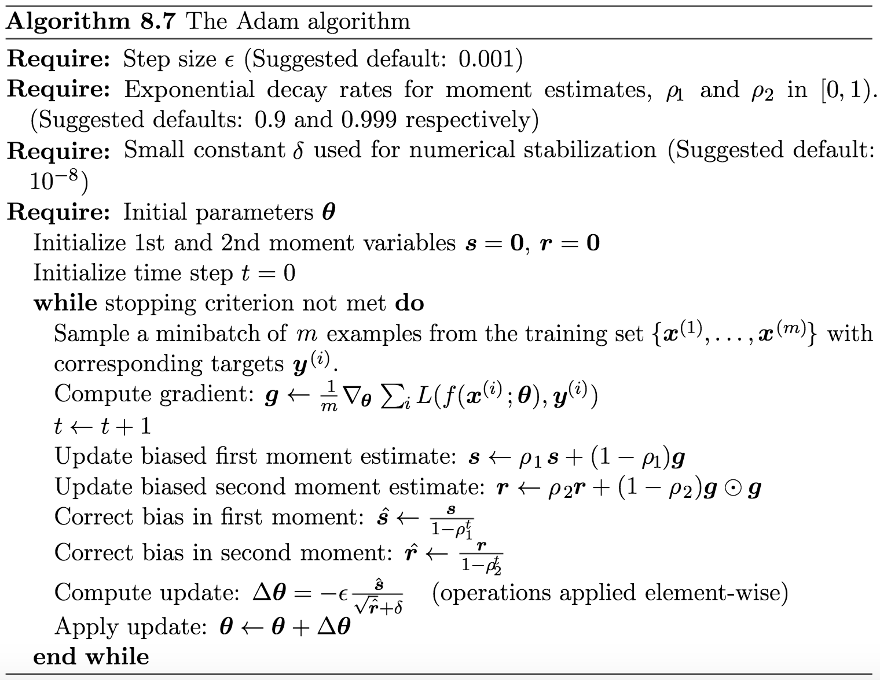
Adam

Slide 39
What’s the optimal optimiser?
There’s still not a generally accepted answer to this question, unfortunately
For a visualisation of different optimisers seeking the minimise various landscapes see the excellent visualisations at https://github.com/Jaewan-Yun/optimizer-visualization
See also http://ruder.io/optimizing-gradient-descent/ for a good summary of the different optimisers available
Also check: https://blog.paperspace.com/intro-to-optimization-momentum-rmsprop-adam/

Slide 40

Second order optimisation
The methods seen so far rely only on first-order information (gradient)
Using second-order information (Hessian) can help to improve convergence
Based on Newton’s method

Slide 41
Second order optimisation
Based on Newton’s method
If J is locally quadratic (H is positive definite) then we can jump directly to the minimum
Otherwise, iterate steps 1) quadratic approximation & 2) update parameters
However if H has negative eigenvalues we may end up moving in the wrong direction

Slide 42

Second order optimisation
We need to modify the Hessian
But when curvature is very high we may need to increase alpha to the point that diagonal dominates and method becomes standard gradient descent with small step size
Also, inverting the Hessian is expensive
O(k³) where k is the number of parameters

Slide 43
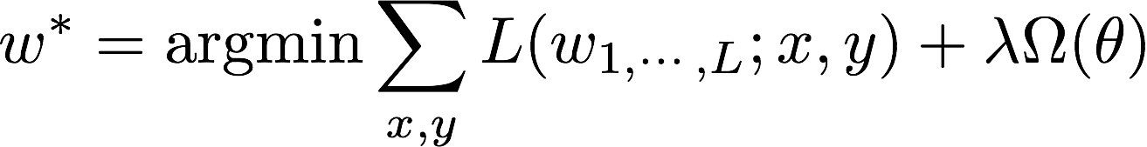
Regularisation
Deep networks can have millions of parameters, often more than the size of the training dat, which can lead to overfitting!
Need to regularise the loss function
Possible methods include L1 regularisation, L2 regularisation, and Dropout
The goal is to reduce the model capacity

Slide 44
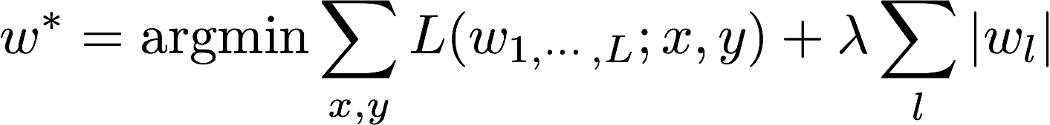
L1 regularisation
L1 regularisation enforces sparse weights, i.e., more weights become 0 (i.e., delete connections)
Performs feature selection (which features of the input data should we retain?)
Why sparse? https://medium.com/mlreview/l1-norm-regularization-and-sparsity-explained-for-dummies-5b0e4be3938a

Slide 45
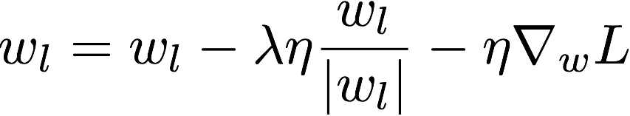
L1 regularisation
L1 regularisation enforces sparse weights, i.e., more weights become 0 (i.e., delete connections)
Performs feature selection (which features of the input data should we retain?)
Sign function (+1 or -1)

Slide 46
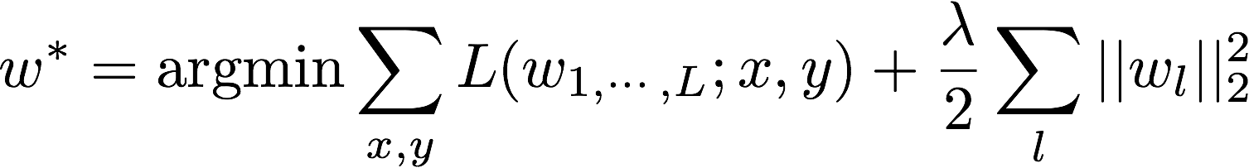
L2 regularisation
Most popular type of regression, drives weights closer to the origin
Nice analytical form (can derive and thus compute gradient)
Usually lambda is 10⁻¹ or 10⁻²

Slide 47
L2 regularisation
Most popular type of regression, drives weights closer to the origin
Nice analytical form (can derive and thus compute gradient)
Usually lambda is 10⁻¹ or 10⁻²
The gradient descent step changes to this
Note the “weight decay”

Slide 48
L2 regularisation
Most popular type of regression, drives weights closer to the origin
Nice analytical form (can derive and thus compute gradient)
Usually lambda is 10⁻¹ or 10⁻²
Practically what happens is that we decrease the weight on features that
have low covariance with the output target (i.e., less important features)

Slide 49
Dataset augmentation
Instead of reducing the capacity of the model, another way to reduce overfitting is to have more training data!
This approach is particularly easy to apply on object recognition tasks, where we can take input data and generate transformed version of it that simulate real-world scenarios (e.g., occlusion, rotation, etc.)

Slide 50
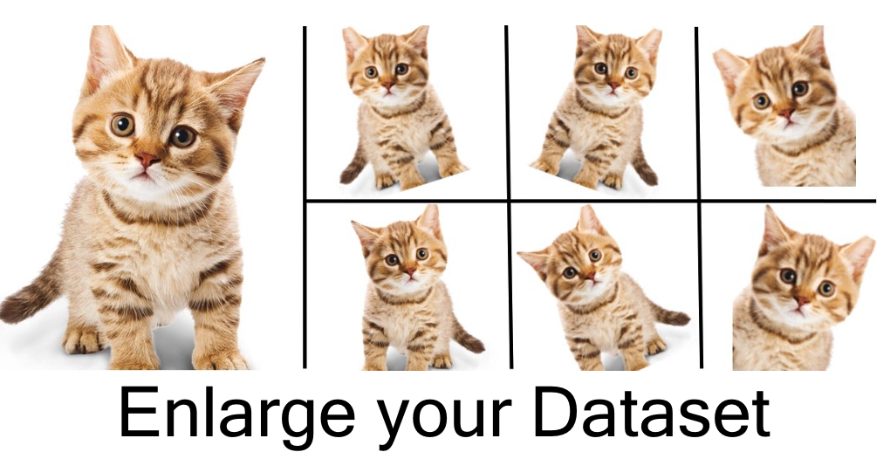
Source: https://medium.com/nanonets/how-to-use-deep-learning-when-you-have-limited-data-part-2-data-augmentation-c26971dc8ced

Slide 51
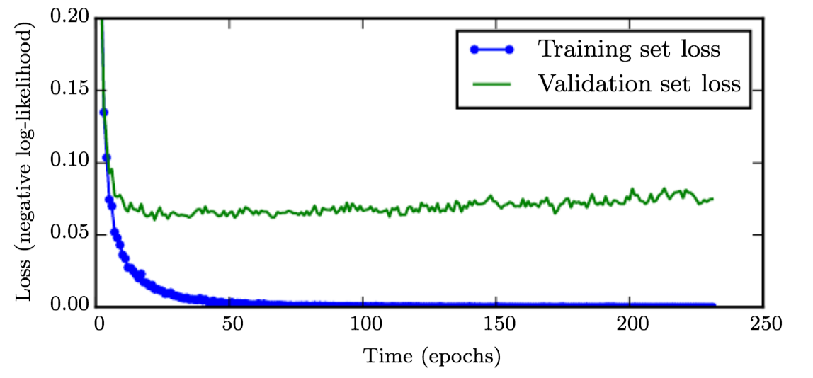
Early stopping
Simple idea: to avoid overfitting, stop training when validation set error starts increasing, even if training error is still decreasing
Number of epochs can be seen as hyper-parameter to optimise

Slide 52
Dropout
During training, randomly “deactivate” some units according to a probability p
At test time, use all units with activations weighted by p
Advantages include:
Faster training
Less overfitting
Units become more robust

Slide 53
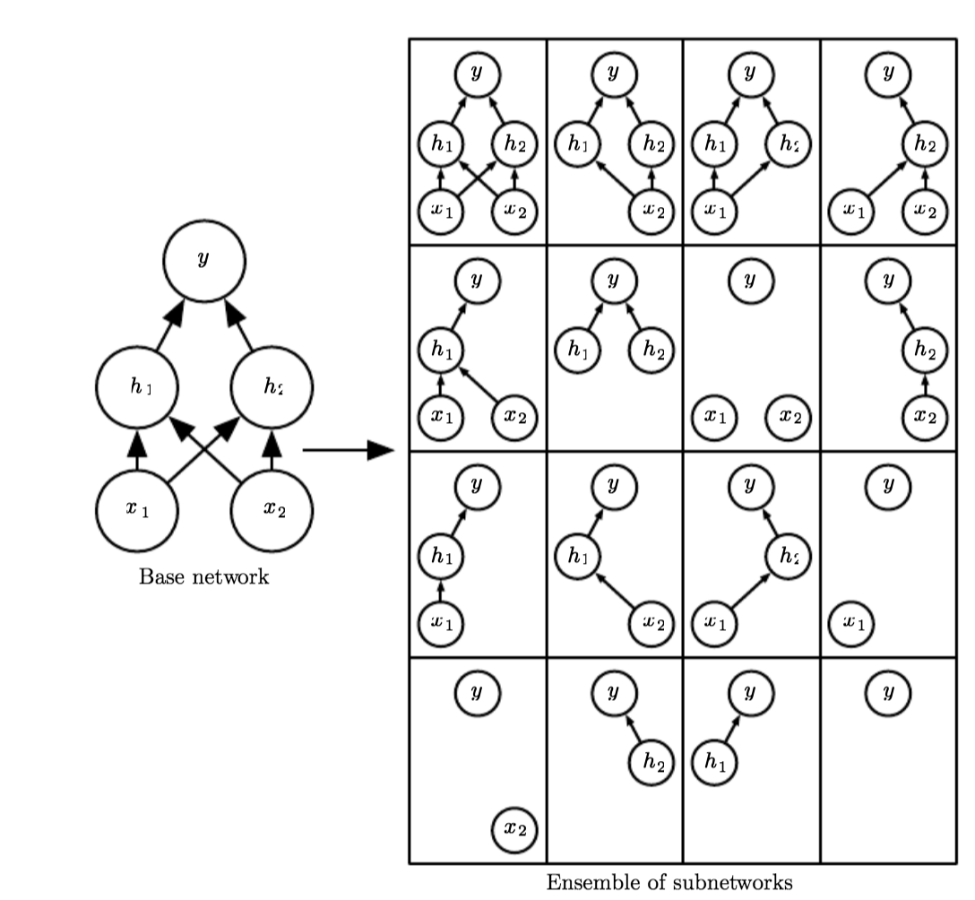
In each epoch we randomly “deactivate” some units, effectively
training a different subnetwork of the base network

Slide 54
Other common practices
Apart from choosing the optimisation scheme and applying regularisations, there are other standard practices we can use to initialise the parameters of the networks and pre-process the input data

Slide 55
Weight initialisation
Deep learning training is iterative and strongly depends on the initialisation point (i.e., how we initialise the parameters of the network)
Important principle: weight asymmetricity
Why? Because if 2 units share the same activation, same weights, and same inputs, they will be updated in the same way (no learning)
So, don’t give same value to all weights (e.g., 0)
Sample weights from Gaussian or uniform dists

Slide 56
Weight initialisation
But, be careful:
Large weights will have strong symmetry-breaking effect and help to propagate strong signal during forward and backward propagation
However they may also cause exploding values, saturation of units
But we also don’t want small weights…
Also, we want to maintain the same variance for input and output (because outputs are inputs of next layer)

Slide 57
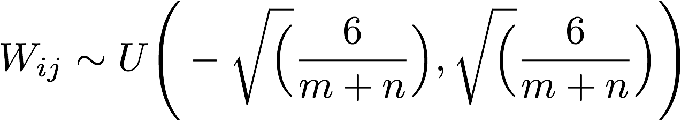
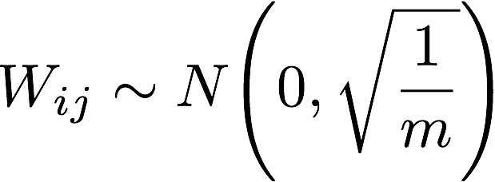
Weight initialisation
Uniform distribution initialisation (tanh)
Xavier initialisation (tanh)
Where m is the number of inputs and n is the number of outputs of the layer
Notes:
Good tutorial about weight initialization: https://prateekvjoshi.com/2016/03/29/understanding-xavier-initialization-in-deep-neural-networks/
Paper of Xavier initialization:

Slide 58
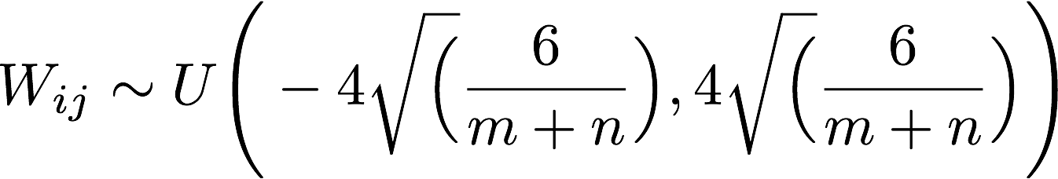
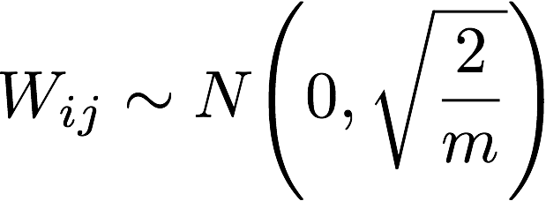
Weight initialisation
Uniform distribution initialisation (sigmoid)
ReLU initialisation
Where m is the number of inputs and n is the number of outputs of the layer

Slide 59
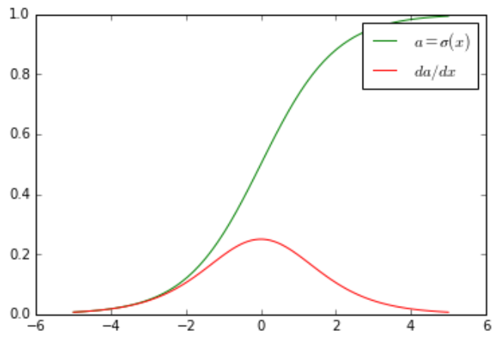
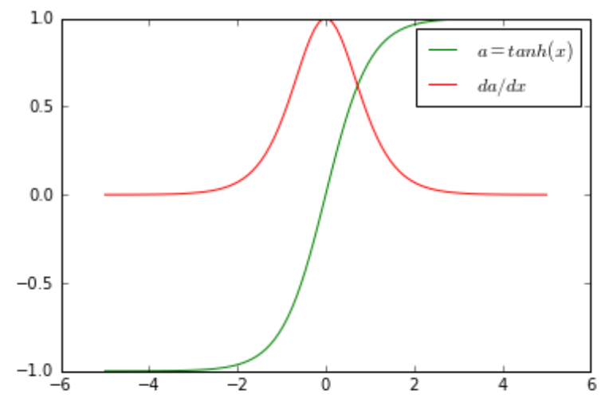
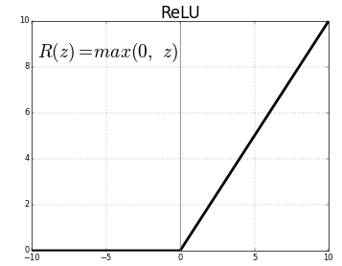
Data pre-processing
Activation functions are usually centred around zero

Slide 60
Data pre-processing
Activation functions are usually centred around zero
Not the sigmoid :( …

Slide 61
Data pre-processing
Activation functions are usually centred around zero
This is a good thing because it helps us to avoid saturation, which leads to vanishing gradients
At the same time, we like one-sided saturations because they help to avoid variance due to noise
More about this here: https://blog.paperspace.com/vanishing-gradients-activation-function/

Slide 62
Data pre-processing
Subtract mean so that training data is centred around zero as well
Otherwise may cause vanishing gradients
Scale inputs to have similar diagonal covariances
Otherwise input samples with very different covariances can generate very different gradients and make the gradient update harder

Slide 63
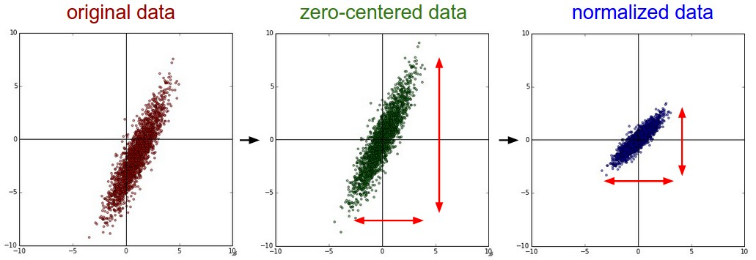
Unit normalisation
When input variables are normally distributed, subtract mean and divide by standard deviation
Source: http://cs231n.github.io/neural-networks-2/

Slide 64
Batch normalisation
Two important principles. The distribution of the data fed to the layers of a network should be:
zero-centred
constant through time and data (mini-batches)

Slide 65
Batch normalisation
Two important principles. The distribution of the data fed to the layers of a network should be:
zero-centred (done)
constant through time and data (mini-batches)
We already took care of the first point, but what about the second one?

Slide 66
Batch normalisation
Two important principles. The distribution of the data fed to the layers of a network should be:
zero-centred (done)
constant through time and data (mini-batches)
We already took care of the first point, but what about the second one?
Normalise the activations of each layer!

Slide 67
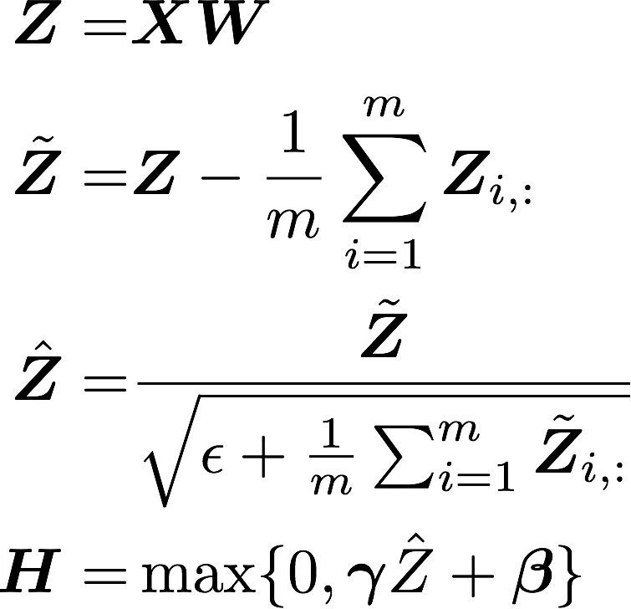
Batch normalisation
2
“Batch Normalization: Accelerating Deep Network Training by Reducing Internal Covariate Shift” Ioffe and Szegedy 2015

Slide 68
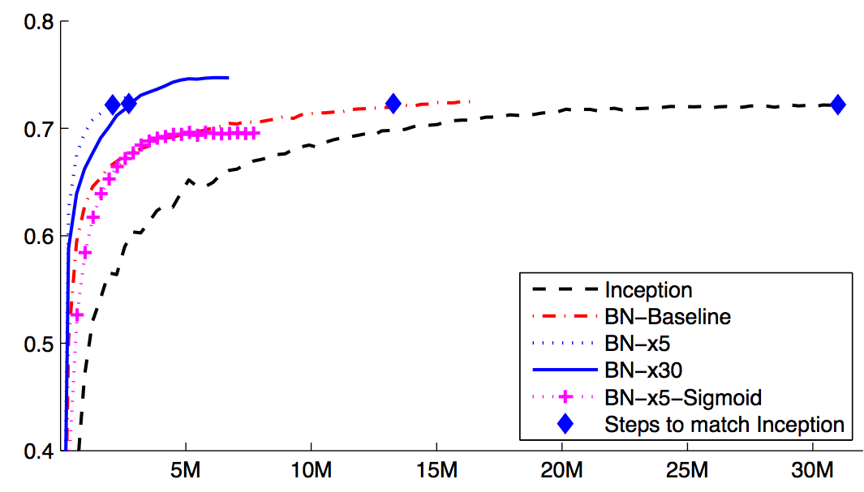
Batch normalisation
“Batch Normalization: Accelerating Deep Network Training by Reducing Internal Covariate Shift” Ioffe and Szegedy 2015

Slide 69
Summary
Gradient descent and variants
Momentum and learning rate
Regularisation
Parameters initialisation
Input normalisation
Batch normalisation

