Slide 1

SWS3009A/B
Lecture 4
Backend Communications
colintan@nus.edu.sg

Slide 2
Motivation
We have been looking at various machine learning models:
Statistical models
Simple dense neural networks
Deep learning models
Many of these models do not run well on edge devices; they need too much computing power.
Edge devices need to send data to back-end cloud servers for further processing.
In this lecture we look at two options for you to do this, as well as two other related topics: Working with databases and setting passwords for MQTT.
Hypertext Transfer Protocol (HTTP)
Message Queuing Telemetry Transport (MQTT)
Working with Databases
Securing MQTT with passwords.

Slide 3
Hypertext transfer protocol
SWS3009 Summer Workshop on Deep Learning and Robotics

Slide 4
Hypertext Transfer Protocol (HTTP)
HTTP is the core request-response protocol for the web.
Layer 7 (application layer) protocol.
Consists of four phases:
Connection: Open a connection to the server.
Request: Make a request (GET, POST, PUT, DELETE).
Response: Receive a response from the server.
Close connection: Close the connection to the server.
HTTP is stateless
HTTP does not keep track of what happened in previous connections.
Application backend must do this on its own through use of databases, etc.
Applications may also deposit “cookies” in the browser to maintain states.

Slide 5
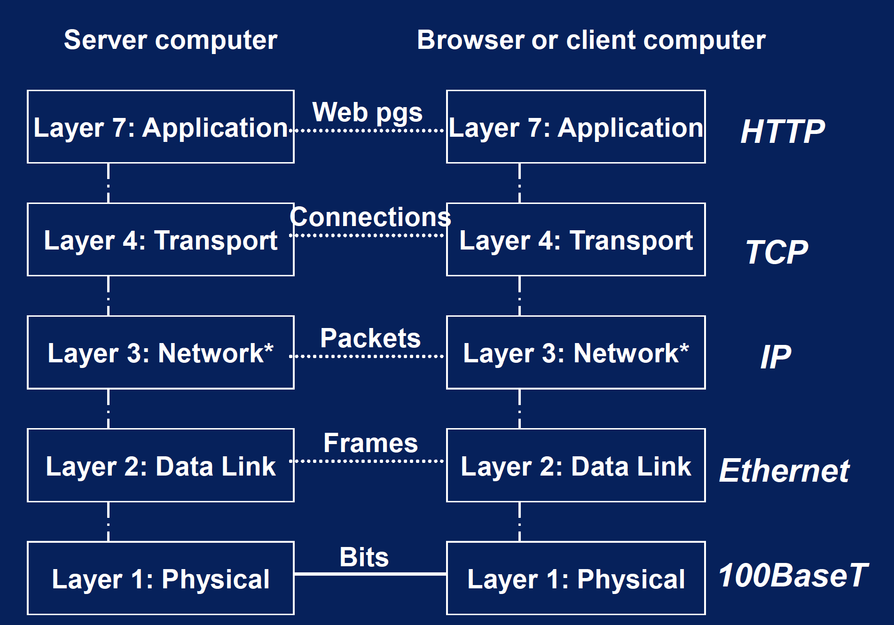
Hypertext Transfer Protocol (HTTP) OSI Model

Slide 6
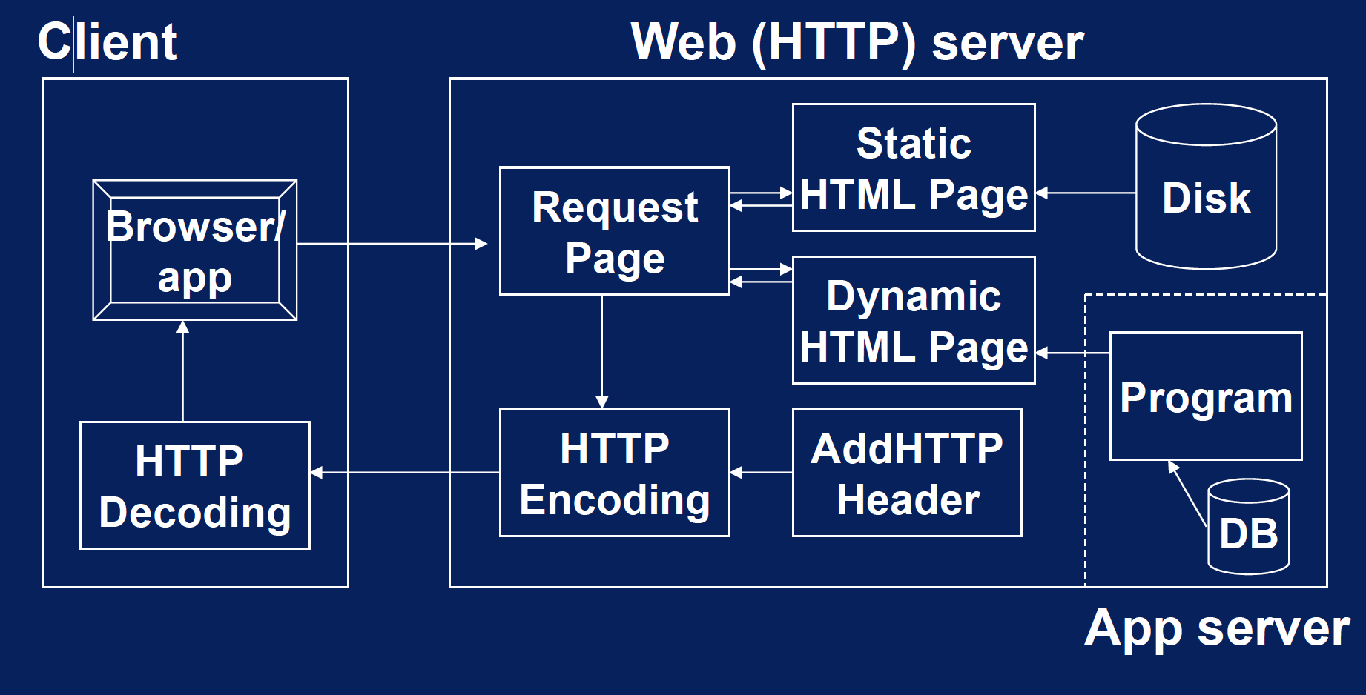
Hypertext Transfer Protocol (HTTP)

Slide 7
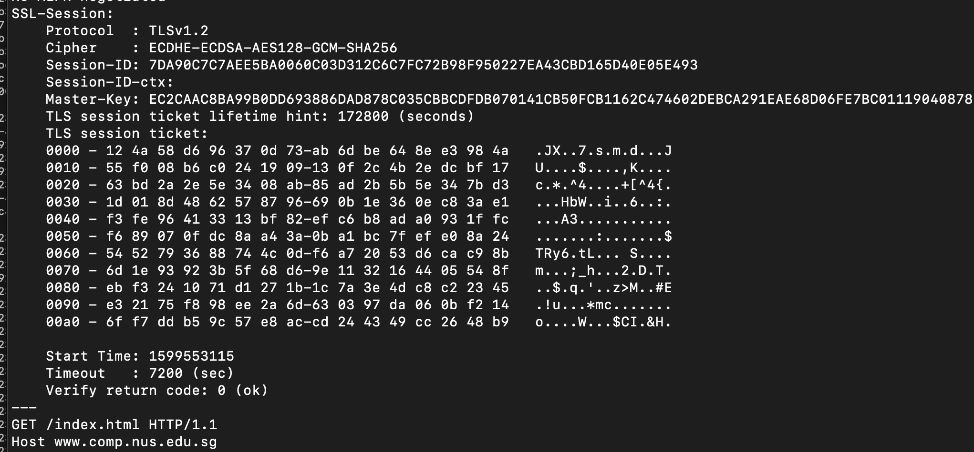
Hypertext Transfer Protocol (HTTP)
Example interaction:
openssl s_client –connect www.facebook.com:443
<Connection information including certificate displayed>

Slide 8
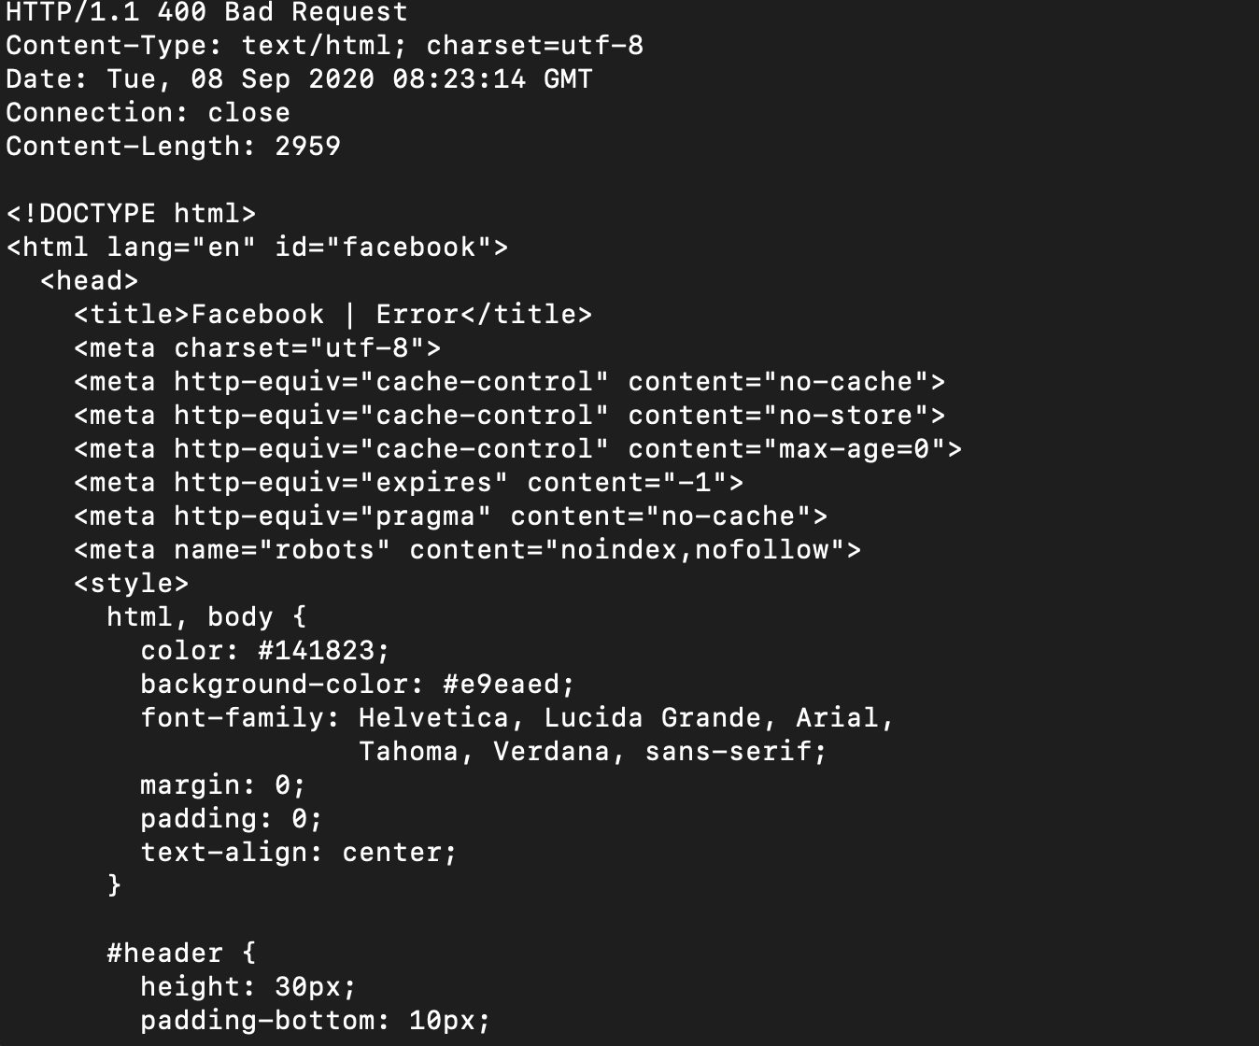
Hypertext Transfer Protocol (HTTP)
Example interaction:
Response from server
(400: Bad Request. Oops!)

Slide 9
HTTP Request Types
There are 5 more common request types (of which only GET and POST are used often):
GET: Request for a specific document (Can also be used to send data)
POST: Request for server to accept data from browser
PUT: Replace a document with the data provided by the browser.
DELETE: Remove a document
HEAD: Retrieve only the header of a document
Documents are in the form of Hypertext Markup Language (HTML) files:
Consists of:
Text that can be “marked-up” to format it (e.g. headings, tables, bold, italic, alignment, etc.)
Hyperlinks: Links to other documents, possibly on other servers.
Scripts: Programs that will be run on your browser.

Slide 10
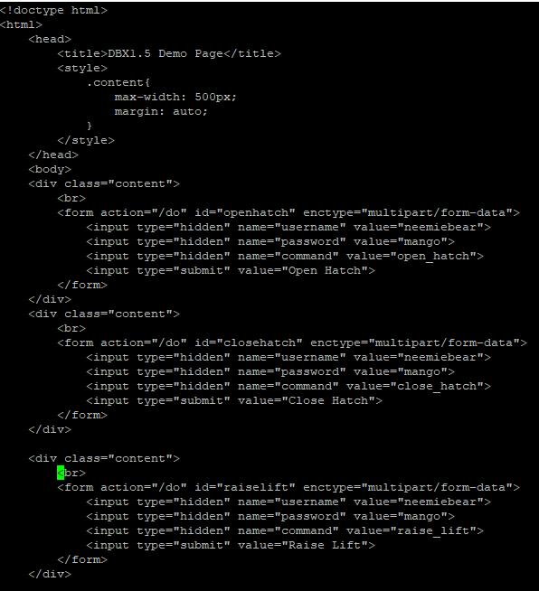
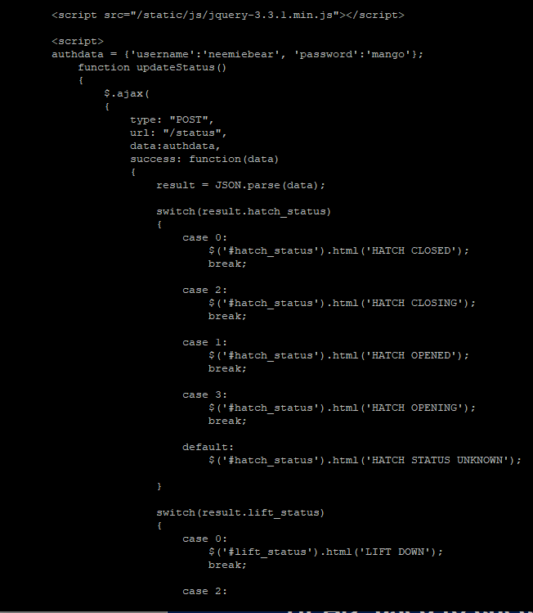

Slide 11
MIME Types
Documents have types:
Multipurpose Internet Mail Extension (MIME) types:
Extensible. Can define new MIME types.
Common MIME types:
application/pdf
application/json
image/gif
image/jpg
text/html
test/plain
video/mpeg
Browser will prompt if it sees an unexpected MIME type.
When you request for a document using GET or POST, you would specify the expected document type in the header. For example:
‘Content-Type: application/json’

Slide 12
Creating a HTTP Server in Python
Python has several frameworks for you to create HTTP servers:
http.server within the Python library itself.
Flask, a very nice framework.
Django, another popular framework.
Flask and Django are full-stack frameworks:
Provides not just HTTP, but also a way of incorporating HTML files.
Installing Flask:
pip3 install flask

Slide 13
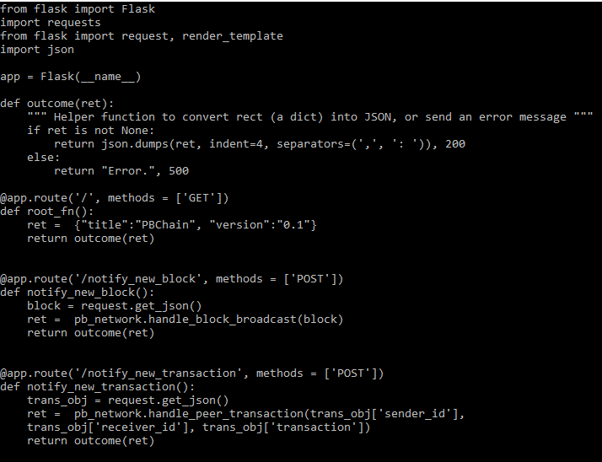
Example Flask Code

Slide 14

Writing Flask Applications
Endpoints (e.g. /get_chain in http://localhost:5001/get_chain) are specified using the @app.route decorator, with the supported methods shown as a list in the “methods” parameter:
The function should return a string followed by a numeric result:
return “Success”, 200
Common return codes:
200: Success
400: Request error
404: Not found
500: Server error
The server can be started using “app.run()”

Slide 15
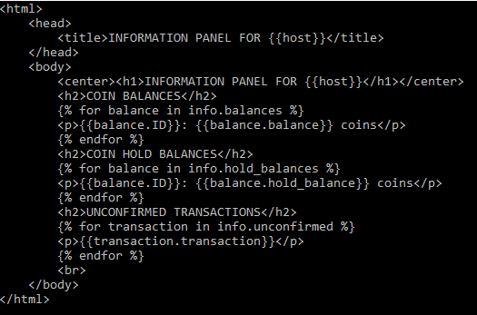
Writing Flask Applications
HTML pages can be incorporated by calling “render_template” with a path to the template file (usually in the “./templates” directory), and parameters to pass to the template:
Templates in Flask are written using the Jinja scripting language (https://jinja.palletsprojects.com/en/3.1.x/) , supporting loops, parameter passing, etc.

Slide 16
Writing Flask Applications
See ‘testsite.ipynb’ for example Flask website.

Slide 17
Flask References
Amazing tutorial here on Flask (including incorporating MySQL databases):
https://blog.miguelgrinberg.com/post/the-flask-mega-tutorial-part-i-hello-world
Flask Reference:
https://flask.palletsprojects.com/en/stable/

Slide 18
Creating HTTP Requests
You can create HTTP requests in Python by using the requests class.
See ‘writesite.ipynb’ for an example, created to work with the ‘testsite.ipynb’ notebook.

Slide 19
Message queuing telemetry transport
SWS3009 Summer Workshop on Deep Learning and Robotics

Slide 20
MQTT
Message Queuing Telemetry Transport (MQTT) is an ISO standard, lightweight protocol for transferring messages across IoT devices.
It has several important advantages over HTTP:
Lightweight, less overheads (don’t need to specify document type, simpler headers).
Publish-subscribe model:
Centralized server.
Clients subscribe to topics.
When someone publishes messages in a topic, all interested clients are notified.
Contrast with HTML:
Essentially a point-to-point (client to server) model.
Client needs to continually poll the server using a client-side script, to get updates.
Some “improvements” are available to solve this, e.g. websockets.
We will have a lab for MQTT (but not for HTTP), so we will keep this lecture short.

Slide 21
MQTT
To implement MQTT, you need a central server (called a “broker”) that all clients will connect to:
Recommended: Mosquitto. We will also install the Paho-MQTT client for Python.
LINUX:
sudo apt-get install mosquitto mosquitto-clients
pip3 install paho-mqtt
MacOS (Mosquitto client is automatically installed):
brew install mosquitto
pip3 install paho-mqtt
Windows:
Install and run the Windows Subsystem for LINUX. Instructions: https://learn.microsoft.com/en-us/windows/wsl/install and follow the instructions above for LINUX.

Slide 22
Playing with MQTT
Once you have Mosquitto and the Mosquitto clients installed:
LINUX: Open a new shell and type “mosquitto” to start the server
sudo service mosquitto start
MacOS: Starts automatically, otherwise:
brew services start mosquitto
If either of these fail, you can do:
nohup mosquitto < /dev/null >/dev/null &
MQTT messages are published with a “topic/subtopic” tag.
Examples:
messages
messages/sensor
messages/sensor/sensor1
etc.

Slide 23
Playing with MQTT
Start two more LINUX / MacOS terminals:
In one we will use mosquitto_sub to subscribe to messages published under the topic test/abc
mosquitto_sub –h localhost –t test/abc
In the other, we will use mosquitt_pub to publish a message:
mosquitto_pub –h localhost –t test/abc –m “Hello world”
Results:
Subscribe side (Waits until you publish, then prints message and waits again):
Publish side (Nothing happens, returns immediately):

Slide 24
MQTT Programming in Python
We will use Paho-MQTT to publish/subscribe to a broker.
Note that publisher/subscriber relationships in MQTT are symmetric:
A publisher can be a subscriber and vice-versa
Paho-MQTT is an event-driven library:
We declare two listeners for:
on_connect: Called when the client has attempted to connect to a broker. Must get a result code of 0 for success.
on_message: Called when the client has received a message on the topic it is subscribing to.
Example sender code is given on the next slide (mqtt_send.py)
We call “connect” to connect to the broker, and “loop_forever” to get the event loop going.

Slide 25
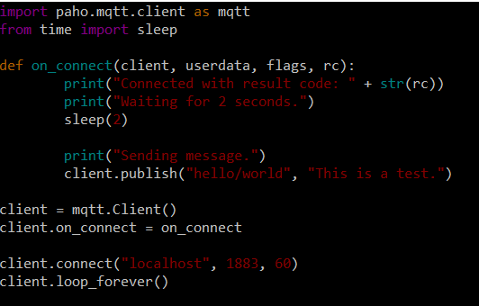
MQTT Programming in Python
Example sender code (mqtt_send.py)

Slide 26
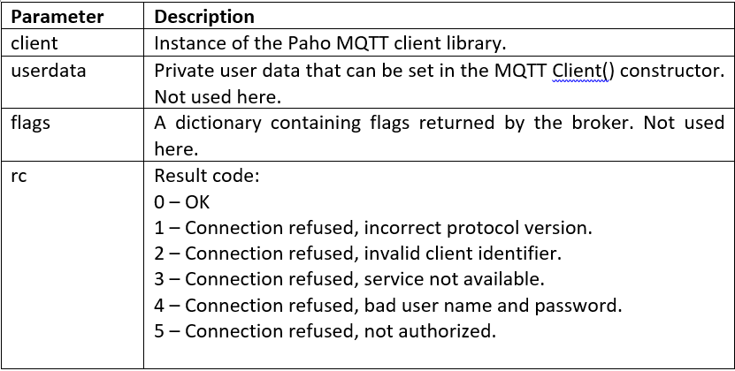
MQTT Programming in Python
The table below shows the parameters for on_connect and their meanings:

Slide 27
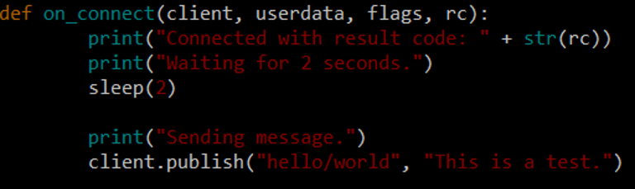
MQTT Programming in Python
Publishing a message is easy:
Call “publish” with the message and topic. We can modify our on_connect to do:

Slide 28
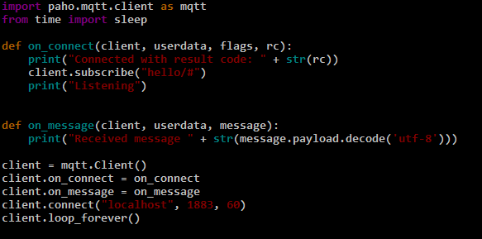
MQTT Programming in Python
Example listener code (mqtt_listen.py):

Slide 29
MQTT Programming in Python
Subscribing is easy (mqtt_listen.py):
Call “subscribe” with the topic name. We can see it in the on_connect callback in mqtt_listen.py:
Here hello/# means listen to all subtopics under hello.
We receive messages using the on_listen callback:

Slide 30
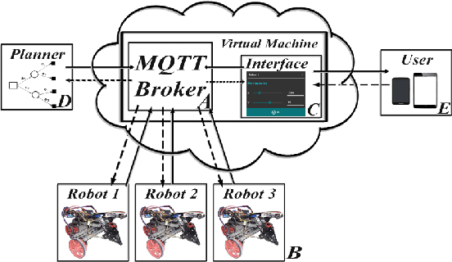
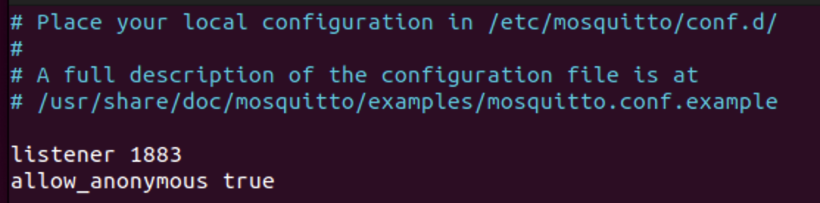
Opening Mosquitto to the World
By default, the Mosquitto broker only accepts local connections.
This is not going to be very useful, as our robots are most probably not going to run the Mosquitto broker themselves.
We can configure Mosquitto to allow external connections.
Need to modify mosquitto.conf
MacOS: /opt/homebrew/etc/mosquitto/mosquitto.conf
Ubuntu: /etc/mosquitto/mosquitto.conf
Windows: c:\mosquitto\mosquitto.conf
Add these line to the mosquitto.conf:
listener 1883
allow_anonymous true
Restart Mosquitto
MacOS: brew services restart mosquitto
Ubuntu: sudo service mosquitto stop; sudo service mosquitto start

Slide 31
Opening Mosquitto to the World
The allow_anonymous line is going to cause us problems:
This means that anyone can connect to your broker – they just need to know your IP address (and maybe be on the same network)
We will look at how to fix this problem later on with password files.

Slide 32
Working with databases
SWS3009 Summer Workshop on Deep Learning and Robotics

Slide 33
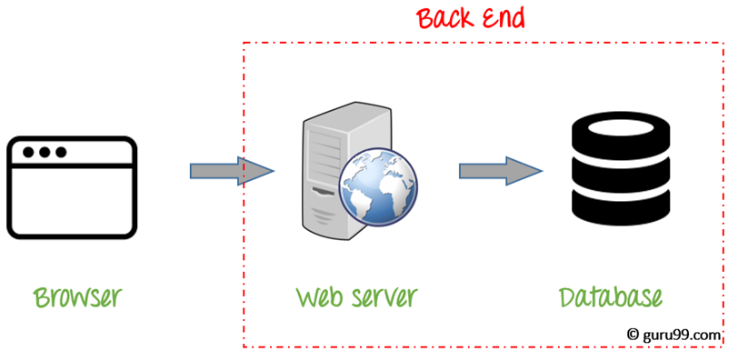
Working with Databases
Motivation:
We can now transfer data between the client and the backend server.
How do we store this data? Two choices:
As flat files – Difficult to search.
As a database – More complex solution, but easier to search for particular images or pieces of data. E.g. data read from a certain range of dates.

Slide 34
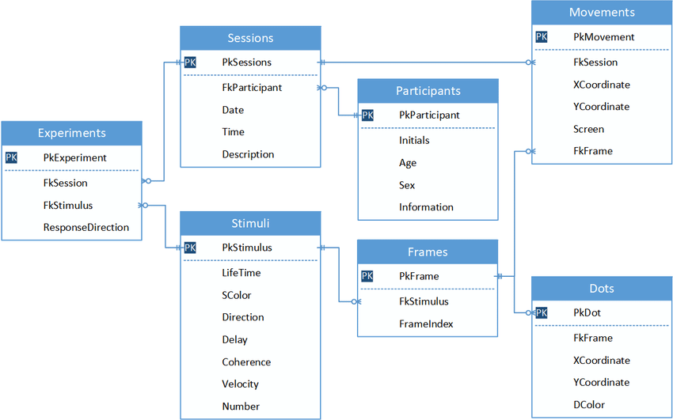
Working with Databases
There are two types of commonly available databases:
Relational (e.g. MySQL):
Data is organized as tables.
Data is indexed by “keys”, especially the “primary key”.
Main identifying key for a piece of data.
Must be unique.
Relationships between tables are formed by declaring foreign keys into the keys of other tables:
Tight relationships governed by rules to maintain integrity of database.

Slide 35
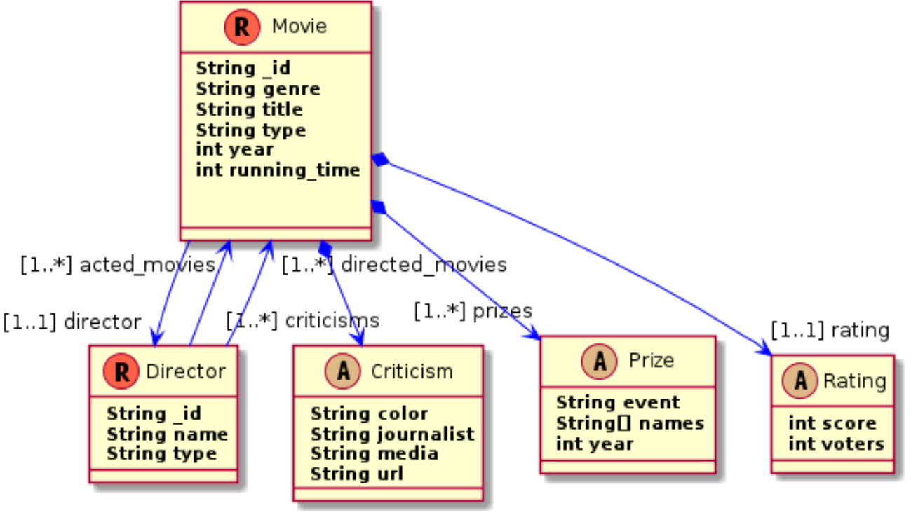
Working with Databases
Document Oriented (e.g. MongoDB)
Organized as collections of documents, which may or may not be related.
Only loose relationships are established between documents, or between collections of documents.
Often called “NoSQL” for this reason.

Slide 36
Working with Databases
For the most part relationships won’t be so useful for doing deep-learning and classification/regression on IoT data.
We can store each image, reading etc. as separate documents.
We can still establish relationships between documents within our code.
We will focus only on MongoDB
See https://docs.mongodb.com/manual/installation/ for how to install MongoDB.
Install the Community Edition, you do not need the Enterprise Edition.

Slide 37
MongoDB Programming in Python
We will use PyMongo to read/write the MongoDB database:
pip3 install pymongo
Please see the “mongo.ipynb” notebook for programming examples.

Slide 38
Securing communications
SWS3009 Summer Workshop on Deep Learning and Robotics

Slide 39
Securing Communications - Motivation
The MQTT server you have set up is highly vulnerable.
Anyone who is on the same WiFi as you and knows your server address can intercept and send messages to your MQTT broker.
This means anyone can read your data, and activate your actuators just by being on the same WiFi as you and knowing your broker IP address.
There are two ways to secure your server:
Using access control lists to control who can send and receive messages.
Using Transport Layer Security (TLS) to encrypt data and to validate clients. This will not be covered today.

Slide 40
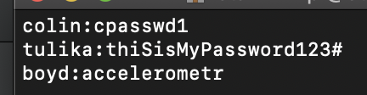
Securing MQTT Create Usernames and Passwords
The first level of securing your MQTT broker is to create usernames and passwords.
Create a file called “users.txt” with the following information on each line:
<username1>:<password1>
<username2>:<password2>
…
You can see a sample file here with three users and passwords:

Slide 41
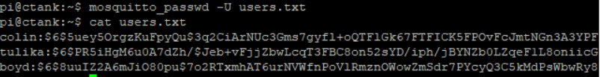
Securing MQTT Create Usernames and Passwords
You can now create the password file:
mosquitto_passwd –U <password file>
In our case <password file> is user.txt, so we have:
mosquitto_passwd –U users.txt
This produces an encrypted user file, as shown (Note: Original users.txt file is overwritten, so back this up if you need to):

Slide 42
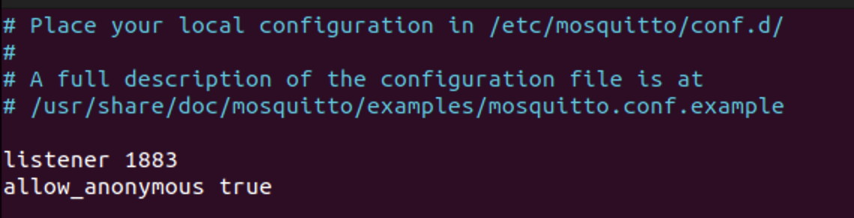
Securing MQTT Create Usernames and Passwords
Now you need to edit your mosquitto.conf file to include the new password file. On Ubuntu it is at /etc/mosquitto/mosquitto.conf. On MacOS it is at /opt/homebrew/etc/mosquitto/mosquitto.conf and in Ubuntu it is at /etc/mosquitto/mosquitto.conf
If you open this file in an editor you will see something like:
We added the ”listener 1883” and “allow_anonymous true” earlier on.

Slide 43
Securing MQTT Create Usernames and Passwords
Change:
allow_anonymous true
to:
allow_anonymous false
password_file <path to password file>
If your password file is at /home/pi/mqtt/users.txt, then the above will be:
allow_anonymous false
password_file /home/pi/mqtt/users.txt
Note that you must provide the full path to the password file; you cannot use “~” to provide a relative path. Restart Mosquitto after making the changes:
sudo service mosquitto restart

Slide 44
Securing MQTT Create Usernames and Passwords
Copy over users.txt to your /etc/mosquitto directory (Ubuntu), or /opt/homebrew/etc/mosquitto (MacOS):
sudo cp users.txt /etc/mosquitto (Ubuntu)
sudo cp users.txt /opt/homebrew/etc/mosquitto (MacOS)

Slide 45
Securing MQTT Create Usernames and Passwords
Now add this line to your .conf file, immediately after the “allow_anonymous false”
password_file <path to password file>
If your password file is at /etc/mosquitto, then this line should read:
password_file /etc/mosquitto/users.txt

Slide 46
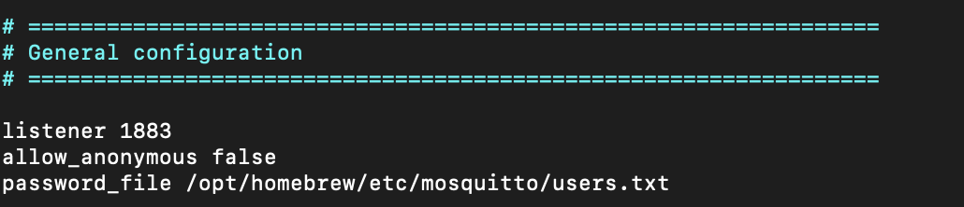
Securing MQTT Create Usernames and Passwords
Your mosquitto.conf file should now look something like this (MacOS):
Note that you must provide the full path to the password file; you cannot use “~” to provide a relative path. Restart Mosquitto after making the changes:
sudo service mosquitto restart (Ubuntu)
brew services restart mosquitto (MacOS)

Slide 47
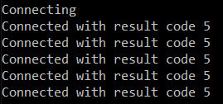
Securing MQTT Create Usernames and Passwords
Now if you connect to your broker using the mqtt.py program that you wrote in the lab, you will see:
From our table of result codes in Lab 3, we see that result code 5 is “Connection refused, not authorized.”

Slide 48
Securing MQTT Create Usernames and Passwords
You need to add in your username and password into your mqtt.py code. To do this we declare two constants USERID and PASSWORD and set these to the userid and password we had in users.txt:
USERID=“colin”
PASSWORD=“cpasswd1”
Now we add in the code to log in. Just after the line “client=mqtt.Client()” add in:
client.username_pw_set(USERID, PASSWORD)

Slide 49
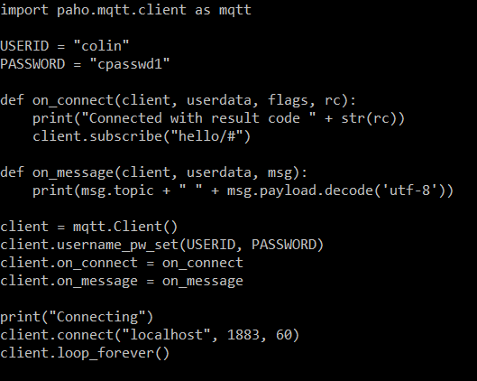
Securing MQTT Create Usernames and Passwords
Your code will now look like this:
When you run the code you will see that it now connects with a result code of 0.

Slide 50
Summary
In this lecture we looked at two alternatives for communications between nodes:
MQTT – Best for edge devices to gateways.
HTTP – Best for gateways to the cloud
We also looked at databases:
Two main types – Relational and Document
We looked at MongoDB.
Finally we looked at how to set passwords for MQTT.

