Slide 1
MSA Scoring & Ranking Based on MSA Transformer
Group lianyh, tengyue & yangxch

Slide 2
Background
AlphaFold & MSA Transformer

Slide 3
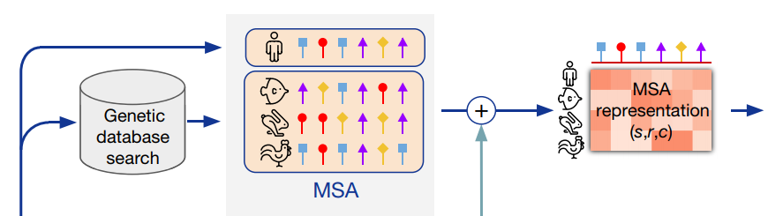
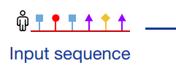
Background: AlphaFold
……
Jumper et al. 2021
Highly accurate in protein structure prediction
Requires Multiple-Sequence Alignment (MSA) as a key input
Various MSA acquisition approaches
Databases: BFD, Uniclust30, Uniref90, MGnify, …
Tools: jackhammer, HHBlits, HHSearch, MMseqs264, …
Motivation: Given 2 or more MSA inputs, which MSA input is of higher quality to help AlphaFold predict highly accurate structure?

Slide 4
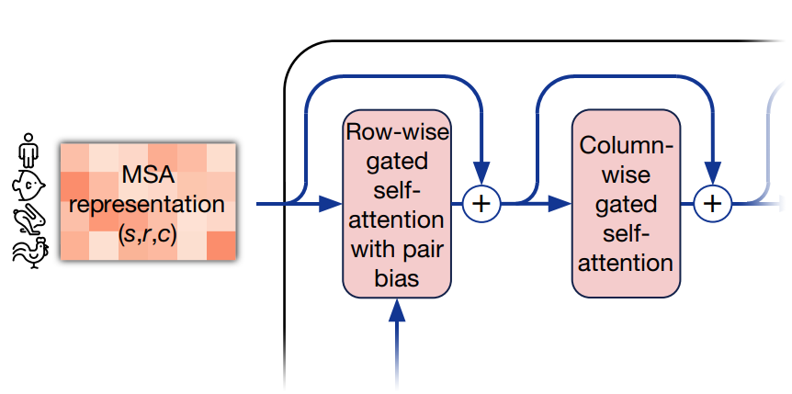
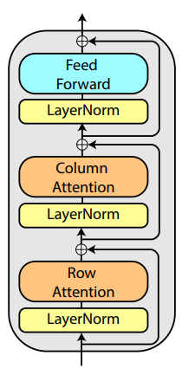
Background: MSA Transformer
Unsupervised protein language model
Masked language modeling objective
Reconstruct masked tokens, similar to BERT pretraining
AlphaFold has similar BERT-like loss at training
Axial self-attention over rows and columns
enables to extract information from dependencies in the input set and generalize patterns across MSAs
Also similar to part of AlphaFold Evoformer blocks, which exchange information within the MSA to enable direct reasoning about the spatial and evolutionary relationships
AlphaFold Evoformer block, Jumper et al. 2021 ↑
MSA Transformer block, Rao et al. 2021 ↓

Slide 5
Methodology
Dataset & Networks & Loss Metrics

Slide 6
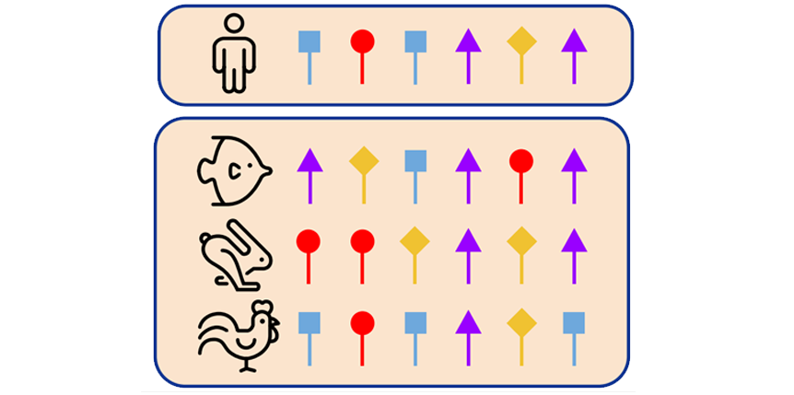
Methodology: Dataset
2850 MSAs from CASP14-fm Dataset
2660 train MSAs: 95 query sequences and 28 MSAs for each query
190 test MSAs: 1 pair of MSAs for each query sequence
Scores: from AlphaFold output accuracy, scaled to 0~1.0
MSA subsampling strategy
HH-Filter: >256 to ≈256 sequences
hhfilter –i input.a3m -o filtered.a3m -diff 256
Diversity Maximizing: ≈256 to 256 sequences
greedily pick sequence with maximum average hamming distance
Result shape: N × L
N ≤ 256 and L ≤ 584
depth N
L residues

Slide 7
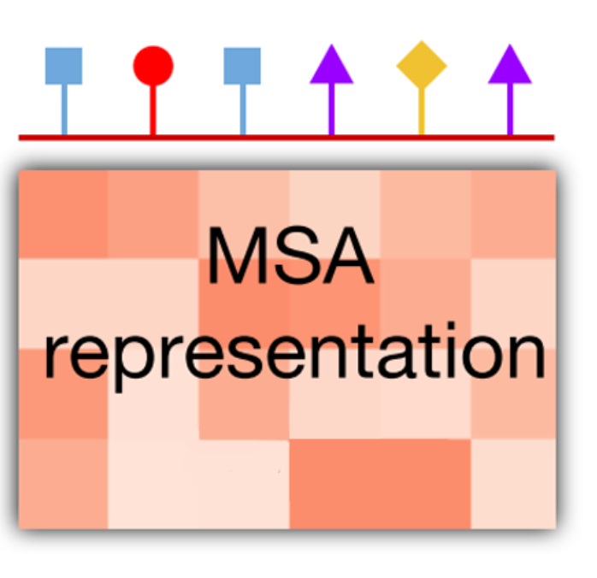
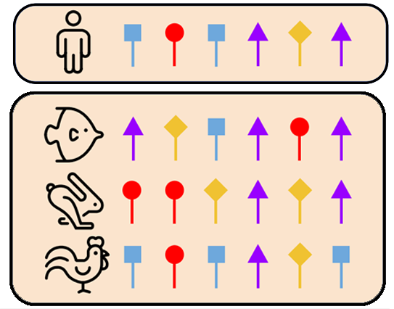
Methodology: MSA Embedding
Use MSA Transformer as encoder
Import esm.pretrained.esm_msa1b_t12_100M_UR50S()
Freeze weights of all layers for transfer learning
Save extracted embedding of each MSA for efficient training
Result MSA embedding shape: N × L × D
MSA Transformer embedding dimension → D = 768
Add zero paddings → L = 584
Extract query reference → L × D feature map each MSA
12 ×

Slide 8
Methodology: Score Regression Network
Use Multi-Layer Perceptron (MLP) for vector regression
Averaging pooling/extract <bos> embedding → 768-dim vector
Feed into 3 fully-connected layers
768 → 128 → 32 → 1
with leaky_relu activations and dropout layers (except output layer)
Output one score and compute MSELoss
Use Convolutional Neural Network (CNN) for feature map scoring
Each MSA is represented by a 1 × L × D feature map (like an image)
We have investigated 2 different models:
LeNet5: Interleaving 2 convolution layers with BatchNorm2d and max-pooling layers
ResNet18: 1 convolution layer + 4 residue blocks + 1 average pooling + 1 FC layer

Slide 9
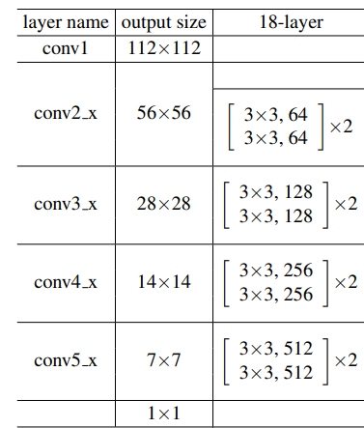
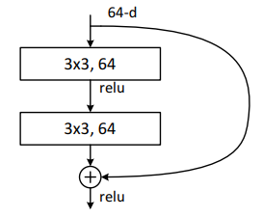
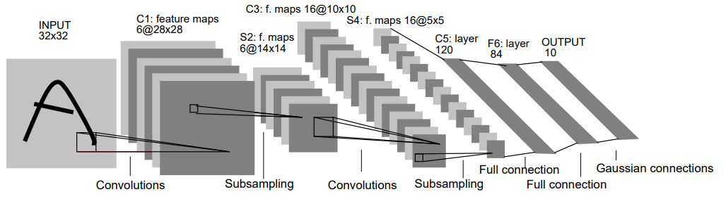
Methodology: Score Regression Network
← ResNet18, He et al. 2015
↓ LeNet5, LeCun et al. 1998

Slide 10
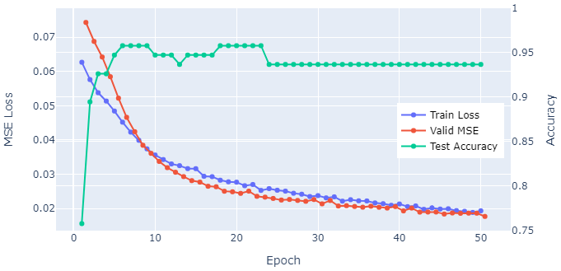
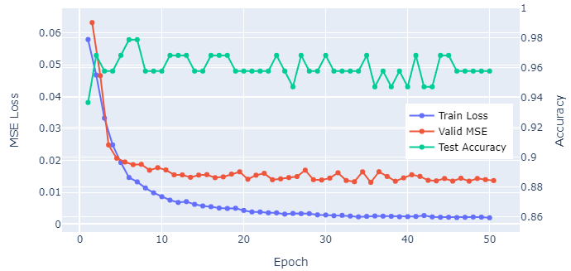
Results: Pointwise Scoring Network
MLP (extract <bos> embedding vector)
lr=1e-4 batch_size=64
Reach 0.9579 test accuracy after 20 epochs
Reach 0.0177 test MSE after 50 epochs
CNN (LeNet)
lr=1e-4 batch_size=32
Reach 0.9789 test accuracy after 6 epochs
Reach 0.0131 test MSE after 35 epochs
Problem:
Test accuracy drops as test MSE decreases
Directly fit each MSA with its score
Compare scores of MSAs with different query sequence is meaningless!
MLP Scoring Network Result ↑
CNN Scoring Network Result ↓

Slide 11
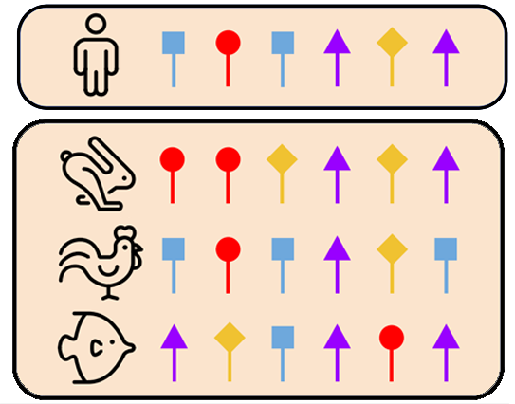





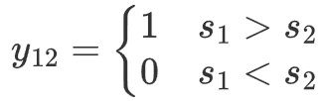


Methodology: Siamese Framework
Pointwise MSA Dataset
Group MSAs by query sequence
query $i$
Paired MSA Dataset
query $i$

Slide 12







Methodology: Siamese Framework
：possibility that is of higher quality than
Score Regression
Network (MLP/CNN)
[1]
Pairwise Binary Cross Entropy loss:
Siamese network
sharing weights
1
2
Mean Squared Error loss:
MSA Transformer
Encoder
Weighted total loss for back propagation:
same query
[1] Burges C . From RankNet to LambdaRank to LambdaMART: An Overview[J]. learning, 2010.

Slide 13
Methodology: Siamese Framework
Score Regression
Network (MLP/CNN)
Score Regression
Network (MLP/CNN)
Siamese network
sharing weights
1
2
1
MSA Transformer
Encoder
MSA Transformer
Encoder
same query
Training stage Inference stage

Slide 14
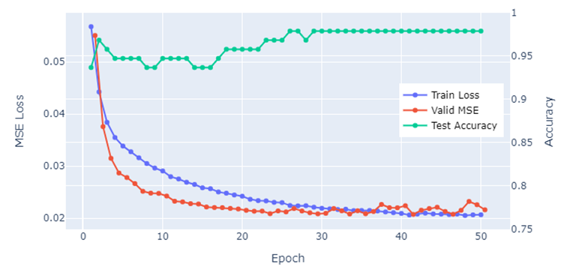
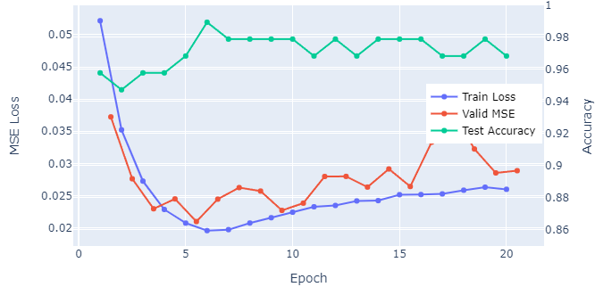
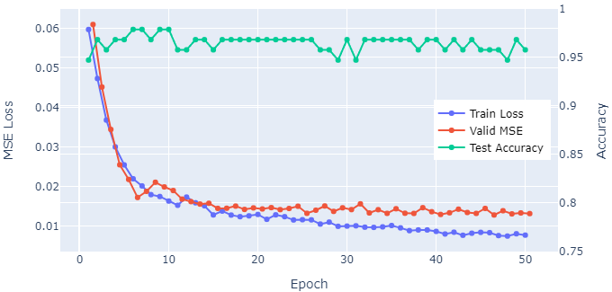
Results: Siamese Network + Pairwise Loss
Pairwise MLP Scoring Network Result
Pairwise CNN Scoring Network Result
Pairwise MLP
lr=1e-4 batch_size=64 λ=0.5
Reach 0.9789 test accuracy after 30 epochs
Reach 0.0207 test MSE after 41 epochs
Pairwise CNN
lr=1e-4 batch_size=32 λ=2.5
Reach 0.9895 test accuracy after 6 epochs
Reach 0.0210 test MSE after 6 epochs

Slide 15
Results & Conclusion
MLP vs. CNN & Pointwise vs. Pairwise & Metric Reports

Slide 16
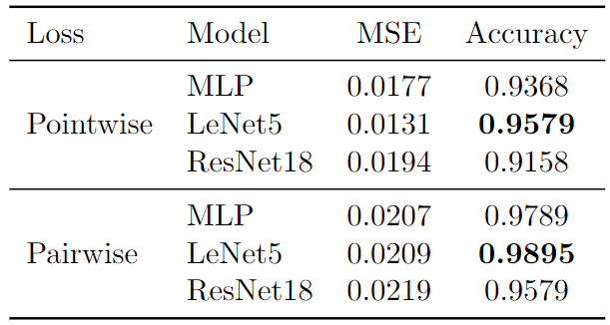
Metric Report
* results are at convergence or early-stopped epoch

Slide 17
Ranking Example
Ground Truth from AlphaFold:
T1024-D1_rand10_fm T1024-D1_aug_fm T1024-D1_deduplicated_fm T1024-D1_meta_fm
0.56865 0.70208 0.88213 0.96243

Slide 18
Ranking Example
Ground Truth from AlphaFold:
T1024-D1_rand10_fm T1024-D1_aug_fm T1024-D1_deduplicated_fm T1024-D1_meta_fm
0.56865 0.70208 0.88213 0.96243
Ranked by our pairwise model:
T1024-D1_rand10_fm T1024-D1_aug_fm T1024-D1_deduplicated_fm T1024-D1_meta_fm
CNN
<
<
<
0.40373 0.79878 0.85233 0.95667
MLP
<
<
>
0.57246 0.63600 0.98783 0.95985

Slide 19
Contributions
Transfer Learning Application of MSA-Transformer for AlphaFold
Apply Image Recognition CNNs to MSA Embedding Feature Map
eg. LeNet5, ResNet18
Combine with RankNet and MSA Scoring/Ranking
Design pairwise dataset and pairwise loss to compare a pair of MSA inputs of the same reference sequence
For the reference sequence and several MSA inputs, possible to rank MSA inputs for better AlphaFold prediction

Slide 20
Thanks for your Attention! MSA Scoring & Ranking Based on MSA Transformer
Group lianyh, tengyue & yangxch

