Slide 1
MSA Scoring Based on MSA Transformer
Group lianyh, tengyue & yangxch

Slide 2
Background
AlphaFold & MSA Transformer

Slide 3
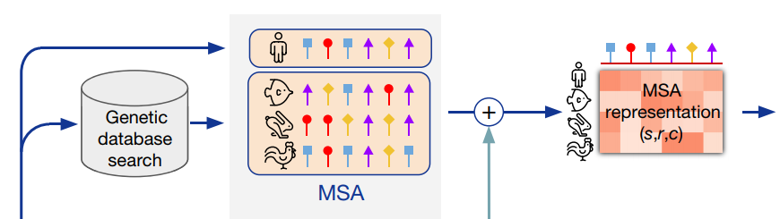
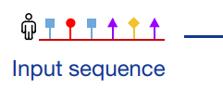
Background: AlphaFold
……
Jumper et al. 2021
Highly accurate in protein structure prediction
Requires Multiple-Sequence Alignment (MSA) as a key input
Various MSA acquisition approaches
Databases: BFD, Uniclust30, Uniref90, MGnify, …
Tools: jackhammer, HHBlits, HHSearch, MMseqs264, …
Motivation: Given 2 or more MSA inputs, which MSA input is of higher quality to help AlphaFold predict highly accurate structure?

Slide 4
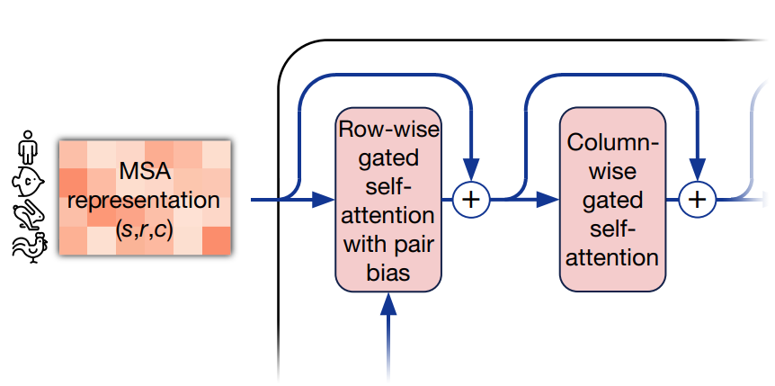
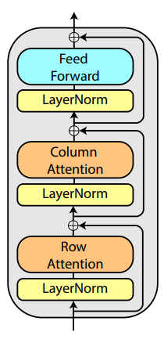
Background: MSA Transformer
Unsupervised protein language model
Masked language modeling objective
Reconstruct masked tokens, similar to BERT pretraining
AlphaFold has similar BERT-like loss at training
Axial attention over rows and columns
enables to extract information from dependencies in the input set and generalize patterns across MSAs
Also similar to part of AlphaFold Evoformer blocks, which exchange information within the MSA to enable direct reasoning about the spatial and evolutionary relationships
AlphaFold Evoformer block, Jumper et al. 2021 ↑
MSA Transformer block, Rao et al. 2021 ↓

Slide 5
Methodology
Dataset & Networks & Loss Metrics

Slide 6
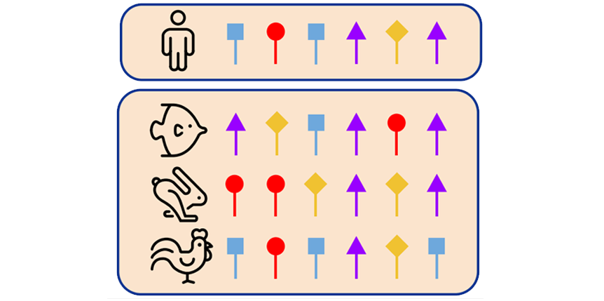
Methodology: Dataset
2850 MSAs from CASP14 Dataset
2660 train MSAs: 95 query sequences and 28 MSAs for each query
190 test MSAs: 1 pair of MSAs for each query sequence
MSA subsampling strategy
HH-Filter: >256 to ≈256 sequences
hhfilter –i input.a3m -o filtered.a3m -diff 256
Diversity Maximizing: ≈256 to 256 sequences
greedily pick sequence with maximum average hamming distance
Result shape: N × L
N ≤ 256 and L ≤ 584
depth N
L residues

Slide 7
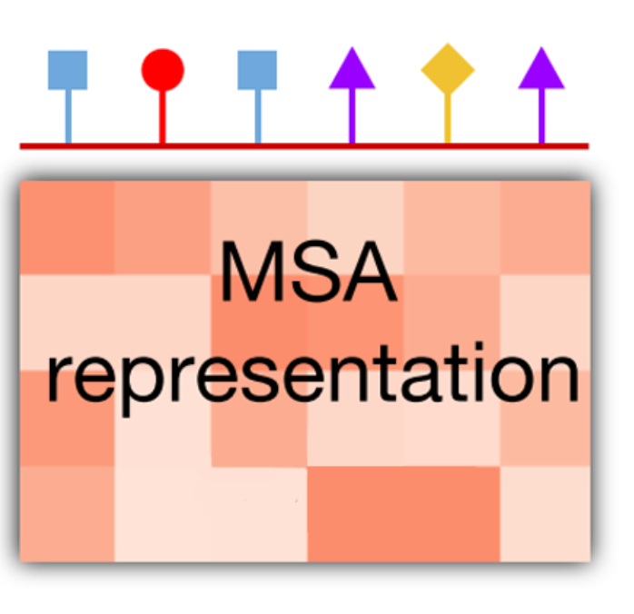
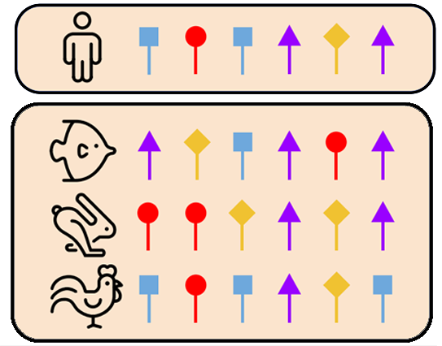
Methodology: MSA Embedding
Use MSA Transformer as encoder
Import esm.pretrained.esm_msa1b_t12_100M_UR50S()
Freeze weights of all layers for transfer learning
Save extracted embedding of each MSA for efficient training
Result MSA embedding shape: N × L × D
MSA Transformer embedding dimension → D=768
Add zero paddings → L=584
Extract query reference → L × D feature map each MSA
12 ×

Slide 8
Methodology: Score Regression Network
Use Multi-Layer-Perceptron(MLP) for vector regression
Averaging pooling/extract <bos> embedding → 768-dim vector
Feed into 3 fully-connected layers
768 → 128 → 32 → 1
with leaky_relu activations and dropout layers (except output layer)
Output one score and compute MSELoss
Use Convolutional Neural Network(CNN) for feature map scoring
L × D feature map → convolution layers
Add residual blocks and pooling layers
Extract query reference → L × D feature map each MSA

Slide 9
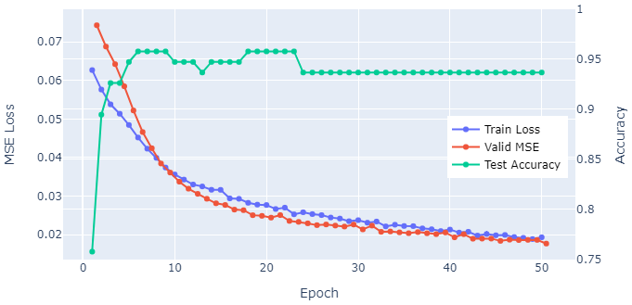
Results: Pointwise Scoring Network
MLP (extract <bos> embedding vector)
lr=1e-4 batch_size=64
Reach 0.958 test accuracy after 20 epochs
Reach 0.0177 test MSE after 50 epochs
CNN
lr=1e-4 batch_size=64
Reach 1e-3 test accuracy after 15 epochs
Reach 1e-3 test MSE after 20 epochs
Problem:
Test accuracy drops as test MSE decreases
Directly fit each MSA with its score
Compare scores of MSAs with different query sequence is meaningless!
MLP Result
CNN Result

Slide 10
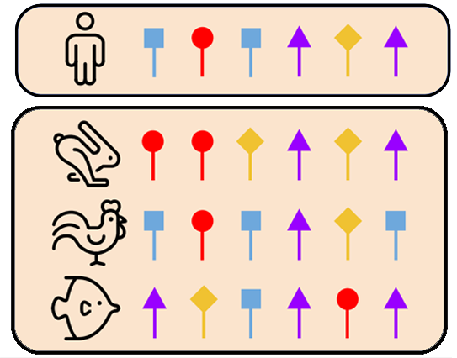





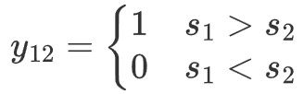

Methodology: Siamese Framework
Pointwise MSA Dataset
Group MSAs by query sequence
query $i$
Paired MSA Dataset
query $i$

Slide 11







Methodology: Siamese Framework
：possibility that is of higher quality than
Score Regression
Network (MLP/CNN)
[1]
Pairwise Binary Cross Entropy loss:
Siamese network
sharing weights
1
2
Mean Squared Error loss:
MSA Transformer
Encoder
Total loss for back propagation:
same query
[1] Burges C . From RankNet to LambdaRank to LambdaMART: An Overview[J]. learning, 2010.

Slide 12
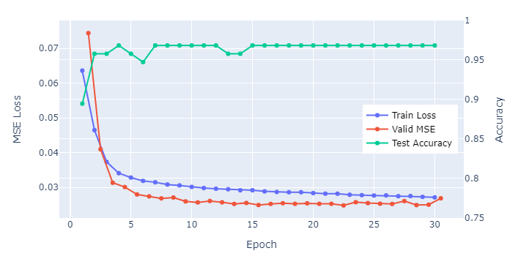
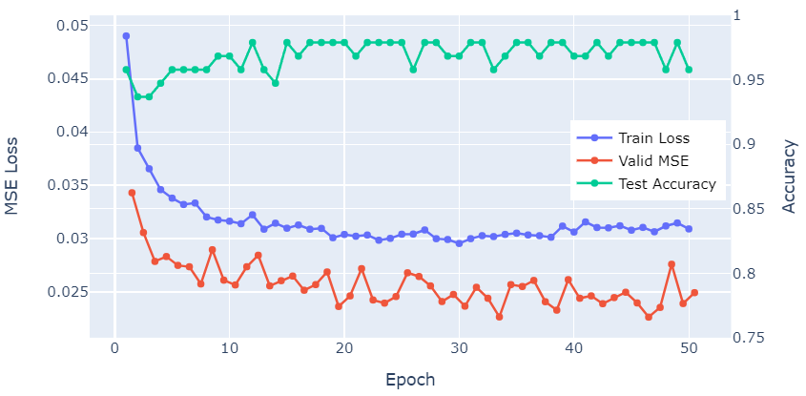
Results: Siamese Network + Pairwise Loss
Pairwise MLP
lr=1e-4 batch_size=64 λ=5.0
Reach 0.979 test accuracy after 20 epochs
Reach 0.0226 test MSE after 46 epochs
Pairwise CNN
lr=2e-5 batch_size=64
Reach 1e-3 test accuracy after 15 epochs
Reach 1e-3 test MSE after 20 epochs
Conclusion:
Test accuracy decreases as test MSE decreases
Directly fit each MSA with its score
MLP Result
CNN Result

Slide 13
Results & Conclusion
MLP vs. CNN & Pointwise vs. Pairwise & Metric Reports

Slide 14
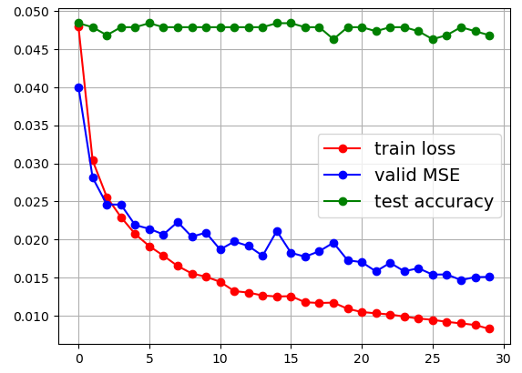
Results: Siamese Network + Pairwise Loss
MLP: 0.00826 train MSE after 20 epochs
CNN: 0.00826 train MSE after 20 epochs
Hyperparameter settings:
output MSA with more sequences
baseline test acc: 0.7789
a great boost!

Slide 15
Thanks for your Attention! MSA Scoring Based on MSA Transformer
Group lianyh, tengyue & yangxch

