Slide 1
MSA Scoring Based on MSA Transformer
Group lianyh, tengyue & yangxch

Slide 2
MSA Input Preprocessing
Read names, sequences and scores
shape of MSA input : [num_sequence, sequence_len]
Remove insertions (lowercase letters) of sequences
Subsampling MSAs
subsample >256 sequences to 256 sequences per MSA
HH-Filter: >256 to ≈256 sequences
hhfilter –i input.a3m -o filtered.a3m -diff 256
Diversity Maximizing: ≈256 to 256 sequences
greedily pick sequence with max hamming distance
result shape: [256, sequence_len]

Slide 3
MSA Embeddings from MSA Transformer
Use esm.pretrained.esm_msa1b_t12_100M_UR50S()
Convert MSA Input to Batch Input
convert letters to numeric tokens
Add <begin_of_sequence> token and paddings for each sequence
result shape: [batch_size, 256, 1+sequence_len]
Obtain MSA embeddings from MSA Transformer
MSA Transformer uses embedding_size = 768
model output shape: [batch_size, 256, 1+sequence_len, 768]
we extract the query sequence and discard <begin_of_sequence>
result embedding shape: [sequence_len, 768] for each MSA

Slide 4
MSA Scoring Network
Now we have [sequence_len, 768] embedding for each MSA
consider it as a feature map (image) and feed into CNN
however, for experiment, we average it over the sequence_len axis
result shape: a 768-dim vector for each MSA
For experiment, we simply train a MLP
input 768-dim vector -> Fully-Connected Layers -> output score
reach 0.00826 train MSE loss after 30 epochs
prediction accuracy on test set: 0.9579 after 20 epochs

Slide 5
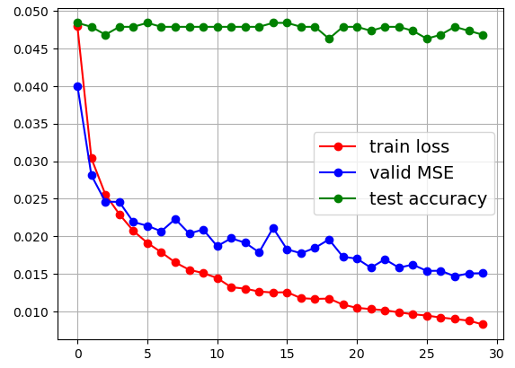
MSA Scoring Network
Reach 0.00826 train MSE loss after 30 epochs
Test accuracy: 0.9579
91 correct out of 95 pairs of MSA
high from the first training epoch
Naïve baseline for comparison:
output MSA with more sequences
baseline test acc: 0.7789
a great boost!

Slide 6










MSA Scoring Network
Some correctly predicted pairs:
Some wrongly predicted pairs:

Slide 7
Future Work
Try other (combinations of) pipelines:
other MSA embedding representations, like a feature map instead of vector
other network structures, like deep CNN instead of MLP
Focus on comparing MSAs of the same query sequence
like T1024-D1_xxx, T1011-D2_xxx as we would like in the test set
might try pairwise loss or triplet loss for MSAs of same query sequence
Instead of blindly fitting arbitrary MSA with its score
Improve explainability
try more weakly supervised model?
try to apply some XAI methods

Slide 8


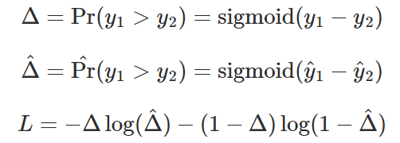
Pairwise Cross-Entropy Loss
T1024-D1_base_fm 0.96112
T1024-D1_aug_fm 0.70208

Slide 9
Triplet Loss
Current regression model cannot score MSAs >90 well
Anchor: T1024-D1_cov50_fm 94.43
Positive: T1024-D1_base_fm 96.112
Negative: T1024-D1_rand9_fm 58.42

