Slide 1

Supply Chain Management
- Created By Nai vaibhav
Powered By

Slide 2
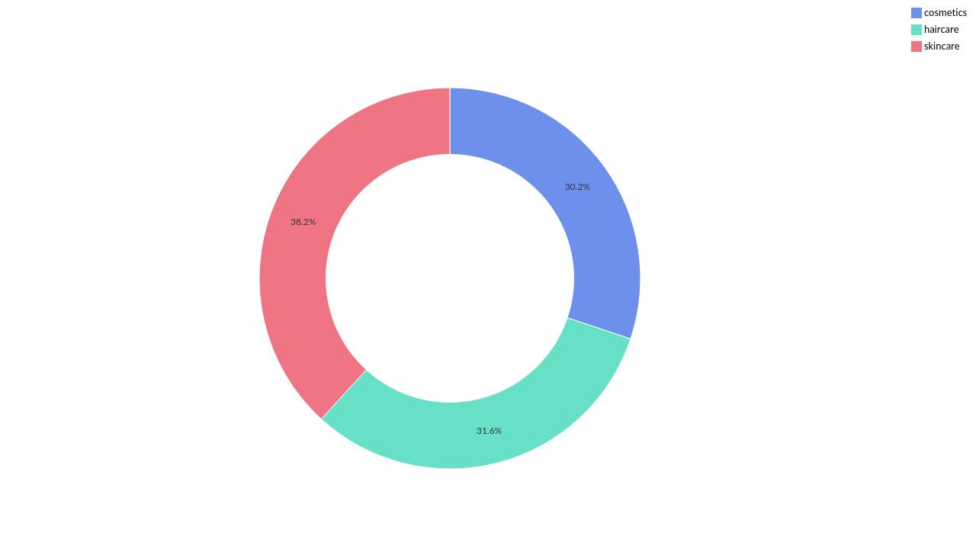

Product type-wise Price
Powered By

Slide 3
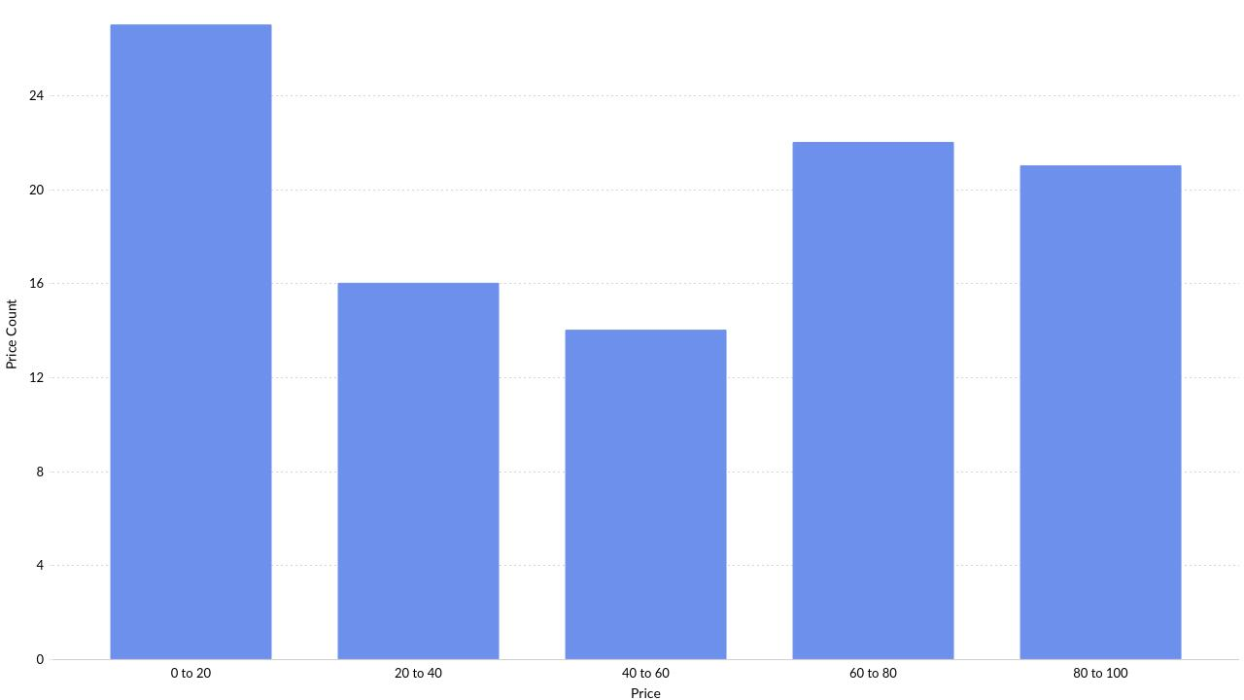
Distribution of Price
Powered By

Slide 4
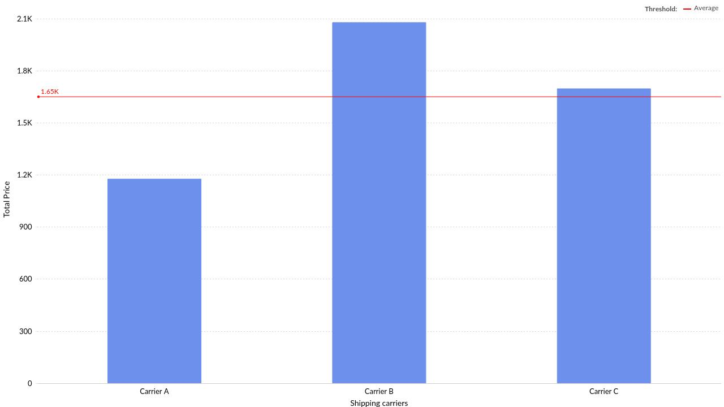
Shipping carriers-wise Price
Powered By

Slide 5
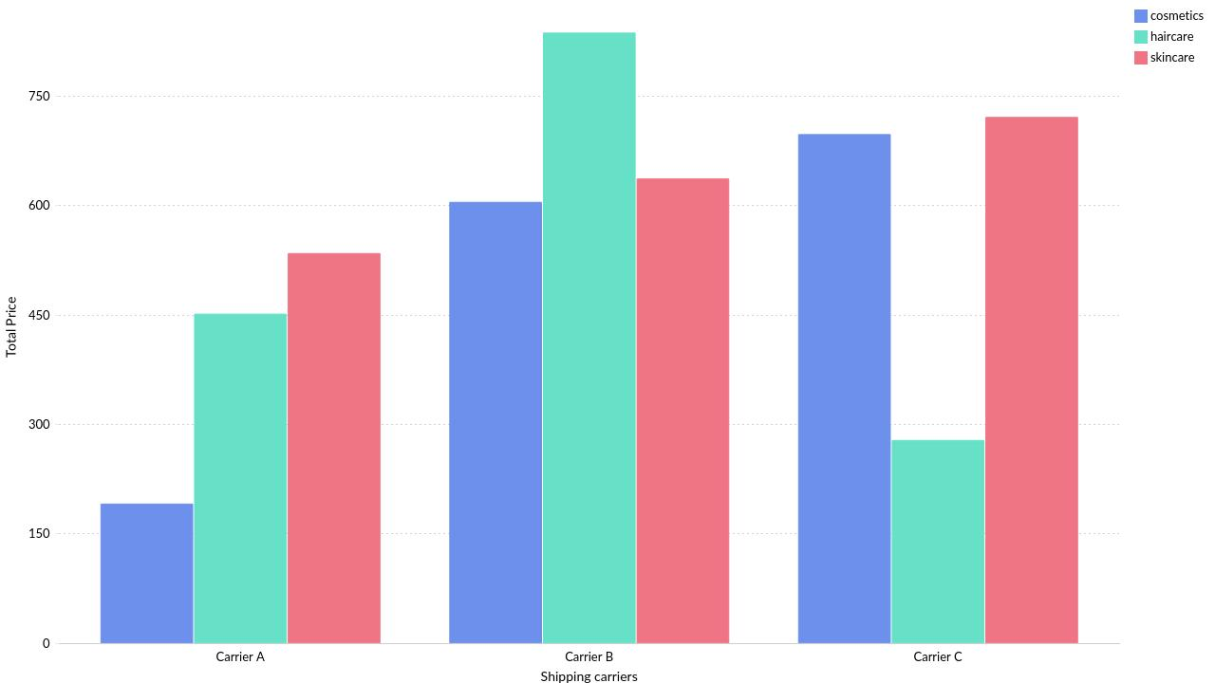
Shipping carriers-wise Price by Product type
Powered By

Slide 6
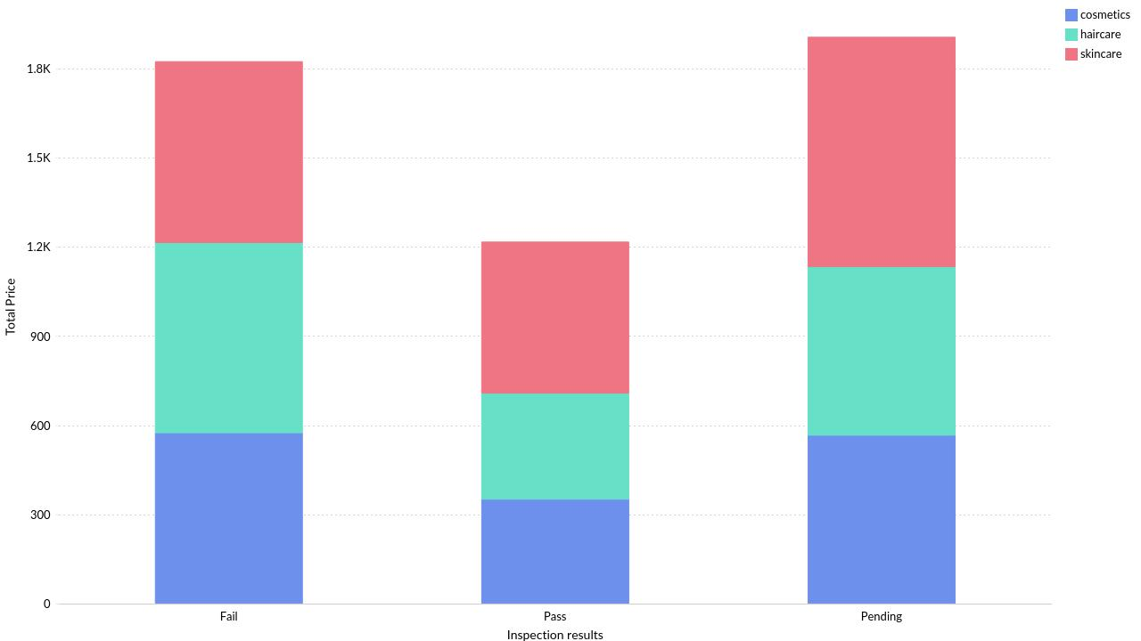
Inspection results-wise Price by Product type
Powered By

Slide 7
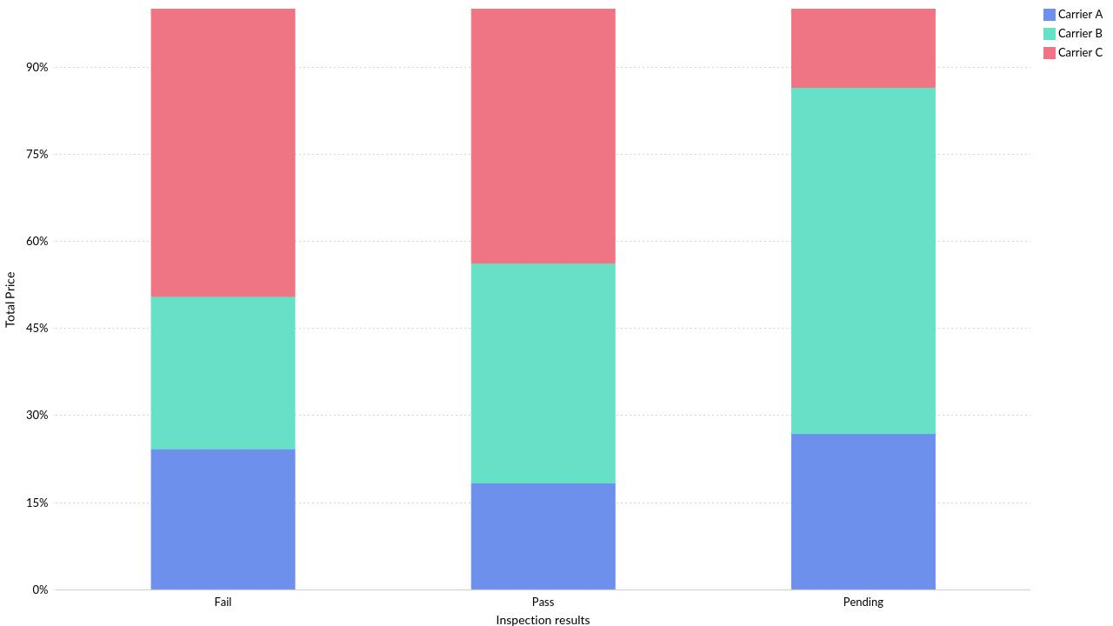
Ratio of Inspection results-wise Price by Shipping carriers
Powered By

Slide 8
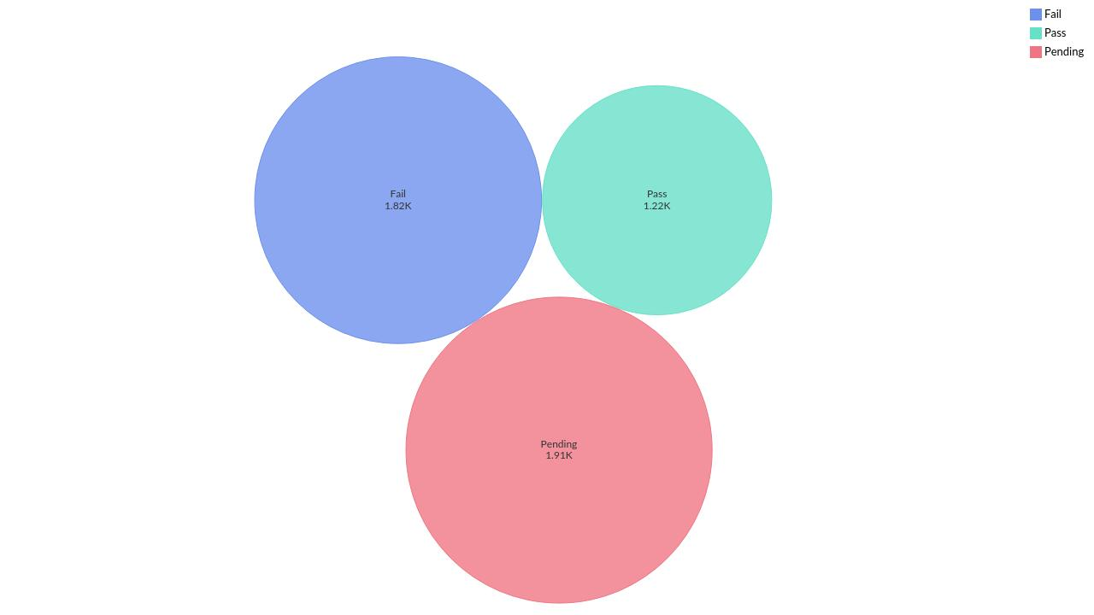
Inspection results-wise Price
Powered By

Slide 9
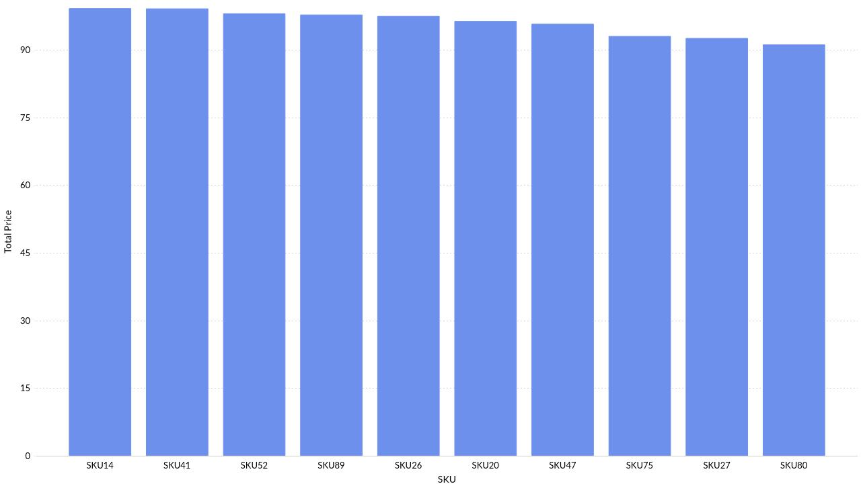
Top 10 SKU by Price
Powered By

Slide 10
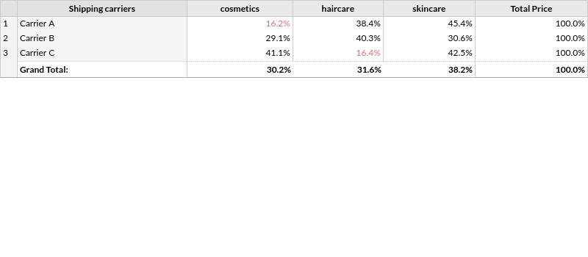
Price distribution across Shipping carriers by Product type
Powered By

Slide 11
Thank you
Powered By

