Slide 1

Software Testing
Test Data Selection
Instructor: Kaveh Eshraghian

Slide 2
Overview
Black Box Test Data Selection
White Box Test Data Selection

Slide 3
Testing Methods
Testing
Exhaustive
Smart
Black Box
White Box

Slide 4
Exhaustive Testing
Definition:
Brute force testing / Complete Testing
A software testing technique in which all possible combinations of scenarios and inputs are tested to confirm that a software system functions properly under every possible situation.
Issue:
Large number of tests
Duplicate tests
Sample 1:
Consider an addition of two 32-bit integers.
Size of each integer: 4,294,967,296
All possible combinations: 18,446,744,073,709,551,616

Slide 5
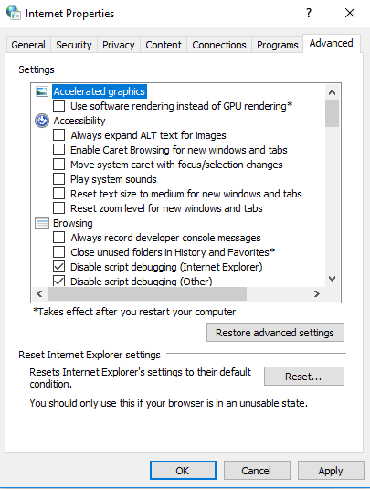
Exhaustive Testing
Sample 2:
IE Tools -> Advanced Options
Possible selections:
53 Binary Selections
1 condition with 3 options
1 condition with 4 options
Combination:
108,086,391,056,891,904

Slide 6
Smart Testing
Definition:
Acknowledging the fact that some tests are more important than others and reallocating resources to perform them.
Pros:
Eliminating Duplication
Reducing test numbers
Black Box
White Box

Slide 7
Black Box – Integer Addition
Non-duplicate Values
Adding two identical even values (eg. 12 + 12),
Adding an even and an odd value (eg. 14 + 19),
Adding an odd and an even value (eg. 23 + 12),
Adding two identical odd values (eg. 23 + 23).
Error-prone areas
Transition points from one area of data to another (moving from positive to negative values)
End points of the data values (the maximum and minimum integer values),
Special values (0 being a special value for addition),
Values immediately adjacent to other special values.

Slide 8
Black Box – Integer Addition
adding 0 to a number
(12 + 0, -13 + 0)
adding 1 to a number
(12 + 1, -13 + 1)
adding -1 to a number
(12 + -1, -13 + -1)
adding MAXINT to a number
(12 + MAXINT, -13 + MAXINT)
adding MININT to a number
(12 + MININT, -13 + MININT)
adding MAXINT-1 to a number
(12 + (MAXINT-1), -13 + (MAXINT-1))
adding MININT+1 to a number
(12 + (MININT+1), -13 + (MININT+1))

Slide 9
Black Box – String Concatenation
String Concatenation
void concat(char dest[], const char src[]) { … }
Test Data to consider:
Routine values
Edge conditions

Slide 10
Black Box – String Concatenation
Edge Conditions
concat("", "");
concat("", "a");
concat("", "abc");
concat("a", "");
concat("abc", "");
Routine values
concat("a", "a");
concat("a", "abc");
concat("abc", "x");

Slide 11
Black Box – String Concatenation
#define MAX_LEN 16
void concat(char dest[], const char src[]) { … }
Routine longer strings not exceeding allocated array size of 16
concat("abcdefg", "hijk"),
concat("abcdefg", "hijklmn")
Longest possible
concat("012345678901234", "x")
Longer than allocated storage
concat("012345678901234", "xy")

Slide 12
White Box – String Concatenation
void concat(char dest[], const char src[])
{
int dp = 0, sp = 0;
if (dest != NULL)
{
for (dp = 0; dest[dp] != '\0'; dp++);
if (src != NULL)
{
for (sp = 0; src[sp] != '\0'; sp++)
{
dest[dp++] = src[sp];
}
dest[dp] = '\0';
}
}
}
concat(NULL, "a")
concat(tmp, NULL)

Slide 13
Splitting text into words
int split(char line[], char words[][MAX_WORD_LEN + 1], int maxWords) { … }
Initial Testing:
Test String:
char line[] = { " The quick\t brown fox " };
Testing Coverage:
Blanks at the begging and ending of the string,
Single blanks between words,
Multiple blanks between words,
Combination of blanks and tabs between words.

Slide 14
Splitting Text Into Words
int split(char line[], char words[][MAX_WORD_LEN + 1], int maxWords)
{
char ch;
char buf[MAX_WORD_LEN + 1] = { 0 };
int lp = 0, bp = 0, wp = 0, result = 0;
ch = line[lp];
while (ch != '\0' && result >= 0)
{
while (ch != '\0' && (ch == ' ' || ch == '\t')) ch = line[++lp];
bp = 0;
while (ch != '\0' && !(ch == ' ' || ch == '\t'))
{
buf[bp++] = ch;
ch = line[++lp];
}
if (bp > 0)
{
buf[bp] = '\0';
if (wp >= maxWords)
{
result = -1;
}
else
{
strcpy(words[wp++], buf);
}
}
}
result = (result < 0) ? result : wp;
return result;
}
Check to see if the number of words exceed the maximum size of the array.
Add test to check appropriate behavior.

