Slide 1

Software Testing
Visual Studio Debugging
Instructor: Kaveh Eshraghian

Slide 2
Overview
VS Debugger Overview
Breakpoints
Run Controls
Variable Pane
Watch Pane
The Call Stack

Slide 3

Visual Studio Debugger
Integrated debugger
Benefits:
Convenient
Efficient
Multi-variable Tracking
Supports
Break points,
Conditional breakpoints,
Stepping,
Stack trace,
Variable display,
Variable watch.
Notes:
Microsoft Visual Studio has an integrated debugger which makes it very easy to debug your programs.
typicaly used when the use of print statements is not sufficient to find the bug.

Slide 4
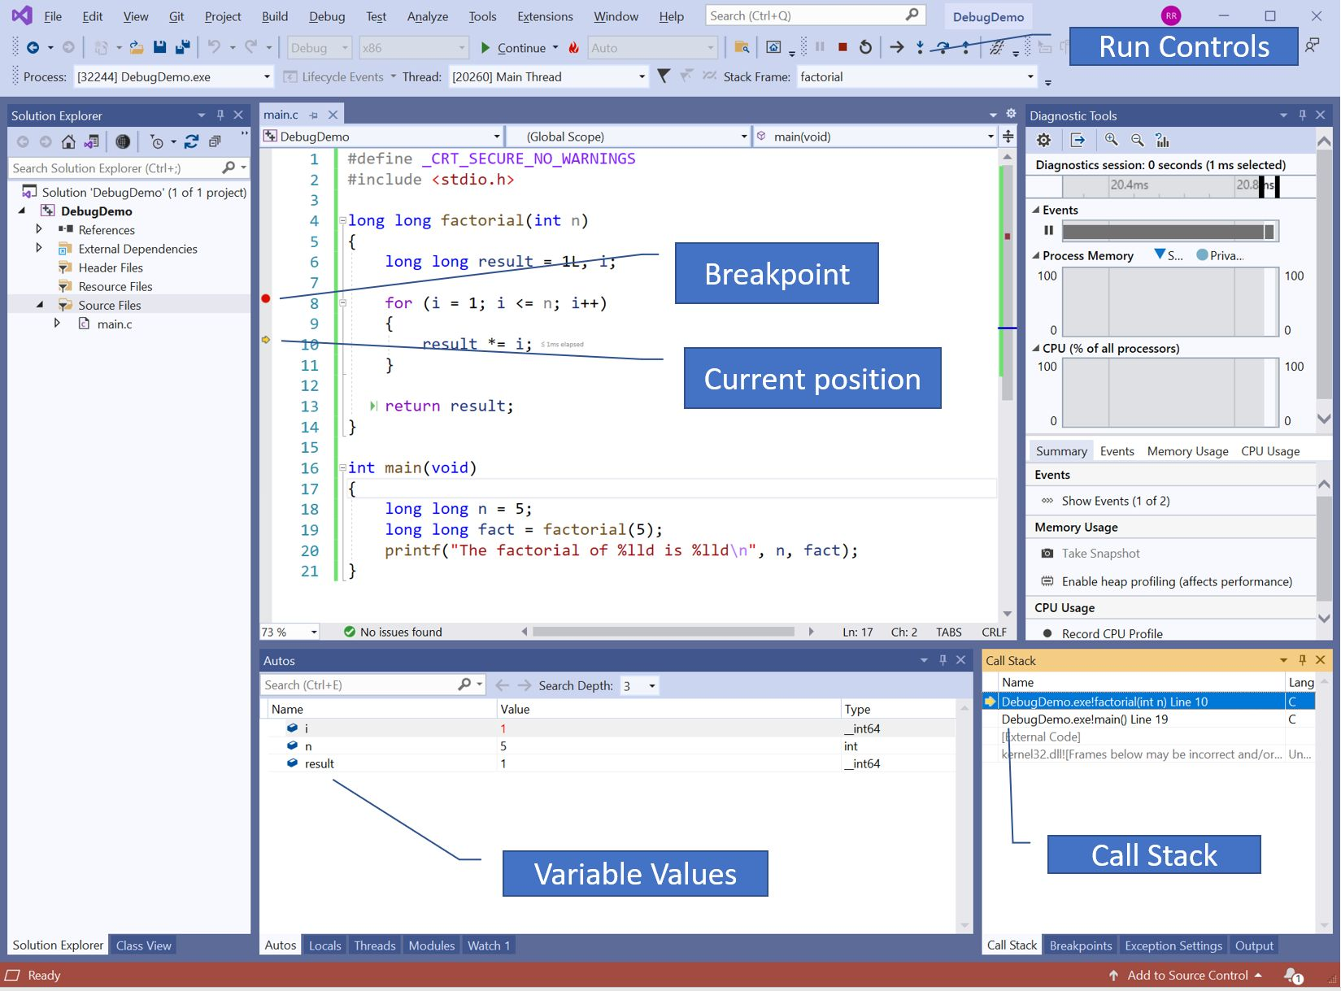
Notes:
the controls at the top of the window allow you to
go to the next statement,
execute into a function and stop
execute until a function returns and stop,
restart the execution,
continue the execution until the next breakpoint
The vertical bar to the left of the code provides:
the ability to set and remove breakpoints by clicking beside a line. A breakpoint is a point at which the code will pause execution and allow you to inspect the variables in a running program. Breakpoints are described in more detail later.
A yellow arrow indicating the next line to be executed. As you execute the lines, this arrow will move to show you where you are in the code.
The bottom left pane shows the values of the variables and has tabs to display:
the local variables,
a list of variables whose value you want to watch.
The pane on the bottom right shows:
the callstack which shows all the functions that have been called and the lines on which they are suspended,
a list of breakpoints which can be temporarily disabled.

Slide 5
Breakpoints
Definition:
One of the most important debugging techniques in your developer's toolbox
Can be set on any line of executable code.
Benefits:
Examining state of code
Examining state of all variables
Changing variables during runtime
Possibility of taking different paths within code using “Run Controls”

Slide 6
Breakpoints Types
Conditional
breakpoints that are hit, only when a certain condition is met.
Tracepoint
A breakpoint used to output messages or executing macros.
Temporary
Break the code only once.
Dependent
Breaks execution only if another breakpoint is first hit.
Notes:
Conditional:
This is just a simple trick that many of you might have been using. It's a small but very powerful tip, especially helpful when you are debugging a large code base. This is the concept of Breakpoint Conditions.
Tracepoint:
a point in the target program where the debugger will briefly stop, collect some data, and then allow the program to continue.
A tracepoint is a breakpoint that prints a message to the Output window. A tracepoint can act like a temporary trace statement in the programming language and does not pause the execution of code.
have an effect similar to inserting print statements in your code. They are faster to set up than print statements, can be made conditional, and can be easily removed
Temporary:
When debugging, the Visual Studio debugger only pauses the running application once for this breakpoint and then removes it immediately after it has been hit.
Dependant:
Dependent breakpoints break execution only if another breakpoint is first hit. So, in a complex scenario such as debugging a multi-threaded application, you can configure the additional breakpoints after another breakpoint is first hit. This can make debugging code in common paths such as game loop or a utility API much easier because a breakpoint in those functions can be configured to enable only if the function is invoked from a specific part of your application.

Slide 7
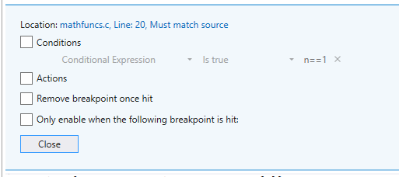
Breakpoints Types

Slide 8
Action Macros
$CALLER
$CALLSTACK
Displays the call stack showing how this function was called.
$FILEPOS
The name of the current file and the line of the breakpoint
$FUNCTION
The name of the function containing the breakpoint
$TICK
The number of milliseconds since the computer was started
The name of the function which called this function.
In $FUNCTION called from $CALLER: i = {i}

Slide 9
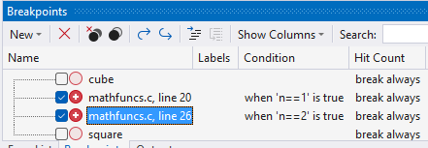
Breakpoint Pane
Definition:
A toolbox to display the list of all breakpoints
within the code in one window.
functionalities:
Each breakpoint has a checkmark to the left of it which can be clicked to temporarily disable the breakpoint.
An X button above the list of breakpoints that will delete the highlighted breakpoint.
A New button which can create two different types of breakpoints.
Notes:
Debug -> Windows
This displays a list of breakpoints you have set in the program. Finding them listed here is much easier than searching all over the code to find them.
Each breakpoint has a checkmark to the left of it which can be clicked to temporarily disable the breakpoint. If you want to actually delete a breakpoint, there is an X button above the list of breakpoints that will delete the highlighted breakpoint. There is also a New button which can create two different types of breakpoints -- a function breakpoint and a data breakpoint.

Slide 10
Breakpoint Types
Function breakpoint
Same type of breakpoint we have been using all along
Allows typing the name of a function
Suspends execution on the first line of function
Data breakpoint
Set to watch for changes in a specified number of bytes at a specific address in memory.
Every time this variable is changed, a breakpoint will be triggered.
Notes:
A function breakpoint is the same type of breakpoint we have been using all along. It allows you to type the name of a function and it will suspend execution on the first line of that function when it is called.
A data breakpoint: This is a very powerful feature for finding the type of bug where one of your variables just seems to change its value all on its own. You can now watch for changes in the variable and identify the line of code which made the change.
Usually, you set the address of one of your variables using the & operator to generate the address of the variable.

Slide 11




Run Controls
continue to execute until it either hits the next breakpoint or the program completes.
stop the current execution of the program and restart it
position the cursor on the next statement that is going to be executed
terminate the current debugging session
resume execution until it enters the next function call.
execute the next statement
continue to the end of a function and return

Slide 12
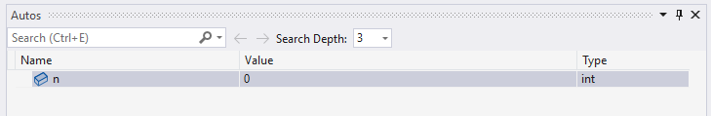
Variables Pane
The Autos and Locals windows show variable.
The windows are only available during a debugging session.
Autos window:
shows variables used around the current breakpoint.
Locals window:
shows variables defined in the local scope
Notes:
What is shown will change based on the scope in which the debugger is paused.
If the variable is an array, struct or class,
it will allow you to expand it and see the internal structure of the variable.

Slide 13
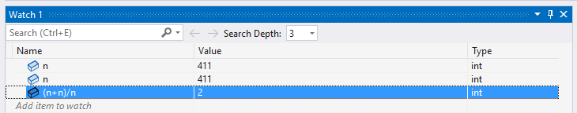
Watch Pane
Watch variables and expressions.
Display several variables at a time while debugging.
Observe any valid expression
Notes:
What is shown will change based on the scope in which the debugger is paused.
If the variable is an array, struct or class,
it will allow you to expand it and see the internal structure of the variable.

Slide 14
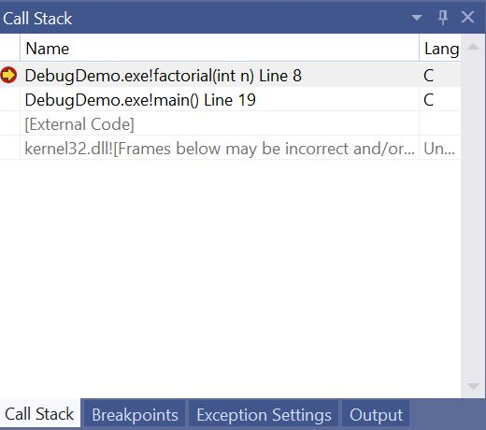
The Call Stack
Shows the line paused at and All calls paused before that Point.

Slide 15
Exporting and Importing Breakpoints
Breakpoints can be exported from the breakpoints pane using the curved arrow buttons at the top of the pane.
This lets you create a set of breakpoints to debug a certain problem and save them to an XML file.
Since you might not have completely solved the problem, you can save the breakpoints and then reload them if the same problem occurs again.

