Slide 1
Toxic comment classification with an RNN Deep Learning KU, Course Project, WS 2024/2025
Team members:
Naida Nožić,
Jakob Hinum-Wagner,
Dominik Haring,
Áron Karsai

Slide 2
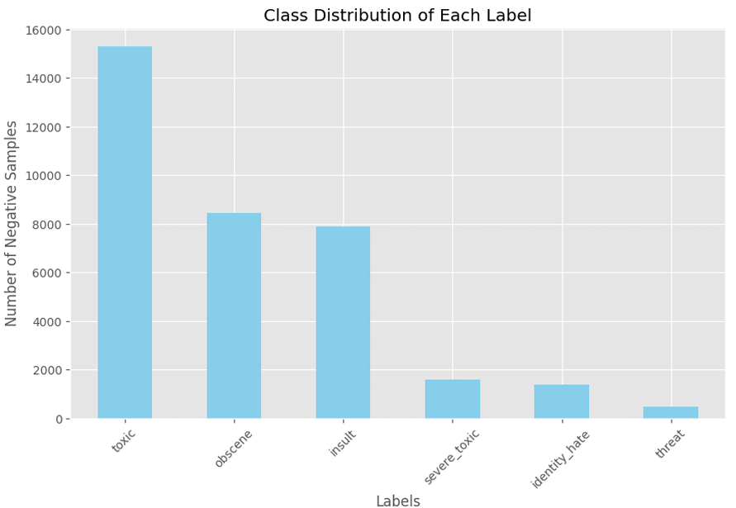
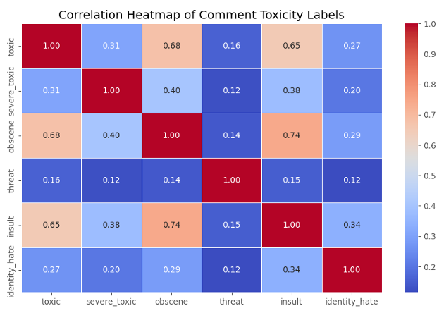
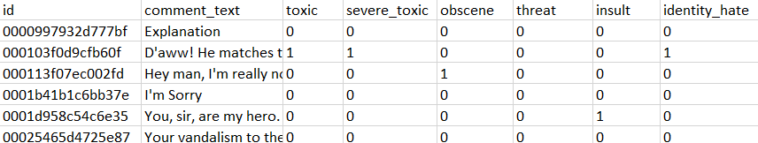
Introduction
Toxic comment classification with an RNN
A multi-label text classification task.
Six toxicity labels (toxic, severe toxic, obscene, threat, insult and identity hate).
Data Cleaning: removal of links, punctuation, special characters, numbers, and newline characters, conversion to lowercase.
Data Preprocessing: tokenization, lemmatization, and stopword removal

Slide 3
Jakob: Architecture choices
Toxic comment classification with an RNN
Few words about the baseline
The two RNN structures (block diagram maybe)
Loss function description

Slide 4
Dominik: Results
Toxic comment classification with an RNN
Analyze training data (e.g. plots of validation losses for the two RNN architectures)
Analyze eval metrics for baseline and the two RNNs

Slide 5
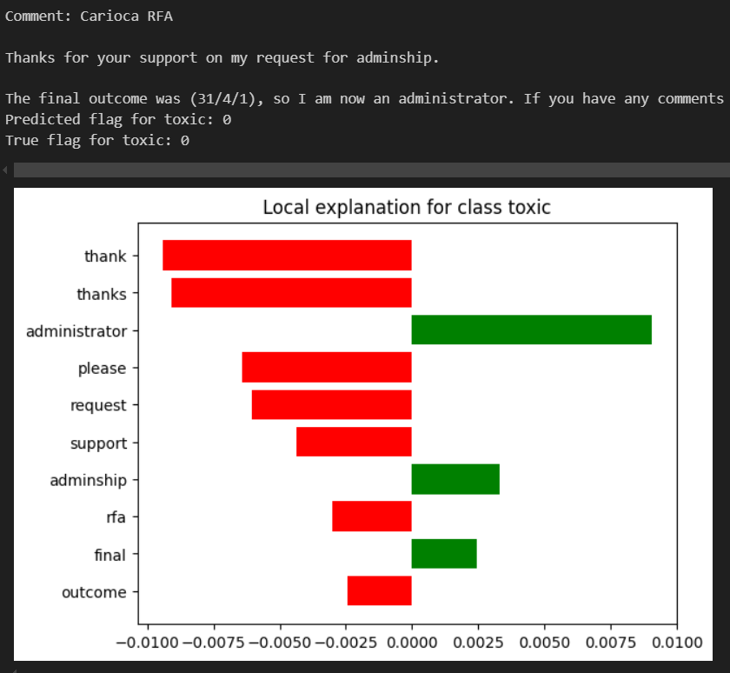
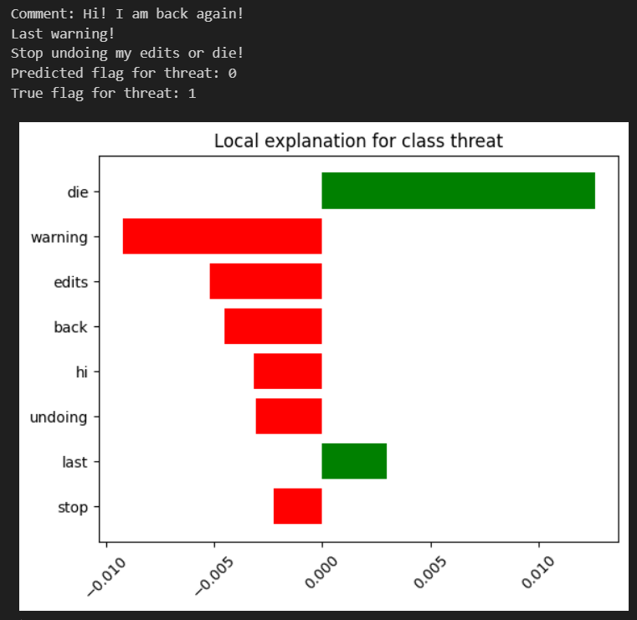
LIME and conclusions
Toxic comment classification with an RNN
Baseline Logistic Regression Model
RNN model with independent probabilites
Notes:
Why we chose the independent RNN -> it perfromed better than the other one
Local Iinterpretable model-Agnostic Explanations
The independent RNN is close to the baseline, although more complicated -> depends on application

