Slide 1
Toxic comment classification with an RNN Deep Learning KU, Course Project, WS 2024/2025
Team members:
Naida Nožić,
Jakob Hinum-Wagner,
Dominik Haring,
Áron Karsai

Slide 2
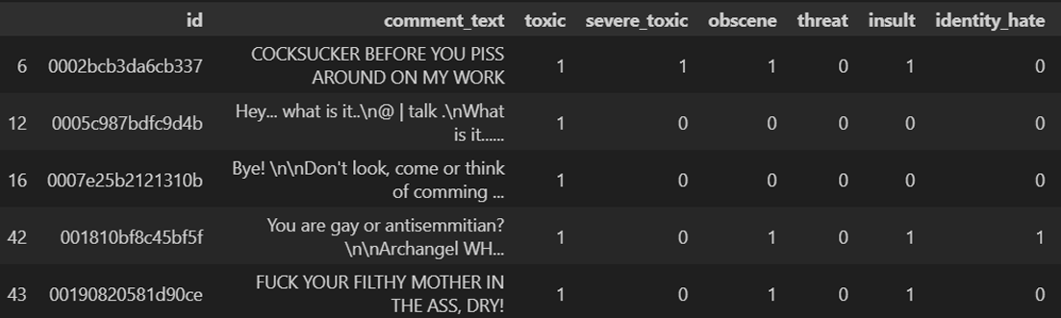
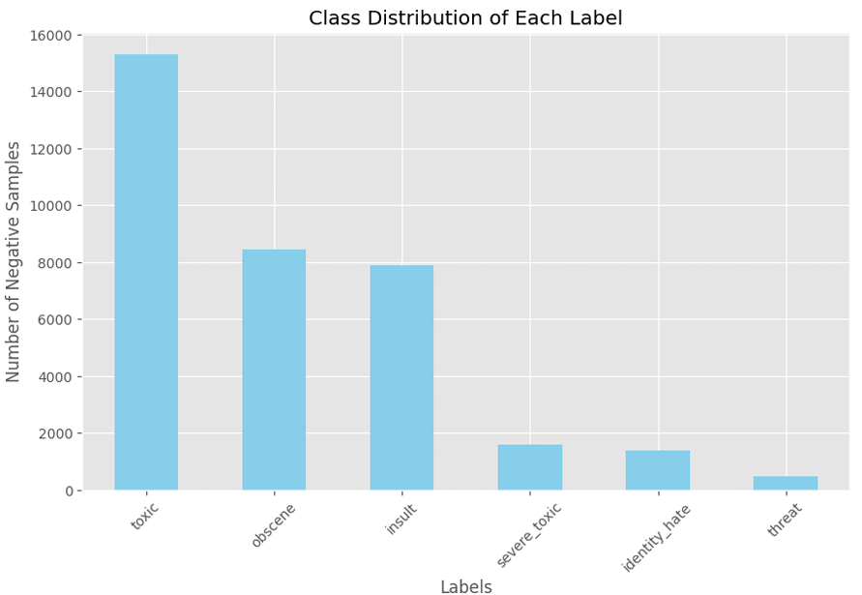
Introduction
Toxic comment classification with an RNN
A multi-label text classification task.
Six toxicity labels (toxic, severe toxic, obscene, threat, insult and identity hate).
Data Cleaning: removal of links, punctuation, special characters, numbers, and newline characters, conversion to lowercase.
Data Preprocessing: tokenization, lemmatization, and stopword removal

Slide 3
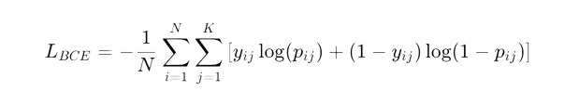
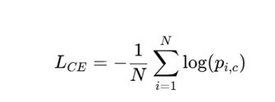
Baseline model and RNN Architectures
Toxic comment classification with an RNN
Baseline model
Logisitc regression
Features:
Text Representation: TF-IDF (Term Frequency-Inverse Document Frequency) → convert text into numerical feature vectors.
Model Design:
Trained independently for each toxicity label using binary cross-entropy loss.
Results:
High accuracy for frequent labels like Toxic and Obscene.
Poor performance for rare labels such as Threat and Identity Hate due to class imbalance.
Recurrent Neural Networks (RNNs)
Embedding Layer :
Converts tokens into dense vectors,
LSTM Layers:
Two stacked LSTM layers capture sequential patterns and long-term dependencies in text.
Dropout Layer:
Reduces overfitting by randomly zeroing activations during training.
Fully Connected Layer:
Maps extracted features to output labels for classification.
Model Variants and Training details
Loss functions
Binary Cross-Entropy:
Used for the Independent Probabilities Model:
Used for the Joint Probabilities Model:
Independent Model: Each label is treated as a separate binary classification
problem using sigmoid activation.
Joint Model: Labels are treated as a single multi-class output using
softmax activation, capturing label dependencies.
Regularization: Dropout and gradient clipping to enhance stability.
Optimization: Adam optimizer with a learning rate of 0.001 and a linear scheduler
Notes:
Recurrent Neural Networks (RNNs) are ideal for processing sequential data like text, making them well-suited for toxic comment classification.
RNNs capture dependencies across words in a sequence by maintaining contextual information over time.
Traditional RNNs face challenges such as vanishing gradients, which limit their ability to handle long sequences effectively.
LSTM (Long Short-Term Memory)

Slide 4
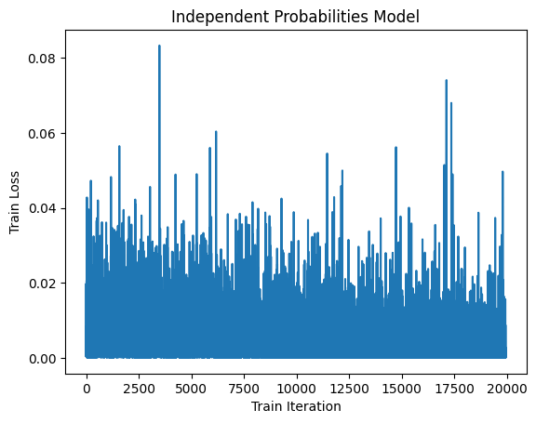
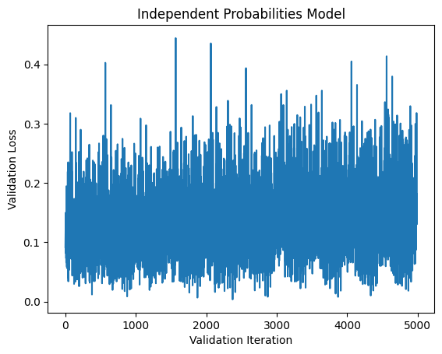
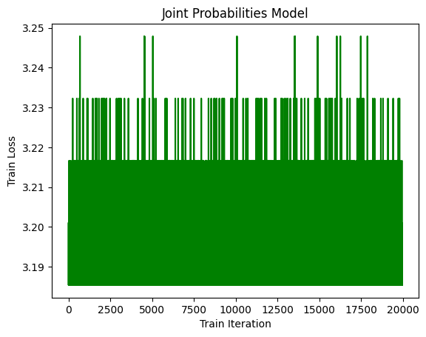
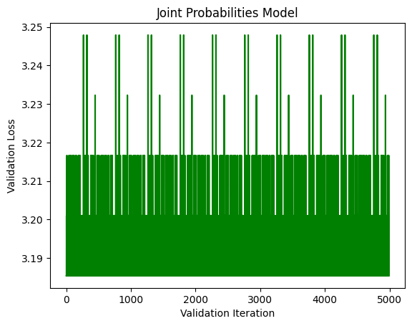
Finetuning & Results
Toxic comment classification with an RNN
Tuned Parameters:
Gradient Clipping Cutoff
Dropout Regularization
Linear Learning Rate Decay
Batch Size
Evaluation Metrics:
Model | Accuracy | F1 | Precision | Recall
Baseline | 0.91 | 0.67 | 0.87 | 0.54
Ind. Prob | 0.89 | 0.68 | 0.68 | 0.69
Joint Prob | 0.03 | 0.15 | 0.09 | 0.43
Notes:
Generally tricky to find good hyperparameters
Train loss with slight downward trend despite spikiness
No Early Stopping due to validation loss
Independent Model: Competetive Accuracy, performs well in F1 score and Recall -> prioritizes correctly identifying positives at the cost of more false positives

Slide 5
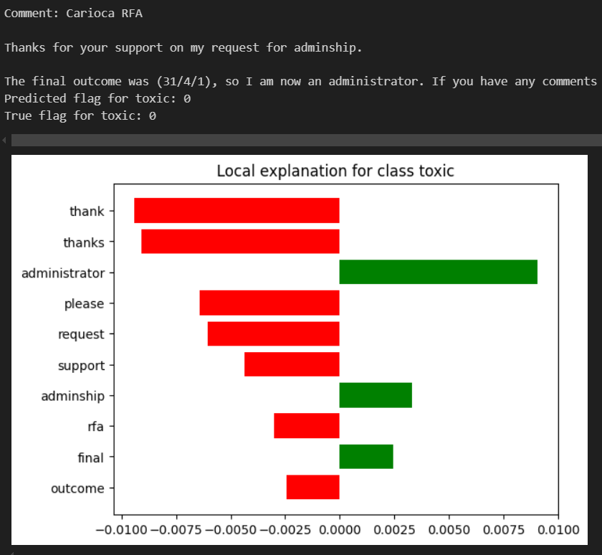
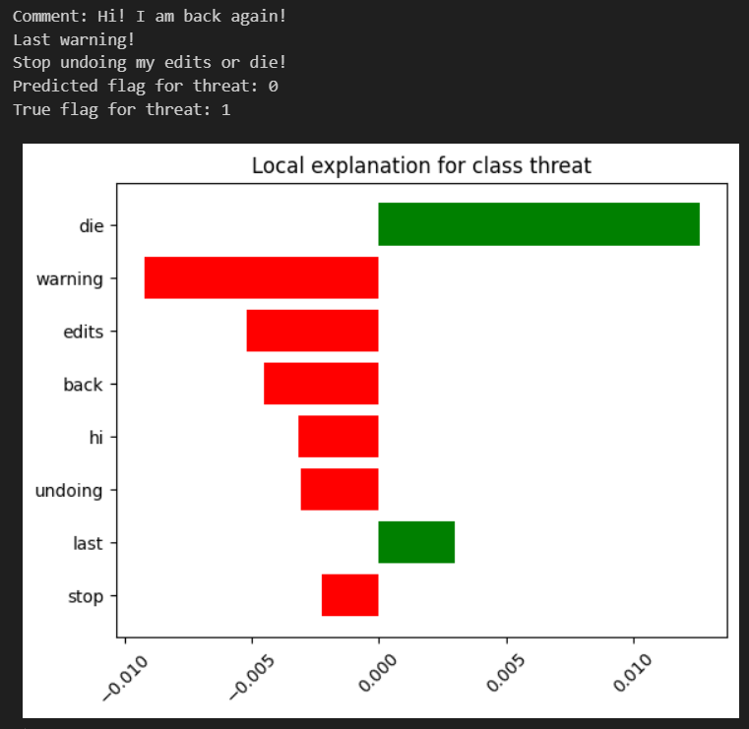
LIME and conclusions
Toxic comment classification with an RNN
Baseline Logistic Regression Model
RNN model with independent probabilites
Notes:
Why we chose the independent RNN -> it perfromed better than the other one
Local Iinterpretable model-Agnostic Explanations
The independent RNN is close to the baseline, although more complicated -> depends on application

