Slide 1
House Price Prediction Knowledge Discovery and Data Mining 1 Project

Slide 2
Motivation
House Price Prediction
Exploritory Data Analysis
Data Preprocessing
House Price Prediction
Evaluation of the Machine Learning Model
Question answers:
If I have a budget of €100,000, what kind of houses will I be able to buy?
How much money can I save if I decide not to get a house with a pool?

Slide 3
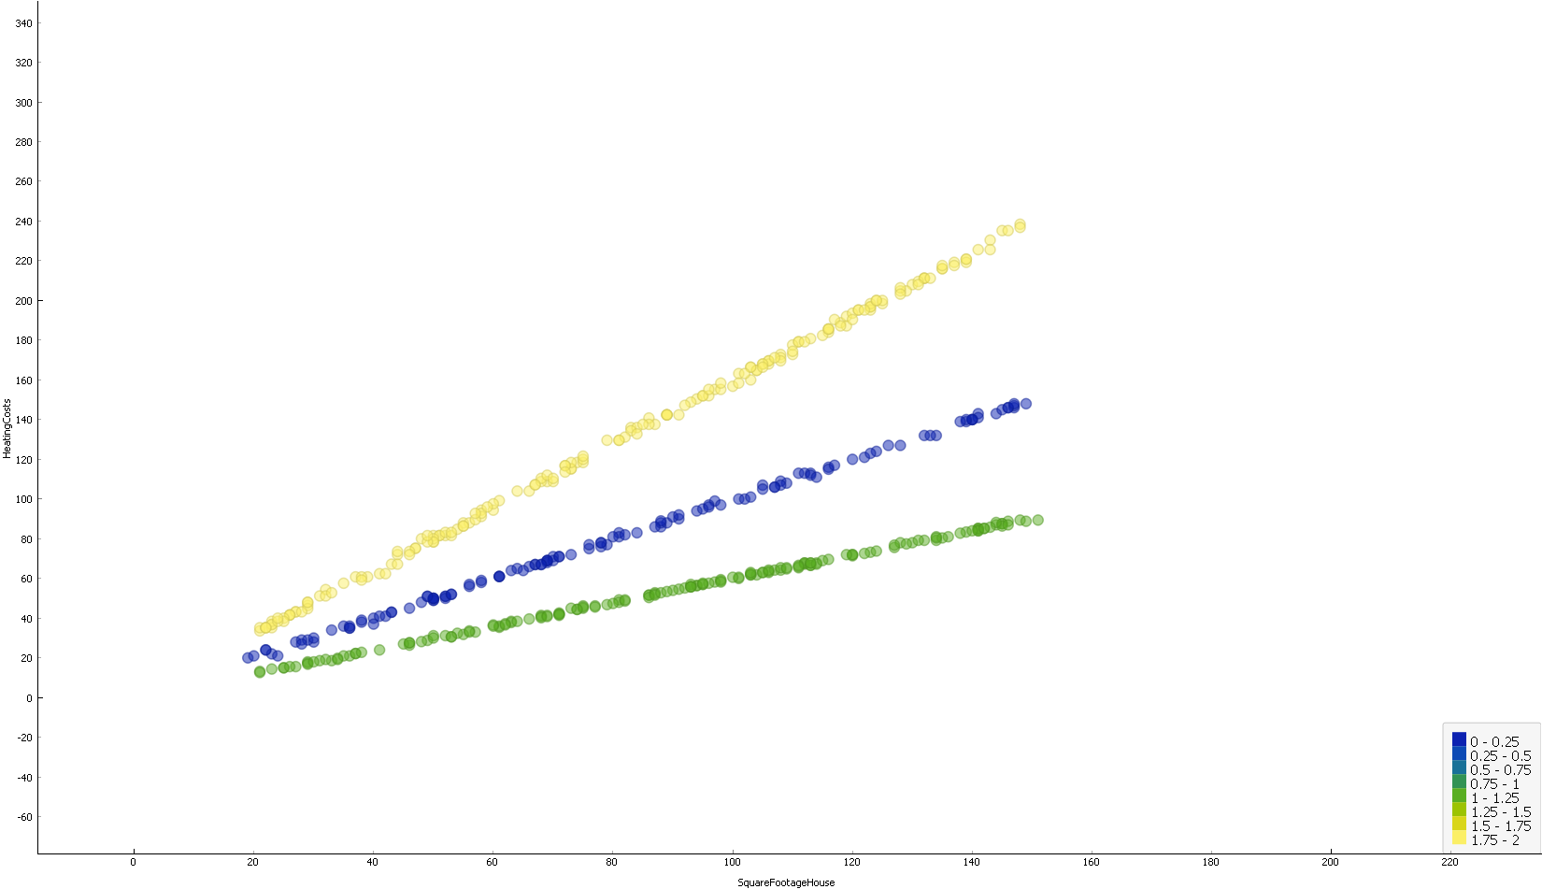
Exploring the data
Exploritory Data Analysis
Bring data into shape
Drop completely empty rows or useless columns
Convert categorical values into enums
Convert numerical values to integers if possible
Simplify redundant values
Coerce some invalid values to null
Notes:
To start off we looked at hard facts about the data, # of missing values, # of unique values, min, max, mean, etc.
Then we checked for correlations and looked at those visually.
Examples:
X: Heating Cost - Y: SquareFootageHouse – Color: HeatingType
X: PoolQuality – Y: SquareFootageGarden

Slide 4
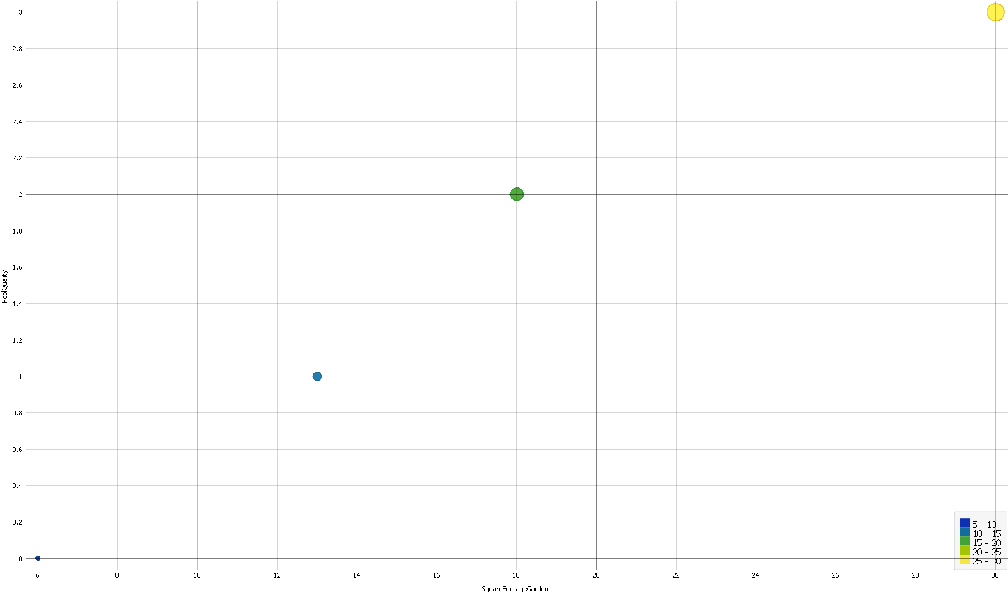
Preprocessing
Exploritory Data Analysis
Impute missing values
SFH => Bed-/Bathrooms
Price => Location
…
Notes:
2a. Square Footage House can be used to impute bedrooms and bathrooms
2b. Price can be used to impute the location
2c. And many more imputations, two are mentioned on the previous slide

Slide 5
Machine Learning Models
House Price Prediction
Linear Regression (LR)
baseline model to asses performance against
Gradient Boosting Regression (GBR)
Best hyperparameters: 'learning_rate': 0.1, 'max_depth': 3,
'min_samples_split': 2, 'n_estimators': 200
Random Forest (RF)
Best hyperparameters: 'max_depth': None, 'max_features': None, 'min_samples_leaf': 1, 'min_samples_split': 2, 'n_estimators': 500
Support Vector Regression (SVR)
best hyperparameters: 'C': 0.1, 'gamma': 0.1, 'kernel': 'linear

Slide 6
Training and Evaluation
Evaluation of the Machine Learning Model
80/20 dataset split to train and evaluate all models.
5 fold cross validation
Performance evaluation metrics: MSE, MEA, R2 score, RMSE
Results:
LR: MSE: 2393, MAE: 39, RMSE: 48, R2 score: 0.77
SVR: MSE: 3966, MAE: 49, RMSE: 63, R2 score : 0.61
RF: MSE: 1052, RMSE: 34, MAE: 25, R2 score: 0.87
GBR: MSE: 856, MAE: 20, RMSE: 31, R2 score 0.90

Slide 7
Discussion
Discussion of findings
Age <-> DateSinceForSale
Typos
Savings
Prices
HeatingType <-> HasPhotovoltaic <-> HeatingCost
Previous Owner
Windows
Houses < 100k
Notes:
Houses < 100k: A house in good quality with around 25-75 m², with 1 bedroom and 1 bathroom. Most likely in the Suburbs
Savings: You are expected to save ~33.000€ by buying a house without a pool in contrast to houses with a pool of any quality.
Typos: Suburbann → Suburban
Previous Owner: 11 people will not own everything, most likely duplicate names
Prices: Once we removed the outliers (houses well above 1M€, the model worked)
Age <-> DateSinceForSale: The age could be younger then the date since for sale because houses might be sold before they are build (Kohlbacher)
HeatingType <-> HasPhotovoltaic <-> HeatingCost : We discussed whether it would be ok to have reduced HeatingCost iff one has good working PhotoVoltaic and an electric heating, dismissed this because the cost would be just as high (kWh wise, just not form the public grid)
Windows: The windows where all unique, but the material was in there product name, so we only used this to get a useful feature

