Slide 1
Cigarettes and Birth weight
Naidan Zheng

Slide 2
Overview
The health scientists are challenging to find the relationship between cigarettes and child's birth weight. We used the data on births to women in the United States to see how cigarettes would affect child's birth weight, and what the determinations of child's birth weight are.
STEP:
1. Eplore the Birth weight dataset.
2. Selecting the significant features.
3. Train, test, validate the model.

Slide 3
Assumptions
Cigarettes and birth weight have negative linear relationship.
There are some other factors that affects birth weight.

Slide 4
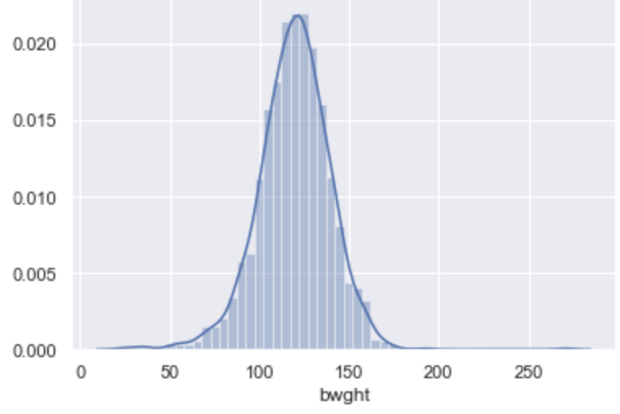
Dataset Overview
The data set bwght.csv contains data on births to women in the United States.
The data set includes 1,388 columns and 14 varialbes.
The average birth weight of the baby when the mother is not a smoker is 119.77 ounces.

Slide 5
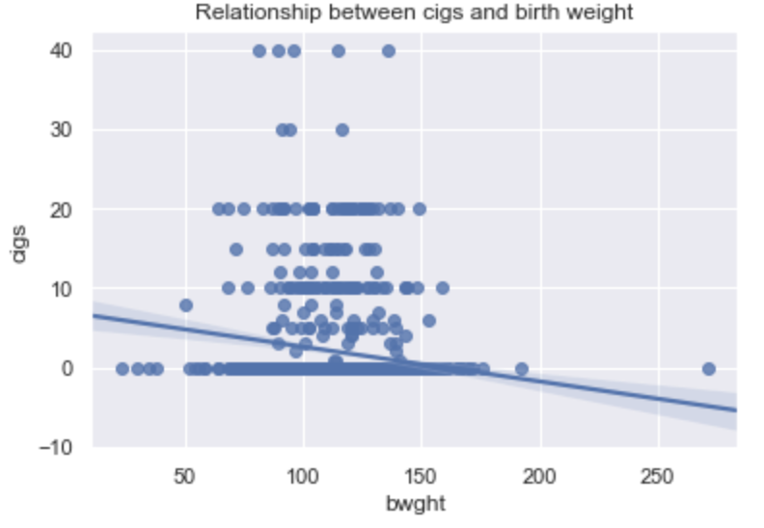
Exploring the data
The line on the line graph moves from left to right, the line falls, which means the graph shows that cigarettes and birth weight have negative linear relationship

Slide 6
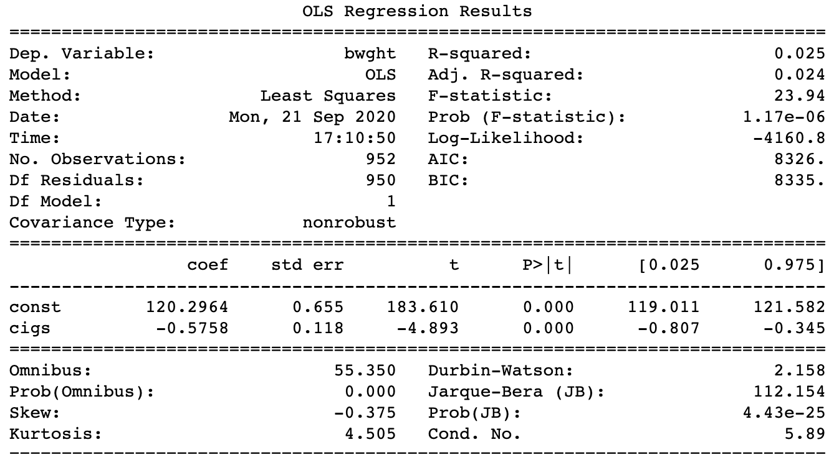
Exploring the data
The simple linear regression model: :
bwght=120.2964-0.5758cigs,
where n=1192,R^2=0.025.
As more cigarettes are smoked, the birth weight of the baby decreases at the rate of 0.5758 ounce for every additional cigarette smoked per day.

Slide 7
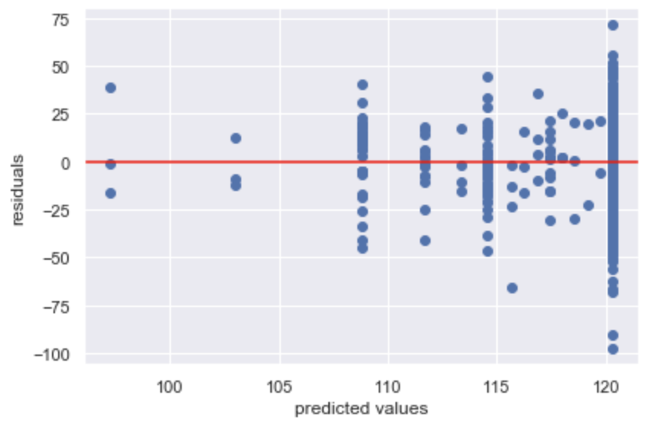
Predicting
The residual plot is a good model when it only used to find the relationship between birth weight and cigarettes.
Good model.

Slide 8
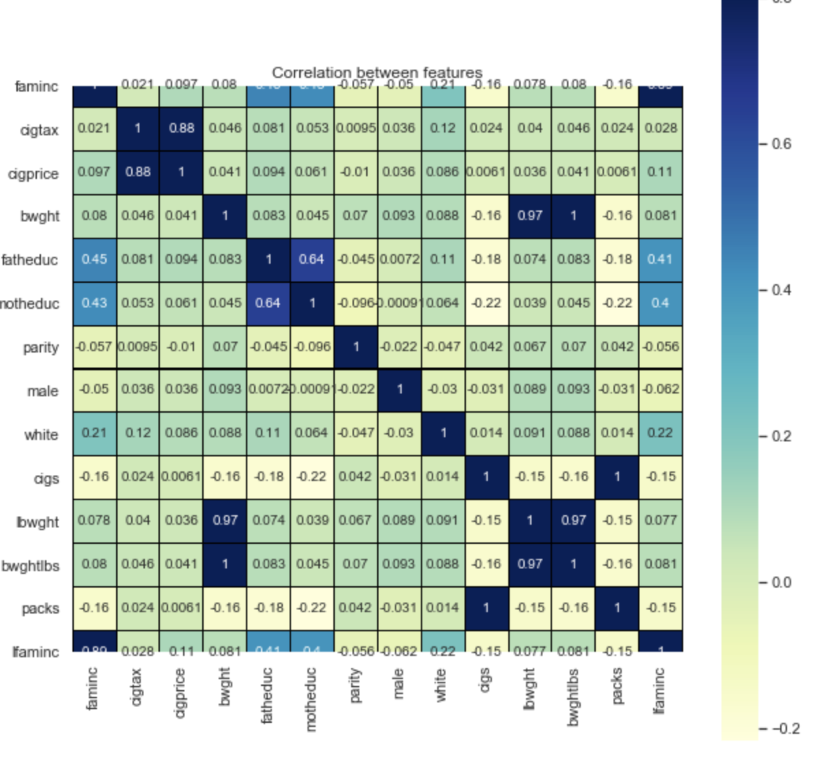
Other factors
The graph shows the correlation between features.
Child's birth weights affects by the factors such as family income, birth order of the child, race, gender, and parent's education.

Slide 9
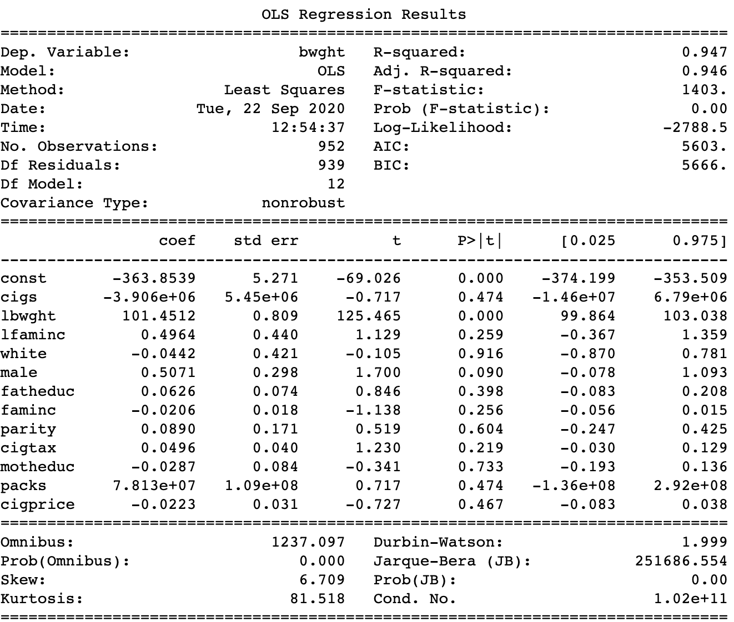
Modeling
The multiple linear regression model: bwght=-363.8539-3.906e+6cigs+101.4512lbwght+ ... + 7.813e+07packs - 0.0223cigprice,n=1192, R^2=0.947.
This model is more accurate than the simple linear regression model.

Slide 10
Conclusion
Mother smoking affects child's birth weight, but it is not the only factor. It is necessary to consider more determinations which will help us to get more accurate data.
The multiple linear regression model will help health scientists to analyze child's birth weight,

Slide 11
Futures
Improve modeling
Get more data.
Find other factors that not present in this dataset
(Example: father smoking,
mother weight,
mother height)

Slide 12

Question?

