Slide 1
Life Expectancy Prediction
DATA 602 Project 1
Naidan Zheng

Slide 2
Overview
Determine
Determine the critical factors which are more representative
Build
Build Regression Models
Choose
Choose the best model

Slide 3
Goal
Search for the elements which effects life expectancy by using statistical tools such as MSE, R squared, RMSE, etc. on different regression models.
Find the best regression model to predict life expectancy

Slide 4
Research question
1. What are the major variables affecting the life expectancy?
2. What is the impact of schooling on the lifespan of humans?
3. What is the impact of Immunization coverage on life Expectancy?

Slide 5
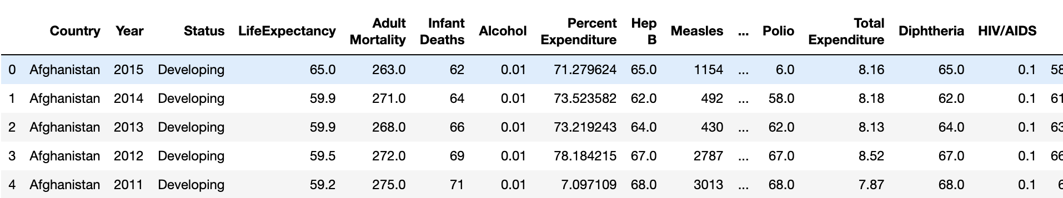
Data

Slide 6
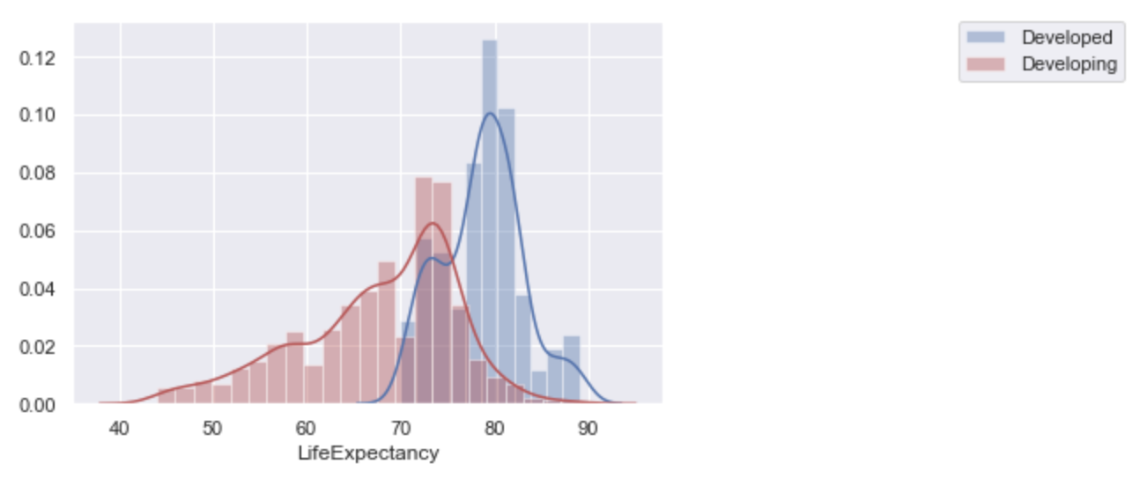
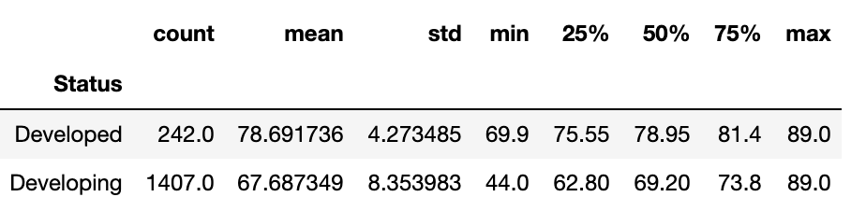
Data

Slide 7
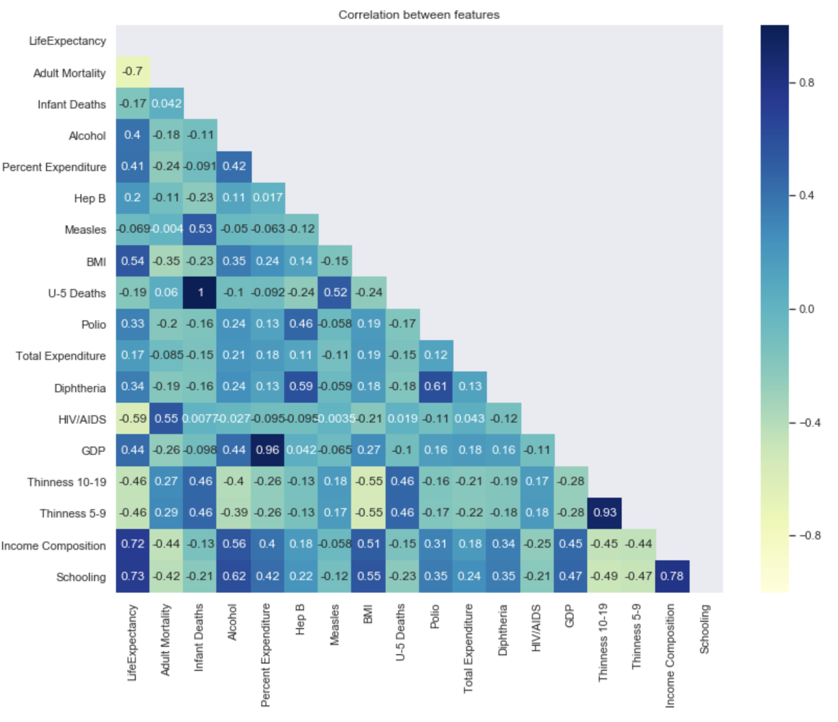
Correlation Matrix
Schooling and Income Composition are the major positive impacts of life expectancy, and Adult Mortality is the major negative impact of life expectancy.

Slide 8
Modeling
Linear Regression
Lasso Regression
Ridge Regression
ElasticNet Regression
Random Forest Regressor

Slide 9
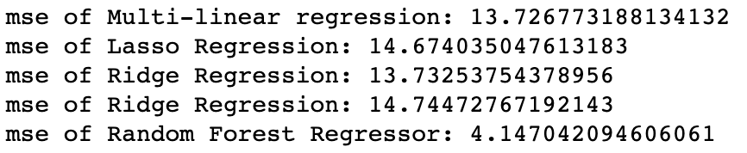
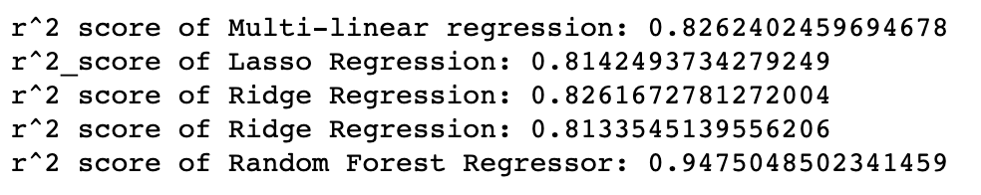
Conclusion
Notes:
A high R-squared does not necessarily indicate that the model has a good fit.

Slide 10
Future Work
Time Series Analysis
Additional Data

