Slide 1

Facial Emotion Detection using Deep Learning

Slide 2
ABSTRACT
Goal: Recognize and classify human facial expressions into six categories—anger, disgust, fear, happiness, pain, and sadness.
Approach: Fine-tune a ResNet-50 model (pretrained on ImageNet) to achieve efficient emotion recognition.
Applications: Real-time emotion detection for healthcare, surveillance, and interactive AI systems.

Slide 3
INTRODUCTION
Importance of Facial Expressions
Primary channel for conveying emotions.
Key for enhancing human-computer interaction, sentiment analysis, and affective computing.
Deep Learning for Emotion Recognition
Convolutional Neural Networks (CNNs) excel in image classification tasks.
ResNet-50’s depth and residual connections help it learn complex representations effectively.

Slide 4
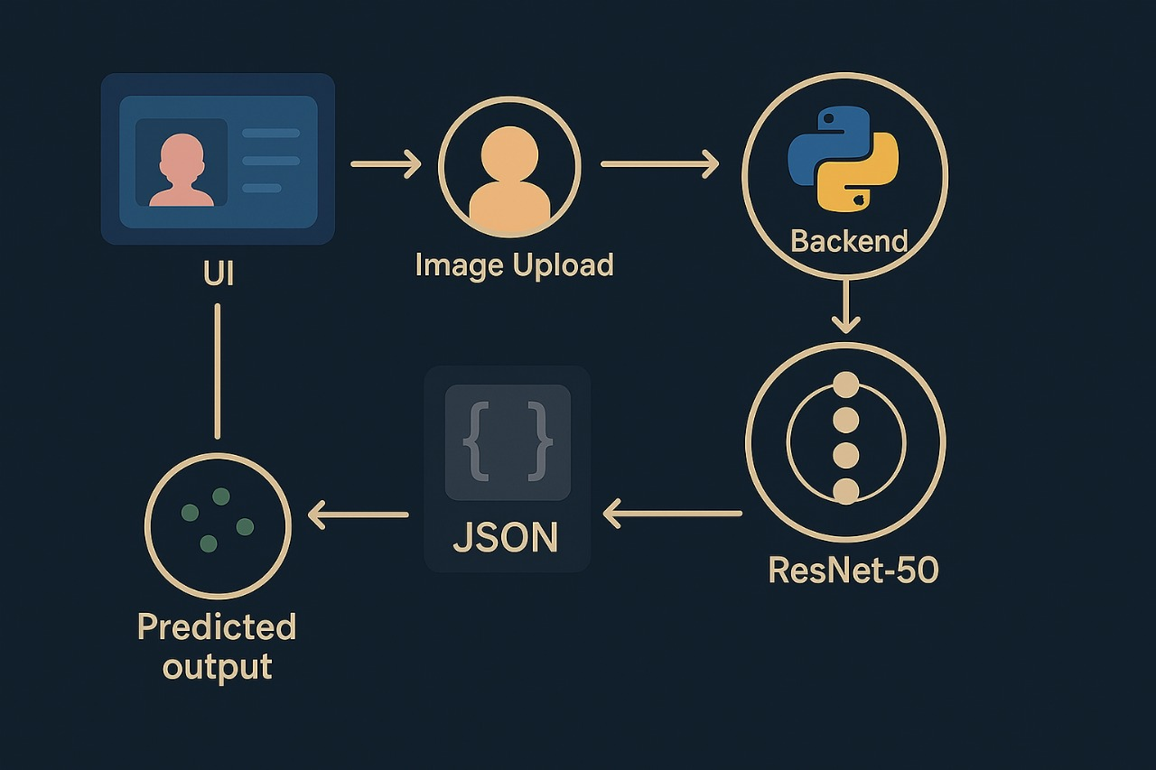
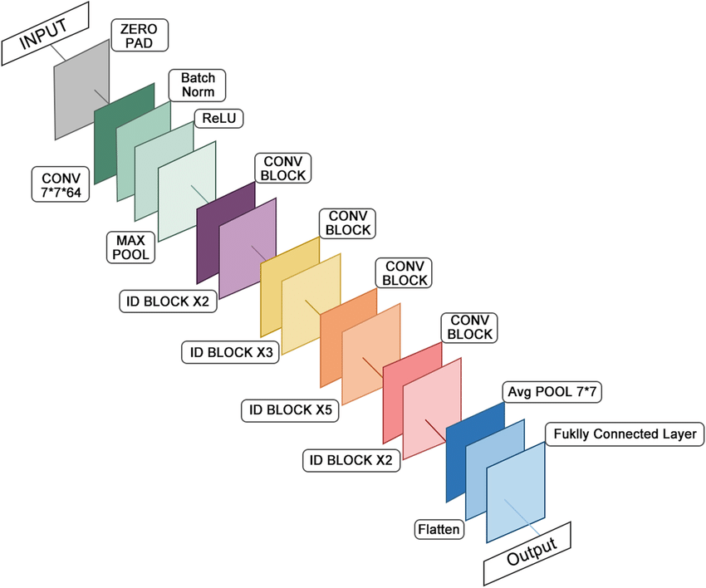
MODEL ARCHITECTURE

Slide 5
MODEL ARCHITECTURE
ResNet-50
50-layer deep CNN with skip/residual connections.
Pretrained on ImageNet for transfer learning.
Customization
Final fully connected layer reconfigured for 6 emotion classes (anger, disgust, fear, happiness, pain, sadness).
Added a Dropout layer (50% rate) to reduce overfitting.
Softmax activation for multi-class probability output.
Architecture Overview
Input: RGB images, resized to 224×224.
Feature Extraction: Sequential convolutional layers to learn hierarchical representations.
Classification Head: Dense layer + Dropout + Softmax (outputs 6 emotion categories).
Residual Connections: Alleviate vanishing gradient issues and improve training.

Slide 6
Training Process
Dataset
Specialized dataset with images labeled as anger, disgust, fear, happy, pain, sad.
Data Augmentation
Random cropping, rotation, color jittering.
Loss Function & Optimizer
Cross-Entropy for multi-class classification.
Adam Optimizer with adaptive learning rate.
Learning Rate Scheduler
ReduceLROnPlateau: decreases learning rate when validation loss plateaus.

Slide 7
Application Flow
Image Preprocessing
Resizing to 224×224.
Normalization using ImageNet mean & standard deviation.
Model Inference
Processed image fed into the fine-tuned ResNet-50.
Prediction with Softmax (class with highest probability selected).
Prediction
Mapping of numeric label to emotion category (0–5)

Slide 8
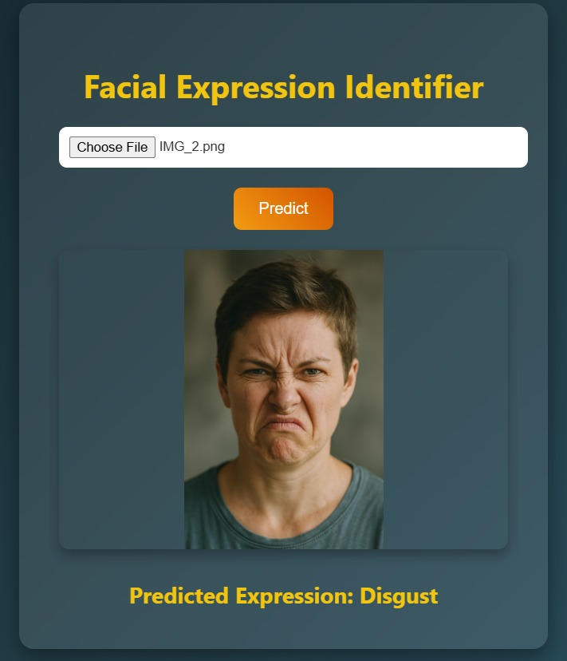
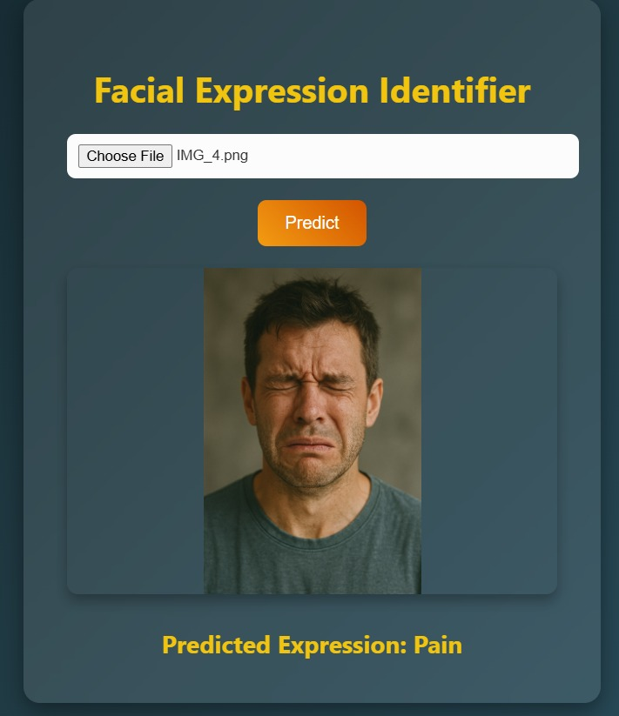
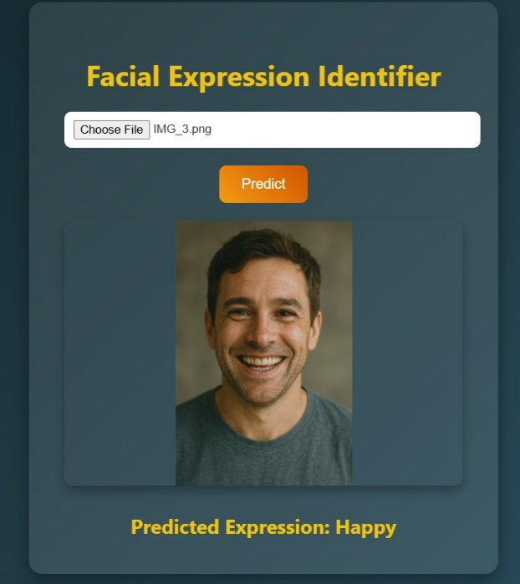
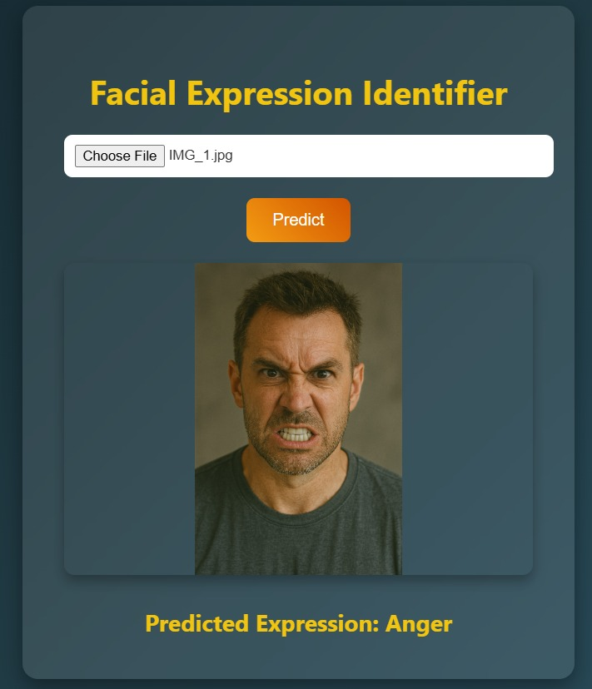
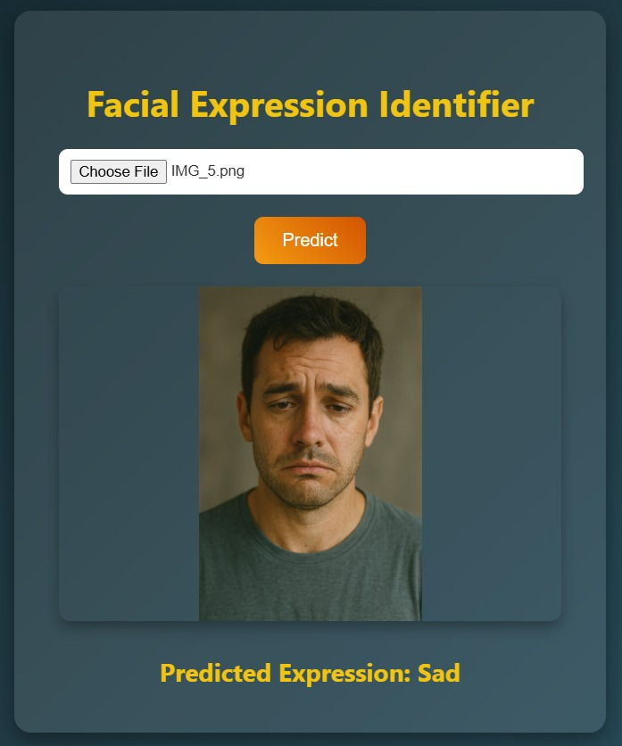
RESULTS
Accuracy
Validation Set: ~72%
Test Set: ~74%
Consistency
Reliable classification across six targeted emotion categories.
Example UI Output
Predicted label displayed on the webpage once the system processes the image.

Slide 9
Key Applications
Healthcare
Real-time emotion monitoring for mental health assessments.
Customer Interaction
Chatbots and virtual assistants that adapt to user emotions.
Surveillance
Monitoring emotional states to enhance safety and behavior analysis.
Education
Tracking student engagement and emotional responses in e-learning.
Gaming
Adaptive gameplay that reacts to the player’s emotions.

Slide 10
Future Scope
Expanded Datasets
More emotion categories and varied demographics.
Multimodal Emotion Recognition
Combine facial expressions, voice, and text for holistic emotion analysis.
Edge Deployment
Optimize model for real-time predictions on mobile and embedded devices.

Slide 11
CONCLUSION
This work illustrates the effectiveness of deep learning for emotion recognition through a ResNet-50 model. By harnessing transfer learning, applying data augmentation, and utilizing advanced training methods, the system achieves reliable facial expression classification. The user-friendly web interface, combined with a Flask backend, makes it well-suited for real-world uses such as healthcare, education, and customer service.

Slide 12
Thank you

