Slide 1


Hyderabad Metro Route Helper
A Smart Route Guidance Tool
Your interactive assistant for finding optimal routes between any two metro stations using a simple Gradio interface
Blue Line
Red Line
Green Line
NAIDU BALAKRISHNA
Made with Genspark

Slide 2
Project Overview
What is Hyderabad Metro Route Helper?
An interactive navigation system designed to help users determine the optimal travel route between any two Hyderabad metro stations.
Key Features:
Simple and intuitive route guidance Interchange assistance at major stations Line-specific navigation support
Implemented using only conditional statements User-friendly Gradio web interface
Technology Stack
Python Conditional Gradio UI
statements

Slide 3
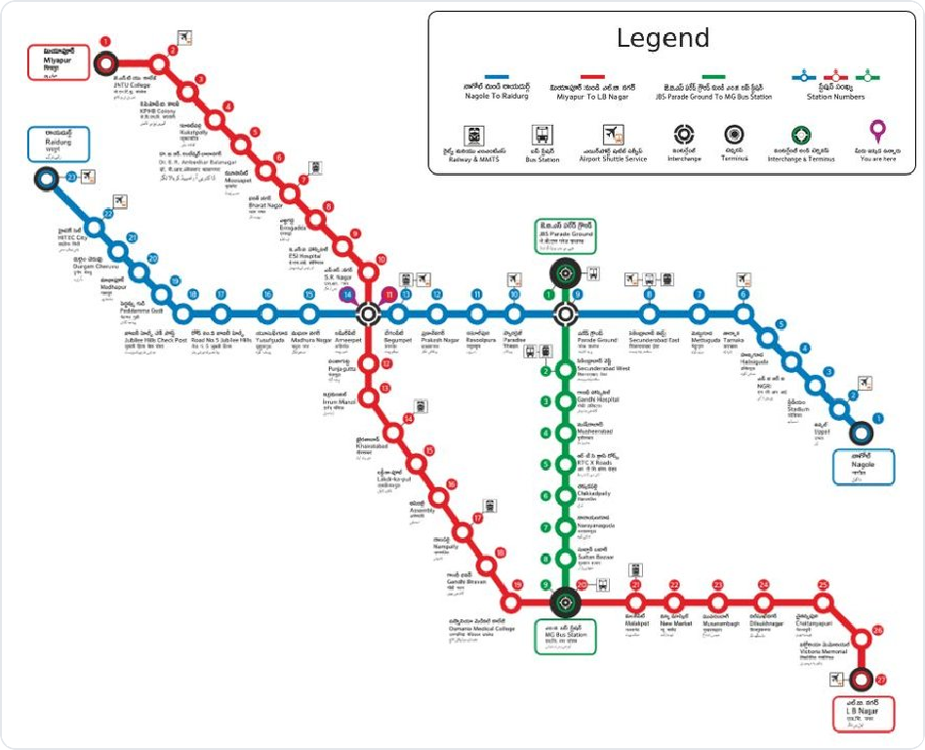
Hyderabad Metro System Analysis
Network Overview
Red Line:
Miyapur ↔ L.B. Nagar (29.21 km, 27 stations)
Blue Line:
Nagole ↔ Raidurg (27 km, 23 stations)
Green Line:
JBS Parade Ground ↔ MGBS (11 km, 10 stations)
Key Interchange Stations
Ameerpet ↔connects Red Line & Blue Line
MG Bus Station (MGBS) ↔connects Red Line & Green Line
Parade Grounds ↔connects Blue Line & Green Line

Slide 4
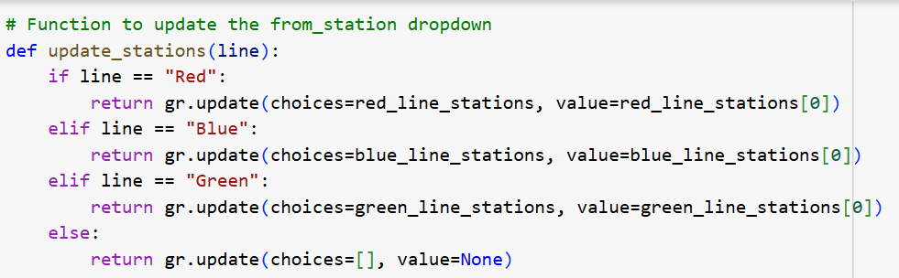
Code

Slide 5
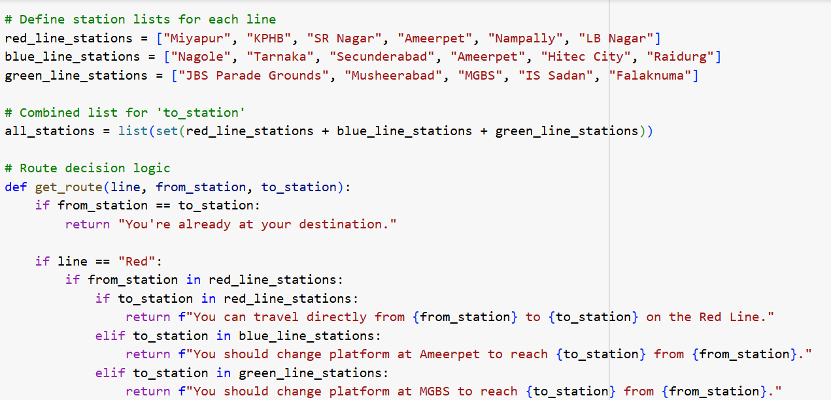

Slide 6
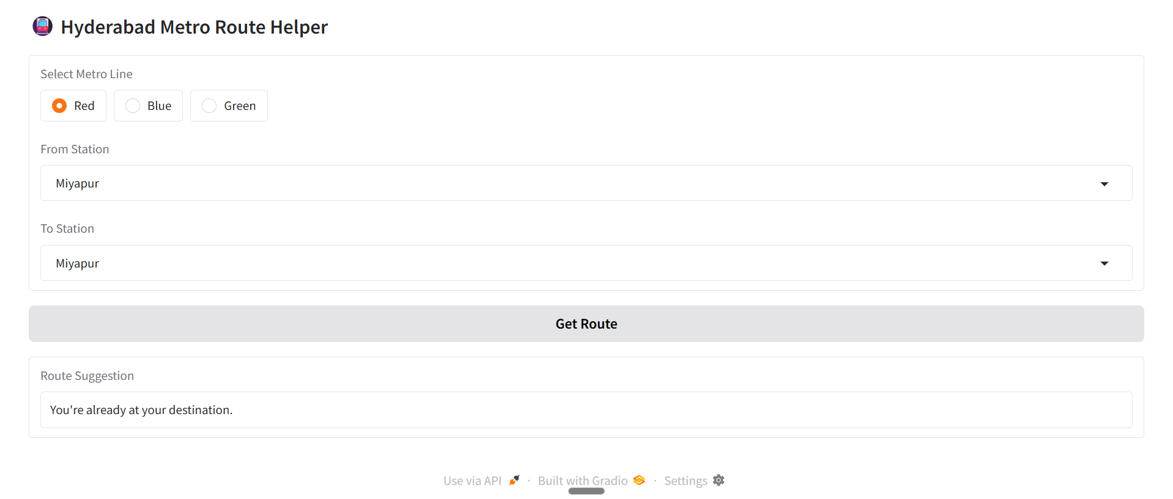
Output screens

Slide 7
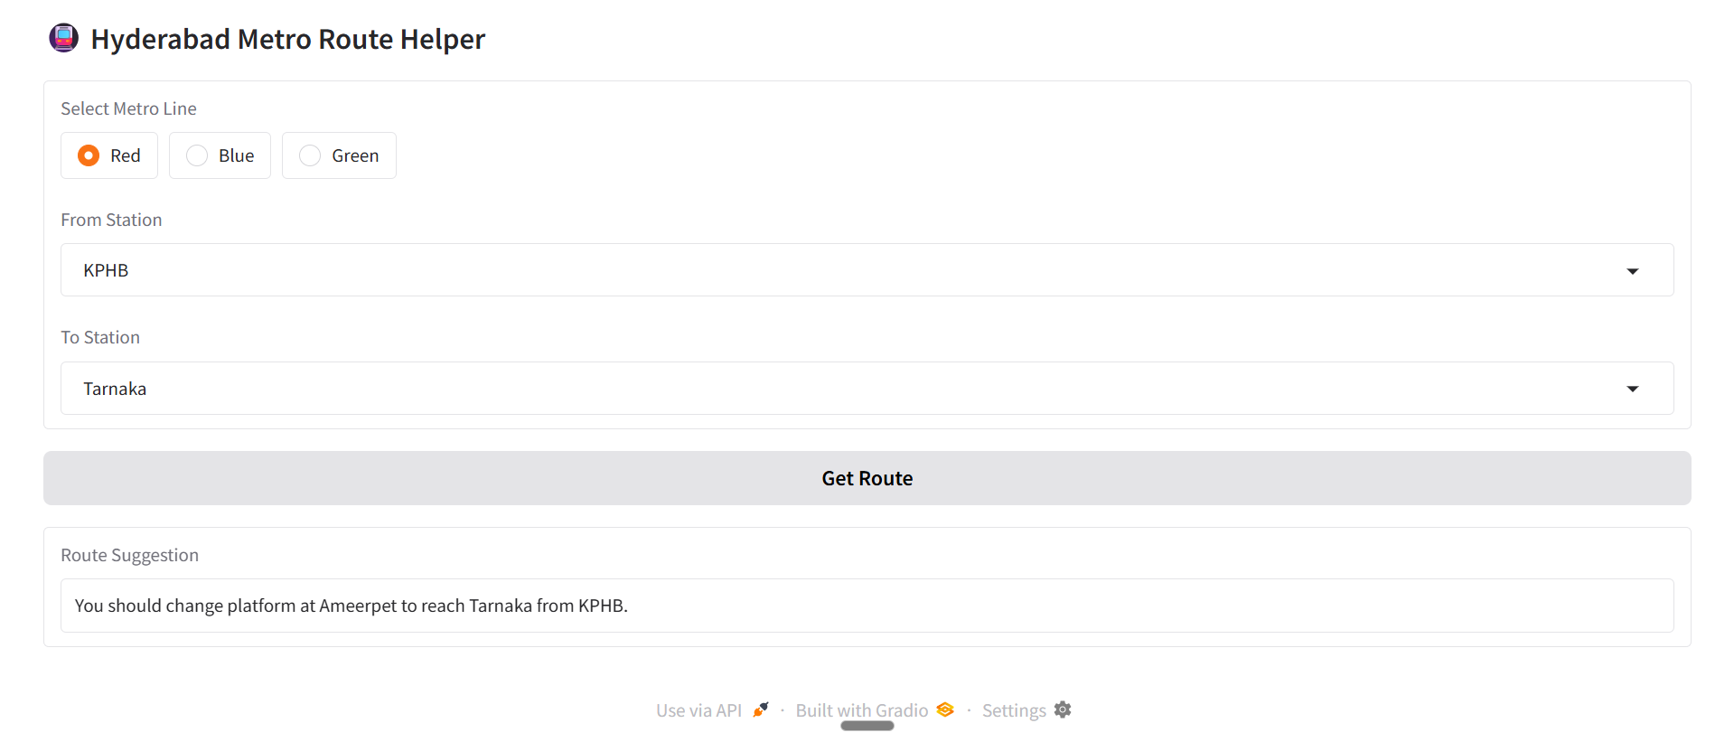
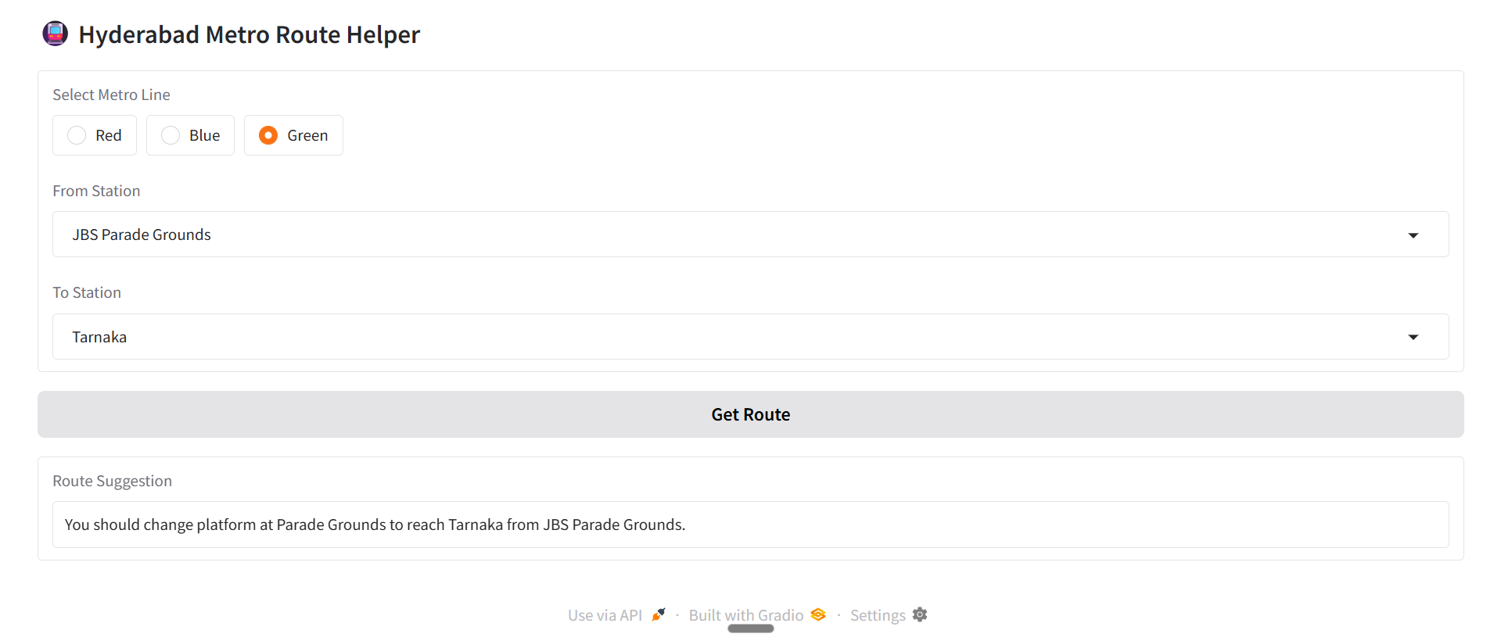

Slide 8
THANK YOU

