Slide 1

“SUDOKU PROJECT”
Submitted by
Naidu Nagendra Babu-11805086-A17
Shaik Hiday Tulla-11804627-B43
Gadde Satwik-11801553-A03
Section:K18PG
Submitted to:Sagar Pande

Slide 2
INTRODUCTION
Sudoku is the Japanese abbreviation of a phrase meaning the digits must remain single, also known as Number Place, where Su means number, doku which translates as single or bachelor. Sudoku is not a mathematical or arithmetical puzzle. It works just as well if the numbers are substituted with letters or some other symbols, but numbers work best. The aim of the puzzle is to enter a numerical digit
from 1 through 9 in each cell of a 9×9 grid made up of 3×3 sub squares or subgrades, starting with various digits given in some cells; each row, column, and sub squares region must contain each of the numbers 1 to 9 exactly once. Throughout this document we refer to the whole puzzle as the grid/game board, a 3x3 sub grid as a block and the individual grids that contains the number as a cell

Slide 3
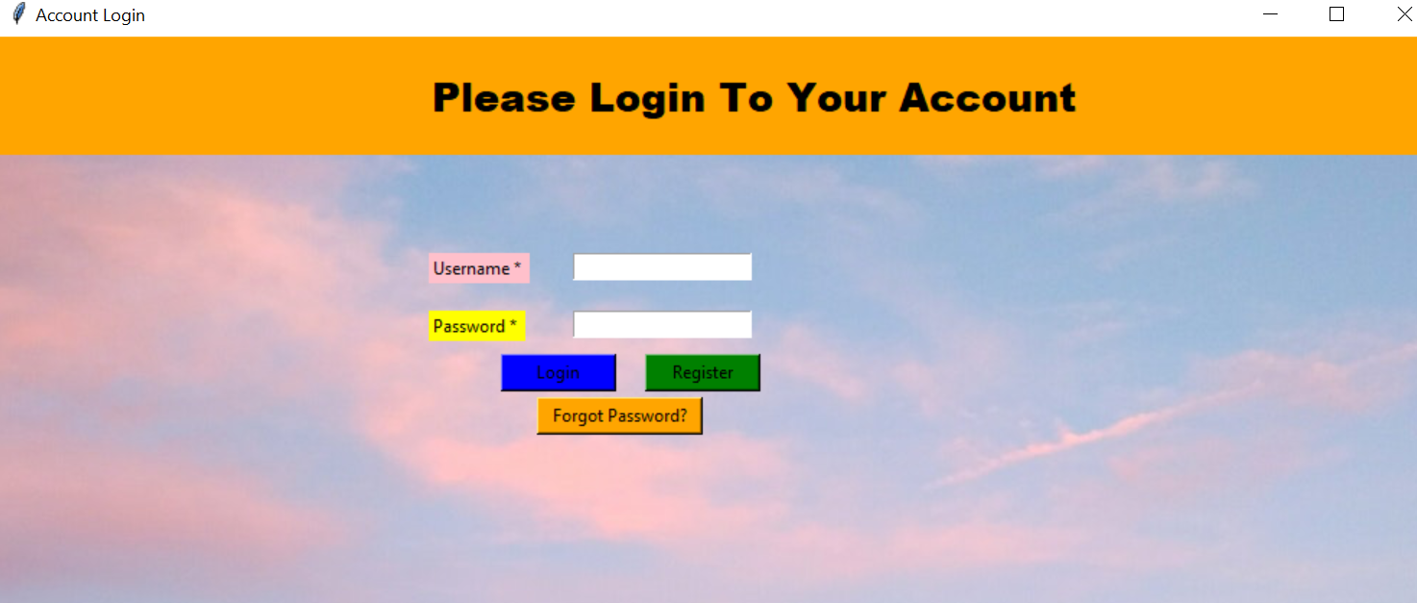
HOME PAGE

Slide 4
Modules used in the project
Login
Sign up
Reset
Solve
Play
Stop
Save
Home page

Slide 5
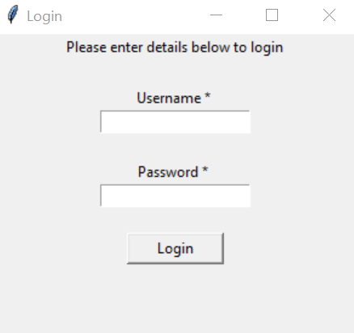
Login page

Slide 6
Login page
To create the login page we use the normal basic python code
The information provided in the login page is stored in the data base
In the login page we provided the “user name “ and the “password” to users

Slide 7
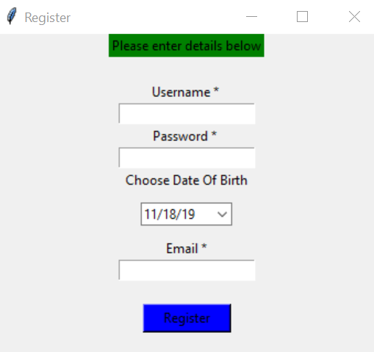
Sign up page

Slide 8
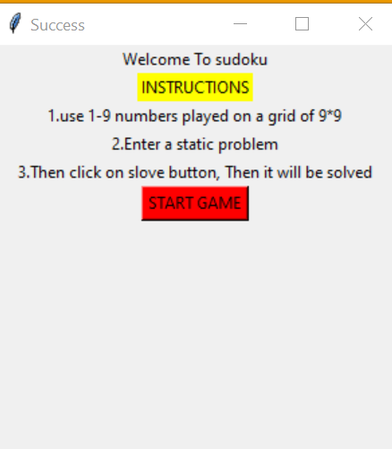
Start Game

Slide 9
Rules:
Solving a Sudoku puzzle can be rather tricky, but the rules of the game are quite simple. Solving a Sudoku puzzle does not require knowledge of mathematics; simple logic suffices. The objective of Sudoku is to enter a digit from 1 through 9 in each cell, in such a way that:
I. Each horizontal row contains each digit exactly once
II. Each vertical column contains each digit exactly once
III. Each sub grid or region contains each digit exactly once

Slide 10
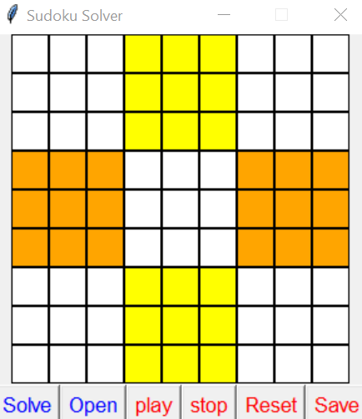
game

