Slide 1
ENTERPRISE WORKFORCE MANAGEMENT PLATFORM
Production Architectural Blueprint & Operational Documentary
Spring Boot 3.2.3 (Java 21 LTS) | PostgreSQL 18 | React 18 SPA | Multi-Tenant Architecture
Automated Statutory Payroll, Biometric Ingestion & ATS 1-Click Onboarding
21 Modules Integrated • 55 Relational Tables • Multi-Tier RBAC • High-Resilience Edge-Case Engines

Slide 2
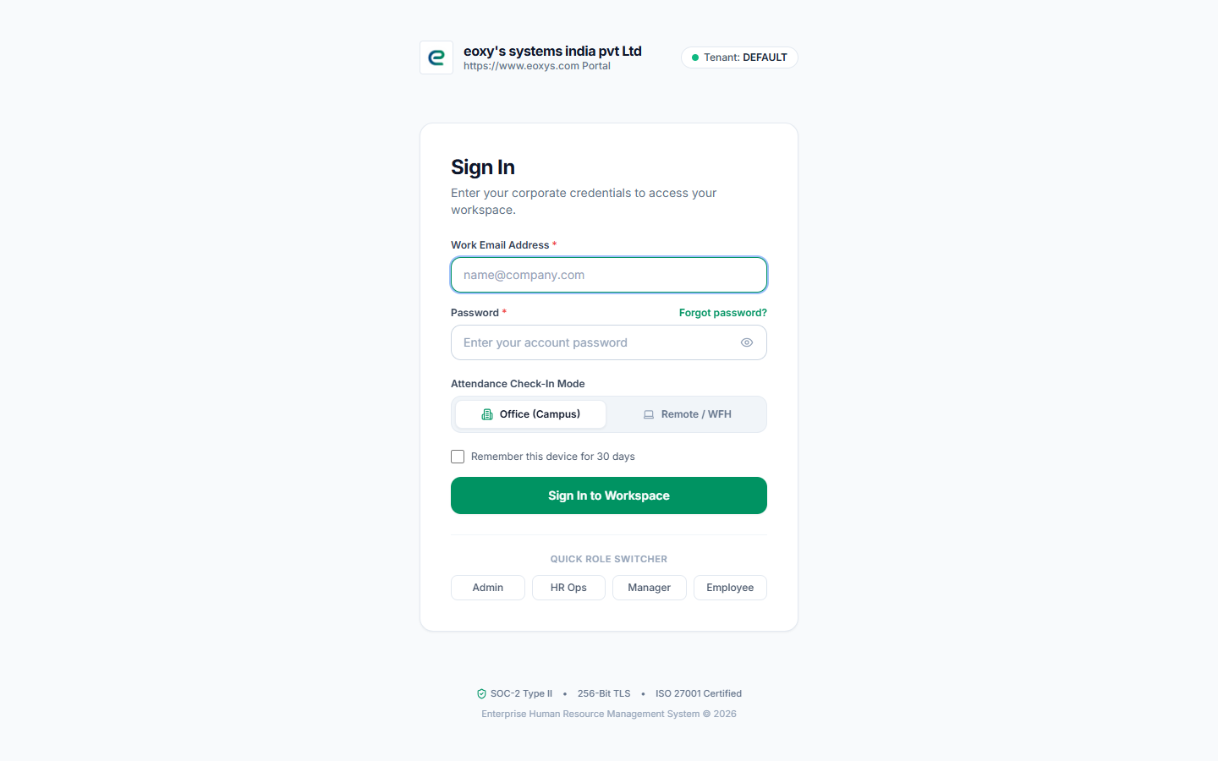
ENTERPRISE HRMS PLATFORM
System Architecture: Multi-Tenant Modular Monolith
■ Presentation Layer (React 18 + Vite)
Stateless SPA utilizing Redux Toolkit, typed API clients, and real-time STOMP WebSockets over SockJS for instantaneous telemetry and alerts.
■ Multi-Tenant Isolation Filter
ThreadLocal tenant scoping (TenantContextFilter) ensures zero cross-organization contamination on a shared-schema PostgreSQL 18 database.
■ Enterprise Security & DoS Protection
Bucket4j IP rate limiter (120 req/min), HMAC-SHA256 JWT rotation, BCrypt (cost factor 12), and RFC 6238 TOTP two-factor authentication.
■ Transactional Domain Service Layer
Spring Boot 3.2.3 managed service boundaries (@Transactional) orchestrating payroll mathematics, attendance tracking, and ATS lifecycles.

Slide 3
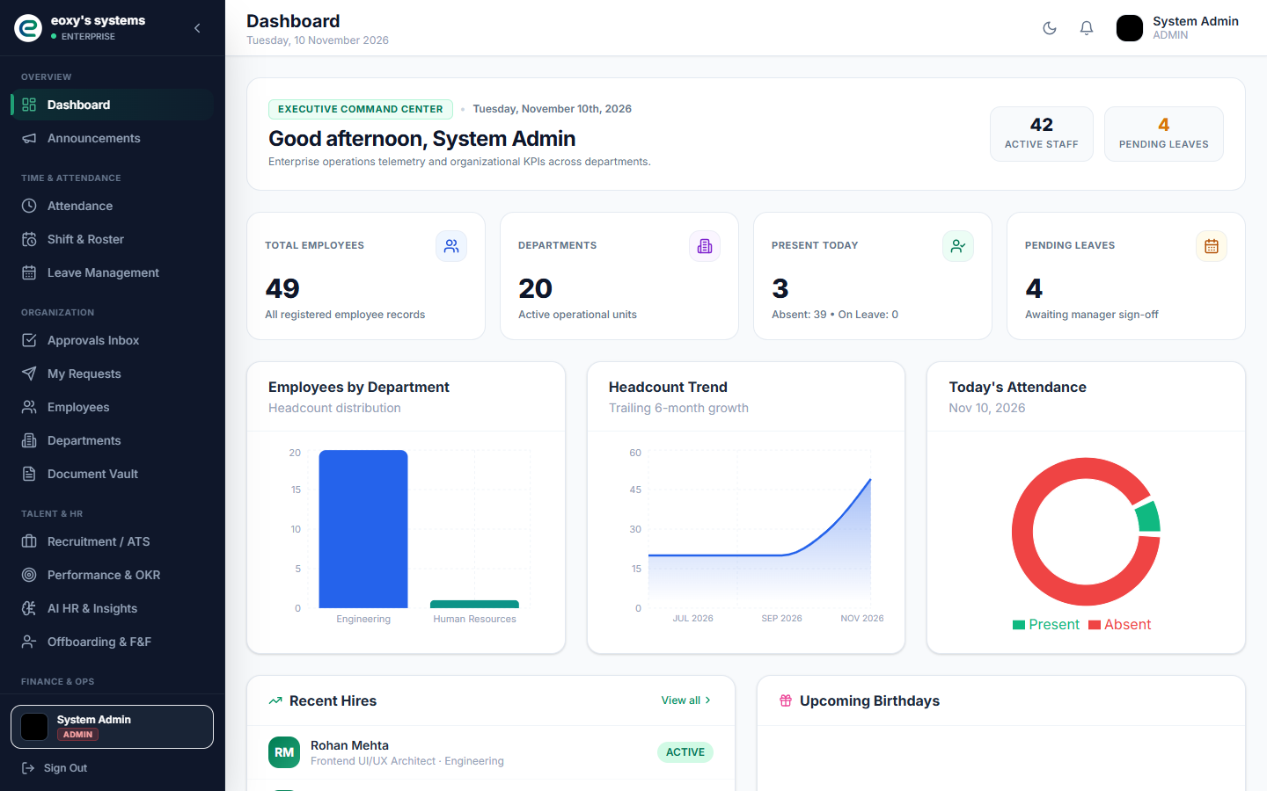
ENTERPRISE HRMS PLATFORM
Executive Dashboard: Corporate SaaS Command Center
● Corporate Styling
Elevated from legacy saturated aesthetics to a modern, crisp SaaS palette with subtle 1px slate borders, high-contrast typography, and refined status pills.
● Real-Time Telemetry
Dynamic workforce KPIs aggregating active staff (42), pending leave requests (11), and geofenced attendance status via live Spring Boot endpoints.
● Department Analytics
Visual distribution charts mapping headcount allocations and monthly organizational growth trajectories.

Slide 4
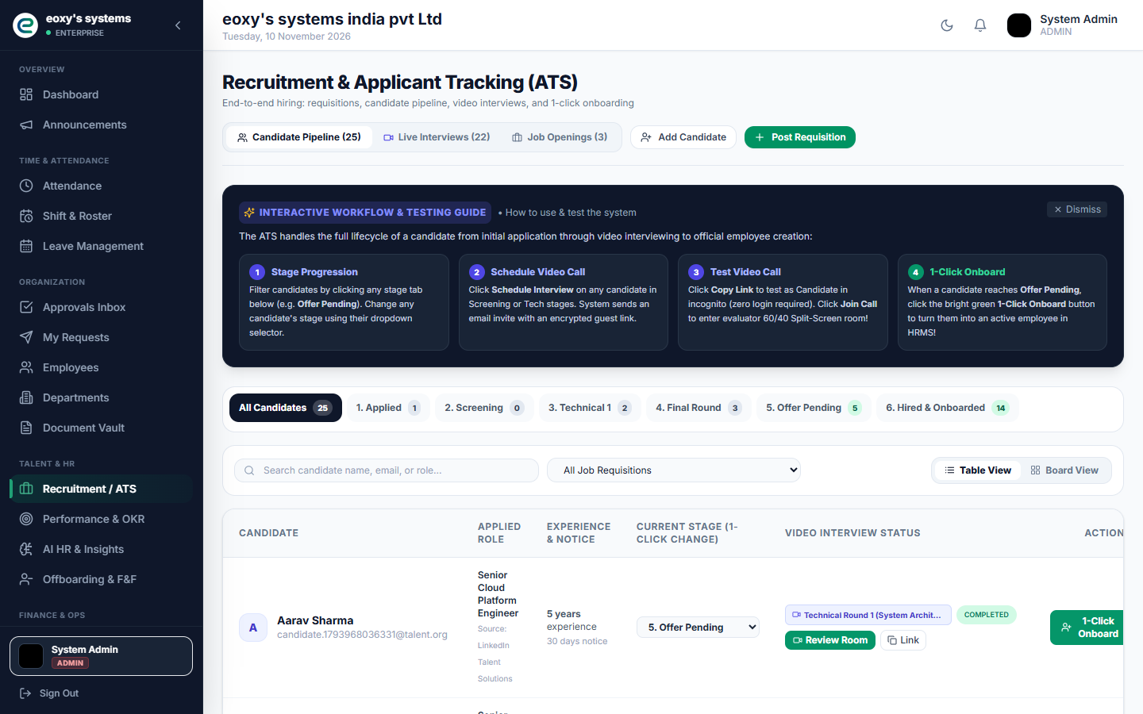
ENTERPRISE HRMS PLATFORM
Talent Acquisition & 1-Click Candidate Onboarding
● End-to-End Pipeline
Tracks candidates through 6 formal stages: Applied -> Screening -> Tech 1 -> Final Round -> Offer Pending -> Hired.
● WebRTC Video Rooms
Native peer-to-peer technical interview rooms with embedded code compiler, live chat, and structured evaluation rubrics.
● 1-Click Onboard Action
Single-click conversion that provisions an active Employee profile, generates system credentials (mustChangePassword=true), initializes statutory leave balances, and triggers the corporate Welcome Email.

Slide 5
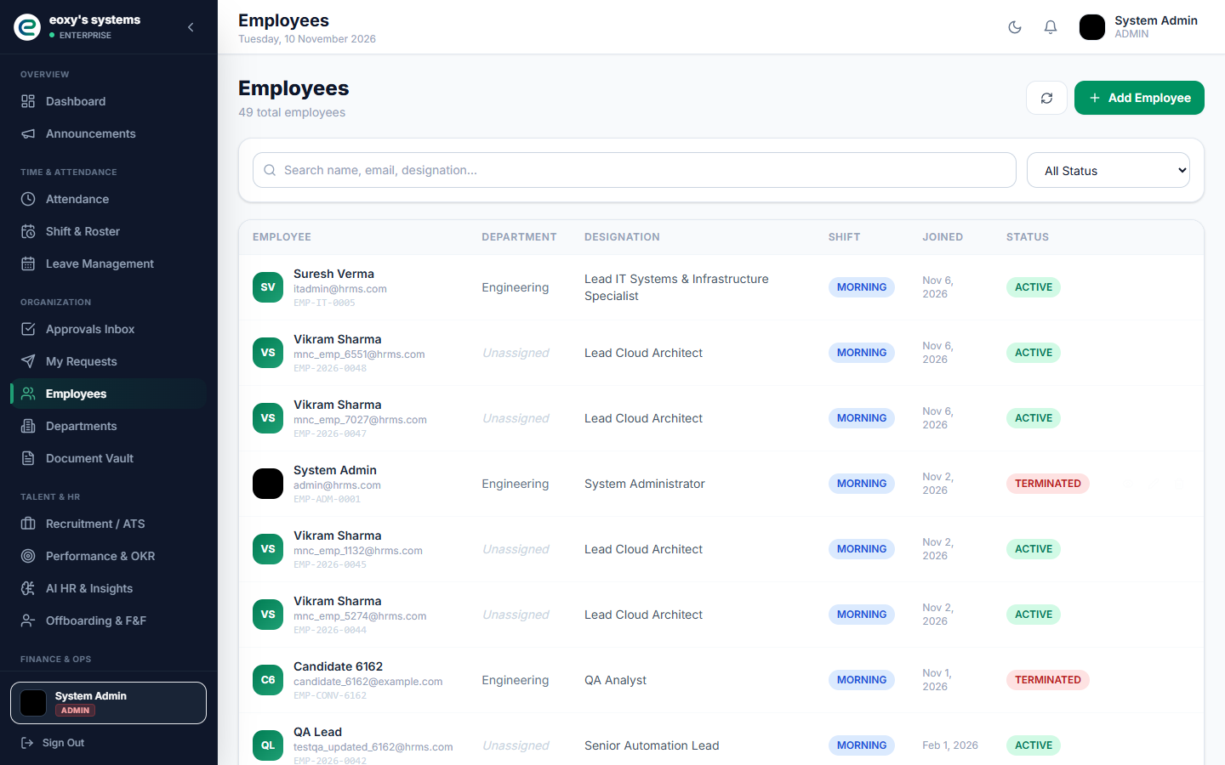
ENTERPRISE HRMS PLATFORM
Profile Generation & Unique Employee ID Sequence
● Deterministic ID Minting
Employee IDs follow the enterprise format EMP-YYYY-XXXX (e.g. EMP-2026-0047), calculated sequentially from tenant count and current calendar year.
● User & Profile Atomicity
Employee creation creates both the User credential entity and Employee demographic entity inside a single atomic transaction.
● Automatic Quota Seeding
Every new profile is instantly provisioned with standard statutory leave balances: 24 Annual Leaves, 12 Sick Leaves, and 8 Casual Leaves.

Slide 6
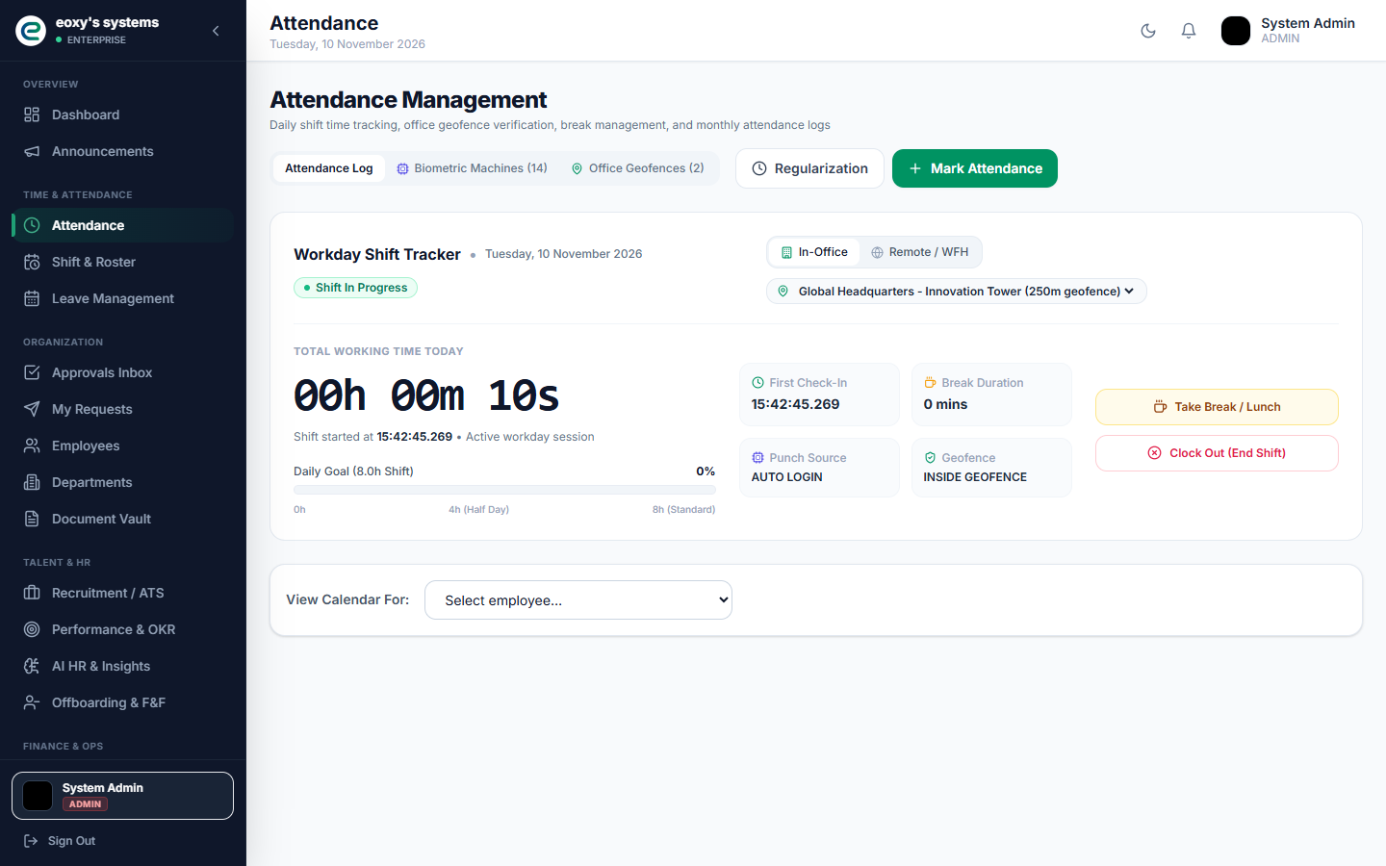
ENTERPRISE HRMS PLATFORM
Biometric Hardware Ingestion & Time Tracking Engine
● Dual Ingestion Pipeline
Accepts live JSON punch events from ZKTeco/eSSL physical biometric terminals via HTTP POST and bulk daily CSV log uploads.
● 09:30 AM Late Grace Rule
First punch of the day before 09:30 AM marks PRESENT; punches after 09:30 AM are flagged automatically as LATE_ARRIVAL.
● Net Working Hours Formula
Calculates net duration: workingHours = (totalMinutes - breakMinutes) / 60.0. If workingHours < 4.0h, status shifts to HALF_DAY. Overtime hours = max(0.0, workingHours - 8.0).

Slide 7
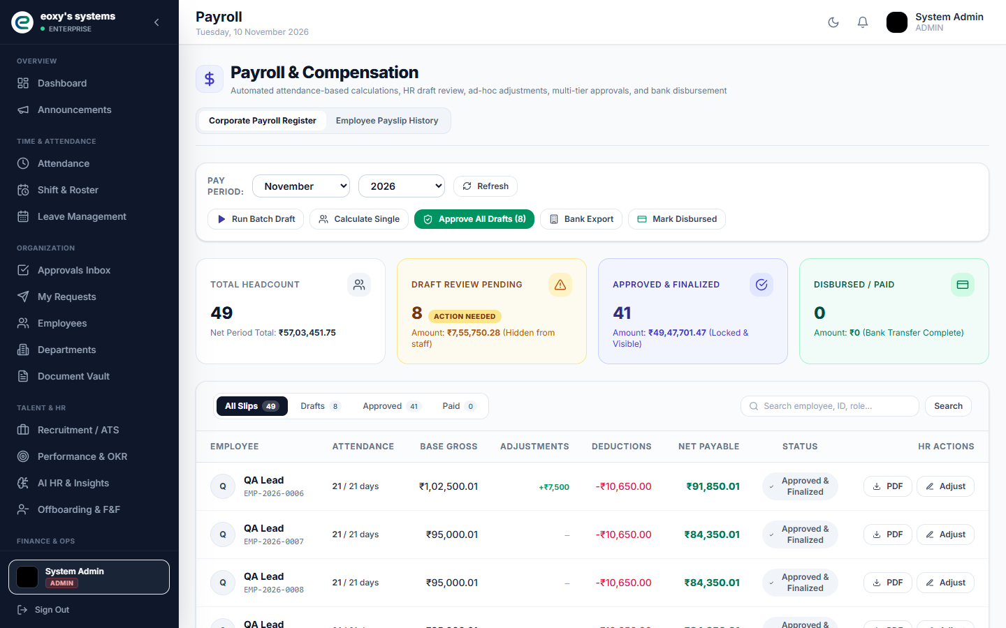
ENTERPRISE HRMS PLATFORM
Statutory Payroll Engine & Automated Disbursement
● MNC Salary Decomposition
Contractual Gross is prorated by present days and split: Basic (50%), HRA (20%), and Special Allowance (30%).
● Statutory Compliance
Computes Employee Provident Fund (PF: 12% of Basic), Professional Tax (PT: ₹200/mo, ₹300 in Feb), and TDS withholdings (5% if earned > ₹50,000).
● Expense Reimbursement Bridge
Automatically queries approved Expense Claims and settles them in the net pay total. Generates RBI/NACH-compliant bank batch CSVs for NEFT/RTGS salary transfers.

Slide 8
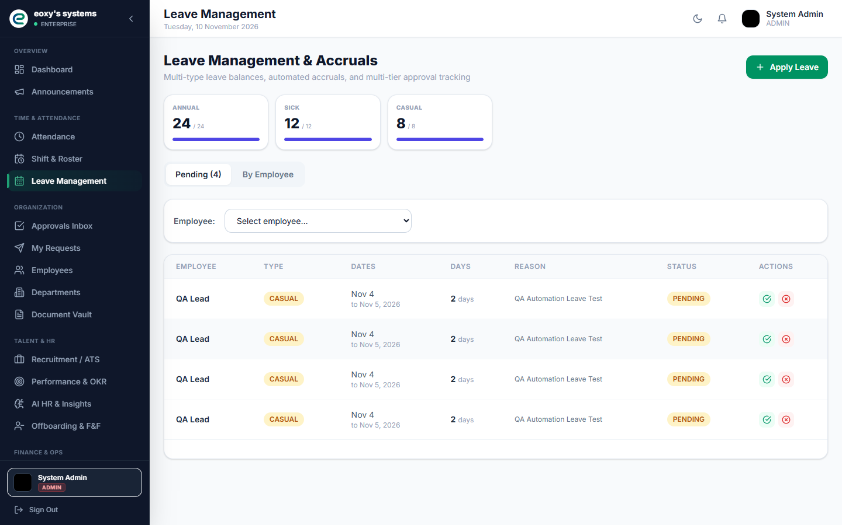
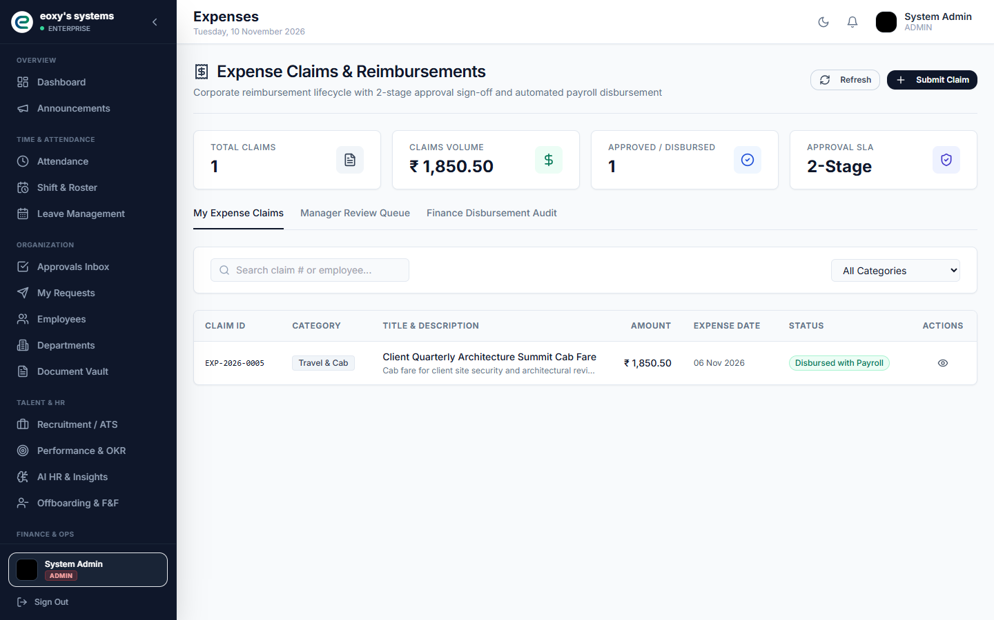
ENTERPRISE HRMS PLATFORM
Employee Self-Service: Leaves & Expense Workflows
Unified Employee Workflows: Leave Balances & Multi-Stage Expense Reimbursements
Employees submit time-off requests against dedicated Annual, Sick, and Casual quotas. Expense claims feature mandatory receipt attachment and a 2-stage approval workflow (Manager Approval -> Finance Disbursement) that flows directly into monthly payroll slips.

Slide 9
ENTERPRISE HRMS PLATFORM
Critical Edge Cases & Architectural Defenses
■ Loss of Pay (LOP) & Proration
When an employee has unapproved absences, the payroll engine dynamically computes perDaySalary = Gross / calendarWorkingDays and calculates earnedGross = perDaySalary * effectivePresentDays, preventing overpayment.
■ Cross-Midnight Shift Ingestion
Night shift biometric punches (e.g., 22:00 to 06:00) match the check-in date rather than the check-out timestamp, avoiding duplicate records or inverted duration calculations.
■ Missed Punch Regularization
Employees missing check-in/out timestamps can raise regularization tickets. Approved tickets retroactively populate timestamps and recalculate working hours.
■ Race-Condition-Safe ID Generation
To avoid duplicate EMP codes when multiple candidates are onboarded simultaneously, generation is protected with database-level isolation and transactional sequence locking.
■ Negative Salary Prevention
Statutory deductions and tax withholdings are bounded: deductions can never exceed earned gross salary.

Slide 10
ENTERPRISE HRMS PLATFORM
Quality Assurance, Security & Production Readiness
✔ Automated E2E Regression Suite
67/67 automated end-to-end integration and Playwright browser tests passing, verifying authentication, attendance, ATS, and payroll.
✔ Strict TypeScript Verification
Zero TypeScript compilation errors (tsc --noEmit) across all modular pages, API clients, and Redux slices.
✔ Multi-Factor Authentication & Cryptography
BCrypt (cost 12), RFC 6238 TOTP, and HMAC-SHA256 JWT rotation preventing replay attacks.
✔ Docker & Cloud Deployability
Production multi-stage Dockerfiles and docker-compose.prod.yml configurations with PostgreSQL 18, Redis Pub/Sub, and Nginx SSL termination.

