Slide 1
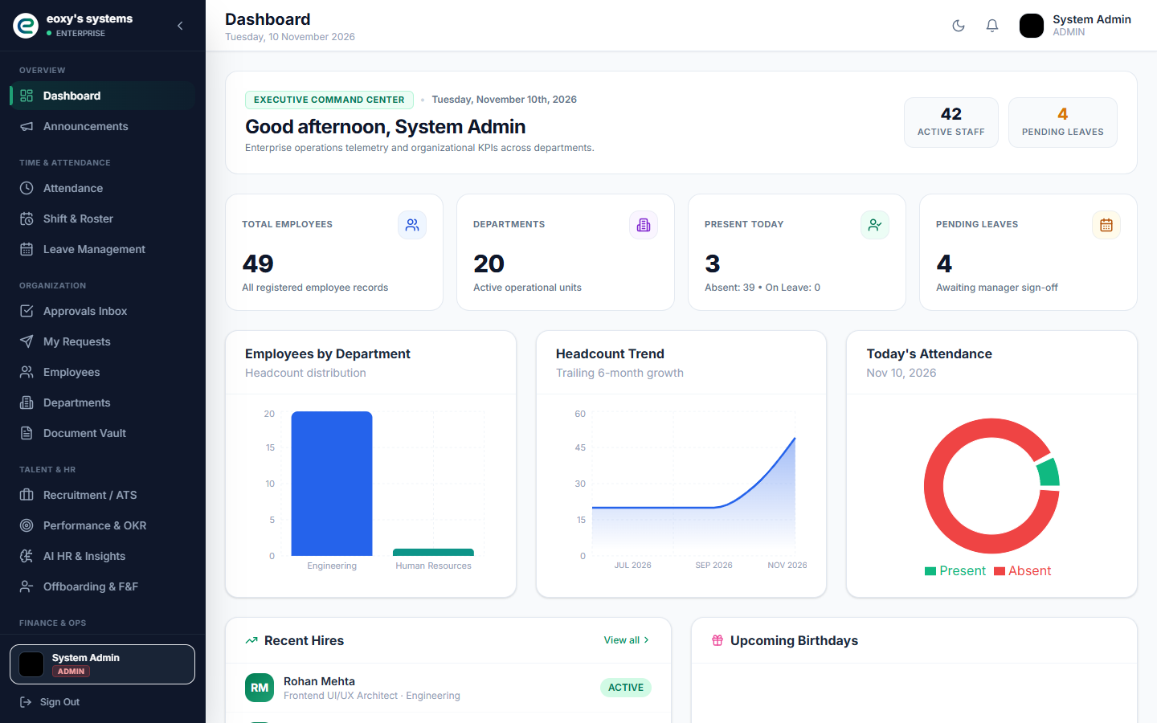
HRMS PLATFORM
Project Analysis
and Product Overview
A source-based walkthrough of the product, architecture, modules, user journeys, and implementation findings.
Employee experience · HR operations · Tenant administration
Repository UI capture. Dashboard metrics shown are sample screen data.
11 November 2026
Notes:
Repository evidence: frontend/src/App.tsx; docs/screenshots/02_corporate_dashboard.png
This opening uses an existing repository screenshot. Its displayed values are illustrative screen data, not verified production metrics.

Slide 2
PRODUCT SCOPE
A broad HR operations platform
Implemented feature areas
PEOPLE
WORKDAY
OPERATIONS
Employees and departments
Profile and documents
Recruitment and interviews
Performance goals and reviews
Attendance and policies
Leave and balances
Shift rosters and swaps
Employee requests and approvals
Payroll and expenses
Assets and offboarding
Helpdesk and announcements
Reports and workforce intelligence
The interface and API are delivered as one multi-tenant application. Module presence in source does not establish that every workflow is production-complete.
HRMS Platform | Repository analysis | UI examples are repository screenshots
02
Notes:
Repository evidence: backend/src/main/java/com/hrms/modules; frontend/src/modules; frontend/src/App.tsx
Module status and boundaries are documented in MODULE_WISE_DOCUMENTATION.md.

Slide 3
SYSTEM ARCHITECTURE
A modular monolith behind a React SPA
One web client calls a Spring Boot API. Services coordinate domain rules and persistence.
Browser
REST API
Application
Persistence
Data
React 18 SPA
Vite · Redux Toolkit
Spring MVC
/api/v1 by default
Security + tenant filters
Domain services
Spring Data JPA
Flyway migrations
PostgreSQL
Redis
External boundaries in code: SMTP email, local upload storage, Redis token blacklist, Prometheus metrics, and interview token/signaling components.
No confirmed live bank or biometric-vendor client was found. Biometric inputs are exposed through REST and CSV ingestion paths.
HRMS Platform | Repository analysis | UI examples are repository screenshots
03
Notes:
Repository evidence: backend/src/main/java/com/hrms/config; security; infrastructure; modules; backend/src/main/resources/application.properties
The default servlet context path is /api, and controllers map under /v1.

Slide 4
BACKEND AND DATA
Backend modules share a common data layer
Java 21 target · Spring Boot 3.2.3
Tenant-aware relational model
Controllers validate requests and define REST routes.
Core records include users, employees, departments, attendance, leave, payroll, notifications, audit history, and tenant configuration.
Services coordinate business operations across modules.
Repositories and JPA entities persist domain records.
Domain tables extend into workflow approvals, documents, expenses, interviews, shifts, assets, offboarding, and workforce intelligence.
Flyway scripts V1–V15 evolve the relational schema.
Review item: V1 contains MySQL-style index/column alteration syntax while the current runtime configuration targets PostgreSQL.
HRMS Platform | Repository analysis | UI examples are repository screenshots
04
Notes:
Repository evidence: backend/pom.xml; backend/src/main/resources/db/migration/V1__fix_payroll_columns.sql through V15; entity @Table mappings
The full entity inventory and migration map are in DATABASE_DESIGN.md.

Slide 5
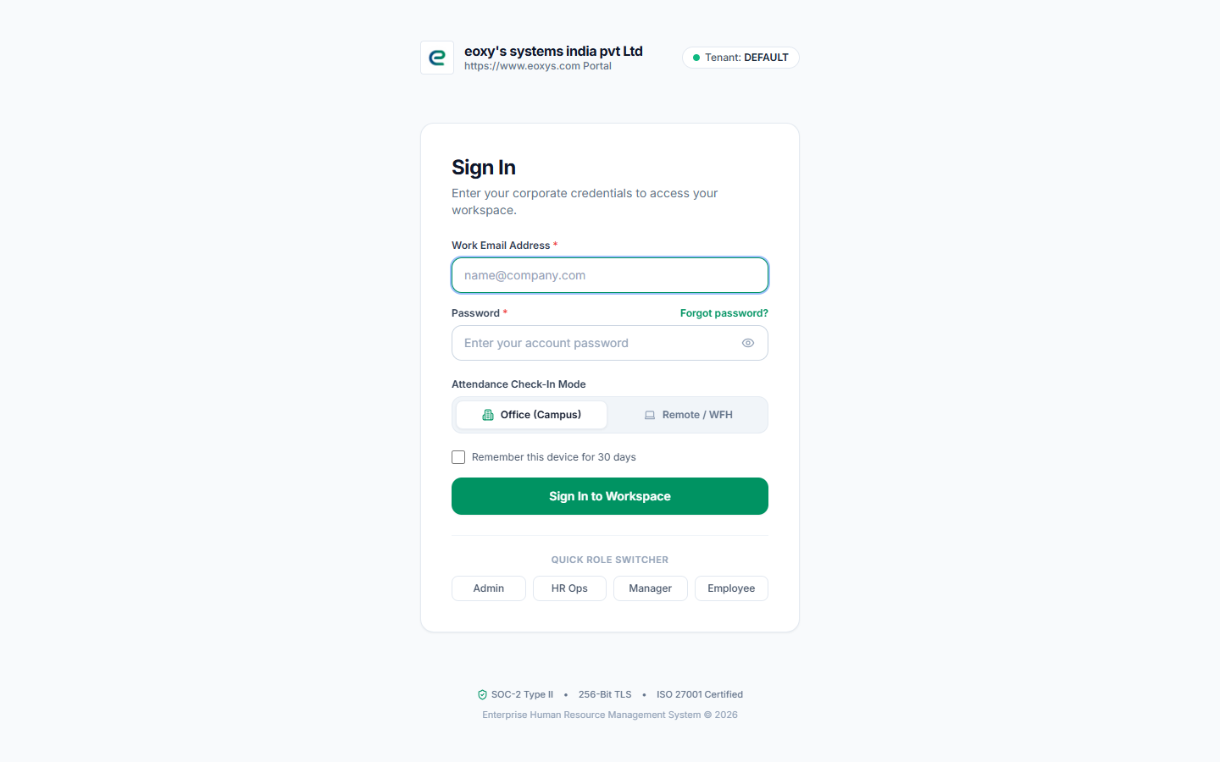
PEOPLE AND ACCESS
Access depends on identity, role, and tenant
Visible application roles
Employee
Manager
HR
Tenant Admin
Super Admin
IT Admin / IT Support
The app supports JWT authentication, email verification, password reset, first-login change, and TOTP setup endpoints.
Sign-in UI from the repository capture set
HRMS Platform | Repository analysis | UI examples are repository screenshots
05
Notes:
Repository evidence: backend/src/main/java/com/hrms/config/SecurityConfig.java; modules/auth/AuthController.java; frontend/src/modules/auth/pages/LoginPage.jsx; docs/screenshots/01_login_page.png
Controller-level guards vary by endpoint. Logout-all is currently a success stub; see AUTHENTICATION_AND_AUTHORIZATION.md.

Slide 6
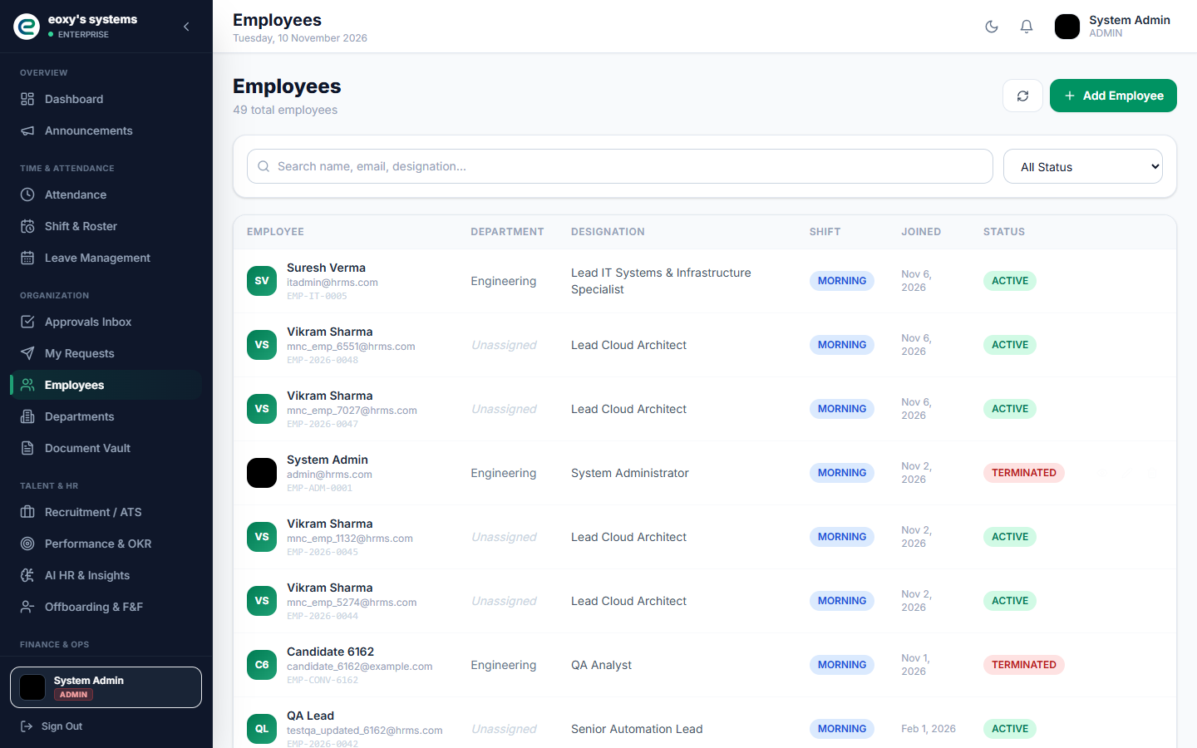
EMPLOYEE EXPERIENCE
Employee records anchor daily HR operations
Employee directory and profile management
Search and browse employee records.
Maintain department and profile details.
Upload profile photos and employee documents.
Connect people data to attendance, leave, payroll, and offboarding.
EmployeeController and EmployeeService provide the backend record paths.
HRMS Platform | Repository analysis | UI examples are repository screenshots
06
Notes:
Repository evidence: backend/src/main/java/com/hrms/modules/employee/controller/EmployeeController.java; EmployeeService.java; docs/screenshots/03_employee_directory.png
UI image is a repository screenshot. Confirm ownership guards on ID-based operations.

Slide 7
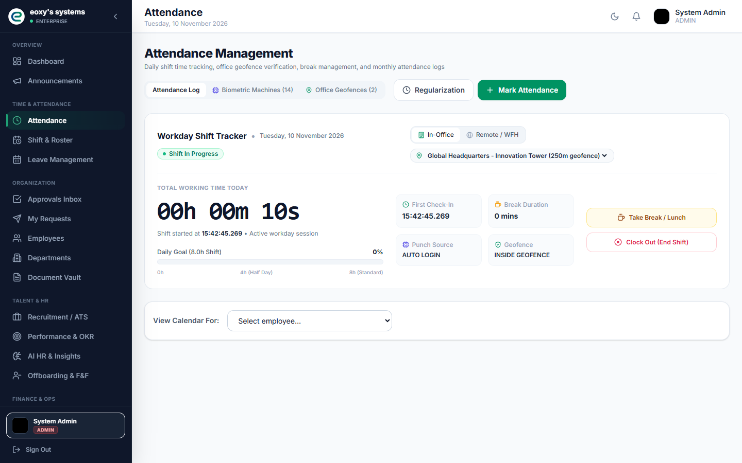
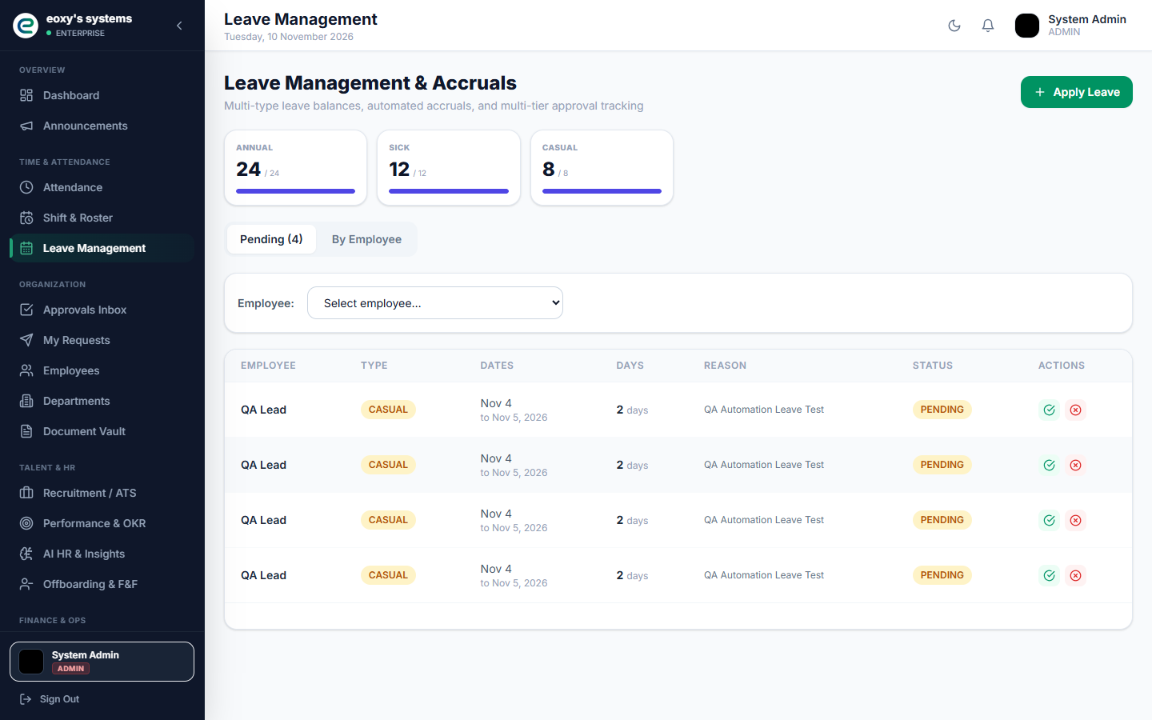
ATTENDANCE AND LEAVE
Attendance and leave are connected to approval paths
Attendance
Punches, breaks, biometric/CSV ingestion, geofence checks, regularization, office locations, and configurable policies.
Leave
Applications, policy configuration, balance ledgers, accrual scheduling, review, cancellation, and employee notifications.
HRMS Platform | Repository analysis | UI examples are repository screenshots
07
Notes:
Repository evidence: modules/attendance/AttendanceController.java; AttendanceService.java; PolicyController.java; modules/leave/LeaveController.java; LeavePolicyController.java; docs/screenshots/04_biometric_attendance.png and 07_leave_management.png
Attendance policies and workflows are configurable in code. Verify the active tenant workflow definitions and business rules.

Slide 8
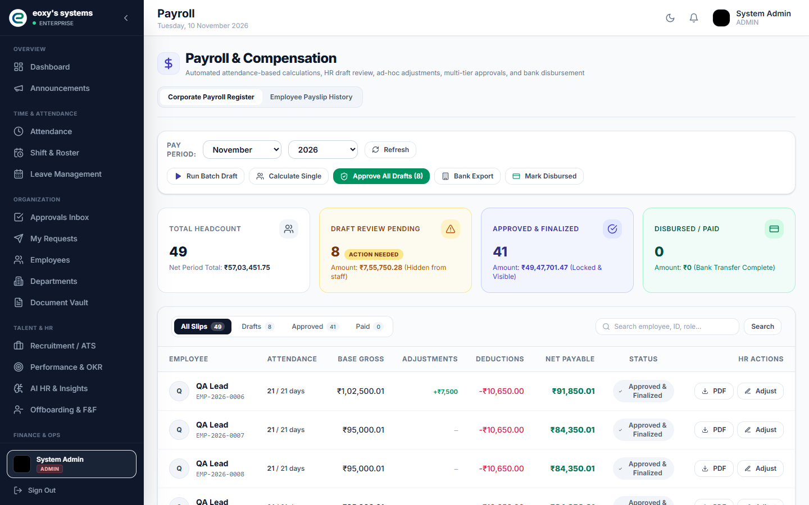
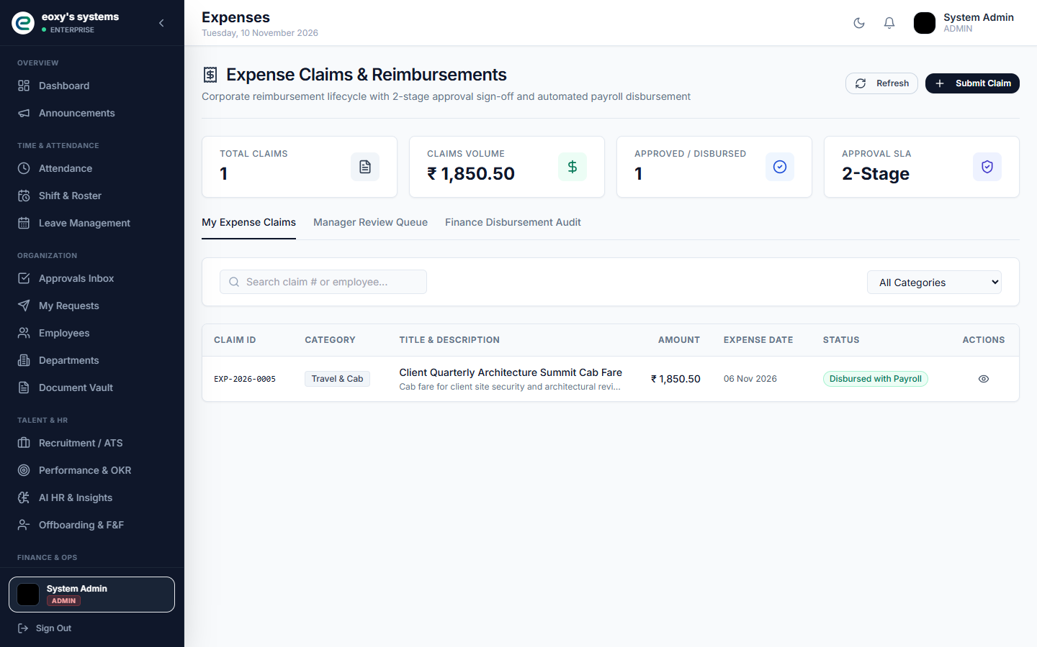
PAYROLL AND EXPENSES
Payroll and expenses share financial workflows
Payroll operations
Process, adjust, approve, mark paid, view registers and summaries, and export bank batch data.
Expense claims
Submit claims and expose manager and finance review steps. Payroll integration should be verified from the service transaction.
Payroll formulas and statutory settings require payroll-owner confirmation.
HRMS Platform | Repository analysis | UI examples are repository screenshots
08
Notes:
Repository evidence: modules/payroll/PayrollController.java; PayrollService.java; modules/expense/ExpenseController.java; ExpenseServiceImpl.java; screenshots 05 and 08
Screens shown are existing UI captures; values may be sample data.

Slide 9
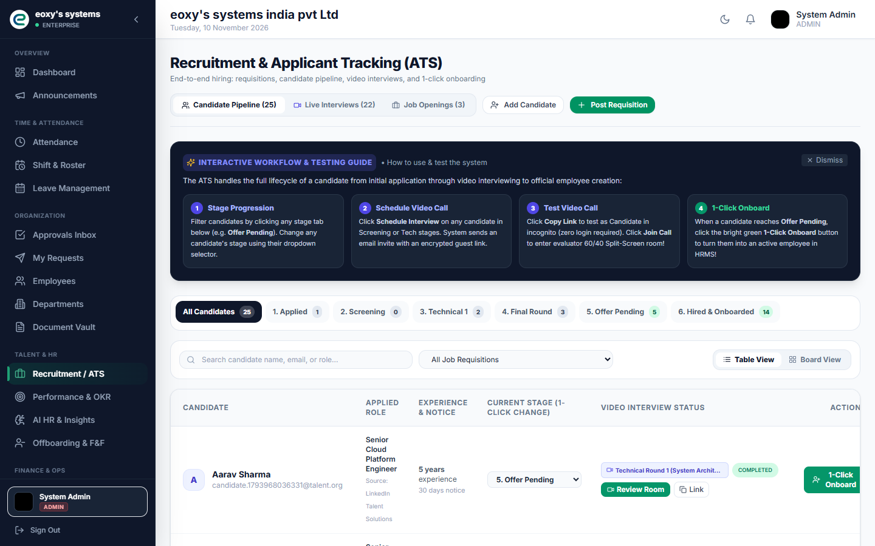
RECRUITMENT
Recruitment extends into live interview sessions
Candidate lifecycle surfaces
Manage jobs and candidate records.
Update applicant stages and scorecards.
Schedule interview sessions and panelists.
Expose candidate guest join and signaling routes.
Convert candidate records into employee onboarding.
Verify media provider configuration and conversion atomicity before relying on this flow.
HRMS Platform | Repository analysis | UI examples are repository screenshots
09
Notes:
Repository evidence: modules/recruitment/RecruitmentController.java; InterviewController.java; RecruitmentService.java; LiveKitTokenService.java; InterviewSignalingService.java; screenshot 06
Guest paths exist in SecurityConfig. External media service readiness is not established by endpoint presence alone.

Slide 10
WORKFLOWS AND OPERATIONS
Workflows coordinate employee requests
Workflow engine
Example request lifecycle
Workflow definitions contain ordered approval steps. Instances track decisions and status. Leave, attendance regularization, and employee requests have completion handling.
01
Submit a request
02
Resolve active workflow
Supporting services
03
Reviewer records decision
Helpdesk tickets, announcements, document acknowledgements, shifts, assets, performance, offboarding, reports, and notifications have API and UI surfaces.
04
Update domain status
05
Notify requester
HRMS Platform | Repository analysis | UI examples are repository screenshots
10
Notes:
Repository evidence: modules/workflow/WorkflowEngineService.java; WorkflowController.java; modules/request/EmployeeRequestController.java; helpdesk, communication, document, shift, asset, performance, offboarding and notification controllers
SLA enforcement and approver filtering need confirmation in service and configuration.

Slide 11
DELIVERY AND OPERATIONS
Container and monitoring assets support deployment
Technology foundations
Repository operations assets
Frontend: React 18, Vite, TypeScript/JavaScript, Redux Toolkit, Axios, React Router, Tailwind.
Backend: Java 21 target, Spring Boot 3.2.3, Spring Security, JPA, Flyway, PostgreSQL, Redis, SMTP.
Docker Compose for PostgreSQL, Redis, backend, frontend, Prometheus, Grafana.
Nginx and Vercel deployment configuration.
Actuator health and Prometheus metrics.
JUnit/Spring and Playwright tests plus scripted E2E checks.
Existing tests were inventoried but not executed during this documentation task. Deployment profiles and CI status need environment confirmation.
HRMS Platform | Repository analysis | UI examples are repository screenshots
11
Notes:
Repository evidence: backend/pom.xml; frontend/package.json; docker-compose.yml; infra/; .github/workflows; backend/src/test; frontend/e2e
No tests or builds were run as part of this artifact task.

Slide 12
IMPLEMENTATION REVIEW
Production readiness needs a few focused confirmations
Database
V1 SQL syntax appears MySQL-oriented; reconcile with PostgreSQL migration history.
Session security
logout-all has no visible revocation logic; refresh cookie uses secure(false).
Tenant boundaries
Confirm tenant and record ownership checks on ID-based self-service endpoints.
Business rules
Validate payroll, offboarding and expense-to-payroll behavior with domain owners.
External services
Confirm live interview/media setup, file persistence, and Redis fallback behavior.
Evidence is drawn from the checked-out source tree. Treat these items as review questions, not confirmed production incidents.
HRMS Platform | Repository analysis | UI examples are repository screenshots
12
Notes:
Repository evidence: project-documentation/DOCUMENTATION_INDEX.md; AUTHENTICATION_AND_AUTHORIZATION.md; DATABASE_DESIGN.md; API_DOCUMENTATION.md
Unresolved questions and evidence are documented in the full analysis package.

Slide 13
FLOWCHARTS
Core HR flows connect records to decisions
ATTENDANCE AND REGULARIZATION
Employee or device submits punch
Resolve policy, location and rules
Create or update attendance record
If needed, submit regularization
Review: correct data or reject and notify
LEAVE REQUEST AND APPROVAL
Employee submits leave application
Validate policy and request details
Create pending leave record
Manager/HR or workflow decision
Update status and balance; notify
Attendance records feed reporting and payroll inputs. Approved leave updates a matching balance when found; workflow behavior depends on tenant configuration.
HRMS Platform | Repository analysis | UI examples are repository screenshots
13

Slide 14
FLOWCHARTS
Payroll and hiring have distinct review paths
PAYROLL PROCESSING
Authorized user starts a run
Gather employee and attendance inputs
Calculate draft payroll records
HR adjusts and approves records
Mark paid, export bank batch or payslip
RECRUITMENT AND INTERVIEW
Create job and candidate record
Update stage and scorecards
Schedule session and assign panel
Guest joins with token and signaling
Submit scorecard; convert if approved
Payroll formulas, statutory behavior and bank acceptance need owner confirmation. Candidate conversion atomicity and external interview media readiness need review.
HRMS Platform | Repository analysis | UI examples are repository screenshots
14

