Slide 1

EDA Project
IKEA Advertising campaign
Naif Albader

Slide 2
About IKEA
IKEA is a Swedish company that designs and sells ready-to-assemble furniture, kitchen appliances, and home accessories, among other goods and home services

Slide 3
TABLE OF CONTENTS
01
02
03
Data gathering
Data assessing & cleaning
Project idea & opportunity
04
Data visualization & findings

Slide 4
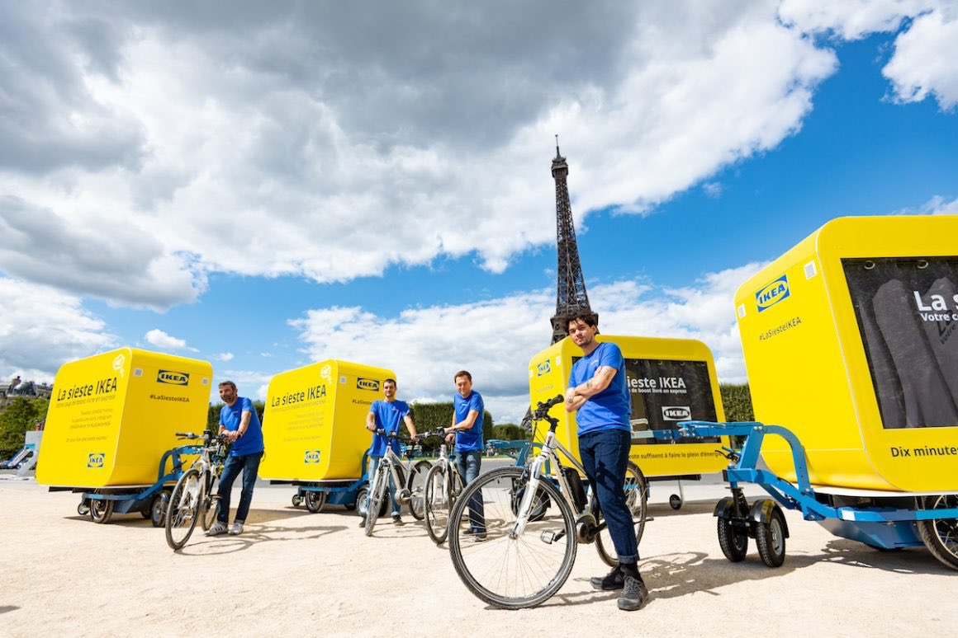
01
Project idea & opportunity

Slide 5
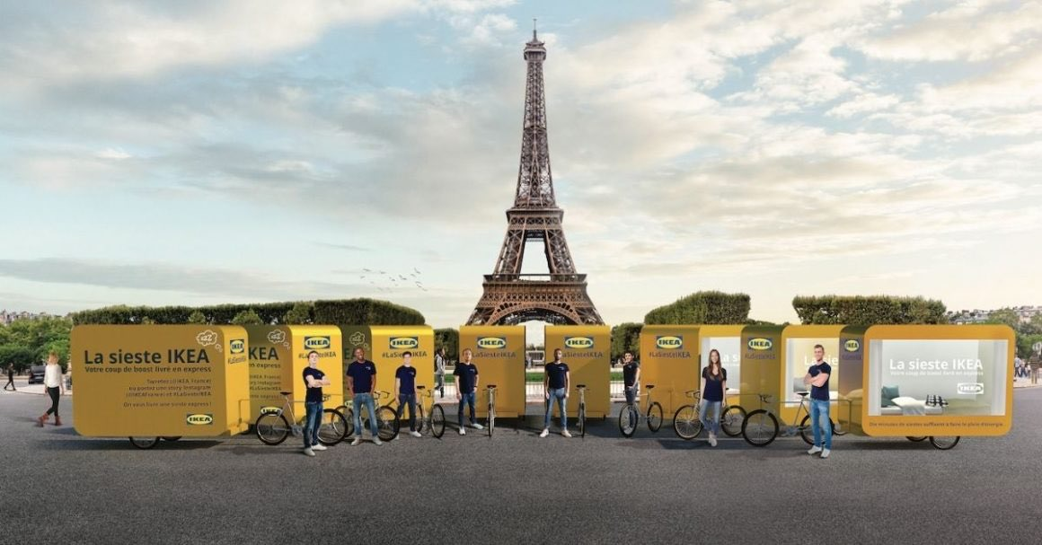
Project idea & opportunity
Advertising campaign using sleeping capsule
People can take a nap in the capsule
Try and see their product
Opportunity to do the campaign in NYC by analyzing MTA data

Slide 6
Questions to be answered
Q2
Q3
Q1
Are weekends busier than weekdays?
Which time slot of day has higher traffic
What are the highest 15 stations on traffic?

Slide 7
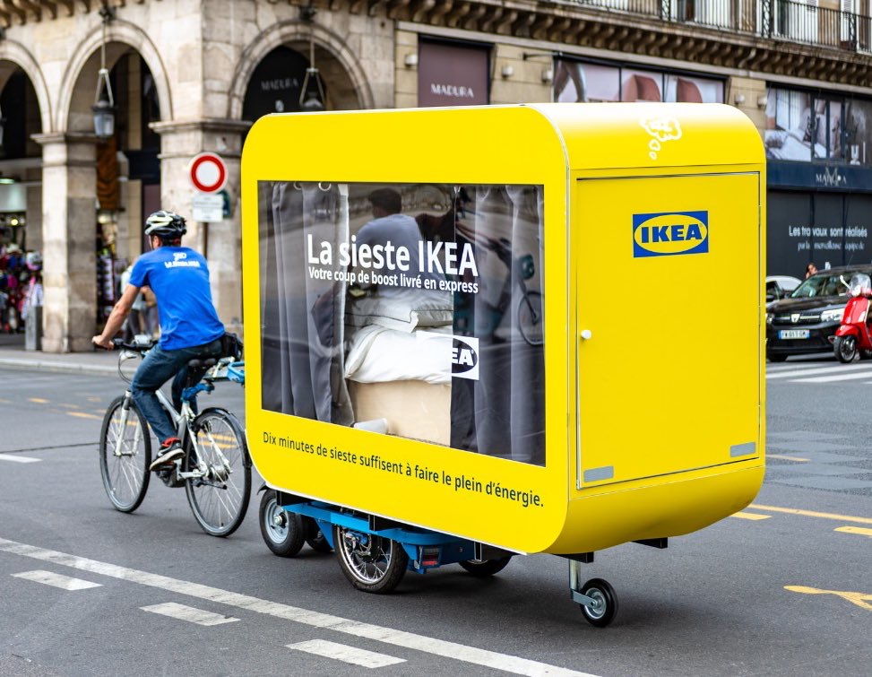
02
DATA GATHERING

Slide 8
DATA GATHERING
MTA website dataset of NYC subways entries & exists
3 Months period JUNE to SEP (2021)
Why this specific period?
The campaign will happen next month and we need to study the current behavior of MTA ridership

Slide 9
03
DATA ASSESSING

Slide 10
DATA ASSESSING & CLEANING
No missing values (Nulls)
29 duplicated turnstile readings I decided to drop them because they will affect the analysis
Calculating entries hourly ( 4 hours period)
Sometimes the counter of entries resets so I returned 0
Some time we have a negative entry so I returned the absolute of the negative value

Slide 11
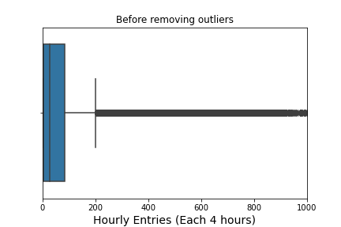
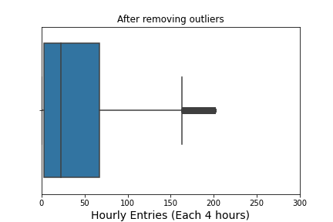
A lot of outliers in hourly entries I decided to remove outliers using the IQR by taking the values above 25% and under 75% from the entries
DATA ASSESSING & CLEANING

Slide 12
04
Data visualization & findings

Slide 13
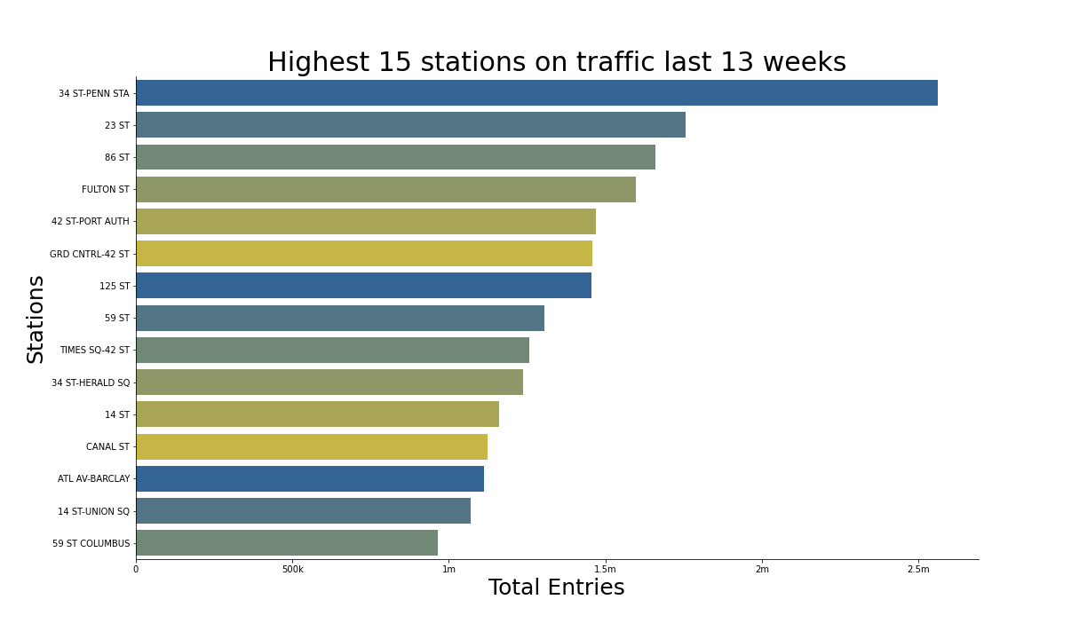
Data visualization & findings
Those 15 stations has the highest entries

Slide 14
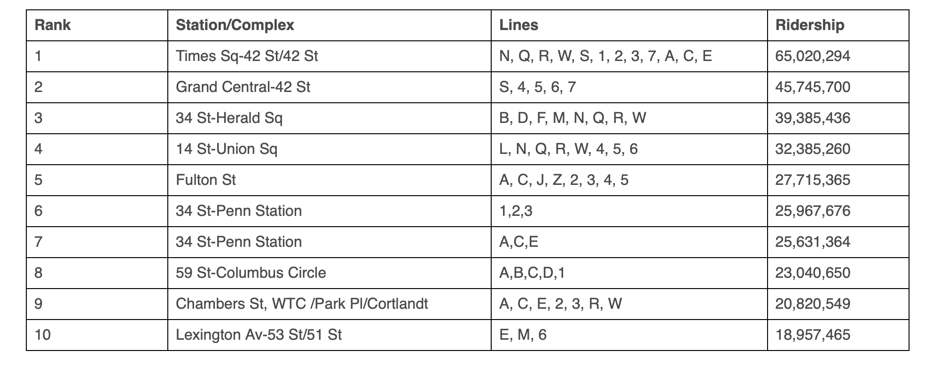
Data visualization & findings
Top 10 busiest subway stations in 2019

Slide 15
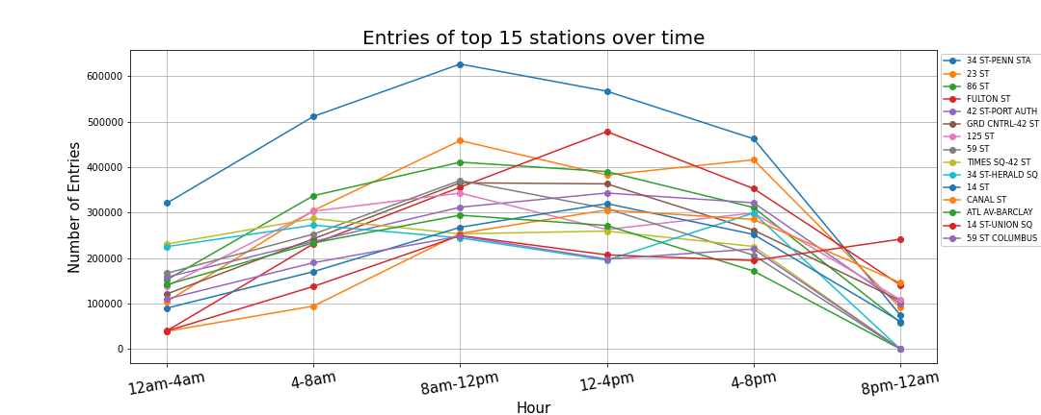
Data visualization & findings
8am-12pm period is always crowded

Slide 16
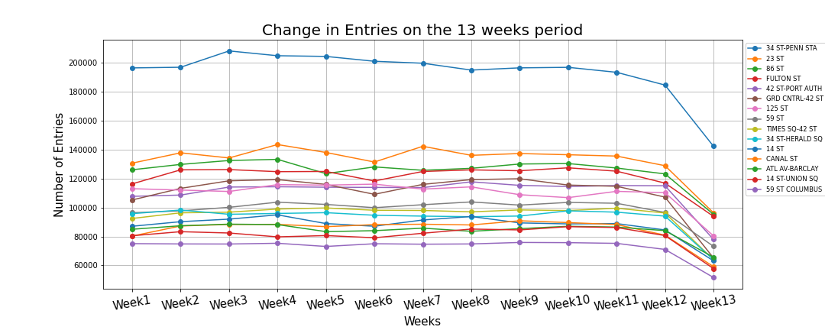
Data visualization & findings
The change in entries over the weeks is almost constant

Slide 17
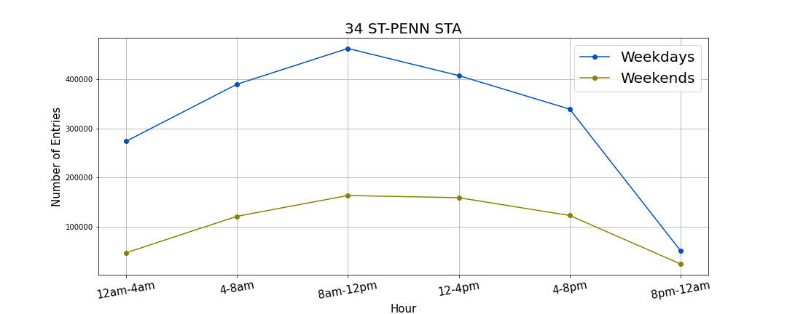
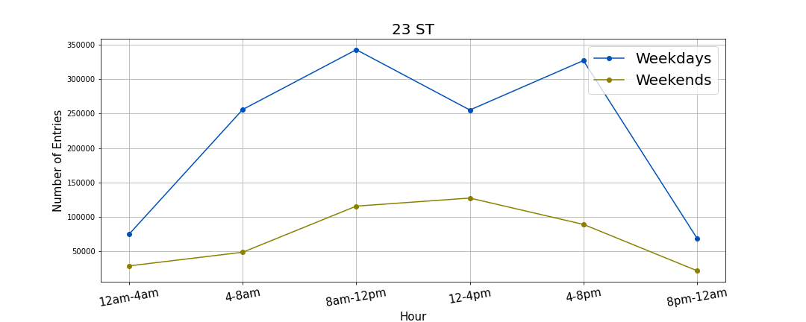
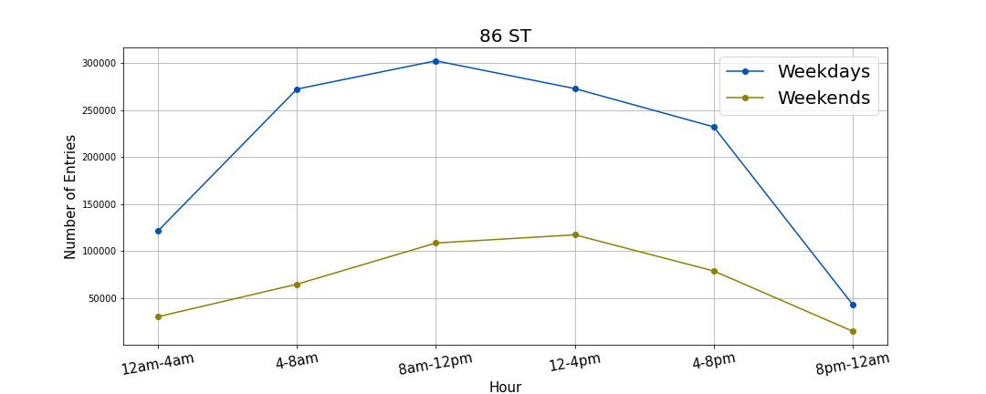
Data visualization & findings

Slide 18
Summary of findings
Top 15 stations on traffic
Weekdays traffic > weekend traffic for all the top 15 stations
8am-12pm time slot has the highest traffic for all the top 15 stations

Slide 19
THANK YOU

