Slide 1
iAQAR
Your confidence prediction!
T5 DATA SCIENCE BOOTCAMP
By:
Naif Albader
Yazeed Musallam

Slide 2
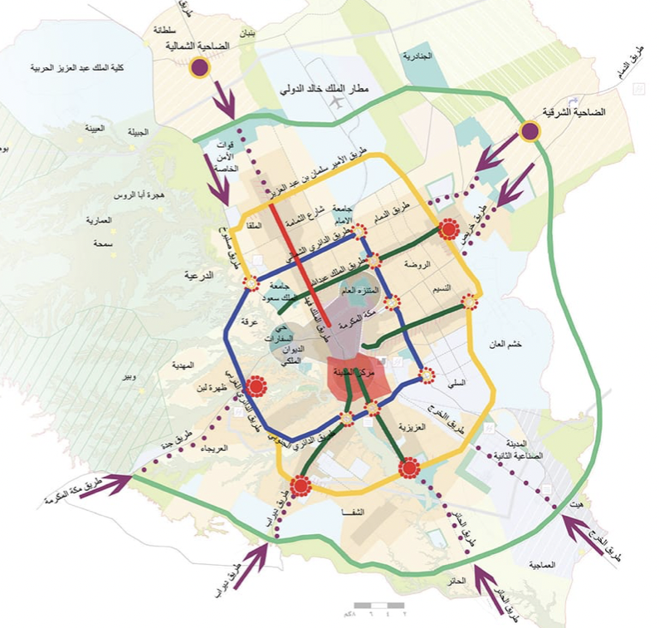
Introduction
What is iAQAR?
Problem Statement
- Value of iAQAR company:
What is the housing price in riyadh in the next 5 years?
Is the price increasing each year?
What is the price growth for each year?

Slide 3




iAQAR Workflow
Web scraping
Offline Data & EDA
Data preparation &
feature engineering
Model training &
evaluation
Trained model

Slide 4
Example of sale
Example of a sale from ministry of justice website

Slide 5
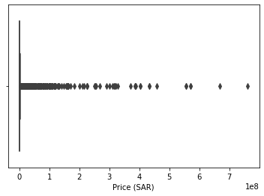
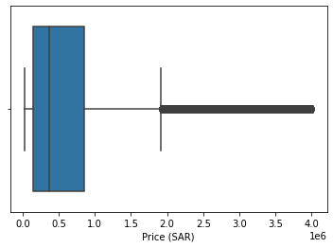
Web Scraping & EDA
Data scrapped:
Years: 2010 to 2021
Number of deals: 600K
Number of features: 8
EDA:
Outliers are handled (IQR)
- 1883 Duplicated deals
- No nulls are found

Slide 6
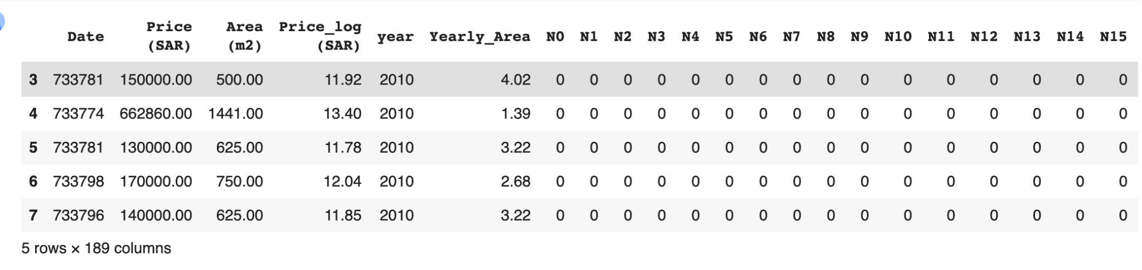
Data preparation & feature engineering
Features add:
Change date to numeric value
Year
Yearly/Area
Categorical values are changed to one label encoder

Slide 7
Model Training & Evaluation
Data split:
Training: 2010 - 2020
Validation: 2021/1 to 2021/5
Testing: 2021/5 to 2021/9
Results on test set (Neural Network)
R2 (Training): 0.70
R2 (Validation): 0.62
R2 (Testing): 0.60

Slide 8
Model training & Evaluation
Tested models:
Model | R^2
Linear regression (Baseline) | 0.47
Polynomial regression | -0.22
Random forest | 0.58
XGboost | 0.54
Neural network (The best)! | 0.60

Slide 9
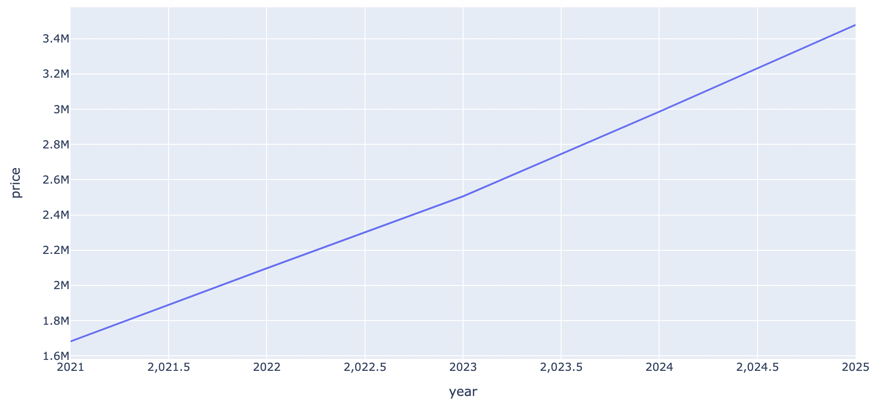
Sample test
Sample of land
Sample Data:
Area: 500
Date: 2021-09-16
Neighbourhood: “الياسمين”
Price
Observation:
The price increases every year
Year

Slide 10



iAQAR
iAQAR cloud environment
User
Prediction
iAQAR website
Trained model

Slide 11

Demo
*Please try it with us

Slide 12
Future works
*Please try it with us
1- Automate iAQAR
2- Enhance the performance

Slide 13
Thank you !
Any Questions?

