Slide 1
Quiz 1

Slide 2
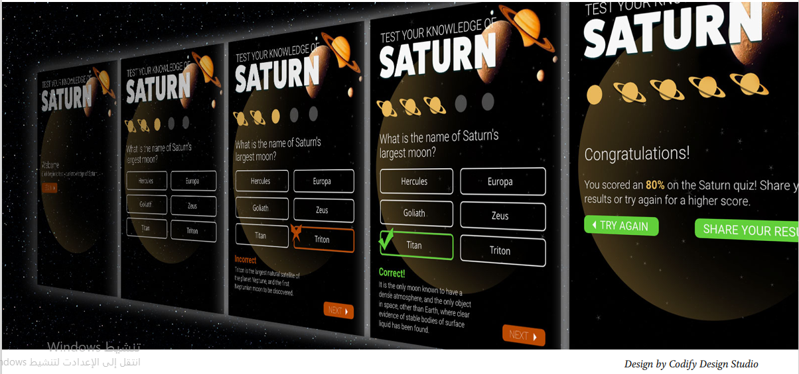
Design and Prototype an Interactive Quiz with XD

Slide 3
