Slide 1
magnesite

Slide 2
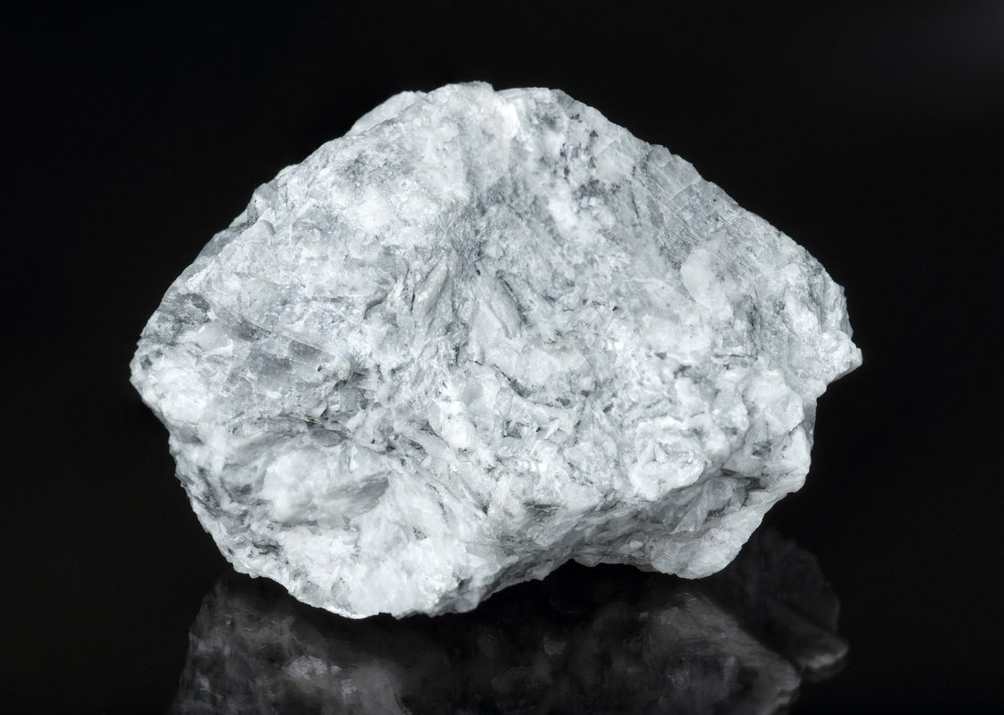
magnesite
It is a mineral composed of magnesium carbonat (MgCO3) which is a widespread mineral
And belongs to the family of carbonate minerals

Slide 3
Magnesite
Scientifically, magnesite is an essential component of the Earth's crust. It serves as an important source of magnesium, a critical element for many living organisms and industrial processes. The mineral is formed when magnesium-rich rocks come into contact.

Slide 4
Magnesite
Despite its long history of use, magnesite was not scientifically recognized and classified as a distinct mineral type until the 19th century. It was officially described in 1808 by German geologist Dietrich Ludwig Gustav Carsten, who named it after the Magnesia region of Greece, due to the prevalence of magnesium-rich minerals there.

Slide 5
Magnesite
Magnesite is generally formed in three environments: sedimentary, metamorphic, and hydrothermal environments.

Slide 6
Magnesite
The use of magnesite dates back to the times of ancient Greece, where it was used as a material for building fire-resistant bricks and ceramics. It also played an essential role in the manufacture of refractories, as it has a high melting point that made it ideal for lining furnaces. Some older ovens from these eras feature a lining composed of magnesite.

Slide 7
Sclerotic
Magnesite has several physical properties that make it unique. It has a hardness of 3.5 to 4.5 on the Mohs scale, making it a relatively soft stone

Slide 8
Color
Its color ranges from white to grey, often with a slight yellow or brown tint.

Slide 9
features
Scratch:white
Specific density: 3.0 – 3.2
Molar mass: 84.3 atomic mass units

