Slide 1

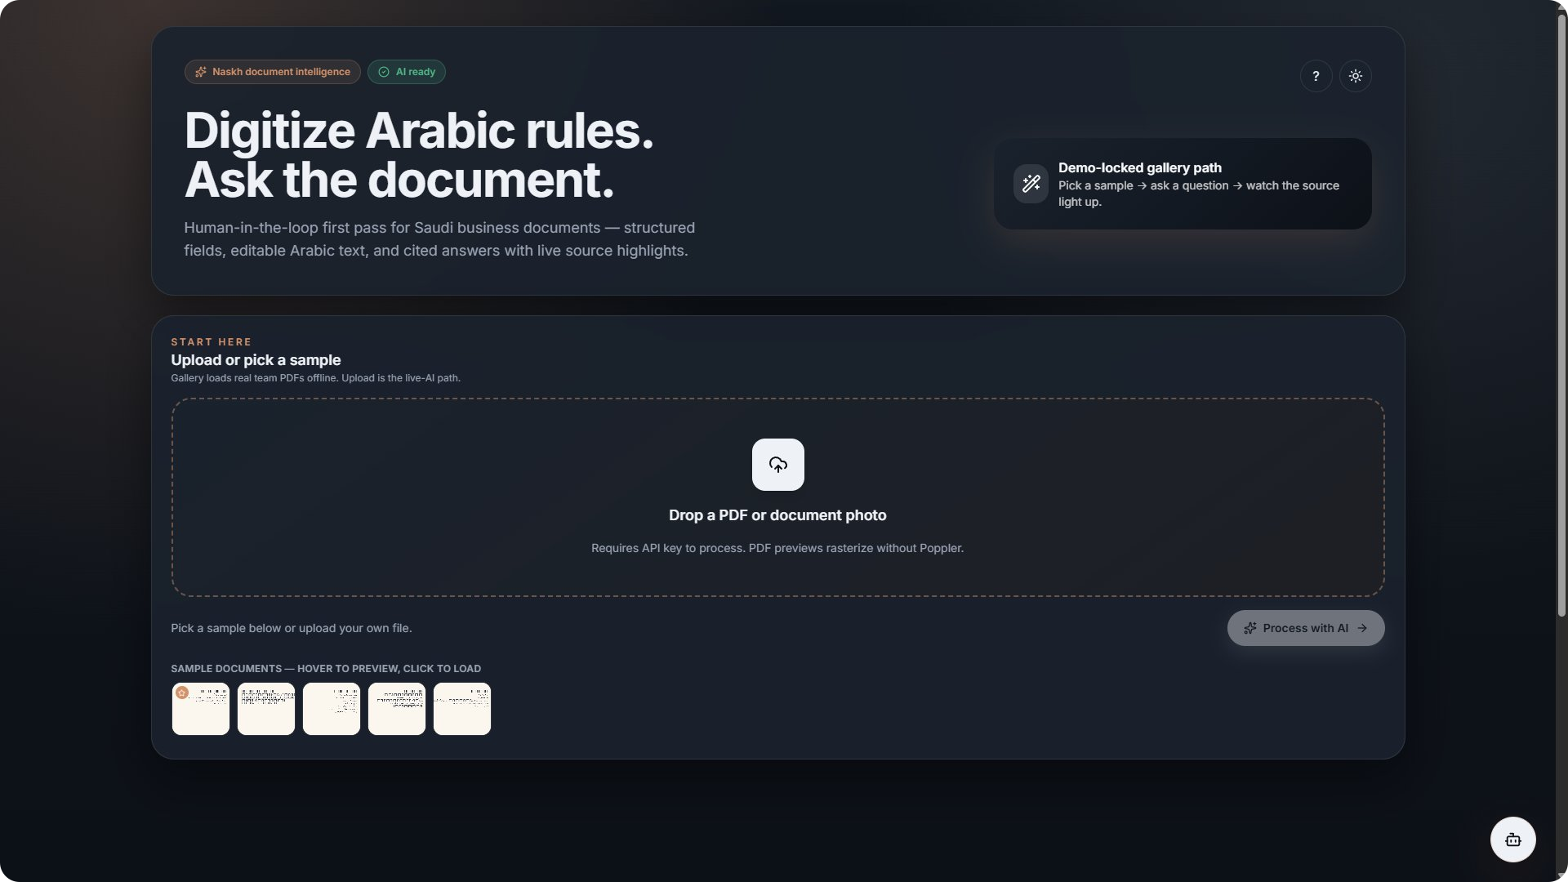
NASKH
نسخ · document intelligence
Digitize Arabic rules.
Ask the document.
Live source highlighting on real Saudi documents
A human-in-the-loop AI first pass for Saudi regulatory and business documents — structured fields, editable Arabic text, and cited answers with live source highlights.
WeCloudData 2026 Hackathon · Saudi Digital Academy
Team Naskh
Notes:
Open: Saudi orgs run on Arabic paperwork that AI can't read. Naskh does an honest first pass — AI extracts, the human approves. Tagline: digitize Arabic rules, ask the document.

Slide 2





THE PROBLEM
Saudi business runs on documents AI can't read.
Locked in paper and PDFs
WHO FEELS IT
Regulatory circulars, contracts, MoUs and board minutes live as scans, photos, and handwritten notes — not data.
Compliance and legal teams tracking obligations and deadlines
Arabic breaks generic tools
Government-facing organizations digitizing regulatory archives
RTL text, ligatures, handwriting, and bilingual Arabic/English layouts defeat mainstream OCR and off-the-shelf AI.
Back-offices converting paper records into searchable data
Manual, slow, no audit trail
Teams retype and re-read by hand. Errors slip through, and there's no link back to the source for review.
Notes:
Three pains: locked in paper/PDF, Arabic breaks generic tools, manual with no audit trail. Who: compliance/legal, government-facing orgs, document back-offices.

Slide 3


MOTIVATION
Vision 2030 is digital — the paperwork isn't, and it's mostly Arabic.
01
A real, local backlog
Arabic-first
Saudi Arabia's digitization push leaves mountains of paper and scanned records still waiting to become usable data.
Built for RTL, bilingual, and handwritten Saudi documents.
02
Arabic is underserved
Most document-AI tooling is English-first. Arabic regulatory documents are exactly where generic solutions fall short.
Cited & auditable
Every field and answer links back to its exact source.
03
The stakes are high
A missed clause, deadline, or obligation carries legal and financial risk — accuracy and traceability matter.
Honest first pass
AI drafts, a human reviews and approves before archive.
Notes:
Why this problem: real local backlog, Arabic underserved by AI tooling, high compliance stakes. Our three principles: Arabic-first, cited/auditable, honest human-in-the-loop first pass.

Slide 4

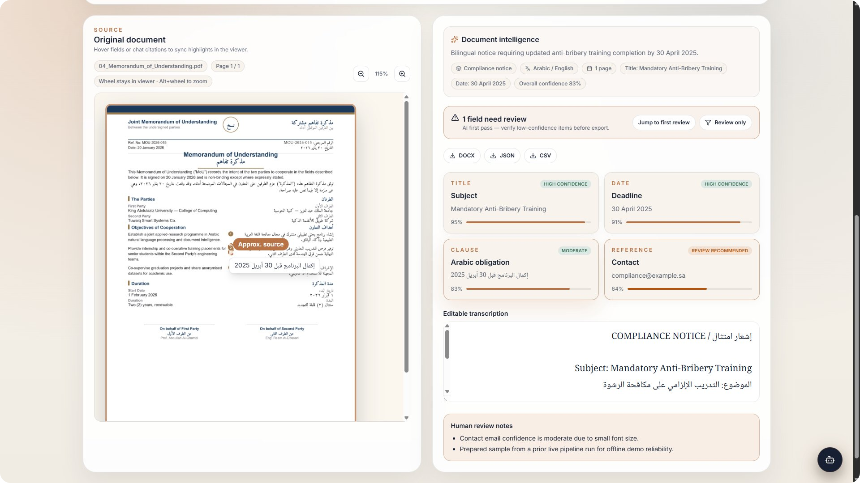





THE SOLUTION
Naskh: a guided first pass from scan to structured, cited data.
Upload
Drop a PDF or document photo — or pick a prepared sample.
Extract
AI vision returns structured fields, confidence, and full Arabic transcription.
Review
Hover a field and the exact source region lights up for verification.
Ask
A cited assistant answers questions grounded in the document via RAG.
Structured fields, confidence, and review flags — with the source on the left.
Export
Download clean DOCX, JSON, or CSV for archive and downstream systems.
Notes:
Walk the five steps: upload, extract (structured + confidence + transcription), review with source highlight, ask cited questions, export. Screenshot shows the real processed contract.

Slide 5




ARCHITECTURE & AI
A real pipeline — server-side AI, grounded answers.
React + Vite
FastAPI
OpenAI Vision
ChromaDB
Tailwind UI
REST + SSE
structured outputs
per-doc RAG
API keys stay server-side — never in the browser.
Vision extraction
Grounded RAG chat
Source highlighting
Pydantic-typed structured outputs: fields, confidence, and Arabic transcription in one schema.
Per-document embeddings in ChromaDB power streaming, cited answers — not generic ChatGPT.
Answers map to exact text-layer coordinates, lighting up the real region on the page.
React 19 · FastAPI · OpenAI gpt-4o · Pydantic · ChromaDB · pypdfium2 · arabic-reshaper + bidi · python-docx
Notes:
Pipeline: React UI → FastAPI → OpenAI vision (structured outputs) + ChromaDB RAG. Three AI uses: typed vision extraction, grounded cited chat, coordinate-accurate source highlighting. Keys server-side only.

Slide 6
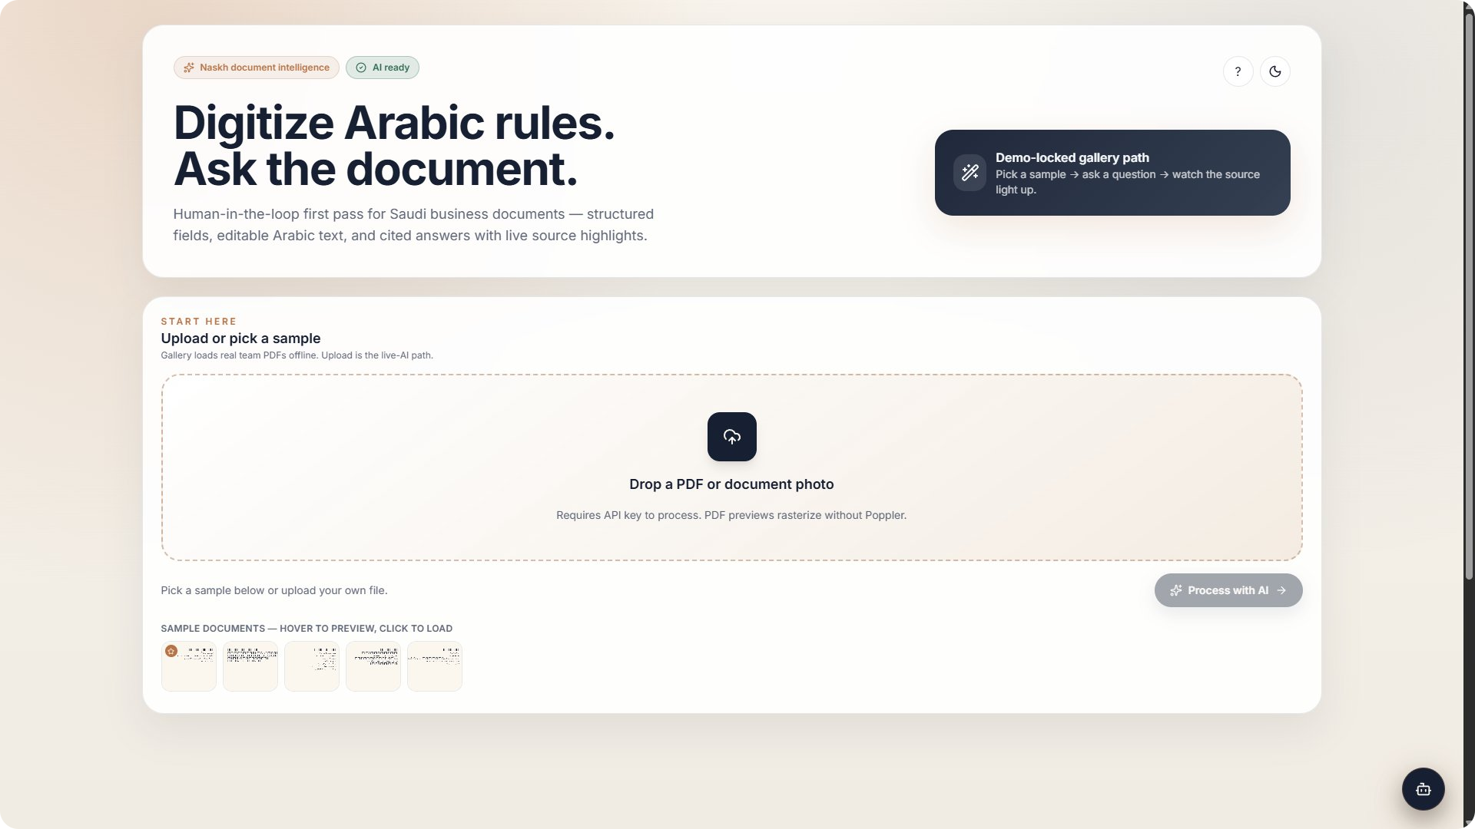
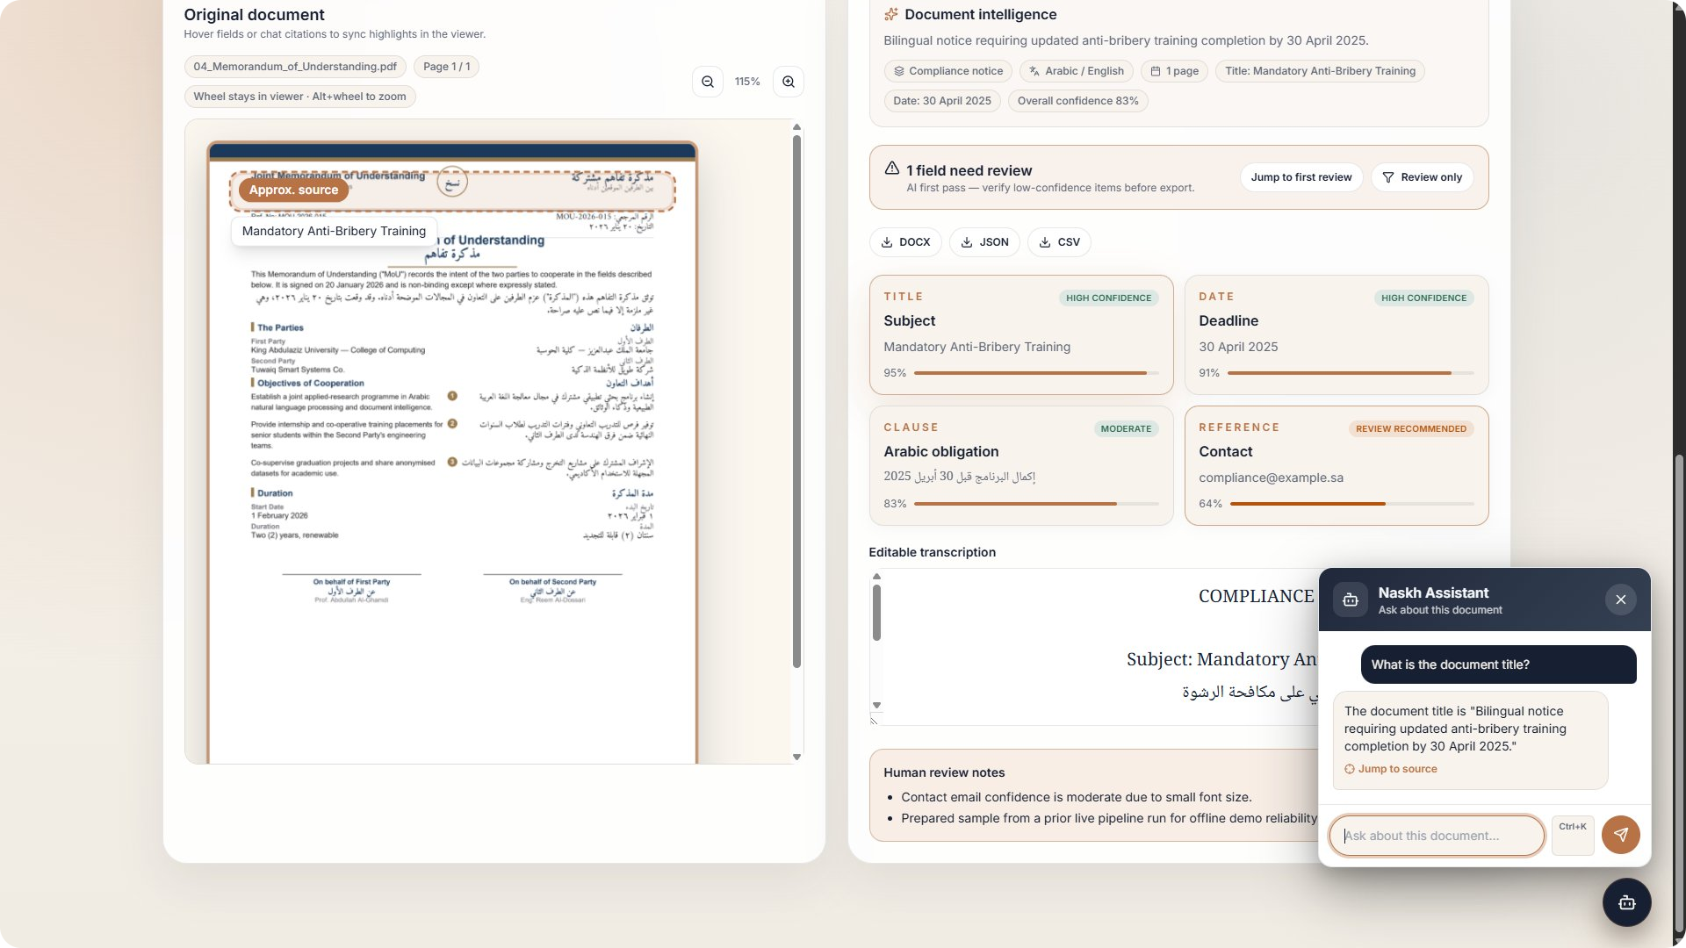
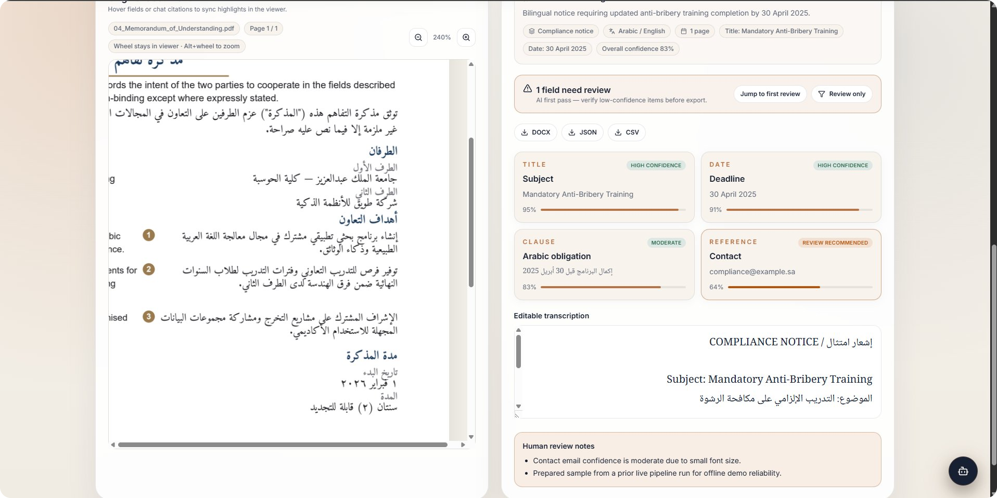
LIVE DEMO
Let's run it on a real Saudi document.
Pick & process
Cited assistant
Inspect closely
Light or dark, a sample loads instantly — offline-safe.
Ask a question; the answer cites and jumps to source.
Zoom and pan the page to verify every detail.
What you'll see: pick a sample → structured extraction with confidence → hover a field and watch the source light up → ask a cited question → export DOCX / JSON / CSV.
Notes:
Switch to the live app here. Demo order: pick a sample, show structured fields + confidence + review flag, hover a field to trigger the source highlight, ask the assistant a question and click Jump to source, then export. Gallery is offline-safe as a fallback.

Slide 7



ROADMAP
From hackathon MVP to a real product.
NOW
NEXT
SCALE
Improve
Build next
Productize
Fine-tune an Arabic handwriting model
Batch / queue digitization at volume
Integrations: gov portals & ECM
Raise extraction accuracy on dense layouts
Multi-document compare and search
Auth, audit logs, data residency
Persist operator edits across sessions
Saved review workflows and roles
Workers + database + object storage
Notes:
Roadmap in three phases: improve (Arabic model, accuracy, persistence), build next (batch, compare, workflows), productize (integrations, security/compliance, scale infra).

Slide 8
Build something useful.
Build something intelligent.
Naskh solves a real Saudi problem with meaningful AI, a working MVP, a clear value story, and a realistic path to production.
Real problem
Meaningful AI
Working MVP
Cited & auditable
Production vision
Naskh · نسخ · Team Naskh · WeCloudData 2026 Hackathon · SDA
Notes:
Close on the brief's own words — useful, intelligent. Recap: real problem, meaningful AI, working MVP, auditable, production vision. Invite questions and move into the live demo if not already shown.

